Slide 1

CS-111
Fundamentals of Computer Programming
Lecture 3
Program Development – II
Course Instructor:
Qurrat-ul-ain Babar
NUST Institute of Civil Engineering (NICE)

Slide 2



Doing the Right Thing

Slide 3
Road Map for Today
RECAP
Variables - Types
Operators

Slide 4
Recap
What are the two essential components of a single C++ statement?
Purpose of cout?
What is the order of execution of statements in a single C++ program?

Slide 5
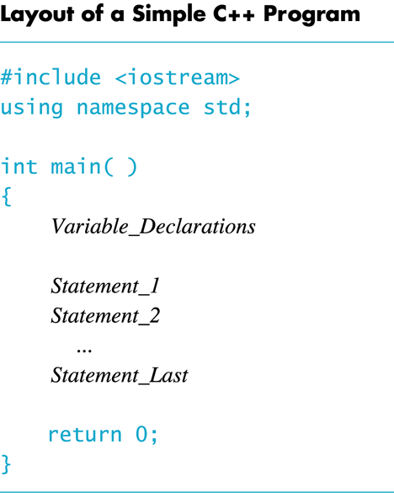
Recap
What is this?
?

Slide 6
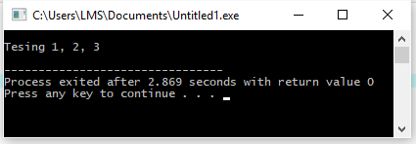
Recap – An Exercise
Write a program which gives the following output

Slide 7


Variables –
Identifiers and Data Types

Slide 8
Variables
A variable is a memory address (placeholder) where data can be stored and changed.
Declaring a variable means specifying both its name (identifier) and its data type.
Defining/initializing a variable means giving the variable a value.

Slide 9
Identifier
An identifier is the name used to denote labels, types, variables, constants or functions, in a C++ program.
C++ is a case-sensitive language.
  Work is not work
Identifiers should be descriptive
  Using meaningful identifiers is a good programming practice

Slide 10
Identifier…
Identifiers must be unique
Identifiers cannot be reserved words (keywords)
  int main return
Identifier must start with a letter or underscore, and be followed by zero or more letters (A-Z, a-z), digits (0-9), or underscores
VALID
age_of_dog _taxRateY2K PrintHeading ageOfHorse
NOT VALID
age# 2000TaxRate Age-Of-Dog main

Slide 11
C++ Data Types
simple
structured
integral enum
floating
array struct union class
char short int long bool
address
float double long double
pointer reference

Slide 12
C++ Primitive Data Types
Primitive types
integral
floating
char short int long bool float double long double
unsigned

Slide 13
Primitive Data Types in C++
Integral Types
  represent whole numbers and their negatives
  declared as int, short, or long
Character Types
  represent single characters
  declared as char
  Stored by ASCII values
Boolean Type
    declared as bool
    has only 2 values true/false
    will not print out directly
Floating Types
  represent real numbers with a decimal point
  declared as float, or double
  Scientific notation where e (or E) stand for “times 10 to the ” (.55-e6)

Slide 14
Samples of C++ Data Values
int sample values
  4578 -4578 0
bool values
  true false
float sample values
  95.274 95.0 .265
char sample values
‘B’ ‘d’ ‘4’ ‘?’ ‘*’

Slide 15
What Does a Variable Declaration Do?
A declaration tells the compiler to allocate enough memory to hold a value of this data type, and to associate the identifier with this location.
int ageOfDog;→
char middleInitial; →
float taxRate;→

Slide 16
Variable Declaration
All variables must be declared before use.
  At the top of the program
  Just before use.
Commas are used to separate identifiers of the same type.
  int count, age;
Variables can be initialized to a starting value when they are declared
  int count = 0;
  int age, count = 0;

Slide 17
#include <iostream>
using namespace std;
int main()
{
int x;
x = 4 + 2;
cout << x / 3 << ' ' << x * 2;
return 0;
}
Output for this code?

Slide 18
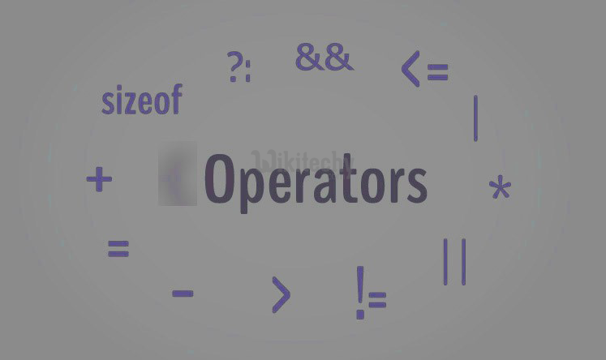

Operators in C++

Slide 19
Operators in C++
Stream Operators
Arithmetic Operators
Decision Making – Equality and Relational Operators
Assignment/ Combined Operators
Unary Operators
Logical Operators

Slide 20
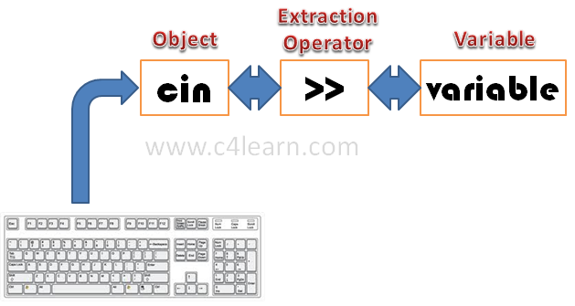
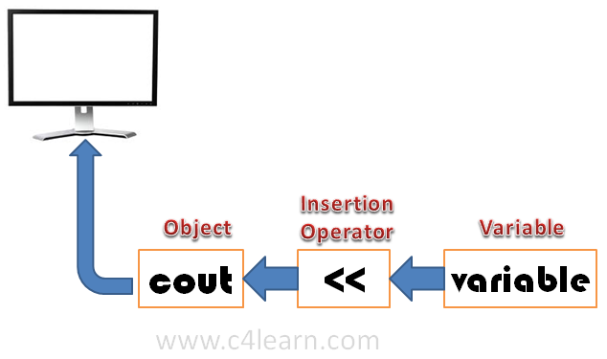
Stream Operators

Slide 21
Stream Operators – Input and Output
C++ treats input and output as a stream of characters.
stream : sequence of characters (printable or nonprintable)
The functions to allow standard I/O are in iostream header file or iostream.h.
Thus, we start every program with
  #include <iostream>
  using namespace std;

Slide 22
Keyboard and Screen I/O
#include <iostream>
input data
output data
executing
program
Keyboard
Screen
cin
(of type istream)
cout
(of type ostream)

Slide 23
Insertion Operator ( << )
Variable cout is predefined to denote an output stream that goes to the standard output device (display screen).
The insertion operator << also called “put to” takes 2 operands.
The left operand is a stream expression, such as cout. The right operand is an expression of simple type or a string constant.

Slide 24
Output Statements
SYNTAX
cout statements can be linked together using << operator.
These examples yield the same output:
cout << “The answer is ”;
cout << 3 * 4 ;
cout << “The answer is “ << 3 * 4 ;
cout << Expression << Expression . . . ;

Slide 25
Output Statements (String constant)
String constants (in double quotes) are to be printed as is, without the quotes.
  cout<<“Enter the number of candy bars ”;
  OUTPUT: Enter the number of candy bars
“Enter the number of candy bars ” is called a prompt.
All user inputs must be preceded by a prompt to tell the user what is expected.
You must insert spaces inside the quotes if you want them in the output.
Do not put a string in quotes on multiple lines.

Slide 26
Output Statements (Expression)
All expressions are computed and then output.
  cout << “The answer is ” << 3 * 4 ;
  OUTPUT: The answer is 12

Slide 27
Escape Sequences
The backslash (\) is called the escape character.
It tells the compiler that the next character is “escaping” it’s typical definition and is using its secondary definition.
Examples:
  new line: \n
  horizontal tab: \t
  backslash: \\
  double quote \”

Slide 28
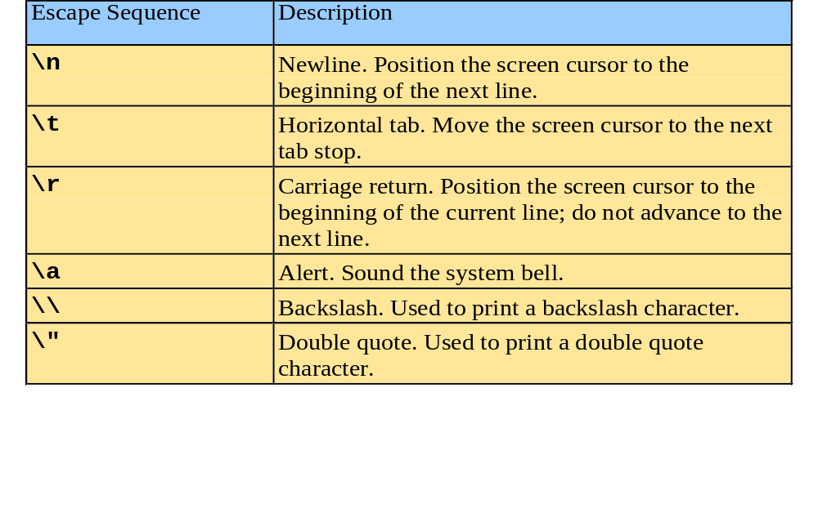
Escape Sequences

Slide 29
Newline
cout<<“\n” and cout<<endl both are used to insert a blank line.
Advances the cursor to the start of the next line rather than to the next space.
Always end the output of all programs with this statement.

Slide 30
fig01_02.cpp
(1 of 1) fig01_02.cpp output (1 of 1)
1 // Fig. 1.2: fig01_02.cpp
2 // A first program in C++.
3 #include <iostream>
4 using namespace std;
5 // function main begins program execution
6 int main()
7 {
8 cout << "Welcome to C++!\n";
9
10 return 0; // indicate that program ended successfully
11
12 } // end function main
Single-line comments.
Function main returns an integer value.
Left brace { begins function body.
Preprocessor directive to include input/output stream header file <iostream>.
Function main appears exactly once in every C++ program..
Statements end with a semicolon ;.
Corresponding right brace } ends function body.
Stream insertion operator.
Name cout belongs to namespace std.
Keyword return is one of several means to exit function; value 0 indicates program terminated successfully.
Welcome to C++!

Slide 31
fig01_04.cpp
(1 of 1) fig01_04.cpp output (1 of 1)
1 // Fig. 1.4: fig01_04.cpp
2 // Printing a line with multiple statements.
3 #include <iostream>
4
5 // function main begins program execution
6 int main()
7 {
8 std::cout << "Welcome ";
9 std::cout << "to C++!\n";
10
11 return 0; // indicate that program ended successfully
12
13 } // end function main
Multiple stream insertion statements produce one line of output.
Welcome to C++!

Slide 32
fig01_05.cpp
(1 of 1) fig01_05.cpp output (1 of 1)
1 // Fig. 1.5: fig01_05.cpp
2 // Printing multiple lines with a single statement
3 #include <iostream>
4
5 // function main begins program execution
6 int main()
7 {
8 std::cout << "Welcome\nto\n\nC++!\n";
9
10 return 0; // indicate that program ended successfully
11
12 } // end function main
Using newline characters to print on multiple lines.
Welcome
to
C++!

Slide 33
Extraction Operator ( >> )
Variable cin is predefined to denote an input stream that comes from the standard input device (keyboard).
The extraction operator >> takes 2 operands.
The left operand is a stream expression, such as cin. The right operand is a variable to which the value input by the user is assigned.

Slide 34
Input Statements
SYNTAX
cin statements can be linked together using multiple >> operator.
Example:
cin >> number1;
cin >> number2;
cin >> number1 >> number2;
cin >> variable >> variable . . . ;

Slide 35
Input Statements
Code:
Output:
int num;
cout<< “Enter number\n \n”;
cin >> num;
Enter number
5
CS 110 – Fall 2014

Slide 36


