Slide 1

CS-111
Fundamentals of Computer Programming
Lecture 4
Operators in C++ - I
Course Instructor:
Qurrat-ul-ain Babar
NUST Institute of Civil Engineering (NICE)

Slide 2
Road Map for Today
RECAP
Operators
  Stream Operators
  Arithmetic Operators
  Decision Making – Equality and Relational Operators
  Assignment/ Combined Operators
  Unary Operators
  Logical Operators

Slide 3
Recap
What is a variable?
Parts of variable declaration?
Naming convention for variables?
Why do we create variables?

Slide 4
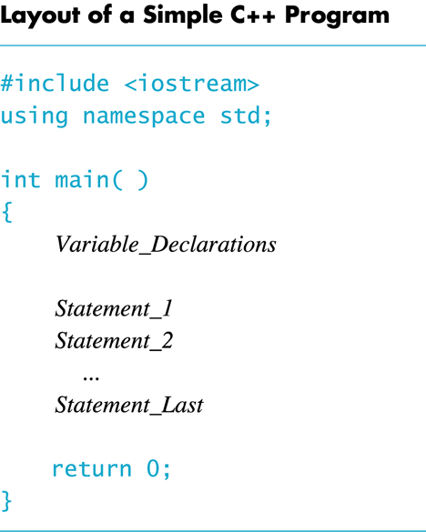
Recap
What is this?
?
What does Variable Declaration mean?

Slide 5
Recap – An Exercise
Write a program which asks the user “Are you a male or a female student? Enter M for Male and F for Female.” The program must take a character input and then display the input given by user.

Slide 6
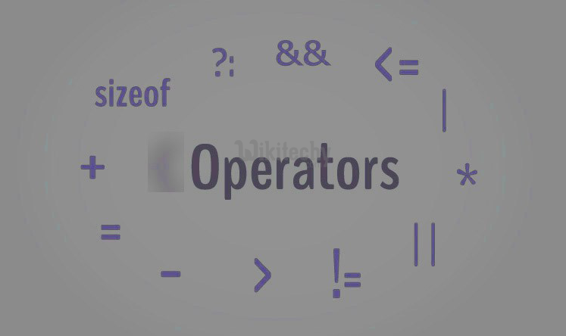
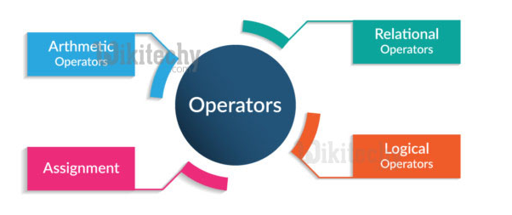
Operators in C++

Slide 7
Operators in C++
Stream Operators
Arithmetic Operators
Decision Making – Equality and Relational Operators
Assignment/ Combined Operators
Unary Operators
Logical Operators

Slide 8

Arithmetic Operators

Slide 9
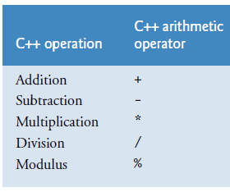
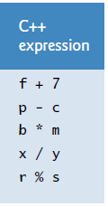
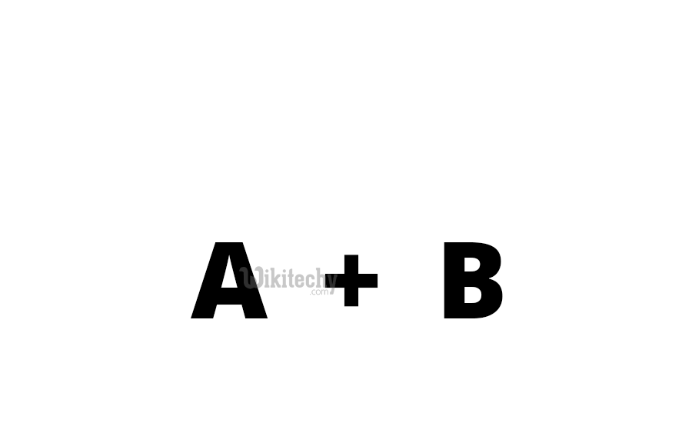
Arithmetic Operators
Binary operators

Slide 10
Arithmetic Operators –
Rules of Operator Precedence
C++ applies the operators in arithmetic expressions in a precise order determined by these rules of operator precedence
  Operators in parentheses evaluated first
    Nested/embedded parentheses
      Operators in innermost pair first
  Multiplication, division, modulus applied next
    Operators applied from left to right
  Addition, subtraction applied last
    Operators applied from left to right

Slide 11
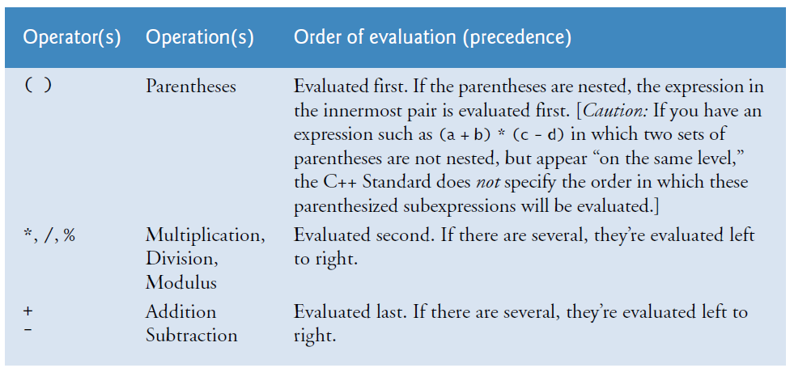
Rules of Operator Precedence

Slide 12

Sample Algebraic and C++ Expressions
Why do we need parentheses here?

Slide 13
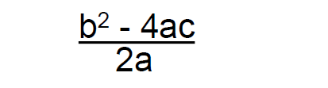

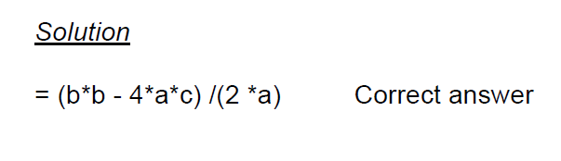
Example

Slide 14
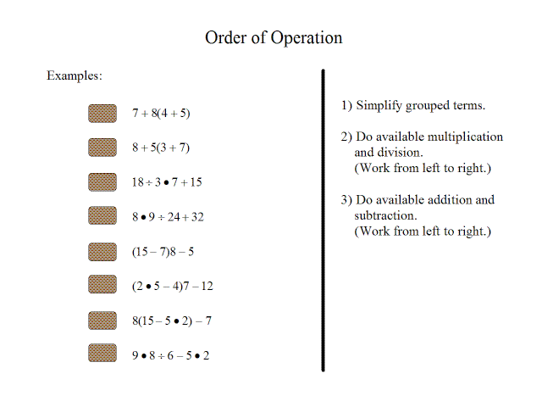

Slide 15

Decision Making –
Equality & Relational Operators

Slide 16
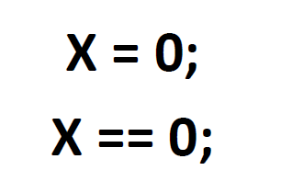
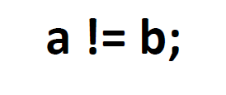
Equality and Relational Operators
Used to define the conditions for making some sort of decision

Slide 17
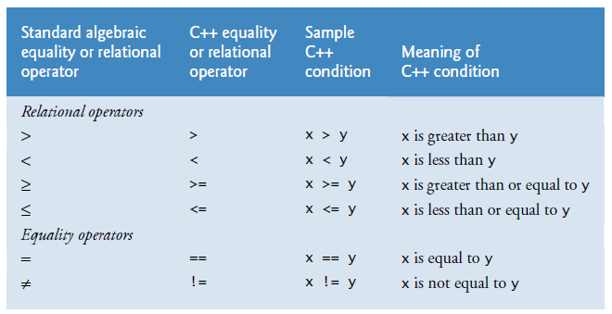
Equality and Relational Operators

Slide 18
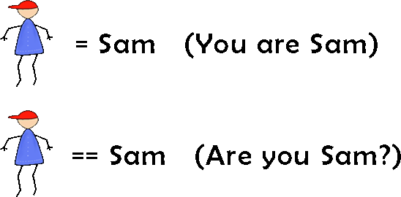
Equality and Relational Operators
Difference between “=” and “==”?

Slide 19
Assignment/ Combined Operators
(=, +=, -=, *=, /=, %=)

Slide 20
Assignment Operator
An operator to give (assign) a value to a variable.
Denote as ‘=‘
Only variable can be on the left side.
An expression is on the right side.
Variables keep their assigned values until changed by another assignment statement or by reading in a new value.

Slide 21
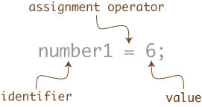
Assignment Operator Syntax
Variable = Expression
  First, expression on right is evaluated.
  Then the resulting value is stored in the memory location of Variable on left.

Slide 22
Assignment Operator Syntax
NOTE: An automatic type coercion occurs after evaluation but before the value is stored if the types differ for Expression and Variable

Slide 23
Assignment Operator Mechanism
Example:
  int count = 0;
  int starting;
  starting = count + 5;
Expression evaluation:
  Get value of count: 0
  Add 5 to it.
  Assign to starting
0
12345 (garbage)
5

Slide 24
Assignment/Combined Operators
C++ provides several assignment operators for abbreviating assignment expressions.
Example
  c = c + 3; can be abbreviated with the addition assignment operator += as c += 3;
  The assignment c += 3 adds 3 to c.

Slide 25
Assignment/Combined Operators
variable = variable operator expression;
variable operator= expression;

Slide 26
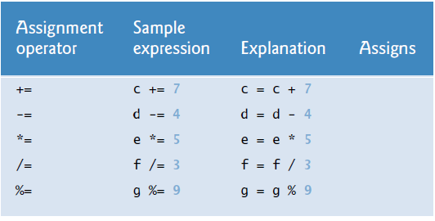

Arithmetic Assignment Operators
?

Slide 27

Unary Operators

Slide 28
Unary Operators
C++ provides two types of unary operators
  unary increment operator (++)
    for adding 1 to the value of a numeric variable
  unary decrement operator (--)
    subtracting 1 from the value of a numeric variable

Slide 29
Unary Operators
When is the unary operation carried out depends on where (before or after the variable) the operator has been placed.
Prefix Unary Operator
Postfix Unary Operator

Slide 30
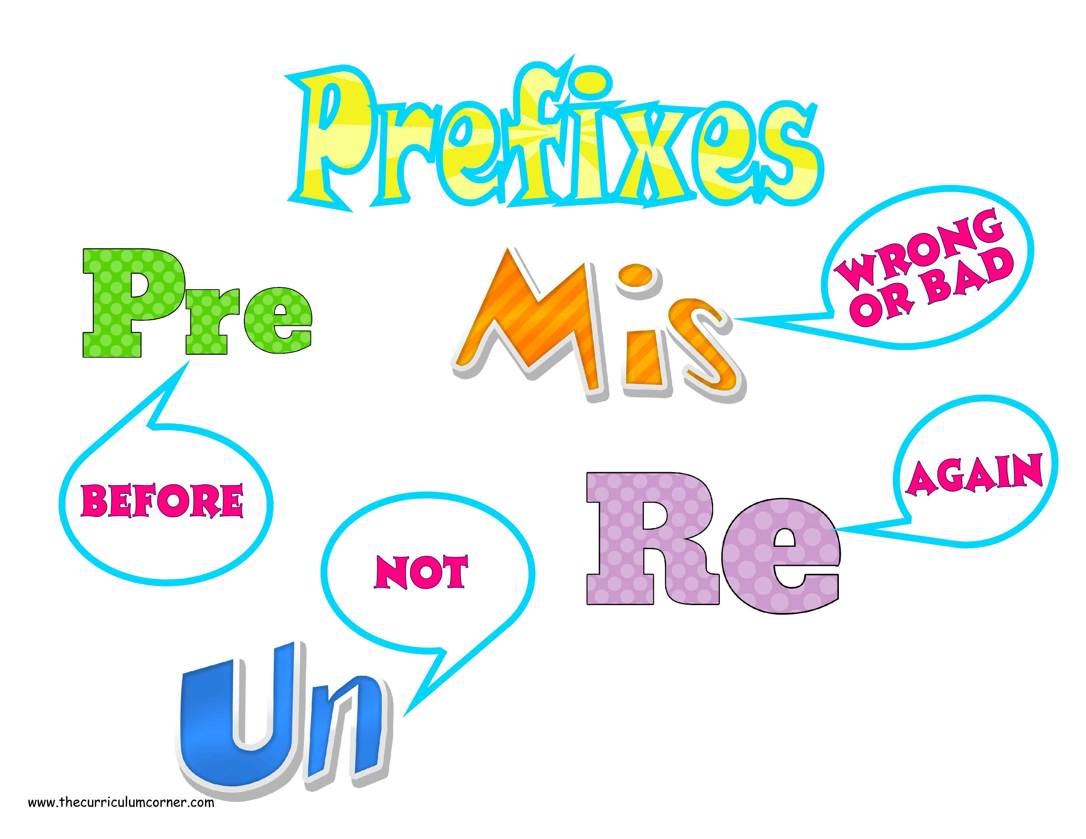
A PREFIX is added before a word to make a new word.

Slide 31
Prefix Unary Operators
An increment or decrement operator that’s placed before (prefixed to) a variable is referred to as the prefix increment or prefix decrement operator, respectively.
  ++variable - prefix increment
  --variable - prefix decrement

Slide 32
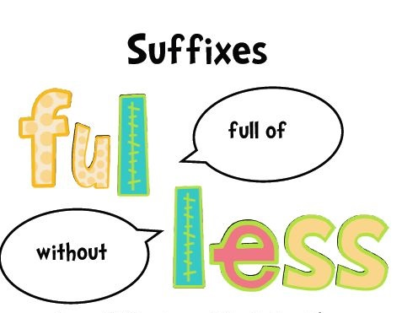
A SUFFIX/POSTFIX is added to the end
of a word
to make a new word.

Slide 33
Postfix Unary Operators
An increment or decrement operator that’s placed after (postfixed to) a variable is referred to as the postfix increment or postfix decrement operator, respectively.
  variable++ - postfix increment
  variable-- - postfix decrement

Slide 34
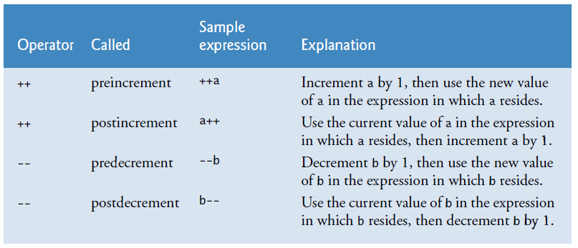
Unary Operators

Slide 35
Preincrement - Example
#include <iostream>
using namespace std;
int main()
{
int var = 1;
cout << ++var << endl;
cout << ++var << endl;
  cout << ++var << endl;
  cout << ++var << endl;
  cout << ++var << endl;
return 0;
}
Output
2
3
4
5
6

Slide 36
Postincrement - Example
#include <iostream>
using namespace std;
int main()
{
int var = 1;
  cout << var++ << endl;
  cout << var++ << endl;
  cout << var++ << endl;
  cout << var++ << endl;
  cout << var++ << endl;
return 0;
}
Output
1
2
3
4
5

Slide 37
Predecrement- Example
#include <iostream>
using namespace std;
int main()
{
int var = 4;
  cout << --var << endl;
  cout << --var << endl;
  cout << --var << endl;
  cout << --var << endl;
return 0;
}
Output
3
2
1
0

Slide 38
Postdecrement- Example
#include <iostream>
using namespace std;
int main()
{
int var = 4;
  cout << var-- << endl;
  cout << var-- << endl;
  cout << var-- << endl;
  cout << var-- << endl;
return 0;
}
Output
?
4
3
2
1

Slide 39
Exercise
#include <iostream>
using namespace std;
int main()
{
int a = 21;
int c ;
c = a++;
cout << c << "\n";
cout << a;
return 0;
}
Output
?
21
22

Slide 40
Exercise
#include <iostream>
using namespace std;
int main()
{
int x = 5, y = 5;
cout << ++x << --y << endl;
return 0;
}
Output
?
64

Slide 41
Common Mistakes – No intervening spaces
The unary increment and decrement operators should be placed next to their operands, with no intervening spaces.
+ + variable variable --
Incorrect
Incorrect

Slide 42
Common Mistakes – Syntax Error
Attempting to use the increment or decrement operator on an expression other than a variable name is a syntax error.
++(x+2)
Incorrect

Slide 43
Caution
Be VERY CAREFUL using these operators.
C++ allows these operators to be used in the middle of a larger expression.
  Suppose num contains the value 3, the statement
  someNum = num++ * 4;
  yields a different result than the statement
  someNum = ++num * 4;
  What do you think the two results are?

Slide 44
Quiz 02
Take out a piece of paper and write your
  Name
  Reg no
  Section

Slide 45
Time: 10 mins Quiz 02 10 marks
y = ax² + bx + c
[5 marks] Convert the above given algebraic expression to C++ expression and also number the precedence order in which the operators will be evaluated.
[5 marks] Calculate the value of ‘y’ by using the following values showing each step as per C++ operator precedence rules.
a = 2, b = 3, c = 7, x = 5

Slide 46


