Slide 1

CS-111
Fundamentals of Computer Programming
Lecture 5
Operators in C++ - II
Course Instructor:
Qurrat-ul-ain Babar
NUST Institute of Civil Engineering (NICE)

Slide 2
Road Map for Today
RECAP
Operators
  Stream Operators
  Arithmetic Operators
  Decision Making – Equality and Relational Operators
  Assignment/ Combined Operators
  Unary Operators
  Logical Operators
Debugging

Slide 3
Recap
Arithmetic operators are also called?
What will be the order of evaluation of following expression?
x = ( 3 * 9 * ( 3 + ( 9 * 3 / ( 3 ) ) ) );
What are the equality operators?
What are the relational operators?

Slide 4
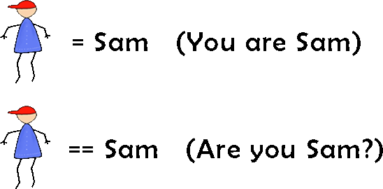
Recap
Difference between “=” and “==”?

Slide 5
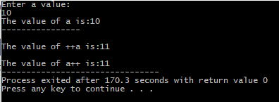
Recap
Unary Operators?
Write a program to prompt the user to input the integral value of a and print out the result as shown below:

Slide 6
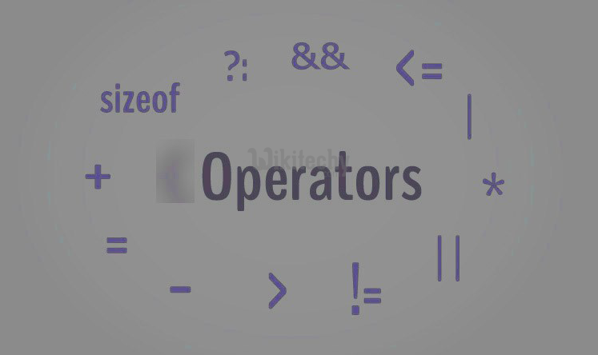
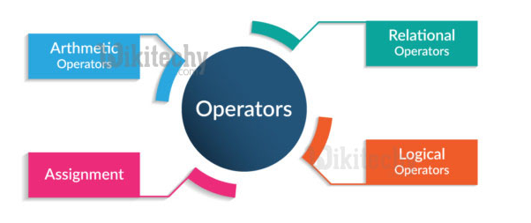
Operators in C++

Slide 7
Operators in C++
Stream Operators
Arithmetic Operators
Decision Making – Equality and Relational Operators
Assignment/ Combined Operators
Unary Operators
Logical Operators

Slide 8
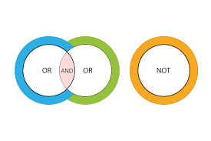
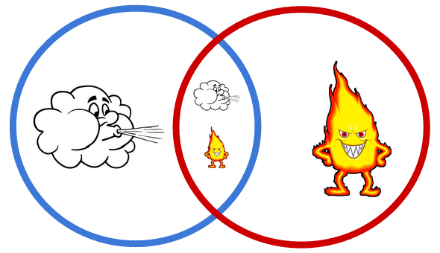
Logical Operators
(!, &&, ||)

Slide 9
Logical Operators
So far we’ve studied only simple conditions, such as:
counter <= 10
total > 1000
number != someValue
We expressed these conditions in terms of the relational operators.

Slide 10
Logical Operators
C++ provides logical operators that are used to form more complex conditions by combining simple conditions.
The logical operators are:
&& (logical AND)
|| (logical OR)
! (logical NOT, also called logical negation)

Slide 11
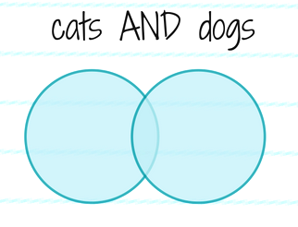
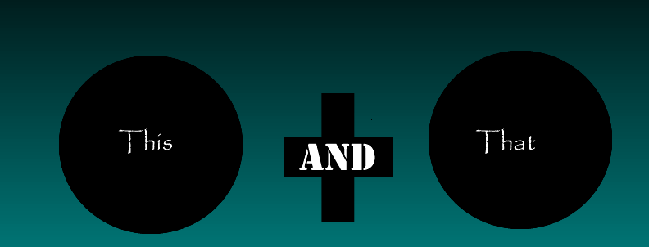
&& – Logical AND
Creates a Compound/Composite Condition
(condition1 && condition2)

Slide 12
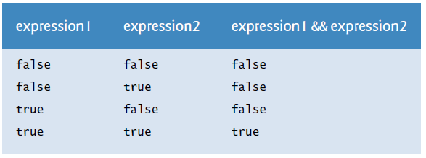
&& – Logical AND
(age >= 21) && (age <= 60)
Truth table

Slide 13
&& – Logical AND – Example
…the age is between 1 and 70 (inclusive)…
In case of a nested IF condition
  IF age >= 1 then
    IF age <= 70 then
      perform operations
    ENDIF
  ENDIF

Slide 14
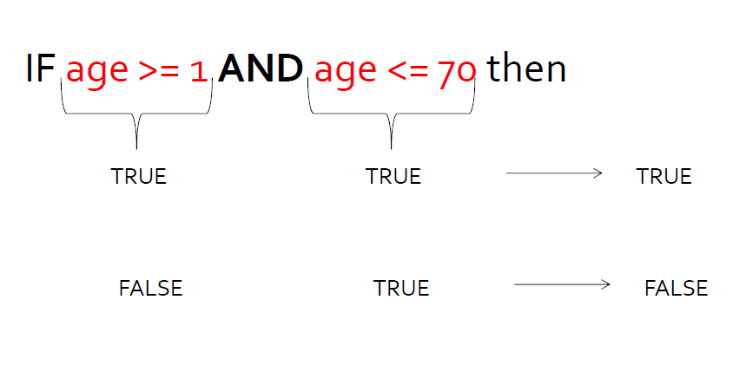
&& – Logical AND – Example

Slide 15
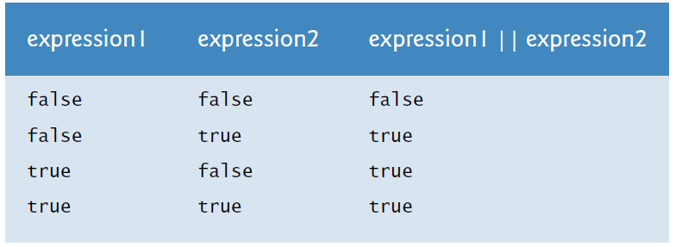
|| – Logical OR – Example
Executes if one or both conditions are true
(condition1 || condition2)
Truth table

Slide 16
|| – Logical OR – Example
…if age is 15, 31, or 45 then give 10% discount…
In case of an IF condition
  IF age == 15 then
  give discount
  ENDIF
  IF age == 31 then
  give discount
  ENDIF

Slide 17
|| – Logical OR – Example
…if age is 15, 31, or 45 then give 10% discount…
In case of an IF condition
  IF age == 45 then
  give discount
  ENDIF

Slide 18
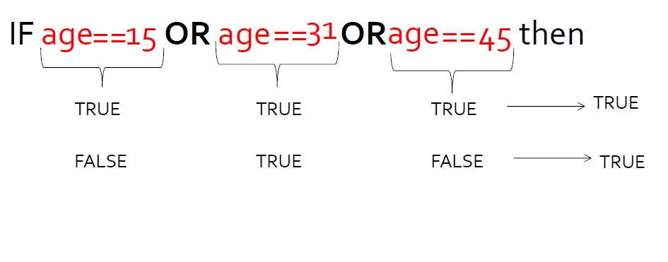
|| – Logical OR – Example
…if age is 15, 31, or 45 then give 10% discount…

Slide 19
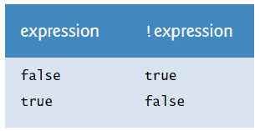
! – Logical NOT (logical negation)
Used to reverse a condition’s meaning
!(condition)
Truth table

Slide 20
! – Logical NOT – Example
…if age is NOT more than 30 then give 5% discount…
if (!(age > 30))
give discount
…if day is not Saturday or Sunday, trigger alarm…
if (!(day == "Saturday" || day == "Sunday")) trigger alarm

Slide 21
Exercise
Evaluate the following expressions:
  x < 2&& y == 1
  !flag && done
  y || z
Assume
    x = 5
    flag = true
    done = false
    y = 1
    z = 0

Slide 22
Exercise – Answers
Evaluate the following expressions:
  x < 2&& y == 1 -> false
  !flag && done -> false
  y || z -> true
Assume
    x = 5
    flag = true
    done = false
    y = 1
    z = 0

Slide 23

Testing and Debugging

Slide 24
Testing and Debugging
Bug
  A mistake in a program
Debugging
  Eliminating mistakes in programs
  Term used when a moth caused a failed relay
  on the Harvard Mark 1 computer. Grace Hopper
  and other programmers taped the moth in logbook
  stating:
  “First actual case of a bug being found.”

Slide 25
Program Errors
Syntax errors
  Violation of the grammar rules of the language
  Syntax errors are also called compiler errors, compile-time errors or compilation errors.
  Discovered by the compiler
    Error messages may not always show correct location of
    errors
  You cannot execute your program until you correct all the syntax errors in it.

Slide 26
Program Errors
Run-time errors
  Error conditions detected by the computer at run-time
  Errors such as division by zero occur as a program runs, so they’re called runtime errors or execution-time errors.
  Fatal runtime errors cause programs to terminate immediately without having successfully performed their jobs.
  Nonfatal runtime errors allow programs to run to completion, often producing incorrect results.

Slide 27
Program Errors
Logic errors
  Errors in the program’s algorithm
  Most difficult to diagnose
  Computer does not recognize an error

Slide 28
Program Errors
What kind of error in the program given below:
#include <iostream>
using namespace std;
int main()
{
  int x, y;
  x = y + 2
  cout << x << "\n";
  cout << y;
}
Syntax Error
Missing semicolon

Slide 29
Program Errors
What kind of error in the program given below:
#include <iostream>
using namespace std;
int main()
{
  int x;
  x = y + 2;
  cout << x << "\n";
  cout << y;
}
Syntax Error
‘y’ : undeclared identifier

Slide 30
Program Errors
What kind of error in the program given below:
Syntax Error
‘=’ : left operand must be l-value
#include <iostream>
using namespace std;
int main()
{
  int x;
  y + 2 = x;
  cout << x << "\n";
  cout << y;
}

Slide 31
Program Errors
What kind of error in the program given below:
// File dividedanger.cpp
#include <iostream>
using namespace std;
int main()
{
  int dividend, divisor;
  // Get two integers from the user
  cout << "Please enter two integers to divide:";
  cin >> dividend >> divisor;
  // Divide them and report the result
  cout << dividend << "/" << divisor << " = "
  << dividend/divisor << endl;
}

Slide 32
Program Errors
What kind of error in the program given below:
// File dividedanger.cpp
#include <iostream>
using namespace std;
int main()
{
  int dividend, divisor;
  // Get two integers from the user
  cout << "Please enter two integers to divide:";
  cin >> dividend >> divisor;
  // Divide them and report the result
  cout << dividend << "/" << divisor << " = "
  << dividend/divisor << endl;
}
Runtime
Error

Slide 33
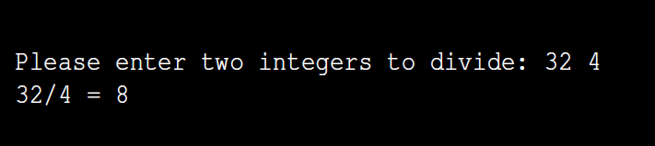
Program Errors
The expression dividend/divisor is potentially dangerous.
If the user enters, for example, 32 and 4, the program works nicely and displays the answer of 8.

Slide 34
Program Errors
If the user instead types the numbers 32 and 0, the program reports an error and terminates.
Division by zero is undefined in mathematics, and integer division by zero in C++ is illegal.
When the program attempts the division at run time, the system detects the attempt and terminates the program.

Slide 35
Program Errors
What kind of error in the program given below:
// File dividedanger.cpp
#include <iostream>
using namespace std;
int main()
{
  int dividend, divisor;
  // Get two integers from the user
  cout << "Please enter two integers to divide:";
  cin >> dividend >> divisor;
  // Divide them and report the result
  cout << dividend << "/" << divisor << " = "
  << dividend/divisor << endl;
}
In what other way can this program crash
?

Slide 36
Program Errors
What kind of error in the program given below:
// File dividedanger.cpp
#include <iostream>
using namespace std;
int main()
{
  int dividend, divisor;
  // Get two integers from the user
  cout << "Please enter two integers to divide:";
  cin >> dividend >> divisor;
  // Divide them and report the result
  cout << divisor << "/" << dividend << " = "
  << divisor/dividend << endl;
}
Logic
Error

Slide 37
Program Errors – Conclusion
Can you…
  Describe the three kinds of program errors?
  Tell what kind of errors the compiler catches?
  What kind of error is produced if you forget a
  punctuation symbol such as a semi-colon?
  Tell what type of error is produced when a program
  runs but produces incorrect results?

Slide 38


