Slide 1

CS-111
Fundamentals of Computer Programming
Lecture 6
Conditional Statements – I
Course Instructor:
Qurrat-ul-ain Babar
NUST Institute of Civil Engineering (NICE)

Slide 2
Road Map for Today
Control Statements
  Selection
  Iteration
  Jump

Slide 3
Control Statements

Slide 4
C++ Control Statements
Normally, statements in a program execute one after the other in the order in which they’re written.
This is called sequential execution.

Slide 5
C++ Control Statements
However, various C++ statements enable you to specify that the next statement to execute may be other than the next one in sequence.
This is called transfer of control.

Slide 6
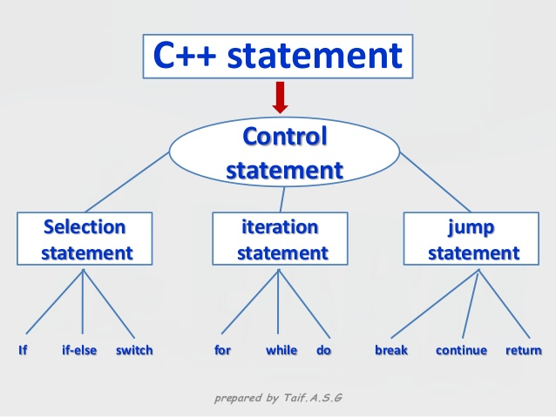
C++ Control Statements
C++ has only three kinds of control structures also known as control statements.

Slide 7
Conditional Statements
Overview of Conditions
Lets imagine you are filling an employment application and one question is,
“Do you consider yourself
a hot-tempered individual?”

Slide 8
Conditional Statements
Overview of Conditions
The source file of such a program would look like this:
#include <iostream>
using namespace std;
int main()
{
  char Answer;
  cout << "Do you consider yourself a hot-tempered individual? ";
  cin >> Answer;
  return 0;
}

Slide 9

Conditional Statements
Overview of Conditions
The variety of these different answers means that you should pay attention to how you structure your programs, you should be clear to the users.

Slide 10
Conditional Statements
Overview of Conditions
A better version of the line that asks the question would be:
cout << "Do you consider yourself a hot-tempered individual? (y=Yes/n=No)";
This time, although the user can still type anything, at least you have specified the expected answers and you can place checks on the input.

Slide 11
C++ Selection Statements

Slide 12
C++ Selection Statements
The selection statements allow
to choose the set of instructions for execution depending upon a certain condition.
C++ provides two types of selections statements:
  if
  switch
The selection statements are also called conditional statements or decision statements.

Slide 13
The if statement
One-Way Selection
Two-Way Selection
Compound (Block of) Statements
Multiple Selections: Nested if
Comparing if…else statements with a series of if statements.

Slide 14
One-Way Selection
The syntax of one-way selection is:
The statement is executed if the condition evaluates to true.
The statement is bypassed if the value is false; program goes to the next statement.
if is a reserved word.
if(condition)
statement;
Note there is no semicolon here

Slide 15
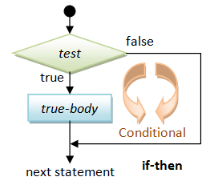
One-Way Selection

Slide 16
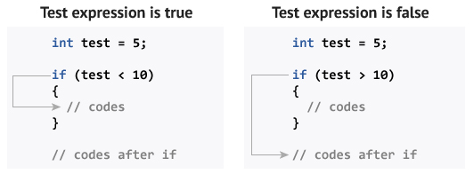
One-Way Selection

Slide 17
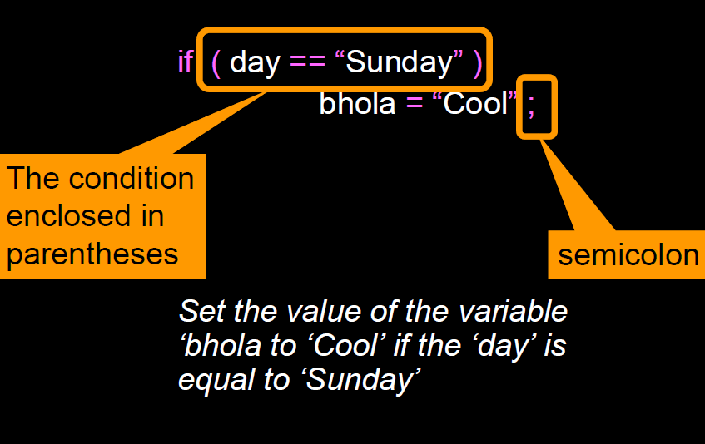
if: Example 1

Slide 18
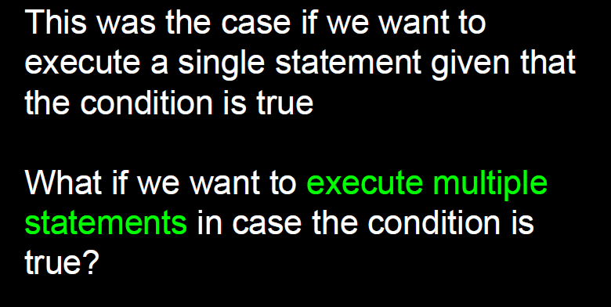

Slide 19
One-Way Selection
if(condition)
{
statement(1);
statement(2);
…
…
statement(n);
}

Slide 20
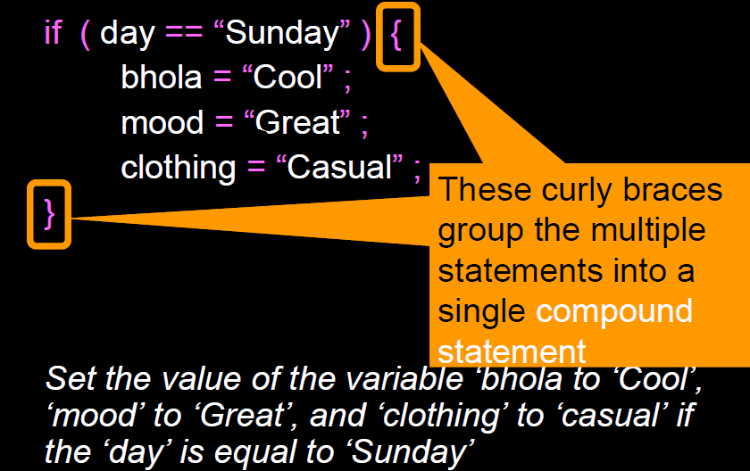
if: Example 2

Slide 21
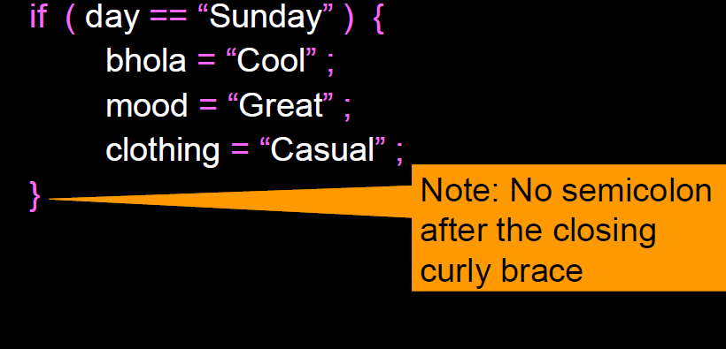
if: Example 2

Slide 22
One-Way Selection – Identify the Error
Syntax Error
Parentheses required
if grade >= 60
cout << "Passed";
if (grade >= 60);
cout << "Passed";
Logical Error

Slide 23
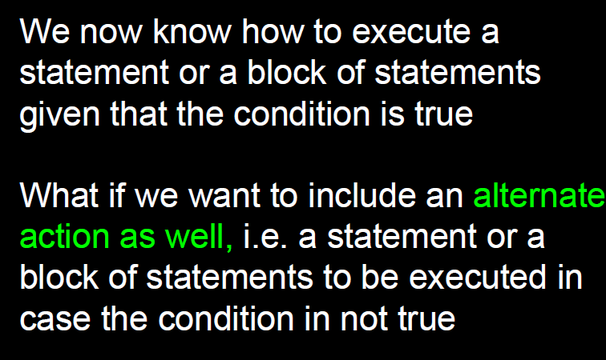

Slide 24
Two-Way Selection
Two-way selection takes the form:
If the condition is true statement1 is executed; otherwise statement2 is executed.
else is a reserved word.
if(condition)
statement1;
else
statement2;

Slide 25
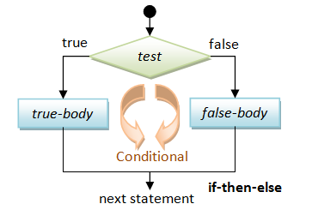
Two-Way Selection

Slide 26
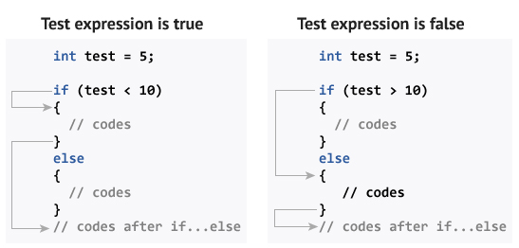
Two-Way Selection

Slide 27
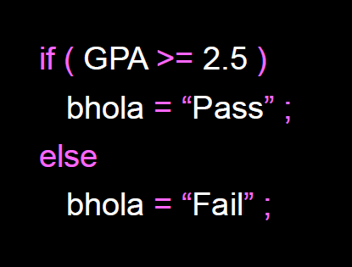
if else: Example 1

Slide 28
Two-Way Selection – Identify the Error
if (grade >= 60)
cout << "Passed";
else (grade < 60)
cout << “Failed";
Syntax Error
else does not require a condition

Slide 29
Two-Way Selection – Identify the Error
if (grade >= 60);
cout << "Passed";
else
cout << “Failed";
Syntax Error
No stand-alone else statement in C++

Slide 30
Compound (Block of) Statement
  if(condition)
  {
  statement1;
  statement2;
  …
  }
  else
  {
  statement3;
    statement2;
    …
  }

Slide 31
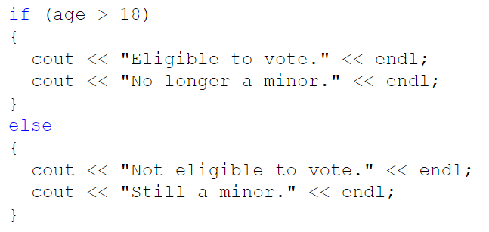
Compound (Block of) Statement

Slide 32
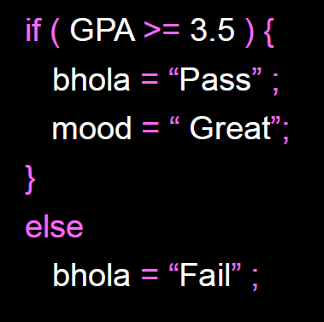
if else: Example 2

Slide 33
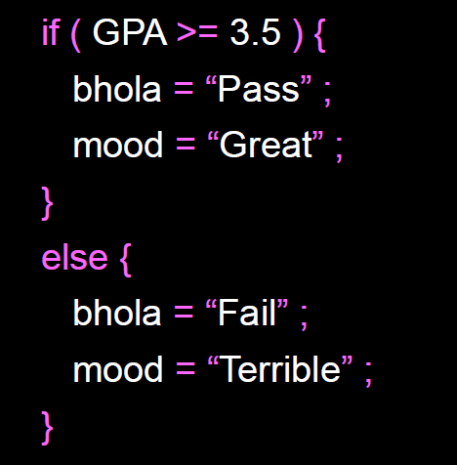
if else: Example 3

Slide 34
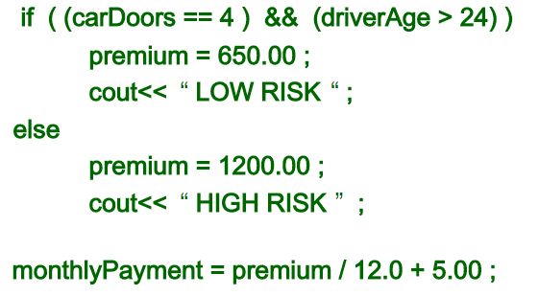
What happens if you omit the braces?
Compile Time Error
No stand-alone else statement in C++

Slide 35
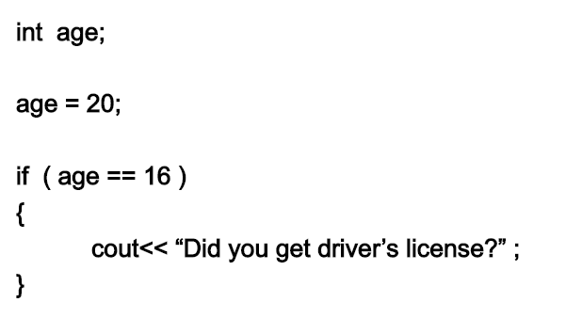
What will be the output?

Slide 36
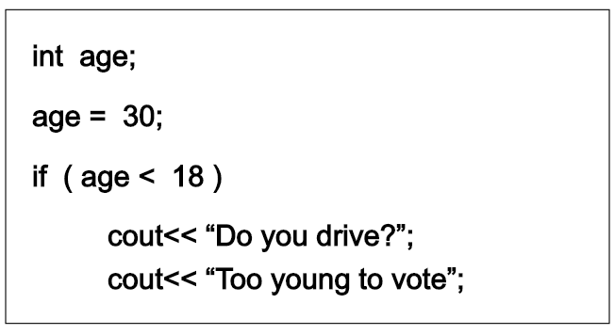
What will be the output?

Slide 37
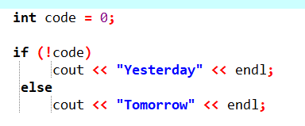
What will be the output?

Slide 38
Multiple Selection – Nested if
Nesting: One control statement within another
if(condition1)
{
if(condition2)
statement1;
}

Slide 39
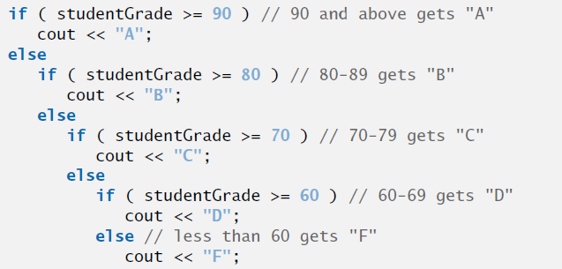
Multiple Selection – Nested if
if(condition1)
{
statement1;
}
else
{
if(condition2)
statement;
else
statement;
}

Slide 40
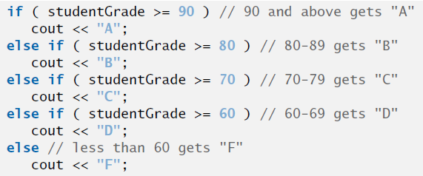
Multiple Selection – if-else-if

Slide 41
Comparison
If – else – if
vs
series of if statements

Slide 42
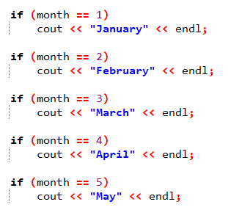
Comparison – If-else-if vs series of if statements

Slide 43
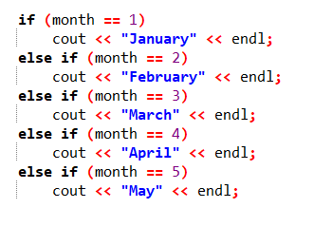
Comparison – If-else-if vs series of if statements

Slide 44
Exercise – Nested if
Air Force has asked you to write a program to label aircrafts as military or civilian. Your program input is plane’s speed and its estimated length.
For planes travelling faster than 1100 km/hr, you will label those shorter than 52m as “military” and longer as “civilian”.
For planes travelling less than 1100 km/hr, you will issue an “aircraft unknown” statement.

Slide 45
Exercise – Nested if
Write a program that takes an integer input from user and displays one word to describe the int value of number is “Positive”, “Negative” or “Zero”.

Slide 46
Conditional Operator (?:)
C++ also provides an operator to deal with if…else scenarios.
This is called Conditional Operator (?:)
It takes three arguments
  Ternary Operator

Slide 47
Conditional Operator (?:)
The syntax of using conditional operator is:
(condition)?expression1:expression2;
Condition is evaluated
Result is expression1 if condition is true
Result is expression2 if condition is false

Slide 48
Conditional Operator (?:)
#include <iostream>
using namespace std;
int main ()
{
  // variable declaration
  int x, y = 10;
  x = (y < 10) ? 30 : 40;
  cout << "value of x: " << x << endl;
  return 0;
}
Output
?
value of x: 40

Slide 49
C++ Selection Statements
C++ provides two types of selections statements:
  if
  switch

Slide 50


