Slide 1


CS-111
Fundamentals of Computer Programming
Lecture 7
Control Statements – II
Course Instructor:
Qurrat-ul-ain Babar
NUST Institute of Civil Engineering (NICE)

Slide 2


Thought of the Week: Tolerance

Slide 3
Road Map for Today
Control Statements
  Selection
    if
    switch
  Iteration
  Jump

Slide 4
Multiple Selection – Nested if
Nesting: One control statement within another
if(condition1)
{
if(condition2)
statement1;
}

Slide 5
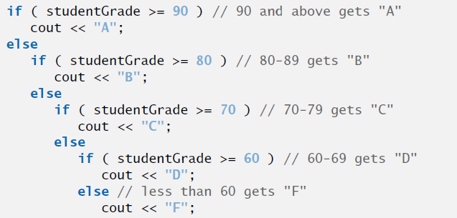
Multiple Selection – Nested if
if(condition1)
{
statement1;
}
else
{
if(condition2)
statement;
else
statement;
}

Slide 6
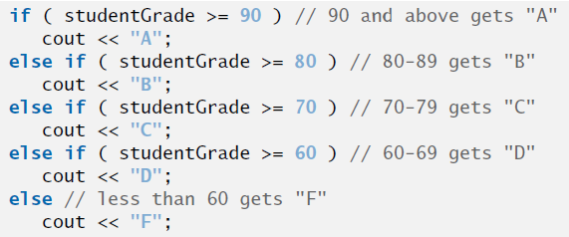
Multiple Selection – if-else-if

Slide 7
Comparison
If – else – if
vs
series of if statements

Slide 8
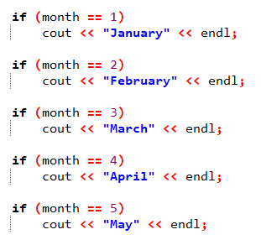
Comparison – If-else-if vs series of if statements

Slide 9
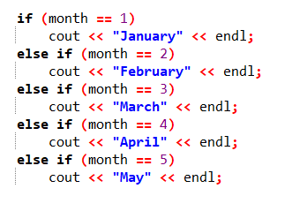
Comparison – If-else-if vs series of if statements

Slide 10
Exercise – Nested if
Write a program that takes an integer input from user and displays one word to describe the int value of number is “Positive”, “Negative” or “Zero”.

Slide 11
Exercise – Nested if
Air Force has asked you to write a program to label aircrafts as military or civilian. Your program input is plane’s speed and its estimated length.
For planes travelling faster than 1100 km/hr, you will label those shorter than 52m as “military” and longer as “civilian”.
For planes travelling less than 1100 km/hr, you will issue an “aircraft unknown” statement.

Slide 12
Conditional Operator (?:)
C++ also provides an operator to deal with if…else scenarios.
This is called Conditional Operator (?:)
It takes three arguments
  Ternary Operator

Slide 13
Conditional Operator (?:)
The syntax of using conditional operator is:
(condition)?expression1:expression2;
Condition is evaluated
Result is expression1 if condition is true
Result is expression2 if condition is false

Slide 14
Conditional Operator (?:)
#include <iostream>
using namespace std;
int main ()
{
  // variable declaration
  int x, y = 10;
  x = (y < 10) ? 30 : 40;
  cout << "value of x: " << x << endl;
  return 0;
}
Output
?
value of x: 40

Slide 15
C++ Selection Statements
C++ provides two types of selections statements:
  if
  switch

Slide 16
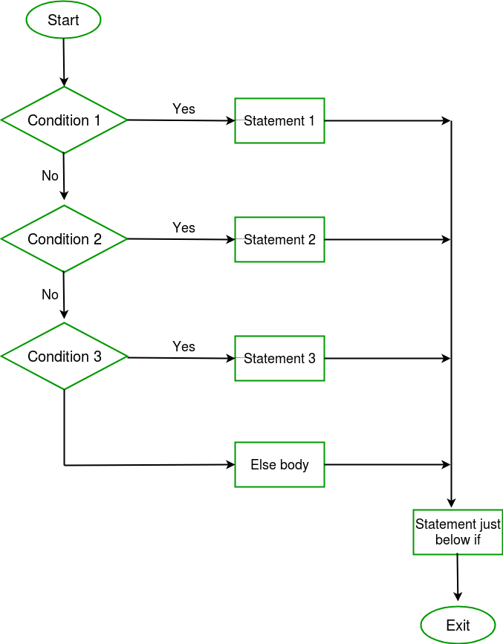
Recap
What kind of selection statement is this flowchart representing?

Slide 17
Recap
if ( n % 2 == 0)
cout << n << " is even.";
else
cout << n << " is odd.";
How can we change the above code using conditional operator?
(n % 2 == 0) ? cout << n << " is even." : cout << n << " is odd.";

Slide 18
Recap
What is better performance wise?
  Multiple if
  if-else (nested)
  if-else-if

Slide 19
Switch Statement

Slide 20
Switch Statement
Alternative to (deeply) nested “if … else …”
Applicable only when all conditions check equality of single variable with different constant values
if (variable == constant1) { … }
else {
if (variable == constant2) { … }
else {
if (variable == constant3) { }
else { … }
}
}
Same variable
Possible values

Slide 21
Switch Statement
if (x == 0) { cout << “Time and tide wait for none.” << endl; }
else {
  if (x == 1)
  { cout << “The pen is mightier than the sword.” << endl; }
  else
  { cout << “Where there is a will, there is a way.” << endl; }
}
switch (x) {
  case 0: cout << “Time and tide wait for none.” << endl;
  break;
  case 1: cout << “The pen is mightier than the sword.” << endl; break;
  default: cout << “Where there is a will, there is a way.” << endl;
}
switch, case, break, default
C++ keywords

Slide 22
Switch Statement
The switch statement provides another way to decide which statement to execute next
The switch statement evaluates an expression, then attempts to match the result to one of several possible cases
The match must be an exact match.
switch(expression)
{
case value1 :
statement-list1
case value2 :
statement-list2
case value3 :
statement-list3
case ...
}

Slide 23
Switch Statement
switch(expression)
{
case value1 :
statement-list1
case value2 :
statement-list2
case value3 :
statement-list3
case ...
}
The flow of control transfers to statement associated with the case value that matches.

Slide 24
Switch Statement – Syntax
Lets see what this keyword break does?
switch(expression)
{
case value1 :
statement-list1
break;
case value2 :
statement-list2
break;
case value3 :
statement-list3
break;
case
...
default:
statement-list
}
Acts like a condition
Can be a single variable
If an expression is given here, it must evaluate to limited possible values
If expression
matches value2,
control jumps
to here
switch, case, break, default
C++ keywords

Slide 25
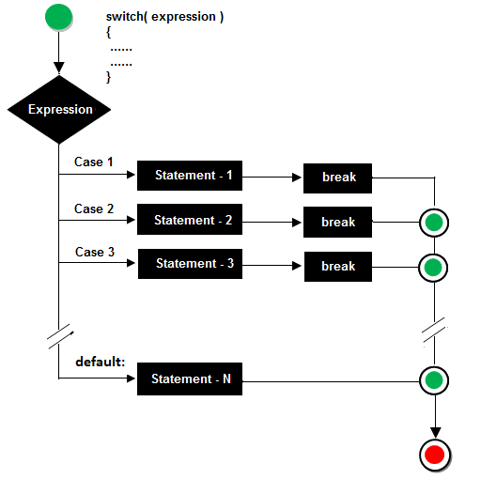
switch Statement - Flowchart

Slide 26
break Statement
The break statement can be used as the last statement in each case's statement list
A break statement causes control to transfer to the end of the switch statement
If a break statement is not used, the flow of control will fall through into the next case
switch ( expression ){
case value1 :
statement-list1
break;
case value2 :
statement-list2
break;
case value3 :
statement-list3
break;
case ...
}

Slide 27
switch Statement with break
switch (x)
{
  case 0:
  cout << “Time and tide wait for none.”;
  break;
  case 1:
  cout << “The pen is mightier than the sword.”; break;
  default:
  cout << “Where there is a will, there is a way.”;
}
Suppose x = 0;

Slide 28
switch Statement with break
switch (x)
{
  case 0:
  cout << “Time and tide wait for none.”;
  break;
  case 1:
  cout << “The pen is mightier than the sword.”; break;
  default:
  cout << “Where there is a will, there is a way.”;
}
Suppose x = 1;

Slide 29
switch Statement – without break
switch (x)
{
  case 0:
  cout << “Time and tide wait for none.”;
  case 1:
  cout << “The pen is mightier than the sword.”;
  default:
  cout << “Where there is a will, there is a way.”;
}
Suppose x = 0;

Slide 30
switch Statement – without break
switch (x)
{
  case 0:
  cout << “Time and tide wait for none.”;
  case 1:
  cout << “The pen is mightier than the sword.”;
  default:
  cout << “Where there is a will, there is a way.”;
}
Suppose x = 1;

Slide 31
switch Statement – without break
Another Example:
switch (option){
case 'A':
aCount++;
break;
case 'B':
bCount++;
break;
case 'C':
cCount++;
break;
}
switch (option){
case 'A':
aCount++;
case 'B':
bCount++;
case 'C':
cCount++;
}

Slide 32
switch Statement - default
switch (x)
{
  case 0:
  cout << “Time and tide wait for none.”;
  break;
  case 1:
  cout << “The pen is mightier than the sword.”; break;
  default:
  cout << “Where there is a will, there is a way.”;
}
What if the value of x = 2?
Executed last – flow control goes to default if no matching case is found

Slide 33
switch Statement - default
switch (x)
{
  case 0:
  cout << “Time and tide wait for none.”;
  break;
  case 1:
  cout << “The pen is mightier than the sword.”; break;
  default:
  cout << “Where there is a will, there is a way.”;
}
What if the value of x = 2?
break is optional with default

Slide 34
switch Statement - default
switch (x)
{
  case 0:
  cout << “Time and tide wait for none.”;
  break;
  case 1:
  cout << “The pen is mightier than the sword.”; break;
  default:
  cout << “Where there is a will, there is a way.”;
}
What if the value of x = 2?
Although the case clauses and the default clause in a switch statement can occur in any order, it’s common practice to place
the default clause last.

Slide 35
switch Statement – default
A switch statement can have an optional default case
The default case has no associated value and simply uses the reserved word default
If the default case is present, control will transfer to it if no other case value matches
If there is no default case, and no other value matches, control falls through to the statement after the switch

Slide 36
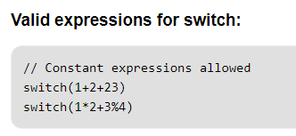
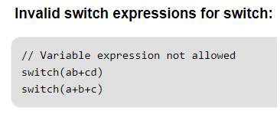
Important Points - Switch Case Statements
The expression provided in the switch should result in a constant value otherwise it would not be valid

Slide 37
Important Points - Switch Case Statements
Duplicate case values are not allowed.
The default statement is optional. Even if the switch case statement do not have a default statement, it would run without any problem.

Slide 38
Important Points - Switch Case Statements
The break statement is used inside the switch to terminate a statement sequence. When a break statement is reached, the switch terminates, and the flow of control jumps to the next line following the switch statement.
The break statement is optional. If omitted, execution will continue on into the next case. The flow of control will fall through to subsequent cases until a break is reached.

Slide 39
Important Points - Switch Case Statements
Nesting of switch statements are allowed, which means you can have switch statements inside another switch.
  However nested switch statements should be avoided as it makes program more complex and less readable.

Slide 40
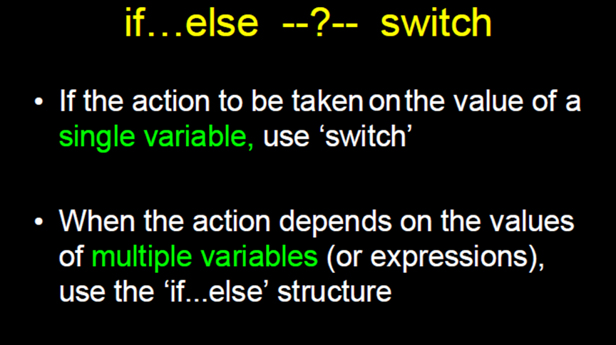

Slide 41
Examples
char grade;
cout << "Enter grade";
cin >> grade;
switch (grade) {
  case 'A':
    cout << "Great job!!";
    break;
  case 'B':
    cout << "Good job";
    break;
  case 'C':
    cout << "Satisfactory job";
    break;
  case 'D':
    cout << "Hmmm ... need to work a little harder";
    break;
  case 'F':
    cout << "Sorry, you failed the class";
    break;
  default:
  cout << "The letter you typed " << grade
  << " is not a valid grade";
}

Slide 42
Examples:
#include <iostream>
using namespace std;
int main() {
int operand1 = 0, operand2 = 0, result=0;
char op= ‘ ‘;
cout << “Please enter expression (num op num) ? “;
cin >> operand1 >> op >> operand2;
switch (op) {
case ‘+’:
result = operand1 + operand2;
break;
case ‘-’:
result = operand1 - operand2;
break;
// other cases left off for room
default:
cout << “Did not recognize operator” << endl;
}
cout << operand1 << “ “ << op<< “ “ <<operand2 << “ = “ << result << endl;
return 0;
}

Slide 43
Examples
int x, y;
cin >>x>>y;
switch (x>y) {
case 0:
cout<<“x is no greater than y”;
break;
case 1:
cout<<“ x is greater than y”;
break;
default:
}
int x, y;
cin>>x>>y;
switch (x>y) {
case false:
cout<<“x is no greater than y”;
break;
case true:
cout<<“ x is greater than y”;
break;
default:
}

Slide 44
Example
….
switch (flight_class)
{
case 3: ticket=300;
break
case 2: ticket=500;
break;
case 1: ticket=1000;
break;
Default: cout<<“unknown class!”;
}
cout<<“you need to pay: ”<<“\n”<<ticket <<“ dollars, thank you!”;
What the third class passenger will need to pay?

Slide 45
Exercise
Convert the following segment of code to switch statement:
    int j, n;
    if (j==3)
    n = 6;
    else if (j==8)
    n = 9;
    else if (j==2)
    n = 8;
    else
    n = 0;

Slide 46
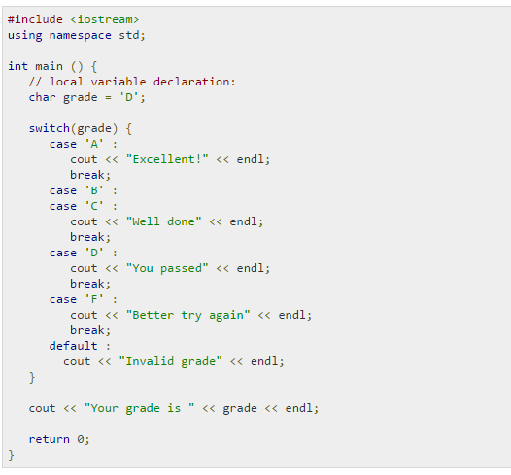

Exercise
Output

Slide 47

Exercise
char grade = ‘B’;
Output

Slide 48
Nested switch statements
  switch (expression ) {
  case value1:
  switch (expression) {
  case x:
  statements;
  break;
  }
  break;
  case value2:
  statements; break;
  default:
  statements;
  }

Slide 49
Exercise: Output?
int x=1, y=2, z=3;
switch (x>0) {
  case 1:
    switch (y<0) {
      case 0: cout<<"?"; break;
      case 1: cout<<"%"; break;
    }
    break;
  case 0:
    switch (z==3) {
      case 0: cout<<"+"; break;
      case 1: cout<<"#"; break;
    }
  default:
  cout<<"&";
}

Slide 50

Questions??
To switch or not to switch, that’s the question….

Slide 51
Road Map for Today
Control Statements
  Selection
    if
    switch
  Iteration
    while
    do…while
    for
  Jump

Slide 52
C++ Iteration/Repetition Statements

Slide 53
Repetition Statements
A repetition statement specifies that a program should repeat an action while some condition remains true.
C++ provides three types of repetition statements (also called looping statements or loops or iterations)
  for performing statements repeatedly
  while a condition remains true
    while
    do…while
    for

Slide 54



Loop
A loop is part of a program that repeats.

Slide 55

The while statement
A repetition statement specifies that a program should repeat an action while some condition remains true.
  Umbridge: Write ‘I must not tell lies’.
  Harry: How many times?
  Umbridge: Till the message sinks in.

Slide 56
The while statement
While there are more items on my shopping list
Purchase next item and cross it off my list
The condition, “there are more items on my shopping list” is either true or false.
  If it’s true, then the action, “Purchase next item and cross it off my list” is performed.
  This action will be performed repeatedly while the condition remains true.
Eventually, the condition will become false

Slide 57
The while statement
A while loop is a “pre test” loop - the condition is tested before the loop body is executed
while(condition)
statement;
while(condition)
{
statement(s);
}

Slide 58
The while statement - Example
  // Local variable declaration:
  int a = 10;
  // while loop execution
  while( a < 15 )
  {
    cout << “Value of a: " << a << endl;
    a++;
  }
Output:
Value of a: 10
Value of a: 11
Value of a: 12
Value of a: 13
Value of a: 14

Slide 59
The while statement - Example
  // Local variable declaration:
  int product = 10;
  // while loop execution
  while( product <= 100 )
    product *= 3;

Slide 60
Flowchart Representation of “while”
Part of program before iteration
Logical expression
(loop condition)
FALSE
TRUE
Loop Body
Part of program after iteration

Slide 61
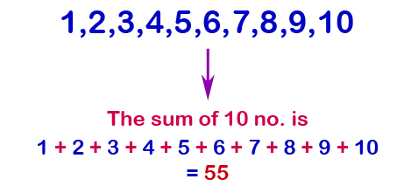
The while statement – Example
Calculate the sum of first 10 natural numbers.

Slide 62
Example
Read in numbers, add them, and
print their sum and average
set sum to 0
set count to 0
input totalNumbers
while (count < totalNumbers)
{
input nextNum
add nextNum to sum
add 1 to count
}
output "Sum was" sum
output "Mean was" sum/count

Slide 63
Example
Read in numbers, add them, and
print their sum and average
set sum to 0
set count to 0
input totalNumbers
while (count < totalNumbers)
{
input nextNum
add nextNum to sum
add 1 to count
}
output "Sum was" sum
output "Mean was" sum/count
Iteration Control
Initialize
Check condition
Update

Slide 64
Example
#include <iostream>
/**********************************\
Read in numbers and add them up
Print out the sum and the average
\**********************************/
int main()
{
return 0;
}
Read in numbers, add them, and
print their sum and average
set sum to 0
set count to 0
input totalNumbers
while (count < totalNumbers)
{
input nextNum
add nextNum to sum
add 1 to count
}
output "Sum was" sum
output "Mean was" sum/count

Slide 65
Example
#include <iostream>
/**********************************\
Read in numbers and add them up
Print out the sum and the average
\**********************************/
int main()
{
float nextNum, sum = 0.0;
int count = 0, totalNumbers;
cout << "Enter total numbers to be summed/averaged = ";
cin >> totalNumbers;
while (count < totalNumbers)
{
cout << "Enter next number = ";
cin >> nextNum;
sum = sum + nextNum;
// sum += nextNum;
count++;
}
cout<<"Sum = "<< sum <<"\n";
cout<<"Mean = "<<sum/count<<"\n";
return 0;
}
Read in numbers, add them, and
print their sum and average
set sum to 0
set count to 0
input totalNumbers
while (count < totalNumbers)
{
input nextNum
add nextNum to sum
add 1 to count
}
output "Sum was" sum
output "Mean was" sum/count

Slide 66
#include <iostream>
/**********************************\
Read in numbers and add them up
Print out the sum and the average
\**********************************/
int main()
{
{
float nextNum, sum = 0.0;
int count = 0, totalNumbers;
cout << "Enter total numbers to be summed/averaged = ";
cin >> totalNumbers;
while (count < totalNumbers)
{
cout << "Enter next number = ";
cin >> nextNum;
sum += nextNum;
count++;
}
cout<<"Sum = "<< sum <<"\n";
cout<<"Mean = "<<sum/count<<"\n";
return 0;
}
Example
totalNumbers | count | nextNum | sum
???? | 0 | ???? | 0.0

Slide 67
#include <iostream>
/**********************************\
Read in numbers and add them up
Print out the sum and the average
\**********************************/
int main()
{
{
float nextNum, sum = 0.0;
int count = 0, totalNumbers;
cout << "Enter total numbers to be summed/averaged = ";
cin >> totalNumbers;
while (count < totalNumbers)
{
cout << "Enter next number = ";
cin >> nextNum;
sum += nextNum;
count++;
}
cout<<"Sum = "<< sum <<"\n";
cout<<"Mean = "<<sum/count<<"\n";
return 0;
}
Example
totalNumbers | count | nextNum | sum
???? | 0 | ???? | 0.0
3

Slide 68
#include <iostream>
/**********************************\
Read in numbers and add them up
Print out the sum and the average
\**********************************/
int main()
{
{
float nextNum, sum = 0.0;
int count = 0, totalNumbers;
cout << "Enter total numbers to be summed/averaged = ";
cin >> totalNumbers;
while (count < totalNumbers)
{
cout << "Enter next number = ";
cin >> nextNum;
sum += nextNum;
count++;
}
cout<<"Sum = "<< sum <<"\n";
cout<<"Mean = "<<sum/count<<"\n";
return 0;
}
Example
totalNumbers | count | nextNum | sum
???? | 0 | ???? | 0.0
3
 |  | 4
1
4.0

Slide 69
#include <iostream>
/**********************************\
Read in numbers and add them up
Print out the sum and the average
\**********************************/
int main()
{
{
float nextNum, sum = 0.0;
int count = 0, totalNumbers;
cout << "Enter total numbers to be summed/averaged = ";
cin >> totalNumbers;
while (count < totalNumbers)
{
cout << "Enter next number = ";
cin >> nextNum;
sum += nextNum;
count++;
}
cout<<"Sum = "<< sum <<"\n";
cout<<"Mean = "<<sum/count<<"\n";
return 0;
}
Example
totalNumbers | count | nextNum | sum
???? | 0 | ???? | 0.0
3
 |  | 4
 |  | -1
1
4.0
2
3.0

Slide 70
#include <iostream>
/**********************************\
Read in numbers and add them up
Print out the sum and the average
\**********************************/
int main()
{
{
float nextNum, sum = 0.0;
int count = 0, totalNumbers;
cout << "Enter total numbers to be summed/averaged = ";
cin >> totalNumbers;
while (count < totalNumbers)
{
cout << "Enter next number = ";
cin >> nextNum;
sum += nextNum;
count++;
}
cout<<"Sum = "<< sum <<"\n";
cout<<"Mean = "<<sum/count<<"\n";
return 0;
}
Example
totalNumbers | count | nextNum | sum
???? | 0 | ???? | 0.0
3
 |  | 4
 |  | -1
 |  | 6.2
1
4.0
2
3.0
3
9.2

Slide 71

Common Mistakes in while – “one liners”
while (num < minimum)
cout << “Enter a number”;
cin >> num
cout(“Number must be greater than” << minimum);
cout(“Please try again.\n”);
while (num < minimum)
{
cout << “Enter a number”;
cin >> num
cout(“Number must be greater than” << minimum);
cout(“Please try again.\n”);
}

Slide 72
Common Mistakes in while-extra semicolon
while (num < minimum);
{
cout << “Enter a number”;
cin >> num
cout(“Number must be greater than” << minimum);
cout(“Please try again.\n”);
}
Marks the end of the while-block -- usual cause of infinite loops

Slide 73


