Slide 1


CS-111
Fundamentals of Computer Programming
Lecture 09
Functions – I
Course Instructor:
Qurrat-ul-ain Babar
NUST Institute of Civil Engineering (NICE)

Slide 2


Honesty & Integrity

Slide 3
Road Map for Today
Functions

Slide 4
Recap Exercise
Write a program which prints ten asterisks (*) in line (**********) first using while loop and then using a for loop.

Slide 5
Exercise
Write a program which repeatedly prints the value of the variable xValue, decreasing it by 0.5 each time, as long as xValue remains positive.

Slide 6
Exercise
Write a program to Drive the user crazy by insisting they re-enter a particular input no matter what they enter. Be creative...

Slide 7
A Quick Recap
Various constructs to help us write useful programs
  Variables & Input/output statements
  Arithmetic & Assignment statements
  Sequential and conditional statements
  Iteration/looping constructs
  All encapsulated within “main( )”

Slide 8
Overview of This Lecture
Break away from the monopoly of “main()”
    Have other sub-units of a program that can compute
    Reduce the burden of programming each and everything in “main()”
A complex problem is often easier to solve by dividing it into several smaller parts, each of which can be solved by itself.
Hello Dear Functions!!!
(divide and conquer)

Slide 9
Introduction to Functions
Functions are the building blocks of C++ programs.
A function is a named block of code that performs some ACTION.

Slide 10
Introduction to Functions
The statements written in a function are executed when it is called by its name.
  Each function has a UNIQUE NAME.
One function can be called MULTIPLE TIMES in a single program.

Slide 11
Advantages of Functions
Easier to Understand
Easier to Modify
Easier to Maintain
Provide Program Reusability
Separate the Concept (what is done) from the Implementation (how it is done)

Slide 12
Advantages of Functions
Easier to Understand
Easier to Modify
Easier to Maintain
Provide Program Reusability
Separate the Concept (what is done) from the Implementation (how it is done)

Slide 13
C++ Functions

Slide 14
C++ Function – syntax
Function Prototypes
Function Definitions
Function Call

Slide 15
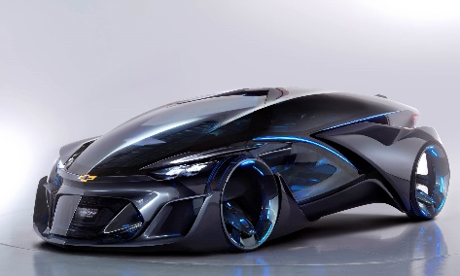
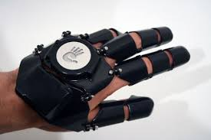
Function Prototypes
A function prototype is a declaration of a function that specifies the function's name and type signature but omits the function body.
Return-type Function-name(parameter-list);
Function signature
Note the semicolon here

Slide 16
Function Definitions
A set of statements that explains what a function does is called Function Definition.
Return-type Function-name(parameter-list)
{
statement(s);
}
Here we can have 0, 1 or many parameters

Slide 17
Function Definitions
In an program, a function definition can be written at:
  Before main() function
  After main() function
  In a separate file

Slide 18
Function Prototype - Example
Return-type
Function-name
Parameter-list
int Sum(int a , int b);

Slide 19
Function Definition - Example
Return-type
Function-name
Parameter-list
int Sum(int a , int b)
{
int sum;
sum = a + b;
return sum;
}
Multiple parameters should be separated by commas

Slide 20
Function Call
A statement that activates a function is known as a Function Call.
One function calls another by using function signature.

Slide 21
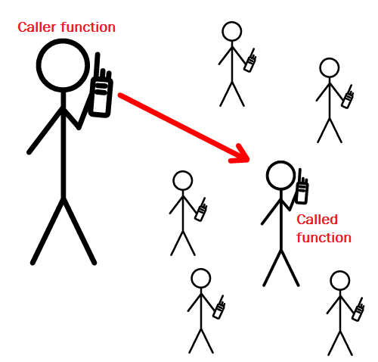
Function Call
The following steps take place when a function is called:
The control moves to the function that is called.
All statements in function body are executed.
Control returns back to calling function.

Slide 22
Function Call – Syntax
Function-name(parameter-list);

Slide 23
C++ Functions
C++ allows the use of both internal and external functions.
Internal Functions – User defined
External functions – Pre-defined (e.g., abs, ceil, rand, sqrt, etc.) are usually grouped into specialized libraries (e.g., iostream, stdlib, math, etc.)

Slide 24
Internal Functions
C++ programs usually have the following form:
  // include statements
  // function prototypes
  // main() function – has the function call
  // function definitions

Slide 25
Internal Functions
C++ programs usually have the following form:
  // include statements
  // function prototypes
  // main() function – has the function call
  // function definitions
What if we skip the prototype here?

Slide 26
Internal Functions
C++ programs usually have the following form:
  // include statements
  // function definitions
  // main() function – has the function call
Give the function definition before the function is called

Slide 27
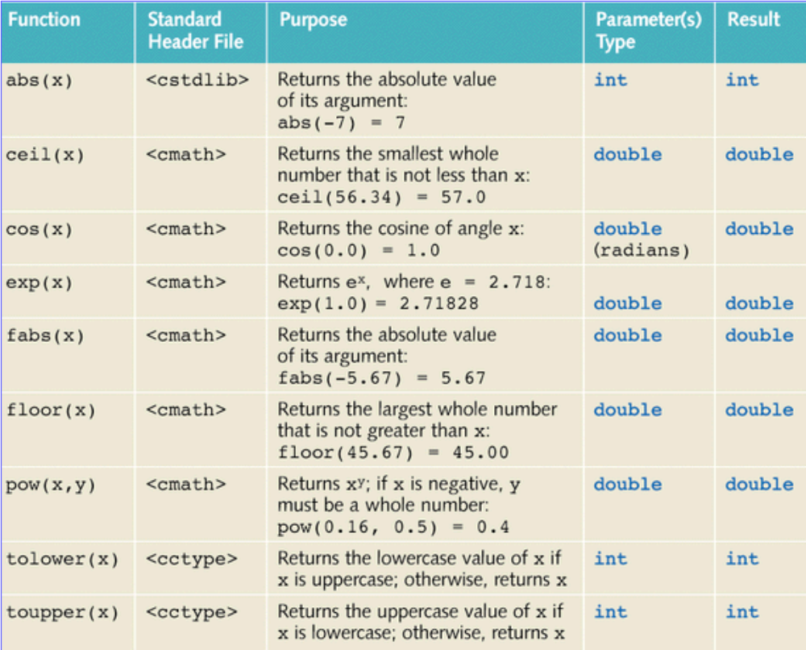
External Functions

Slide 28
C++ Function – Example (Cube)
#include <iostream>
using namespace std;
int Cube (int n);
int main()
{
  int yourNumber = 14;
  int myNumber = 9;
  cout << "My Number =" << myNumber ;
  cout << " its cube is" << Cube (myNumber) << endl ;
  cout << "Your Number = " << yourNumber ;
  cout << " its cube is " << Cube (yourNumber) << endl ;
}
int Cube (int n)
{
return n * n * n ;
}
Function prototype
Function Call
Function Call
Function definition

Slide 29
C++ Function – Example (Cube)
#include <iostream>
using namespace std;
int Cube (int n);
int Cube (int n)
{
return n * n * n ;
}
int main()
{
  int yourNumber = 14;
  int myNumber = 9;
  cout << "My Number =" << myNumber ;
  cout << " its cube is" << Cube (myNumber) << endl ;
  cout << "Your Number = " << yourNumber ;
  cout << " its cube is " << Cube (yourNumber) << endl ;
}
Function prototype
Function definition
Function Call
Function Call

Slide 30
C++ Function – Example (Cube)
#include <iostream>
using namespace std;
int Cube (int n)
{
return n * n * n ;
}
int main()
{
  int yourNumber = 14;
  int myNumber = 9;
  cout << "My Number =" << myNumber ;
  cout << " its cube is" << Cube (myNumber) << endl ;
  cout << "Your Number = " << yourNumber ;
  cout << " its cube is " << Cube (yourNumber) << endl ;
}
Function definition
Function Call
Function Call

Slide 31
C++ Function – Example (AddNumbers)
#include <iostream>
using namespace std;
int addition (int a, int b)
{
  int r;
  r = a + b;
  return r;
}
int main ()
{
  int z;
  z = addition (5,3);
  cout << "The result is " << z;
}
Function definition
Function Call

Slide 32
Exercise
Write a program which calls a function which prints ten asterisks (*) in line. (**********).
In this example main function just calls the function named asterisks which just prints the line of ten asterisks.

Slide 33
Class Work – Solution
#include <iostream>
using namespace std;
void asterisks ()
{
  for (int i=0; i<10; i++)
    cout << "*";
}
int main ()
{
  asterisks ();
}

Slide 34
Quiz 04 in next class

Slide 35

Thank You
The illiterate of the 21st century will not be those who cannot read and write,
but those who cannot learn, unlearn, and relearn.
--Unknown

