Slide 1


CS-111
Fundamentals of Computer Programming
Lecture 11
Functions – II
Course Instructor:
Qurrat-ul-ain Babar
NUST Institute of Civil Engineering (NICE)

Slide 2


Persistence needs Preparation & Faith

Slide 3
Road Map for Today
Recap
Parameters & Arguments
Default Values for Function Parameters
Scope Rules

Slide 4
Recap
C++ Function syntax -How many components?
Where to define the functions in C++?
When & why do we use function prototype?
Depending on whether a function is predefined or created by programmer; how many types of functions are there?

Slide 5
Recap – Example
#include <iostream>
using namespace std;
int absolute(int a)
{
  int r;
  r = abs(a);
  return r;
}
int main ()
{
  int z;
  z = absolute (-5);
  cout << "The result is " << z;
}
No. of parameters?
?
Function Prototype?
output?

Slide 6
Recap – An Exercise
Write a function called DisplayMessage() which when called from main() displays the message “It’s a beautiful day today!”
Write a function called welcome() which takes name of the user as parameter and when called from main() displays the message
  “Hello [nameOfUser]!”

Slide 7
Parameters & Arguments

Slide 8
Classified by Location
Parameters | Arguments
Always appear in the function definition, or function prototype. | Always appear in a function call.

Slide 9
Parameters & Arguments – Example
#include <iostream>
#include <cstdlib>
using namespace std;
int absolute(int a)
{
  int r;
  r = abs(a);
  return r;
}
int main ()
{
  int z;
  z = absolute (-5);
  cout << "The result is " << z;
}
Parameter
Argument

Slide 10
Default Values for
Function Parameters

Slide 11
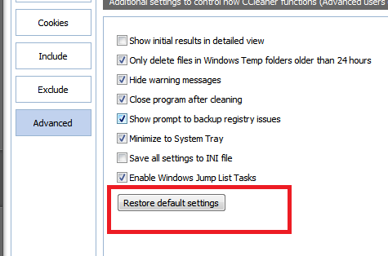
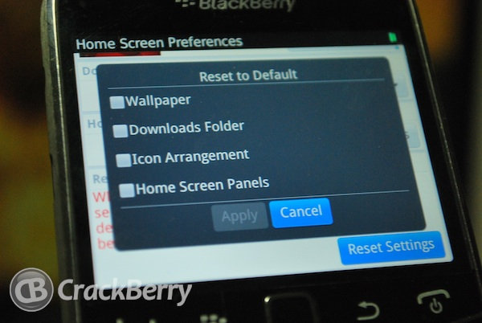
What do we mean by DEFAULT?
Pre-established/ pre-defined value
  Software – default settings
  Cell phones – factory settings

Slide 12
Default values for Parameters
In C++ programming, you can provide default values for function parameters.
The idea behind default argument is simple.
  If a function is called by passing argument/s, those arguments are used by the function.
  But if the argument/s are not passed while invoking/calling a function then, the default values are used.

Slide 13
Default Values – Example (AddNumbers)
#include <iostream>
using namespace std;
int addition (int a, int b)
{
  int r;
  r = a + b;
  return r;
}
int main ()
{
  int z;
  z = addition (5,3);
  cout << "The result is " << z;
}
Parameters
Arguments

Slide 14
Default Values – Example (AddNumbers)
#include <iostream>
using namespace std;
int addition (int a, int b)
{
  int r;
  r = a + b;
  return r;
}
int main ()
{
  int z;
  z = addition (5);
  cout << "The result is " << z;
}
Integers a and b have not been given any values here
What will happen if we miss an argument here?

Slide 15
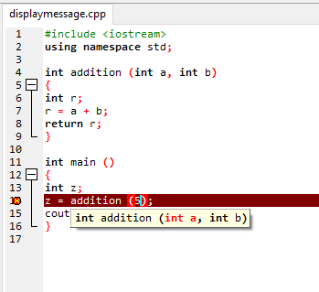
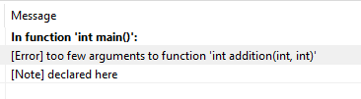
Default Values – Example (AddNumbers)
Gives an error
Error description

Slide 16
Default Values – Scenario I
#include <iostream>
using namespace std;
int addition (int a = 0, int b = 0)
{
  int r;
  r = a + b;
  return r;
}
int main ()
{
  int z;
  z = addition (5,3);
  cout << "The result is " << z;
}
Give some value to variables in function definition
and it will be called as default value of that variable
Passing both argument values

Slide 17
Default Values – Scenario II
#include <iostream>
using namespace std;
int addition (int a = 0, int b = 0)
{
  int r;
  r = a + b;
  return r;
}
int main ()
{
  int z;
  z = addition (5);
  cout << "The result is " << z;
}
IMPORTANT FACT NO 1
If you miss a parameter, the compiler assumes that the rightmost parameter is missing.
Now what will happen if
we miss an argument here?

Slide 18
Default Values – Scenario III
#include <iostream>
using namespace std;
int addition (int a = 0, int b = 0)
{
  int r;
  r = a + b;
  return r;
}
int main ()
{
  int z;
  z = addition();
  cout << "The result is " << z;
}
What if we omit both arguments?

Slide 19
Default Values – Scenario IV
#include <iostream>
using namespace std;
int addition (int a, int b = 0)
{
  int r;
  r = a + b;
  return r;
}
int main ()
{
  int z;
  z = addition (5);
  cout << "The result is " << z;
}
Only one variable has default value
Now What?

Slide 20
Default Values – Scenario IV
#include <iostream>
using namespace std;
int addition (int a = 0, int b)
{
  int r;
  r = a + b;
  return r;
}
int main ()
{
  int z;
  z = addition (5);
  cout << "The result is " << z;
}
Only one variable has default value
Now What?

Slide 21
Default Values – Scenario V
In this case, c should also be assigned a default value.
#include <iostream>
using namespace std;
int addition (int a, int b = 0, int c, int d = 4)
{
  int r;
  r = a + b;
  return r;
}
int main ()
{
  int z;
  z = addition (5,3,1);
  cout << "The result is " << z;
}
The above function will not compile.
IMPORTANT FACT NO 2
You cannot miss a default argument in between two arguments.
Now What?

Slide 22
Default Values – Scenario VI
In this case, c and d should also be assigned a default values.
#include <iostream>
using namespace std;
int addition (int a, int b = 0, int c, int d)
{
  int r;
  r = a + b;
  return r;
}
int main ()
{
  int z;
  z = addition (5,3,1);
  cout << "The result is " << z;
}
IMPORTANT FACT NO 3
You cannot miss a default argument after the occurrence of a default argument.
The above function will not compile.
Now What?

Slide 23
Single Default Argument
If you want a single default argument, make sure the argument is the last one.
int addition (int a,int b,int c,int d = 2);

Slide 24
Scope Rules
(Variables)

Slide 25
Scope
A scope is a region of a program.
Scope defines where your variables will be accessible
throughout your script.

Slide 26
Scope of Variables
Scope can be explained by looking at the ways that international laws, national laws, and local laws work together.

Slide 27


Slide 28
Scope of Variables
Broadly speaking there are three places, where variables can be declared −
Inside a function or a block which are called local variables.
In the header of function definition which are called formal parameters/parameter-list.
Outside of all functions which are called global variables.

Slide 29
Local Variables
Function Scope
Block Scope
They can be used only by statements that are inside that function or block of code.
Local variables are not known to functions outside their own.

Slide 30
Local Variables – Example
#include <iostream>
using namespace std;
int main ()
{
  // Local variable declaration
  int a, b, c;
  // initialization
  a = 10;
  b = 20;
  c = a + b;
  cout << c;
  return 0;
}

Slide 31
Local Variables – Example
#include <iostream>
using namespace std;
int someFunction()
{
  int a, b, c; // Local variable declaration
  // initialization
  a = 10;
  b = 20;
  c = a + b;
  return c;
}
int main ()
{
cout << someFunction();
cout << a << b;
}

Slide 32
Global Variables
Defined usually on top of the program.
Will hold their value throughout the life-time of a program.
Can be accessed by any function after declaration of global variables.

Slide 33
Global Variables – Example
#include <iostream>
using namespace std;
// Global variable declaration
int g;
int main ()
{
  // Local variable declaration
  int a, b;
  // Initialization
  a = 10;
  b = 20;
  g = a + b;
  cout << g;
  return 0;
}

Slide 34
Global Variables – Example
#include <iostream>
using namespace std;
// Global variable declaration & initialization
int g = 10;
int main ()
{
  // Local variable declaration
  int a, b;
  // Initialization
  a = 10;
  b = 20;
  g = a + b;
  cout << g;
  return 0;
}

Slide 35
Global Variables – Example
#include <iostream>
using namespace std;
// Global variable declaration
int g = 10;
void display(int g) {
cout << g << endl;
}
int main () {
  // Local variable declaration
  int a, b;
  cout << g << endl;
  display(g);
  // Initialization
  a = 10; b = 20;
  g = a + b;
  cout << g << endl;
}

Slide 36
Local & Global Variables – Naming
A program can have same name
for local and global variables
But
value of local variable inside a function
will take preference.

Slide 37
Local & Global Variables – Naming
#include <iostream>
using namespace std;
// Global variable declaration
int g = 20;
int main ()
{
  // Local variable declaration
  int g = 10;
  cout << g;
  return 0;
}

Slide 38
Semester Project
Group Project
In the coming lecture, you will submit:
  Names of Group Members
  Mark the Team Lead
  Group of 5 students each
Start thinking about the application you are going to design as your semester project.

Slide 39


