Slide 1


CS-111
Fundamentals of Computer Programming
Lecture 11
Functions – III
Course Instructor:
Qurrat-ul-ain Babar
NUST Institute of Civil Engineering (NICE)

Slide 2
Road Map for Today
Passing Variable to Functions
Recursive Functions
Function Overloading

Slide 3
Passing Variables to Functions

Slide 4
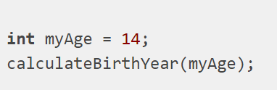
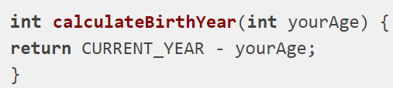
Passing Variables to Functions
The term "passing a variable" is used when a function is called with a variable you defined previously.
The variable myAge is "passed" to the function calculateBirthYear. The function can then use the value of that variable.

Slide 5
Passing Variables to Functions
There are two ways that variable myAge can be passed to the function.
  pass by value
  The value in the memory is copied to another location to be used within the function.
  pass by reference
  The memory address of the variable is passed to the function. & operator is used with the variable name to pass its memory address to function.

Slide 6
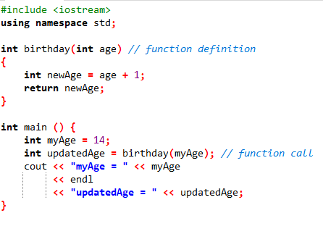
Pass by Value – Example
Output
myAge = 14
UpdatedAge = 15

Slide 7
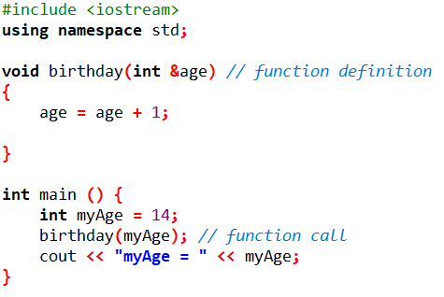
Pass by Reference – Example
Output
myAge = 15

Slide 8
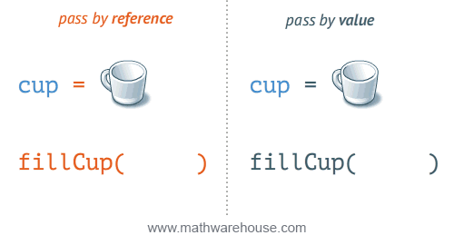
Example

Slide 9
Which method to use?
There are two simple general rules:
If a function should return a single value:
  use pass by value
If a function should return two or more distinct values:
  use pass by reference

Slide 10
Recursive Function

Slide 11
Recursive Function
A function that calls itself
is known as
a recursive function.
And, this technique is known as recursion.

Slide 12
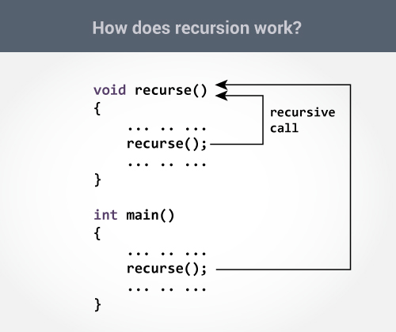

Slide 13
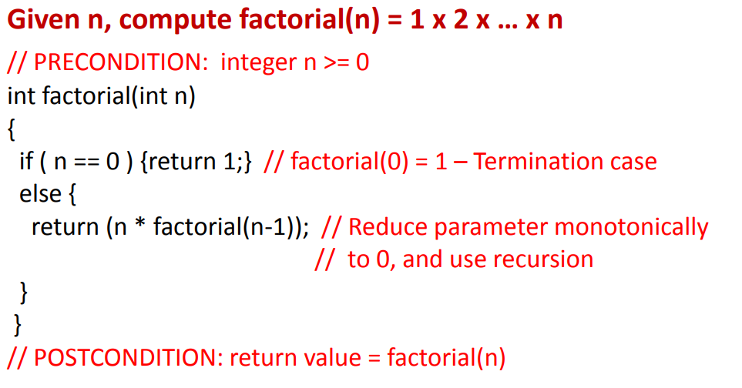
Recursive Function – Example

Slide 14
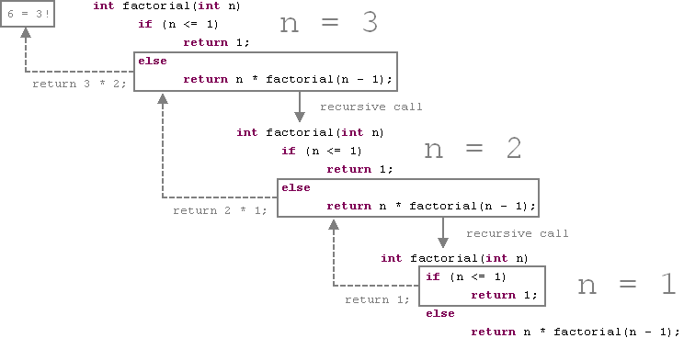
Recursive Function - Example

Slide 15
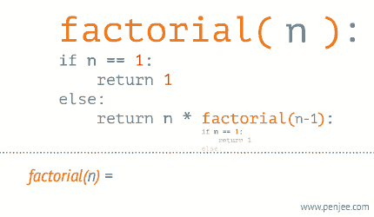
Recursive Function - Example

Slide 16
Recursive Function - Exercise
Write a program to calculate the Sum of first n Natural numbers using Recursion

Slide 17
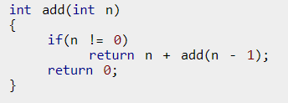
Recursive Function - Exercise

Slide 18
Function Overloading

Slide 19
Function Overloading
Two or more functions
having same name
but
different argument(s)
are known as
overloaded functions.

Slide 20
Function Overloading – Examples
int test() { }
int test(int a) { }
float test(double a) { }
int test(int a, double b) { }
Here, all 4 functions are overloaded functions because argument(s) passed to these functions are different.

Slide 21
Function Overloading – Examples
int test() { }
int test(int a) { }
float test(double a) { }
int test(int a, double b) { }
Overloaded functions may or may not have different return type but it should have different argument(s).
Notice that, the return type of all these 4 functions are not same

Slide 22
Function Overloading – Examples
// Error code
int test(int a) { }
double test(int b){ }
What is the error here?

Slide 23
Function Overloading – Examples
// Error code
int test(int a) { }
double test(int b){ }
The number and type of arguments passed to these two functions are same even though the return type is different. Hence, the compiler will throw error.

Slide 24

Function Overloading – Examples
int test(int a) { }
double test(float b){ }
Will the compiler throw an error?

Slide 25
Function Overloading – Examples
int test(int a) { }
double test(float b){ }
The is correct because even if the number of arguments is same but the type of arguments is different.

Slide 26
Function Overloading – Example
#include <iostream>
using namespace std;
void display(int);
void display(float);
void display(int, float);
int main() {
  int a = 5;
  float b = 5.5;
  display(a);
  display(b);
  display(a, b);
  return 0;
}

Slide 27
Function Overloading – Example continued
void display(int var)
{
cout << "Integer number: " << var << endl;
}
void display(float var)
{
cout << "Float number: " << var << endl;
}
void display(int var1, float var2)
{
  cout << "Integer number: " << var1;
  cout << " and float number:" << var2;
}

Slide 28
Function Overloading – Example continued
void display(int var)
{
cout << "Integer number: " << var << endl;
}
void display(float var)
{
cout << "Float number: " << var << endl;
}
void display(int var1, float var2)
{
  cout << "Integer number: " << var1;
  cout << " and float number:" << var2;
}

Slide 29
Function Overloading – Exercise
Write a set of overloaded functions named print which takes only one argument.
The function simply prints the argument passed to it like if you pass an integer 5, the function prints “Integer: 5” and if you pass a float 5.0, the function prints “Float: 5.0”
Pass an integer, a float and a string argument to show how overloaded function print works.

Slide 30
Semester Project Groups
Write down the following on a paper and hand over to me:
  Names of Group Members
  Mark the Team Lead
  Group of 5 students max

Slide 31


