Slide 1


CS-111
Fundamentals of Computer Programming
Lecture 13
Arrays & Jump Statements
Course Instructor:
Qurrat-ul-ain Babar
NUST Institute of Civil Engineering (NICE)

Slide 2
Project Titles
The application you are going to develop as your project – give it a name/title
Project Abstract – one page summary of your project
  Introduction/ Background
  The problem that your application addresses – Motivation
  Your approach to solving that problem/ How your project is going to solve the problem
Deadline: To be submitted on LMS by 7th Dec, 2018 2355 hrs. Only the Team Lead should upload the abstract on LMS.

Slide 3
Road Map for Today
Recap
Arrays
Jump Statements

Slide 4
Recap
What are recursive functions?
What are overloaded functions?
Why is the purpose of overloading functions?

Slide 5
Recap – Overloaded functions – I
void display(int var)
{
cout << "Integer number: " << var << endl;
}
void display(float var)
{
cout << "Float number: " << var << endl;
}
void display(int var1, float var2)
{
  cout << "Integer number: " << var1;
  cout << " and float number:" << var2;
}

Slide 6
Recap – Overloaded functions – II
#include <iostream>
#include <string>
using namespace std;
int add(int a, int b)
{
  int sum;
  sum = a + b;
  return sum;
}
string add(string a, string b)
{
  string sum;
  sum = a + b;
  return sum;
}
Library for including the return type “string”
string is a keyword
+ operator when used with strings concatenates them

Slide 7
Recap – Overloaded functions – II
int main()
{
  int a = 1;
  int b = 1;
  int c;
  string x = "Hello";
  string y = “World";
  string z;
  c = add(a, b);
  cout << "c is: " << c << endl;
  z = add(x, y);
  cout << "z is: " << z << endl;
}

Slide 8
Practice Question
Write a program that calculates the area of circle, rectangle and triangle using function overloading.
Area of circle = πr²
Area of rectangle = length * width
Area of triangle = ½ * base * height

Slide 9
C++ Arrays

Slide 10
Why do we need Arrays?
Consider a situation where we need
to store five integers.
int main() {
  int number1;
  int number2;
  int number3;
  int number4;
  int number5;
}
Quite simple!!!

Slide 11
Why do we need Arrays?
Now consider a situation where we need
to store 500 integers.
Now what?

Slide 12
Why do we need Arrays?
int main() {
  int number1;
  int number2;
  int number3;
  int number4;
  int number5;
  int number6;
  int number7;
  int number8;
  int number9;
  int number10;
  …
  …
  … }

Slide 13
Why do we need Arrays?
int main() {
  int number1;
  int number2;
  int number3;
  int number4;
  int number5;
  int number6;
  int number7;
  int number8;
  int number9;
  int number10;
  …
  …
  … }
We would like to have:
Some data structure which can handle a large number of
values of same data type

Slide 14
What we need is…
Instead of many variables with different names, we need:
A single name to represent a set of variables and
The elements could be accessed individually
To handle such situations, almost all the programming languages provide a concept called array.

Slide 15
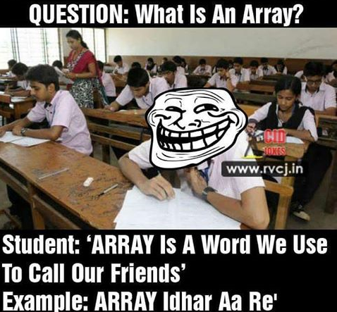
What is an Array?
An array is a collection of data items/variables that are of the
  Same type and
  Referenced by the common name
    e.g., a collection of integers, collection of characters, collection of doubles

Slide 16
Array Declaration – syntax
Return-type Array-name[sizeOfArray];
int roll_numbers[100];
float distances[25];
int marks[500];

Slide 17
Array Declaration – syntax
All array elements are of the type int.
Name of the array is marks.
The size of the array is 500, which gives us the number of elements in the array.
int marks[500];

Slide 18
Pictorial view of an Array
    // array of 10 uninitialized ints
    int Ar[10];
1
2
3
4
5
6
7
8
9
10
Ar
--
--
--
--
--
--
--
--
--
--

Slide 19
Array Index
Declare an array of 10 integers:
  int Ar[10]; // array of 10 ints
  Index expression is used to refer to an element
  It is written in square brackets [ ], immediately after the array name

Slide 20
Array Index
When we use a[i]
  if i is equal to 5 at that point, refers to 5th element
  if i is equal to 123, refers to 123rd element
IMPORTANT: C++ array index starts with 0

Slide 21
Array Index
    // array of 10 uninitialized ints
    int Ar[10];
    Ar[3] = 1;
    int x = Ar[3];
0
1
2
3
4
5
6
7
8
9
Ar
--
--
--
1
--
--
--
--
--
--
Ar[0]
Ar[1]
Ar[2]
Ar[3]
Ar[4]
Ar[5]
Ar[6]
Ar[7]
Ar[8]
Ar[9]

Slide 22
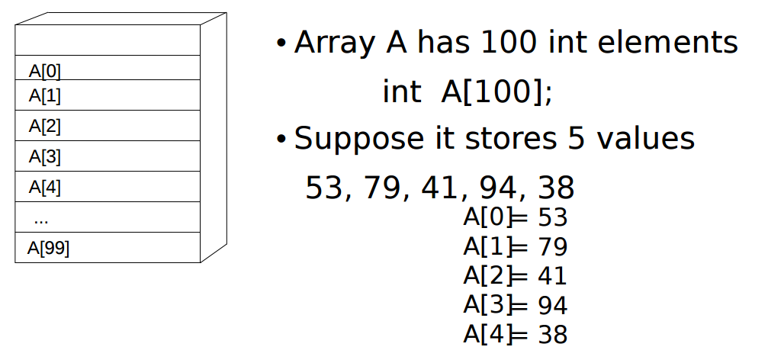
Array Index - Example

Slide 23
Array Index - Example
Consider
  int Ar[10], i = 7, j = 2, k = 4;
  Ar[0] = 1;
  Ar[i] = 5;
  Ar[j] = Ar[i] + 3;
  Ar[j+1] = Ar[i] + Ar[0];
  Ar[Ar[j]] = 12;
  cin >> Ar[k]; // where the next input value is 3
What will Ar[1] print on the screen?
0
1
2
3
4
5
6
7
8
9
Ar
1
--
8
6
3
--
--
5
12
--
Ar[0]
Ar[1]
Ar[2]
Ar[3]
Ar[4]
Ar[5]
Ar[6]
Ar[7]
Ar[8]
Ar[9]

Slide 24
Uninitialized Array Elements
If the elements of array are uninitialized, then the behavior of the compiler is undefined
  As we are trying to read them before writing them.
The program will be ill-formed.
There is no way to "check" for this; it is the developers responsibility to write a correct program.

Slide 25
Array Initialization

Slide 26
Array Initialization
Individually assign values to each element
      n[ 0 ] = 1;
      n[ 1 ] = 2;
      n[ 2 ] = 3;
      n[ 3 ] = 4;
      n[ 4 ] = 5;
  To set every element to same value
      int n[ 5 ] = { 0 };

Slide 27
Array Initialization
Initializer list
    Specify each element when array declared
    int n[ 5 ] = { 1, 2, 3, 4, 5 };
    If not enough initializers, rightmost elements 0
    If too many, syntax error

Slide 28
Array Initialization
If array size omitted, initializers determine size
    int n[] = { 1, 2, 3, 4, 5 };
  5 initializers, therefore 5 element array

Slide 29
Array Initialization
Use a loop to set each array element within the loop
int n[10];
        for ( int i = 0; i < 10; i++ )
        n[ i ] = 0;

Slide 30
What will be the output?
int main()
{
int i;
int arr[5] = {1};
for (i = 0; i < 5; i++)
cout << arr[i];
return 0;
}

Slide 31
Exercise - I
Take 10 character inputs from user and store them in an array and print them on screen.

Slide 32
Exercise - II
Write a program to find the sum and product of all elements of an array.

Slide 33
Jump Statements
(break & continue)

Slide 34
break & continue
In C++, there are two statements
break; and continue;
to alter the normal flow of a program.

Slide 35
When to use break & continue?
Sometimes, it is desirable
  to skip the execution of a loop for a certain test condition or
  terminate it immediately without checking the condition.
For example: You want to loop through data of all people except people aged 65. Or, you just want to find the first person aged 20.

Slide 36
break Statement
The break statement
terminates a loop (for, while and do…while loop) and a switch statement immediately when it appears.

Slide 37
break Statement - syntax
break;

Slide 38
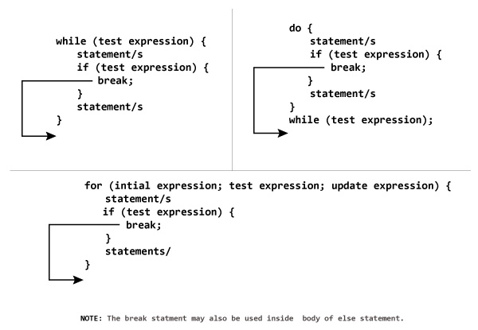
How break statement works?
1
2
3

Slide 39
break Statement – Example
C++ program to add all number entered by user until user enters 0.

Slide 40
break Statement – Example
  #include <iostream>
  using namespace std;
  int main() {
    float number, sum = 0.0;
    // test expression is always true
    while (true) {
      cout << "Enter a number: ";
      cin >> number;
      if (number != 0.0) {
      sum += number;
      }
      else {
        // terminates the loop if number equals 0.0
        break;
      }
    }
    cout << "Sum = " << sum;
    return 0;
  }

Slide 41
break Statement – Example
  #include <iostream>
  using namespace std;
  int main() {
    float number, sum = 0.0;
    // test expression is always true
    while (true) {
      cout << "Enter a number: ";
      cin >> number;
      if (number != 0.0) {
      sum += number;
      }
      else {
        // terminates the loop if number equals 0.0
        break;
      }
    }
    cout << "Sum = " << sum;
    return 0;
  }

Slide 42
break Statement – Example
  #include <iostream>
  using namespace std;
  int main() {
    float number, sum = 0.0;
    // test expression is always true
    while (true) {
      cout << "Enter a number: ";
      cin >> number;
      if (number != 0.0) {
      sum += number;
      }
      else {
        // terminates the loop if number equals 0.0
        break;
      }
    }
    cout << "Sum = " << sum;
    return 0;
  }

Slide 43
break Statement – Example
  #include <iostream>
  using namespace std;
  int main() {
    float number, sum = 0.0;
    // test expression is always true
    while (true) {
      cout << "Enter a number: ";
      cin >> number;
      if (number != 0.0) {
      sum += number;
      }
      else {
        // terminates the loop if number equals 0.0
        break;
      }
    }
    cout << "Sum = " << sum;
    return 0;
  }

Slide 44
break Statement – Example
  #include <iostream>
  using namespace std;
  int main() {
    float number, sum = 0.0;
    // test expression is always true
    while (true) {
      cout << "Enter a number: ";
      cin >> number;
      if (number != 0.0) {
      sum += number;
      }
      else {
        // terminates the loop if number equals 0.0
        break;
      }
    }
    cout << "Sum = " << sum;
    return 0;
  }

Slide 45
break Statement – Example
  #include <iostream>
  using namespace std;
  int main() {
    float number, sum = 0.0;
    // test expression is always true
    while (true) {
      cout << "Enter a number: ";
      cin >> number;
      if (number != 0.0) {
      sum += number;
      }
      else {
        // terminates the loop if number equals 0.0
        break;
      }
    }
    cout << "Sum = " << sum;
    return 0;
  }

Slide 46
break Statement – Example
  #include <iostream>
  using namespace std;
  int main() {
    float number, sum = 0.0;
    // test expression is always true
    while (true) {
      cout << "Enter a number: ";
      cin >> number;
      if (number != 0.0) {
      sum += number;
      }
      else {
        // terminates the loop if number equals 0.0
        break;
      }
    }
    cout << "Sum = " << sum;
    return 0;
  }

Slide 47
break Statement – Example
  #include <iostream>
  using namespace std;
  int main() {
    float number, sum = 0.0;
    // test expression is always true
    while (true) {
      cout << "Enter a number: ";
      cin >> number;
      if (number != 0.0) {
      sum += number;
      }
      else {
        // terminates the loop if number equals 0.0
        break;
      }
    }
    cout << "Sum = " << sum;
    return 0;
  }

Slide 48
continue Statement
It is sometimes necessary to skip a certain test condition within a loop.
In such case, continue statement is used

Slide 49
continue Statement - syntax
continue;

Slide 50
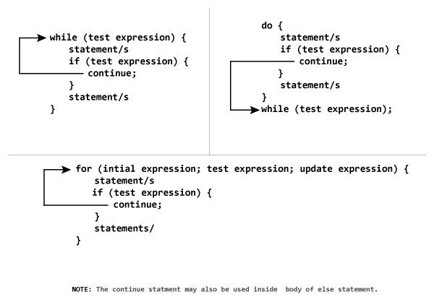
How continue statement works?
1
2
3

Slide 51
continue Statement – Example
C++ program to display integer from 1 to 10 except 6 and 9.

Slide 52
continue Statement – Example
#include <iostream>
using namespace std;
int main()
{
  for (int i = 1; i <= 10; ++i)
  {
    if ( i == 6 || i == 9)
    {
    continue;
    }
    cout << i << "\t";
  }
  return 0;
}

Slide 53
continue Statement – Example
#include <iostream>
using namespace std;
int main()
{
  for (int i = 1; i <= 10; ++i)
  {
    if ( i == 6 || i == 9)
    {
    continue;
    }
    cout << i << "\t";
  }
  return 0;
}

Slide 54
continue Statement – Example
#include <iostream>
using namespace std;
int main()
{
  for (int i = 1; i <= 10; ++i)
  {
    if ( i == 6 || i == 9)
    {
    continue;
    }
    cout << i << "\t";
  }
  return 0;
}

Slide 55
continue Statement – Example
#include <iostream>
using namespace std;
int main()
{
  for (int i = 1; i <= 10; ++i)
  {
    if ( i == 6 || i == 9)
    {
    continue;
    }
    cout << i << "\t";
  }
  return 0;
}

Slide 56
continue Statement – Example
#include <iostream>
using namespace std;
int main()
{
  for (int i = 1; i <= 10; ++i)
  {
    if ( i == 6 || i == 9)
    {
    continue;
    }
    cout << i << "\t";
  }
  return 0;
}

Slide 57
continue Statement – Example
#include <iostream>
using namespace std;
int main()
{
  for (int i = 1; i <= 10; ++i)
  {
    if ( i == 6 || i == 9)
    {
    continue;
    }
    cout << i << "\t";
  }
  return 0;
}

Slide 58


