Slide 1
Quantity Surveying & Cost
Estimation

Slide 2
LASHARI CONSTRUCTION ESTIMATORS
M. Asfand Yar Tahir Khan (Leader)
Kh. Awais Ahmed
Mohammad Usama Shahid
Fraz Saeed
Hassan Farooq
Qudees Tariq Kiani

Slide 3
Objective
Performing a detailed estimate of cost and quantities required to build a one story, 10 marla house in Bahria Enclave, Bahria Town, Rawalpindi.

Slide 4
Project Contents
Structural Drawings, Plans and Sectional Details
Quantity Take-off Sheets
Summary Sheets
Report
Bill of Quantities (BOQ)

Slide 5
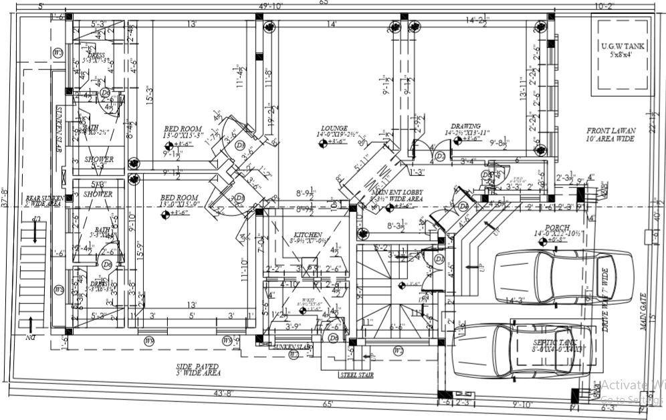
Plan view of the house to be built

Slide 6
Project details
Ground floor covered area = 1801.739 sft
Masonry structure
Raft footing
It consists of 2 Bedrooms with attached dressing room and bathroom, a T.V. Lounge, a Kitchen with W/Kit, a Drawing Room, an Entrance Lobby and a Powder Room.

Slide 7
Calculated items
Excavation (bcf)
Foundation- Raft and Boundary Wall Foundation
Backfilling (ccf)
DPC in foundation
Plinth protection
Masonry (cft)
Concrete (P.C.C. and R.C.C.)-(beams and lintels) (cft)
Steel- (Beams, Slab, Foundation and Parapet Wall)
Flooring and Roofing
Roof slab concrete
Plaster (sft)
Skirting (rft and sft)
Paint (sft)
Tiles
Wood work and Varnishing in Doors
Aluminium frame in Windows
Gate, Ramp and Stairs to Ground Floor

Slide 8
Assumptions
  The plan was originally meant for a 2 story house with basement, which was reduced to a single story building.
  Foundations details were consequently modified reasonably to suit the above assumption.
  The type of paint was assumed.
  RCC for beam lintels and slabs (1:2:4)
  Skirting Height was assumed to be 3”
  Plinth protection details were assumed.
  Tiling details were assumed.
  Architectural details of windows and doors were assumed.

Slide 9
Steel
Roof Slab
Beams
Lintels
Foundation
Column

Slide 10
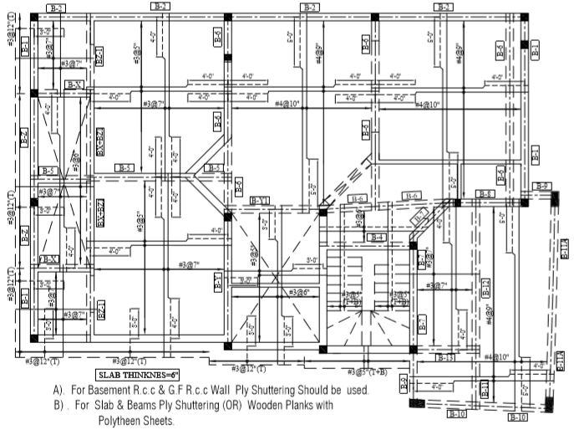
Steel in Roof Slab
Room | #3 Bar (ft) | #4 Bars (ft)
Dressing Room | 100.61
 | 43.3125
 | 82.5
Bathroom | 137.291
 | 43.75
Bathroom | 91.4375
 | 121.97
 | 38.8125
T.V. Lounge |  | 405.4167
 |  | 227.5
 |  | 398.25
 |  | 432
Bedroom and Dressing | 1805.375
Drawing Room |  | 886
 |  | 654.75
Staircase Room | 2158
 | 290.5
Bedroom | 391.5
 | 487.5
 | 703
 | 536.75
Kitchen | 582.667
 | 630.33
 | #3 Bar (ft) | #4 Bars (ft)
Total | 8245.3055 | 3003.9167
#3--- 8245 ft
#4--- 3003 ft

Slide 11
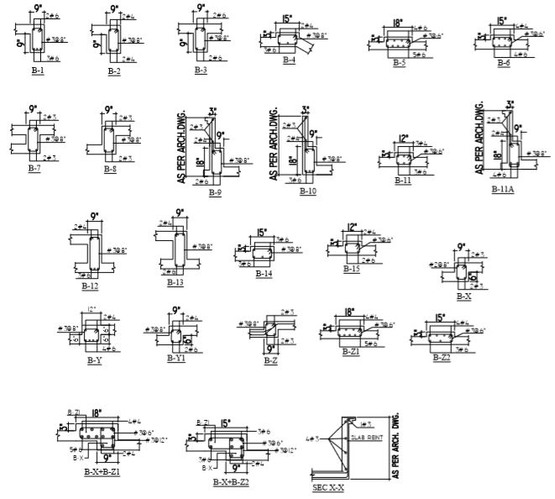
Steel in Beams
#2 bars : 62.33 ft
#3 bars : 1927.119 ft
#4 bars : 566.375 ft
#6 bars : 792.681 ft

Slide 12
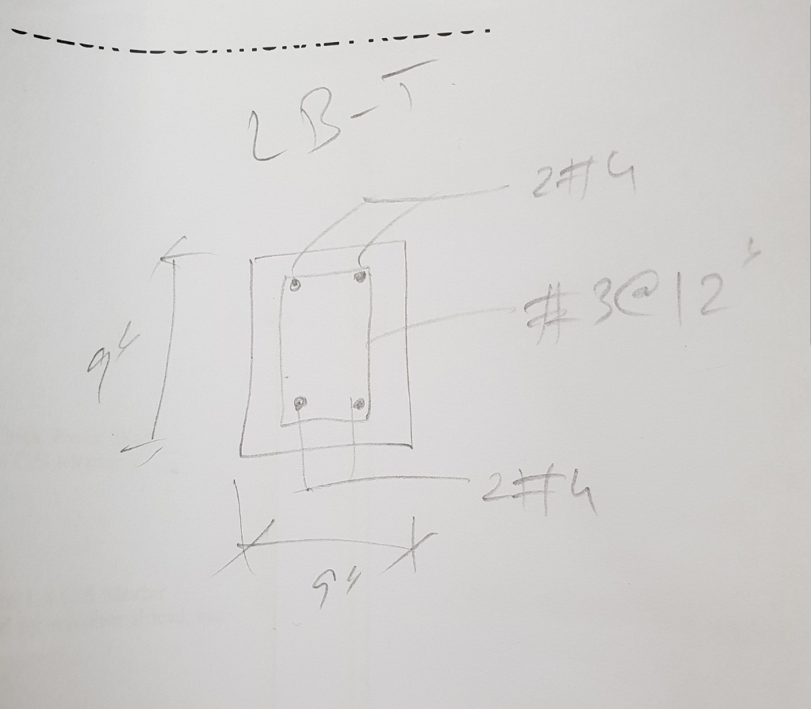
Steel in Lintels
#3 bars : 1423 ft
#4 bars : 900 ft

Slide 13
Steel in Columns
Column Type | #3 Bars (ft) | #4 Bars (ft) | #6 Bars ((ft)
Column C-1 | 1110.667 | 1163
Column C-2 | 311.5 |  | 322.75
Total | 1422.167 | 1163 | 322.75

Slide 14
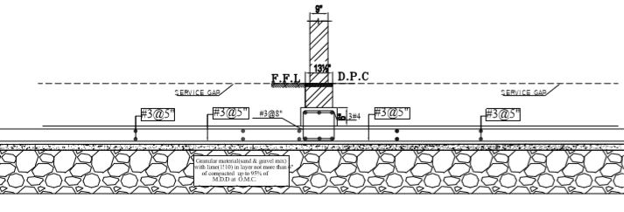
Steel in Foundations

Slide 15
Steel Schedule
STEEL SCHEDULE
TOTAL LENGTH OF #2 BARS (ft) | 62.33
TOTAL LENGTH OF #3 BARS (ft) | 32313.4702
TOTAL LENGTH OF #4 BARS (ft) | 7449.1537
TOTAL LENGTH OF #6 BARS (ft) | 1115.431
TOTAL TONNAGE | 20.47019245
TOTAL QUANTITY IN cwt | 357.14

Slide 16
Excavation
Total Excavation = 14925 cft

Slide 17
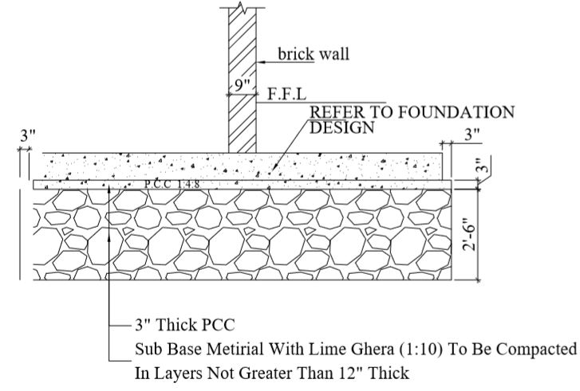
Raft Foundation

Slide 18
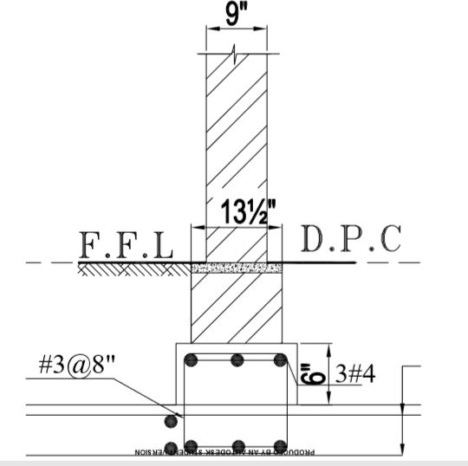
Interior Wall Foundation

Slide 19
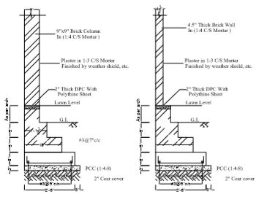
Boundary Wall Foundation

Slide 20
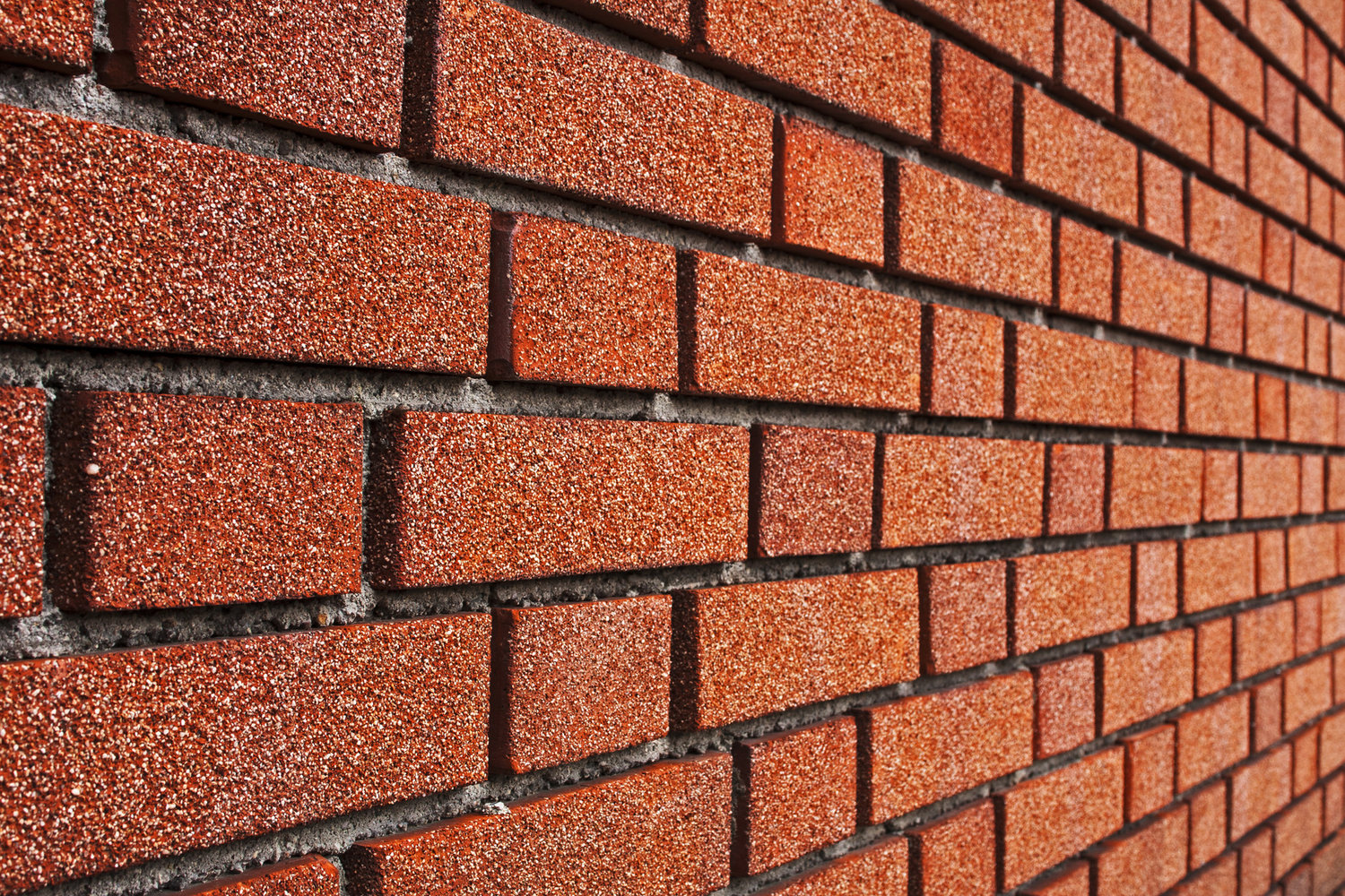
Masonry
Masonry was present in:
Interior wall foundation
Boundary wall foundation
Superstructure
Roof

Slide 21
Summary of Brickwork
BrickWork | Volume (cft)
Foundation | 1790
Super Structure | 2196

Slide 22
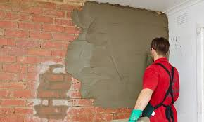
Plaster
Plaster (1:2)
½” thick
MRS: 100 sft
Deductions

Slide 23
Plastering - Summary Sheet
Plastering
 | Area (sft)
Inner | 6248.655
Outer | 3467.7
Deductions | 219.625
Total | 9496.97

Slide 24
Skirting
Height | 3”
Length (Running ft) | 360.92
Area (sft) | 90.23

Slide 25
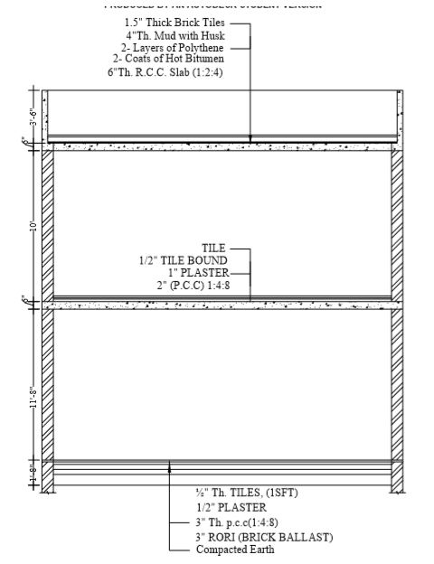
Flooring
½” thick tiles (1’x1’)
½” thick plaster
3” thick P.C.C. (1:4:8)
3” Brick Ballast (Rori)
Compacted Earth

Slide 26
Roofing
1 ½” thick Brick Tiles
4” thick mud with husk
2 layers of ploythene
2 coats of hot bitumen
6”thick R.C.C. Slab (1:2:4)

Slide 27
Doors and Windows
Door Type | Area
Door D-1 | 63
Door D-2 | 28
Door D-3 | 49
Door D-5 | 70
Window W-2 | 39
Window W-5 | 27
Window W-7 | 13.125
Window W-8 | 21
Window W-9 | 36

Slide 28
Concrete
PCC (1:4:8)
RCC (1:2:4)
RCC was calculated differently for foundations and superstructure according to MRS
PCC was same throughout the structure
RCC was used in foundations, lintels, beams, columns and roof slabs
PCC was used in plinth protection, foundations and DPC

Slide 29
Damp proof course (DPC)
MRS unit = 100 sft
Inclusive of polythene sheet as well
4” of lean concrete(PCC)
All these were given in MRS so lean concrete was not calculated separately.

Slide 30
Paint
MRS unit = 100 sft
Area of painted area = Plastered area – Skirting – Doors - Windows
Painted Area = 9187.115 sft
Emulsion paint inside and weather shield paint on the exterior surfaces.
Prices were calculated separately

Slide 31
BOQ CONTINUED…
8 | Paint | 100 sft | 5505.275 | 460 | 25323
 | Preparing surface and painting with emulsion paint:- First Coat
 | Second coat | 100 sft | 5505.275 | 356.85 | 19644.59
 | Providing and applying weather shield paint of approved quality on external surface of building including preparation of surface, application of primer complete in all respect:
 | 1st Coat | % sft | 3788.13 | 1457.6 | 55213.88
 | 2nd Coat | % sft | 3788.13 | 742 | 28106.96
9 | Varnishing | 100sqft | 210
 | Varnishing wood work, including cleaning and preparing surface.
 | First coat |  |  | 356.65 | 748.965
 | Second coat |  |  | 184.85 | 388.164
10 | Skirting | 100sft | 90.23 | 11,410.80 | 10295.96
 | Tile skirting laid in 1:2 cement mortar, over ¾"(20 mm) thick cement mortar, 1:2 including cement washing and filling joints complete:- b) mosaic tiles
11 | Flooring | 100sft | 4286.5 | 1,437.10 | 61601.29
 | Earth flooring, consisting of 6"(150 mm) thick consolidated layer of moistened earth, including ramming.
 | Providing, laying, watering and ramming brick ballast 1½" to 2"(40 mm to 50 mm) gauge mixed with 25% sand, for floor foundation, complete in all respects. | 100cft | 494.74 | 4668.15 | 23095.2
 | Cement plaster 1:2 upto 20' (6.00 m) height:- ½" (13 mm) thick | 100cft | 76.88 | 2207.15 | 1696.85
 | Cement concreting using washed screened and graded stone aggregate: ratio 1:4:8 | 100cft | 435.27 | 17597 | 76594.46
 | White glazed tile (6"x6"x¼") (6 mm) thick dado jointed in white cement and laid over 1:2 cement sand mortar 3/4" (20mm) thick, including finishing. | 100sft | 1381.942 | 15,743.60 | 217567.42

Slide 32
BOQ CONTINUED…
12 | Double Glazed Aluminium | per sft | 136.125 | 452.25 | 61562.5 | (1) Reduce rate by 20/sft if section thickness is 1.2mm. (2) Reduce rate by 20/sft if sections are of dual aluminum shade. (3) Reduce rate by 20/sft if local glass is used.
 | Providing and fitting all types of glazed aluminum windows of glazed anodized bronze color partly fixed and partly sliding using deluxe sections having frame size of 4"x0.75" and leaf frame sections of 2"x0.75" all of 1.6 mm thickness including 5mm thick imported tinted glass with rubber gasket using approved standard latches, hardware etc. as approved by engineer in charge.
13 | Bitumen | 100sft | 267.4845 | 3167.7 | 8473.1
 | Providing and laying damp proof course with cement sand plaster and bitumen coating:- (a) with one coat of bitumen and one coat of polythene sheet 500 gauge :- i) Ratio 1: 4 a) ½" thick (13 mm)
14 | Steel | cwt |  |  |  | The rate includes wastage, overlapsand chairs, etc.
 | Fabrication of mild steel reinforcement for cement concrete,including cutting, bending, laying in position, making jointsand fastenings, including cost of binding wire and labour charges for binding of steel reinforcement (also includesremoval of rust from bars):
 | Def bar G40 |  | 365.54 | 6489.3 | 2372098.72

Slide 33
BOQ CONTINUED…
15.1 | Roof Details | 100 sft | 1906.2542 | 1123.45 | 21415.76 | Add extra 13%, 32% & 51% on labor rates only or 6%, 15% & 23% on composite rates for 2nd, 3rd, 4th & sub-sequent floors respectively.
 | Earth filling over roof including watering, ramming with 1" (25 mm) mud plaster finished, with gobri leeping: 3" (75 mm) thick earth filling and 1" (25 mm) mud plaster
15.2 | Two coats of bitumen laid hot using 34 lbs. per %Sft, or 1.72 Kg per square metre over roof and blinded with sand at one Cft. per %Sft. (0.003 cu.m per sq.m) | 100 sft | 1906.2542 | 2170.75 | 41374.495
15.3 | Single layer of tiles 9"x4½"x1½" (225x113x40 mm) laid over 4"(100 mm) earth and 1" (25 mm) mud plaster without Bhoosa, grouted with cement sand 1:3 on top of RCC roof slab, provided with 34 lbs. per %Sft. or 1.72 Kg/Sq.m bitumen coating sand blinded. | 100 sft | 1906.2542 | 6,791.80 | 129451.7
15.4 | Layer of Polythene with a thickness of 2'' | 100 sft | 1906.2542 | 10,865.90 | 207104.054
15.5 | 6" thick RCC slab (1:2:4) | per cft | 159.065 | 355.00 | 56468.075
16 | washroom tiles | 100 sft | 87.715 | 14,515.00 | 12731.83
 | Laying floor of approved white glazed tile ¼" (6 mm) thick in white cement 1:2 over ¾" (20mm) thick cement mortar 1:2, complete
Total BOQ |  |  | 5436527.283

Slide 34
Bill of Quantities
Item | Description of work with General Specification | Unit | Total Quantity | Rate per Unit | Amount
1 | Excavation | 1000cft | 14925 | 4383.45 | 65422.99
 | Borrowpit excavation undressed lead upto 100 ft
2 | Plain Cement Concrete (1:4:8) | 100cft | 749.815 | 17597 | 131944.94
 | Cement concrete plain including placing, compacting, finishing and curing complete (including screening and washing of stone aggregate):
 | Reinforced Cement Concrete for raft (1:2:4) | cft | 2296.75 | 258.2 | 593020.85
 | Reinforced cement concrete in slab of rafts / strip foundation, base slab of column and retaining walls; etc and other structural members other than those mentioned in Type C (nominal mix 1: 2: 4)
3 | Backfilling | 1000cft | 4855 | 5,491.75 | 26662.45
 | Earthwork excavation in open cutting upto 5'-0" (1.5 m) depth for storm water channels, drains, sullage drains in open areas, roads, streets, lanes, including under pinning of walls and shoring to protect existing works, shuttering and timbering the trenches, dressed to designed level and dimensions, trimming, removal of surface water from trenches, back filling and surplus excavated material disposed of and dressed within 50 ft. (15 m) lead:- i) ordinary

Slide 35
BOQ CONTINUED…
4 | Reinforced Cement Concrete (1:2:4) |  |  |  |  | 100 cft | 396.965 | 22550.6 | 89517.98
 | Reinforced cement concrete in roof slab, beams, columns lintels, girders and other structural members laid in situ or precast laid in position, or prestressed members cast in situ, complete in all respects, Type C (nominal mix 1:2:4)
5 | Brickwork |  |  |  |  | 100cft | 1789.782 | 19615.2 | 351069.32
 | Pacca brick work in foundation and plinth in: (i)cement, sand mortar ratio 1:6
 | Pacca brick work in ground floor: cement, sand mortar 1:4 |  |  |  |  | 100cft | 1767.41 | 21827.25 | 385776.99
6 | Plastering on all walls |  |  |  |  | 100sft | 9496.97 | 2094.25 | 198890.29
 | Cement Neru plaster 1:2 (cement and sand) up to 20 ft height: (i) ½ inch thick
7 | Woodwork |  |  |  |  | sqft | 210 | 777.45 | 163264.5
 | Deodar wood Framed , braced and battened doors, complete with iron fittings and fixed in position including chowkats: (i)2 ¼ inch thick with 1 ¼ inch battens and 1 inch planks

Slide 36
Final Project Summary
Project summary
Cost (Rs)
BOQ items | 5436530
Overheads (12%) | 652380
Contingencies (1.4%) | 76110
Profits (2%) | 108730
Government Tax(14%) | 761110
Total | 7034860

Slide 37
Thank you

