Slide 1
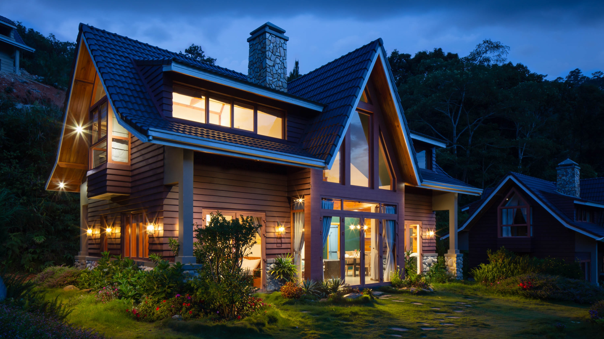

COST ESTIMATION
Cost Estimation and Quality Surveying of a 5 marla (22.5’ x 50’) House

Slide 2

Group Members
Omer Basit
Muhammad Abdullah
Muhammad Ali
Muhammad Sameer
Muhammad Anique

Slide 3
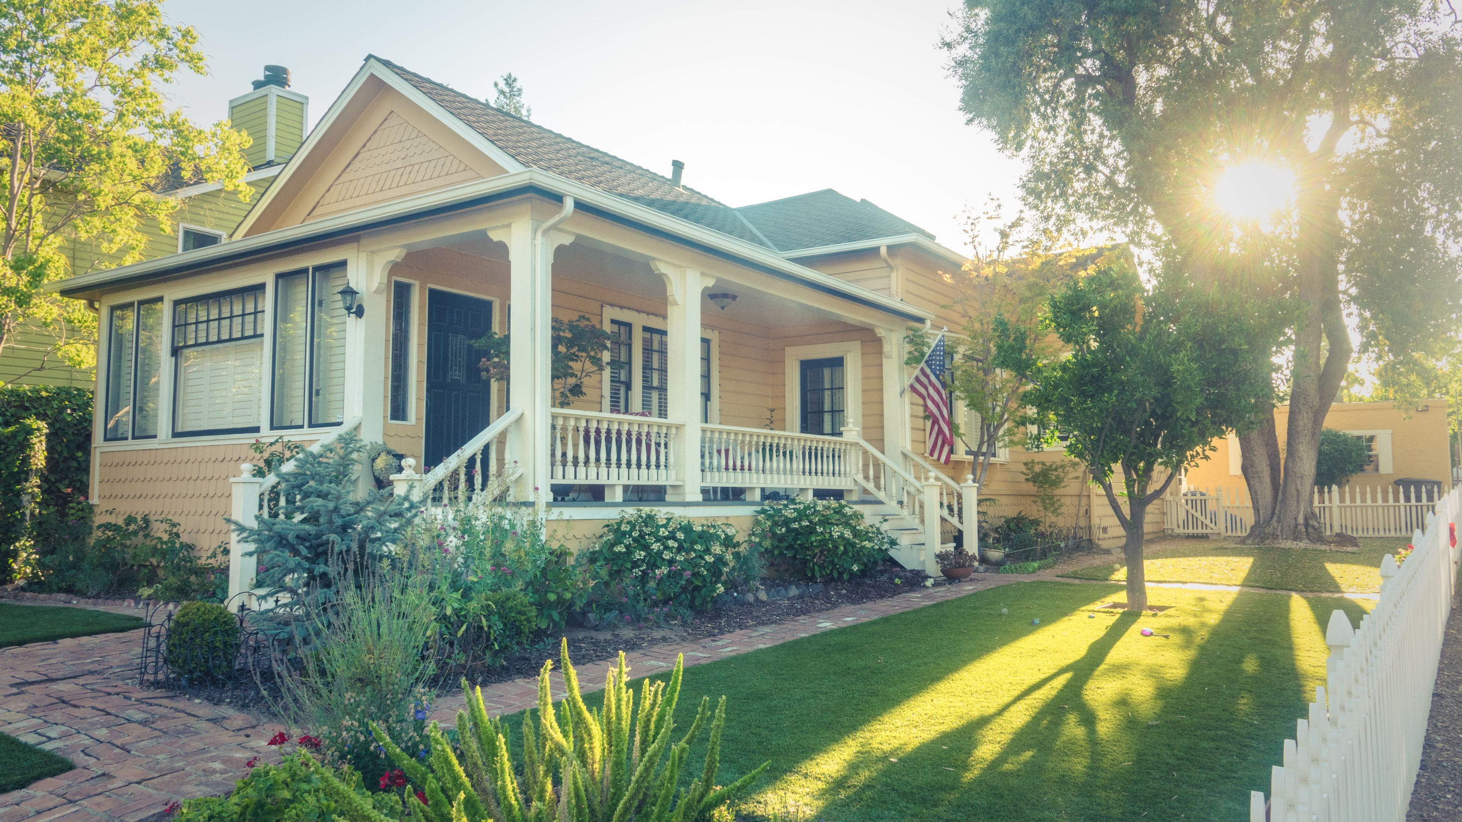
OBJECTIVE
“
Performing a detailed estimate of cost and quantities required to build a one story, 05 marla house in Paragone City Housing Scheme, Burki Road, Lahore Cantt.
”

Slide 4
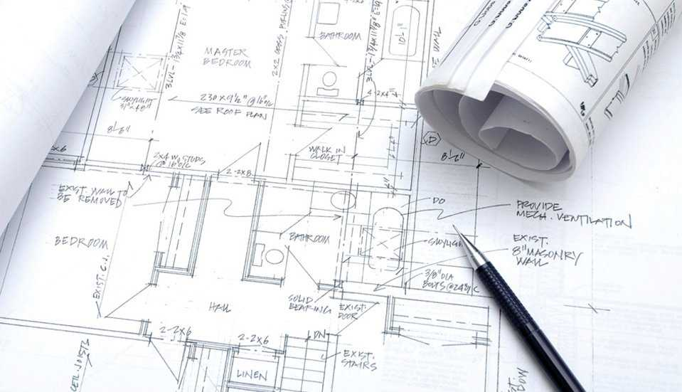
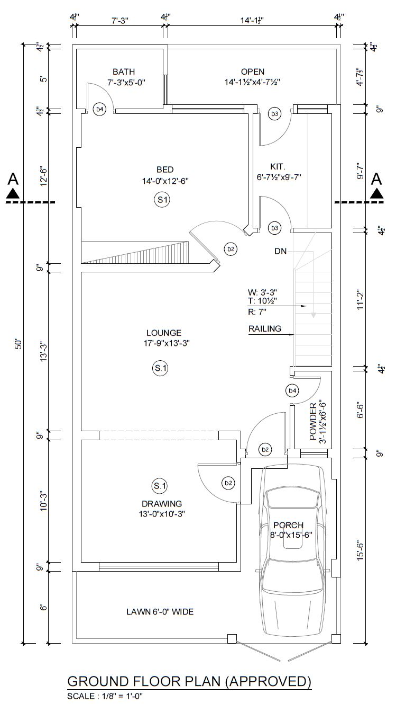
PLAN DETAILS
AREA STATEMENT
Total Area Of Plot = 1125 sq ft
Covered Area Of Ground Floor = 843 sq ft
Open Area of Plot = 208 sq ft
“
House is a masonry structure. It consists of a bedroom with bath, drawing, lounge, kitchen, powder, porch, lawn at front and an open space at back of house
”

Slide 5
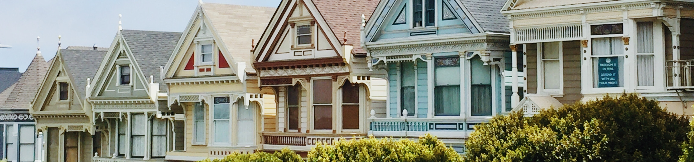
Assumptions and Difficulties Faced
The unlabelled windows were given dimensions from schedule provided accordingly.
Inclined Wall S7 was assumed short wall.
Boundary Wall Height was assumed 6'.
Tiling Details were assumed.
Plinth Protection Details were assumed.
The plan was originally meant for a 2 story house, which was reduced to a single story building.
The type of paint was assumed.
Skirting Height was assumed to be 4".
Tiling Details were assumed.

Slide 6
Assumptions and Difficulties Faced
Lintel Beam Details was taken from a fellow group due to absence of its details in plan.
Stair Case, Overhead and Underground Water Tank details was excluded from our estimation.

Slide 7
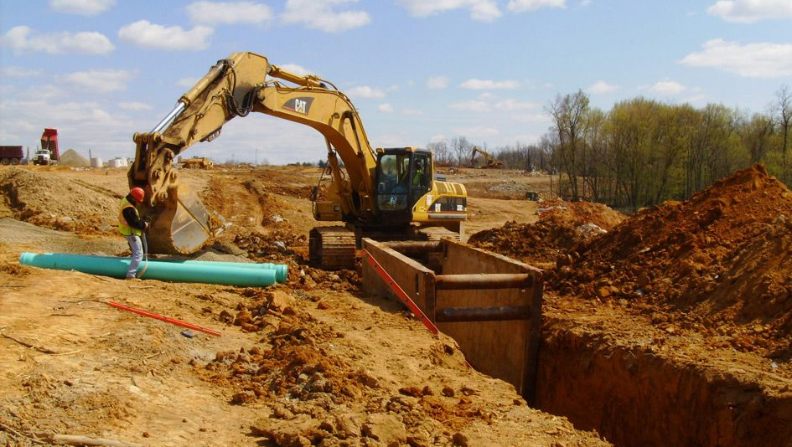
Excavation Estimate

Slide 8
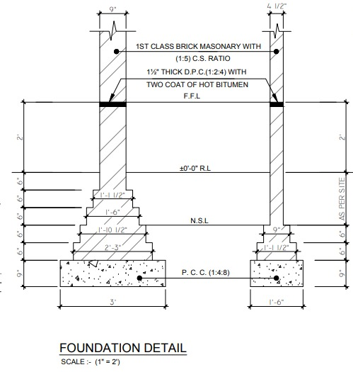
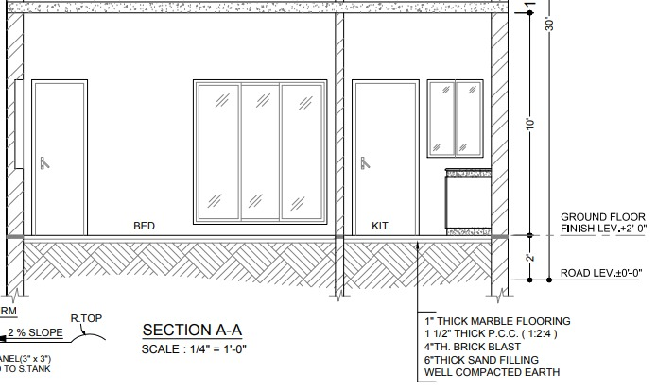
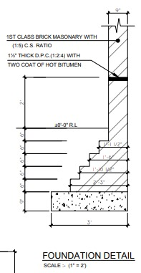
DETAILS
Interior Wall Foundation
Section A-A with Foundation Details
Boundary Wall Foundation

Slide 9
Excavation
Excavation
Total Excavation
Excavation Cost
935.516 cft
7,130 PKR

Slide 10
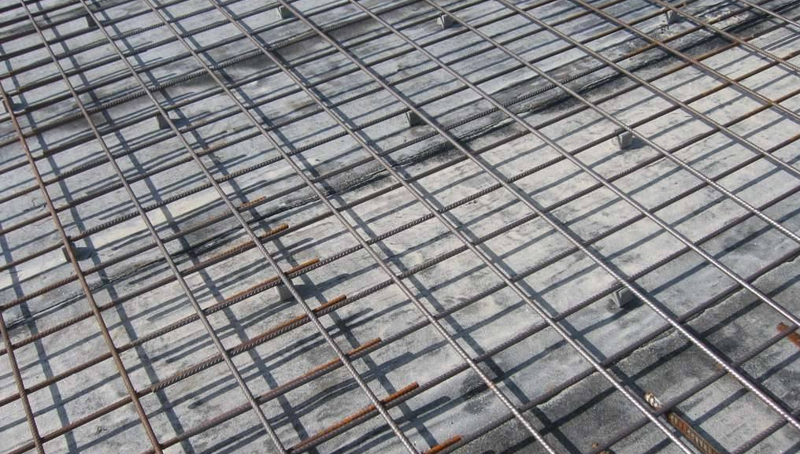
Steel Estimate

Slide 11
Steel Application
01
Roof Slab S1
02
Lintel Beam
03
Beam

Slide 12
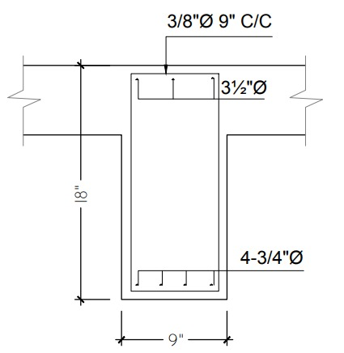
Steel in Beam
#4/0.5" bars: 23‘
#6/0.75" bars: 30'8“
#3/ 0.375" bars: 23'4"

Slide 13
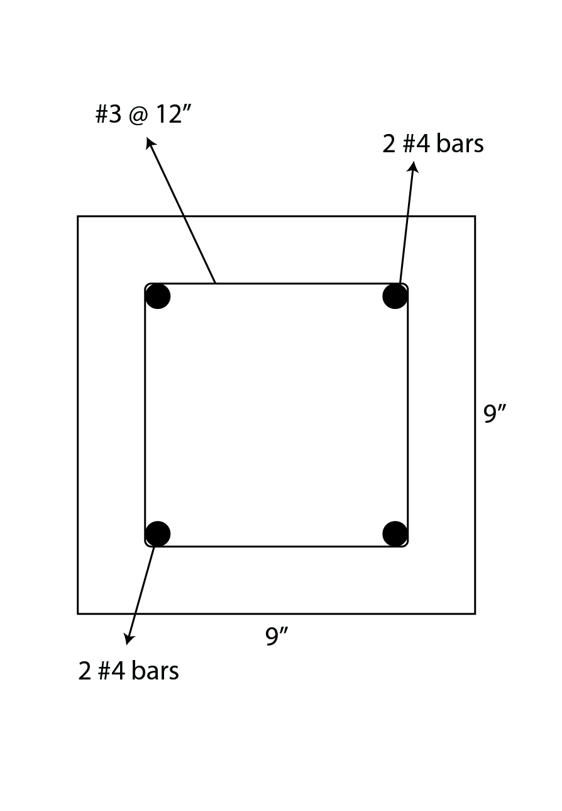
Steel In Lintel Beam
Total #4 Horizontal Bars: 182.5 ft
Total Stirrups : 105 ft

Slide 14
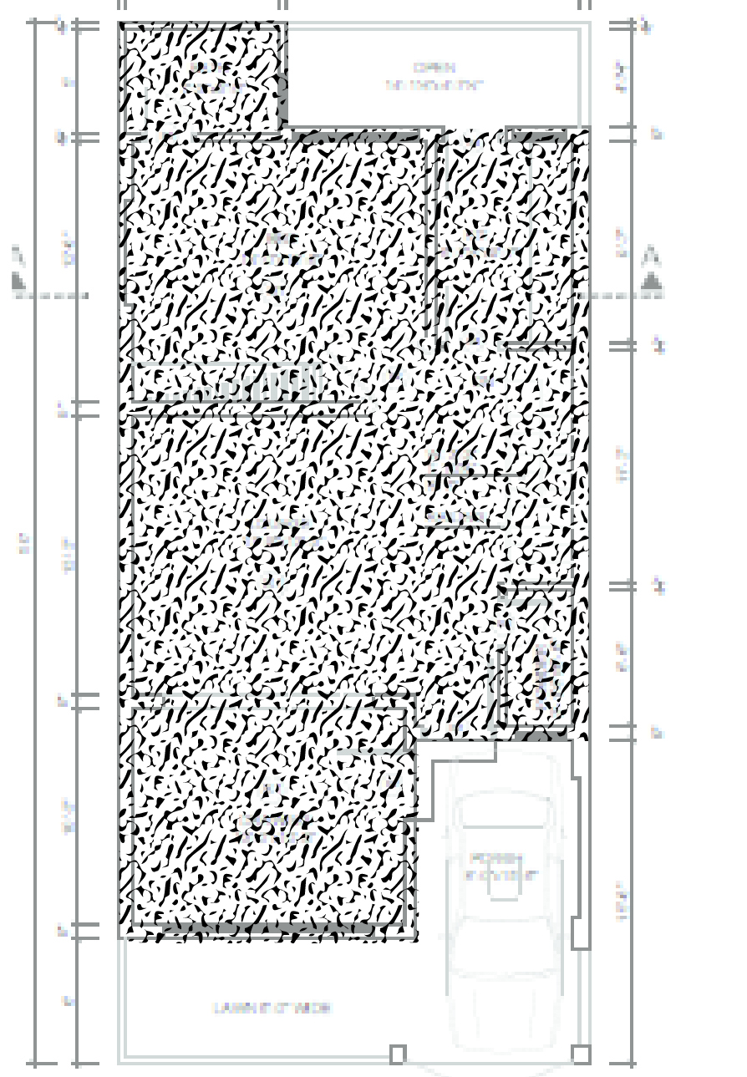
Steel In Slab
#04/0.5" Positive Reinforcement Bar: 3724.25 ft
#04/0.5" Negative Reinforcement Bar: 2165 ft

Slide 15
Steel Schedule
Bar # | Length
#4 | 6094.75’ | 0.668 lb/ft | 4071.293 lb
#3 | 128’4” | 0.376 lb/ft | 48.253 lb
#6 | 30’8” | 1.502 lb/ft | 46.0613 lb
 |  |  | Σ = 4163.6 lb
Tonnage = 2.083 tons

Slide 16
Steel Cost
Total Steel
Total Steel Cost
4156.61cft
3,00,910 PKR

Slide 17
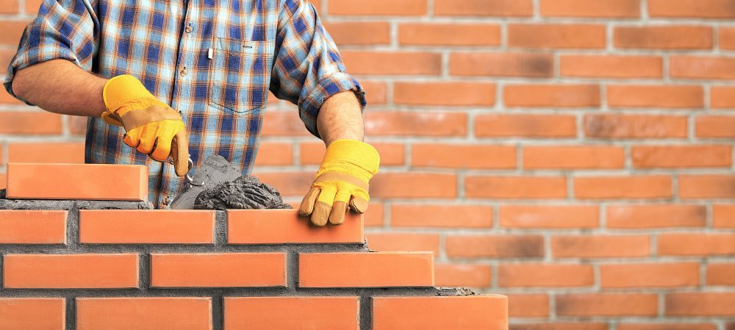
Concrete Estimate

Slide 18
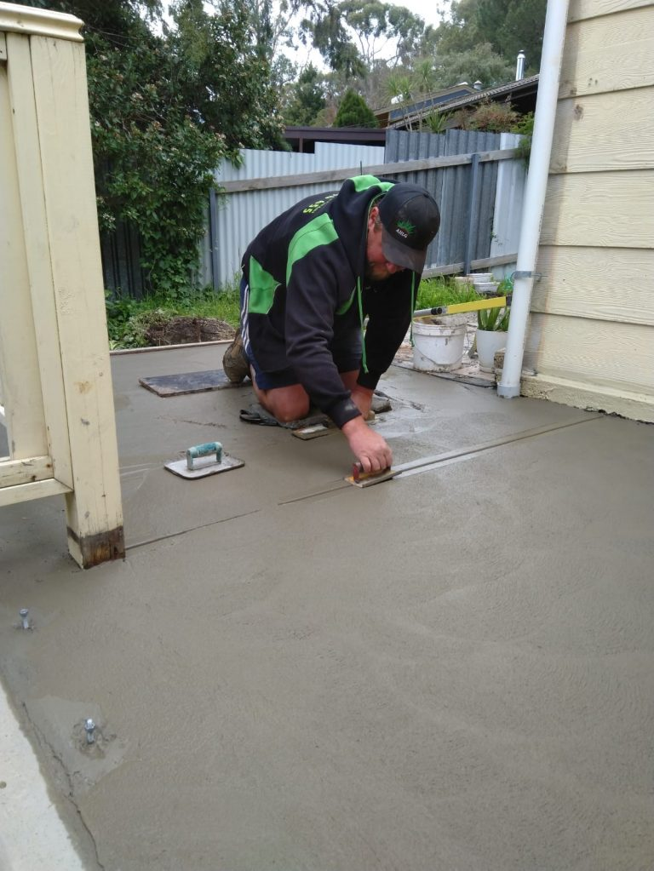
Concrete
Estimate for Concrete:
Volume = 915.34 cft
Total Cost
2,10,325 PKR

Slide 19
Masonry Estimate

Slide 20
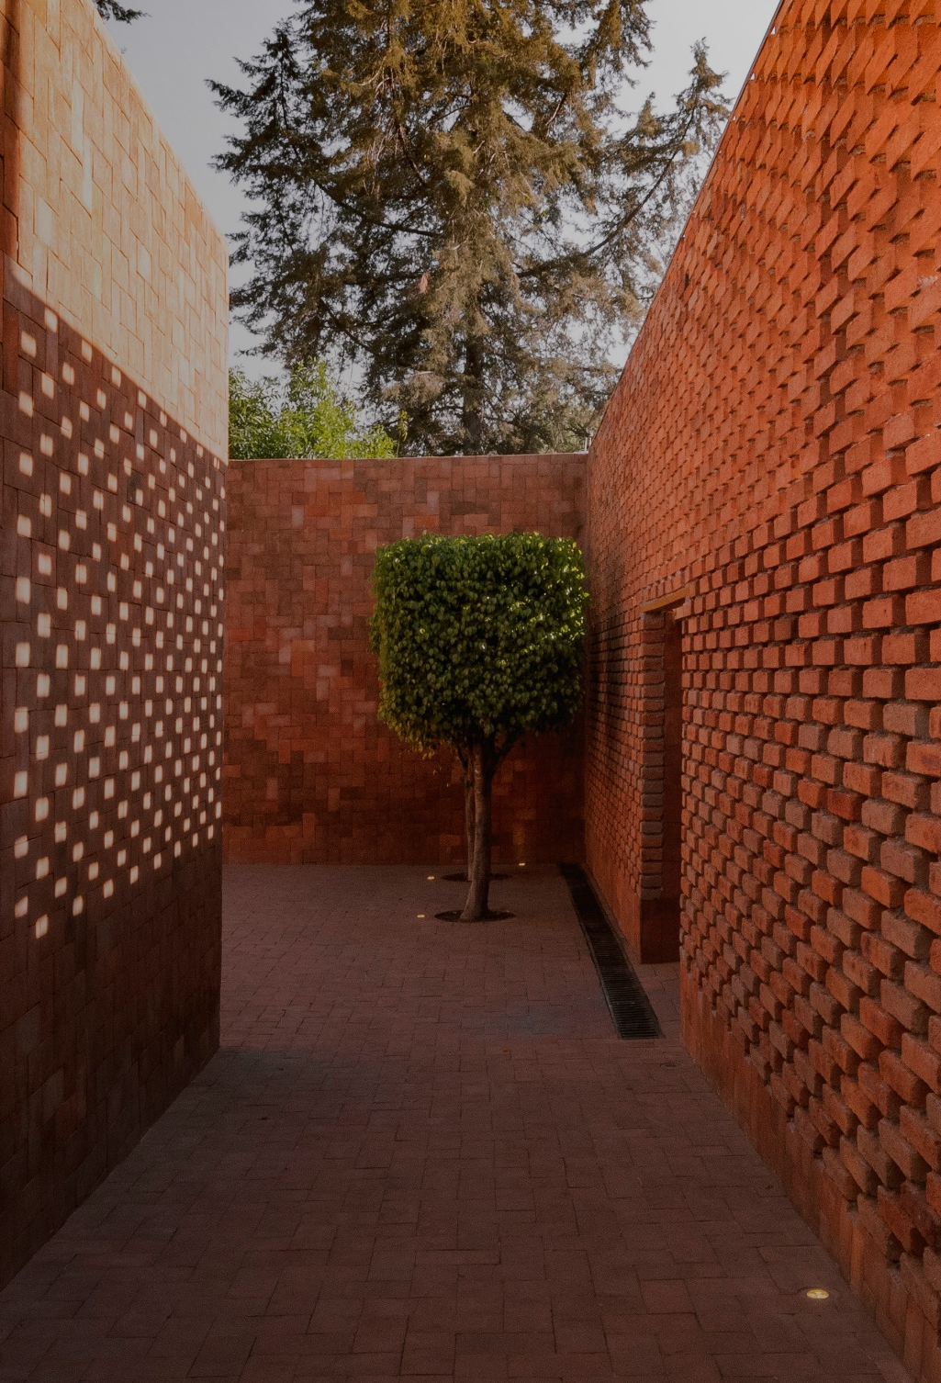
Masonry
Masonry was present in:
Interior wall foundation
Exterior wall foundation
Superstructure
Roof

Slide 21
Masonry
Volume of Brickwork from FFl till slab: 1101.5085 cft
Volume of Brick blast: 301.019 cft
Volume from foundation till FFL: 1065.228 cft
Volume of Brickwork in roof: 36.627 cft
Total Brickwork: 2504.383 cft

Slide 22
Masonry
Total Brickwork including mortar: 2203.364 cft
Number of Bricks with Mortar: 27182.4856
Total Bricks: 31998.784 ≈ 32,000

Slide 23
Summary of Brickwork
Structure | Volume
Foundation + Plinth | 1065.228 cft
Super Structure | 1402.532 cft
Roofing | 36.62733125 cft
Total Brick Work | 2504.382587 cft
Total Bricks | 32000 Bricks

Slide 24
Mortar Estimate

Slide 25
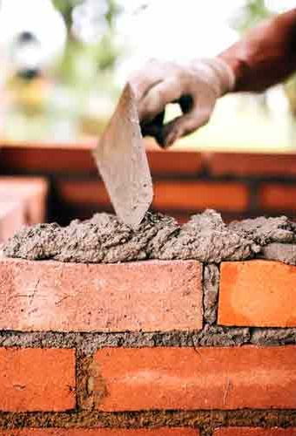
Mortar
Wet mortar: 504.455 cft
Dry mortar: 605.3456 cft
Cement: 121.069 cft
Cement Bags: 98.751 ≈ 99 bags
Sand: 484.28 cft

Slide 26
Cost of Brickwork and Mortar
Total Bricks and
mortar Cost
6,29,450 PKR

Slide 27
Skirting Estimate

Slide 28
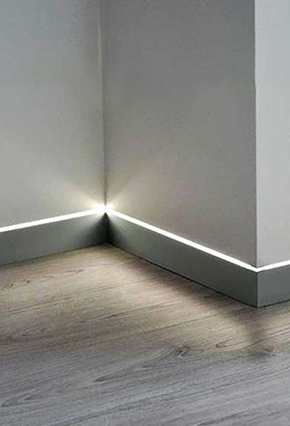
Skirting
Estimate for Skirting:
Height = 4“
Length(Running) = 235.6842’
Area = 78.5614 sq ft

Slide 29
Skirting
Total Area
Total Skirting Cost
78.5614 sq ft
9,650 PKR

Slide 30
Tiles Estimate

Slide 31
Tiles
Estimate for Tiles:
Provided at Kitchen counter, half the height of kitchen and bathroom walls
Thickness of tile=1 inch
Total Cost
14,080 PKR

Slide 32
Plaster Estimate

Slide 33
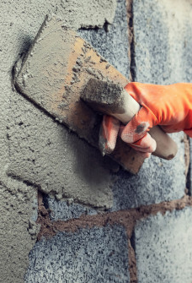
Plaster
Area of walls to be plaster: 3751.84 cft
Dry Volume of Mortar: 254.036 cft
Cement: 63.51 cft
Cement Bags: 51.8 ≈ 52 bags
Sand: 190.53 cft

Slide 34
Plaster
Area of roof to be plaster : 604.85 cft
Dry Volume of Mortar: 40.954 cft
Cement: 10.34 cft
Cement Bags: 8.35 bags
Sand: 31.02 cft

Slide 35
Cost of Brickwork and Plaster
Total Plaster Cost
Total Cost of
Bricks and plaster
93,834 PKR
7,23,280 PKR

Slide 36
Floor and Roof Finishing Estimate

Slide 37
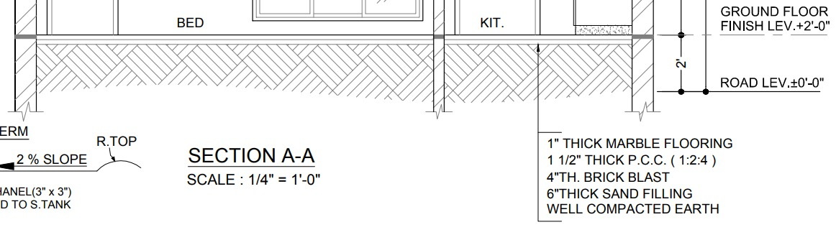
Floor
Estimate for Marble:
Area = 903 sq ft
Estimate for Sand Filling:
Volume = 490.53 cft
Estimate for Well Compacted Earth:
Volume = 2108.78 cft
Total Cost
1,01,053.6 PKR

Slide 38
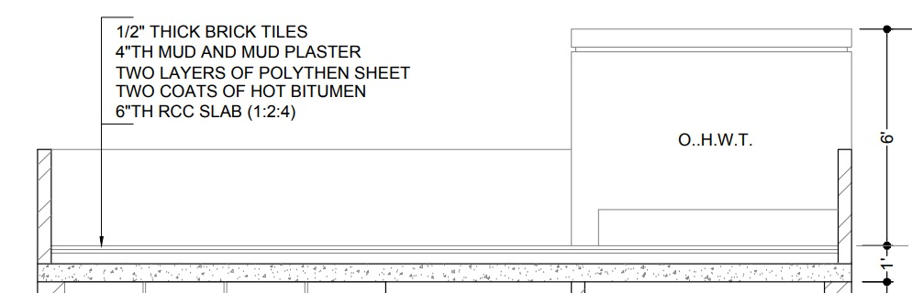
Roof
Estimate for ½” Thick Brick Tiles:
Volume = 36.6 cft
Estimate for Hot Bitumen:
Area = 903.056 sq ft
Estimate for Polythene Sheet:
Volume = 903.056 sq ft
Estimate for Mud Plaster:
Volume = 301.02 cft
Total Cost
1,01,053.6 PKR

Slide 39
Paint Estimate

Slide 40
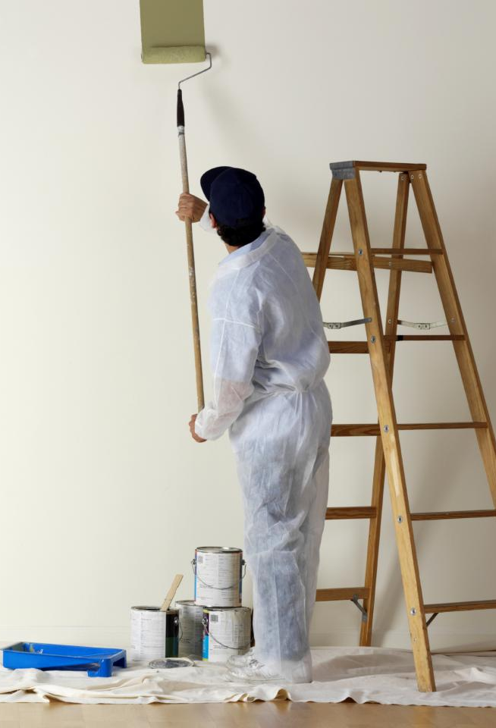
Paint
Estimate for Exterior Paint:
Area = 1520.21 sq ft
Estimate for Interior Paint:
Area = 3249.21 sq ft
Total Cost
74,475 PKR

Slide 41
Paint
Total Area
Total Paint Cost
4769.42 sq ft
74,475 PKR

Slide 42
Doors And Windows Estimate

Slide 43
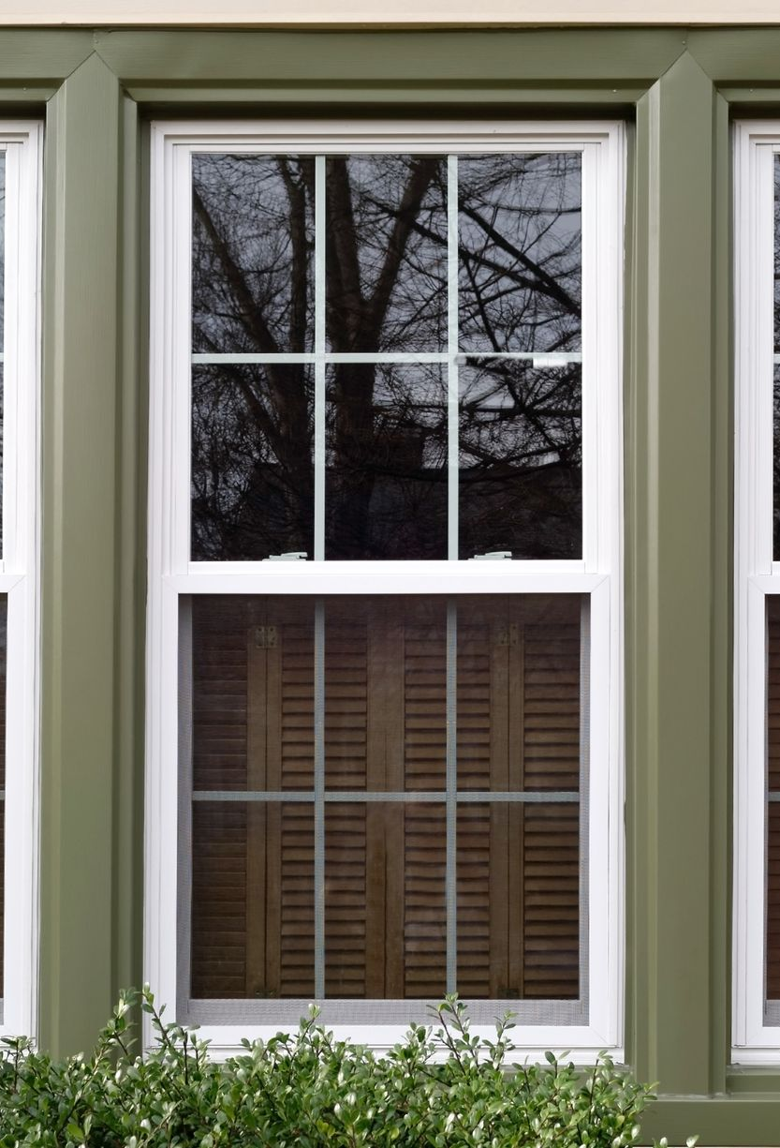
Doors And Windows
Estimate for doors and windows:
Woodwork = 119 sft
Glasswork + Aluminium = 115.83 sft

Slide 44
Cost of Doors and Windows
Total Cost
5,09,200 PKR

Slide 45
D.P.C Estimate

Slide 46
D.P.C
Estimate for D.P.C:
Area = 11.83 sq ft
Total Cost
60,462 PKR

Slide 47
Summary Of Estimation
Sr No. | Name Of Item | Quantity | Unit | Rate | Per | Amount In Rupees
1 | Excavation | 935.516 | Cft | 7,623.55 | 1000 cft | 7,128.02
2 | Concrete | 915.34 | Cft | 22,977.75 | 100 cft | 2,10,324.54
3 | Pacca Brick Work In Foundation And Plinth in: (Cement, Sand mortar (1:4)) | 1065.228 | Cft | 27,027.5 | 100 cft | 2,87,904.5
4 | Pain Exterior Coat 2 | 1520.21 | Sq ft | 960.85 | 100 cft | 14,606.94
5 | Pain Exterior Coat 1 | 1520.21 | Sq ft | 1,957.4 | 100 cft | 29,756.6
6 | Pacca Brick Work In Ground Floor: (Cement, Sand mortar (1:4)) | 1402.532 | Cft | 23,707.6 | 100 cft | 3,32,506.7
7 | Pain Interior Coat 2 | 3249.21 | Sq ft | 446.15 | 100 cft | 1,990.5
8 | Pain Interior Coat 1 | 3249.21 | Sq ft | 865.5 | 100 cft | 28,121.9
9 | Wood Work | 119 | Sq ft | 3,774 | Sq ft | 4,49,106
10 | Glasswork + Aluminum | 115.83 | Sq ft | 477 | Sq ft | 55,250.9
11 | Plaster | 4356.69 | Sq ft | 21,53.8 | 100 Sq ft | 93,834.4

Slide 48
Summary Of Estimation
Sr No. | Name Of Item | Quantity | Unit | Rate | Per | Amount In Rupees
12 | Steel | 4828.1 | Lb | 8090.45 | Cwt = 112 lb | 3,00,907.67
13 | Marble | 903.072 | Sft | 9226.45 | 100 sq ft | 83,321.4865
14 | Tiles | 283.2 | Sq ft | 4971.35 | 100 sq ft | 14,078.86
15 | D.P.C | 11.83 | Sq ft | 5112.35 | Sq ft | 60,462.059
16 | Backfilling | 149.712 | Cft | 7623.55 | 1000 cft | 1,141.34
17 | Skirting | 78.56 | Sq ft | 12287.25 | 100 sq ft | 9,657.04
18 | Pacca Brick Work In Roof: (Cement, Sand mortar (1:4)) | 36.63 | Cft | 24667.05 | 100 cft | 9,035.241
19 | Main Gate | 48 | Sq ft | 1251.95 | Sq ft | 60,093.6
20 | Two Coats of Bitumen | 903.1 | Sq ft | 2137.7 | 100 Sq ft | 19,304.63
21 | Two Layers of Polythene Sheet | 903.1 | Sq ft | 10865.9 | 100 Sq ft | 98,125.2
22 | Well Compacted Earth | 2108.8 | Cft | 3516.5 | 1000 cft | 7,415.525
23 | 6” Sand Filling | 490.53 | Cft | 2103.15 | 100 cft | 10,316.5817

Slide 49
Summary Of Estimation
Total BOQ | 21,84,386.157
Over Head Cost | 3,27,657.9235
Contingencies | 43,687.72
Taxes | 3,05,814.062
Net Total | 28,61,545.866 rupees

Slide 50
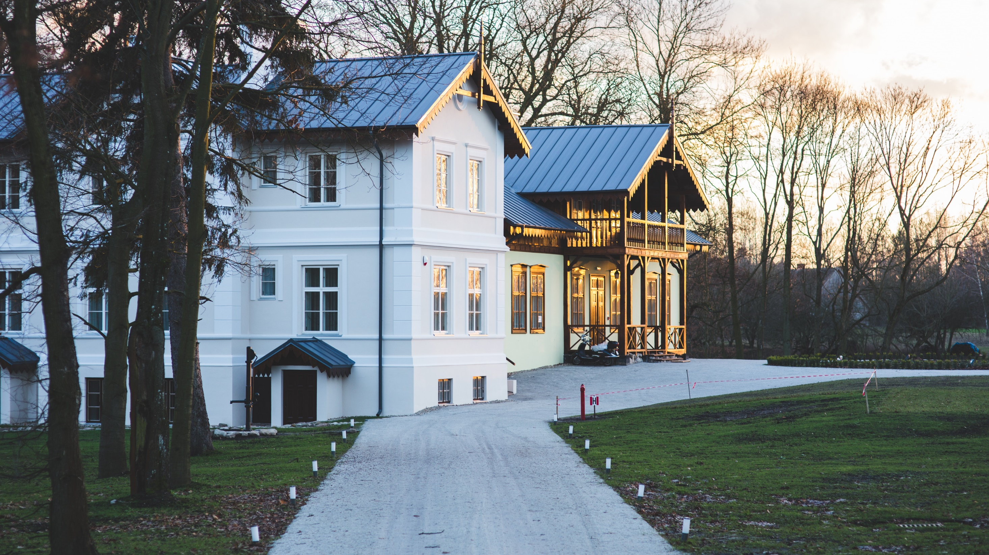

THANK YOU !!!

