Slide 1

STEEL CEP
SCHEME 1

Slide 2
Group Members
Adnan Haider
Ahmad Shah
Ahmed Ebadullah
Ahmer Naseer
Alamzaib Qureshi
Ali Ahmed
Ameer Hamza
Ammar Akhtar Goraya
Fahad Nasir Mughal
Haider Taseer Khan
Hammas Zubair
Husnain Kabir
Hassan Ahmad Khan
Irtaza Badar
Khizer Aamer
Mukarim Ali Syed

Slide 3
Contents
Problem Statement | 4
Initial Thoughts | 5
Assumptions | 6
Introduction | 7
Client Requirements | 8
Loads & Combinations | 9
Plans & Sections | 12
Scheme Sketches | 17
Modelling | 18
Recommendations | 19

Slide 4
Problem Statement
A multi-national polythene manufacturer’s factory
Factory to be clad with profiled steel sheet sandwich panels
50% roof lighting
Several checks such as secondary bending and local buckling of the truss member walls omitted.
A design appraisal need to be prepared with:
  Appropriate sketches
  Functional framing
  Load transfer
  Serviceability
  Stability aspects

Slide 5
Initial Thoughts
3 available schemes to complete this task
We are using Scheme 1
Consists of:
  1 central column,
  Primary & secondary trusses
  Lateral & elevation bracing
Modelling done in SAP 2000
Checked for deformations

Slide 6
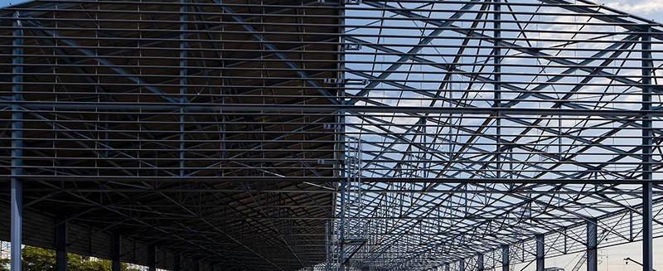
Assumptions
The following assumptions have been made for ease of modelling:
  The ground is level across site
  Access for all types of vehicles is adequate
  Site has sufficient storage place
  Existing buildings are far away
  Ground conditions are constant across the site
  Bracing is allowed on external elevations
  Bracing is allowed on roof

Slide 7
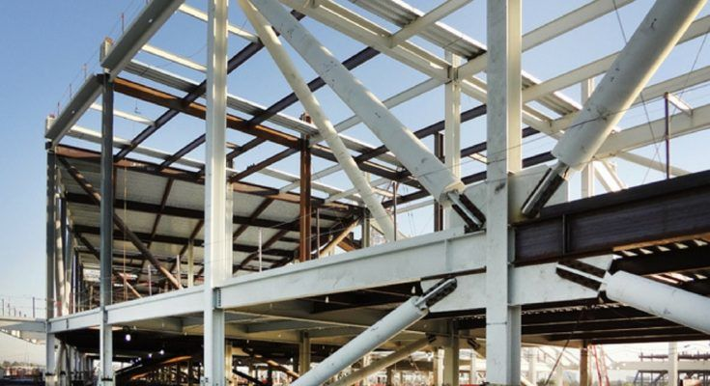
Introduction
The structure contains 2 systems:
Gravity System which consists of:
  Primary Truss
  Secondary Truss
  Central Column
  Edge Columns
Lateral System which consists of:
  Lateral Roof Bracing
  Elevation Bracing
Additional cladding on all sides

Slide 8
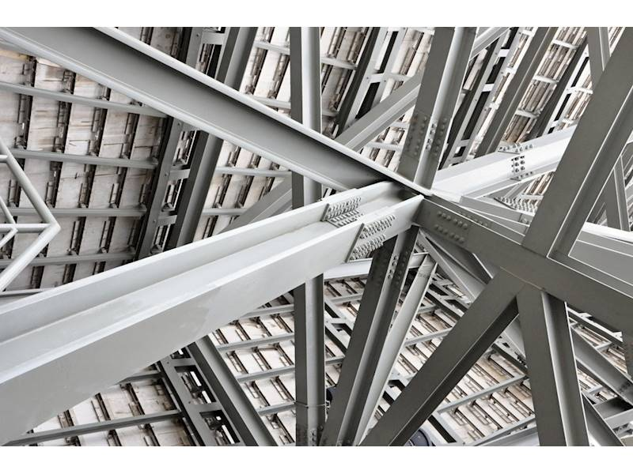
Client Requirements
200 ft. square, single storey factory
Only one central column allowed
One large sliding door opening 16ft. high
Minimum clearance inside the building of 20.ft
Structure has no windows

Slide 9
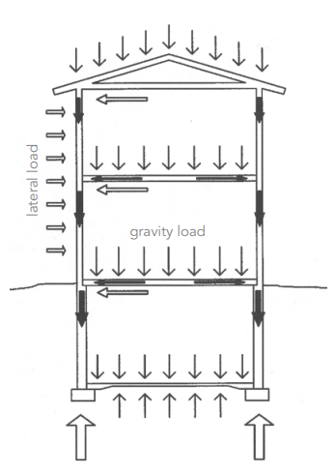
Loads
Live load (L.L):
Roof snow load: 0.75 kN/m²
Factory roof services: 0.65 kN/m²
Dead load (D.L):
Cladding load: 0.30 kN/m²
Steel load: 0.20 kN/m²
Wind load (W.L):
Wind load: 2.0 kN/m²

Slide 10
Load Combination:
1.2 D.L + 1.6 L.L (we will use this combination)
1.4 D.L
0.9 D.L + 1.0 W.L
1.0 D.L + 1.0 L.L (F^{n})

Slide 11
Load Calculations
L.L = (0.75+0.65) x 21 = 29.4 Psf
D.L = (0.30+0.20) x 21 = 10.5 Psf
W.L = 2.0 x 21 = 42 Psf
Factored Load = 1.2 D.L + 1.6 L.L
= 1.2 (10.5) + 1.6 (29.4)
= 59.64 Psf ≈ 60.0 Psf

Slide 12
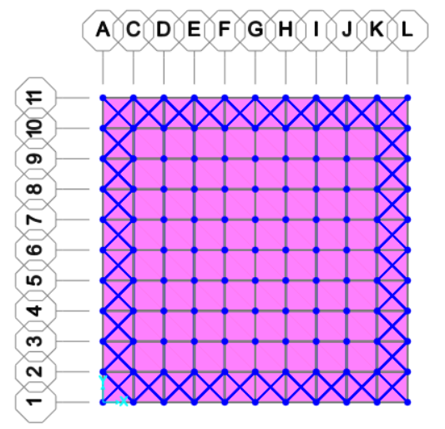
Plan View

Slide 13
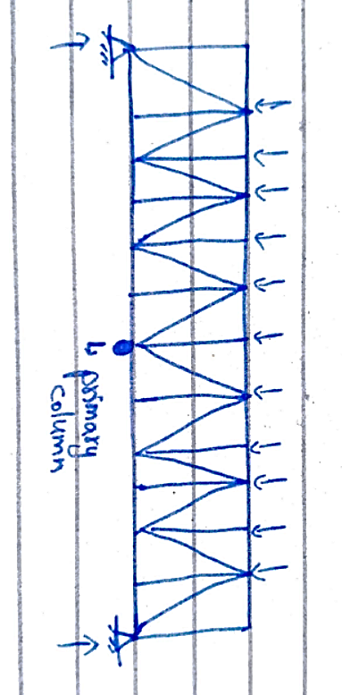
Sections
Primary Truss

Slide 14
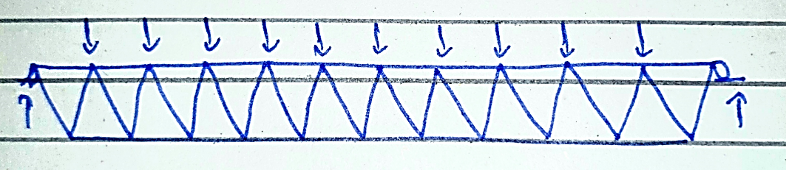
Sections
Secondary Truss

Slide 15
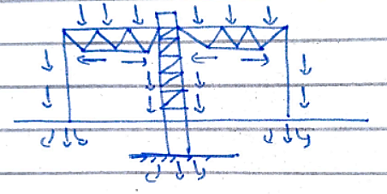
Load Path

Slide 16
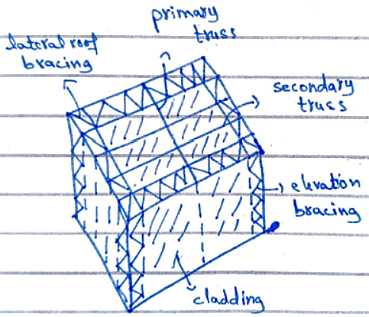
3D view
Lateral system

Slide 17
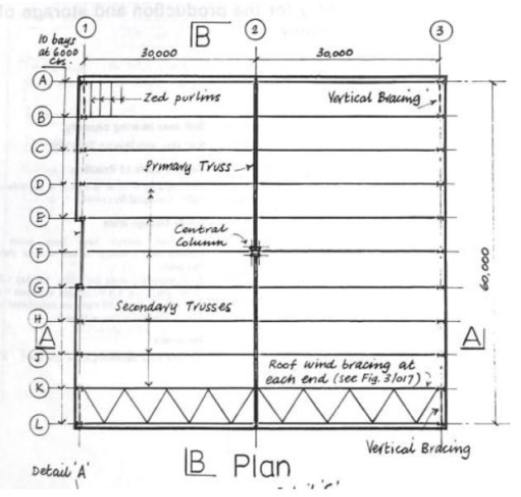
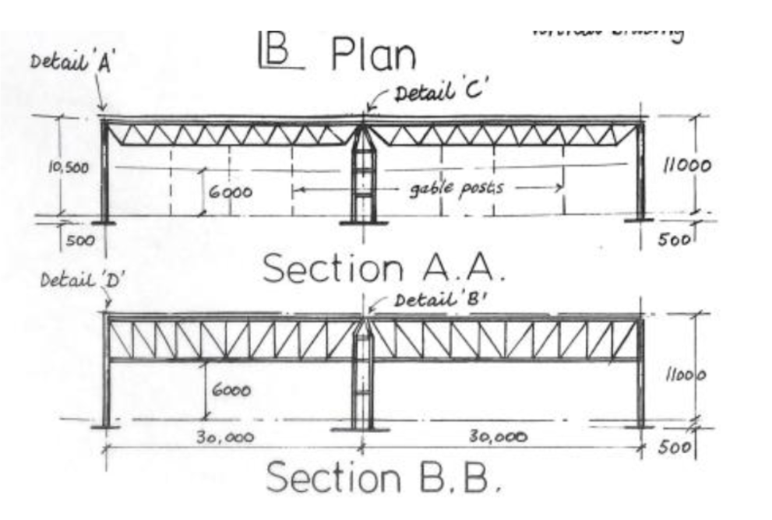
Scheme Design

Slide 18
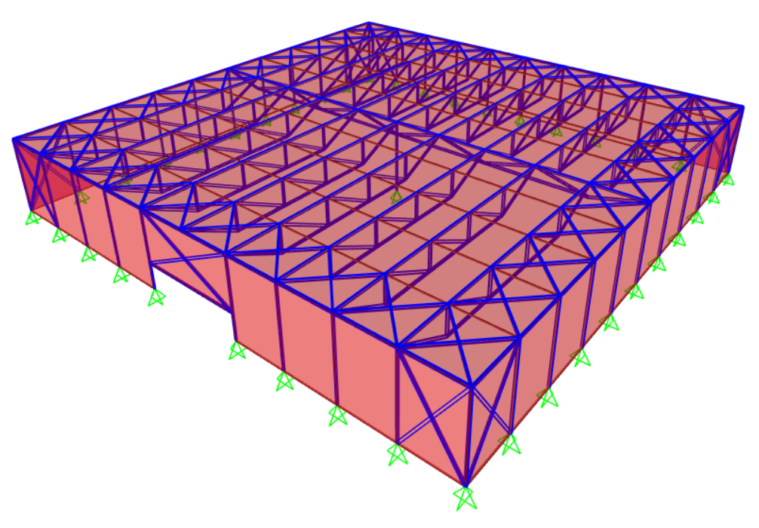
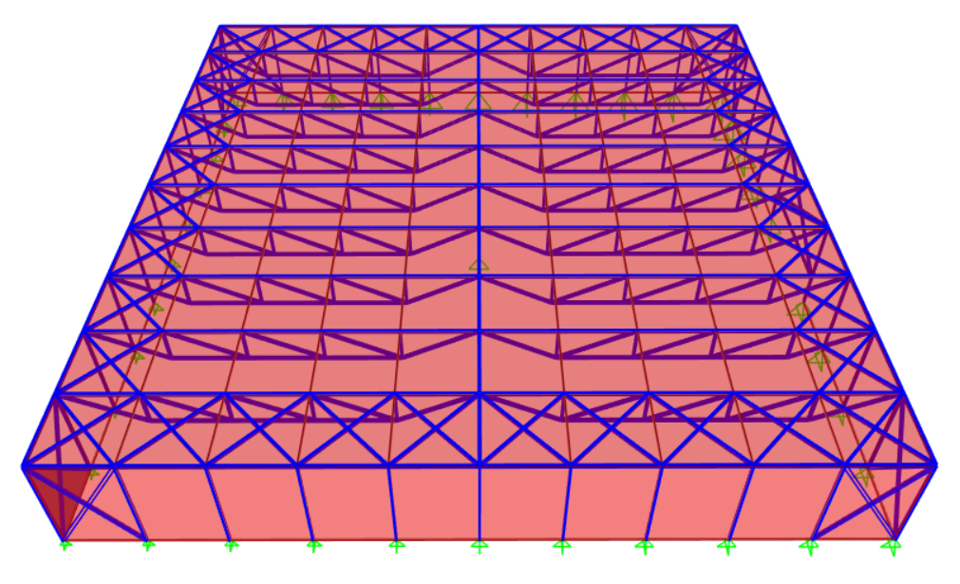
Software Model

Slide 19
Recommendations
The advantages of using Scheme 1 are as follows:
  Central Column will reduce internal loads and moments on structure
  Less chances of deflection
  Less steel involved as less dead load of structure
  Less load running into foundation, as load is well distributed

Slide 20
Contd.
The dis-advantages of using Scheme 1 are as follows:
  Central Column takes up space
  Lots of primary connections – dangerous in case of seismic activity

Slide 21


Slide 22


