Slide 1
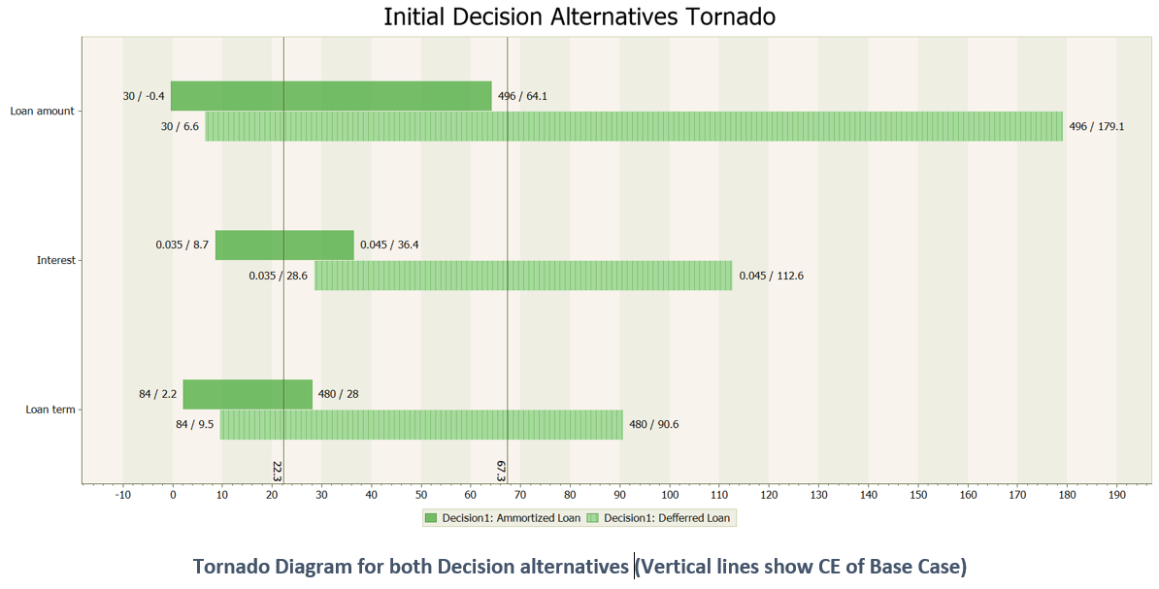
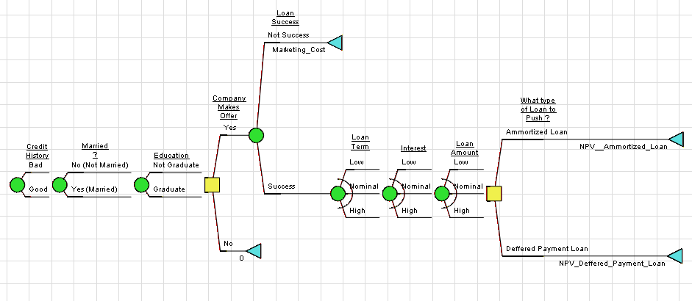
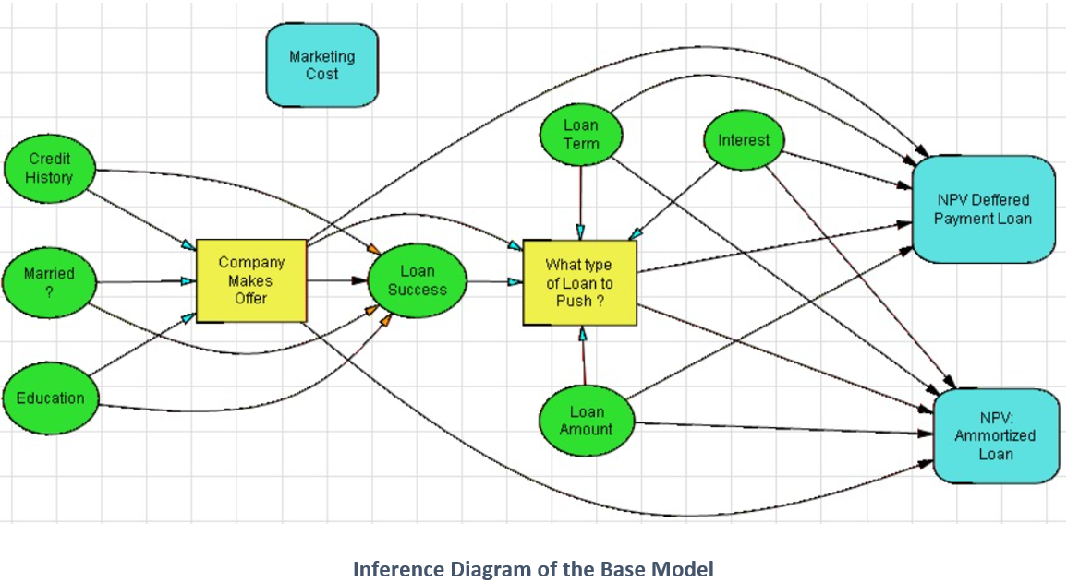
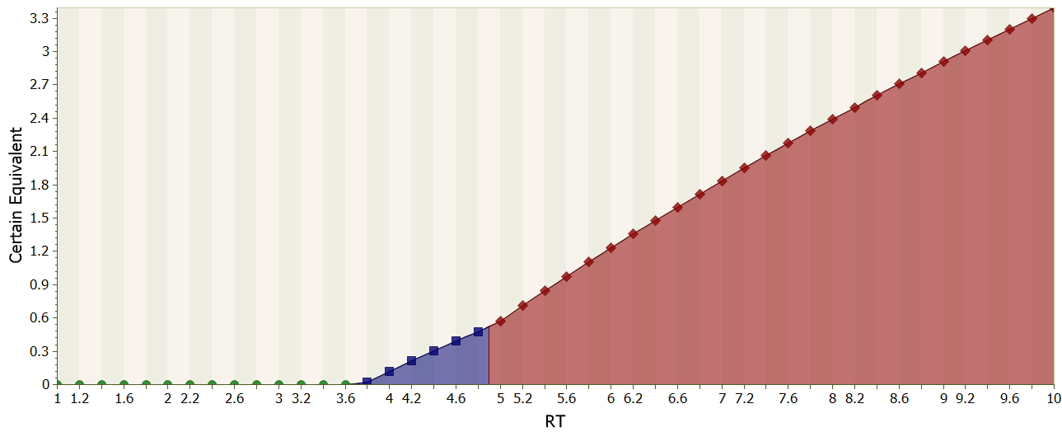
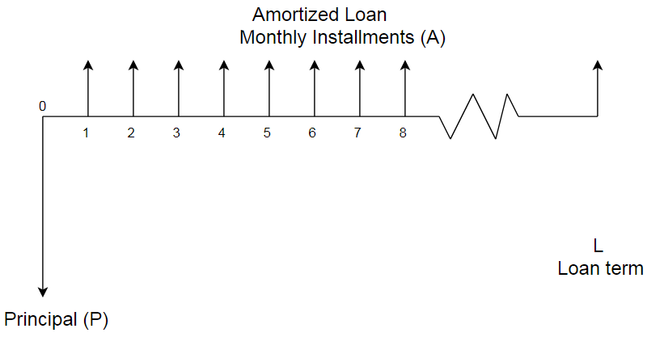
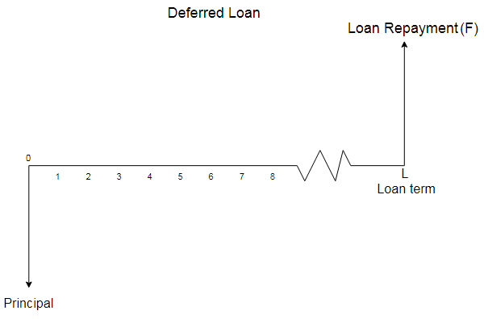
MOD500: Modeling for Decision Insight
Group Members: Muhammad Usama, Asim Sabir
30. November 2020
Executive Summary:
Everyday corporations, governments and individuals face different situations in which they need to find an optimal solution or a suitable decision policy, which can help them steer their way out of a complex situation. In order to find this optimal decision or policy, corporations and governments use different analysis techniques, they assign probabilities to uncertain events, determine the associated cost of each event and decision alternative and then they arrive at the most beneficial decision. Decision analysis (DA) is a systematic, quantitative, and visual approach to addressing and evaluating the important choices that businesses, governments or individuals sometimes face. DA finds its application in R&D projects, Investment projects, business ventures, product launches and even in personal decisions. This project is focused on finding an elaborate decision policy for the Customer Service Representative (CSR) department of a Home Financing company, which can be adopted by the CSR in the CSR-customer interactions and will result in maximum profit for the company.
Framing and Formulation:
Tornado analysis
Company: | Dream Home Financing
Decision Analysts: | Muhammad Usama Asim Sabir
Decision Context: | Dream Home Financing is a home financing company, its leadership has 28 years of experience in lending and real estate since 1992. The company provides consumers with an education in various mortgage programs and lending alternatives.^{[1]} Decision analysts are risk neutral in this investment due to a large portfolio they manage. They will use old data from company’s database to make a decision policy. The dataset of the project is present on Kaggle, and it contains very detailed information regarding the interaction between the company CSR and customers.^{[2]}
Decision Objective: | Among all industries, insurance domain has the largest use of analytics & decision analysis methods. This decision analysis project is aimed towards helping the company define a decision policy, by identifying suitable customer segments and offering them loan package which is most profitable to the company by calculating the net present value of the interest included in the loan payments.
Possible Scenarios | Dream Home Financing does not make an offer to the customer based on his/her data. The company makes an offer, but the loan is not successful (Customer not interested). The company makes an offer, the customer is interested, company pushes Amortized Loan. The company makes an offer, the customer is interested, company pushes Deferred Loan.
Uncertainty of Data: | Almost 11 uncertainties are supposed to influence the Loan Status. By creating and analyzing the Correlation Matrix, decision analysts will only consider the uncertain variables of Education, Married, Credit History, Loan Amount and Loan Term, regardless of the fact that some of these are weakly correlated, as this will allow the analysts to come up with a more detailed and diverse decision policy for Dream Home Financing.
The tornado analysis shows no tornado dominance, since none of the tornado diagrams are completely to the right of the other. There is no immaterial variable hence the variability in all uncertain variables causes huge changes in value of decision.
Probabilistic Evaluation
Summary of the above probabilistic decision analysis.
 | Circumstances | Decision Policy | Takeaway points for CSR
1. | Customers credit history is bad. | Company does not extend any offer. | NPV = 0.
2. | Company extends an offer, customer is interested in listening, but interest is lower than MARR. | Decision Policy dictates to push Amortized Loan package, but this costs the company additional money as shown in the Figure 14. | Read just Interest-Rate by meeting with the leadership of the company, or don’t make an offer.
3. | Company extends an offer, customer is interested in listening, but interest is higher than MARR. | Decision policy dictates to push Deferred Payment loans as the NPV is much greater as compared to Amortized Loan Package. | Offer Deferred Loan Payment Package to the customer, as NPV is greater.
Inference diagram
Model Appraisal
This decision analysis activity aims to identify the customer segments which are more likely to get a loan and suggests these segments to the CSR team, which is then tasked to sell these customers, the loan packages which will be most profitable to the company, these loan packages are decided by the company leadership. There are two decisions to be made, first being whether the CSR should approach customer and make an offer and second being if the customer is interested in getting a loan which type of loan package should be offered to the customer.
NPV and Cash Flow Analysis
Assuming the company is Risk-Averse, sensitivity analysis shows that almost at a RISK TOLERANCE of 3.65 thousand dollars, the company chooses to never offer the loan to the customer. There is also a policy change at Risk Tolerance of 4.85 thousand dollars. The policy summary changes to this, “What type of Loan to Push ?: Amortized Loan=10%, Deferred Payment Loan=49%, DNO=41%; Company Makes Offer: Yes=73%, No=27%”, from this, “What type of Loan to Push ?: Amortized Loan=6%, Deferred Payment Loan=31%, DNO=63%; Company Makes Offer: Yes=44%, No=56%”.
Recommendations & Conclusion
After completing all the decision analysis steps, it is clear from the established decision policy, that CSR of Dream House Financing should give the most preference to Credit history before contacting customers, and it should make sure that the Interest rate offered in the package is higher than the MARR, otherwise the resulting NPV will be negative and the investment will be deemed not viable for the company.
The first decision node aims to solve a classification-type problem, and many machine learning models such as Support Vector Machines and random Forrest are proved to perform excellent in this area. Incase Dream House Financing was to upgrade their decision policy by incorporating these techniques in the analysis then the established policy will be much more effective and successful.
$$NPV_{Amortized}\left(MARR\right)= −P−Marketing cost+A×\left[P | A,MARR,Loan term\right]$$
$$NPV_{Deferred}\left(MARR\right)= −P−Marketing cost+F×\left[P | F,MARR,Loan term\right]$$
Marketing Cost ($k), MC = |  |  | $ 4.50
MARR(compounded monthly)= |  |  | 3%
Variables | Low | Base | High
Loan Term | 240 | 379 | 564
Loan Amount ($ k) | $ 76.00 | $ 194.00 | $ 390.00
Cost of loan to customer (i) | 3.50% | 4.00% | 4.50%
Amortize Loan (Base Case)
Loan payment($ k), A = Loan Amount*[A|P,4%/12,379] |  |  | $ 0.90
NPV at MARR ($ k) |  |  | $ 22.3
Deferred Loan (Base Case)
F at the end of loan term ($ k), F = Loan Amount*[F|P,4%/12,349] |  |  | $ 684.78
NPV at MARR ($ k) |  |  | $ 67.3
References
[1] Dream Home Financing, Official Page.
[LINK]: https://dreamhomefinancing.com/
[2] Dream Home Financing Customer Dataset, Loan Predication | Kaggle.
[LINK]: https://www.kaggle.com/ninzaami/loan-predication
[3] Minimum Acceptable Rate of Return | Typical Values
[LINK]: https://en.wikipedia.org/wiki/Minimum_acceptable_rate_of_return
[4] Interest Rates in US for Home Financing.
[LINK]: https://www.usbank.com/home-loans/mortgage/mortgage-rates.html
[5] Correlation Matrix and Correlation Coefficient Interpretation
[LINK]: https://www.investopedia.com/terms/c/correlationcoefficient.asp
[6] Kolmogorov Smirnov Test for continuous random variables.
[LINK]: https://en.wikipedia.org/wiki/Kolmogorov%E2%80%93Smirnov_test
[7] Chi-Squared Test, for discrete random variables.
[LINK]: https://en.wikipedia.org/wiki/Chi-squared_test
[8] Amortized Loan
[LINK]: https://www.investopedia.com/terms/a/amortized_loan.asp
[9] Deferred Loan
[LINK]: https://www.investopedia.com/terms/d/deferred-interest-mortgage.asp
[10] Loan Calculator
[LINK]: https://www.calculator.net/loan-calculator.html

