Slide 1


MEDS-S1 R-03: Instruction Cache, Data Cache, Zicbom, and meds_sram_wrapper
Presented by: Muhammad Usman
August 20th, 2026

Slide 2



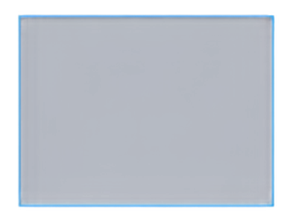








PROJECT
MEDS-S1 SoC
SCOPE & CONTEXT
Building the cache subsystem abstraction for MEDS-S1
Instruction Cache (I$)
Data
Cache (D$)
meds_sram_wrapper
Parameterized
Parameterized
Abstraction Layer
12-week Priority P1 project
in MEDS-S1 WP7
Zichom Extension
Delivering a parameterized I$ and D$ with meds_sram_wrapper abstraction
CBO.CLEAN | CBO.INVAL | CBO.FLUSH
Implements Zichom extension
CBO.CLEAN, CBO.INVAL, CBO.FLUISH
12-WEEK PROJECT TIMELINE
WEEKS 1–4
WEEKS 5–9
WEEKS 10–12
Design & Architecture
Implementation & Integration
Verification & Delivery

Slide 3

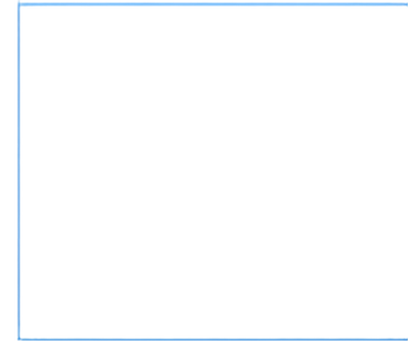
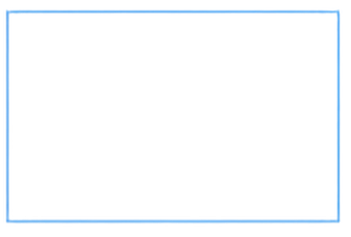














ZICBOM — THE SOFTWARE COHERENCY CONTRACT
ZICBOM COMMANDS
CBO_CLEAN
CACHE
COHERENT
ACCESS
CPU / SOFTWARE
write back dirty lines
data cache
DMA
Issues zicbom command
CBO.INVAL
device
invalidate stale lines
CBO.FLUISH
clean + invalidate atomic
STOREBUFFER
ordered interaction
Software contract today — hardware coherency arrives in v2
CBO.CLEAN
write back before DMA reads
CBO.INVAL
invalidate after DMA writes
CBO.FLUISH
atomic clean and invalidate
Correct interaction with Store Buffer

Slide 4




















CACHE MICROARCHITECTURE (SPEC §15)
2-WAY SET-ASSOCIATIVE CACHE
2-way set-associative
64-byte (512-bit) cache lines
WAY 0
WAY 1
Write-back policy with dedicated write buffer
TAG ARRAY
TAG ARRAY
CPU CORE
CACHE CONTROLLER
WRITE BUFFER (WRITE-BACK)
MAIN MEMORY
DATA ARRAY
(64B LINE)
DATA ARRAY
(64B LINE)
Blocking design
misses stall the pipeline
Configurable sizes
S1-Nano: 8KB
S1/Base/AI: 16KB
BYPASS PATH
NON-CACHEABLE PMA REGIONS (MMIO)
=>"I$ is structurally identical but read-only (no write buffer, no CBO.CLEAN)"

Slide 5















PMA/PMP PARALLEL CHECKING
(SPEC $11)
D$ TAG LOOKUP
address-to-tag match
DECISION LOGIC
RESULT
combine results
CPU LOAD/STORE REQUEST
ALLOW / DENY ACCESS
addr, type, priv
PMA/PMP CHECKER
ACCESS PROCEEDS? CACHE THIS ACCESS?
CACHE / BYPASS (NO CACHE POLLUTION)
parallel attribute evaluation
CACHEABLE
IDEMPOTENT
ATOMIC
Attributes checked
in parallel with tag lookup
Determines access and caching behavior
Prevents cache pollution from MMIO regions

Slide 6

















meds_sram_wrapper – The Abstraction Layer
meds_sram_wrapper
Abstraction Layer
PARAMETERS
DATA_WIDTH
ADDR_WIDTH
DEPTH
Mandatory wrapper for all memory arrays
No direct memory instantiations in core RTL
Strict 1-cycle registered read outputs for timing closure
clk
wen
Memory Array
addr
Output
Register
rdata
(Tags / Data / Register File
/ TLB / FIFOs)
wdata
Registered Read
(1 Cycle)
Tags
Data
Register File
TLB
FIFOs

Slide 7







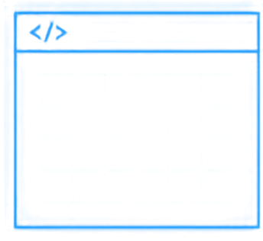











WRAPPER IMPLEMENTATION - THREE MODES
BEHAVIOURAL
BRAM
ASIC
SystemVerilog arrays for fast Verilator simulation
Xilinx RAM36E1 primitive for KC705 FPGA
Macro stub for future tape-out ensuring architectural portability
ADDR
ADDR
DOUT
DOUT
mem []
DIN
RAMB36E1
DIN
SRAM_MACRO
DOA
DOA
EN
EN

Slide 8




KEY DESIGN DECISIONS
& RATIONALE
01
Chosen for v1 stability and predictable timing.
Blocking over non-blocking
Non-blocking deferred to v2.
02
Software coherency over hardware
Zicbom software contract simplifies v1.
Hardware coherency deferred.
03
Unified wrapper architecture
Ensures ASIC-clean RTL and portability.
Avoids FPGA-specific primitives in core logic.

Slide 9









DELIVERABLES & ACCEPTANCE
(12 WEEKS)
RTL DELIVERABLES
I$ and D$ FSMs in rtl/cache/cache/ meds_sram_wrapper.sv inrtl/common/
VERIFICATION DELIVERABLES
Unit testbenches covering hit, miss, and eviction scenarios
DOCUMENTATION DELIVERABLES
Zicbom Software Contract note delivered to BSP team
METRICS DELIVERABLES
Baseline hit-rate measurements published for v1

Slide 10
















MILESTONES & DEFINITION OF DONE
DEFINITION OF DONE
No inferred latches
CBO semantics verified against DMA testbench
W1-2
W3-4
W5-7
W8-10
W11-12
Spec Review & Zicbom Note
SRAMWrapper Implementation
Instruction Cache
Data Cache & Write Buffer
Zicbom Logic & Testbenches
Hit rates published
CI lint clean

