Slide 1

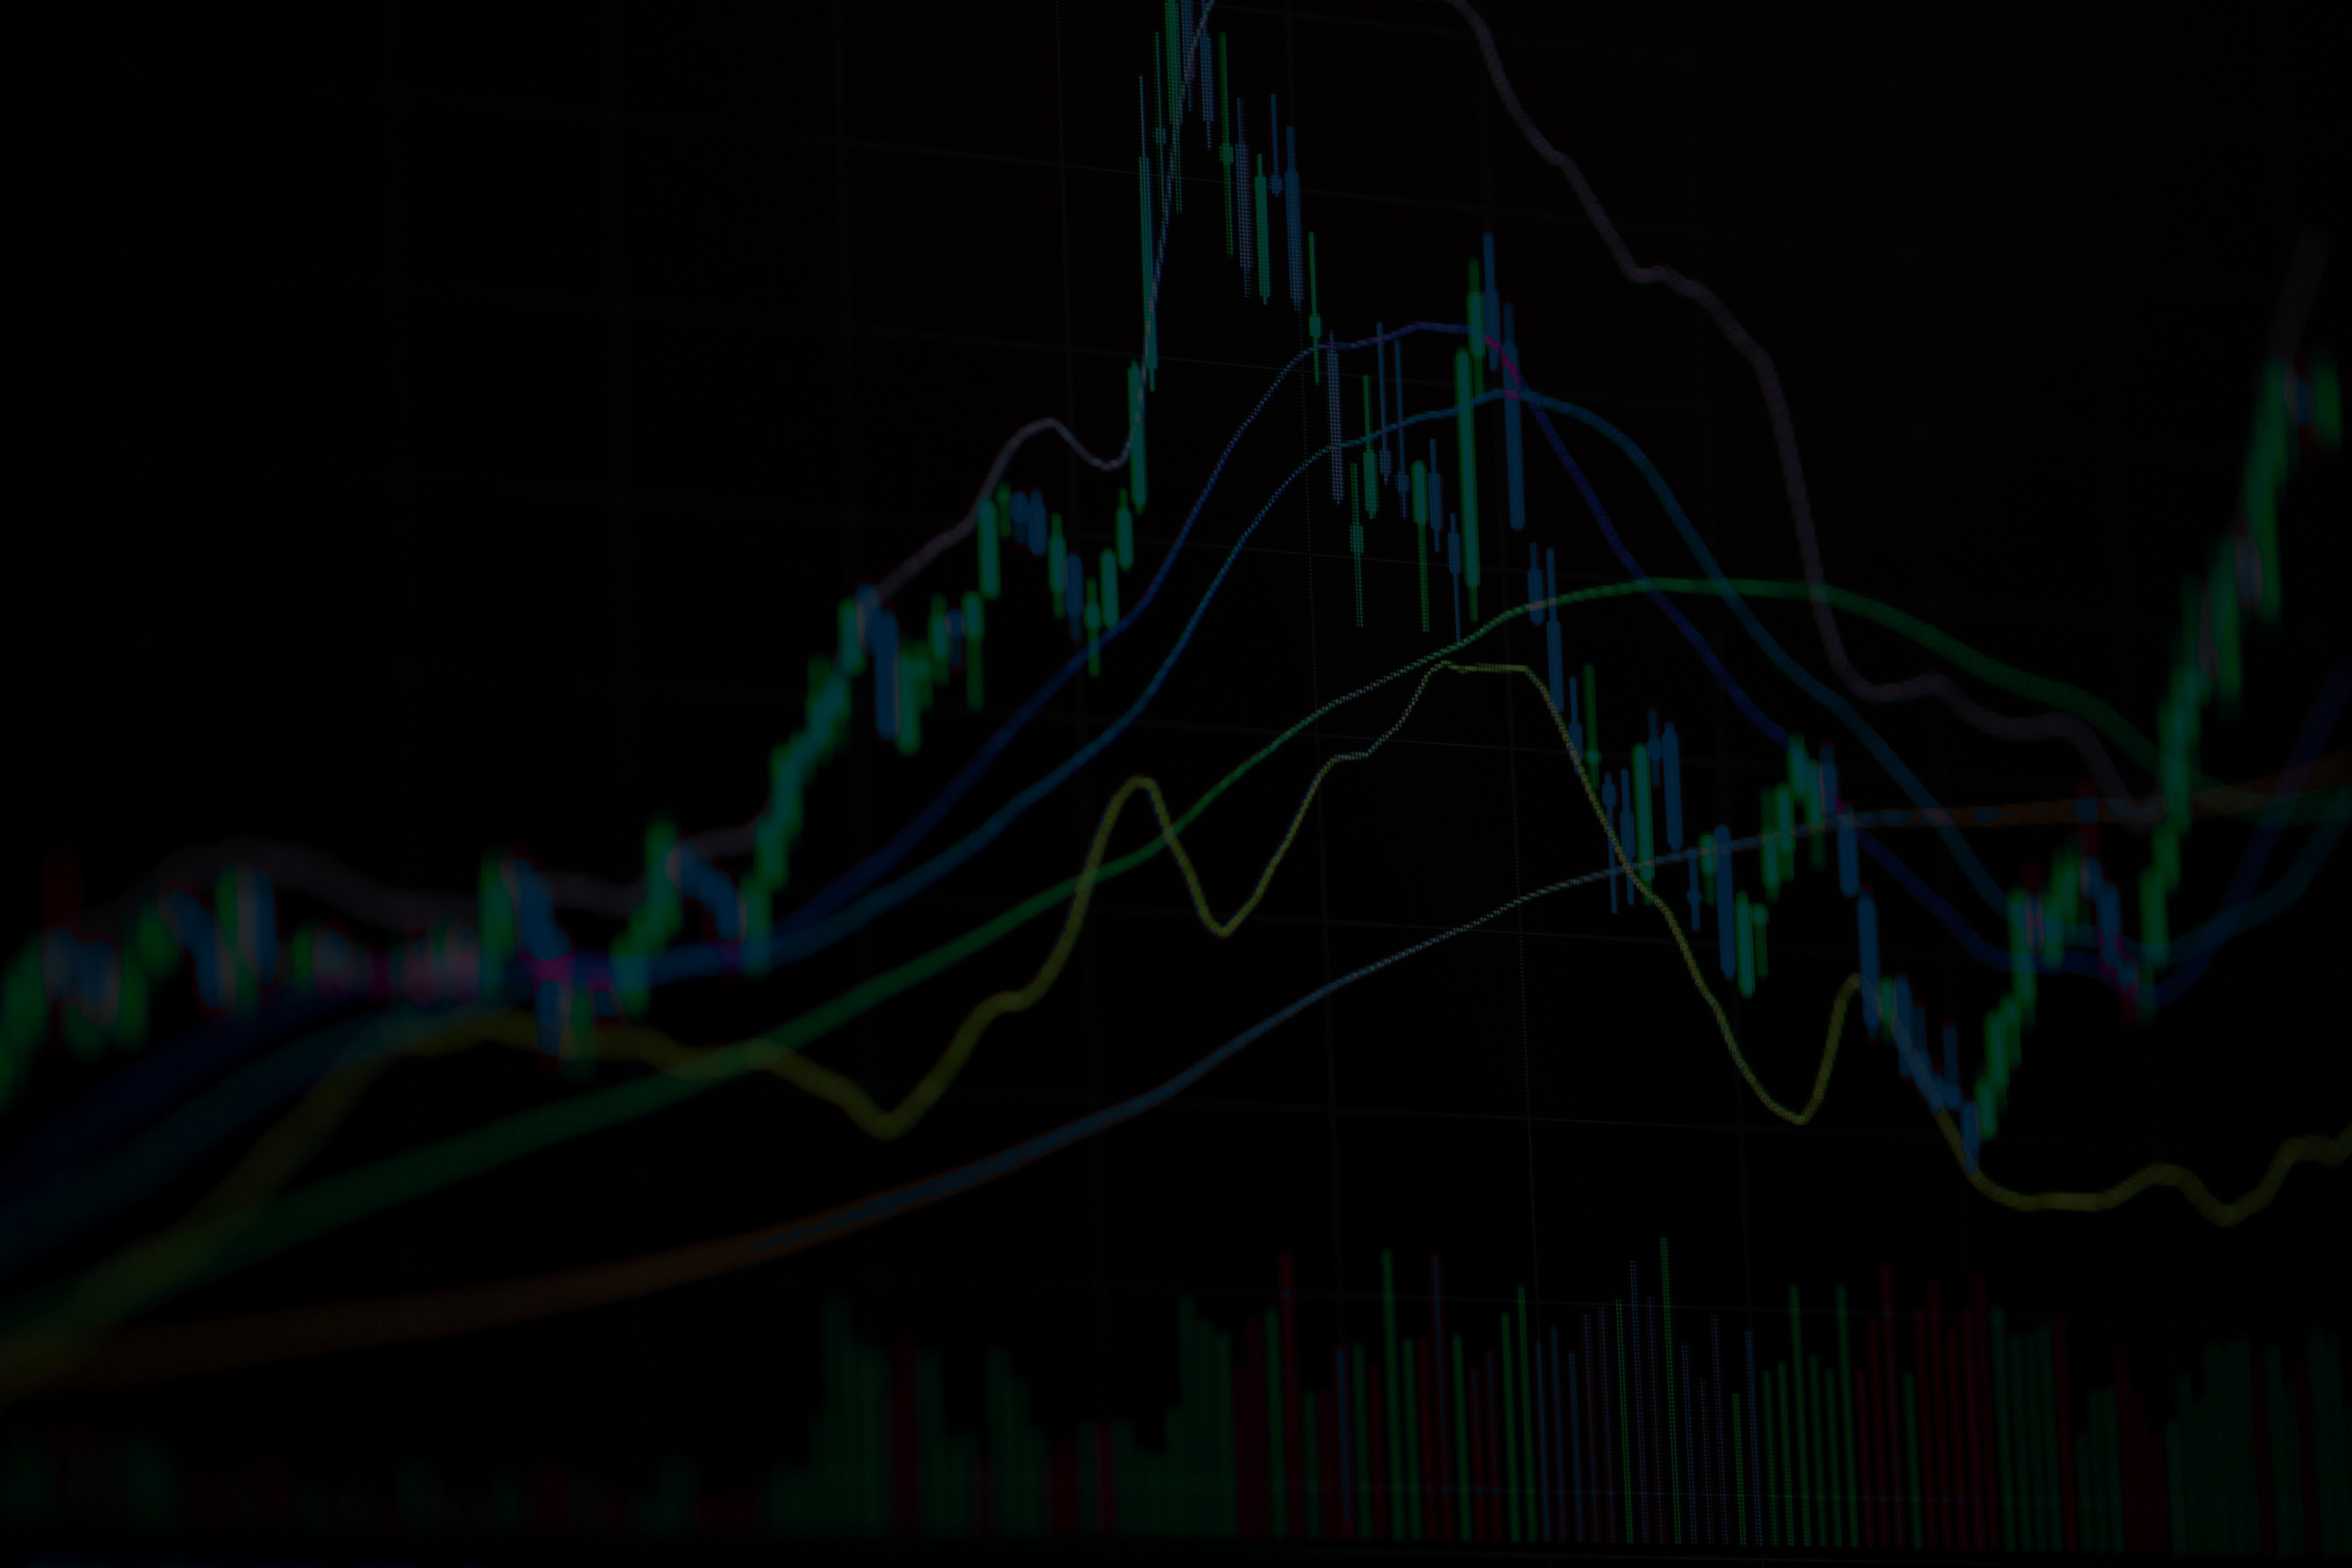

AI FRAUD
DETECTION
FINRA / SEC REAL-TIME SURVEILLANCE & FRAUD PREVENTION ENGINE

Slide 2
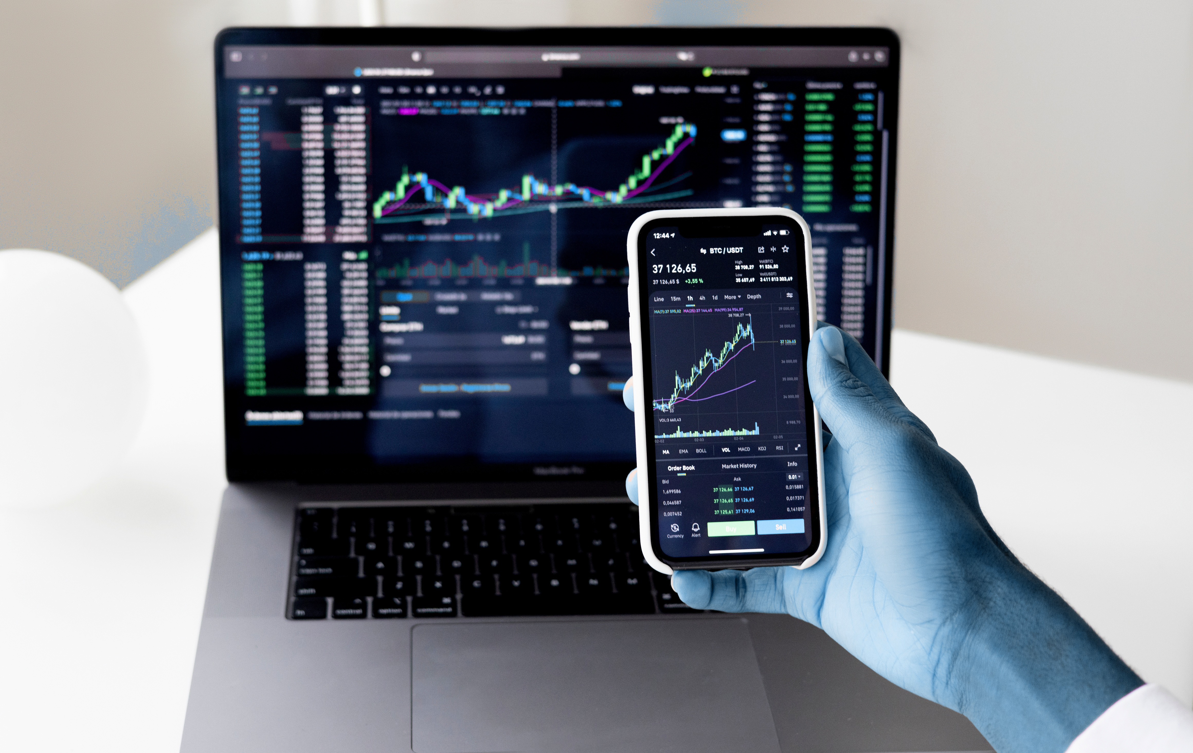

What is the
FINRA AI Platform?
An enterprise-grade real-time market surveillance platform built to detect and intercept predatory financial crimes across equity and crypto exchanges before trades settle.
Replaces outdated reactive next-day T+1 batch auditing with a continuous streaming tri-brid AI pipeline operating at <0.42 millisecond latency to protect retail investor capital and ensure market integrity.

Slide 3

Evolution of
Surveillance
Our modern architecture ingests live order feeds directly into a Medallion Delta Lakehouse via Azure Event Hubs, executing continuous sub-millisecond AI inference at the order book level.
From T+1 to Real-Time
Traditional surveillance relied on next-day T+1 batch files and rigid SQL rules (e.g. volume > threshold), leaving a 24-hour blind spot where bad actors easily laundered illicit trading profits before detection.

Slide 4



How the
AI Engine Works
Streaming Pipeline
Live Level-2 order book feeds stream into Apache Spark via Azure Event Hubs, where 15 rolling mathematical features are extracted in under 0.15ms per transaction.
Scoring & Alerts
The ensemble computes a composite fraud probability (<0.42ms). Scores >=0.70 trigger automated Logic Apps circuit breakers and escalate to compliance officers instantly.

Slide 5



Market Manipulation
Key Threats
Spoofing & Layering
Wash Trading
Pump & Dump
Non-bona fide orders placed to shift order book depth, cancelled in <50ms.
Colluding accounts trading with themselves to fabricate artificial volume.
Aggressive volume bursts elevating prices before dumping onto retail buyers.

Slide 6

Tri-Brid
AI Ensemble
Deep Autoencoder (15% Weight): PyTorch neural network evaluating reconstruction loss MSE to identify microsecond order book anomalies and quote stuffing.
XGBoost (60%)
Supervised classification; 0.982 ROC-AUC on known fraud signatures.
Composite Decision Boundary: Composite Score = 0.60(XGB) + 0.25(IF) + 0.15(AE). Scores >=0.70 trigger instant freeze & compliance triage.
IsoForest (25%)
Unsupervised outlier isolation for zero-day, unseen anomalous attacks.

Slide 7



Engineered
Features
Order-to-Trade Ratio
Cancellation Velocity
Volume Z-Score & Imbalance
Calculates ratio of submitted orders vs executed fills. Extreme ratios (>90%) immediately expose spoofing and book manipulation.
Measures microsecond delta between order placement and cancellation, flagging high-frequency spoof probing algorithms.
Statistical standard deviations from 15-min rolling baselines combined with multi-tier bid-ask depth skews to uncover wash trading.

Slide 8
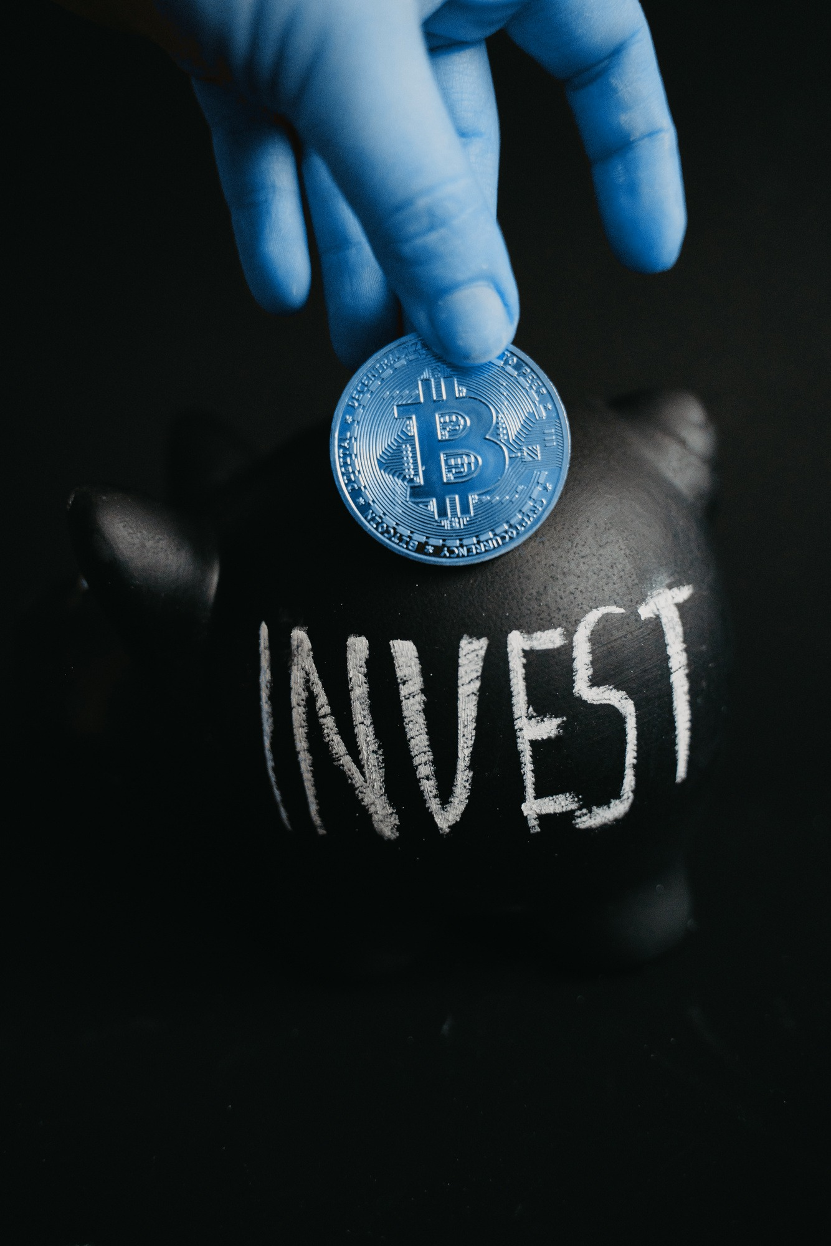

XGBoost vs. Random Forest
Random Forest
XGBoost (Chosen)
Bagging; slower latency (>2.5ms), ROC-AUC ~0.92, struggles on 0.1% fraud imbalance.
Gradient boosting; <0.28ms tree traversal, ROC-AUC 0.982, native scale_pos_weight.
Why XGBoost won: In high-frequency market surveillance, a 0.06 AUC difference prevents thousands of costly false alarms while guaranteeing strict sub-millisecond execution budgets.

Slide 9

Regulatory XAI & Audit Trail
Regulators (SEC & FINRA) strictly reject black-box models. Our architecture integrates Fast Tree-SHAP to compute exact mathematical feature contributions for every flagged transaction, recorded into an immutable Delta Lake audit trail ready for legal subpoenas and court-admissible evidence.

Slide 10
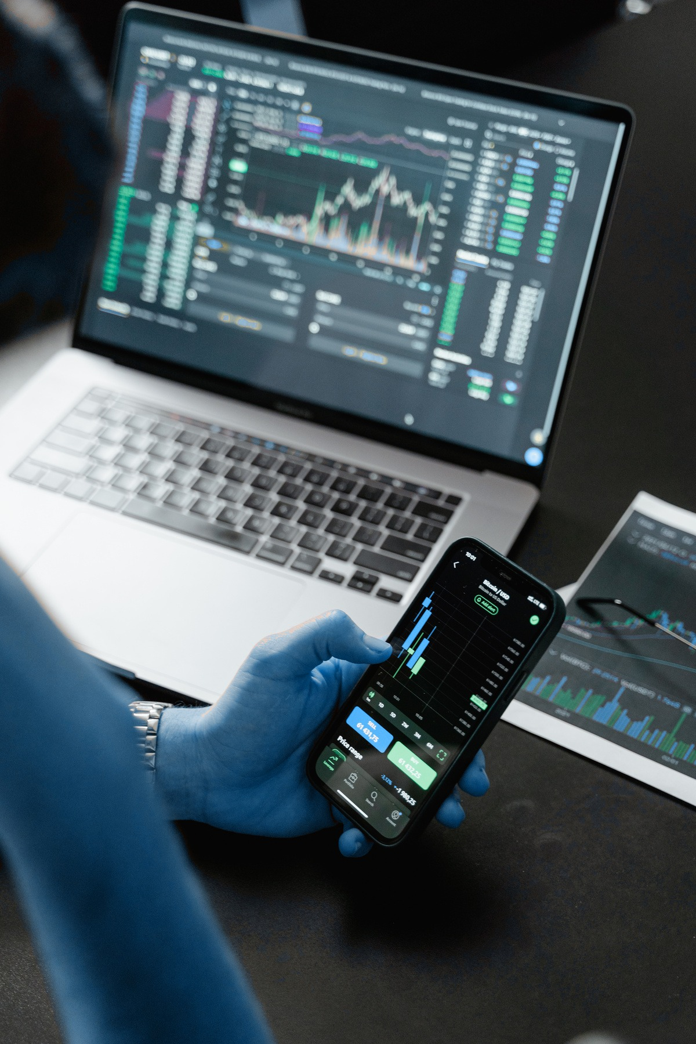

Enterprise Tech Stack
Streaming Ingestion
Azure Event Hubs & Kafka: High-throughput ingestion (50k+ msgs/sec).
Data Lakehouse
Delta Lake Medallion: ACID Bronze (Raw), Silver (Features), Gold (BI).
Command Center & BI: 60FPS Vanilla JS live surveillance web stream paired with interactive Microsoft Power BI executive reporting dashboards for comprehensive audit governance.
AI Serving Engine
FastAPI Microservice: Ultra-low latency asynchronous scoring engine.

Slide 11
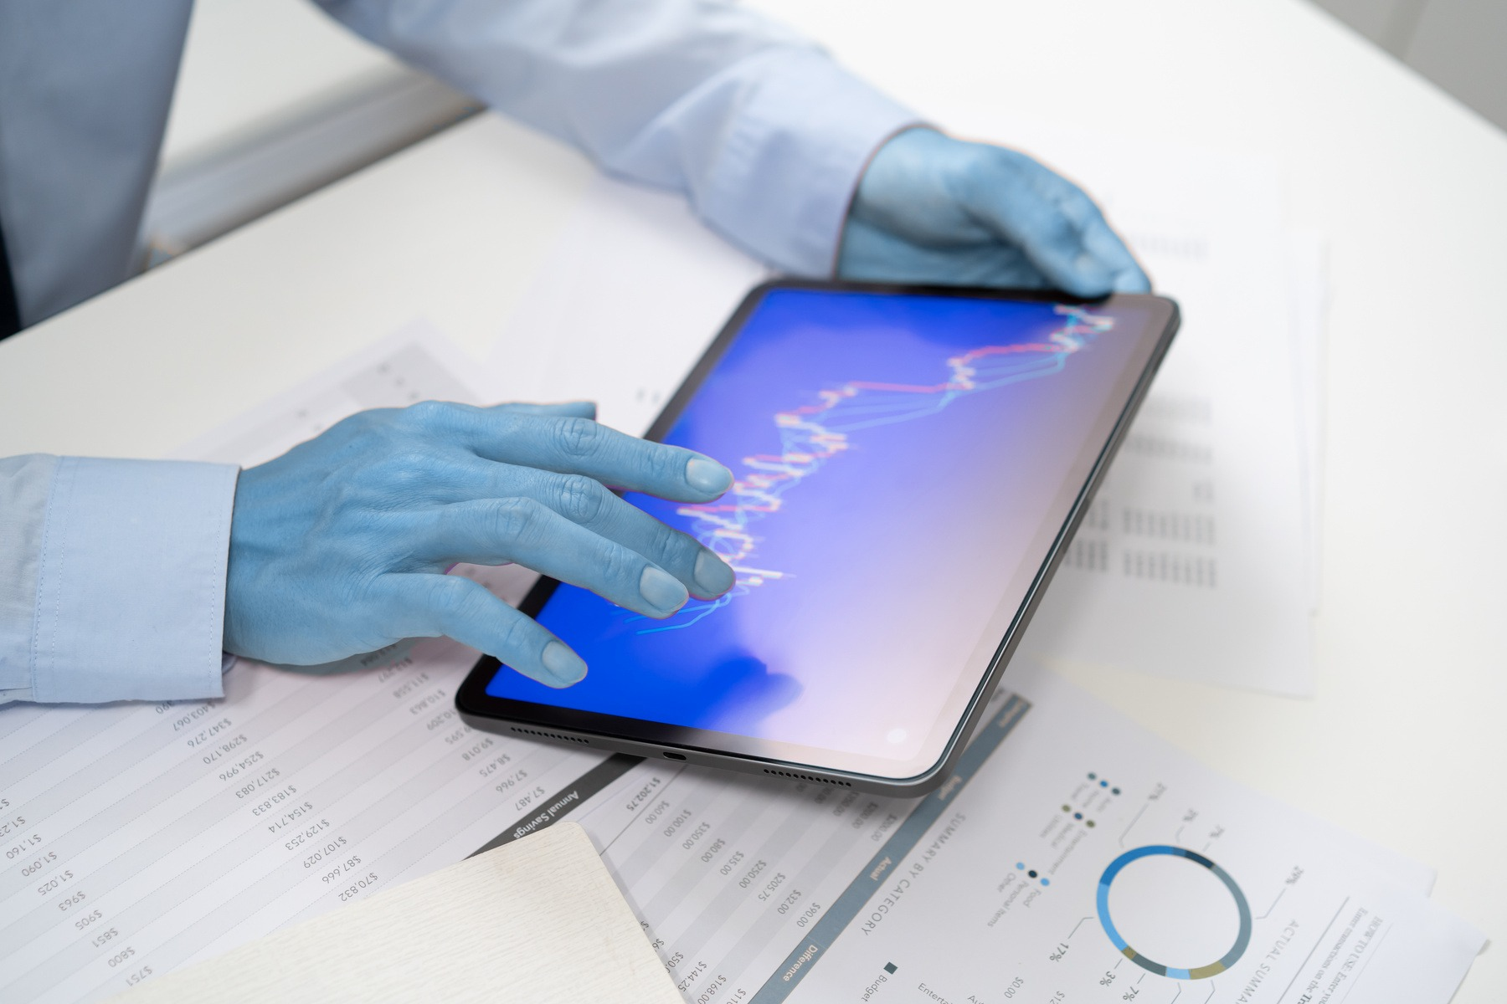


System Benchmarks
Achieved 0.982 ROC-AUC with 94.6% precision and 96.2% recall at 0.418ms scoring latency. False alarms reduced by 87% compared to legacy SQL rule systems.
Reduces compliance triage investigation time from 4 hours down to under 2 minutes per alert, saving institutions millions in potential fines and protecting market integrity.

Slide 12
THANK
YOU.
FINRA AI Market Surveillance System | Real-Time Fraud Defense Engine

