Slide 1
Chapter 1
MIDDLEWARE_CLASSES:
Middleware are classes and methods, including the methods that are performed during the request process. To simplify the beginning of the development, we will remove a middleware from

Slide 2
Root URL
In settings.py file
ROOT_URLCONF = ‘main.urls‘ //determines root url when website starts
Run server on custom port no
manage.py runserver 127.0.0.1:8000
Integrating variables in templates
<span> {{my_var}} </span>
Note
Note that for a display variable, double brackets {{}} are used, but once we have an action to be made as a condition or loop, we will use {%%}.

Slide 3
If statement in template
If statement in template
{% if years < 10 %}
You are a child
{% elif years < 18 %}
You are a teenager
{% else %}
You are an adult!
{% endif %}
{% if years < 10 %}
You are a child
{% elif years < 18 %}
You are a teenager
{% else %}
You are an adult!
{% endif %}
Looping
{% for city in array_city %}
{{ city }}
{% endfor %}

Slide 4
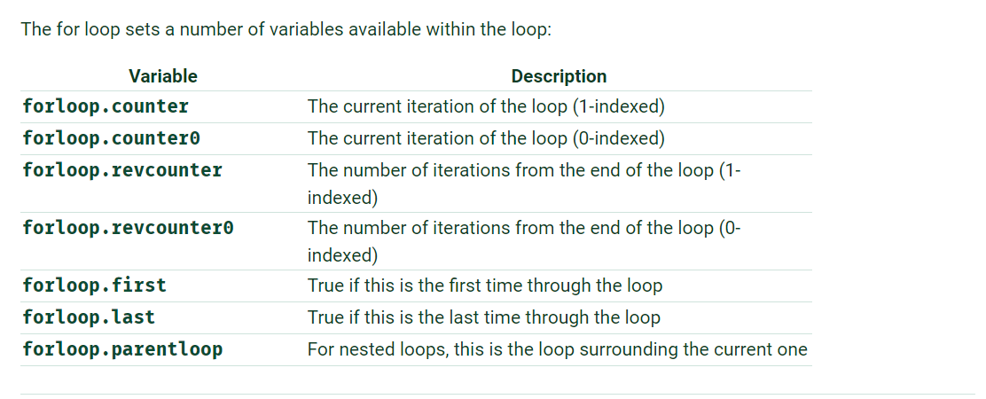
For loop Variables
Start with 0 index
Start with 1 index

Slide 5
If statement in template
Filters
Lower Filter
{{ my_hello | lower }}
Upper Filter
{{ my_hello | upper }}
capfirst Filter
{{ my_hello | capfirst }}
LineBreaks filter
{{ text|linebreaks }}
Turncatechars filter //truncates a string and puts dot… after that
{{ text|truncatechars:14 }}
{% if years < 10 %}
You are a child
{% elif years < 18 %}
You are a teenager
{% else %}
You are an adult!
{% endif %}
Passing parameter to filters
For this we use following syntax
{{ variable | filter:"parameters" }}

Slide 6
If statement in template
Creating Dynamic URLS
path(“home”,home,name="home_url")
We have given this path a name=“home_url”
<a href="{% url ‘home_url' %}">Connection</a>
Extending templates
In our base.html we write as follow
<title>
{% block title_html %}{% endblock %}
</title>
similarly
<article>
{% block article_content %}{% endblock %}
</article>

Slide 7
If statement in template
Index.html file
Now at top of our file write s follow
{% extends "base.html" %}
Now to extend our tag write it as follow
{% block article_content %}
Hello world !
{% endblock %}

Slide 8
If statement in template
Static files
To set the path where Django will look for static files, we have to change our settings.py file by adding or changing the following line:
STATIC_URL = '/static/'
STATICFILES_DIRS = ( os.path.join(PROJECT_ROOT, '../project_name/static/'), )
Tag for Loading Static files
{% load staticfiles %}
Using static files
<link href="{% static "css/style.css" %}" rel="stylesheet" type="text/css" />

Slide 9
If statement in template
Models
Basic datatypes in Django are as follow
CharField:
TextField
IntegerField
DateField
DateTimeField
DecimalField
ImageField
Note :
Django automatically saves an id field in auto increment. Therefore, we do not need to define a primary key.

Slide 10
If statement in template
Models
name = models.CharField(max_length=50, verbose_name="Name")
phone = models.CharField(max_length=20, verbose_name="Phone number" , null=True, default=None, blank=True)
born_date = models.DateField(verbose_name="Born date" , null=True, default=None, blank=True)
last_connection = models.DateTimeField(verbose_name="Date of last connection" , null=True, default=None, blank=True)
email = models.EmailField(verbose_name="Email") years_seniority = models.IntegerField(verbose_name="Seniority", default=0, auto_now_add=True))
Note :
Verbose name is used by django admin to display them while inserting data in tables

Slide 11
If statement in template
Registering the Models
In admin.py file write following
from django.contrib import admin
admin.site.register(model_name)
Foreign Key
class Manufacturer(models.Model):
name=models.CharField(max_length=20)
class Car(models.Model):
name=models.CharField(max_length=20)
manufacturer=models.ForeignKey(Manufacturer,on_delete=models.CASCADE)

Slide 12
If statement in template
Many To Many Field
class Person(models.Model):
name = models.CharField(max_length=128)
def __str__(self):
return self.name
class Group(models.Model):
name = models.CharField(max_length=128)
members = models.ManyToManyField(Person, through='Membership')
def __str__(self):
return self.name
class Membership(models.Model):
person = models.ForeignKey(Person, on_delete=models.CASCADE)
group = models.ForeignKey(Group, on_delete=models.CASCADE)
date_joined = models.DateField(auto_now_add=True)
invite_reason = models.CharField(max_length=64)
def __str__(self):
return self.invite_reason

Slide 13
If statement in template
Getting Records from database
All() method:
Objects=tableName.objects.all() #returns all objects in table
Filter():
Objects=tableName.objects.filter(name=“waqas”)
Get():
first_project = Project.objects.get(id="1")
Returns only one record.and it is an instance or our model
If there will be more than 1 record that satisfy the same condition it will generate an error
Order by :
queryset_project = Project.objects.filter(client_name="Me").order_ by("id")
Indexing :
= queryset_project[:1]
But the return record will not be an instance of model but get() return an instance of model

Slide 14
If statement in template
Parameters in URLS
Parameters in URLS
path(r‘shop/<int:id>',views.home)
And in view we define a function named home which takes a parameter id ie
Def home(request,id)
return HttpResponse("Your Primary Key is : {0}".format(id))
path(r‘shop/<int:id>',views.home)
And in view we define a function named home which takes a parameter id ie
Def home(request,id)
return HttpResponse("Your Primary Key is : {0}".format(id))
Re_path and Regular Expressions
If we have to use regular expression in our url than we use re_path instead of path
For Example:
re_path(r'regular/(?P<pk>\d+)$',regular_param)
Than in views we define following function.
def regular_param(request,pk):
return HttpResponse("Your Response Primary Key is : {0}".format(pk))

Slide 15
If statement in template
Adding new Records
Parameters in URLS
new_project = Project(title="Tasks Manager",description="desc.",client_name="Me")
new_project.save() #this will save it in database
Updating A single Record
task = Task.objects.get(id = 1)
task.description = "New description“
task.save() #Updates the record in database
Updating Multiple Records
Use update() method to update multiple records.
task = Project.objects.filter(client_name = "people").update(client_name="Nobody")

Slide 16
If statement in template
Deleting a Record
Parameters in URLS
one_task = Task.objects.get(id = 1)
one_task.delete() # line 1
Updating A single Record
task = Task.objects.get(id = 1)
task.description = "New description“
task.save() #Updates the record in database
Updating Multiple Records
Use update() method to update multiple records.
task = Project.objects.filter(client_name = "people").update(client_name="Nobody")

Slide 17
If statement in template
OR Operation in Query
Parameters in URLS
To perform OR operation in query we write condition in Q()
This Q object allows you to set complex queries on models.
from django.db.models import Q
projects_list = Project.objects.filter(Q(client_name="Me") | (client_name="Nobody"))
Relational Operators
__gte: This is equivalent to SQL's greater than or equal to operator, >=
__gt: This is equivalent to SQL's greater than operator, >
__lt: This is equivalent to SQL's lower than operator, <
__lte: This is equivalent to SQL's lower than or equal to operator, <=
Query Example
tasks_list = Task.objects.filter(time_elapsed__gte=4)

Slide 18
If statement in template
Exclude() function
Parameters in URLS
This works as – operator in sql.
tasks_list = Task.objects.filter(time_elapsed__gt=4)
array_projects = tasks_list.values_list('project', flat=True).
projects_list = Project.objects.all() projects_list_lt4 = projects_list.exclude(id__in=array_projects)
RAW SQL Queries
We use raw() method to write raw sql queries.
first_task = Project.objects.raw("SELECT * FROM TasksManager_project") [0]

Slide 19
If statement in template
Exclude() function
Parameters in URLS
This works as – operator in sql.
tasks_list = Task.objects.filter(time_elapsed__gt=4)
array_projects = tasks_list.values_list('project', flat=True).
projects_list = Project.objects.all() projects_list_lt4 = projects_list.exclude(id__in=array_projects)
RAW SQL Queries
We use raw() method to write raw sql queries.
first_task = Project.objects.raw("SELECT * FROM TasksManager_project") [0]

