Slide 1


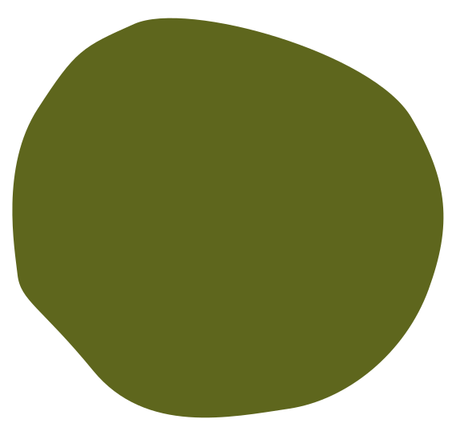




Radix Sort with Digit Buckets
PRESENTED BY :
MUHAMMAD YASIR
Rehan Ali
Ahmed Hassan

Slide 2




NON-COMPARATIVE SORTING METHOD
Radix Sort efficiently sorts numbers by processing individual digits, demonstrating a unique approach that eliminates the need for comparisons.
Radix Sort Overview
IMPLEMENTATION SCOPE
We will implement Radix Sort in C++ and Python, complemented by visual animations to enhance understanding and performance analysis through educational simulations.

Slide 3
CORE CONCEPT UNDERSTANDING
We have successfully grasped the foundational principles of Radix Sort, differentiating between Least Significant Digit (LSD) and Most Significant Digit (MSD) methods.
Achievements in Radix Sort
HISTORICAL INSIGHTS COLLECTED
Extensive research has allowed us to gather valuable historical insights, informing our implementation strategy and enhancing our understanding of previous Radix Sort applications and developments.

Slide 4
PSEUDOCODE AND COMPLEXITY ANALYSIS
We have successfully completed the pseudocode explanation and analyzed time and space complexity, ensuring a solid foundation for our implementation.
Current Progress Update
C++ AND PYTHON DEVELOPMENT
Currently, we are testing the C++ version while enhancing the Python version with Pygame, which will improve visual representation and interactivity.

Slide 5
Challenges We Encountered
ANIMATION COMPLEXITY ISSUES
Creating engaging animations for Radix Sort has proven to be technically challenging and time-consuming, requiring meticulous attention to detail and precision.

Slide 6
COMPLETE PROGRAM DEVELOPMENT
We aim to finalize both C++ and Python programs, ensuring functionality and performance through rigorous testing and validation processes.
Final Project Goals
VISUAL ENHANCEMENTS
We will develop flowcharts and finalize animations and GUI, enhancing user experience and educational value while maintaining clarity in our project presentation.

Slide 7


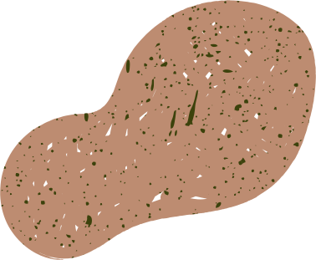
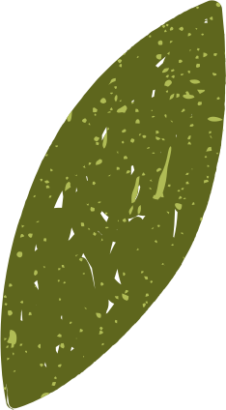

Thank You

