Slide 1
SMART DIET PLANNER USING ARTIFICIAL INTELLIGENCE
Thesis Presentation – Muhammad Yazir

Slide 2
Abstract
This project introduces a Smart Diet Planner using Artificial Intelligence.
It creates personalized diet plans based on age, weight, activity level, and health status.
GPT-4o, real-time nutrition APIs, and image analysis enable smart and flexible meal suggestions.
The system simplifies healthy eating through intelligent and user-friendly recommendations.

Slide 3
Introduction
Unhealthy eating is a major contributor to global health issues like obesity and diabetes.
Most people find it difficult to maintain consistent and personalised diet plans.
With AI and modern tools, there is a need for a system that gives smart, dynamic, and accurate meal planning.
This project bridges that gap using advanced AI, nutrition science, and a user-focused design.

Slide 4
Problem Statement
Most existing diet apps rely on manual data input and lack intelligent personalization.
Users often struggle to get dynamic, health-specific meal suggestions in real-time.
There is no single platform that combines AI, nutrition data, and image analysis in one system.

Slide 5
Aim & Objectives
Aim: Develop an intelligent, user-centric diet planning app.
Objectives:
Automate diet plan generation
Use AI to suggest recipes
Provide food image analysis
Store user history

Slide 6
Scope of Project
Build an intelligent diet planner using AI (GPT-4o) to personalize recommendations.
Integrate real-time nutrition data from FatSecret API for accurate macro calculations.
Enable users to upload food images and get automatic ingredient & calorie estimation.
Target users aiming for weight loss, fitness goals, or managing health conditions.

Slide 7
Literature Review
Traditional diet apps offer static tracking and lack advanced automation.
Studies show AI models (e.g., NLP) can assist in generating meaningful food plans.
APIs like FatSecret provide nutritional insights but need integration.
Research supports use of image-based food recognition to estimate meal content.

Slide 8
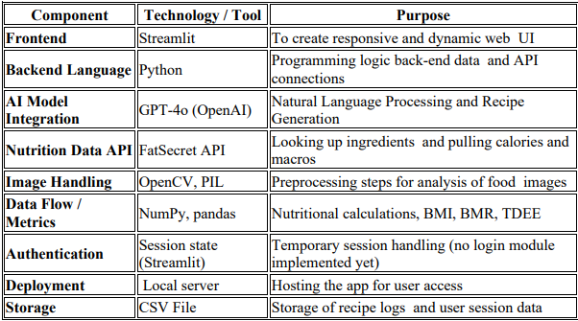
Technology Stack
Frontend: Streamlit
Backend: Python
AI: OpenAI GPT-4o
API: FatSecret
Libraries: NumPy, Pandas, Pillow, OpenCV

Slide 9
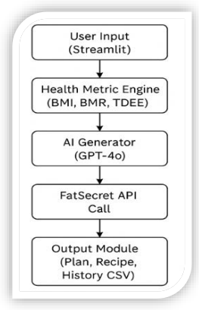
System Architecture
User Input Interface – Collects age, height, weight, goal
GPT-4o Module – Generates personalised meal plans
Nutrition API – Provides nutritional data for meals
Image Analyzer – Estimates food details from pictures
Data Storage – Saves user results and history

Slide 10
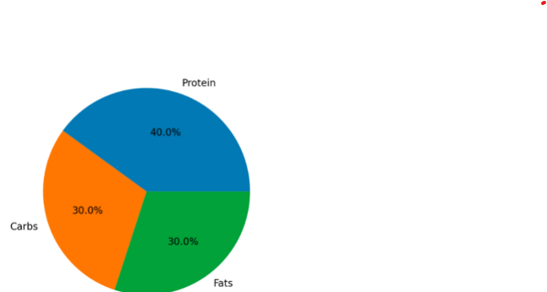
Main Features
Personalized Plan
Macronutrient Pie Chart
Recipe Generator
Image Analyzer
User History

Slide 11
AI & GPT Integration
Uses GPT-4o for diet personalization
Understands user's goal & health condition
Generates smart meal plans & recipes
Analyzes food images for nutrition info
Makes interaction natural & intelligent

Slide 12
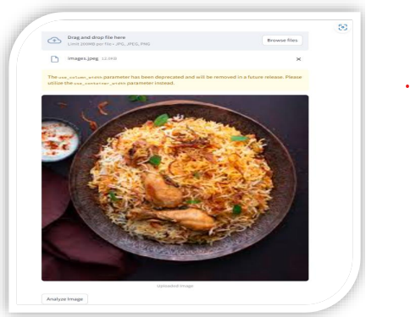
Food Image Analysis
Users upload food images, which are analyzed using GPT-4o vision API for ingredient and nutrition estimation.

Slide 13
Recipe Generation
User selects dish or types ingredients
GPT-4o generates a customised recipe
Considers:
Fitness Goal (e.g., weight loss)
Health Conditions (e.g., diabetes)
Includes:
Step-by-step cooking instructions
Balanced macro-nutrient content

Slide 14
User Testing
Tested by 5 users
Main features used:
  Diet plan
  Recipe generation
  Food image analysis
Positive Feedback
Interface: Simple & friendly
Plans: Accurate & personalised
Recipes: Relevant and easy to follow
Suggested Improvements
Add user accounts
Sync with fitness trackers

Slide 15
Limitations & Future Scope
Limitations:
No login system → results not saved for future use
External APIs → image nutrition estimates may vary
Not medically certified → lacks clinical diet validation
Future Enhancements:
Add user accounts & cloud storage
Custom AI model for better food recognition
Integration with fitness devices (e.g., Fitbit)
Collaborate with health professionals for validation

Slide 16
Conclusion
The Smart Diet Planner bridges the gap between AI and personal health.
It offers intelligent, personalised diet plans using GPT-4o, nutrition APIs, and user data.
Real-time recipe generation and food image analysis make it more interactive and user-friendly.
Though a prototype, it demonstrates practical potential in AI-powered healthcare solutions.
Sets the foundation for future development into a scalable, medically reliable system.

Slide 17
Thank You
Questions?

