Slide 1
MS Word (What, Why, When, Where)

Slide 2
Agenda
What is MS Word?
When was MS Word Created?
Why is MS Word Important?
Where is MS Word Used?

Slide 3
What is MS Word?
MS Word is a word processing program that helps users type and format documents on a computer.
Helps in essays, letters, reports, resumes, and more.
Versatility in fonts, sizes, colors, and alignments.
You can insert pictures, tables, charts, and links.
MS Word includes tools like spell check and grammar check to help improve the quality of writing.

Slide 4
When was MS Word Created?
MS Word was first created and released by Microsoft on October 25, 1983, for computers running the MS-DOS operating system.
It became more popular after versions for Windows and Mac were released.
Over the years, new versions of MS Word have been released.
Today, MS Word is one of the most widely used programs.
Reference: https://www.britannica.com/technology/Microsoft-Word

Slide 5
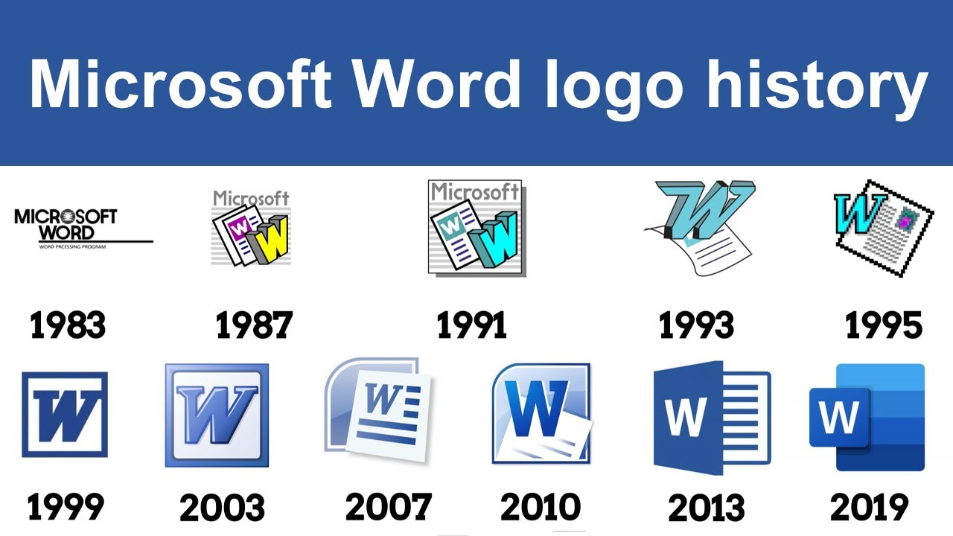

Slide 6
Why is MS Word Important?
Professional Document Creation.
Ease of Use.
Versatility: It supports a range of document formats (like .docx, .pdf, and .txt).
Collaboration: With Office 365, users can collaborate in real time with others.

Slide 7
Where is MS Word Used?
Education: Essays, reports, and academic research.
Business: Letters, contracts, and reports in offices.
Personal Use: For writing personal documents such as resumes, cover letters, or journals.
Publishing: Authors and writers use it for drafting books, articles, and other content.

Slide 8
Thank You
Muhammad Ali
Khawaja Haris Khan
Group-A BCS
Presentations: G-3

