Slide 1

AI Based Travel Assistant
Muhammad Ali
(22-Arid-5404)
Daniyal Rashid
(21-Arid-4682)
(Date: 30/04/2026)
Supervisor: Miss Afifa
Department of Computer Science
Barani Institute of Management Sciences, Rawalpindi

Slide 2
Introduction
A smart, cross-platform AI-powered Travel Assistant that combines navigation and tourism discovery into a single mobile application for Pakistani travelers.
Discover top destinations across Pakistan with ratings and pricing
Get fastest or tourist-friendly scenic routes
Book or customize trips directly from the app
AI Chat assistant for real-time travel guidance
Backend: Python + Supabase | Images: Unsplash API
Notes:
1- main usage social media
2- twitter facebook
3- usage of twiiter entertainment
4- share karty hain news without authentication of current affairs
5- schemers is ka faida uthaty hain yeah 1 thread ha
6- isko overcome karnay kay liay bohat say reserachers nay different techniques use ki hain isay overcome karny ky liay

Slide 3
Relevance to Course Modules
This project integrates knowledge from across the BS Computer Science program into one real-world intelligent system.
Artificial Intelligence : NLP-based query processing + AI Chat assistant
Software Engineering : Agile methodology, UML diagrams, SRS documentation
Database Management Systems : Supabase (PostgreSQL) for cloud data storage
Mobile App Development : Flutter cross-platform app (Android & iOS)
Computer Networks : REST API integration (Unsplash, Supabase, OpenRouteService)
Notes:
1- main usage social media
2- twitter facebook
3- usage of twiiter entertainment
4- share karty hain news without authentication of current affairs
5- schemers is ka faida uthaty hain yeah 1 thread ha
6- isko overcome karnay kay liay bohat say reserachers nay different techniques use ki hain isay overcome karny ky liay

Slide 4
Existing Systems
Existing System | Limitations | Technology
Google Maps | Provides only fastest/shortest route; does not suggest tourist attractions | JavaScript, Google Directions API
TripAdvisor | Suggests places to visit, but lacks integrated routing or trip customization | Web portal, crowdsourced POI listings
Rome2Rio | Offers multi-modal routes but limited tourist POI support | Travel APIs, route aggregation engine
Visit A City (App) | Provides itineraries but mostly limited to popular cities | App-based with static database content

Slide 5
Literature Review
Reference Title | Summary | How My Idea Is Better
“Tourism Recommendation using AI & ML (IJCA, 2022)” | Clustering-based spot suggestions | We add NLP input + dual route options
“POI-Aware Route Planning (ACM, 2021)” | Walking route optimization via POI density | We support long-distance travel + mobile UI
“Personalized Itinerary using Geospatial Data (2023)” | Day-wise schedules from spatial data | We add real-time booking + AI chat
“Conversational Travel Assistant (2021)” | Scripted chatbot for trip planning | Our NLP interprets free-text dynamically

Slide 6
Problem Statement
Users are forced to switch between multiple apps when planning travel. No single platform intelligently handles both routing and tourist discovery together.
Navigation apps ignore attractions; tourism apps ignore routing
Existing tools use rigid filters : no natural language support
No real-time POI filtering based on personal interests
No unified platform for discovery, routing, and booking
Our system solves all of this in one Flutter app

Slide 7
Proposed Solution (System Model)
A Flutter mobile app backed by Python and Supabase that lets users discover, plan, and book trips across Pakistan through an intelligent, personalized interface.
User inputs travel query in natural language
NLP module (Python) extracts preferences and filters
System generates fastest route + scenic tourist route
Destination images fetched dynamically via Unsplash API
Trip data stored and managed in Supabase (PostgreSQL)
User can Book Now or fully customize their itinerary

Slide 8
System Architecture
The system follows a client-server architecture with cloud backend integration across four layers.
Frontend: Flutter (Android & iOS)
Backend: Python for NLP processing, business logic, API orchestration
Database: Supabase (PostgreSQL) for storing users, trips, bookings, POIs
External APIs: Unsplash (images), OpenStreetMap, Nominatim, OpenRouteService
Flow: User → Flutter → Python Backend → Supabase → Response to UI

Slide 9
Methodology & Software Lifecycle
The project follows Agile Software Development : an iterative approach chosen for its flexibility with evolving AI and NLP requirements.
Requirement Analysis : SRS, functional & non-functional requirements
System Design : UML diagrams, architecture definition
Implementation : Flutter app, Python backend, Supabase, Unsplash API
Testing : Unit, integration, and system testing per module
Deployment : Controlled release with iterative feedback-based improvements

Slide 10
Why Agile?
Agile was chosen because AI and NLP components require continuous testing and refinement : a linear model cannot support this effectively.
Requirements evolve as AI modules are tested and improved
Each sprint delivers a testable feature (auth, routing, recommendations, chat)
Parallel development of Flutter frontend and Python backend
Continuous feedback reduces overall development risk
Supports fast iteration and course correction at every stage

Slide 11
Tools and Technology
Built using modern, industry-relevant tools across the complete development stack.
Frontend: Flutter (Android & iOS)
Backend: Python
Database: Supabase (PostgreSQL cloud database)
Image API: Unsplash API (dynamic destination imagery)
Routing & Maps: OpenStreetMap, Nominatim, Overpass API, OpenRouteService
Current Data: Hardcoded dummy data used during development phase
Dev Tools: VS Code, Android Studio, Git/GitHub

Slide 12
Use Case Diagram
Shows interactions between the two primary actors : User and Admin : and the system's core operations.
User: Register/Login, Enter Travel Query, Filter Preferences, Get Recommendations, View POIs, Save Trip, Chat with AI
Admin: Manage Users, Packages, POIs, View Reports, System Settings
Get Recommendations <<includes>> Generate Route
Generate Route <<extends>> View Map, Real-time Updates, Save Trip

Slide 13
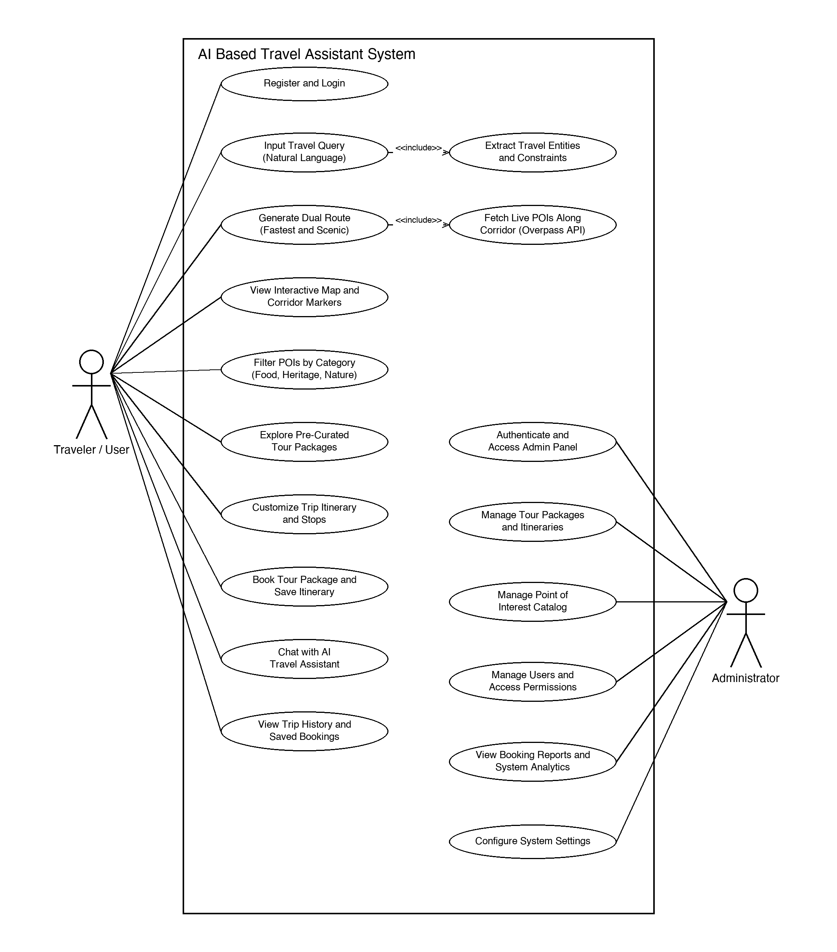
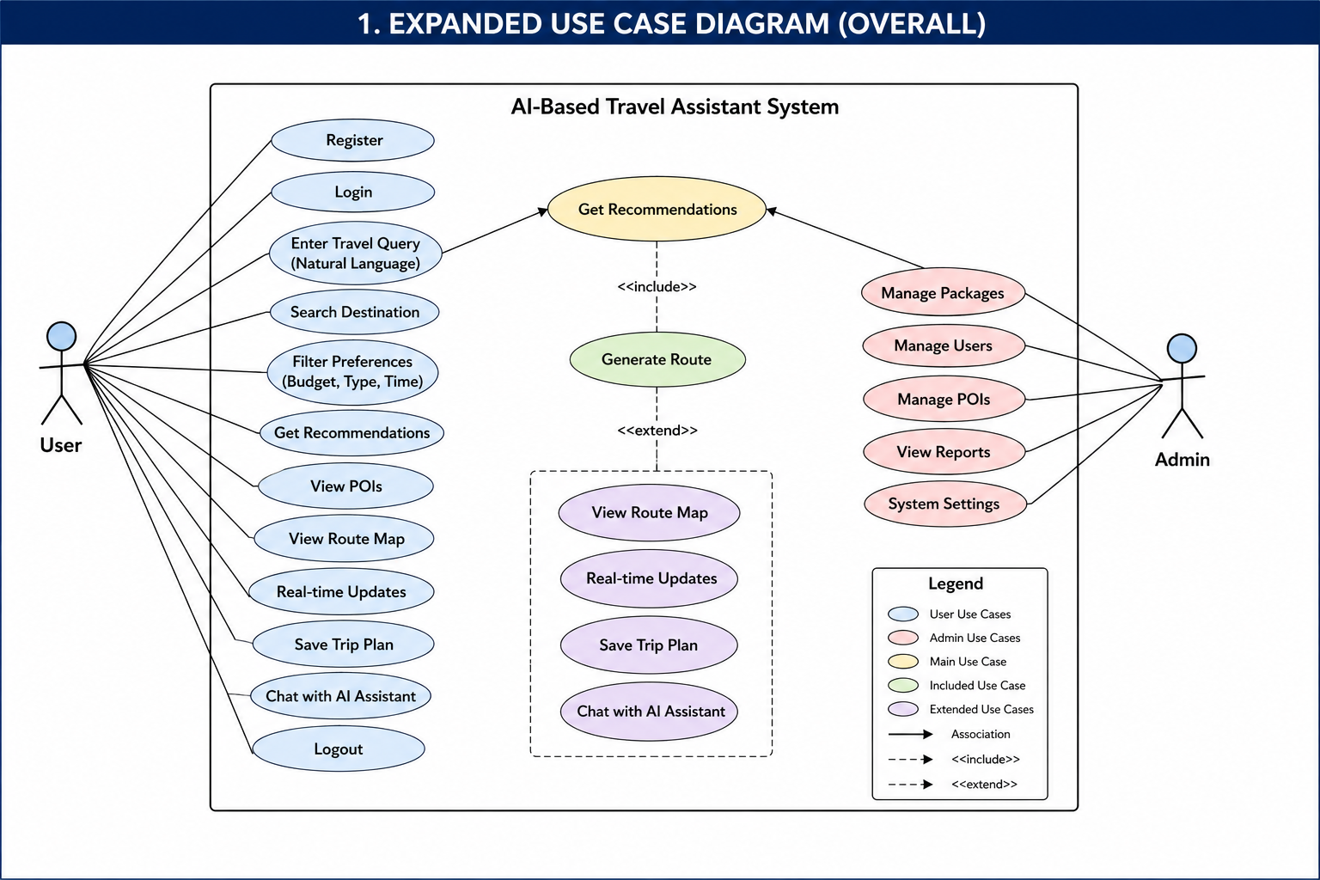

Slide 14
Sequence Diagram
Illustrates the step-by-step data flow between system components when a user submits a travel query.
User enters query → Flutter sends to NLP Module (Python)
NLP extracts keywords → forwards to Recommendation Engine
Recommendation Engine fetches POIs & user data from Supabase
Route Engine calls OpenRouteService for route + POI data
Combined results returned to Flutter → displayed to user

Slide 15
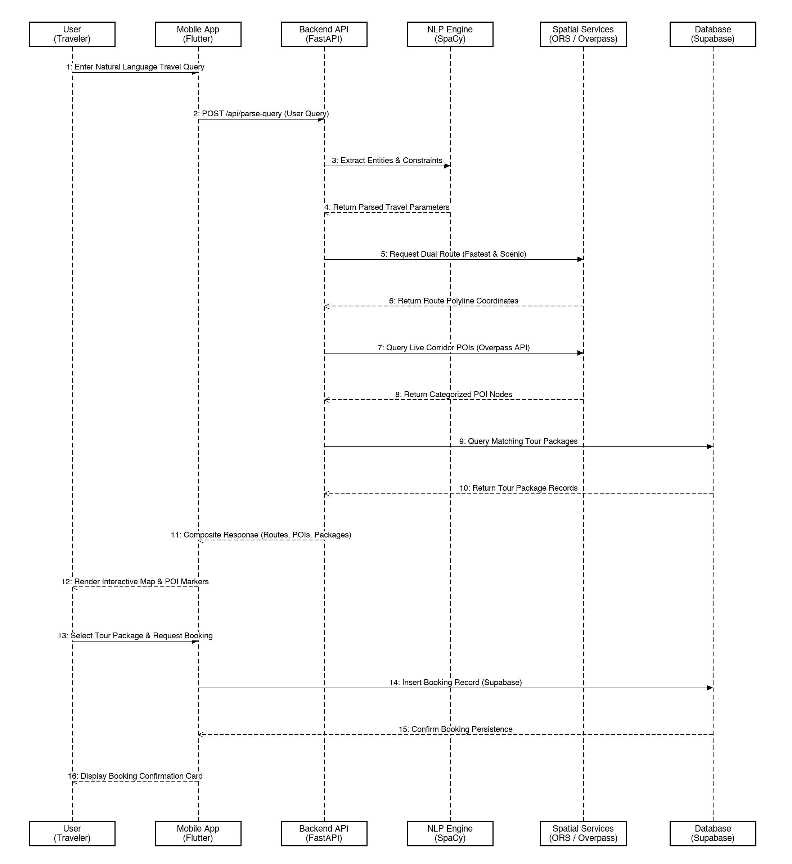
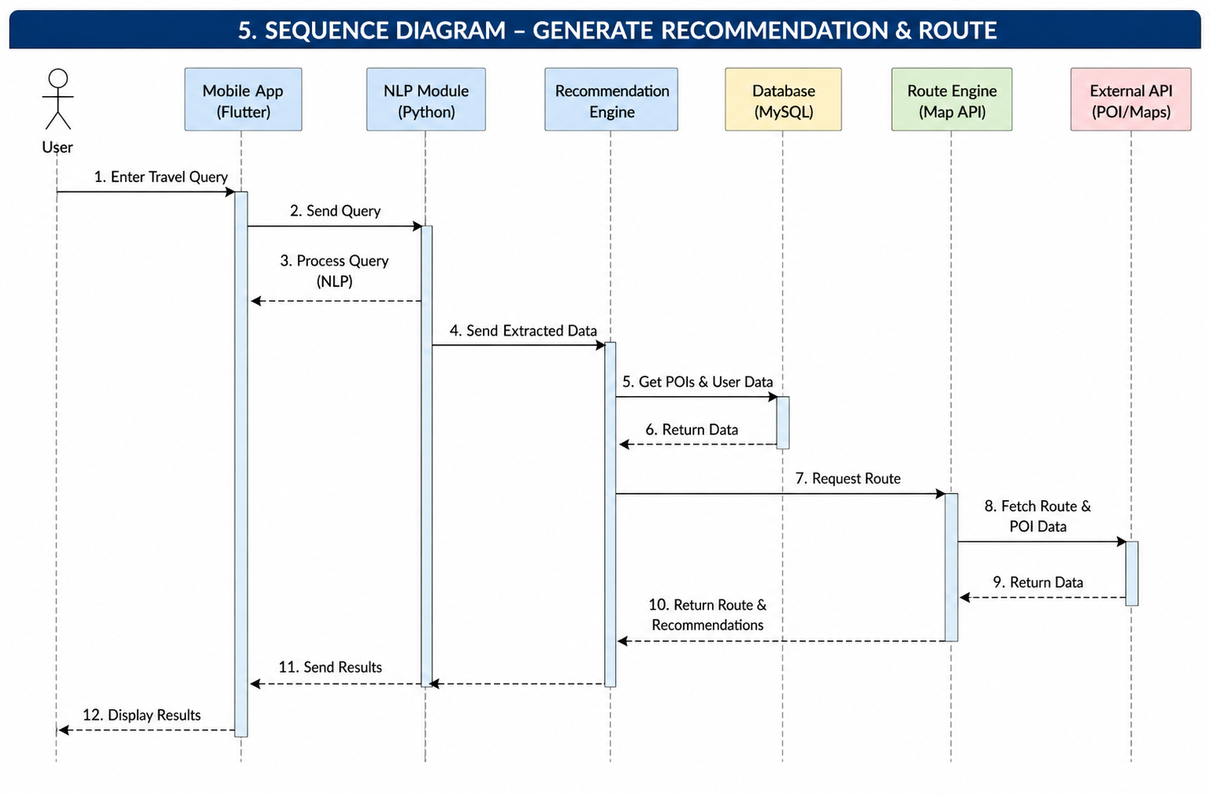

Slide 16
Activity Diagram
Maps the complete travel planning workflow from app launch to trip saving, including the iterative refinement loop.
Start → Login/Register → Enter Travel Query
Process Input (NLP) → Get Recommendations → Generate Route
Display Results → Decision: User Satisfied?
Yes → Save Trip Plan → End
No → Modify Query → loop back to NLP

Slide 17
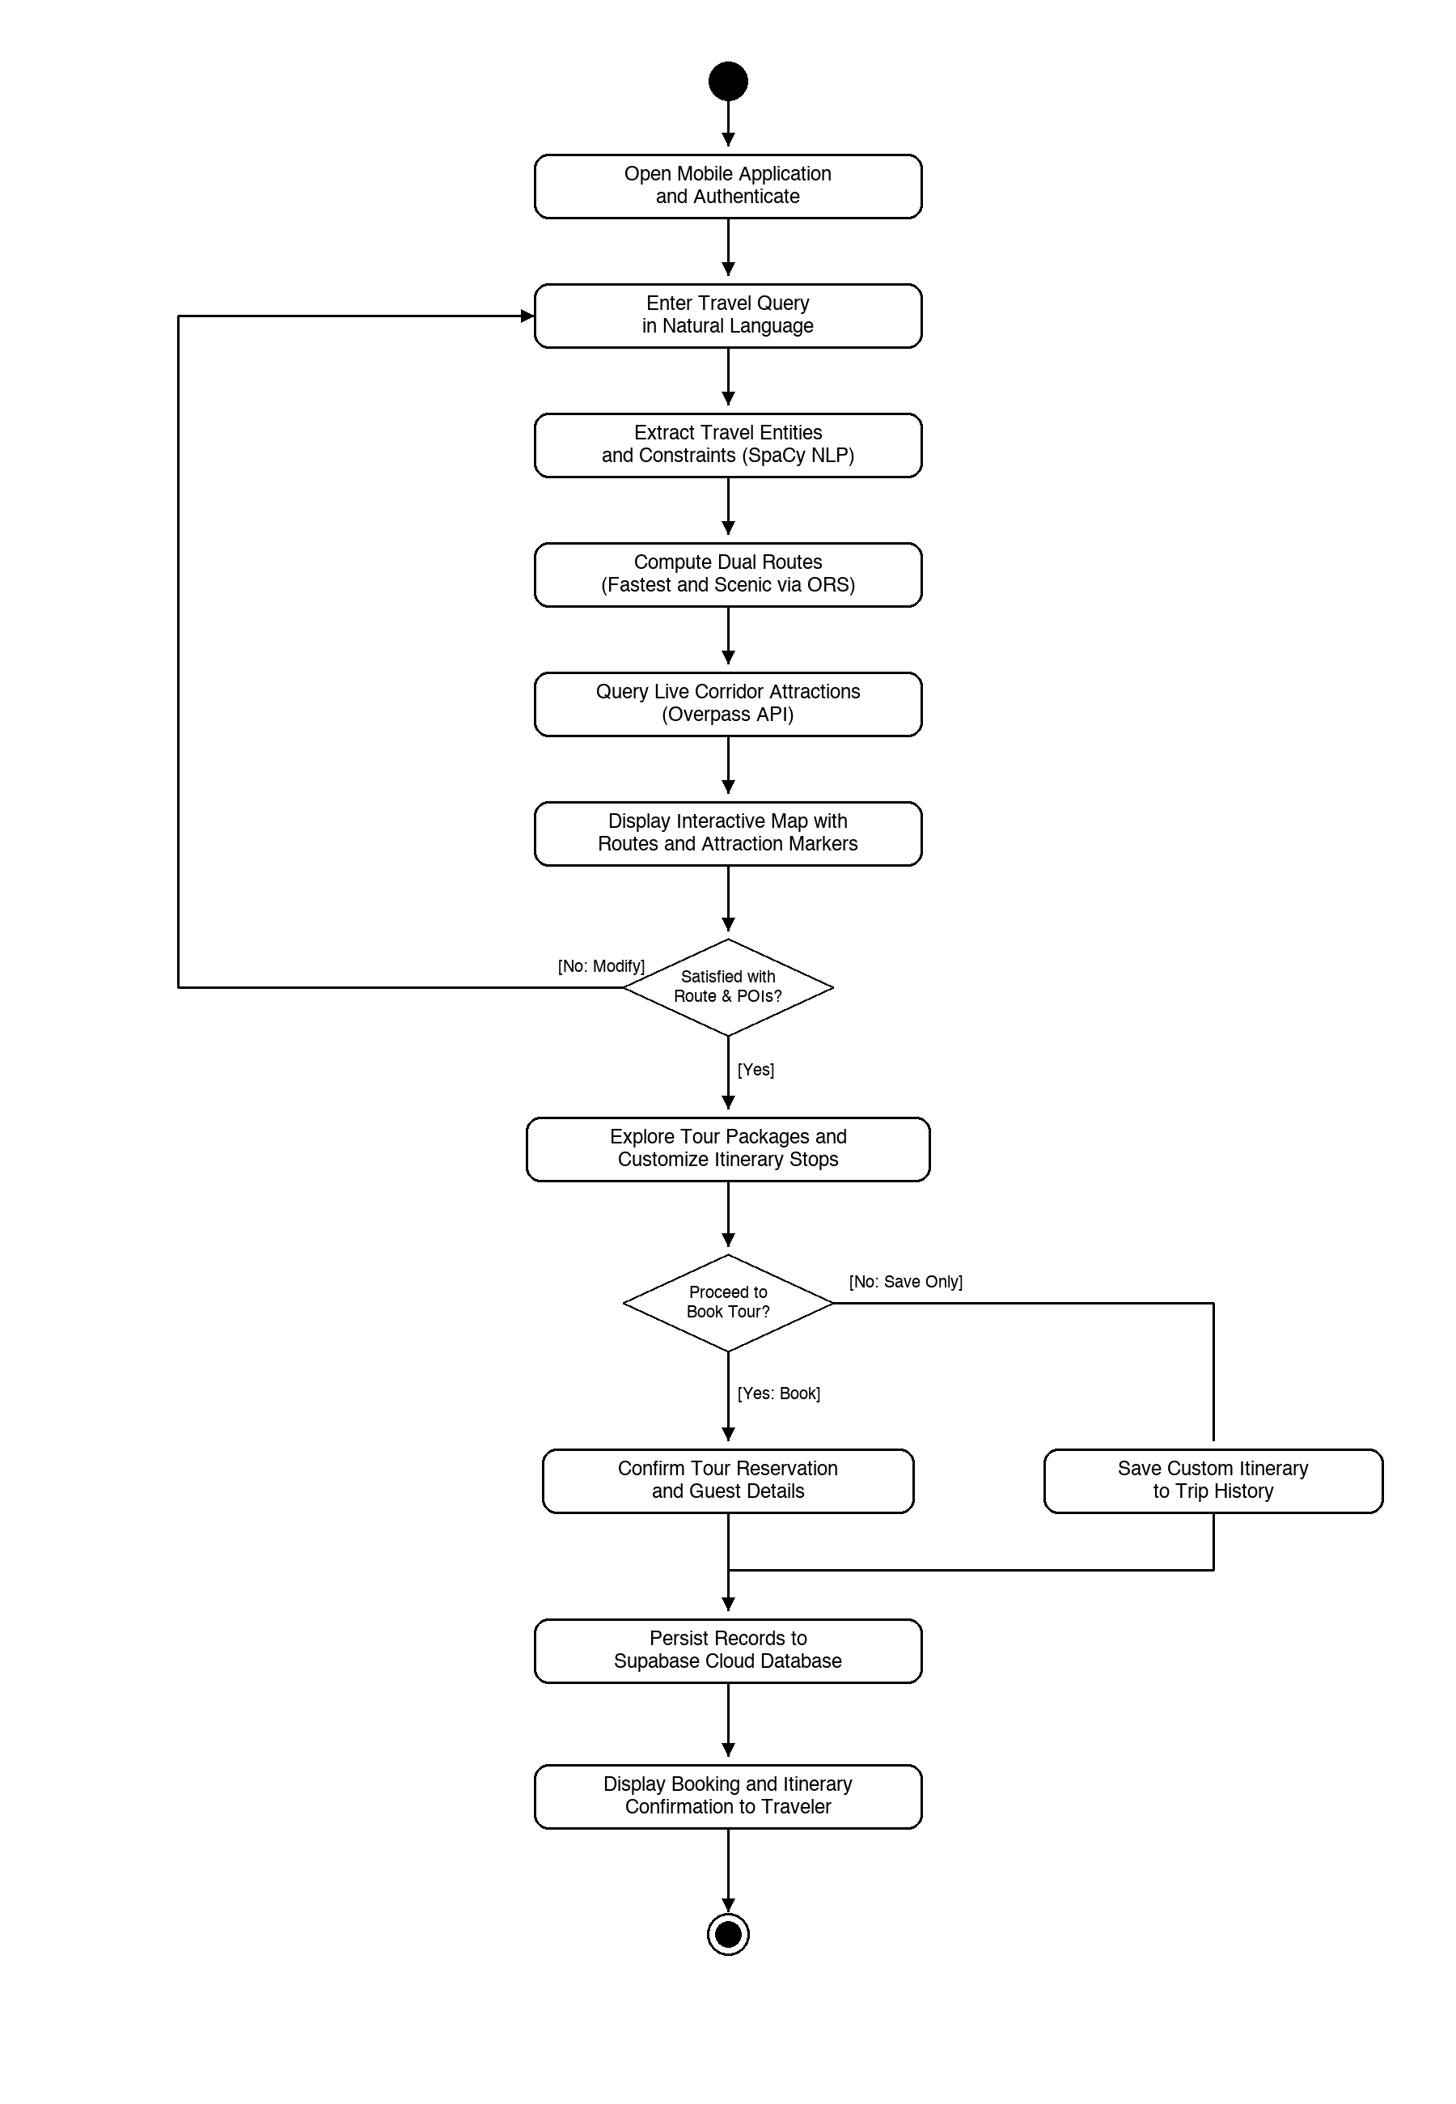
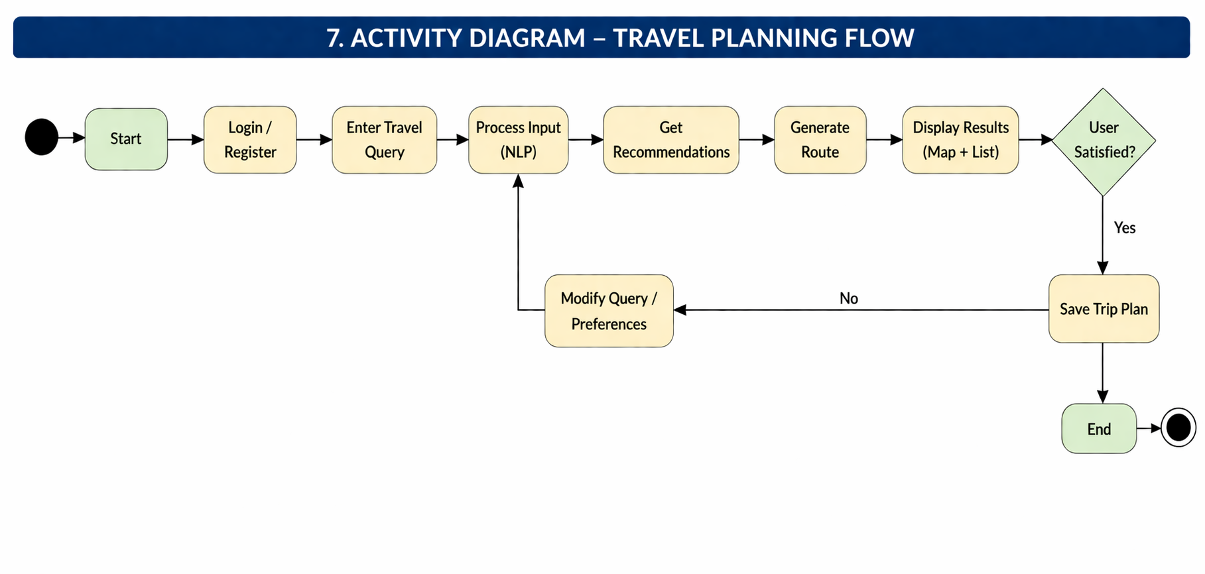

Slide 18
Entity-Relationship Diagram (ERD)
Models the relational database schema in Supabase PostgreSQL, enforcing primary/foreign keys and data integrity.
USERS: user_id (PK), email, password_hash, full_name, role
TOUR_PACKAGES & BOOKINGS: package_id, destination, price, booking_date, status
ITINERARIES & STOPS: itinerary_id, origin, destination, stop_order, planned_arrival
POINTS_OF_INTEREST: poi_id, name, category, latitude, longitude, image_url
Cardinalities: 1:N relations for Users to Bookings, Packages to Itineraries, and Itineraries to Stops

Slide 19
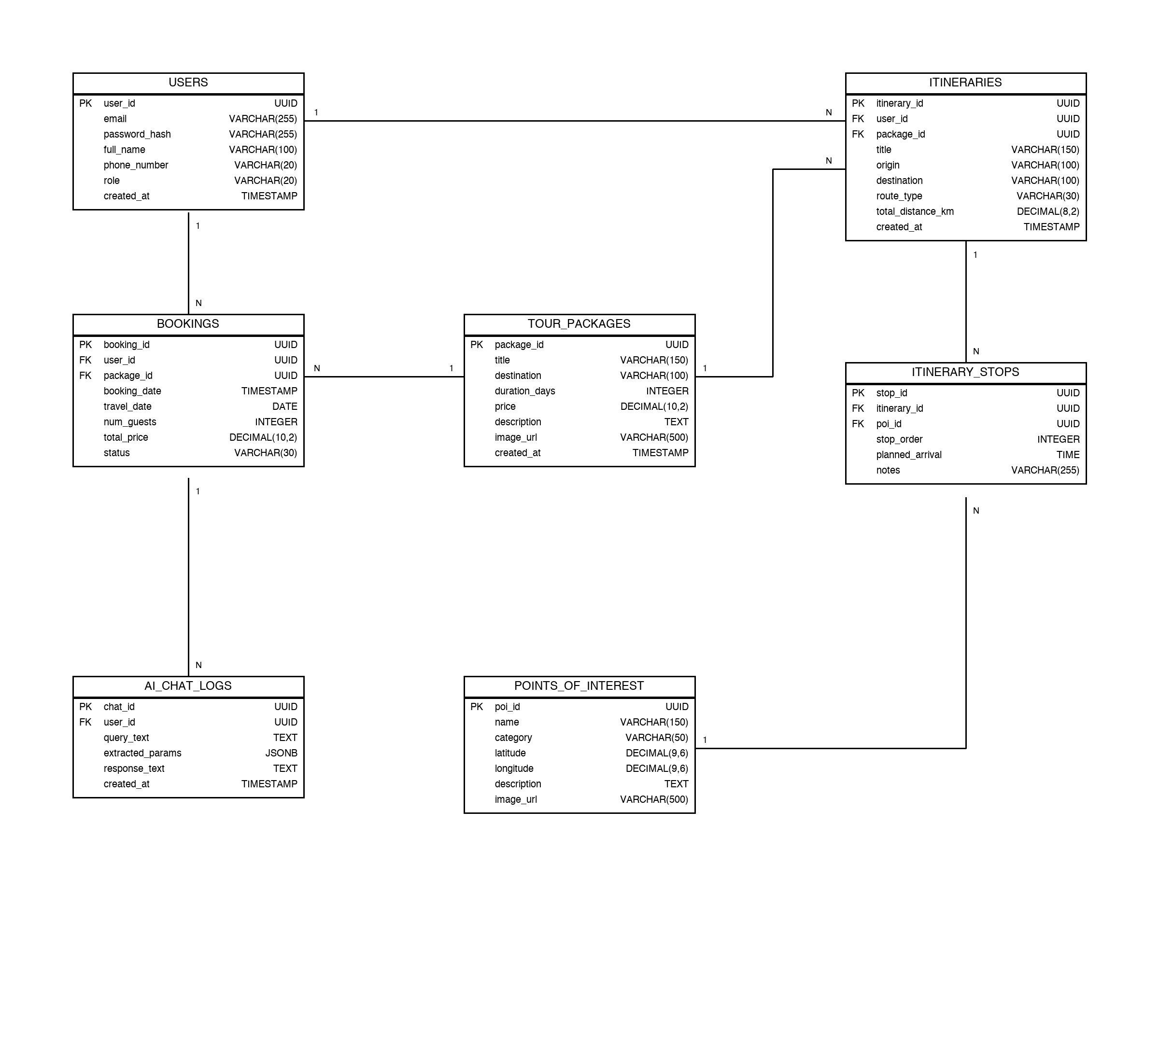
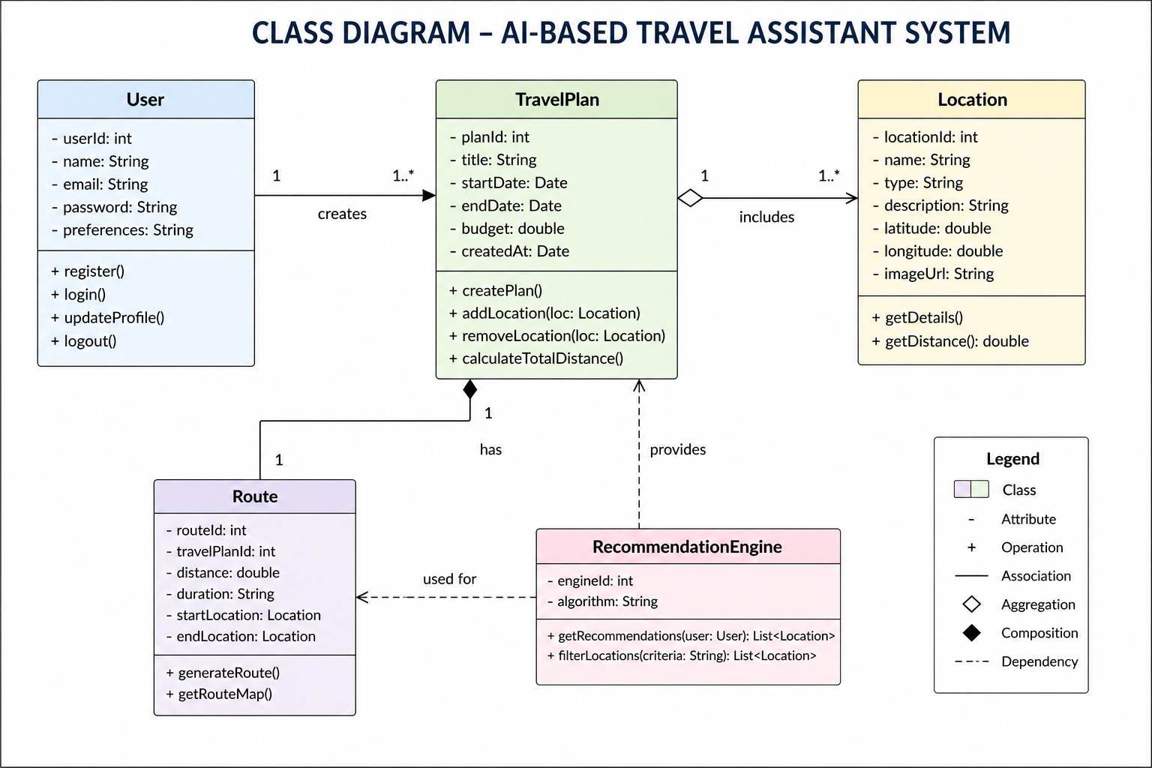

Slide 20
Component Architecture Diagram
Illustrates structural decomposition into modular subsystems, service contracts, and data persistence.
Presentation Layer (Flutter): UI Widgets, Provider State Management, Map Canvas Controller
Application Services (FastAPI): SpaCy NLP Pipeline, Dual Routing Engine, Corridor POI Evaluator
External & Persistence Layer: OpenRouteService API, Overpass API, and Supabase PostgreSQL DB

Slide 21
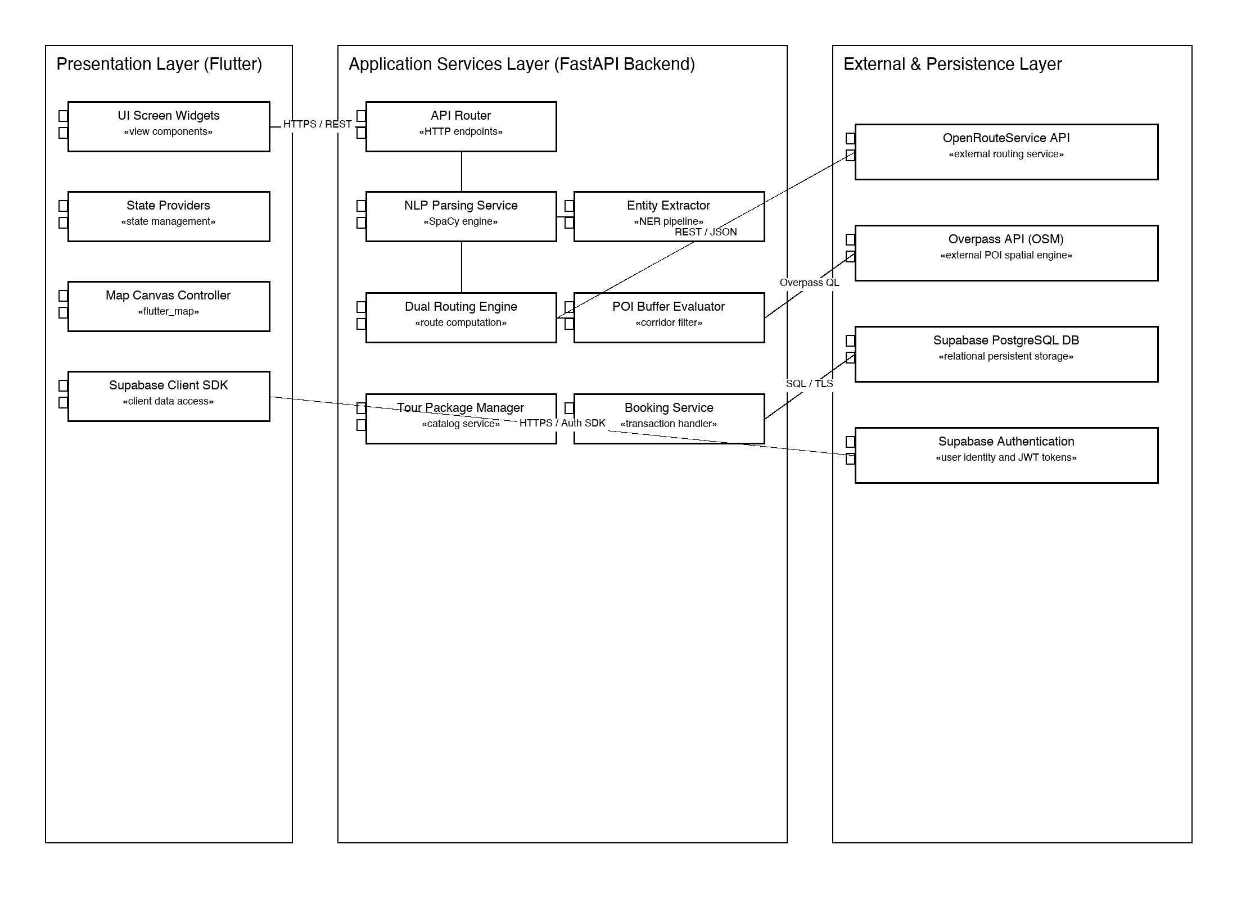
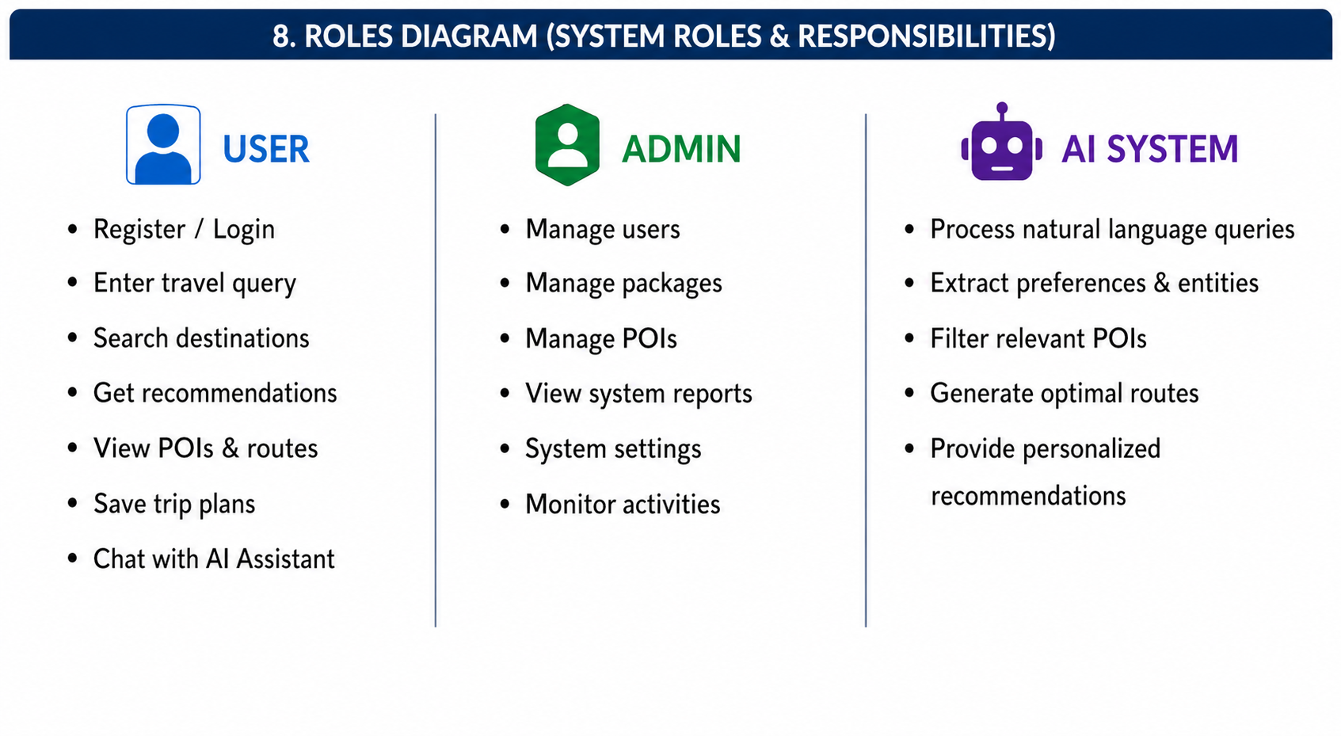

Slide 22
Functional Requirements
Four functional areas cover the complete scope of user and admin operations in the system.
Account: Register, login securely, update profile
Query Processing: Accept natural language input, extract keywords via NLP
Route & Recommendations: Generate optimized routes, display POIs with images and ratings
Interaction: Real-time updates, save/manage trips, AI chat assistant
Admin: Manage users, packages, POIs, and view system reports

Slide 23
Non-Functional Requirements
The system must meet quality standards across performance, security, and reliability.
Performance: Fast response for recommendations and route generation
Security: Data encrypted and securely stored in Supabase; unauthorized access prevented
Reliability: Consistent operation without crashes; API fallbacks implemented
Scalability: Supabase cloud infrastructure supports future expansion

Slide 24
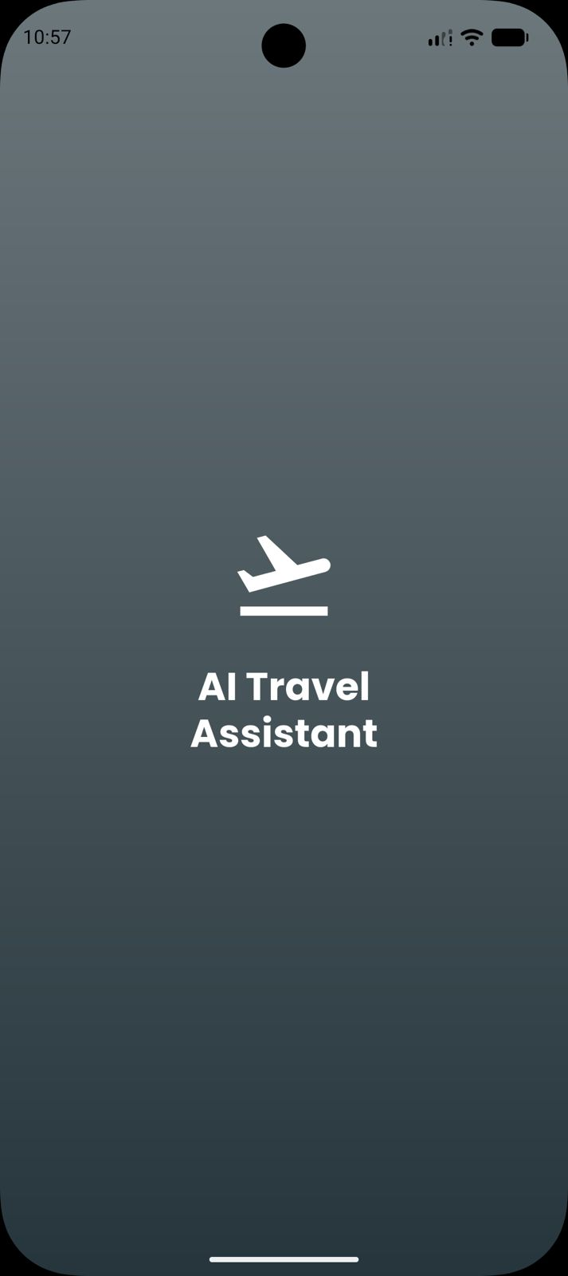
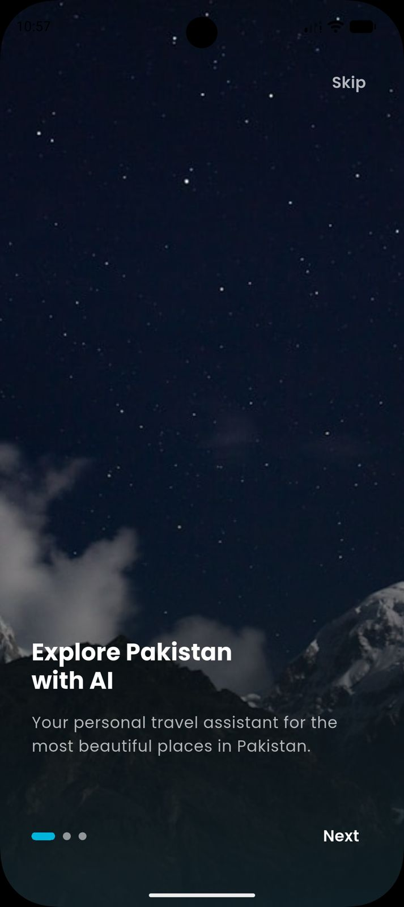
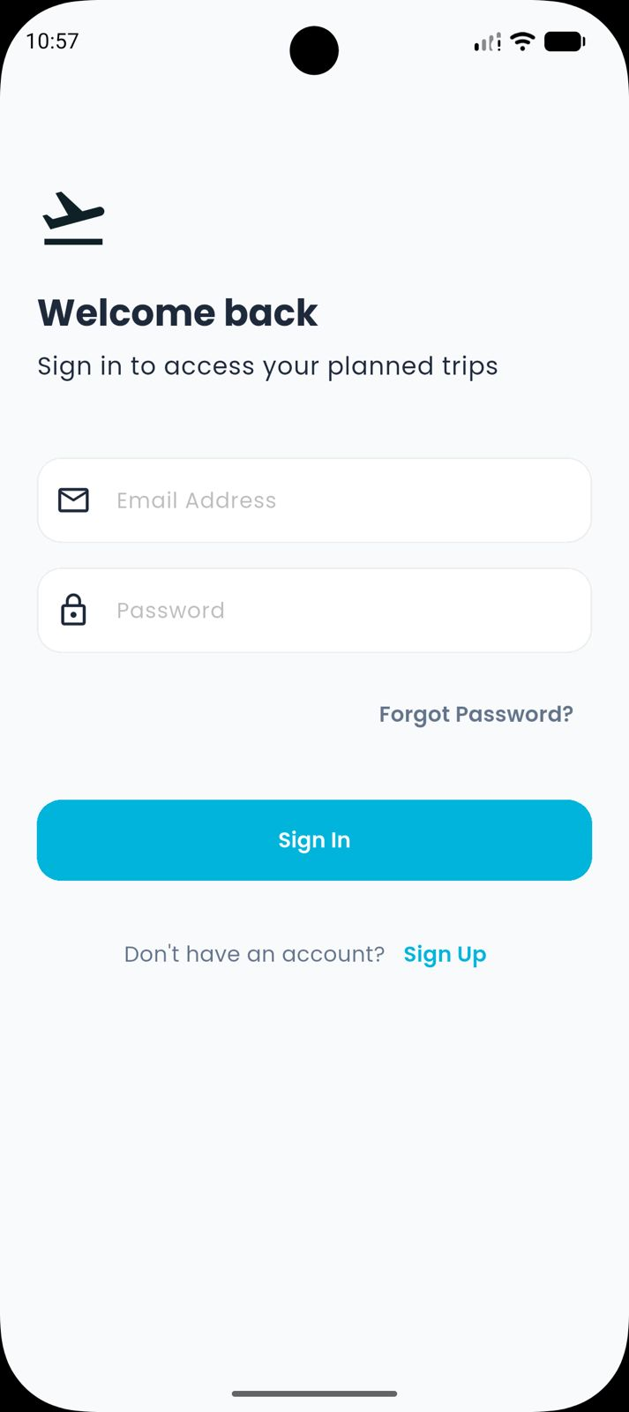
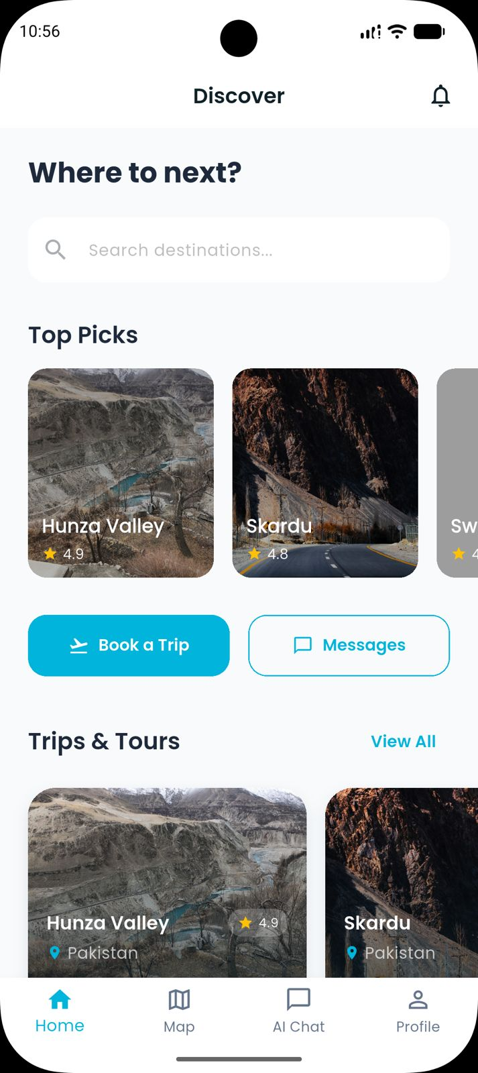
Splash screen
Onboarding screen 1
Login screen
Home Screen

Slide 25
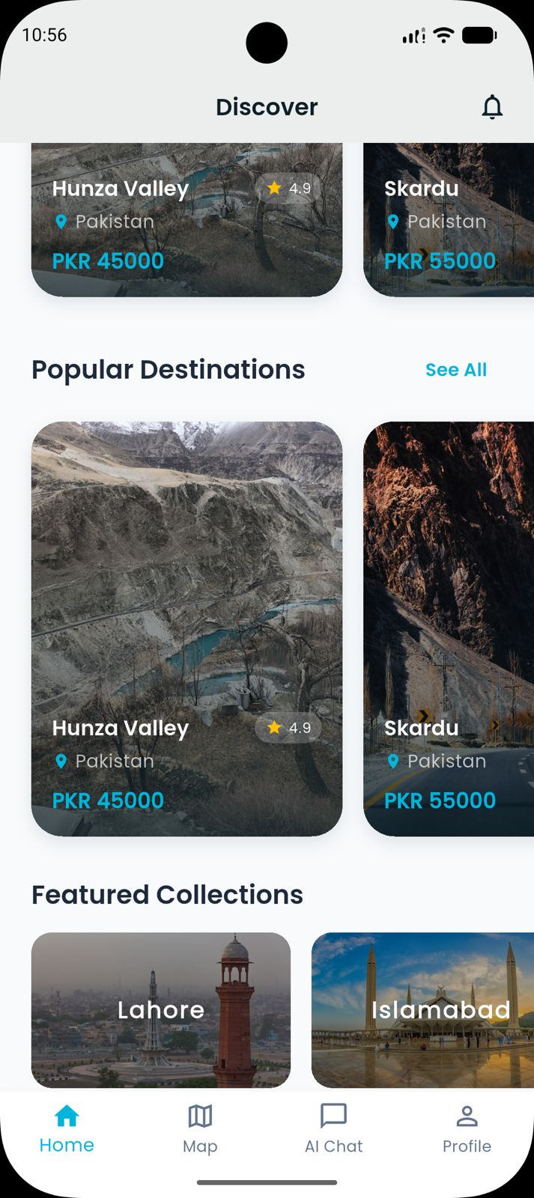
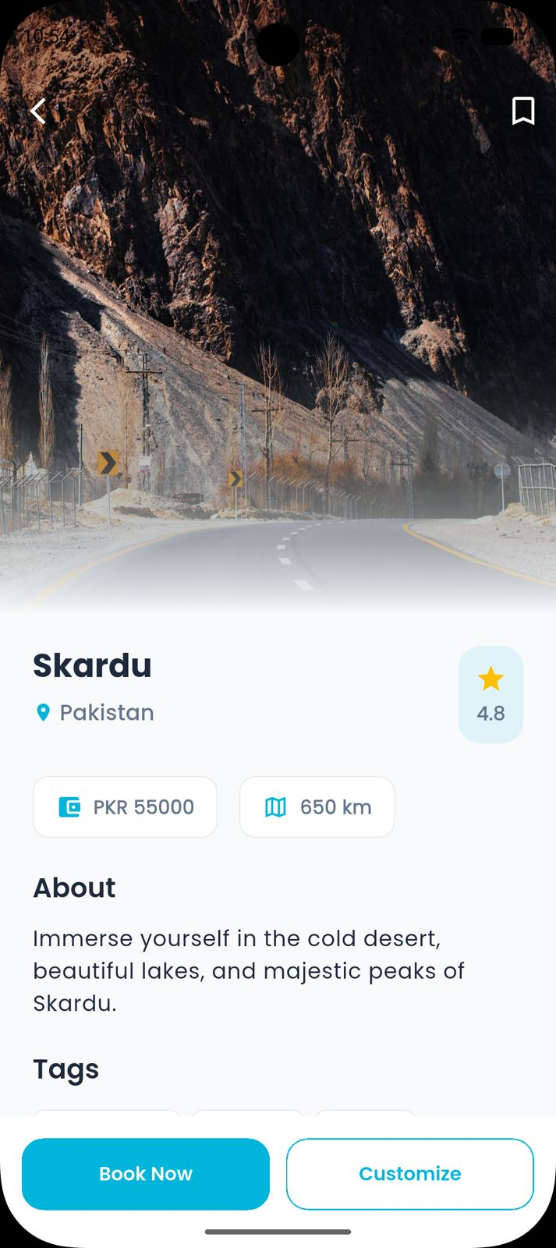
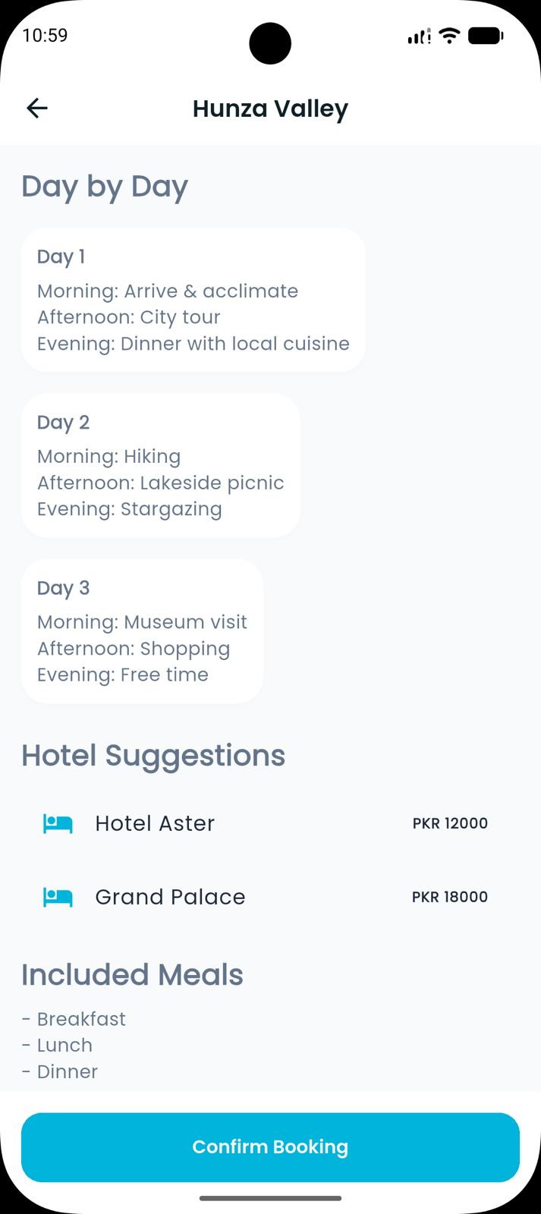
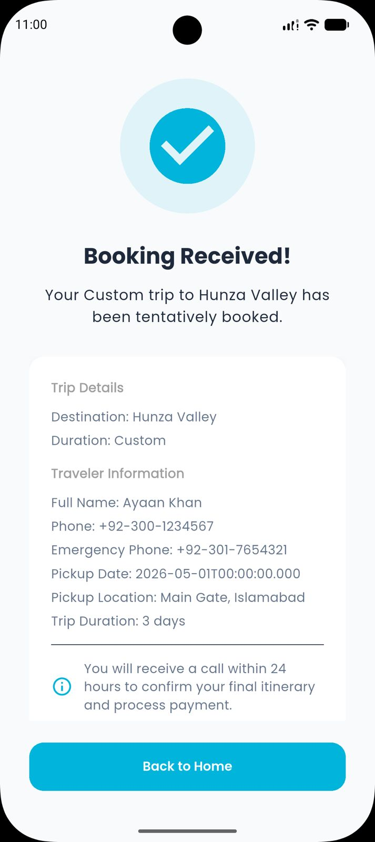
Home Screen
Booking screen
Booking Details
Booking Confirmation

Slide 26
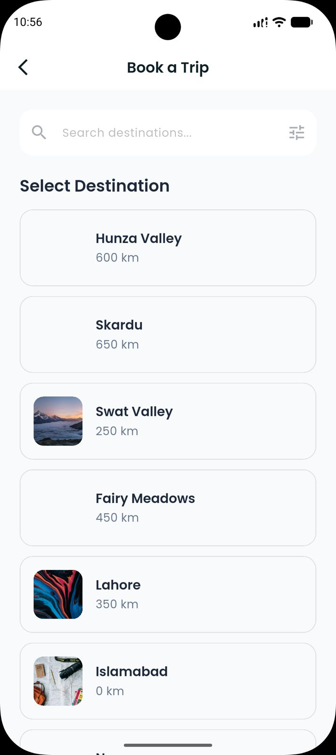
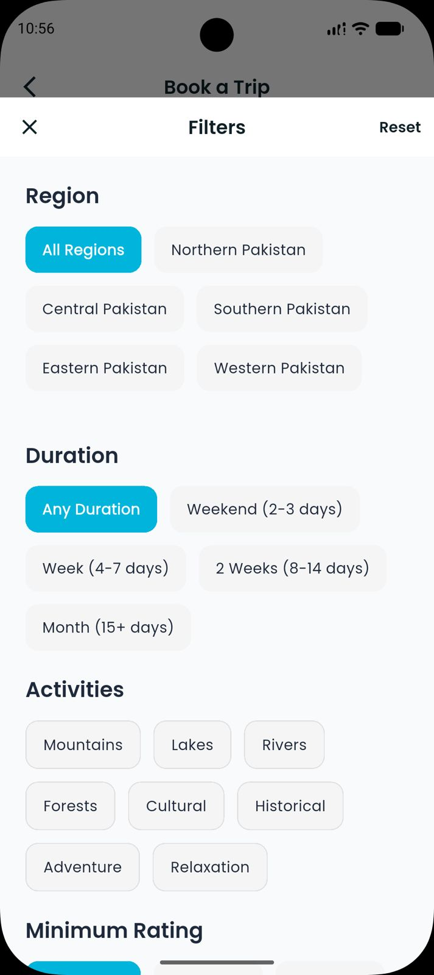
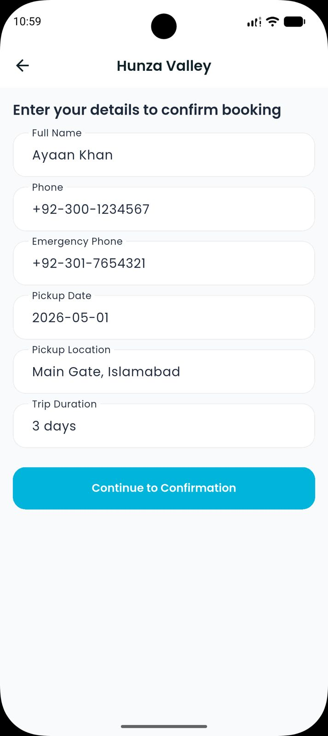
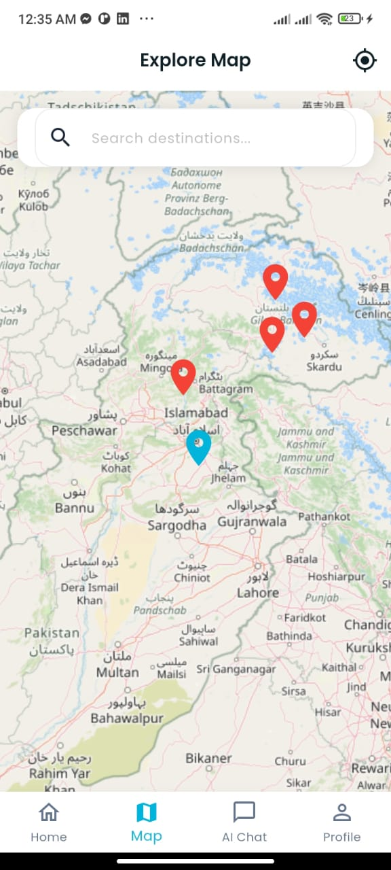
Book a trip
Booking filters
Details Confirmation
Maps screen

Slide 27
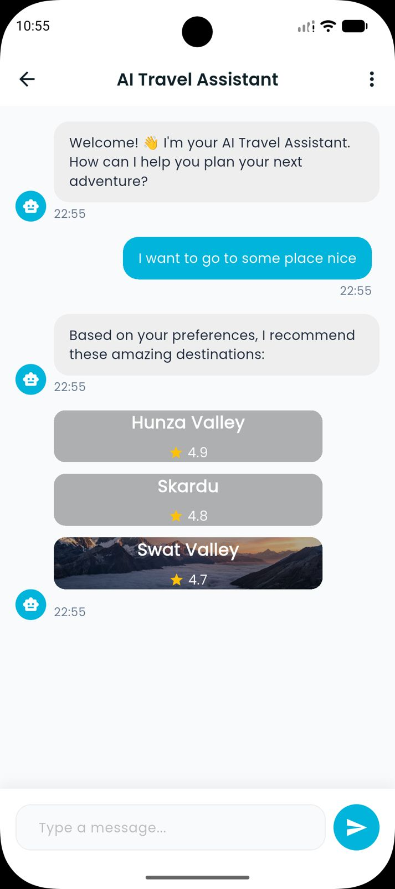
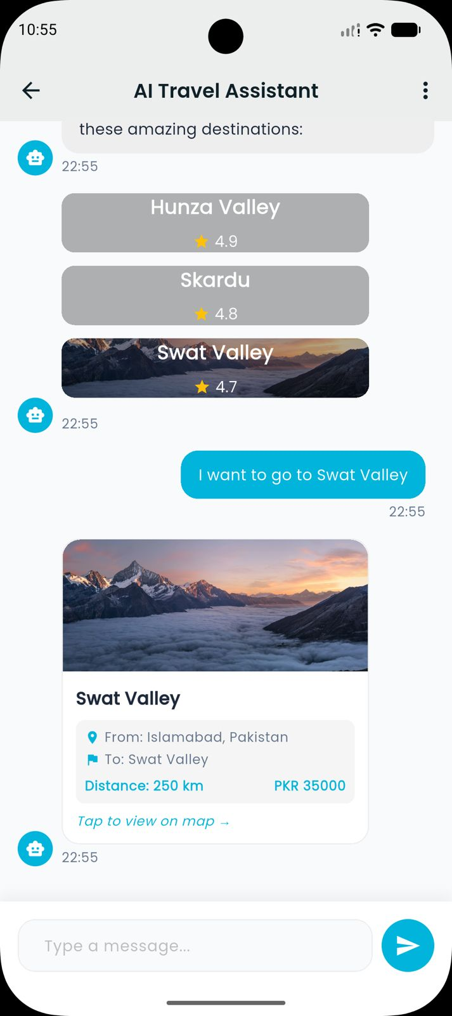
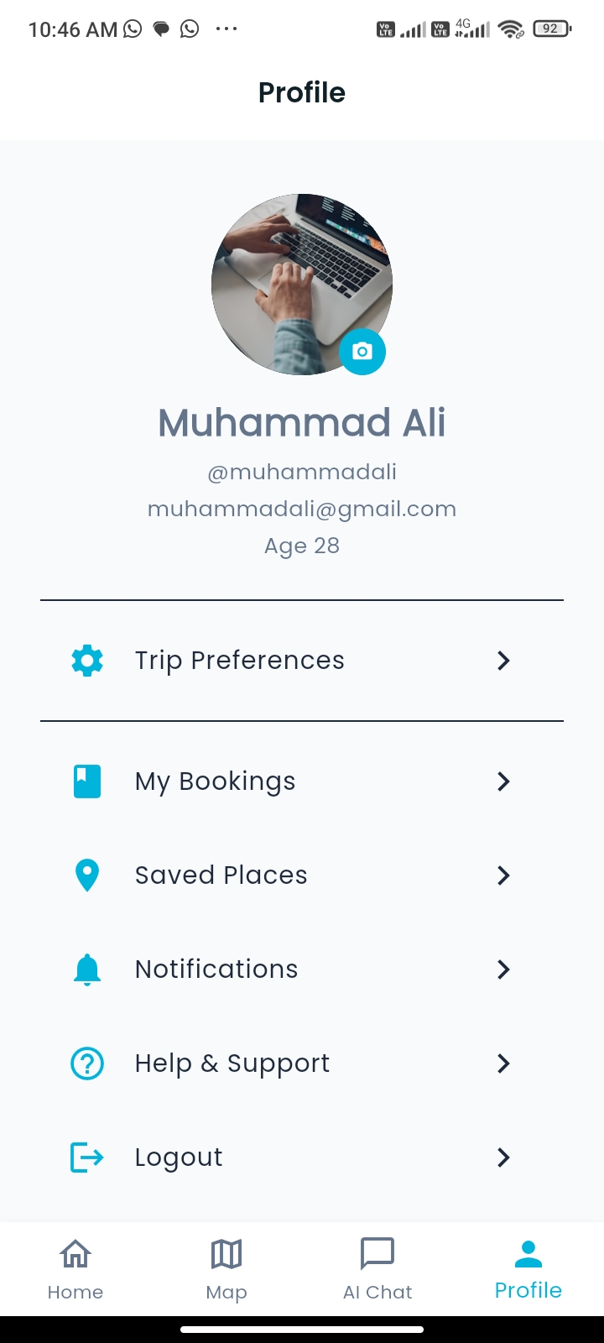
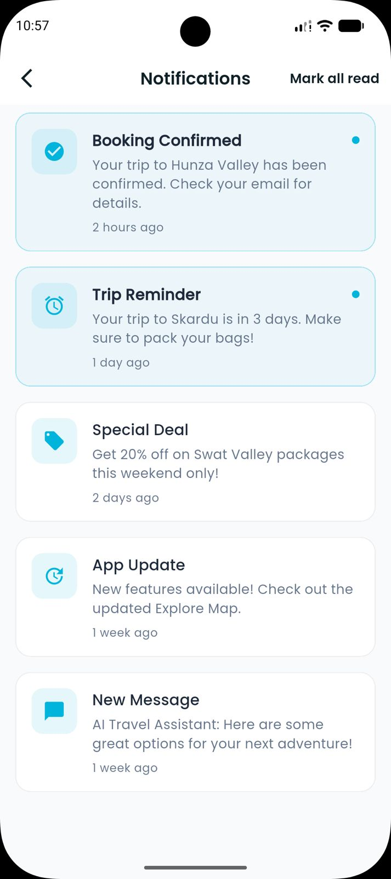
Chat screen
Chat screen
Profile screen
Notification screen

Slide 28
Key Features
Eight core features built across the full stack deliver a complete travel planning experience.
NLP-based natural language travel query processing
Dual route generation : fastest + tourist-friendly scenic route
Dynamic destination imagery via Unsplash API
POI filtering by type (parks, museums, landmarks, food, shopping)
Trip booking and full itinerary customization
AI Chat assistant built into the app
Cloud backend : Python + Supabase
Cross-platform : single Flutter codebase for Android & iOS
.

Slide 29
Significance
This project delivers real value for Pakistani travelers while demonstrating practical integration of AI, cloud, and mobile technologies.
Unifies navigation and tourism : no more app-switching
Promotes local tourism across Pakistan (Hunza, Skardu, Islamabad, Lahore, etc)
NLP makes trip planning accessible : plain English instead of dropdowns
Supabase ensures scalable, secure, production-ready infrastructure
Extensible for travel agencies, tourism boards, or commercial platforms
.

Slide 30
Challenges & Limitations
Several limitations in the current state are acknowledged and planned for resolution in the next phase.
Hardcoded dummy data : live Supabase population pending
NLP accuracy varies for complex or ambiguous queries
Requires stable internet : no offline mode yet
Full iOS deployment requires Apple Developer account
Destination coverage currently limited to major Pakistani cities
.

Slide 31
Expected Outcomes
Upon full completion, the system will serve as a functional, demonstrable, and extensible AI-powered travel assistant.
Fully functional cross-platform app (Android + iOS)
NLP-driven route and POI recommendations from live data
Live Supabase backend replacing hardcoded dummy data
Dynamic Unsplash imagery fully integrated
Practical demonstration of AI in the travel domain
Foundation for a commercial Pakistani tourism platform
.

Slide 32
Conclusions
The AI-Based Travel Assistant bridges the gap between navigation and tourism in a unified, intelligent mobile application built on Flutter, Python, Supabase, and Unsplash API.
Combines NLP, cloud database, REST APIs, and cross-platform mobile in one system
17 app screens fully designed and implemented in Flutter
All core architectural diagrams completed: Use Case, Sequence, Activity, ERD, and Component Architecture
Agile methodology ensured steady, testable progress across all modules
System ready for live data integration and production deployment

Slide 33
References
"Tourism Recommendation System: A Systematic Review," IJERT, 2021
"Artificial Intelligence in Tourism: A Systematic Literature Review," Sustainability (MDPI), 2025
"A Systematic Survey of Tourism Recommender System Techniques," Journal of IoT, 2022
"Machine Learning Predictive Model for Intelligent Tourism Recommendation," JART, 2025
"A Hybrid Tourism Recommendation System," AIJCST, 2026
"Artificial Intelligence Innovation of Tourism Businesses," IJIM, 2024
"Smart Tourism Recommendation Model," IJACSA, 2021
"Travel Agent: An AI Assistant for Personalized Travel Planning," arXiv, 2024
"Enhancing Tourism Recommender Systems Using RAG," arXiv, 2024
"Collaborative Filtering for Personalized Travel Recommendation," ACM Transactions, 2020

Slide 34
Thank You

