Slide 1

Unity Game Development Group members Muhammad Atif Supervised by Dr. Sara Shahzad Session 2020-21

Slide 2
Agenda
Project Introduction
Project scope
Project objectives
Main features
Technology stack used
Major use cases
Product workflow
Work distribution in team members
Work completed and presented as FYP-1
Work to be completed as FYP-2
Product demo (followed by the presentation)

Slide 3
Introduction
Operation-Bio Purge is a game to be developed using the Unity Game Engine.
The game is featuring a character who will eliminate all of the enemies to complete a level.
The game will be developed to implement different environments to make the game more engaging and appealing to the end-users.
The game will be able to run on Android and iOS.
The enemies will be some type of pests (mutated insects) that are to be eliminated by the player.

Slide 4
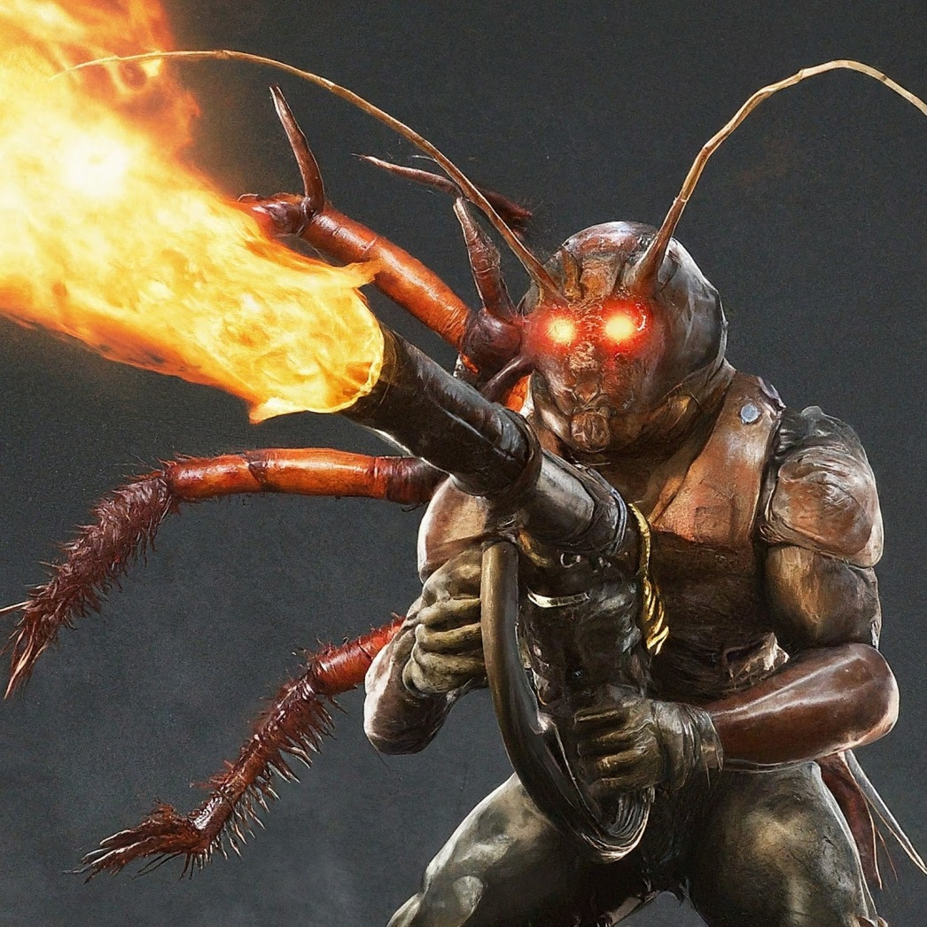

Slide 5
Project Scope
The core game-play systems of Operation-Bio Purge, including the inventory system, health system, damage system, generic team ID system, AI perception system, AI behavior tree system, shop system, UI management system, and level management system.
The game’s levels.
The game’s assets, including the game’s art, audio, and animations.
The game’s user interface.
Testing.

Slide 6
Project Objectives
Develop a game using a Unity Game Engine.
Familiarize myself with the how the actual development works.
Implement variety of game plays which includes an inventory system, health system, damage system etc.
Use the latest technologies including the Unity Game Engine and Microsoft Visual Studio as a platform for coding.
Test the game on different devices.

Slide 7
Main Features
Play as an Exterminator tasked with eliminating pests(insects, rodents).
Player will experience to interact with different types of enemies.
Variety of Weapons and Tools selections.
Player will be tasked with a clear objective at each level of the game.
Game state and Progression indication will provide a feedback to user.
Player will be able to customize their equipment's and character.

Slide 8
Technology stack
Unity as Core Engine: it’s a popular and versatile game engine well-suited for making 2D and 3D mobile games.
Programming Language (C#): C# is used for scripting game logic and object behavior with in the unity game engine.
VCS: probably consider git and github my primary options because of free and familiarity.
Graphics Designing Software: Options like Photoshop/Figma are options available for making UI, game textures etc.
Physics Engine: Unity built in physics engine will be used for calculating the projectile and motion of the objects.

Slide 9
Major Use cases
Play Game: This will initiate a new game session.
Move Character: This will control the movement of character.
Use Weapon: Allow to use different types of weapons.
Load Game: Allow to resume the game from previously saved state.
Game Over: If the health of a player becomes zero the game will stop.
Level Progression: Upon the successful completion of a specific level, the player will advance into a new level.
Shop system: A shop will allow players to purchase different equipment's to add more fun to the game.

Slide 10
Product Workflow
Pre-Production:
Game Design Documents: This document contains the game’s features, objectives story and level design.
Asset Gathering: All of the assets are made from scratch no assest were imported pre made.
Production:
Iterative Development: Develop the game feature incrementaly with testing.
Programming: Developing logic for the game, object interaction and user interface.
Testing: Every feature will be tested upon intergration.
VCS: Use Git and GitHub for code changes tracking and revert changes if needed.

Slide 11
Post Production:
Final Testing: During this phase of development every feature will be tested and verified.
Deployment: After complete verification and validation testing the game will be deployed to the actual environment.

Slide 12
Work Distribution
As a solo developer with no prior experience.
I plan for every feature before implementation.
Consult the unity documentation, and other resources before moving to implementation.
My work distribution is as follow;
Plan.
Learn and Document.
Design on how to implement the feature.
Actual implementation.

Slide 13
Work Completed as FYP-1
Installations and environment setup for game development.
Setting up unity remote with Android and iOS.
Collecting assets from built in Unity Library.
Basic Lighting set up.
Structure the Joystick and Touch events.
Implementation of joystick.
Movement of joystick with touch input.
Refactoring everything developed.
Documentation (partially completed).

Slide 14
Work to be completed as FYP-2
Movement directions
Player character animation.
Weapons and Inventory System
AI perception
AI Behavior Tree
Menu
.
.
.
Building the game.

Slide 15
Demo

