Slide 1
“AUTOMATED PATIENTS INFORMATION SYSTEM”
A CASE STUDY OF BEST CHOICE CLINIC KANO .
BEING A PROJECT DEFENCE
IN THE DEPARTMENT OF COMPUTER SCIENCES AND INFORMATION TECHNOLOGY .

Slide 2
Electronic Patient Information Systems have the potential to improve health by giving health professionals improved information about their patients. Prior to the problem encountered with patient’s attitude to their check up and treatment, the nurse’s laxity (laziness) over their duties, the need arose to develop a software that will be able to solve the problem. The problem caused by the use of manual method of keeping outpatient information can only be solved by computerizing the clinic outpatient information system. The clinic records information on piece of papers called prescription sheet and output it in a file jacket provided for each patient. This system is designed to overcome the problems encountered by Best choice clinic is storing patient information

Slide 3
STATEMENT OF THE PROBLEM
A study of the clinic patient information system reveals the following problems:
Lack of enough and proper storage facilities like file cabinets, visible shelf filing system.
The type of materials used for keeping records are easily damaged which results in the loss of information.
Time as well as energy wasted in an attempt to provide information which is needed in the generation of statistical report.

Slide 4
STATEMENT OF PROBLEM CONT.
The last drugs administered to a patient.
The last diagnosis made.
Retrieval of a patient file who has misplaced his/her hand card (small card) and cannot recall his/her registration number.
Contents in a file are misplaced as a result of laziness and carelessness of the people working in the storage section.
The security and privacy of medical record is not guaranteed.

Slide 5
AIM OF THE STUDY
This project is aimed at developing a customized, computerized patient information system designed to monitor and control the tracking of out patient record in the health Centre.

Slide 6
OBJCTIVES OF THE STUDY
The overall objectives of the project is to provide a computerized program that:
Stores data relating to patient in the hospital
Provides a means of easy access of record generated from the processing of the mass data collected concerning an entity or patients in the clinic.
To Provide menu-driven and user friendly software programs for the purpose of maintaining records in the clinic.

Slide 7
OBJECTIVES OF THE STUDY CONTD
To Generate reports and data that can be used for analysis.
To Reduce staff stress levels.
To Computerize the present convention method of keeping patients record in the clinic.

Slide 8
SCOPE AND LIMITATION OF STUDY
The project will provide a system that will enable health personnel effectively manage patient related information In the clinic. It will also maintain the integrity of the information being processed by using password to limit access to only authorized users .
Some of the project limitations are:
It is not suitable for large organization .
Only Single admin panel is made.
Patient Biometric Authentication is not enabled

Slide 9
LITERATURE REVIEW
S/N | NAME OF AUTHOR | YEAR | CONTRIBUTION
1 | Lawrence and Dyer | 2018 | Hospitals can also be regarded as organizations based on high technology and information intensive processes. According to such organizations are not hierarchically structured bureaucracies but are often based on democratic control mechanisms with Institutionalized stakeholder influence in decision processes.
2 | Smith and Gert vander Pijl | 2017 | The use of IT in diagnostic and treatment processes will all to the development of networks of clinical, hospital and health care processes .

Slide 10
LITERATURE REVIEW CONTD
3 | Ndira, Rosenberger, and wetter | 2013 | Implementation of a hospital information system could not happen without an analysis of the feelings and perceptions of individuals who make use of it (, 2008)
4 | Ananth Met al, | 2018 | Computers may make it possible for physicians and health scientist to conduct research that will extend the frontier of medical knowledge, without computers some promising area of research could not be explored.

Slide 11
LITERATURE REVIEW CONTD
5 | Stain ruce | 2013 | Computers can help to improve the quality of a physician’s diagnosis. However, with all these, computerization has found its place in the maintenance of medical records.
6 | Eric W., et al, | 2005 | An Electronic patient information management system is essentially a computer system that can manage all the information to allow health care providers to do their job effectively.

Slide 12
METHODOLOGY
In this project, the method of data collection adopted is the interview. The interview method of data collection was used because the accuracy in using this method of is high because there are no assumed figures or data. The information gotten is trusted to be genuine.
For this project waterfall model was adopted as the Software design or software development life cycle (SDLC)
The Software and Hardware tools used in developing the System are:
Software Tools:
XAMPP/WAMP Servers
Browsers
Hardware Tools:
Computer System
Keyboard

Slide 13
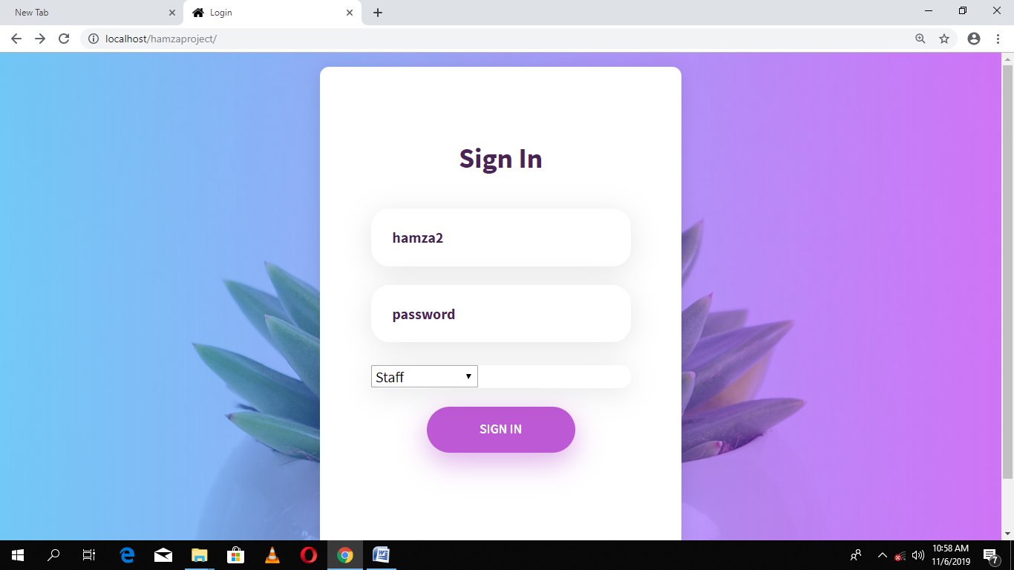
RESULT
Notes:
Fig:

Slide 14
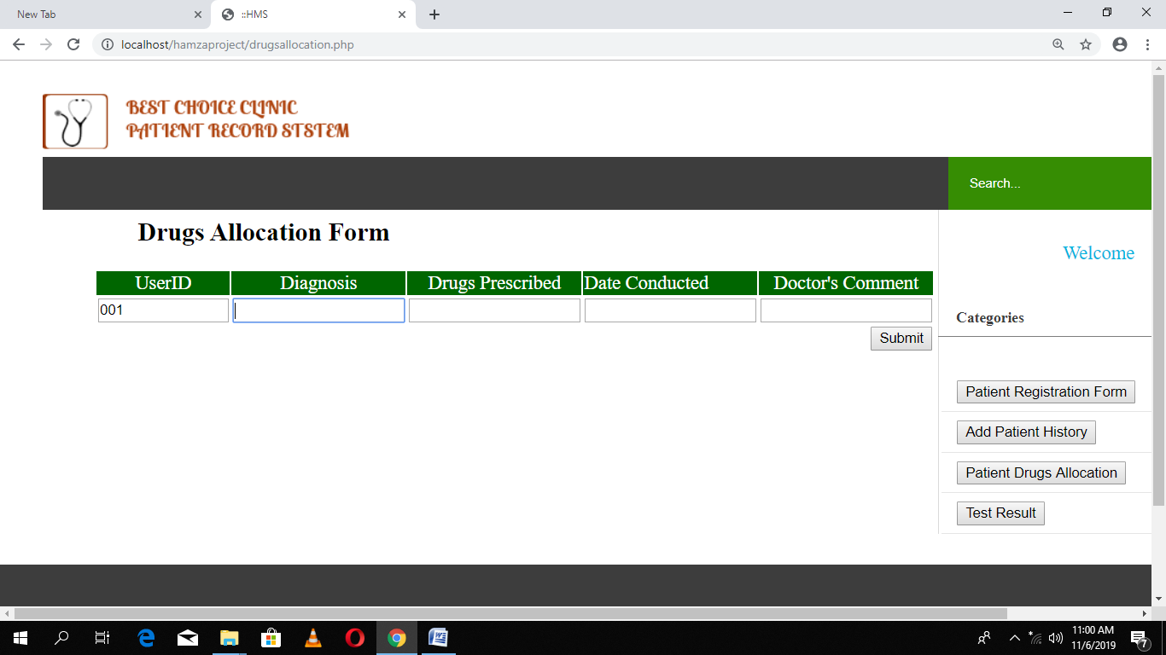
RESULT
Notes:
FIG;DRUG ALLOCATION FORM

Slide 15
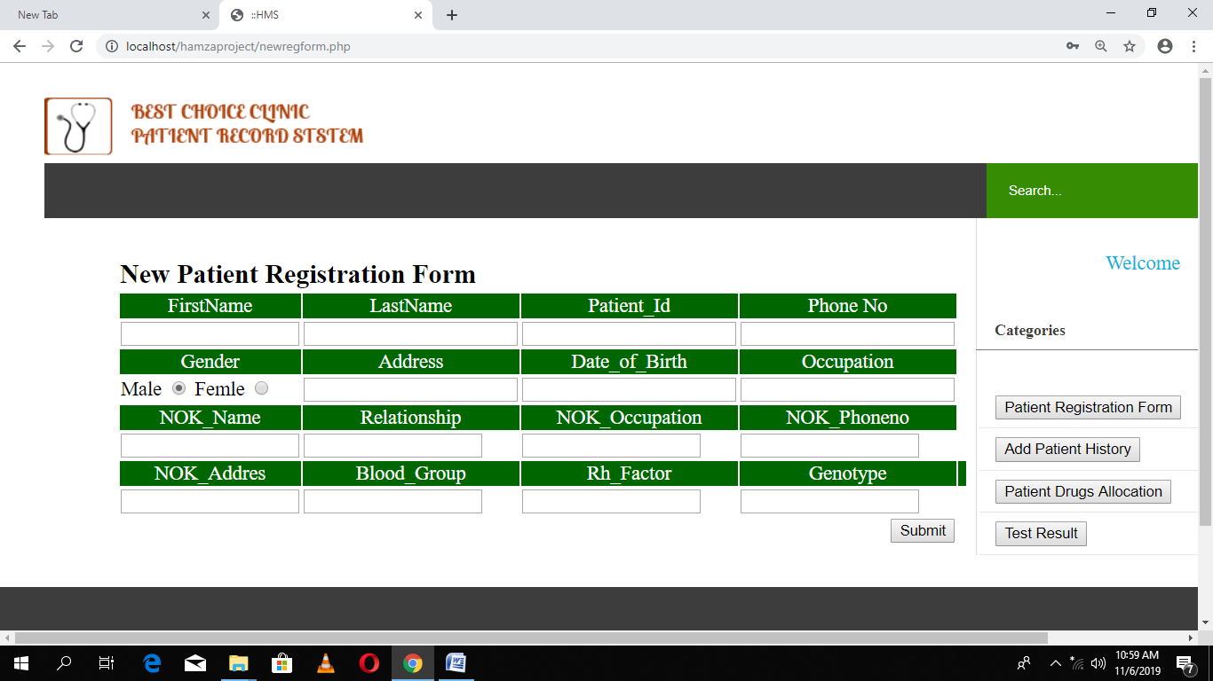
Notes:
FIG;NEW PATIENT REGISTRATION FORM

Slide 16
CONCLUSION
To conclude, Patient Management System is a simple Web based application basically suitable for a small clinic . It has every basic function which are used in the clinic. The application allows registration of a new patient , insertion, deleting, and updating of patient record as per the requirement. This application also provides a simple report on registered patients , diagnoses and drug allocation. The user friendliness of the system implies easy usage with little or no help from experts.

Slide 17
RECOMMENDATION
This project presents the Automated record management system for Best Choice Clinics, Kano. However there is ample room for improvement. Therefore, for those interested in building further on this work, it is recommended that further researchers should work on areas such as more user groups should be created with specified functions. The user should be able to send a complain to the admin through the system , Admin should be able to monitor and control the entire activities of other users. Biometric authentication should be embedded in the system also, the system should be able to generate detailed report as per requirement criteria.

Slide 18
REFERENCES
Luke.W.; L Thompson,(2009):PHP and MYSQL Web Development.
Mc Fadden, F.R. (1994), Modern Database Management. 5th ed; Addisson-Wesley Educational Publishers,inc U.K.
Ndira SP, Rosenberger KD, Wetter T. (2008) Assessment of data quality of and staff Satisfaction with an electronic health record system in a developing country (Uganda): a qualitative and quantitative comparative study:

