Slide 1

Predict : superstore (profit)

Slide 2
INTRODUCTION
Problem statement
Dataset Overview
Data Exploration and Visualization
Data Preprocessing
Building the Model
Evaluating the Results
Summary of Performance

Slide 3
Problem Statement
The goal is to predict the profit of a retail business based on key factors such as sales, discounts, and quantity sold. helping businesses make better decisions to maximize earnings.

Slide 4
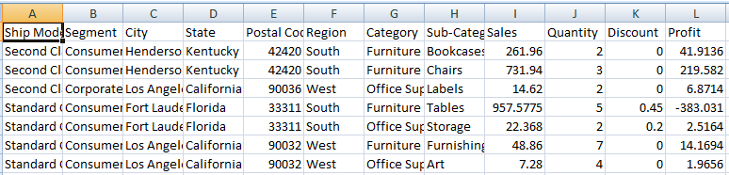
Dataset Overview
Dataset Description:
Includes features such as sales, profit, discounts, and quantity sold
Dataset Size:
9,977 rows
12 columns
Example Data:

Slide 5
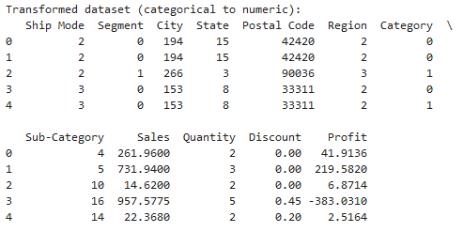
Data Preprocessing
Encoding Categorical Data
Convert categorical variables (e.g., Segment, Category, Region) into numeric format using techniques like Label Encoding .

Slide 6
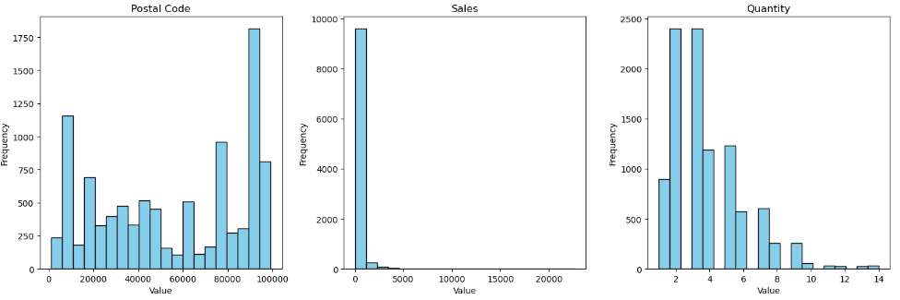
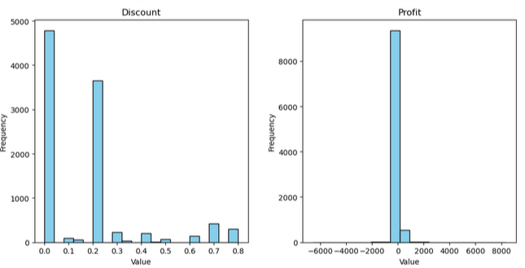
Data Exploration and Visualization
Notes:
1. Postal Code (Top Left)
This chart shows the number of transactions for each postal code.
What it tells us: Some postal codes have more transactions, meaning the business is more active in those areas.
Why it’s important: Knowing this can help us target locations with high sales activity.
2)sales (Top Middle)
This chart shows how much money is made in sales for each transaction.
What it tells us: Most transactions have low sales values, but there are a few with very high sales.
Why it’s important: This shows that the business gets most of its income from many small sales rather than a few big ones.
3. Quantity (Top Right)
This chart shows the number of items sold in each transaction.
What it tells us: Most transactions involve small quantities, usually between 2 and 4 items.
Why it’s important: This means customers generally buy in small amounts, and bulk purchases are rare.
4. Discount (Bottom Left)
This chart shows the discounts offered to customers.
What it tells us: The most common discount is 20%, and higher discounts are less frequent.
Why it’s important: Offering discounts affects profit, so it’s helpful to see how often and how much discounts are given.
5. Profit (Bottom Right)
This chart shows how much profit the business makes for each transaction.
What it tells us: Most transactions have low profit, but there are some with very high profits. There are also a few with negative profit (loss).
Why it’s important: It highlights areas where the business is losing money, likely because of large discounts or low sales.
Summary of the Slide
Most sales involve small amounts and low quantities.
Discounts are mostly around 20%, but higher discounts are rare.
The business has some transactions with negative profit, which may need further investigation

Slide 7
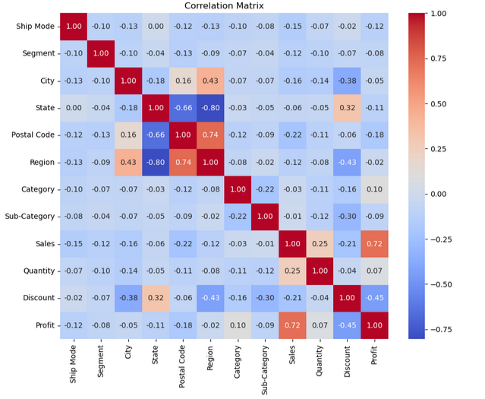
continue
Notes:
How to Present
Show the heatmap or a table of correlation values.
Explain each relationship with simple language:
"Here, we can see that sales and profit are closely related because higher sales bring more profit."
"Discounts have a negative correlation with profit, meaning giving too many discounts can reduce earnings."

Slide 8
Building the Model:
Model Selection:
We chose multiple regression models, including Linear Regression, Random Forest Regressor, KNeighbors Regressor, Decision TreeRegressor and Gradient Boosting Regressor, to compare their performance in predicting Profit.
Data Split:
The dataset was split into 80% training and 20% testing using the train_test_split() function.
feature_name = ['Sales', 'Discount', 'Quantity']
target = 'Profit'
Notes:
1. Linear Regression
What it is:
Linear Regression is one of the simplest models. It tries to find a straight-line relationship between the input variables (like sales and discounts) and the target variable (profit).
When to use it:
When the relationship between variables is linear or straightforward.
Strengths:
Fast and easy to understand.
Weaknesses:
Doesn’t work well with complex patterns or non-linear data.
2. Random Forest
What it is:
Random Forest is a collection of decision trees. It splits the data into smaller groups and makes predictions by averaging the results from multiple trees.
When to use it:
When the data has complex relationships and patterns.
Strengths:
Handles noisy data well and works for both linear and non-linear data.
Weaknesses:
Slower than simpler models like Linear Regression, especially with large datasets.
3. Gradient Boosting
What it is:
Gradient Boosting is an advanced model that builds predictions step by step, improving accuracy with each step. It focuses on correcting errors from earlier predictions.
When to use it:
When you need highly accurate predictions and can handle more complex data processing.
Strengths:
Very accurate and works well with both small and large datasets.
Weaknesses:
Requires more tuning and computing power compared to simpler models.
4. K-Nearest Neighbors (KNN)
What it is:
KNN predicts the target variable (profit) by looking at the closest "neighbors" in the dataset. It assumes similar data points will have similar outcomes.
When to use it:
When the dataset is small, and relationships between variables are not linear.
Strengths:
Easy to understand and works well with non-linear data.
Weaknesses:
Slow with large datasets and sensitive to noisy data.
Why Use All Models?
Each model has its own strengths and weaknesses. By testing multiple models, we can compare their performance and choose the one that works best for predicting profit. In this case, Gradient Boosting gave the most accurate results.

Slide 9
Evaluating the Results
Model | MSE | RMSE
Linear Regression | 30300.1 | 27.35
Random Forest Regressor | 7074.6 | 83.03
Gradient Boosting Regressor | 959.1 | 97.93
Notes:
1. Linear Regression
What it is:
Linear Regression is one of the simplest models. It tries to find a straight-line relationship between the input variables (like sales and discounts) and the target variable (profit).
When to use it:
When the relationship between variables is linear or straightforward.
Strengths:
Fast and easy to understand.
Weaknesses:
Doesn’t work well with complex patterns or non-linear data.
2. Random Forest
What it is:
Random Forest is a collection of decision trees. It splits the data into smaller groups and makes predictions by averaging the results from multiple trees.
When to use it:
When the data has complex relationships and patterns.
Strengths:
Handles noisy data well and works for both linear and non-linear data.
Weaknesses:
Slower than simpler models like Linear Regression, especially with large datasets.
3. Gradient Boosting
What it is:
Gradient Boosting is an advanced model that builds predictions step by step, improving accuracy with each step. It focuses on correcting errors from earlier predictions.
When to use it:
When you need highly accurate predictions and can handle more complex data processing.
Strengths:
Very accurate and works well with both small and large datasets.
Weaknesses:
Requires more tuning and computing power compared to simpler models.
4. K-Nearest Neighbors (KNN)
What it is:
KNN predicts the target variable (profit) by looking at the closest "neighbors" in the dataset. It assumes similar data points will have similar outcomes.
When to use it:
When the dataset is small, and relationships between variables are not linear.
Strengths:
Easy to understand and works well with non-linear data.
Weaknesses:
Slow with large datasets and sensitive to noisy data.
Why Use All Models?
Each model has its own strengths and weaknesses. By testing multiple models, we can compare their performance and choose the one that works best for predicting profit. In this case, Gradient Boosting gave the most accurate results.

Slide 10
Summary of Performance:
Best Model:
Gradient Boosting Regressor showed the best performance, with the lowest MSE.
Good Models:
Random Forest also gave good results, but they didn’t perform as well as Gradient Boosting.

Slide 11
Thanks

