Slide 1
Google Ads Performance Report
November 2024 Analysis
November 2024 — $33.4M Ad Spend, 110K+ Conversions

Slide 2
CAMPAIGN OVERVIEW
DATA ANALYST
• Analysis Period: 1-30 November 2024
• Total Budget: $33.4 Million
• Campaign Scale: 2.3 Million Clicks | 110K+ Conversions
✓ Identified high-performing ads with CPA as low as $690
✓ Uncovered optimization opportunities for 40%+ of budget
✓ Discovered significant CPA variance between best/worst performers
4

Slide 3
OVERALL CAMPAIGN PERFORMANCE
DATA ANALYST
CPA is relatively high, indicating need for optimization
📊 Total Cost: $33,456,586
🎯 Total Conversions: 110,940
💰 Average CPA: $690.47
👆 Total Clicks: 2,379,250
4

Slide 4
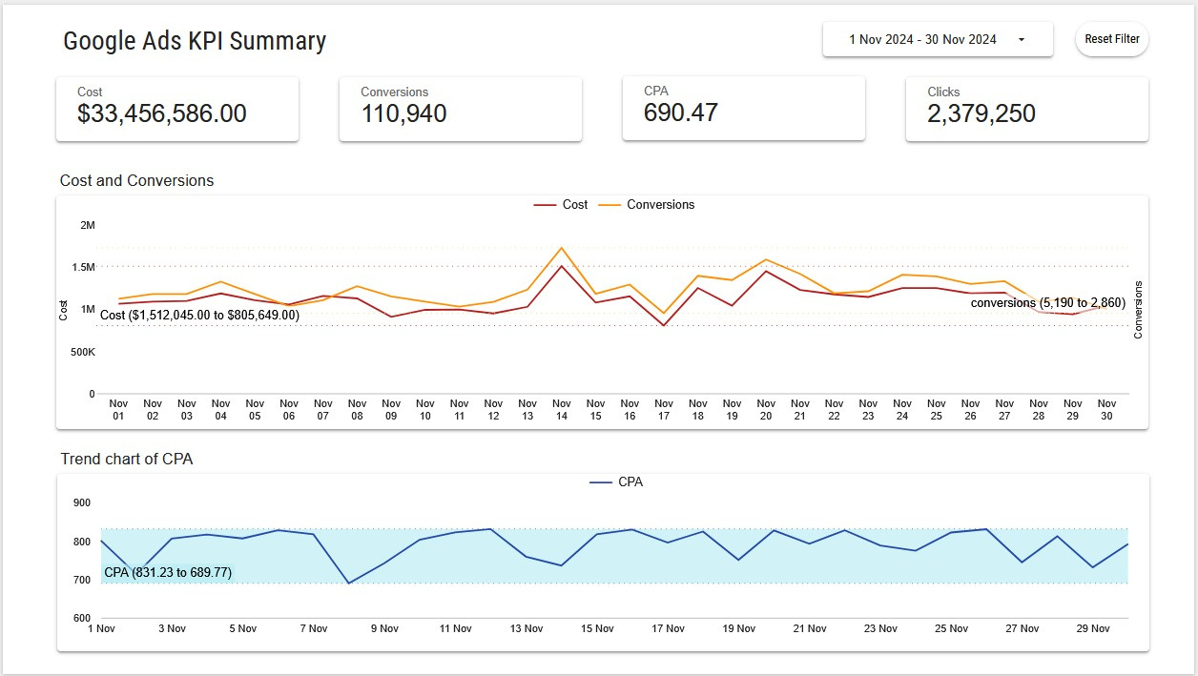
DAILY PERFORMANCE TREND
DATA ANALYST
KEY INSIGHTS:
• Cost fluctuates between $805K–$1.5M daily.
• Conversions range from 2,860 to 5,190.
• Peak efficiency: Nov 14 (high conversions, moderate cost).
7

Slide 5
CPA OPTIMIZATION OPPORTUNITIE
DATA ANALYST
CRITICAL FINDINGS:
• CPA consistently above $700 on weekends.
• Lowest CPA: Nov 8 ($689) → optimal day for ad spend.
7

Slide 6
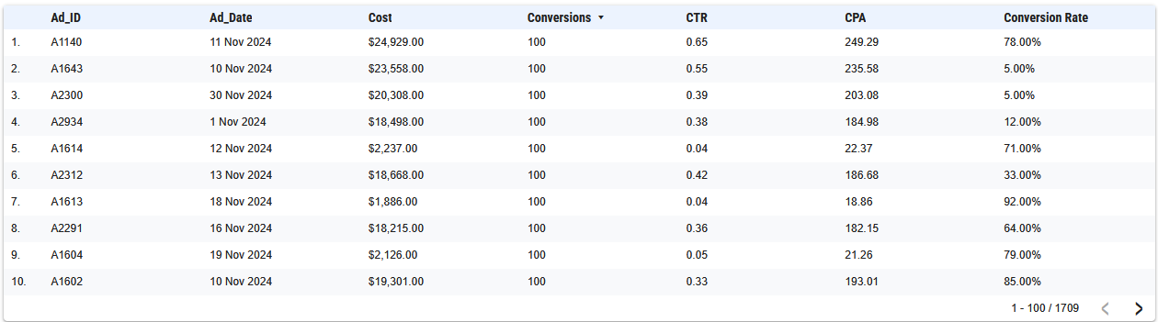
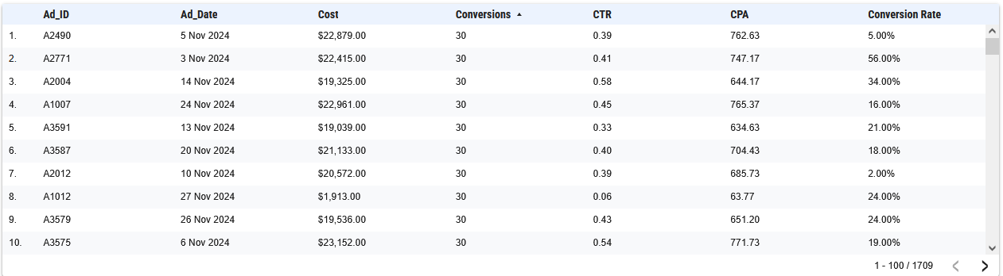
Ad-Level Performance
DATA ANALYST
•TOP PERFORMERS (High Conversion):
Conversions = 100 (this is the highest conversion number that appears repeatedly in the data)
CPA < $25 (significantly below the average campaign CPA of $690)
•UNDERPERFORMERS (High CPA):
Conversions = 30 (lowest number of conversions that consistently appear)
CPA > $700 (significantly above the average campaign CPA of $690)
7

Slide 7
The
End
M. Rafif R.
Data Analyst

