Slide 1
AJOU Food Order System (AFOS)
Order food online: from menu to doorstep
IT Project Management | Prof. S. S. Kim
AJOU Team (I24D): Sobirov Muhammadullo (Leader), Begjanov Artur, Ahmadjonov Shohruz

Slide 2
The Problem and Our Solution
Project Plan
The problem
Our solution: AFOS
Ordering by phone is slow and error-prone
Customers cannot see a live menu or track their order
Restaurants lose orders and time on calls
Couriers get unclear delivery instructions
One system for customers, restaurants, couriers and admin
Browse menu, order and pay online or by cash
Real-time order status tracking
Clear pickup and delivery tasks for couriers
AJOU Team | IT Project Management | 2

Slide 3
Project Plan
Goal, scope, users
Goal
Scope
Target users
Plan and model a complete food order and delivery system, ready to be built.
In: requirements, use cases, process model, database design, WBS, schedule
Out: full coding, hosting, real payment integration
Customers
Restaurant staff
Couriers
Administrators
AJOU Team | IT Project Management | 3

Slide 4
Key Features
What AFOS does
Register / Login
Menu and Search
Cart and Checkout
Accounts for customers, restaurants and couriers
Browse restaurants, filter and search dishes
Place orders with address and payment choice
Payment
Order Tracking
Admin and Reports
Online payment or cash on delivery
Status: placed, preparing, on the way, delivered
Manage users, restaurants and sales reports
AJOU Team | IT Project Management | 4

Slide 5
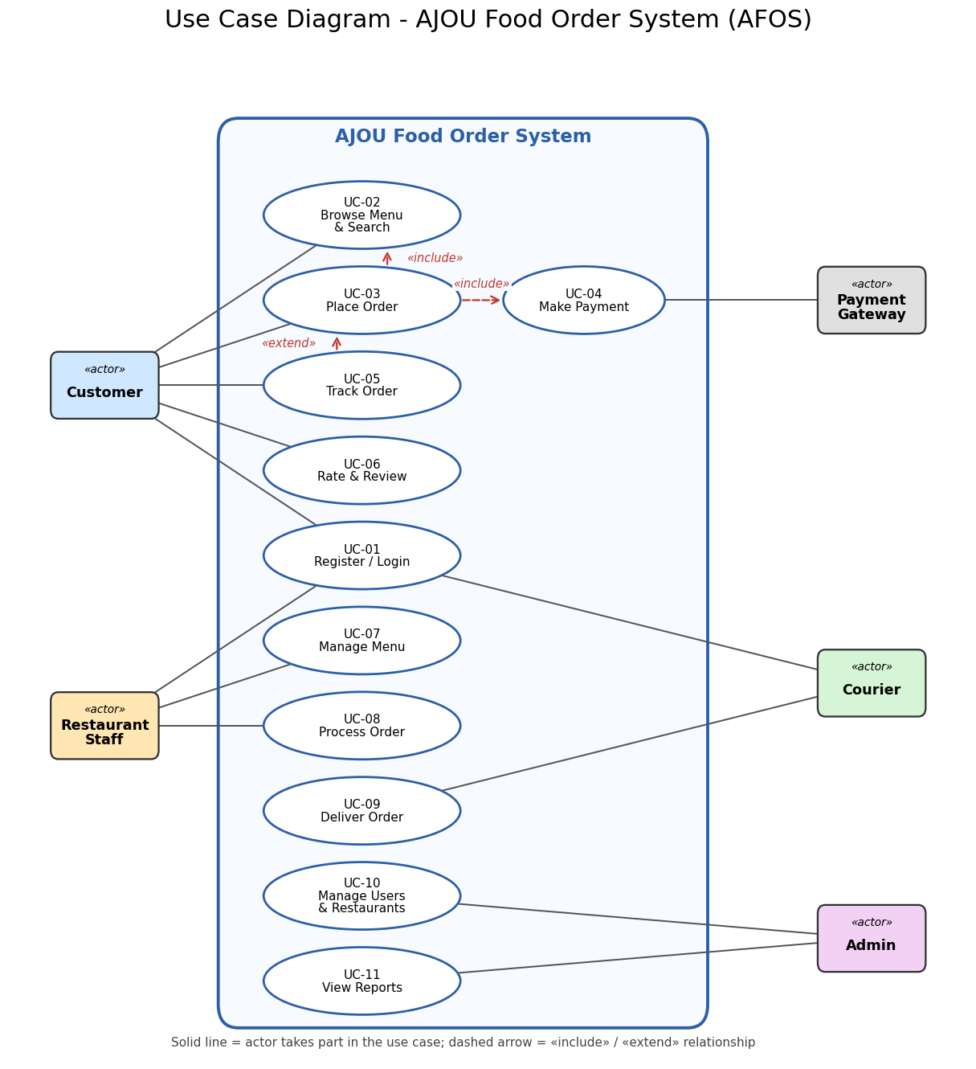
Use Case Model
5 actors, 11 use cases
Who does what
Customer: browse, order, pay, track, rate
Restaurant staff: manage menu, process orders
Courier: deliver orders
Admin: manage users, view reports
Payment gateway: processes online payments
AJOU Team | IT Project Management | 5

Slide 6
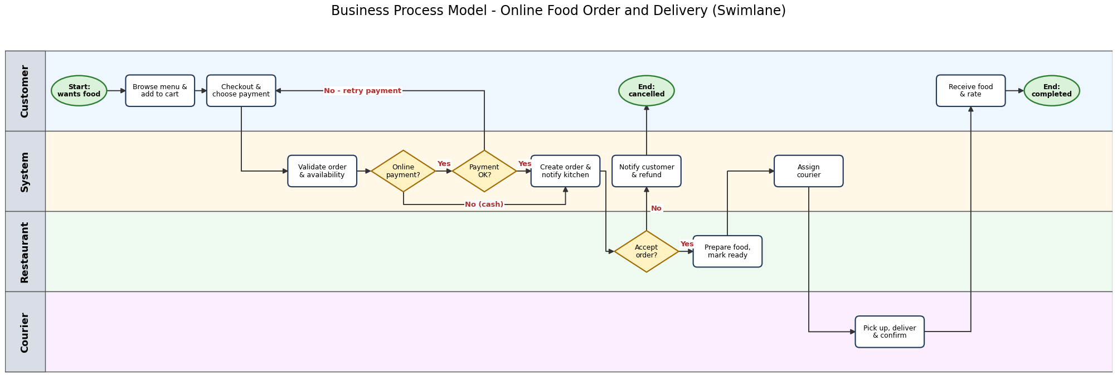
Order and Delivery Process
Business Process Model
Customer orders, system checks payment, restaurant accepts and cooks, courier delivers, customer rates. Failed payment returns to checkout; a rejected order is refunded.
AJOU Team | IT Project Management | 6

Slide 7
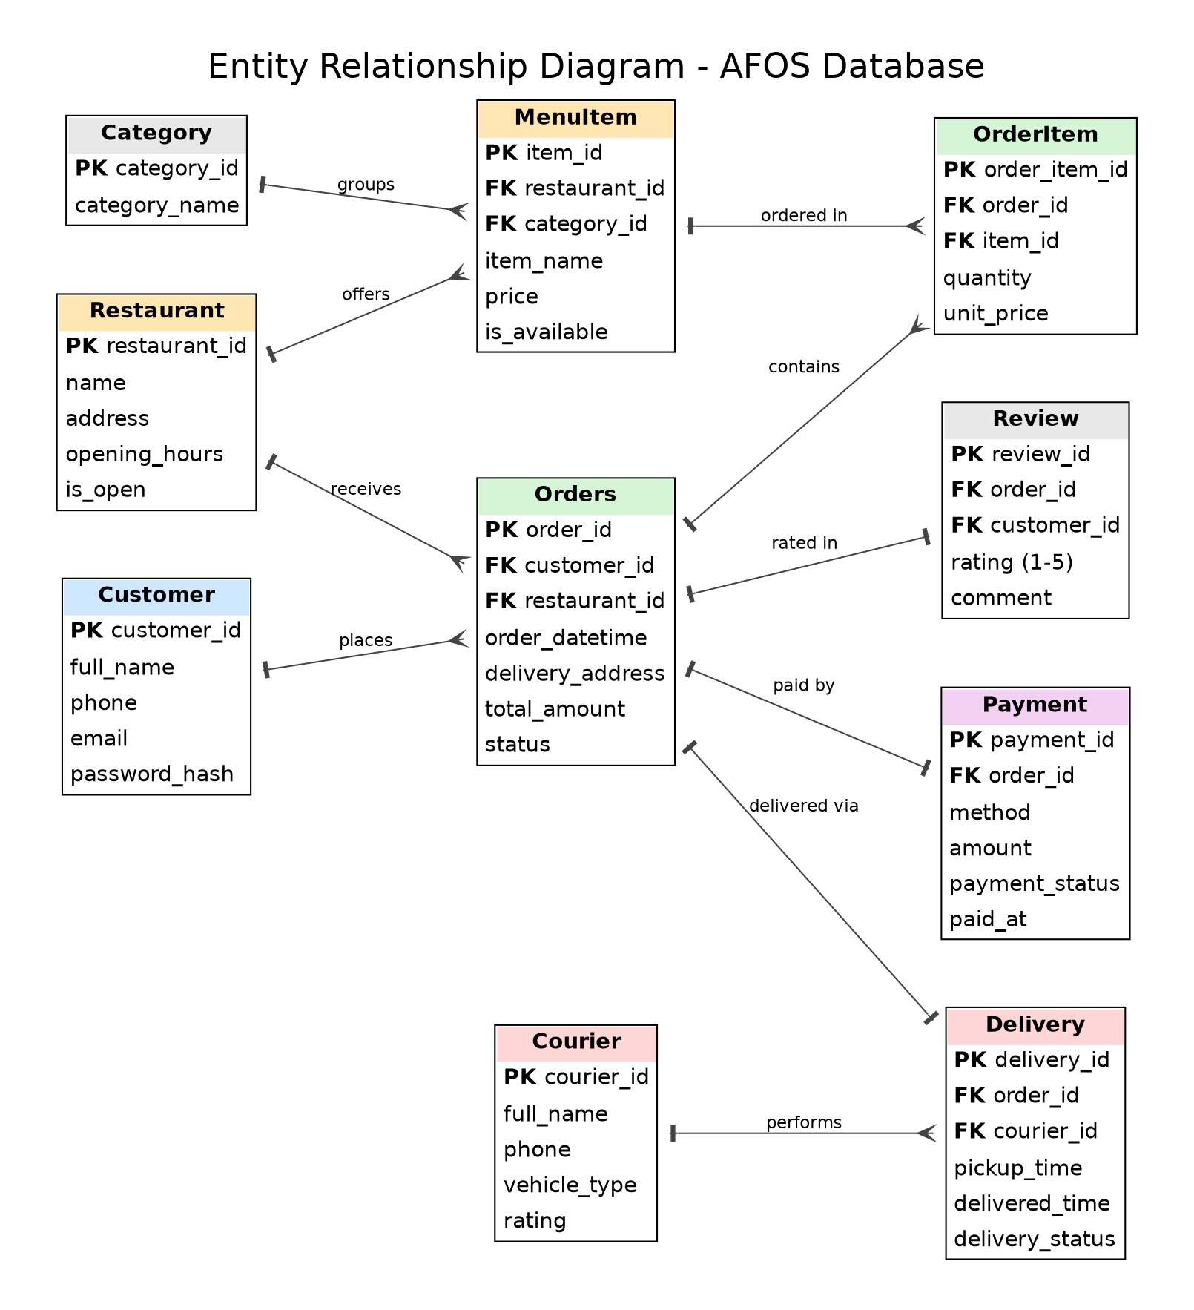
Database Design
Entity Relationship Diagram
Core idea
Customers place Orders at Restaurants
Orders contain items from the menu
Each order has one Payment and one Delivery
Couriers perform Deliveries
Customers can Review an order
AJOU Team | IT Project Management | 7

Slide 8
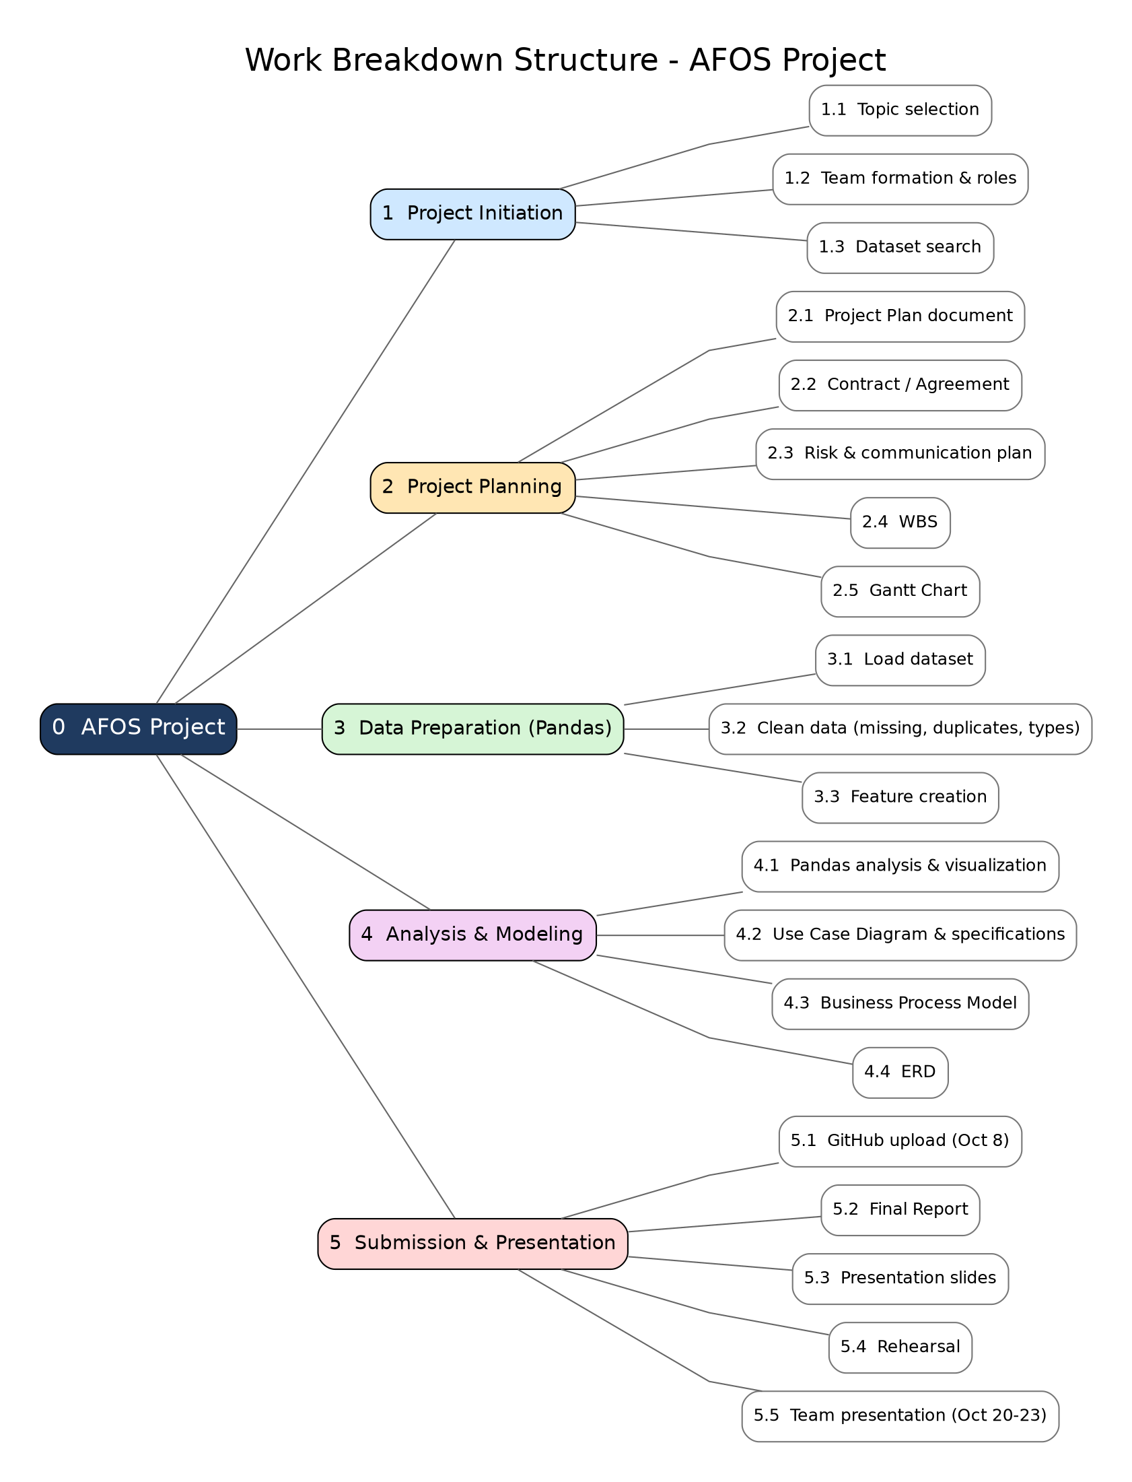
Work Breakdown Structure
5 phases, 20 work packages
Phases
1 Initiation
2 Planning
3 Data preparation
4 Analysis and modeling
5 Submission and presentation
AJOU Team | IT Project Management | 8

Slide 9
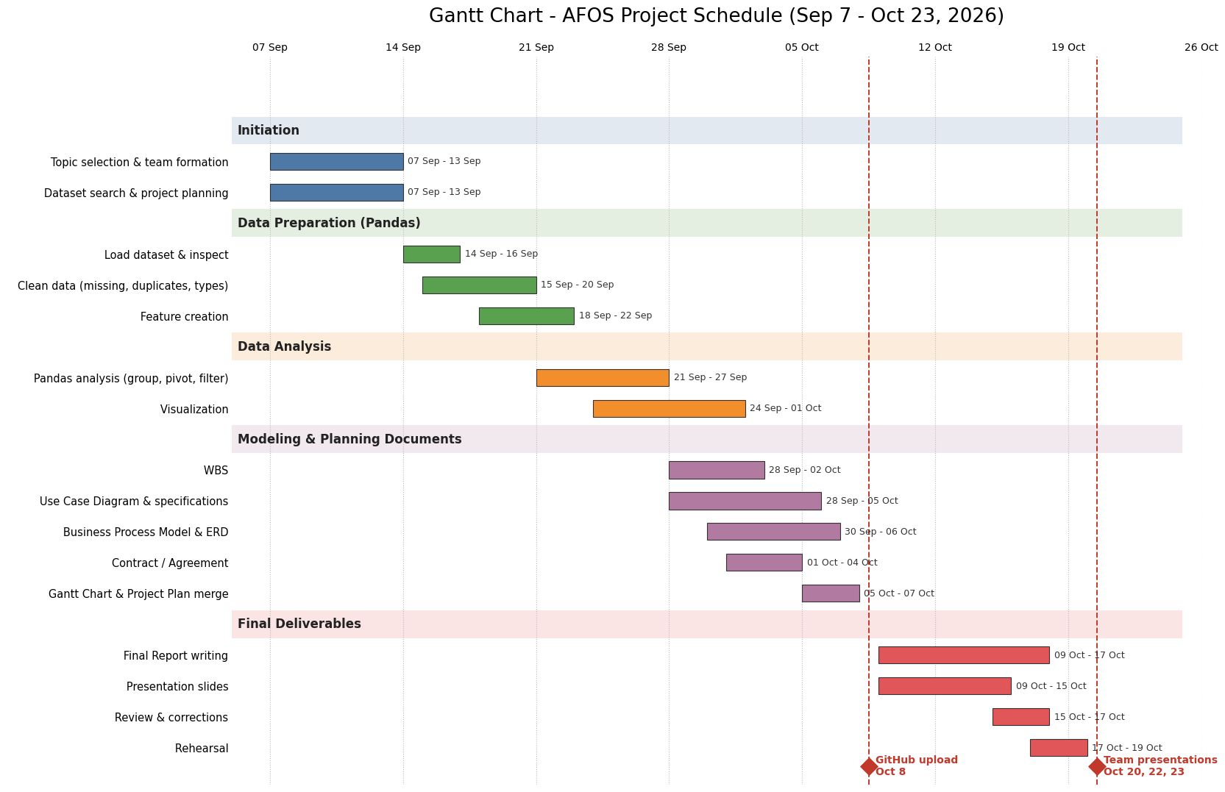
Project Schedule
Gantt Chart, 7 Sep to 23 Oct 2026
Milestone | Date
Topic and team set | 13 Sep
Modeling docs done | 7 Oct
GitHub upload | 8 Oct
Slides and report | 17 Oct
Presentation | 20, 22 or 23 Oct
AJOU Team | IT Project Management | 9

Slide 10
Team and Agreement
Contract
Name | Role | Responsibilities
Sobirov Muhammadullo | Team Leader | Coordination, plan, contract, Gantt, final merge
Begjanov Artur | Member | Requirements, use cases
Ahmadjonov Shohruz | Member | BPM, ERD, WBS
Agreement highlights
Weekly meeting and daily Telegram chat; internal deadlines 2 days early
Every document is peer-reviewed; all files live on the team GitHub
Decisions by consensus (majority vote if needed); changes need all three members
AJOU Team | IT Project Management | 10

Slide 11
Conclusion
What we delivered
Next steps
Project plan and team contract
Use case model, process model, database design
WBS and Gantt schedule
Build the system from these models
Use delivery data analysis to improve delivery estimates and courier planning
Thank you
AJOU Team | IT Project Management | 11

