Slide 1


Final Year Project
Alzheimer’s Disease Detection
Supervised By: Mr. Mubariz Rehman (Lecturer)

Slide 2
Project Team
Durab Haider (46614)
M. Umar (46952)

Slide 3
Table of Content
Background and Introduction
Literature Review
Problem Statement
Project Scope
Proposed Solution
Requirements Summary
Design Summary
Methodology
Implementation Summary
Experiments and Results Summary
Conclusion and Outlook

Slide 4
BACKGROUND AND INTRODUCTION

Slide 5
Background and Introduction [1/3]
Global Health Challenge
Alzheimer’s is a progressive neurodegenerative disorder characterized by cognitive decline, memory loss, and loss of functional independence.
Currently 55 million people are affected with Alzheimer’s and it is to reach about 139 million by 2050 (livhospital.com)
Current diagnostic standard relies on clinical cognitive assessments and neuroimaging, which is time taking and often leads patients to an irreversible stage.
Our goal is to create a system that helps doctors in early-diagnosis and detect quickly rather than the long and tiring standard ways.

Slide 6
Background and Introduction [2/3]
Using AI to detect Alzheimer’s Early
What is the project: An AI based system that helps doctors in identifying Alzheimer’s disease by looking at brain scans and test results.
Our system uses MRI of brain to see if it is shrinking and simple cognitive tests to show how a patient’s mind is working.
Why it matters: As people get older, more people are getting this disease. We need faster and better ways to catch it early.

Slide 7
Background and Introduction [3/3]
Why do we need this system
Looking at thousands of brain images is tiring for doctors, and they might miss tiny changes.
Early Alzheimer’s changes are so small that the human eye often cannot see them on screen.
We use a Deep Learning model that can see patterns in MRI that human eye might miss.
Our system combines MRI with cognitive test scores to give one final result.

Slide 8
Literature Review

Slide 9
Literature Review [1/4]
Name | Year | Input | Accuracy | Description
Mohammed et al. | 2024 | MRI (ADNI, OASIS, Kaggle) | 98.24% | Application of fully convolutional CNNs to classify four stages of dementia. Highlights lateral ventricle enlargement and hippocampal atrophy as primary diagnostic features.
Sorour et al. | 2024 | MRI (6000 + images) | 99.92% | Comparative study identifying DenseNet-121 as the superior architecture for multiclass stage classification over ResNet and Vanilla CNN.
Raj et al. | 2025 | MRI | 96.6% | Hybrid Inception v3 / ResNet-50 model utilizing Adaptive Rider Optimization (ARO) for superior hyperparameter tuning and local minima avoidance.

Slide 10
Literature Review [2/4]
Name | Year | Input | Accuracy | Description
Golovanevsky et al. | 2022 | MRI + Clinical | 96.88% | Introduction of CAAT-EHR, a cross-attentional transformer for task-agnostic, longitudinal patient embeddings to capture complex interrelationships.
Wang et al. | 2024 | MRI + Cognitive | 90% | Prediction of cognitive decline (CDR-SB changes) for clinical trial enrichment, using deep neural networks to isolate subregions like the anterior temporal lobe.
Gupta et al. | 2025 | MRI + PET + Cognitive | 98.0% | Hybrid CNN-SVM framework using Xception for feature extraction to reduce computational cost while maintaining high diagnostic boundaries.

Slide 11
Literature Review [3/4]
Name | Year | Input | Accuracy | Description
Castellano et al. | 2024 | MRI + Demographics | 95.3% | Design of EffSwin-XNet, merging EfficientNetB0 and Swin Transformer with Grad-CAM for enhanced spatial focus and model interpretability.
Raza et al. | 2025 | Multimodal | 92.14% | Evaluation of novel entropy-based measures (ExSEnt) to detect reduced signal irregularity and "slowing" of rhythms as biomarkers for AD.
Song et al. | 2021 | MRI + PET | 94.11% | Implementation of a U-shaped multi-scale architecture (ResGLPyramid) to extract inter-slice and intra-slice metabolic features of hypometabolism.

Slide 12
Literature Review [4/4]
Name | Year | Input | Accuracy | Description
Mohsen et al. | 2025 | MRI(Deep Features) + MRI Handcrafted (Texture, shape and intensity) | 97.5% | Development of a hybrid classical-quantum model using parameterized quantum circuits to achieve high accuracy with low computational resources.
Nagarajan et al. | 2025 | MRI | 99.21% | Comprehensive review of early detection pipelines, focusing on pre-processing, autoencoders, and comparative performance analysis across modalities.

Slide 13
PROBLEM STATEMENT

Slide 14
Problem Statement [1/2]
Alzheimer’s disease is difficult to track because it hits the brain in multiple ways: through physical shrinkage, functional loss, and mental decline.
Structural MRI is our best tool for seeing brain changes, but in early stages, these changes are often too subtle to catch.
Cognitive tests give us a look at how the patient is functioning, but test results can be skewed by patient’s education level or judge bias.
Relying on single data source makes early-stage diagnosis very unreliable.

Slide 15
Problem Statement [2/2]
While AI models like CNNs are great at identifying Alzheimer’s from MRI, they struggle with fine-grained tasks such as telling between EMCI and LMCI.
In these early stages, brain almost looks identical. This is where unimodal system fails.
The most promising solution is Multimodal Fusion.
The combine approach significantly improves diagnostic sensitivity.
Our research develops a framework that handles this complex data and improve model accuracy.

Slide 16
ENDEAVOUR

Slide 17
Endeavour [1/3]
Durab Haider
Preprocessing of Dataset
Model Training
Documentation
Model Implementation and Testing
M. Umar
UI/UX Design
Dataset Collection
Web App Development
Model Implementation and Testing.
Documentation

Slide 18
Endeavour [2/3]
Software Development Process
Research and Requirement Analysis
Data Acquisition and Preprocessing
Model Design and Fusion Development
Iterative Training and Optimization
Website Development and Model Integration
Testing and Documentation

Slide 19
Endeavour [3/3]
Way of Working as a Team
Regular meetings to discuss progress, challenges, and next steps.
Used tools like GitHub for collaboration.
Brainstorming for solutions of challenges being faced such as dataset limitation.
Tasks were assigned after mutual discussion.

Slide 20
PROPOSED SOLUTION

Slide 21
Proposed Solution [1/2]
We developed a multimodal fusion framework that process MRI brain scans and cognitive data.
Instead of looking at images in isolation, our system performs fusion, merging brain scan with functional data like MMSE and CDR scores.
This dual-input approach allows the model to pick on subtle relations between brain shrinkage and actual mental performance.

Slide 22
Proposed Solution [2/2]
Our framework utilizes a Late Fusion architecture with an integrated Attention Mechanism to weight the importance of each data stream.
The system processes brain features through an MRI Branch and a 30-question diagnostic vector through a Cognitive Branch in parallel.
A Softmax Attention Layer dynamically calculates attention weights, allowing the model to focus more on imaging or clinical data depending on the patient's specific symptoms.

Slide 23
Requirements Summary
Dataset Requirements: Multimodal data sourced from ADNI, containing paired MRI scans and clinical records.
Data Preprocessing: Standardized imaging pipeline for MRI slice normalization and a custom StandardScaler mapping for cognitive features.
Clinical Data Pipeline: A normalized dataset of MMSE, CDR, and ADAS13 scores transformed into a 30-question vector.
Hardware and Compute: High-performance GPU acceleration via Google Colab to handle model training.
Evaluation Metrics: Comprehensive monitoring via confusion matrices and accuracy scores to ensure model reliability.

Slide 24
Design Summary [1/2]
The system architecture utilizes a Late Fusion strategy with two parallel, independent processing branches for imaging and clinical data.
The MRI feature branch accepts pre-extracted features, while the cognitive branch processes a high-dimensional question vector derived from MMSE and CDRSB scores.
A feature alignment pipeline was designed to synchronize these disparate data types using unique patient ID (RID), ensuring temporal consistency across all dataset.

Slide 25
Design Summary [2/2]
A Softmax-weighted Attention Mechanism is embedded at the fusion layer to dynamically calculate the relative diagnostic importance of each input stream.
The integration of Batch Normalization and Dropout (0.3 – 0.5) within the architecture ensures numerical stability and prevents the model from overfitting to the training sample.
The training logic is governed by Adaptive Learning Rate strategy, optimizing the loss function over 60 epochs to reach the final classification stage.

Slide 26
Methodology [1/4]
Data Acquisition
The research utilizes data sourced from the ADNI (Alzheimer's Disease Neuroimaging Initiative) database.
We curated a dataset consisting of four primary diagnostic categories: CN, EMCI, LMCI, and AD.
The study incorporates multimodal features, specifically MRI scans and clinical scores.
Clinical markers include standardized assessments from MMSE, CDRSB, and ADAS13 tests.

Slide 27
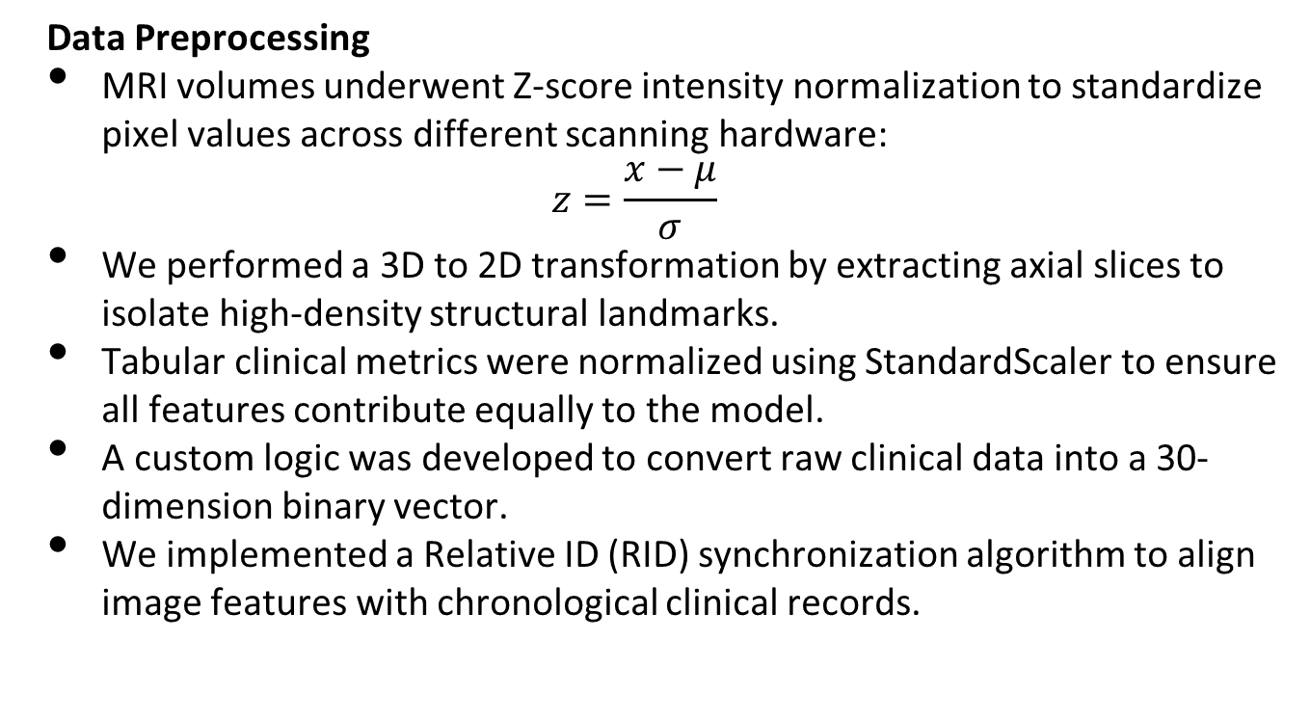
Methodology [2/4]
Data Preprocessing
MRI volumes underwent Z-score intensity normalization to standardize pixel values across different scanning hardware:
$$z=\frac{x−μ}{σ}$$
We performed a 3D to 2D transformation by extracting axial slices to isolate high-density structural landmarks.
Tabular clinical metrics were normalized using StandardScaler to ensure all features contribute equally to the model.
A custom logic was developed to convert raw clinical data into a 30-dimension binary vector.
We implemented a Relative ID (RID) synchronization algorithm to align image features with chronological clinical records.

Slide 28
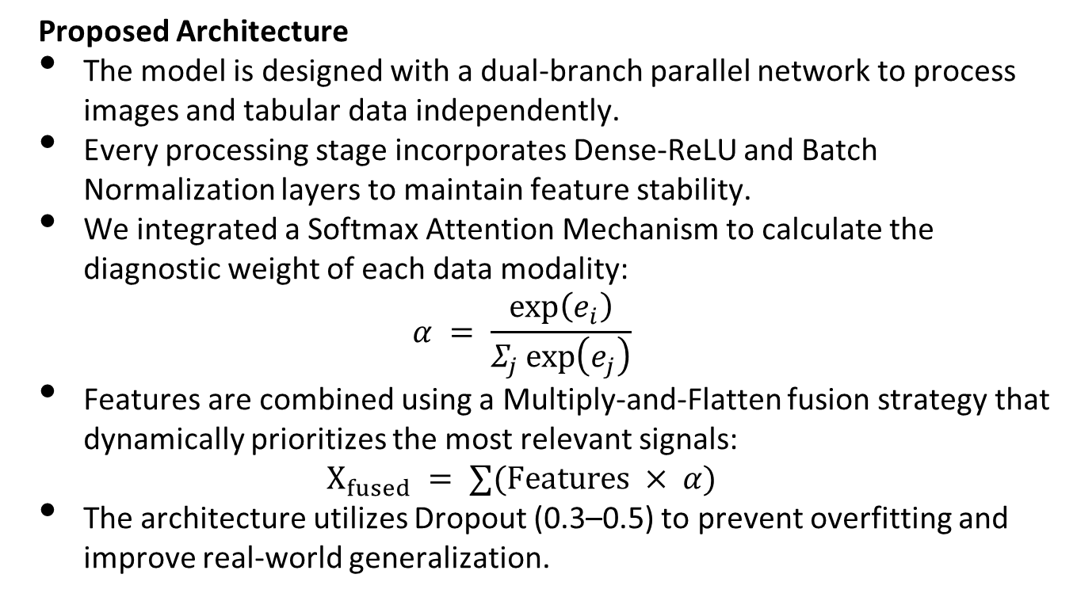
Methodology [3/4]
Proposed Architecture
The model is designed with a dual-branch parallel network to process images and tabular data independently.
Every processing stage incorporates Dense-ReLU and Batch Normalization layers to maintain feature stability.
We integrated a Softmax Attention Mechanism to calculate the diagnostic weight of each data modality:
$$α = \frac{\exp\left(e_{i}\right)}{Σ_{j}\exp\left(e_{j}\right)}$$
Features are combined using a Multiply-and-Flatten fusion strategy that dynamically prioritizes the most relevant signals:
$$X_{fused} = ∑(Features × α)$$
The architecture utilizes Dropout (0.3–0.5) to prevent overfitting and improve real-world generalization.

Slide 29
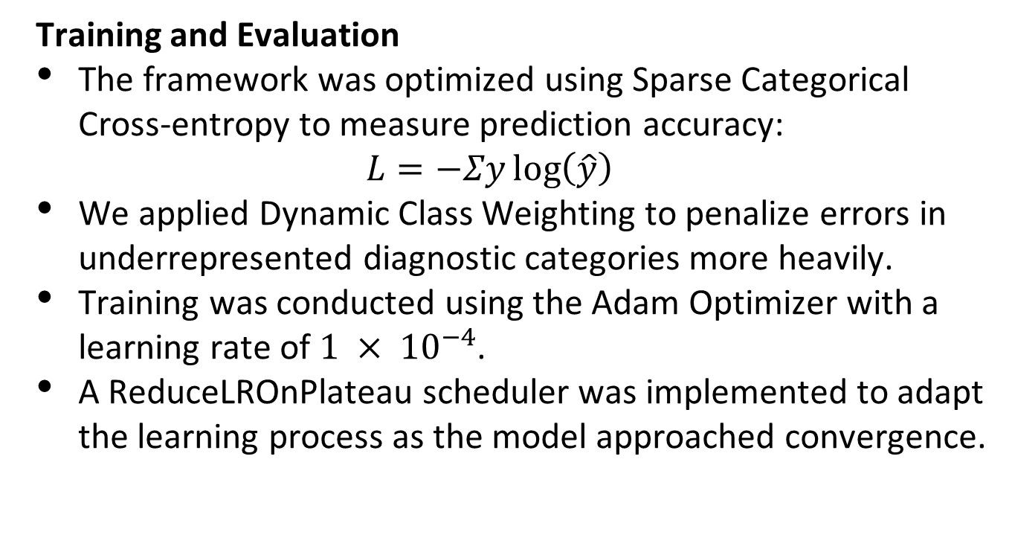
Methodology [4/4]
Training and Evaluation
The framework was optimized using Sparse Categorical Cross-entropy to measure prediction accuracy:
$$L=−Σy\log\left(\hat{y}\right)$$
We applied Dynamic Class Weighting to penalize errors in underrepresented diagnostic categories more heavily.
Training was conducted using the Adam Optimizer with a learning rate of ${1 × 10}^{−4}$.
A ReduceLROnPlateau scheduler was implemented to adapt the learning process as the model approached convergence.

Slide 30
Implementation Summary [1/2]
Integrated Tech Stack
Development of the architecture utilizing a React frontend and a Python Node.js backend.
Implementation of TensorFlow and Keras for high-performance model execution and inference
Imaging and Preprocessing Pipeline
Automated extraction of central axial slices from raw 3D NIfTI volumes.
Application of Z-score Intensity Normalization and resizing to a uniform 128x128 pixel resolution.

Slide 31
Implementation Summary [2/2]
Feature Engineering and Fusion
Transformation of raw clinical scores into a specialized 30-bit binary functional vector.
Deployment of a Multimodal Attention Layer to dynamically prioritize imaging versus cognitive data streams
Deployment & Diagnostic Workflow
End-to-end workflow delivering diagnostic forecasts within a 1 to 8-second window.
Support for four-class classification: AD, CN, EMCI, and LMCI.
Real-time result rendering through a responsive, clinician-focused dashboard.

Slide 32
Experiments and Results Summary
Comparative Performance Overview
The following table summarizes the progression of various architectures tested during the research phase.
Architecture | Accuracy | F1-Score
VGG16_LeakyReLU | 95.09% | 0.9509
ResNet50_LeakyReLU | 90.25% | 0.9023
Inceptionv3_MobileNet_LeakyReLU | 86.19% | 0.8619
InceptionV3_DenseNet121_LR | 68.90% | 0.6702
ResNet50_Cog | 97.23% | 0.9723
IncV3_MobNet_Attention_Pooling | 93.95% | 93.94%
Inceptionv3_MobNet_Cog_Fusion_Softmax (Proposed Model) | 98.84% | 0.9884

Slide 33
CONCLUSION AND OUTLOOK

Slide 34
Conclusion & Outlook [1/2]
Conclusion:
Successfully developed a multimodal AI system that classifies in AD, CN, EMCI and LMCI.
Integrated a unique 30-question cognitive vector with MRI features to outperform single-modality models.
Fulfilled all project objectives, including patient-wise data alignment and full-stack interface development.
Overcame technical hurdles in 3D NIfTI preprocessing and hybrid architecture optimization.

Slide 35
Conclusion & Outlook [2/2]
Future Outlook:
Transition from an academic framework to real-time clinical verification within hospital settings.
Expand the model to include longitudinal progression, predicting the timeline of disease transitions.
Implement Explainable AI (XAI) features, such as brain atrophy heatmaps, to assist clinician decision-making.

