Slide 1
Wideband Rx
Lineup and System Specs + Base Band LPF

Slide 2
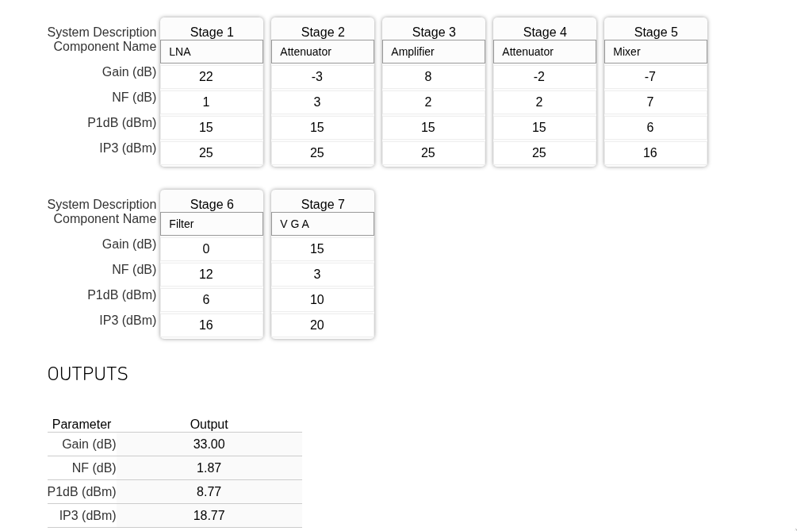
Recap: Proposed Line-up
Cascade analysis (Max gain)

Slide 3
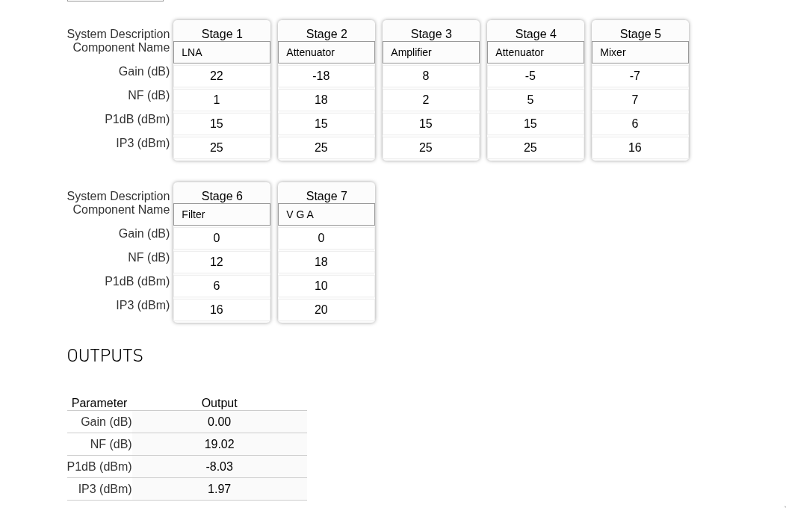
Recap: Proposed Line-up
Cascade analysis (Min. gain)

Slide 4
Recap: Simulation setup
Matlab simulation uses memory-less non-linear model for RF Blocks: Vo= α1 Vin + α2 Vin ² + α3 Vin ³
RF blocks are cascaded as follows:
Vo_(n+1) = α1Vo_n + α2Vo_n ² + α3Vo_n ³
For noise calculation , Friis’ equation is used.
Problem setup: RF BW = 400MHz , LO frequency = 1GHz, RF tone1 = 1.17GHz, RF tone2 = 1.18GHz
CW blocker: Power = -15dBm , at 1.3GHz
Blocker appears at Psens + 6dB

Slide 5
Recap: Simulation setup (Cont.)
DC offset is assumed to be canceled completely
Baseband Filter Specs:
Rejection at 300MHz = 25dB
OIP2 = 55dB (for filter and VGA)
Maximum peak power for ADC = -10dBm
Assuming PAR = 10dB → Maximum average power = -20dBm
ADC integrated noise power (200MHz ) = -66dBm → Enob = 9bits

Slide 6
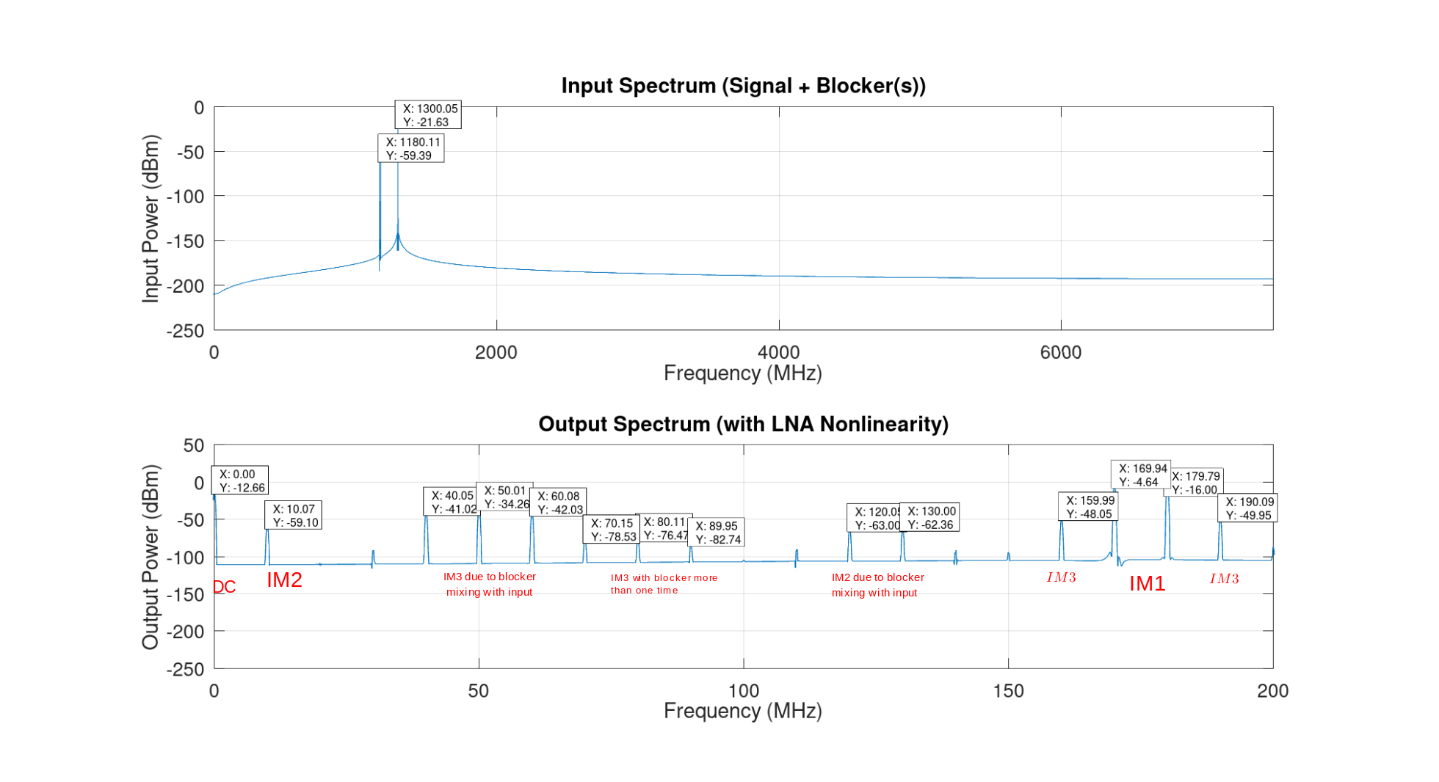
Two tone test – output spectrum
Input power (two tones) = -50dBm (Note that this is actually double sided spectrum and BlackmanHarris window is used for FTT to reduce FTT noise floor)

Slide 7
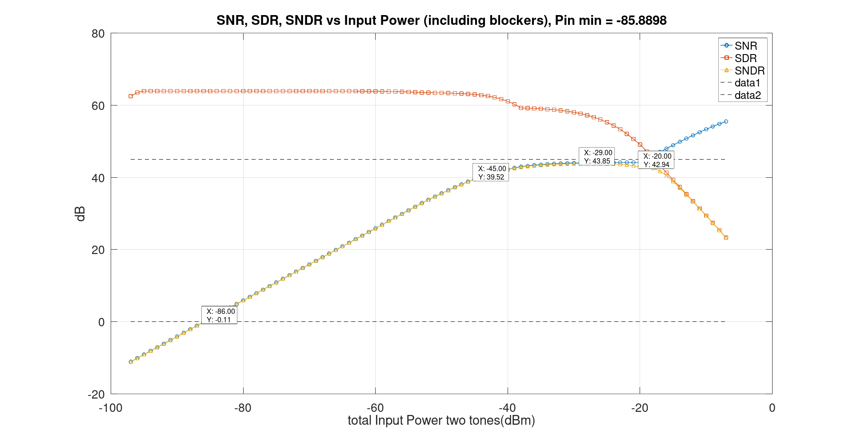
SNR, SDR and SNDR without blockers

Slide 8
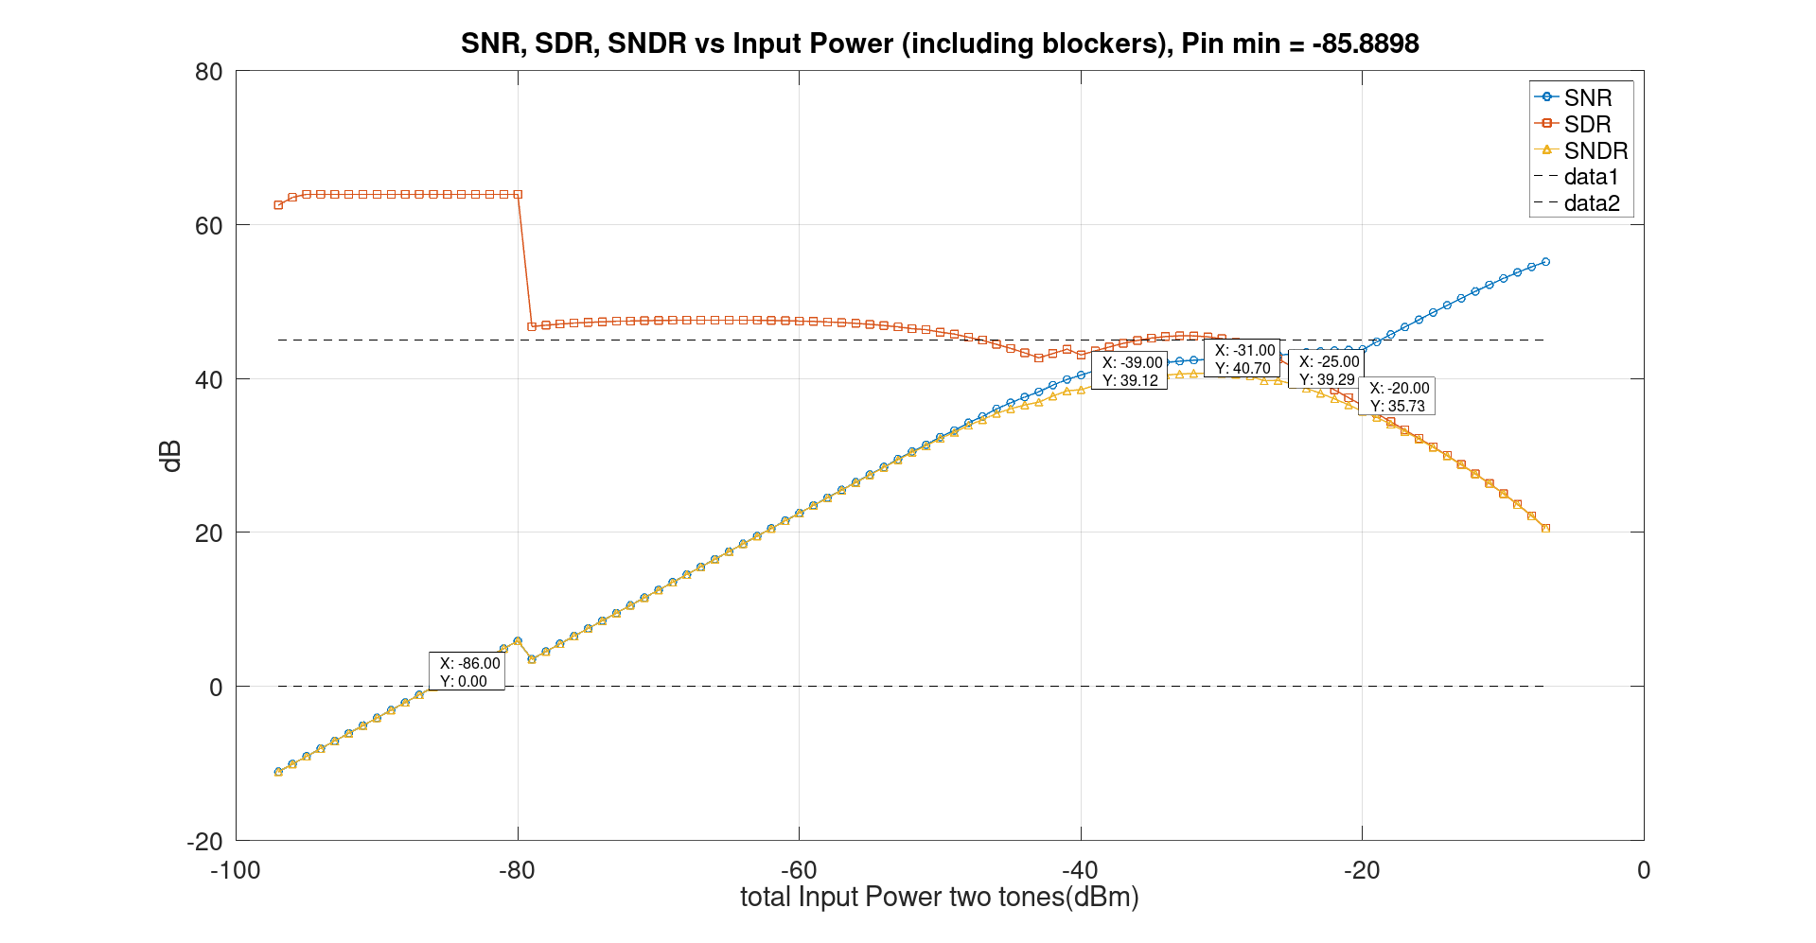
SNR, SDR and SNDR (With blocker and IP2)

Slide 9
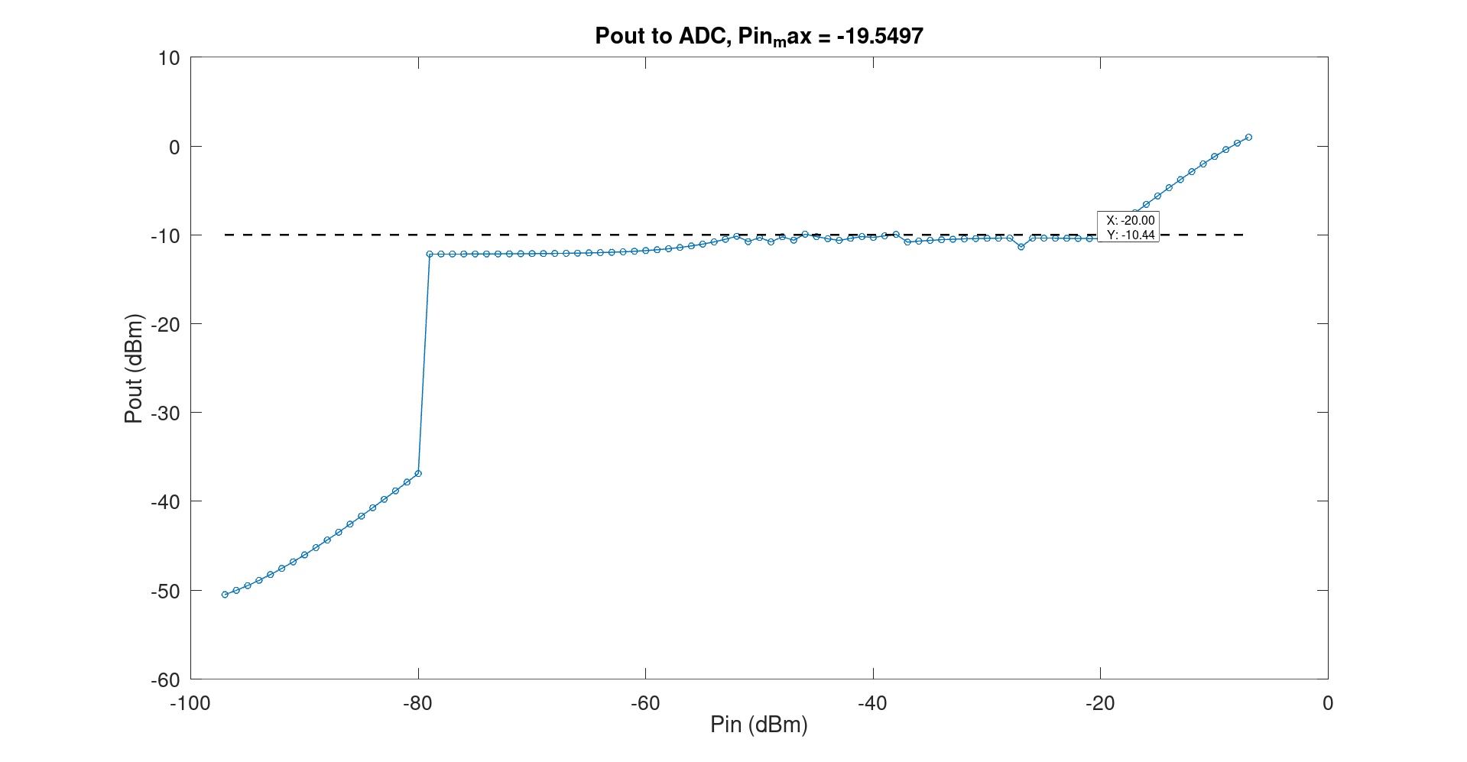
Maximum Input power for ADC

Slide 10
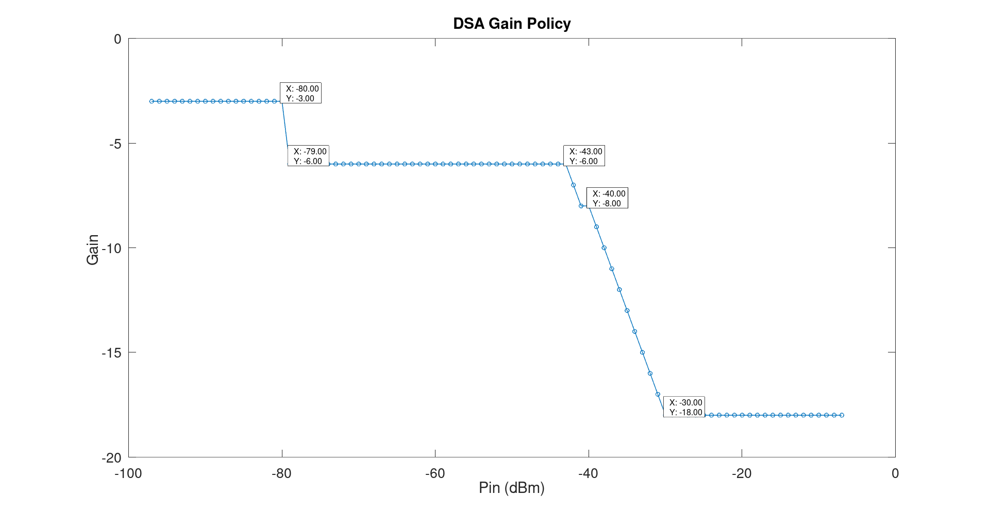
Gain Policy Under Blocking : First DSA

Slide 11
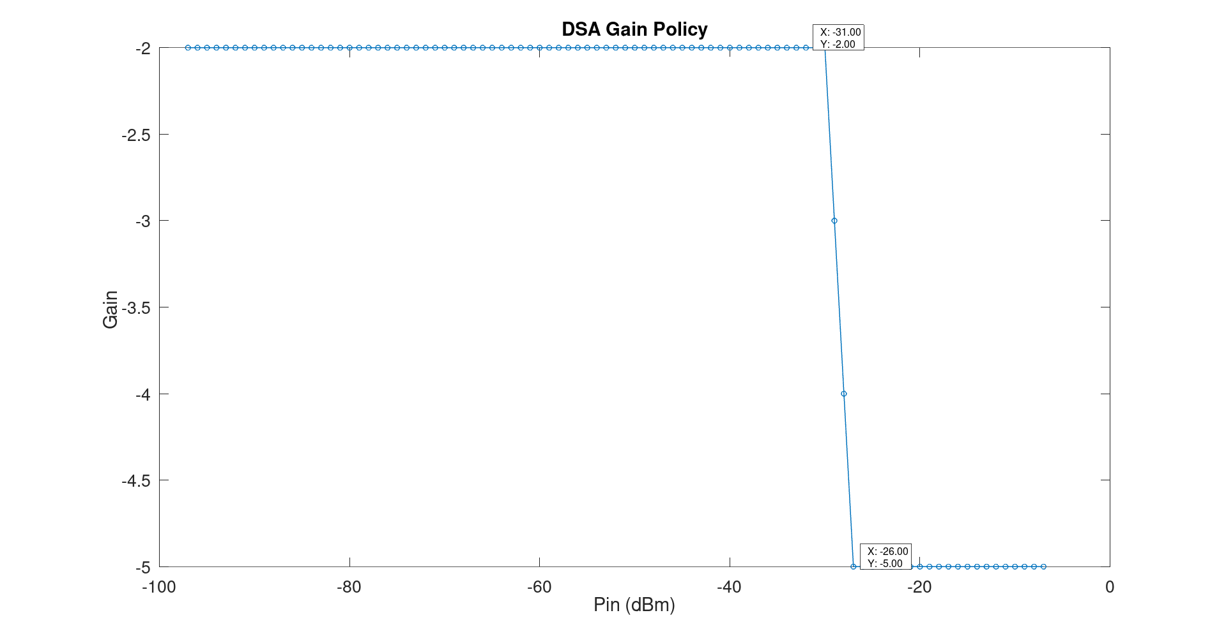
Gain Policy Under Blocking : Second DSA

Slide 12
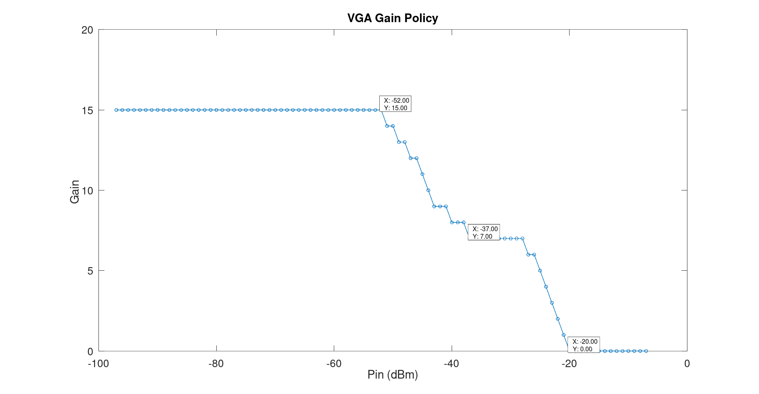
Gain Policy Under Blocking: VGA

Slide 13
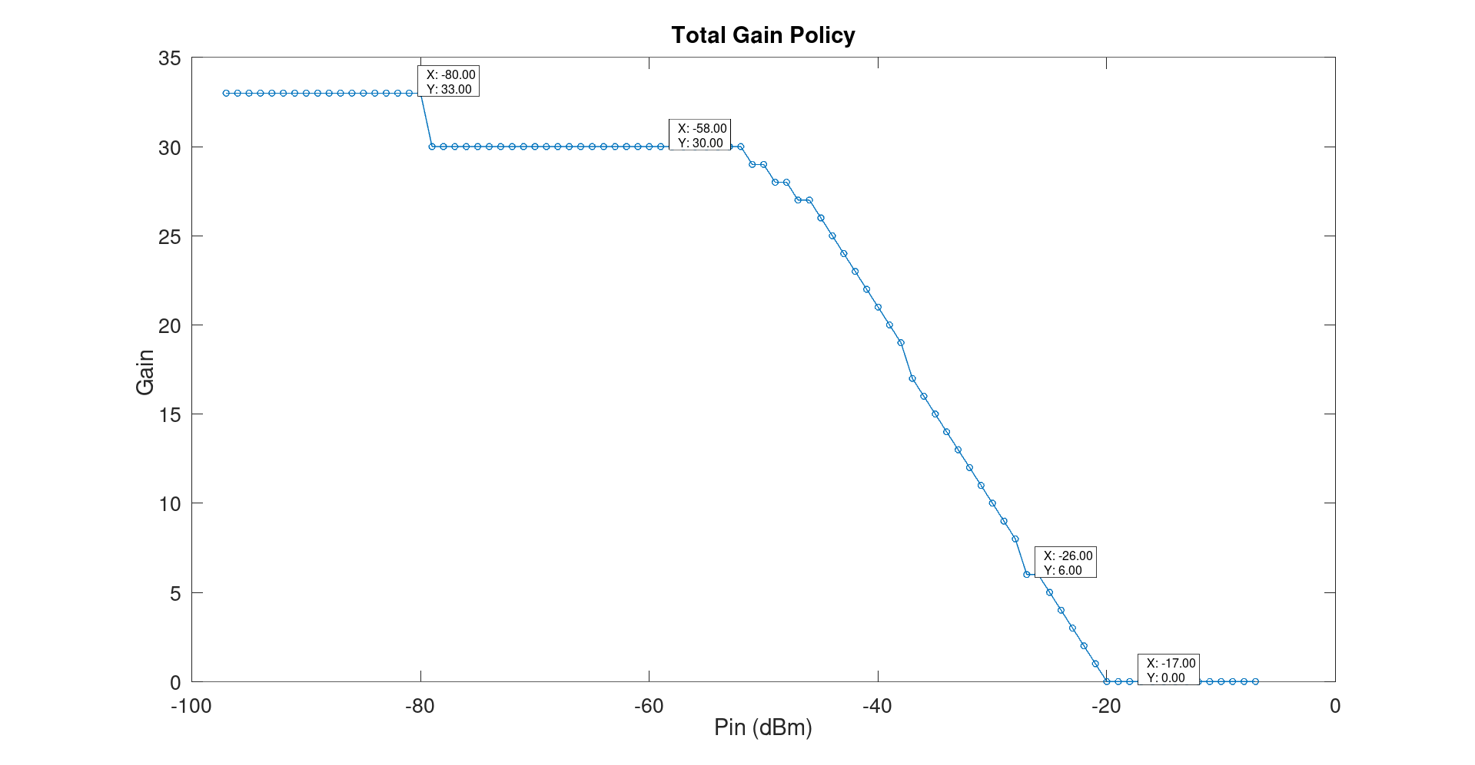
Gain Policy Under Blocking: Total Gain

Slide 14
Wideband Rx
Baseband LPF schematic

Slide 15
Baseband LPF specs:
First Mode:
Rejection at 300MHz = 25dB (changed later to 30dB)
0.5dB BW = 250MHz
OIP3 = 16dBm
NF = 12dB
Gain = 0dB
Second Mode : 3dB BW = 600MHz , 0.5dB BW = 250MHz

Slide 16
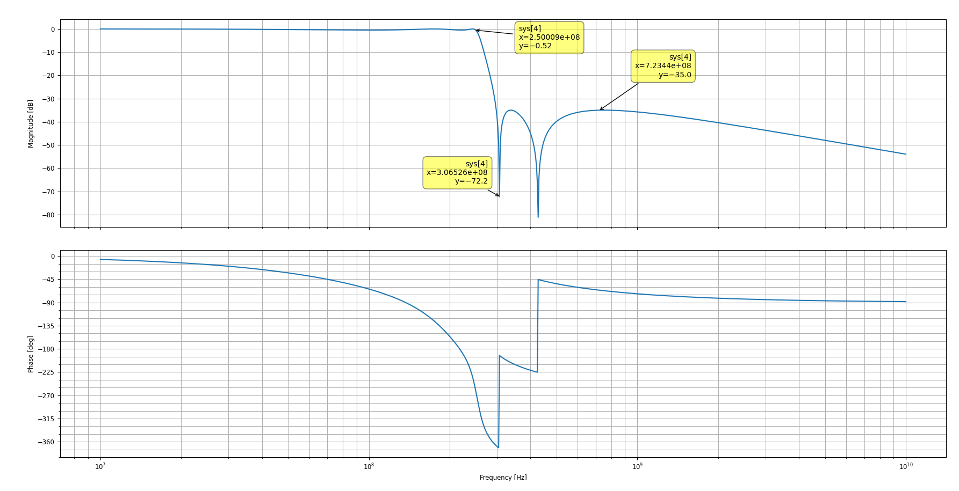
Filter Approximation:
5th order Elliptic Approximation is used:

Slide 17
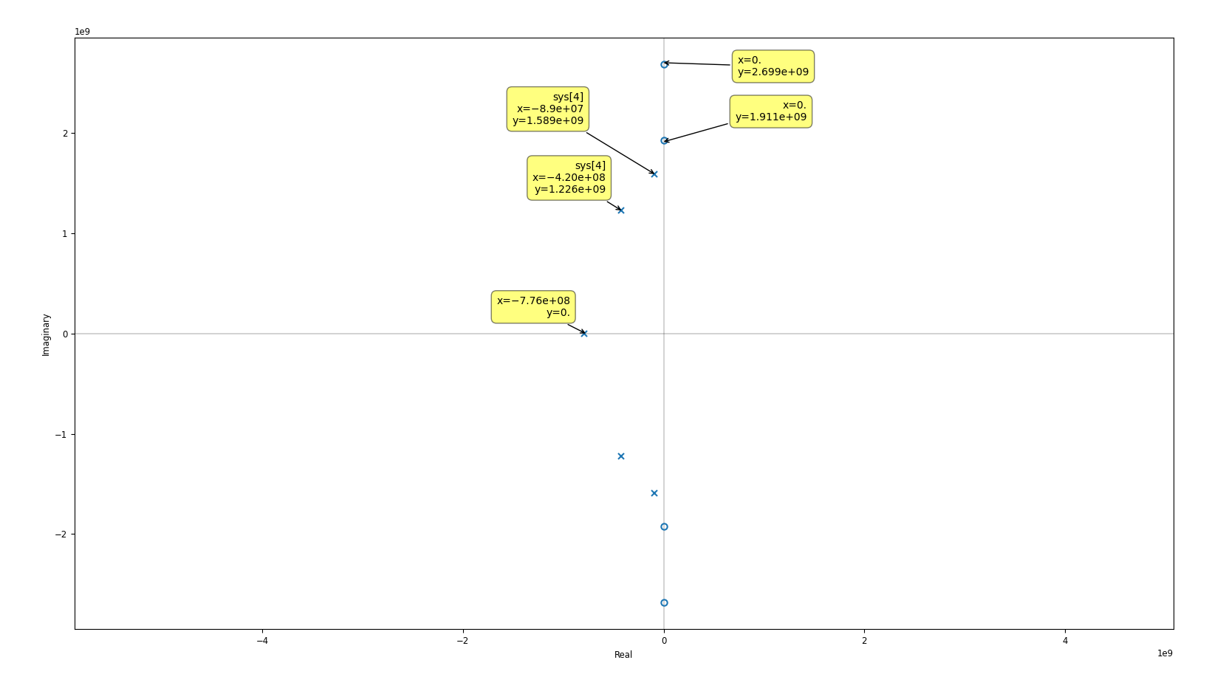
Filter Approximation: topology selection
Poles Quality factors:
8.9, 1.5, 0.5(real pole)
Since maximum Q > 4 Bi-quad doesn’t have good
component sensitivity for high Q→ use LC ladder simulation instead
Leap-frog implementation is used
GM-C implementation is chosen for high BW

Slide 18
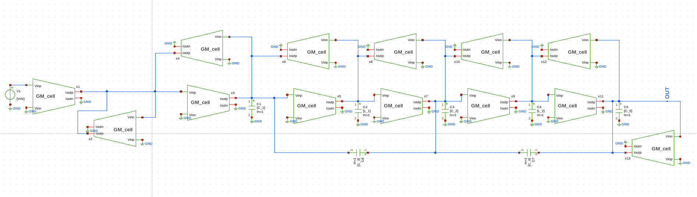
Filter Behavioral Modeling:
Note: Actual filter is differential , this is just a behavior model for SLICAP simulation

Slide 19
Lossy integrator:
Doing some iterations required GM-cell gain can’t be less than 200 → AV is chosen to be 250
Losses Mapping is required to determine C/gm.
Losses mapping is done with SLICAP

Slide 20
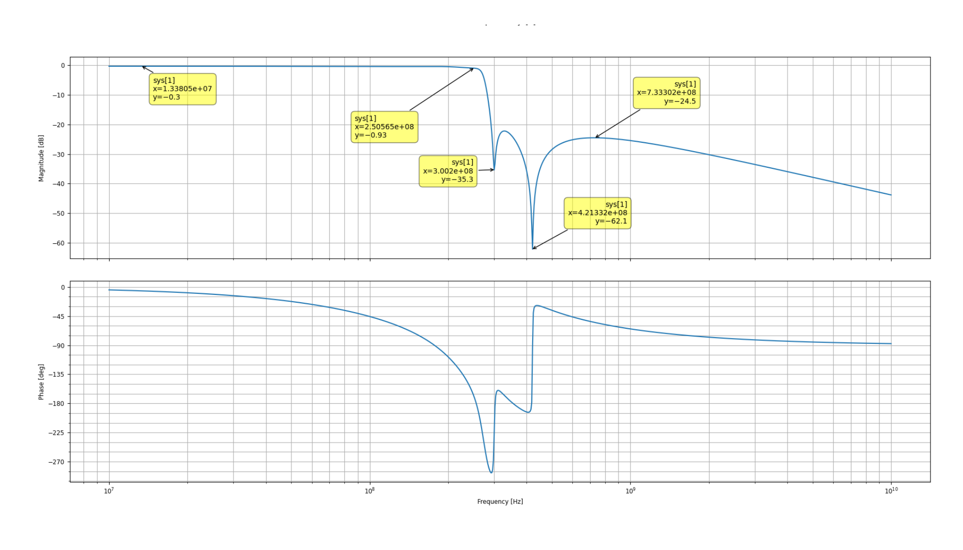
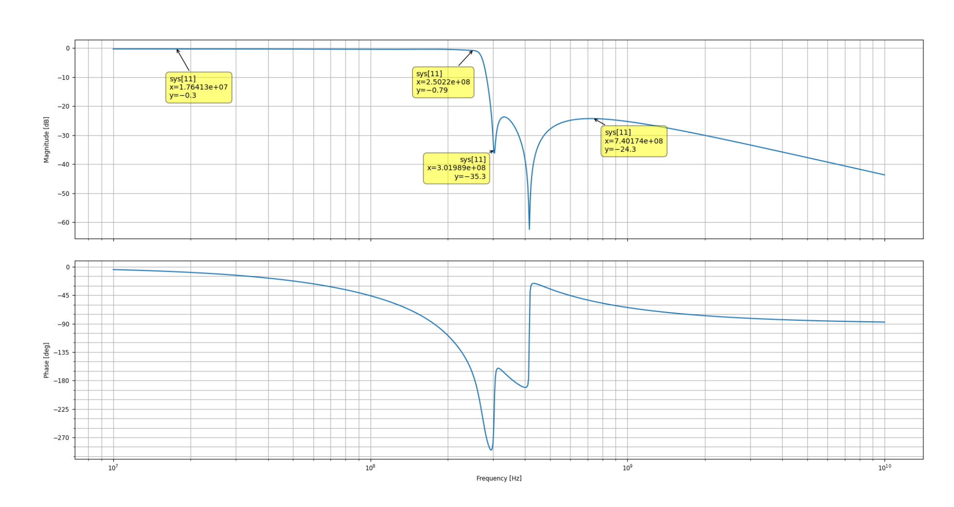
Losses Mapping
With losses mapping
Without losses mapping

Slide 21
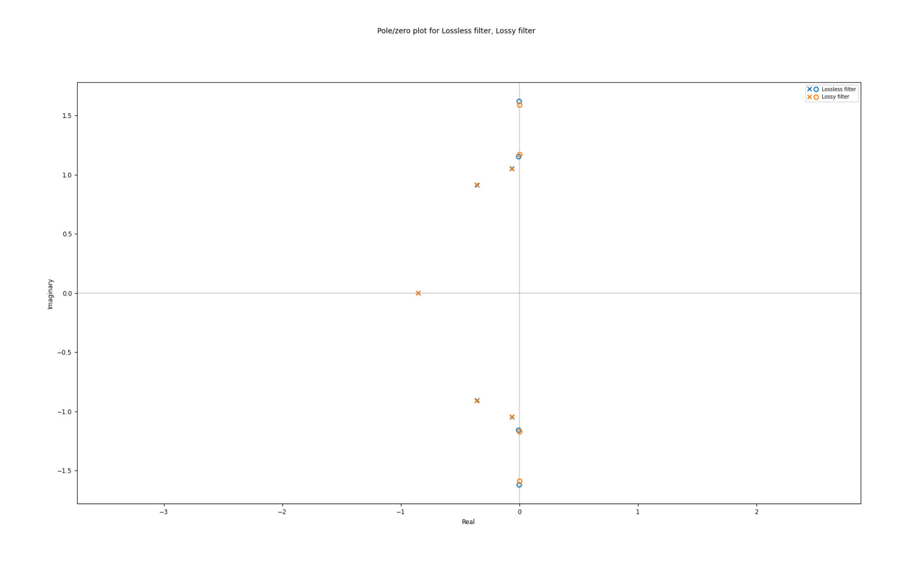
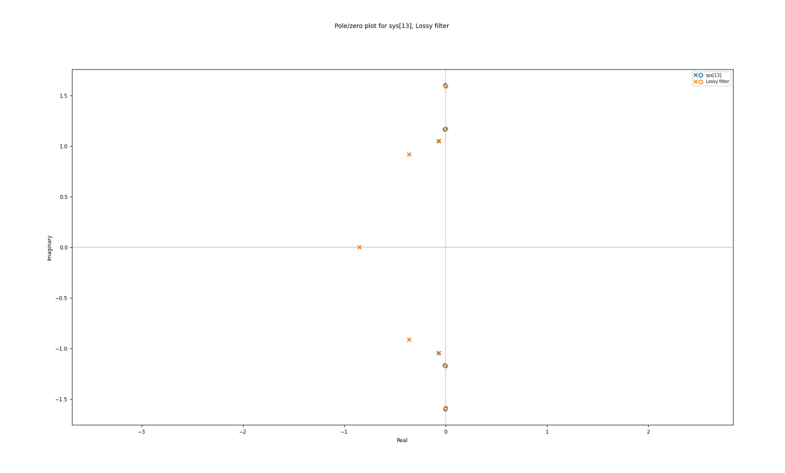
Losses Mapping (Normalized PZ-map)
With losses mapping
Without losses mapping

Slide 22
Losses Mapping (pole-zero map)
It appears that solver struggles with mapping zeros that’s because these zeros is lossless ,for this reason losses mapping doesn’t improve the response so much.

Slide 23
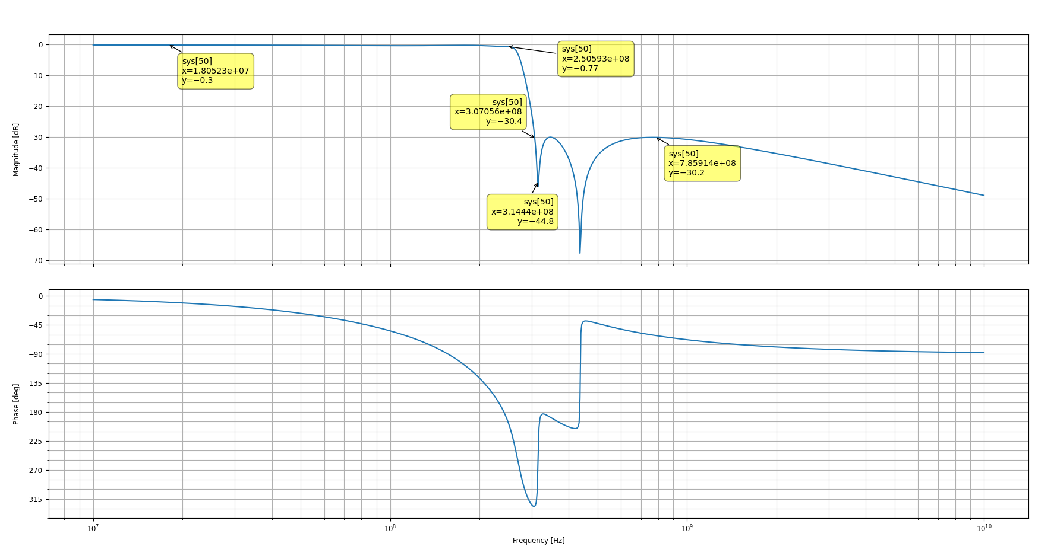
More Optimized Response:

Slide 24
Required C/gm:
C₁: 6.635e-10, C₂: 9.054e-10, C₃: 2.1e-10, C₄: 7.062-10, C₅: 4.169e-10, L₁ : 6.317e-10, L₂: 3.615e-10.
This values are divided by GM of the GM-cell

Slide 25
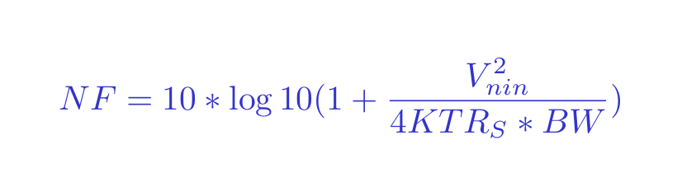
Impelementation: Specs
NF = 12dB → integrated output noise = 99uV
IIP3dBV = IIP3dBm – 10 = 6dBV (peak)
IP2dBV = 45dBV

Slide 26
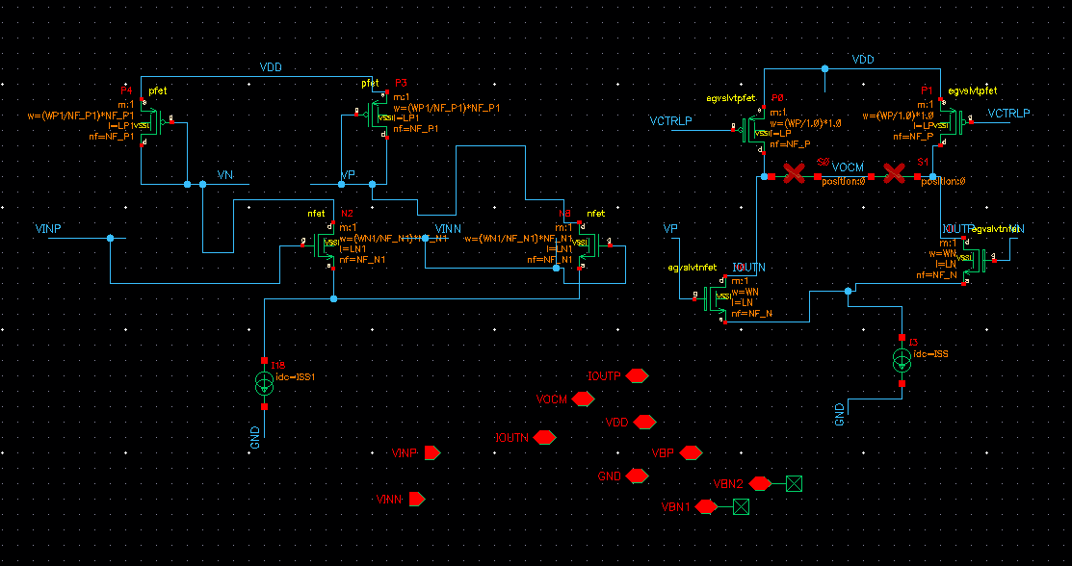
Proposed GM-cell: (Two stages)
Notes : VDD = 1.6V ,Current mirrors and common mode feed back isn’t done yet

Slide 27
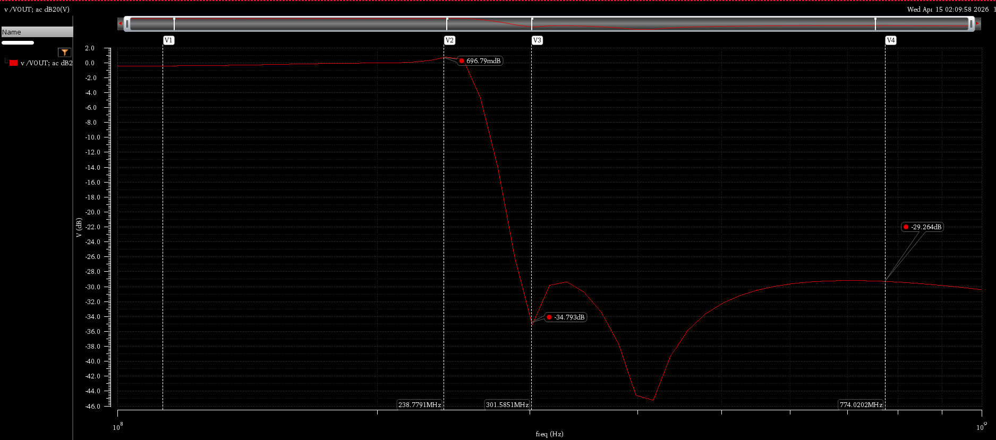
Filter intial results:
Frequency response: shows peaking at 240MHz

Slide 28
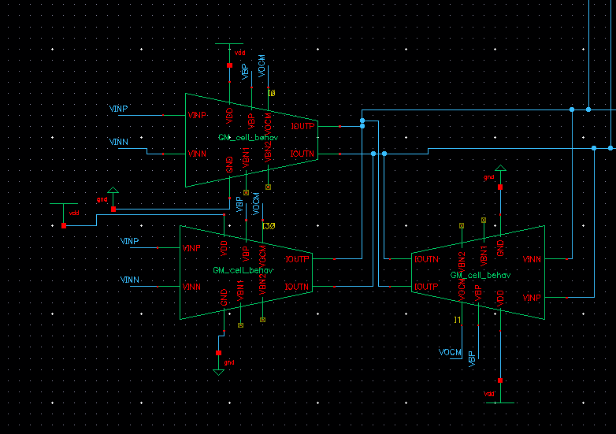
Filter intial results: (cont.)
Peaking is probably caused by this stage,because it has no external capacitors

Slide 29
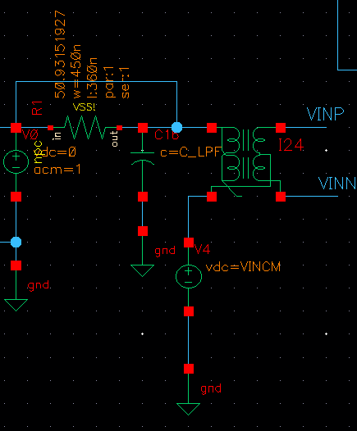
Filter results :Temporary solution
Adding Passive RC section before the filter, can reduce this peaking
Also can serve as the other mode of the filter (3dB BW=600MHz)
But it produces noise and losses
Also it’s very sensitive to parasitics

Slide 30
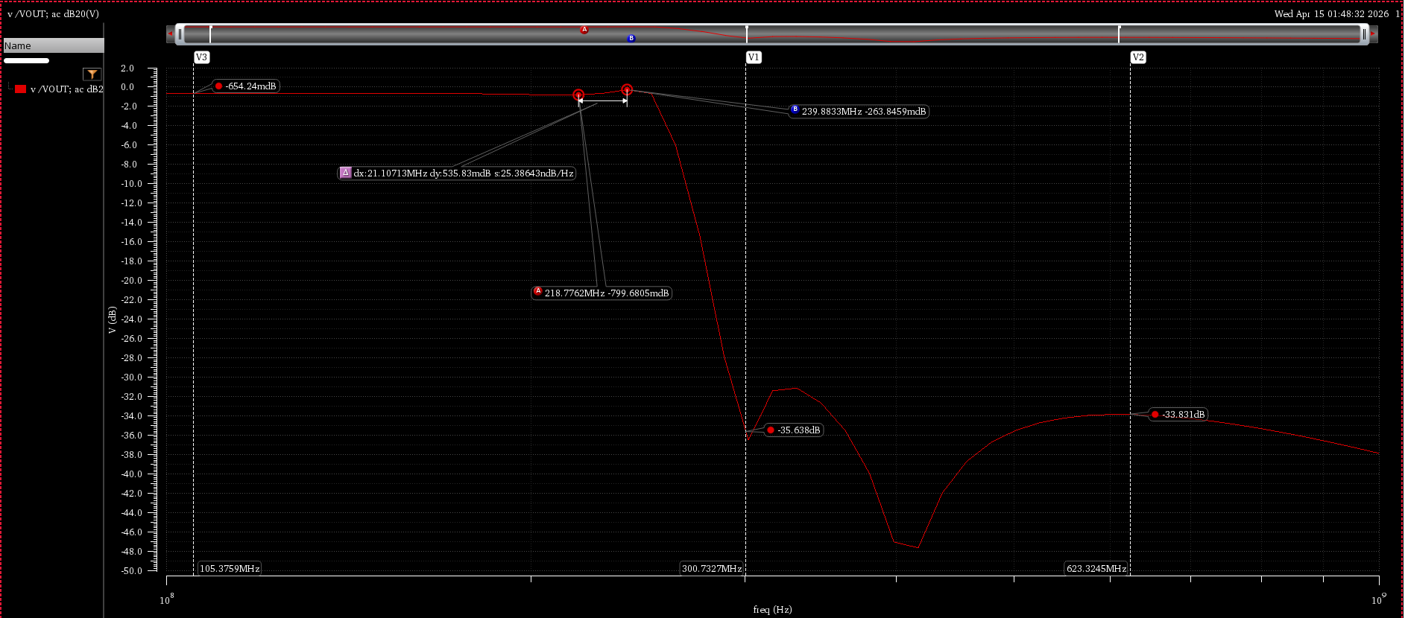
Filter results after RC-section:
Peaking is reduced but losses increase, achieved output noise = 96uV

Slide 31
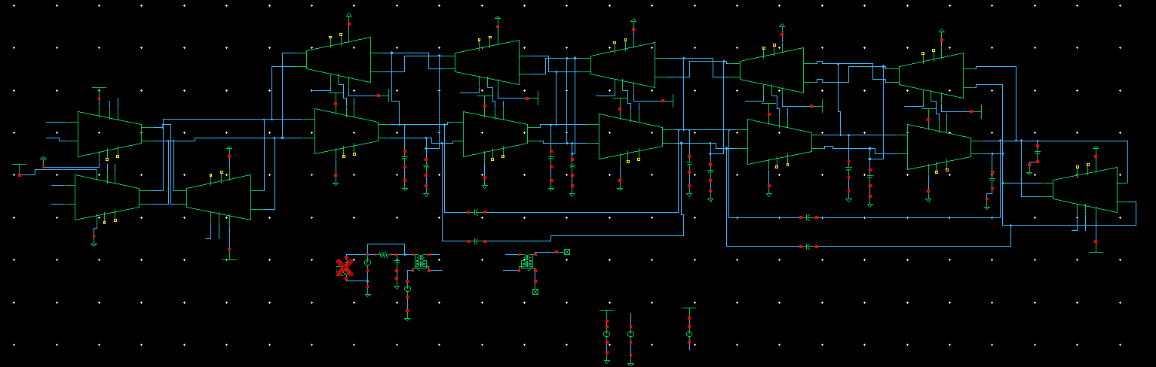
Filter Schematic and Test bench

Slide 32
Filter Results summary (till now):
Output noise= 96uV (NF =11.7dB) < 99u
Power Consumption = 100.8mA*1.6 = 161.28mW
OIP3 = -11dBV (Problem)

Slide 33
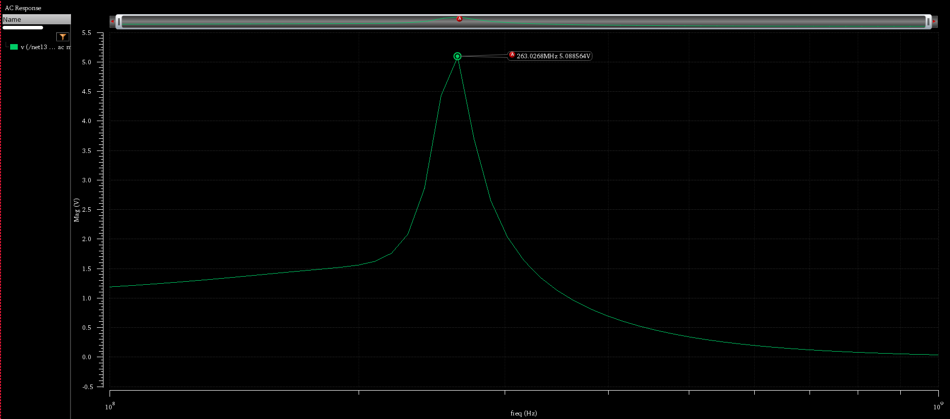
Linearity Problem
Internal node of the filter shows larger peaking,which degrades linearity
Also for the second stage of the GM-cell the swing is limited (maybe using PMOS as input pair is better here)

Slide 34
What’s to be done
Modify GM-cell to achieve IP3 spec and to eliminate peaking
CM and CMFB implementation
Getting all the results across corners: BW,GD,NF,IP3 and IP2
Starting Layout

