Slide 1
Wideband Rx
Lineup and System Specs

Slide 2
Previous points of discussion
DC cancellation (Zero DC for now)
Filter Specs:
Rejection at 300MHz = 25dB
OIP2 = 55dB (for filter and VGA)
Blocker at Psens + 6dB
Effect of increasing Enob of ADC on SNDR

Slide 3
Previous points of discussion
RF amplifier is added between DSAs
Output Blocker power is calculated at the input of ADC

Slide 4
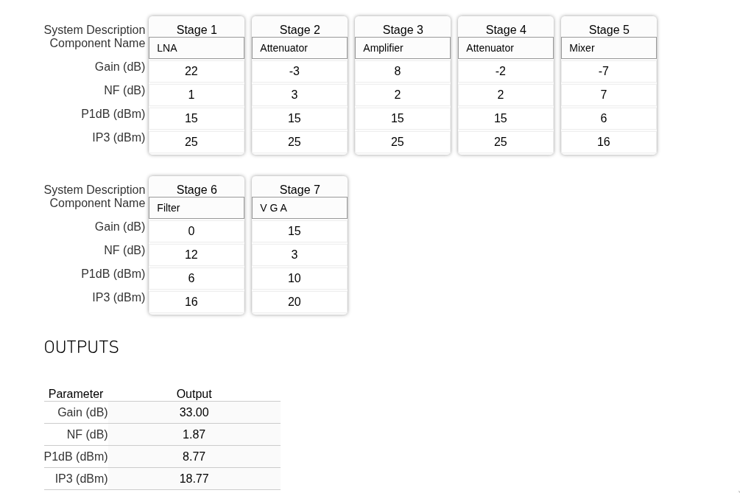
Proposed Line-up
Cascade analysis (Max gain)

Slide 5
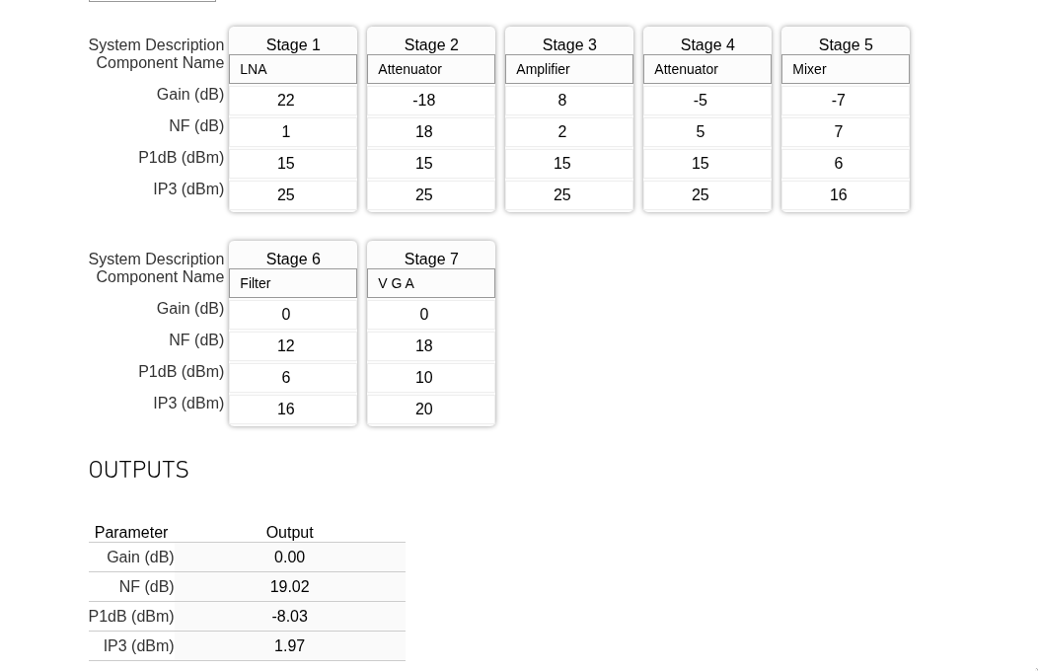
Proposed Line-up
Cascade analysis (Min. gain)

Slide 6
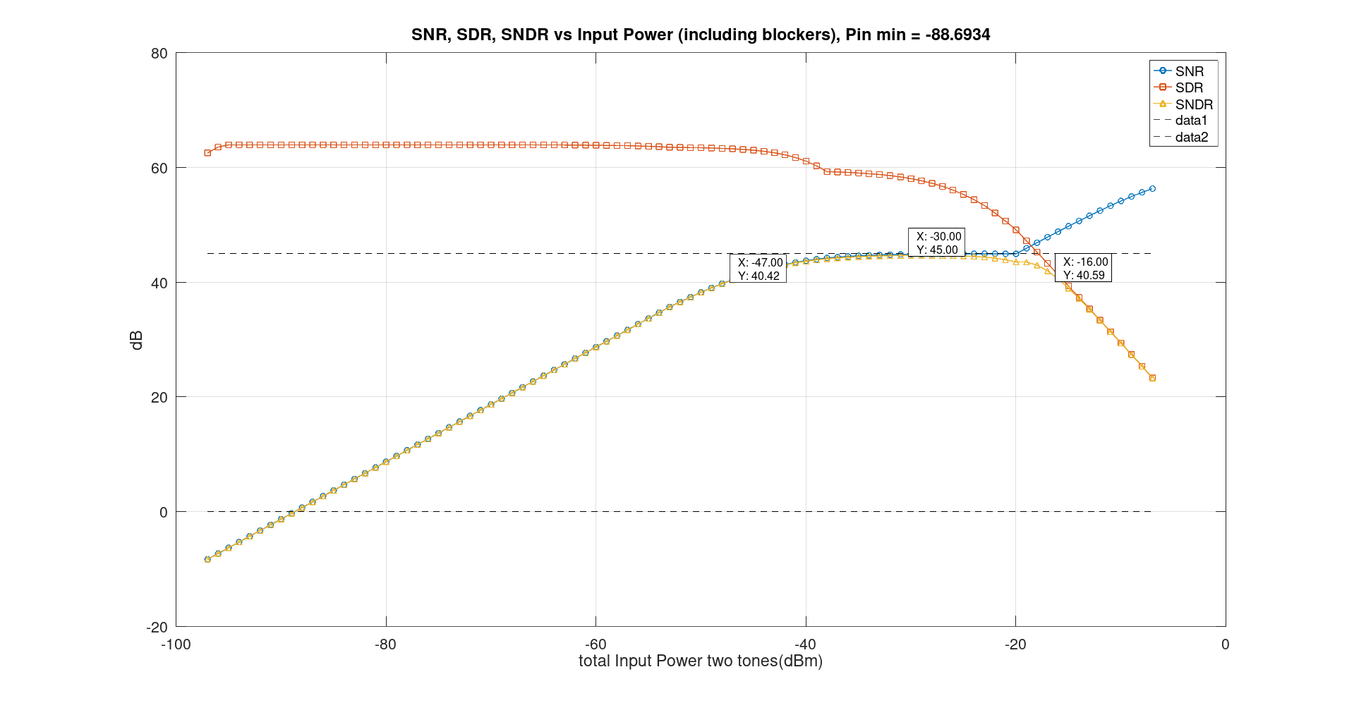
SNR, SDR and SNDR without blockers

Slide 7
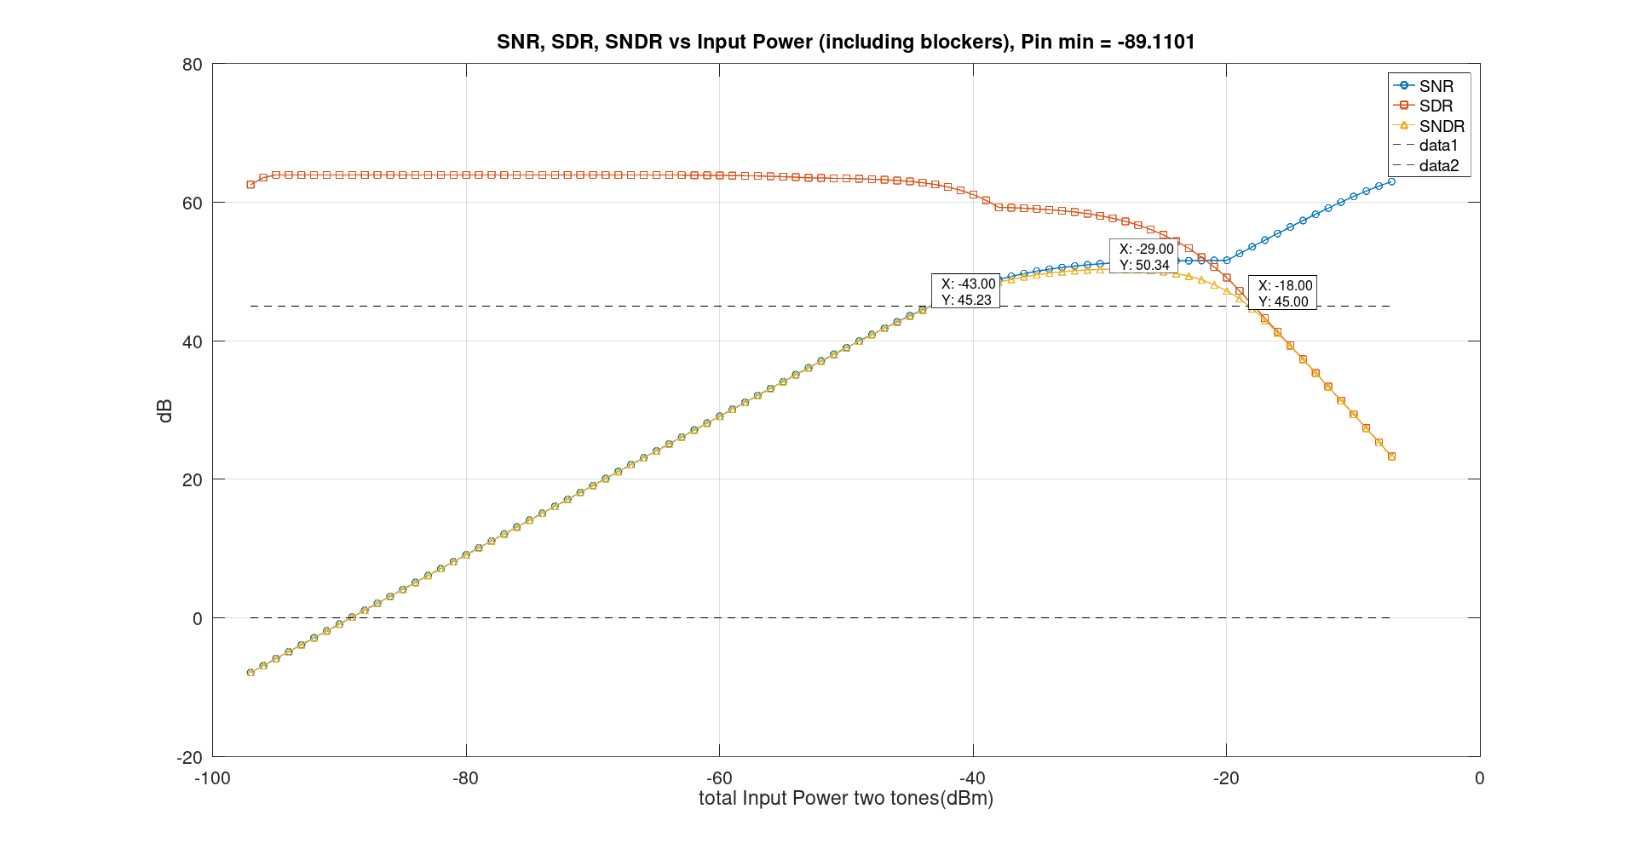
SNR, SDR and SNDR without blockers (ADC enob = 12bits)

Slide 8
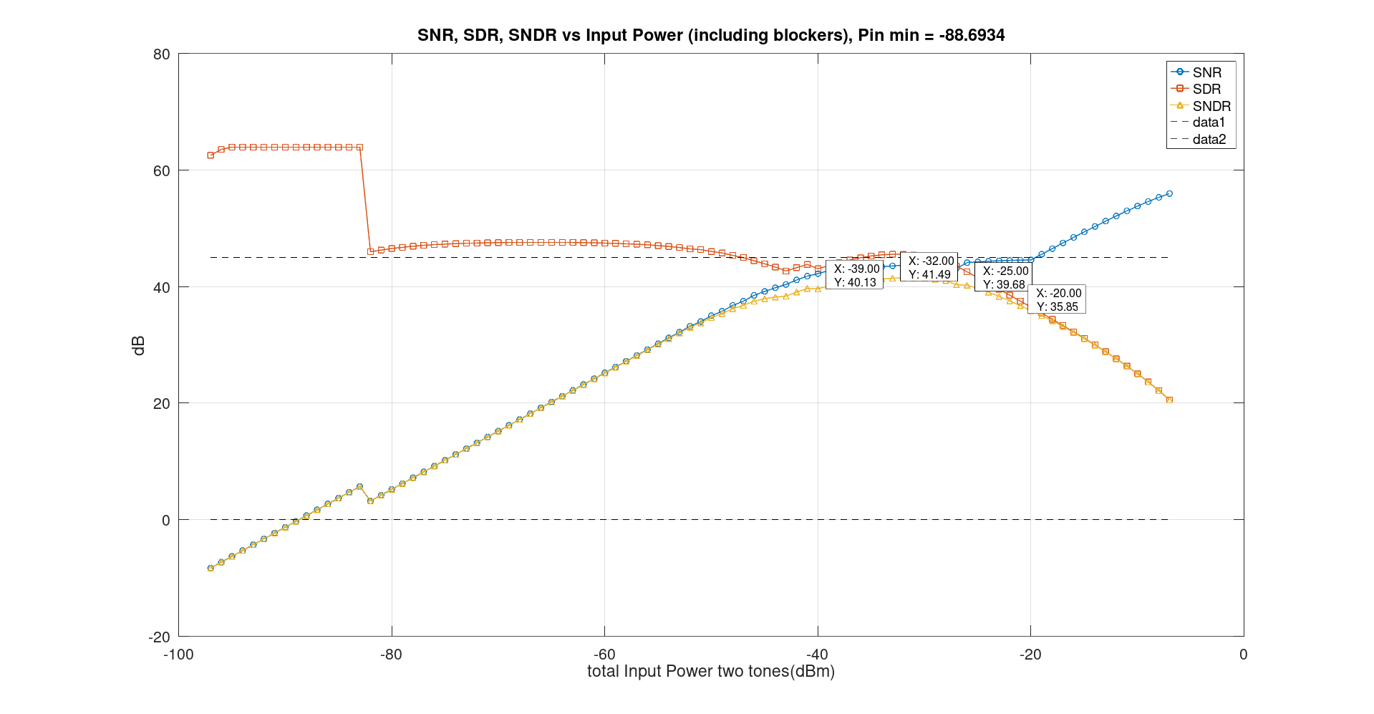
SNR, SDR and SNDR without blockers (With blocker and IP2)

Slide 9
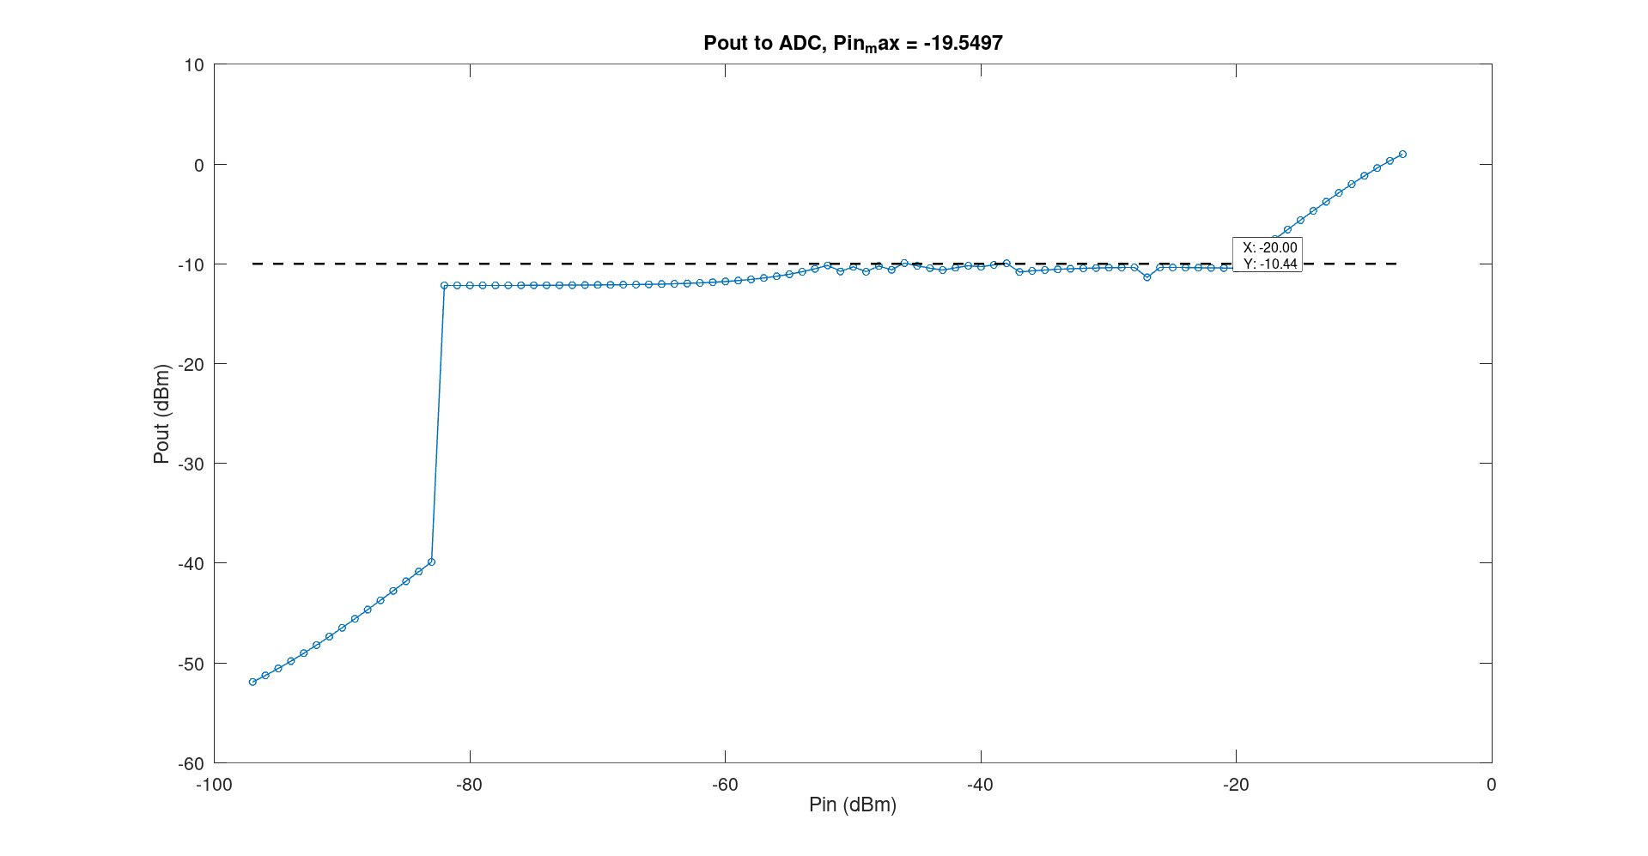
Maximum Input power for ADC
9

Slide 10
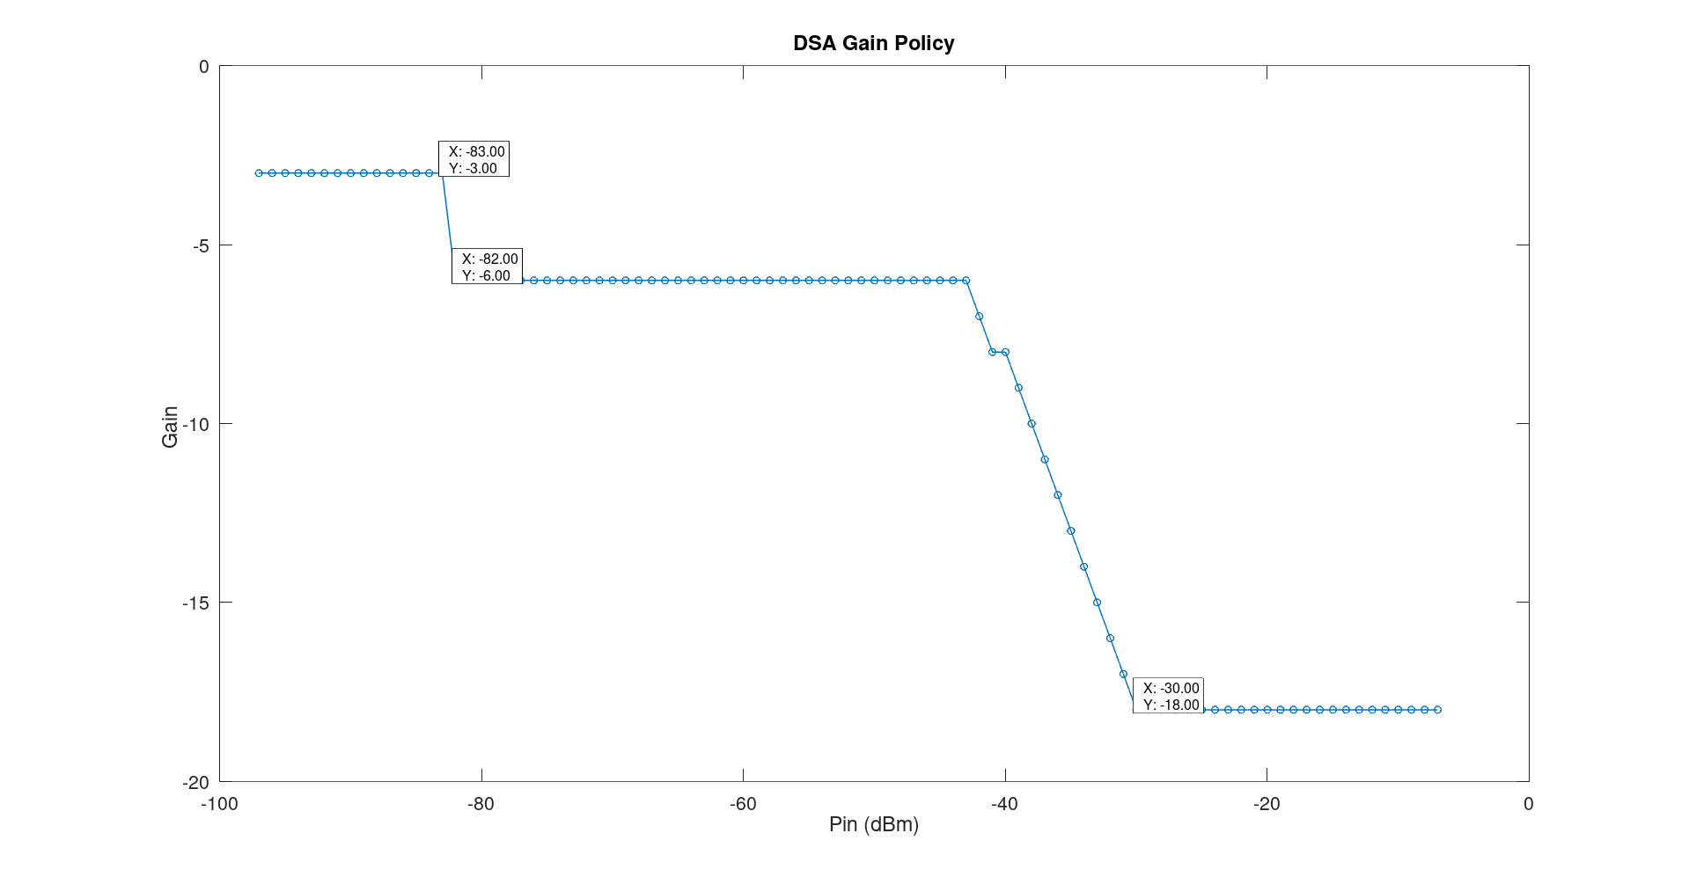
Gain Policy Under Blocking (First DSA)
10

Slide 11
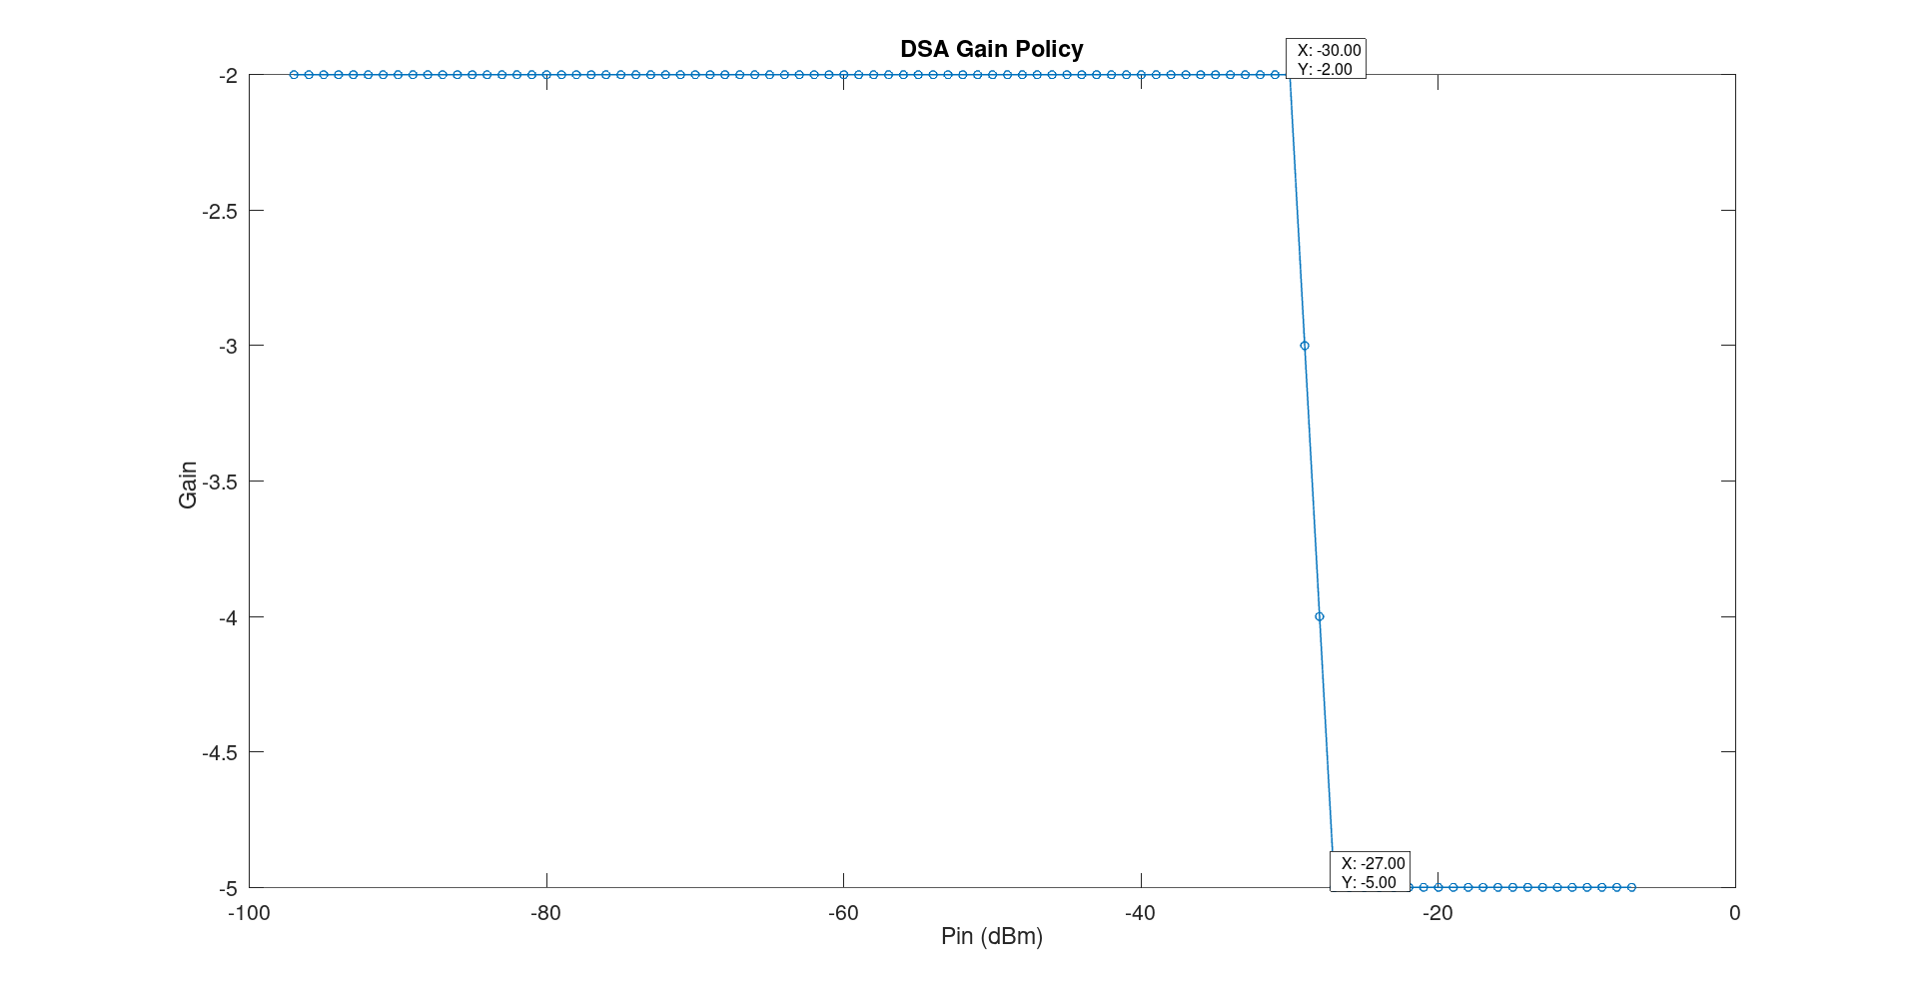
Gain Policy Under Blocking (Second DSA)
11

Slide 12
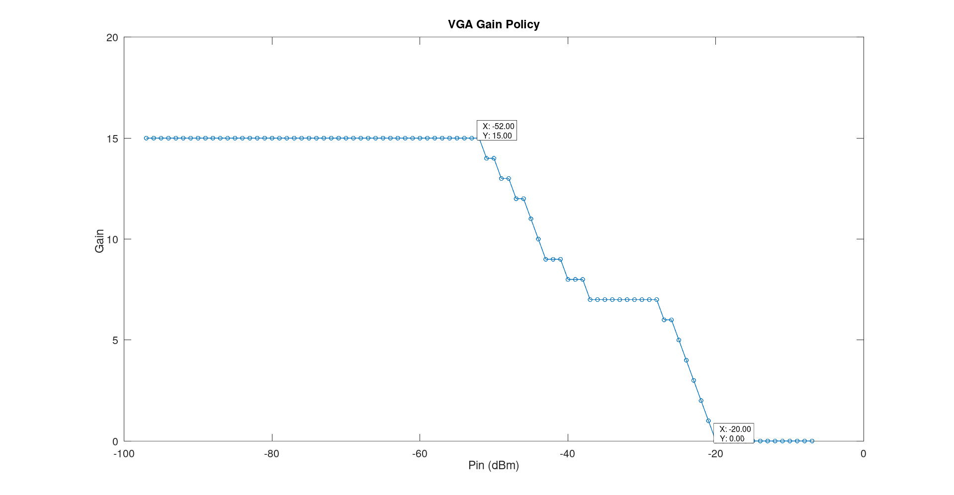
Gain Policy Under Blocking (VGA)
<number>

Slide 13
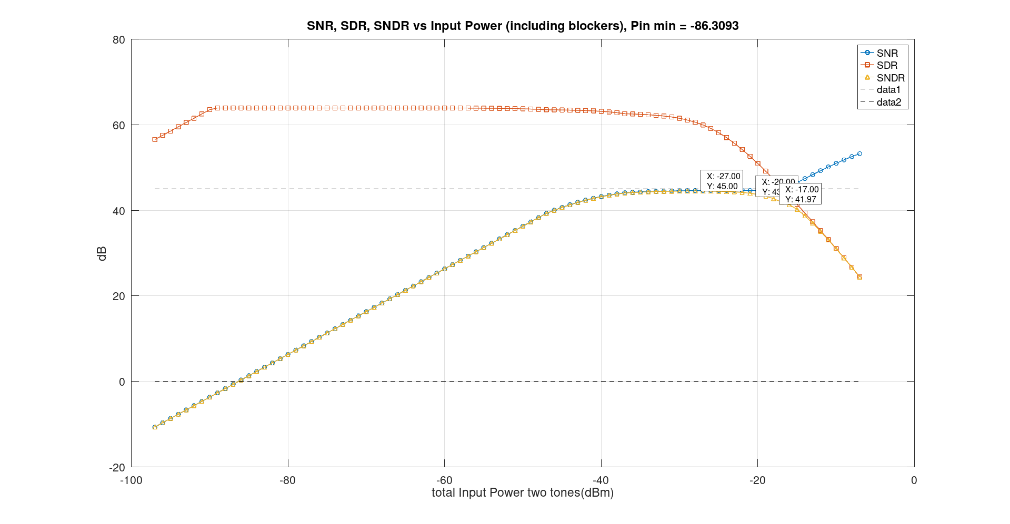
Comparison Between With and Without RF Amp
<number>

Slide 14
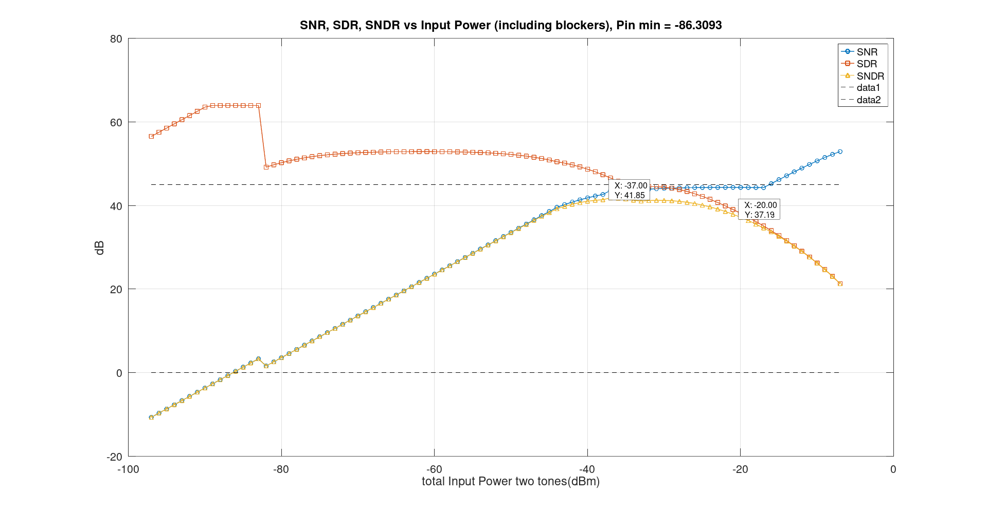
Comparison Between With and Without RF Amp

Slide 15
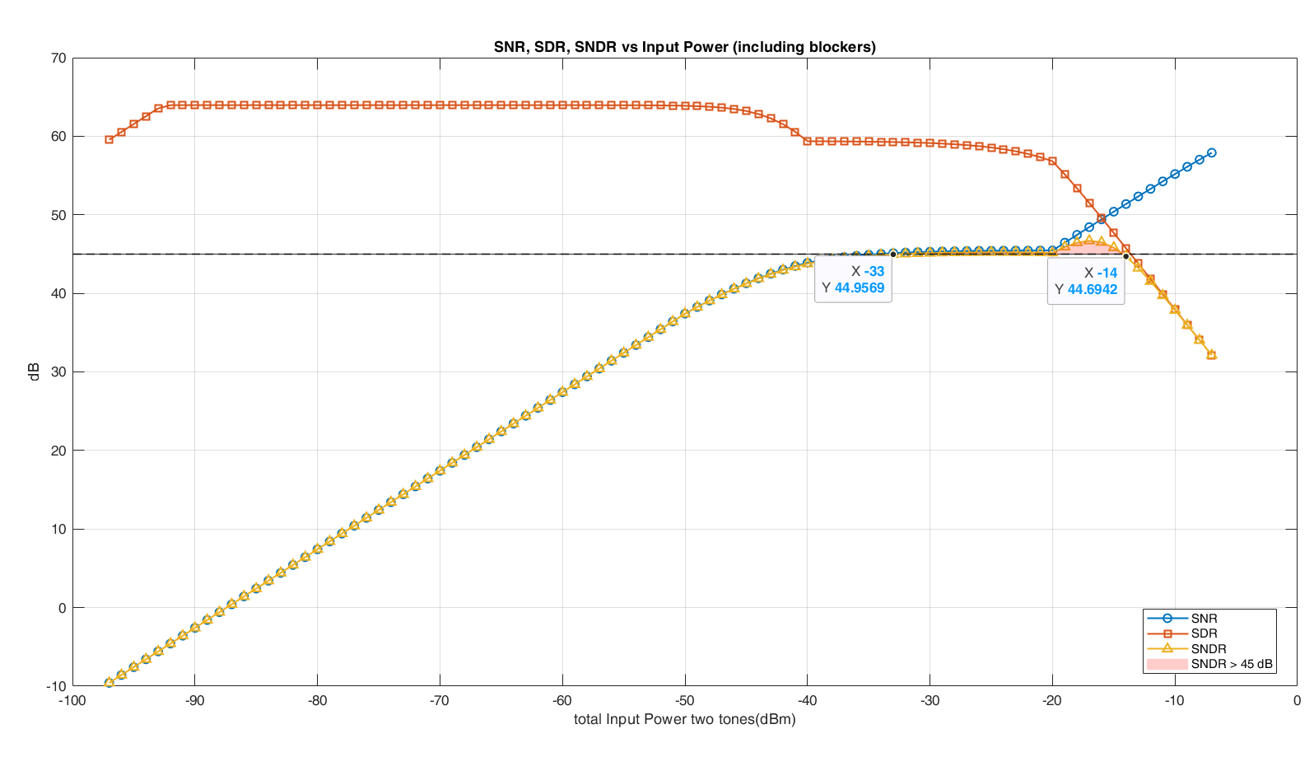
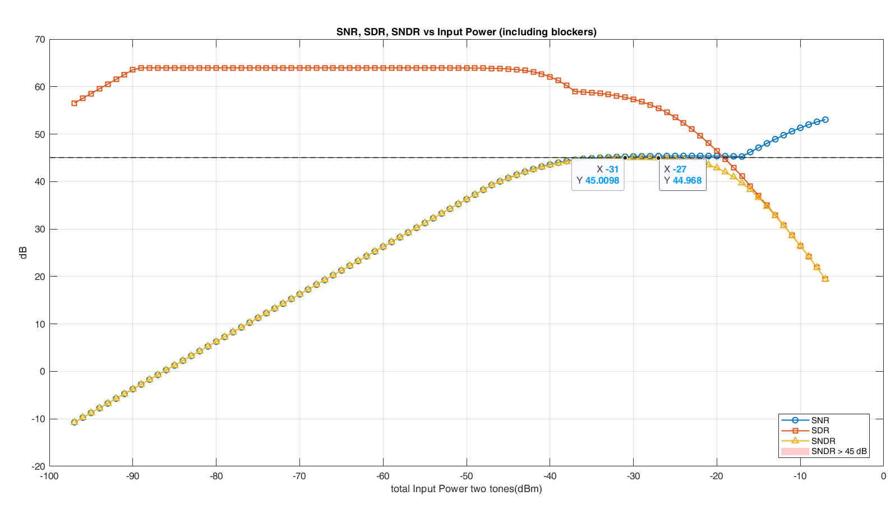
SNR, SDR and SNDR without blockers
External LNA
Internal LNA

Slide 16
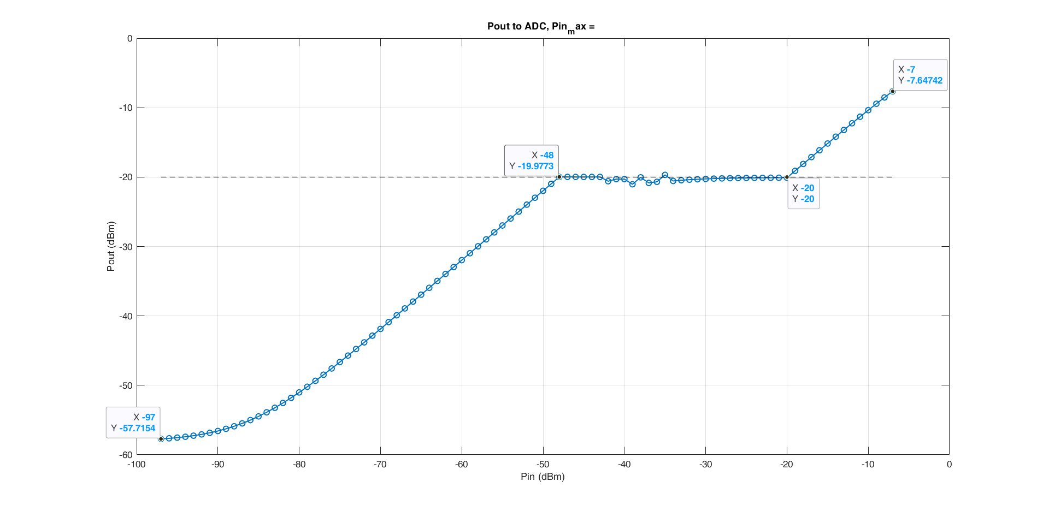
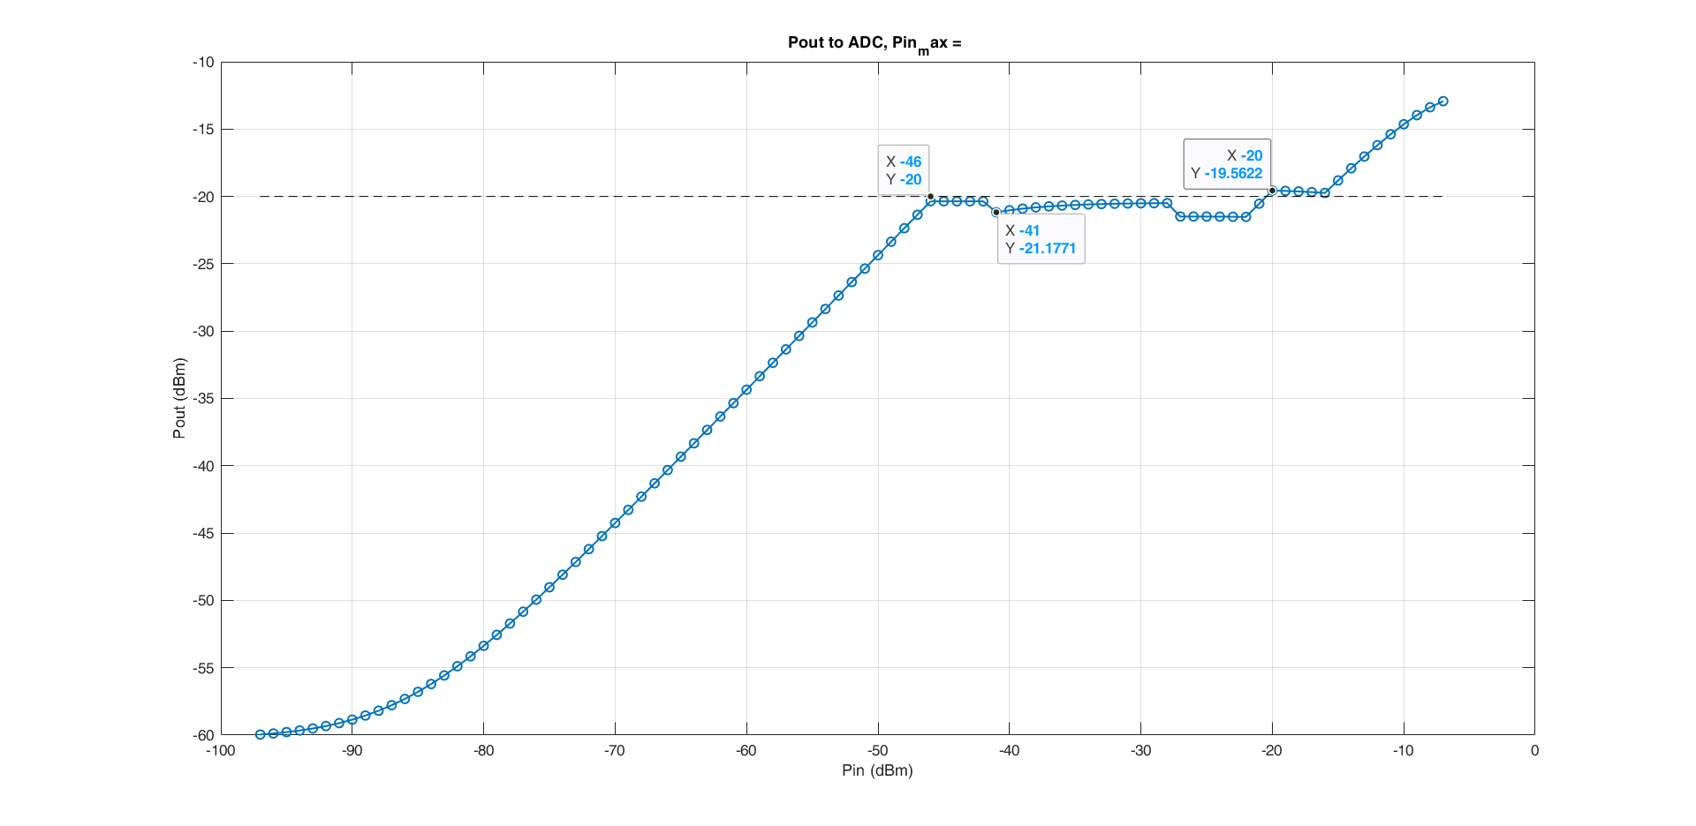
Input power to ADC with blockers
External LNA
Internal LNA

Slide 17
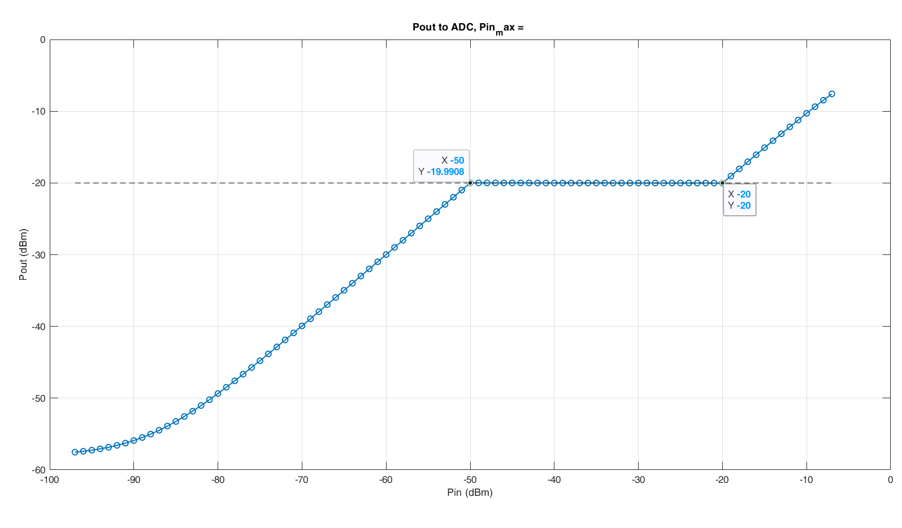
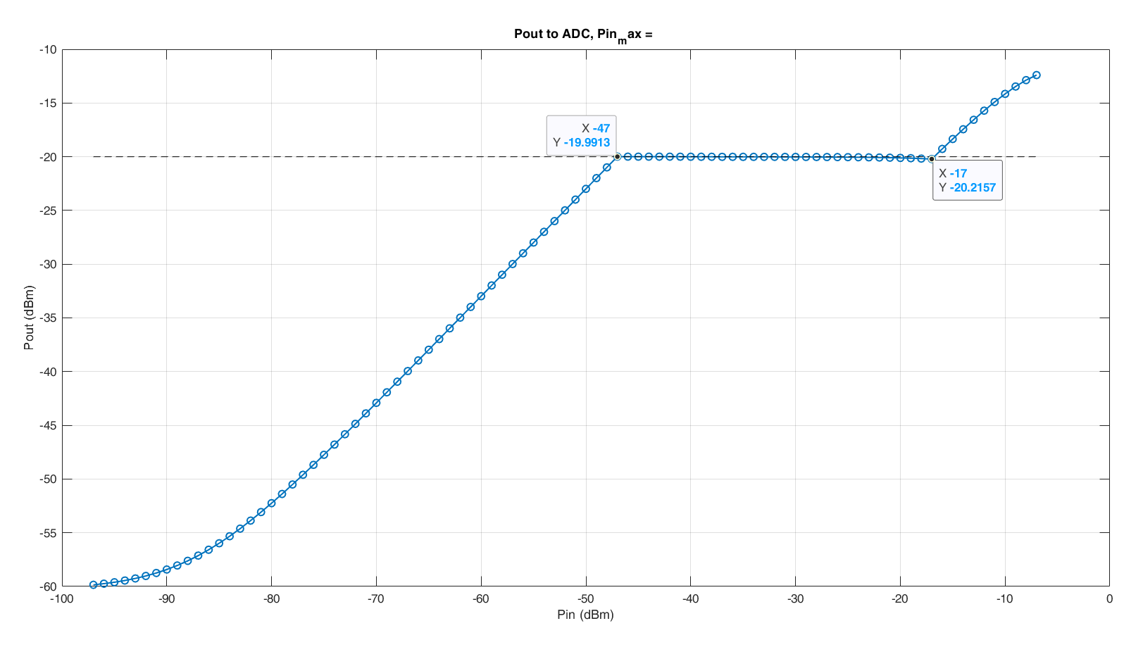
Input power to ADC without blockers
External LNA
Internal LNA

Slide 18
Input power to ADC with blockers
External LNA
Internal LNA

Slide 19
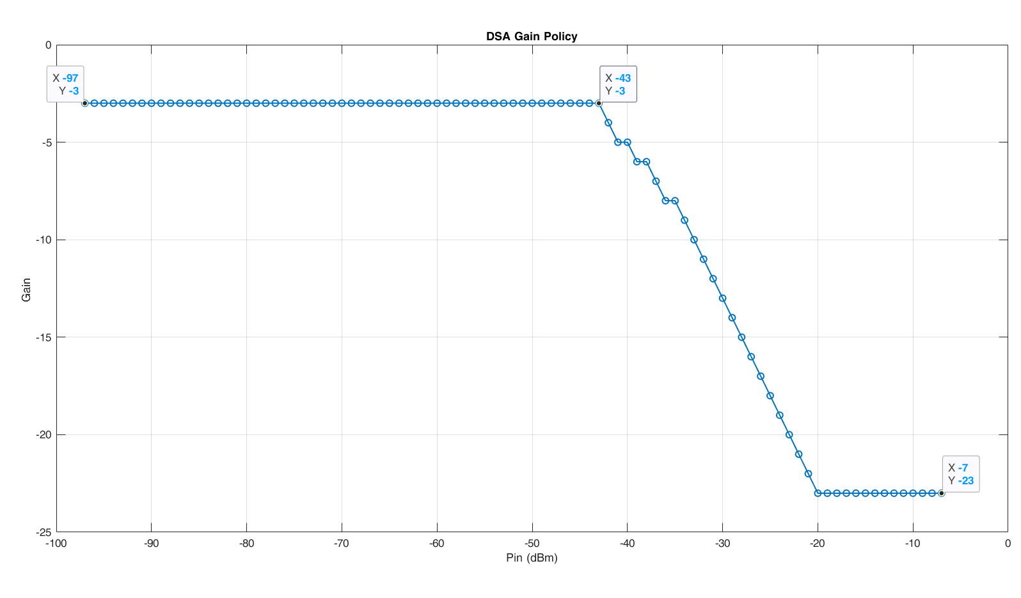
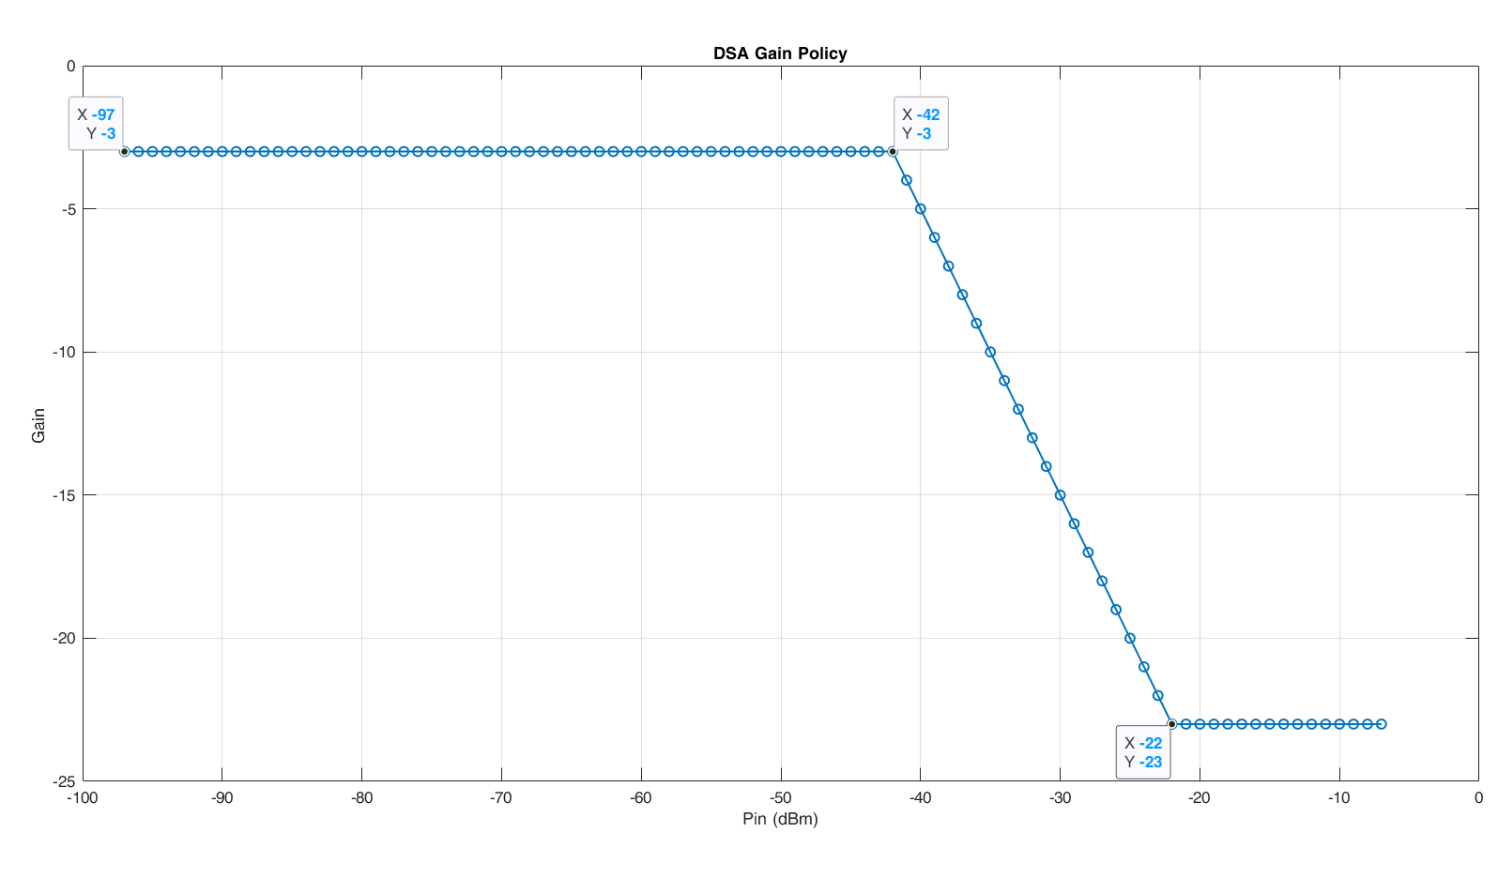
DSA Policy with blockers
External LNA
Internal LNA

Slide 20
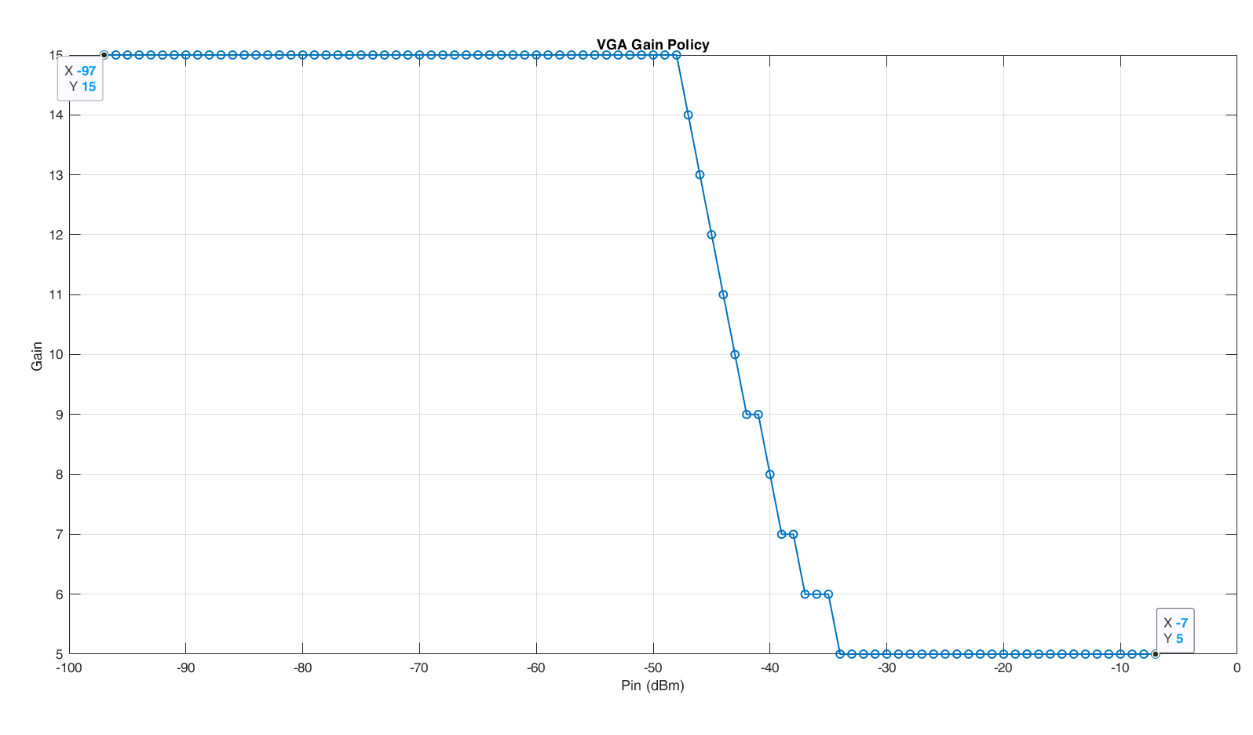
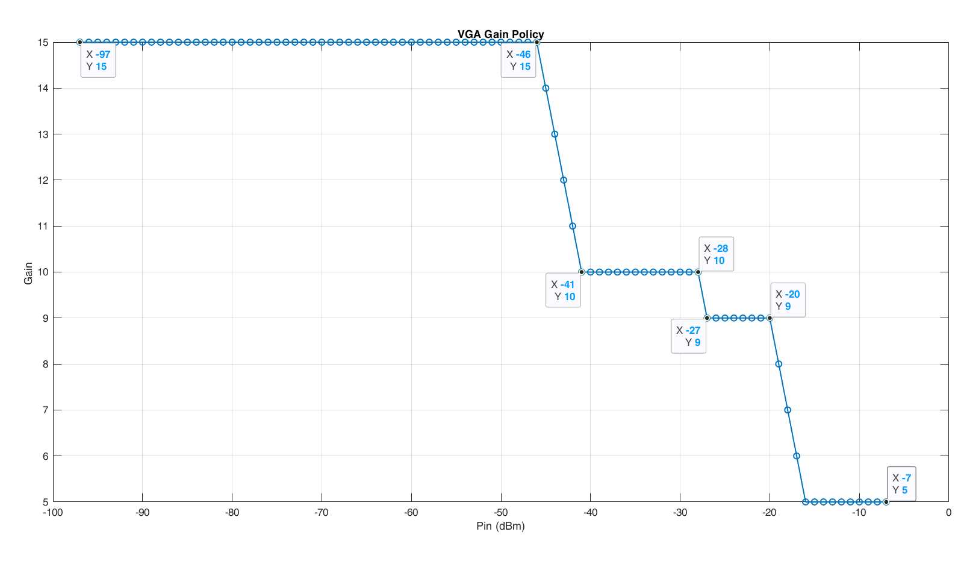
VGA policy with blockers
External LNA
Internal LNA

Slide 21
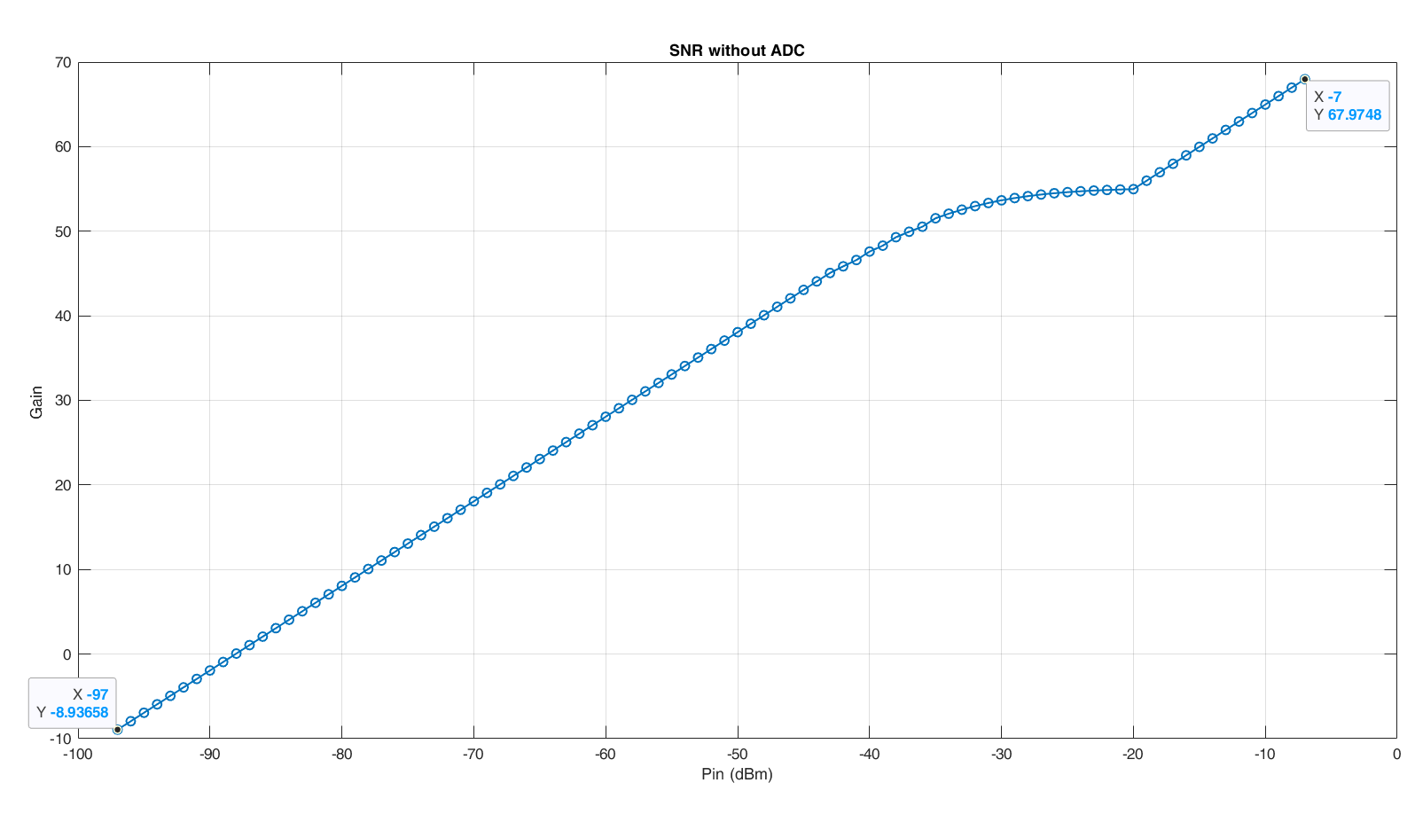
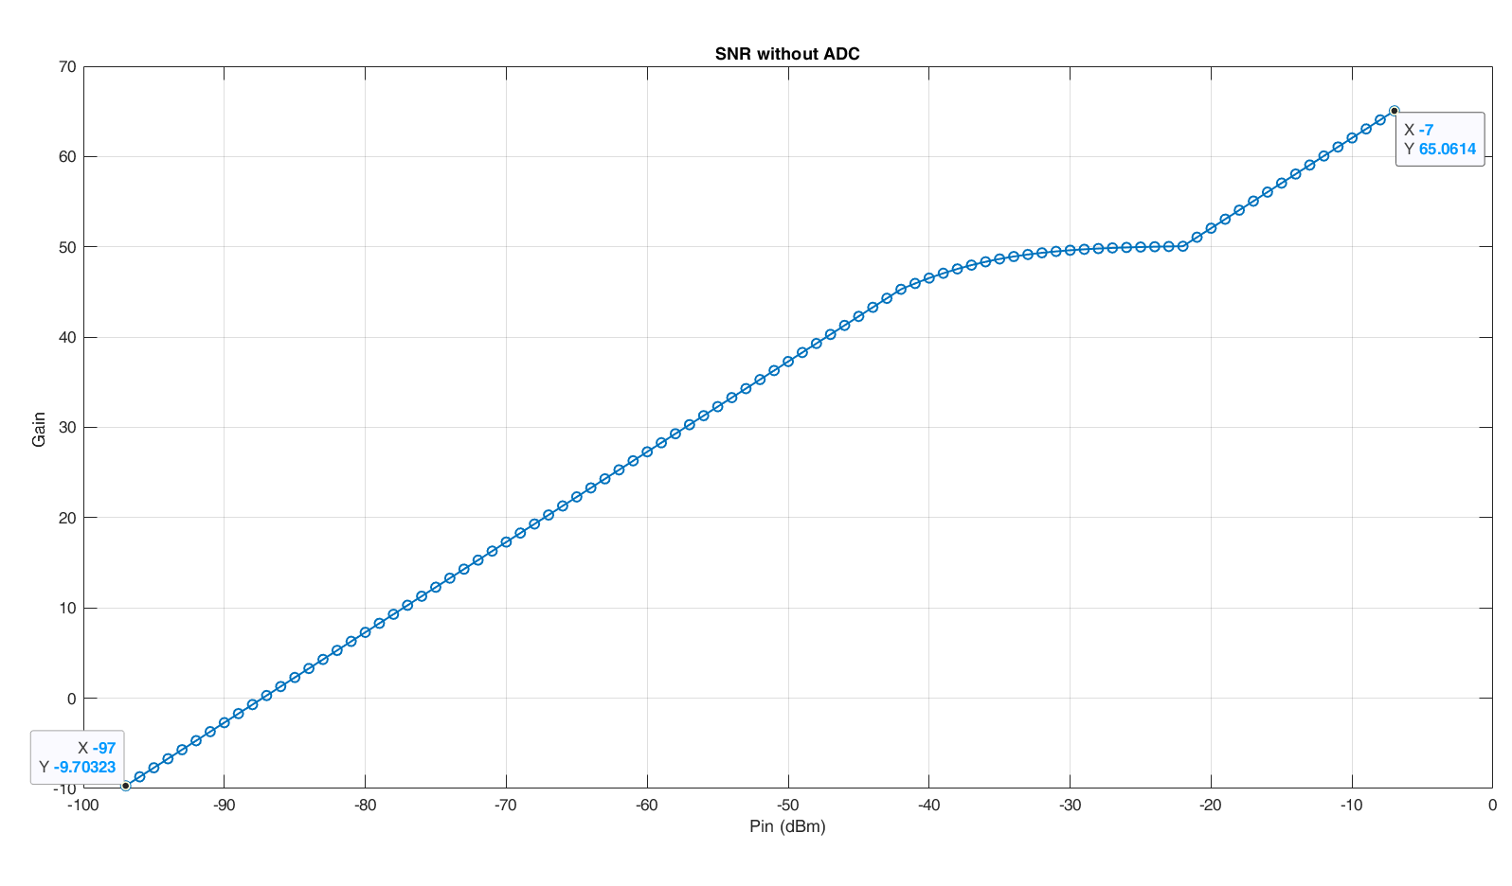
SNR before ADC
External LNA
Internal LNA

Slide 22
Summary
 | On chip LNA | External LNA | Notes
Gain | 22dB | 25dB
OIP3 | 23dB | 35dB
SNDR >= 45dB (blockers) | Below 45dB | Below 45dB | Ex. LNA is better
SNDR >= 45dB (no blockers) | 19 dBm | 4 dBm | Ex. LNA is larger
Input power to ADC (no blockers) | 30dBm range (-20dBm) | 30dBm range (-20dBm) | Same performance
Input power to ADC (blockers) | 28dBm range around -20dBm | 26dBm range around -20dBm | Ex. LNA is better
SNR | - | - | For high input, Ex. LNA is better, but it doesn’t matter as IP3 dominates

