Slide 1


By Muhammed Marashdeh
LOYALITY + STORE
QA Final Project Presentation
Al-Hussein Technical University
Q2 Impact

Slide 2




Overview
System Under Test
Test Scope
Test Strategy
Manual Testing
API Automation (Postman + Newman)
Performance Testing
UI Automation (Selenium)
Conclusion

Slide 3



System Under Test
Background:
Web UI
Backend API
E-commerce QA across 2 layers: SauceDemo UI + DummyJSON API
Relevance:
Protects the core journey
(login → cart → checkout) from user-blocking issues.
Login & Authentincation
Browse Products
Add To Cart & Checout
UI/UX Verification
Authentication Endpoints
Products (CRUD Operations)
Carts & Users Resources
API Stability & Integrity
Scope:
UI: Login, Products, Carts, Checkout
API: Auth, Products, Carts, Users
Methods: Manual, Automation, Performance

Slide 4

QA Strategy
Scope
Evidence Produced
Authentication & session stability
Cart state & checkout completion
Product listing & sorting correctness
API correctness (auth, products, carts, users)
Performance: latency, throughput, error rate
Manual test cases + defect log (severity + Location + repro)
API automation results (Newman report)
k6 performance metrics (p95 latency, throughput, errors)
UI regression suite coverage (Selenium/TestNG)
Risk-based strategy (SDLC/STLC)

Slide 5
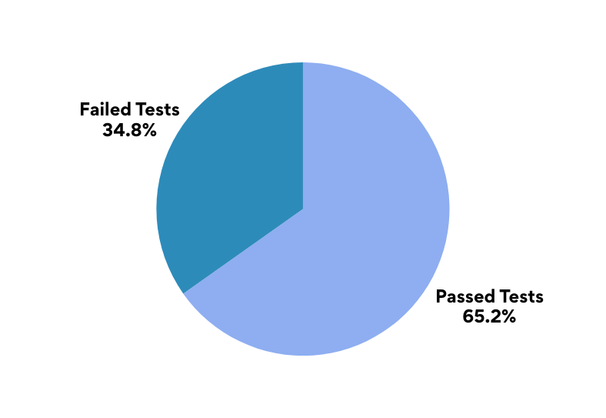
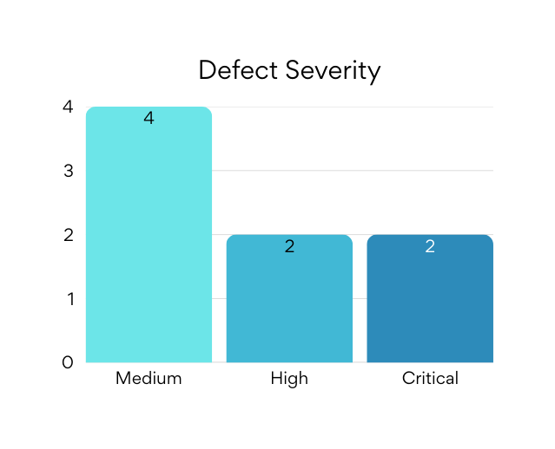
Manual Testing Results
23 Tests Executed, 15 Passed Tests, 8 Failed Tests (65% Pass Rate)
Coverage:
Authentication: login (valid/invalid), locked user behavior
Products: browse, sorting, product details
Cart: add/remove, quantity/badge updates
Checkout: information step, completion flow
UI/UX: layout/visual checks, error messaging
Defects Identified:
Checkout (Critical) error_user: Last Name input rejected
Checkout (Critical) problem_user: input goes to wrong field
Cart (High) problem_user: Remove not working / badge not updating
Products (High) problem_user: Sorting broken (low → high)
UI/Visual (Medium) visual_user: layout/alignment issues
Performance (Medium) performance_user: slow page loads
Product details (Medium) problem_user: incorrect product images
Checkout flow (Medium) standard_user: checkout allowed with empty cart

Slide 6




Key Defects
2 Critical
2 High
4 Medium
Checkout blockers preventing completion
Core shopping functionality broken
Visual, performance, and UX issues
Last Name input rejected
Cart state not updating
Visual + product display issues
Where/User: Checkout → Your Information (error_user)
What happens: Last Name field rejects input
Impact: Cannot continue → purchase blocked
Where/User: Cart / Inventory item (problem_user)
What happens: Remove not clickable; badge not updated
Impact: Cart unreliable → shopping disrupted
Where/User: Inventory UI (visual_user)
What happens: layout/alignment issues
Where/User: Product details (problem_user)
What happens: image mismatch vs product
Input goes to wrong field
Sorting not applied
Performance + flow edge case
Where/User: Checkout → Your Information (problem_user)
What happens: typing goes to First Name / Last Name not accepted
Impact: Form fails → checkout blocked
Where/User: Products page → Sort dropdown (problem_user)
What happens: Price low→high not applied
Impact: Wrong ordering → discovery/trust reduced
Where/User: Inventory/product pages (performance_user)
What happens: slow page loads
Where/User: Cart → Checkout (standard_user)
What happens: checkout allowed with empty cart

Slide 7

API Testing
Postman + Newman
29 requests organized across 6 sections: HealthCheck
Authentication
Products
Carts
Users
NegativeCases
Data-Driven Testing (Boundary Value Coverage):
Newman reads a CSV with 9 different product IDs, including boundary/invalid IDs (0, -1, 999999), to validate expected outcomes (200 vs 404).
Key validations:
HTTP status codes, response times, content-type, schema checks, token extraction and reuse.
Newman Results
261
Total Requests
9 Iterations Executed
927
Assertions
100% Passed
140ms
Average Response Time
59.1s Total Duration
Report: HTML Newman report generated (for readable evidence)

Slide 8


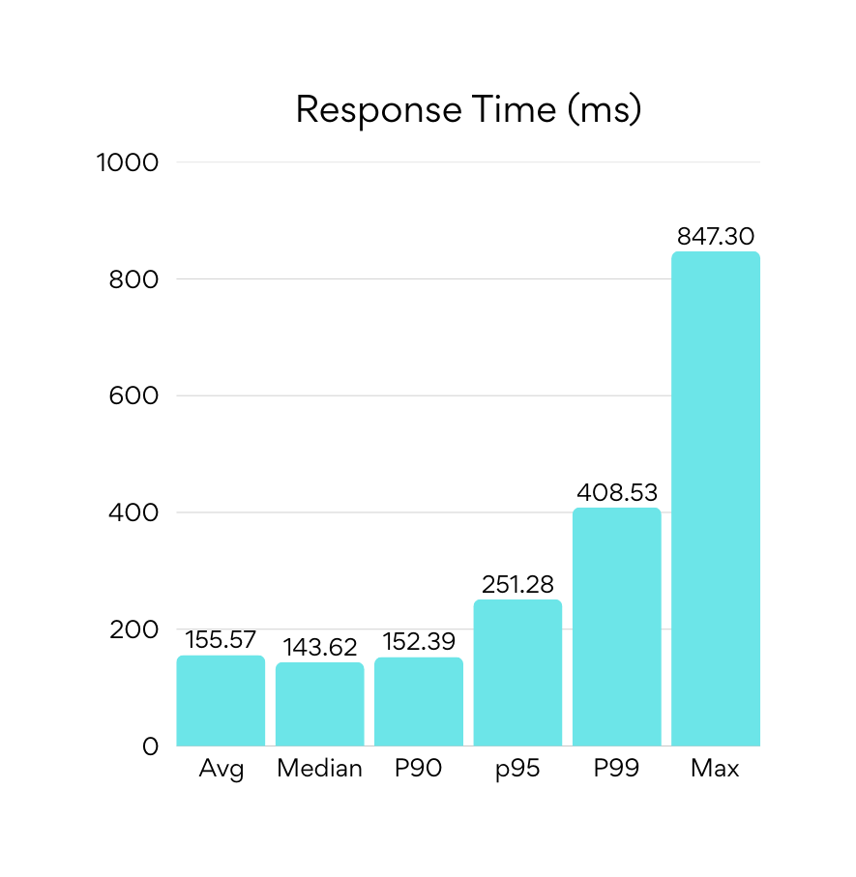

Performance Testing (k6)
Response time • Throughput • Error rate
Key Results:
• Total requests: 3,088
• Error rate: 0% (all checks passed)
• Throughput: ~16.16 req/s
• p95: 251ms • p99: 409ms
• Max: 847ms
Interpretation:
At the tested load, the API remained stable (0% errors) with strong latency (p95 251ms). No performance bottlenecks were observed at this level.

Slide 9


UI Automation (Selenium /TestNG)
Regression detection for the core user journey
01
02
Login Test
Verify Standard_user login and inventory page Loads
Add One Item To Cart
Add product, Verify cart badge and contents
03
04
Reset App State
Reset app state; confirm cart returns to empty
Sort Products By Price
Apply low→high sort; validate ordering behavior
05
06
Select Multiple Products
Add multiple items; verify cart count and totals
Checkout → Overview
Navigate checkout, enter customer info, and verify navigation to checkout step two.
07
08
Verify Total Price & Finish
Validate item total + tax calculation, then finish order and confirm checkout complete page.
Back to Products & Logout
Verify cart badge cleared, return to inventory page, open menu, logout, and confirm redirect to login page.
Framework
Result
Java + Selenium WebDriver + TestNG with Maven Build
8 prioritized tests covering critical end-to-end workflows.
All Tests Passed: 0 failures, 0 errors, 0 skipped

Slide 10

Conclusion
What I delivered
End-to-end QA across UI + API: manual, automation, and performance evidence
23 manual tests executed → 8 defects found (2 Critical, 2 High, 4 Medium)
API regression suite: 261 requests / 927 assertions / 0 failed
k6 performance: 0% errors, p95 251ms, ~16 req/s
UI regression suite: 8 Selenium/TestNG tests covering the core journey
Key takeaway
Highest risk is concentrated in Checkout (critical blockers) and Cart/Sorting (high)
Thank you
Q&A

