Slide 1
Loyalty+ Store
Scope: SauceDemo UI + DummyJSON API
Manual • API Automation • Performance • UI Automation
QA Capstone — End‑to‑End Testing
Presenter: Muhammed Derar Marashdeh
Date: January 2026
Notes:
Timing: ~0:35 Say: - Hello, I'm Muhammed. In the next ~7 minutes I'll walk you through my QA capstone for the Loyalty+ Store. - I tested two real targets: SauceDemo for the web UI and DummyJSON for the backend API. - I’ll cover: strategy, manual testing & defects, API automation with Postman/Newman, performance testing with k6, and UI automation with Selenium/TestNG.

Slide 2
Agenda
What you’ll see
How I’m presenting (interview-style)
1) Project targets & tools
2) SDLC/STLC + test strategy & scope
3) Manual testing results + defect reporting
4) API automation (Postman + Newman) + report
5) Performance plan/results (k6)
6) UI automation (Selenium + TestNG)
7) Summary + next steps
• Clear structure, one idea per slide
• Visuals > walls of text
• Timed to fit the limit + Q&A
• Backup plan + cue-card prompts
Outcome
Demonstrate QA skills across the lifecycle:
strategy → execution → evidence → automation → analysis.
Loyalty+ Store QA Capstone
Notes:
Timing: ~0:45 Say: - Quick agenda so you can track the story. - I’m using an interview-presentation style: structured, timed, and visuals as prompts, not a script. - At the end I’ll share recommendations and leave time for questions.

Slide 3
System Under Test (SUT) & Tooling
Targets
Toolchain
Web UI: SauceDemo (Swag Labs)
• login → browse → cart → checkout
API: DummyJSON
• auth, products, carts, users
Manual: Excel test cases + evidence
API: Postman collection + environments
Newman CLI + HTML report
Performance: k6 scenarios + thresholds
UI automation: Java + Selenium + TestNG (Maven)
Version control: Git/GitHub
Why these targets?
• Realistic e‑commerce flows (high business value)
• Known edge cases via multiple test accounts
• Public APIs allow automation + performance validation
Targets: SauceDemo UI + DummyJSON API
Notes:
Timing: ~0:55 Say: - The project treats “Loyalty+ Store” as a retail platform tested through two real systems: SauceDemo for UI and DummyJSON for API. - This gives a realistic end-to-end QA story: manual exploration and defect reporting, then automation for repeatability, plus performance validation.

Slide 4
SDLC / STLC & Test Strategy
SDLC
Requirements
Design
Build
Deploy
STLC
Test Plan
Test Design
Execute
Closure
Strategy & scope (high level)
QA role
• In scope: Web UI + API functional, smoke, regression
• Out of scope: security, mobile (per rules of engagement)
• Entry/exit criteria + metrics (pass rate, defect density, perf KPIs)
• Risk-based focus: login, cart, checkout, auth, products
Translate requirements → testable scenarios
Collect evidence
Report defects clearly
Automate repeatable checks
Feed back risks + recommendations
SDLC ↔ STLC alignment
Notes:
Timing: ~0:55 Say: - I align testing with the SDLC: as features are defined and built, the STLC runs in parallel. - My strategy was risk-based: prioritize the highest-value retail journey (login → cart → checkout) and the core API resources (auth/products/carts/users). - I also defined entry/exit criteria and metrics so testing is measurable and sign-off is objective.

Slide 5
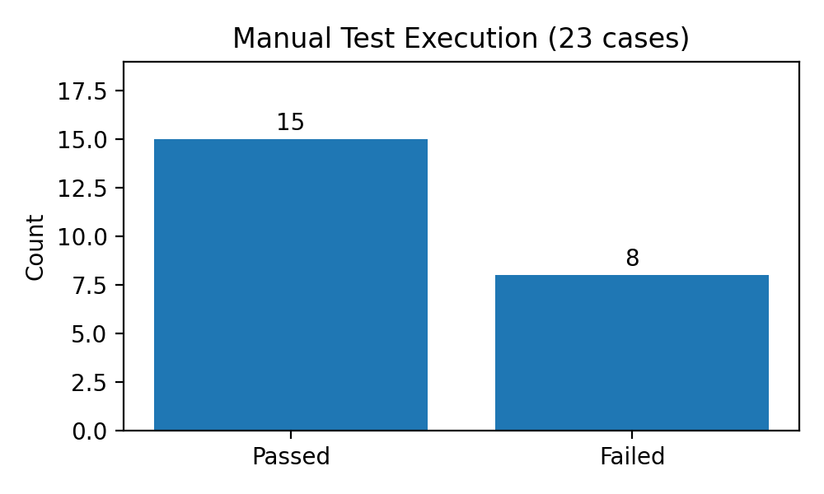
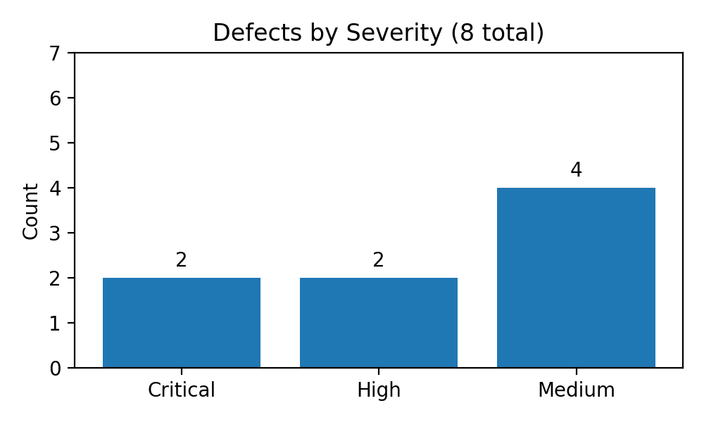
Manual Testing: Coverage, Evidence, Defects
Manual cases executed
Pass rate
Defects / findings
23
65%
8
Execution summary
Defect severity
Evidence captured per test case (screenshots/links)
Notes:
Timing: ~1:10 Say: - Manual testing validated core user journeys and edge cases across multiple accounts. - I executed 23 cases: 15 passed and 8 failed, which produced 8 logged findings with clear reproduction steps and evidence. - Severity was risk-based: 2 critical issues in checkout, 2 high, and 4 medium. - Example: last-name field not accepting input blocks checkout completion — that’s a critical defect because it prevents purchase.

Slide 6
API Automation: Postman Collection + Newman Report
Iterations (CSV)
Total requests
Assertions
9
261
927
Design highlights
Newman run (HTML report)
• Modular folders: Auth, Products, Carts, Users, Negative cases
• Environment variables: BaseUrl, tokens, IDs
• Pre-request + tests: schema/field checks, status codes, timing
• Data-driven: productId via CSV to validate multiple IDs
newman run FinalProjectApiTest.json -e DummyJson.postman_environment.json \
-d products_datadriven.csv -r htmlextra \
--reporter-htmlextra-export newman-report.html
Run outcome
✅ 0 failed tests
Avg response: 140 ms
Total duration: 59.1 s
Automation adds fast, repeatable regression confidence
Notes:
Timing: ~1:05 Say: - For the API, I built a Postman collection with reusable folders and shared assertions. - I externalized configuration with an environment, and captured tokens/IDs for chaining authenticated calls. - I ran it data-driven using a CSV for product IDs, then executed via Newman to produce an HTML report. - The documented run completed with 0 failures, 261 total requests, and an average response time of ~140ms.

Slide 7
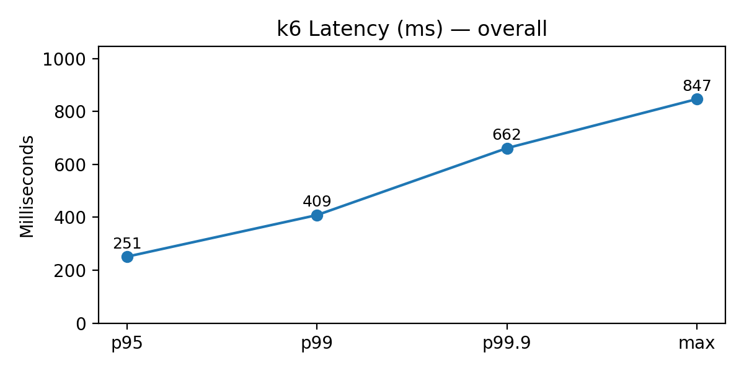
Performance Testing: k6 Scenarios + Results
Plan
Observed latency (overall)
Endpoints (DummyJSON):
• GET /products/categories
• GET /products/category-list
• GET /products/category/{CATEGORY}
Profiles per endpoint: 5 VUs/10s (smoke) then 25 VUs/45s (load)
Acceptance thresholds (SLOs)
• Error rate: < 0.5% (http_req_failed < 0.005)
• Latency: p90 < 500ms, p95 < 800ms, p99 < 1200ms
• Tail: p99.9 < 1800ms, max < 2500ms
Result
✅ 0% failures
✅ All thresholds met
Max observed: 847ms (<< 2500ms cap)
k6 run: smoke + load, staggered scenarios
Notes:
Timing: ~1:00 Say: - I created a k6 plan with three key product endpoints, each tested with a smoke and heavier load profile. - I defined SLO thresholds so the result is objective: error rate and latency percentiles. - In the documented run, there were zero failures and all thresholds passed; even the max request stayed well under the cap. - Next step would be longer duration tests and mixed traffic for more production-like evidence.

Slide 8
UI Automation: Selenium + TestNG (Java)
Automated end-to-end flow (8 tests)
Maintainability (next improvements)
1) LoginTest
2) AddOneItemToCart
3) ResetAppState
4) SortProductsByPrice
5) SelectMultipleProducts
6) checkout_goToOverview
7) VerifyTotalPrice
8) BackToHomePageAndLogout
• Refactor to Page Object Model (POM)
• Replace implicit waits with explicit waits
• Externalize creds/base URL
• Add screenshots on failure + reporting (Allure)
• Run in CI (GitHub Actions)
How to run
mvn clean test
(or) mvn test -Dtest=SauceDemoTests
Typical result: Tests run: 8, Failures: 0
Goal: fast regression for critical purchase journey
Notes:
Timing: ~0:55 Say: - To make regression repeatable, I automated the critical purchase flow in Selenium + TestNG. - The suite is intentionally end-to-end and sequential to mimic a real shopping session. - The immediate value is fast confidence on login/cart/checkout, and the roadmap is to improve maintainability with POM, better waits, and CI execution.

Slide 9
Summary, Value, Q&A
What I delivered
• Test plan with scope, risks, entry/exit criteria
• Manual execution: 23 cases + evidence + 8 defects
• API automation: Postman + Newman (HTML report)
• Performance testing: k6 scenarios + SLO validation
• UI automation: Selenium/TestNG suite (8 tests)
Thank you
Q&A
I’m happy to dive deeper
into any section.
If this were production…
1) Add CI pipeline (Newman + smoke UI + k6 smoke)
2) Expand negative/API schema tests
3) Increase performance duration + mixed traffic
4) Refactor UI suite to POM + reporting
Loyalty+ Store QA Capstone
Notes:
Timing: ~0:40 + Q&A Say: - Summarize the value: measurable strategy, evidence-based defect reporting, repeatable automation, and performance SLO validation. - Call out the production next steps: CI, more negative/schema coverage, longer performance tests, and POM refactor. - Invite questions.

