Slide 1


Steganography
Team Member
Mohammed Usama Tharwat Elhagari
Fares Ahmed Swedan

Slide 2
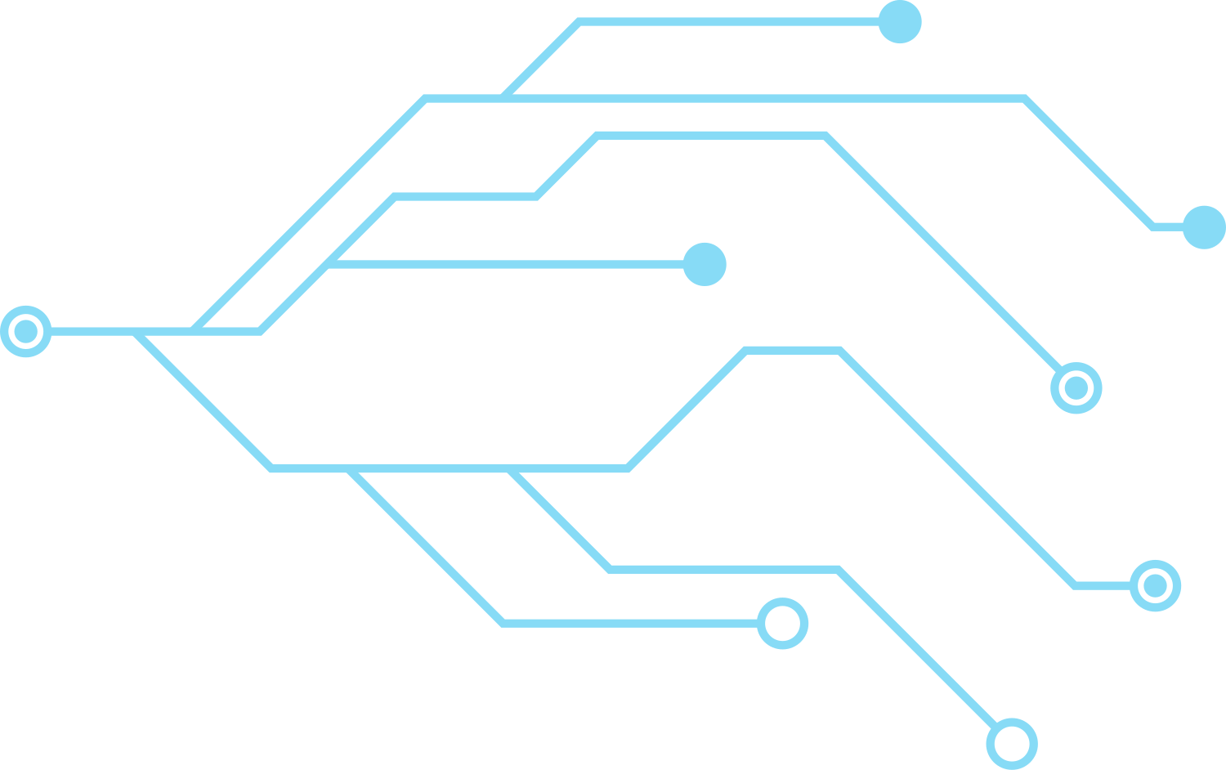


Agenda
Problem Definition
objective
System Architecture
Methodology
Conclusion

Slide 3
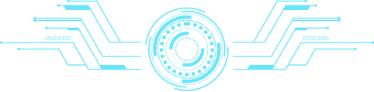
Problem Definition

Slide 4
Problem Definition
cryptography able to keep messages secret yet visible poses a challenge. Communicating how encryption conceals information from unauthorized viewers while making it accessible to intended recipients in simple terms is essential. This dilemma requires crafting a concise and clear explanation to bridge the comprehension gap for non-experts, enhancing understanding of cryptography's significance in safeguarding sensitive data.

Slide 5
objective

Slide 6





Objective
Develop a desktop app for steganography, concealing secret messages within innocuous media imperceptible to human senses. Enhance privacy by enabling users to hide sensitive data securely, thwarting detection by unintended recipients. Empower users with a user-friendly interface for seamless concealment of confidential information in digital communication.
Sender
Receiver
Intruder understands that
secret message is being sent

Slide 7
System Arc

Slide 8
System Architecture
Cover File(X)
Steganographic Encoder
f(X,M,K)
Stego object
Secret Message(M)
Communication
Channel
KEY(K)
Secret Message
Steganographic Decoder
Stego
object

Slide 9

System Architecture: With Encryption
Key
Stego Key
Cover File
Message
Encryption
Algorithm
Cypher
Text
Steganographic Encoder
Stego Object
Sender
Communication
Channel
Decryption
Algorithm
Steganographic Decoder
Cypher
Text
Stego Object
Message
Receiver
Key
Stego Key

Slide 10
Methodology

Slide 11

Pixels & Bits
Toltal: 24Bits
R
1 | 0 | 1 | 1 | 0 | 1 | 1 | 1
Pixel
G
1 | 1 | 0 | 1 | 1 | 0 | 0 | 1
B
1 | 0 | 1 | 0 | 0 | 1 | 0 | 0

Slide 12
Least Significance Bit Steganography
If we change MSB, it will have larger impact on final value. If we change LSB, the impact on final value
is very less
value: 255
1 | 1 | 1 | 1 | 1 | 1 | 1 | 1
Most significant bit(MSB)
Least SignificantBit(LSB)
255
1 | 1 | 1 | 1 | 1 | 1 | 1 | 1
1 | 1 | 1 | 1 | 1 | 1 | 1 | 1
255
127
0 | 1 | 1 | 1 | 1 | 1 | 1 | 1
1 | 1 | 1 | 1 | 1 | 1 | 1 | 0
245
change in bytes is 99.99999%
change in bytes is 0.000002%

Slide 13
Least Significance Bit Steganography
Least Significant Bit Steganography(LSBS) involves overwriting the bit with the lowest arithmetic value
Secret message to hidden:
Letter 'A'
1 | 0 | 0 | 0 | 0 | 0 | 0 | 1
Pixels before insertion(3 pixels)
Pixels after insertion
10000000 10100100 10110101
10110101 11110011 10110111
11100111 10110011 00110011
10000001 10100100 10110100
10110100 11110010 10110110
11100110 10110011 00110011

Slide 14
How use it in the real-life

Slide 15
In Real-Life
1-Maintaining confidentiality: Steganography can be used to hide sensitive information within images, such as personal data or secret messages, to ensure it is not seen by unauthorized individuals.
2-Secure information exchange: Images containing hidden data can be used to exchange information securely, for example, over the internet or via email, without the data being noticed by observers.
3-Copyright protection: Images containing hidden data can be used to protect copyright and prevent unauthorized use of images

Slide 16
Conclusion

Slide 17
In Real-Life
In conclusion, the development of a steganography application represents a significant advancement in digital privacy and security. By harnessing the power of concealment within innocuous media, the app empowers users to safeguard their sensitive information effectively. With a user-friendly interface and robust encryption techniques, this tool stands as a vital asset in the protection of confidential data, ensuring privacy in the digital age.

Slide 18
Thank you

