Slide 1

Human resources slide 1
SQL Query Techniques
By Muhammed, Ruby and Mikaeel

Slide 2
Human resources slide 2
Learning Outcomes
Select Queries
Joins
Subqueries
Unions
Stored Procedures
Window Functions
CTE's

Slide 3

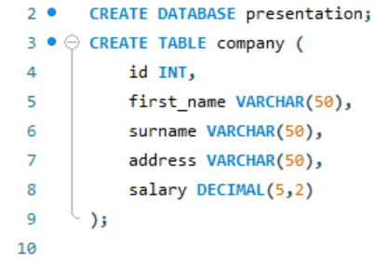
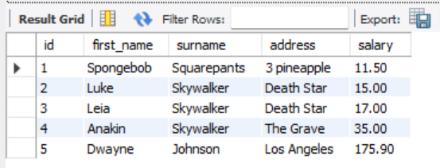
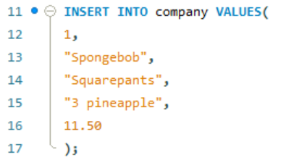
Human resources slide 8
Select Queries
The select statement is used to retrieve data from a database table. This means that from a large list of data, we can utilise select to retrieve specific data.
1. Creating a Table
To visually express the effects of the SELECT query we can utilize a table created in SQL Workbench. The code on the right shows the commands used to create the table as well as an example code to insert data. Finally, the resulting table is presented below.

Slide 4

Human resources slide 8
Select Queries
2. SELECT FROM
SELECT FROM is used to specify the table from which the data is retrieved from. For example, to select all data from the company table we use:
The ‘*’ symbol is used to denote all. Therefore, we are presented with the following table:

Slide 5

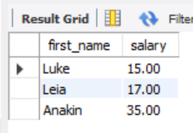
Human resources slide 8
Select Queries
3. SELECT FROM WHERE
The WHERE syntax can be used to specify a condition for the retrieved data. For example, the following code will provide the first name and salary for the employees with surname ‘Skywalker’.
Giving us:

Slide 6

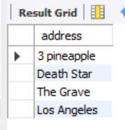
Human resources slide 8
Select Queries
4. SELECT DISTINCT
The DISTINCT syntax retrieves data with distinct values from a database table.
A column can often contain many duplicate values, and so, DISTINCT can be used to list the different(distinct) values. The following code will retrieve data from the company table that have different(distinct) addresses:

Slide 7

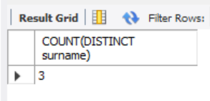
Human resources slide 8
Select Queries
5. COUNT DISTINCT
COUNT can also be used to count the number of distinct rows. So, the following code will count the number of unique surnames in the table:
Which results in the following:

Slide 8
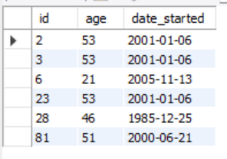
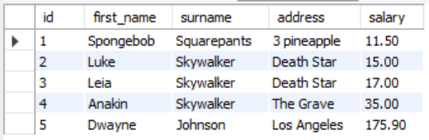
Human resources slide 8
Joins
The JOIN query can be used to merge rows of two or more different tables based on a common column. To visualize this query another table was created with another id column:
From this table we can see we have id 2 and 3 as seen previously in the ‘company’ table. We can use JOIN to merge the common rows.

Slide 9
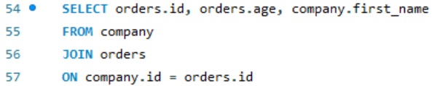
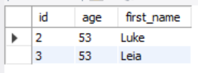
Human resources slide 8
Joins
Orders:
1. JOIN/ INNER JOIN
The following code can be used to merge the rows of the two tables
Based on the common id.
This joins the columns ‘id’ and ‘age’ from the table ‘orders’ to the column ‘first_name’ from the table ‘company’ based on the common data in the ‘id’ column of both tables.
Company:
INNER JOIN and JOIN will provide the same result as INNER JOIN is the default clause for JOIN.
Notes:
ON:
Specify the columns that have data in common.
JOIN:
Specify the table from which you are merging to.
FROM:
Specify from which table you are taking the data
SELECT:
Select the columns you want to merge with table name followed by a period and then the name of the column.

Slide 10
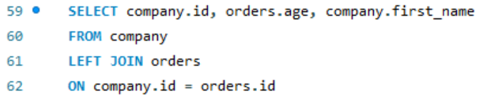
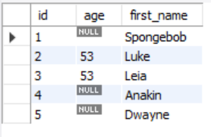
Human resources slide 8
Joins
Orders:
2. LEFT JOIN/ LEFT OUTER JOIN
LEFT JOIN will join tables in a way that keeps all rows in the specified column/s from the LEFT (first) table.
The following code uses the ‘company’ table as the left table so will keep the ‘id’ and ‘first_name’ columns while merging the common rows with the ‘age’ column from the ‘orders’ table.
Company:

Slide 11
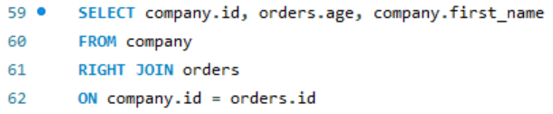
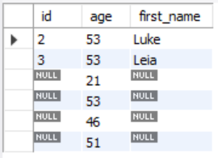
Human resources slide 8
Joins
Orders:
3. RIGHT JOIN/ RIGHT OUTER JOIN
RIGHT JOIN will join tables in a way that keeps all rows from the RIGHT (second) table.
Using the same code as before but replacing LEFT with RIGHT will give keep the ‘age’ column but merge the rows with common ‘id’.
Company:

Slide 12
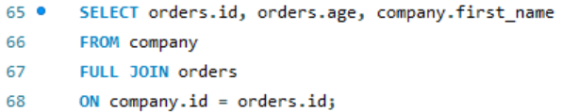
Human resources slide 8
Joins
Orders:
4. FULL JOIN/ FULL OUTER JOIN
FULL JOIN will return all rows of both tables when there is a common column. However, all rows will still be present even if there is no corresponding data in the other table/s. This can lead to a large data-set result.
A FULL JOIN command would look something like this:
Company:

Slide 13
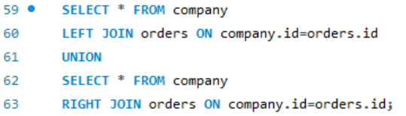
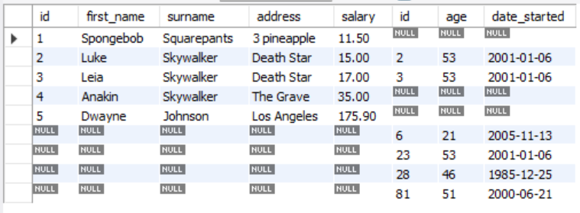
Human resources slide 8
Joins
Orders:
5. FULL JOIN/ FULL OUTER JOIN Continued
My SQL Workbench does not fully support FULL OUTER JOIN so we must emulate it through the following code:
Resulting in the following table:
Company:

Slide 14
Human resources slide 8
Subqueries
What is a subquery?
A subquery, also known as a nested or inner query, is a query that is embedded within another SQL statement, known as an outer query. We can apply subqueries with the 'SELECT', 'INSERT', 'UPDATE' and 'DELETE' statements along with the operators, such as =, <, >, >=, <=, 'IN', 'BETWEEN', etc.
Rules
There are some rules that need to be followed when creating subqueries:​
​
Subqueries must be enclosed in parentheses.​
Subqueries can be nested inside another subquery.​
A subquery must always contain the 'SELECT' query and the 'FROM' clause.​
A subquery consists of all the clauses an ordinary 'SELECT' clause can contain: 'GROUP BY', 'WHERE', 'HAVING', 'DISTINCT', 'TOP/LIMIT', etc. However, an 'ORDER BY' clause is only used when a 'TOP' clause is specified. It can't include 'COMPUTE' or 'FOR BROWSE' clause.​

Slide 15

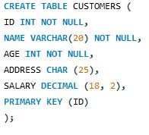

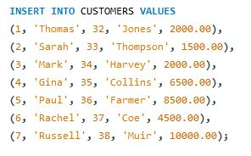
Human resources slide 8
Subqueries with the SELECT statement
We check the following subquery with the 'SELECT' statement, where the results show customers with a salary greater than 4500.
Subqueries are regularly used with the 'SELECT' statement.
In the following query, we are making a table called 'CUSTOMERS'.
Then, we are putting data into the created table using the 'INSERT INTO' statement.
This is how the table is displayed.

Slide 16
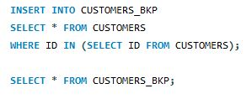
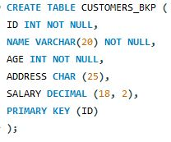
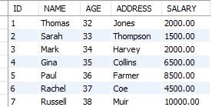
Human resources slide 8
Subqueries with the INSERT statement
We can use the following query to copy the data of the 'CUSTOMERS' table into the 'CUSTOMERS_BKP' one. To verify whether the data from the 'CUSTOMERS' table have been copied to the 'CUSTOMERS_BKP' one or not, we use the 'SELECT' statement.
The data returned by the subquery is inserted into another table.
We are making another table called 'CUSTOMERS_BKP', similar to the structure as the 'CUSTOMERS' table.
This is the following result.

Slide 17

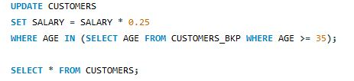
Human resources slide 8
Subqueries with the UPDATE statement
This is the result.
A subquery can also be used with an 'UPDATE' statement. As the name suggests, we can update single or multiple columns in a table using a subquery.
We have the 'CUSTOMERS_BKP' table as the back-up of the 'CUSTOMERS' table. This table updates 'SALARY' by 0.25 times in the 'CUSTOMERS' table for all customers whose 'AGE' is greater than or equal to 35.

Slide 18


Human resources slide 8
Subqueries with the DELETE statement
A subquery can be used with the DELETE statement as well.
The following example deletes the data from the 'CUSTOMERS' table for all the customers who are 35 years old or over.
This is what the result looks like when displayed in a table.

Slide 19
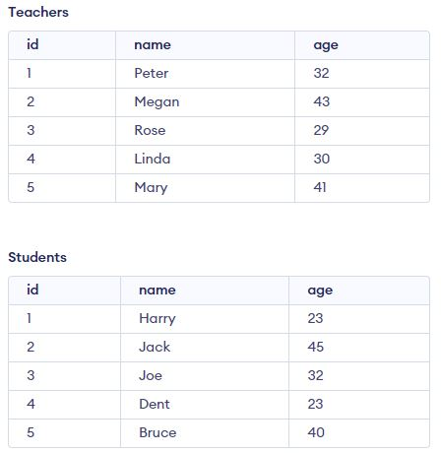
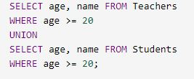
Human resources slide 8
UNION
This is what the results look like when displayed in a table.
The 'UNION' operator is used to combine the result of two or more 'SELECT' command queries into a single result set. This operator deletes any duplicates present in the results being combined. A 'WHERE' clause can used in the 'UNION' operator.
In this example, the SQL command selects the union of the name columns from two different tables: Teachers and Students.

Slide 20
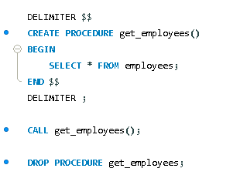
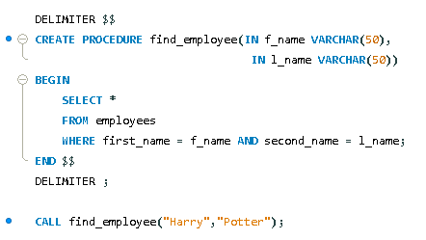
Human resources slide 8
Stored Procedures
Pros | Cons
Reduces network traffic Increases performance secure | -increases memory usage of every connection
Creating and calling a stored procedure:
What is a Stored Procedure?
A Stored Procedure is a prepared SQL code that you can save, this is useful if it's a query you write often.
How do we use a Stored Procedure?
First, we must define our stored procedure (similar to a function in JS but stored procedures can return multiple values, one value or no value and are focused on data manipulation and processing as opposed to functions being used for calculations and returning results). On line 4 of the example, we have a semicolon which usually would cause our code to come to an end, but we don’t want that we want our code to end on like 5 at "END". To change this, we temporarily change what symbol is used to separate our code using "DELIMITER" and then revert it back afterwards.
To call/ invoke a stored procedure we just use the keyword "CALL" followed by the procedure name and brackets (Line 8). To drop a procedure or remove its definition from the database, we use the keywords "DROP PROCEDURE" followed by the procedure name without brackets.
We can also pass data through stored procedures separating them with a comma, however we must use the key word "IN" followed by the name of the value and then the data type. (As shown in the second example)
Example with parameters:

Slide 21
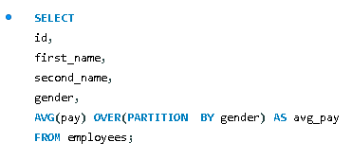
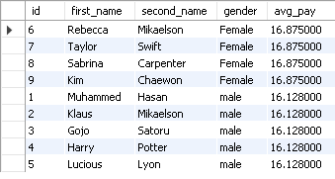
Human resources slide 8
Window Functions
What are window functions?
Window functions are analytical functions that perform calculations/ aggregate operations (such as sum, avg etc.) across a set of rows related to the current row that has been selected. Whilst "group by" collapses rows into a single row, window functions produce a result for each row.
As seen on the example on the right we first SELECT the columns we want to display (id, first_name, second_name, and gender). Then on line 6 we are calculating the average pay per hour, partitioned or separated based on the gender of our employee and then naming the column using the keyword AS.
The "OVER()" clause constructs a window, when nothing is passed into the brackets then the window will include all records (so in our example it would just calculate the average pay per hour of every employee regardless of their gender).
The "PARTITION BY" keywords are used to form rows into a grouped row and separate data by a given variable.

Slide 22
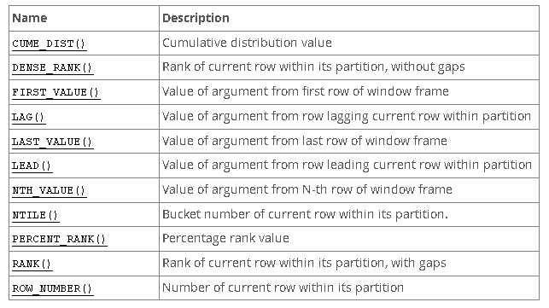
Human resources slide 8
Window Functions
What are nonaggregate window functions?
Window functions also have nonaggregate functions that for each row form a query and perform a calculation related to that row. The key difference is that you can't do these with group by.
Here is a list of them:

Slide 23
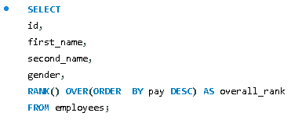
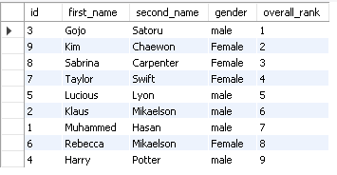
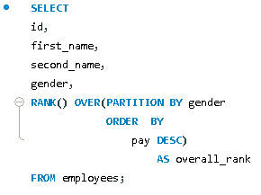
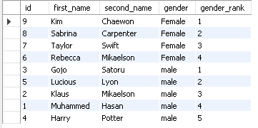
Human resources slide 8
Window Functions
RANK()
The window function "RANK()" ranks the current row within its partition with gaps.
Within the OVER() clause we use "ORDER BY" which reorders rows within each window. We can then use keywords such as DESC to get the result in descending order. (As shown in the example on the right)
We can also still use PARTITION BY to order the data based on a variable such as gender as seen in the example below.

Slide 24

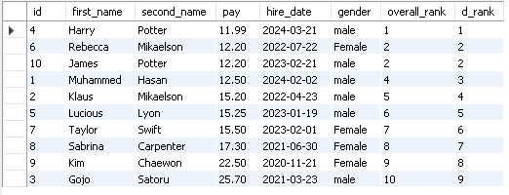
Human resources slide 8
Window Functions
DENSE_RANK()
DENSE_RANK() is very similar to RANK() as it is used to rank our data, however there is one key difference.
This is when we come across data with the same value such as James Potter and Rebecca Mikaelson in our example. They both have the same pay but notice how with RANK() after them it skips to 4 whilst with DENSE_RANK() it continues to 3.
RANK() will skip a value for every duplicate value it comes across whilst DENSE_RANK() wont.

Slide 25
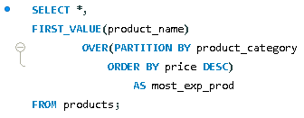
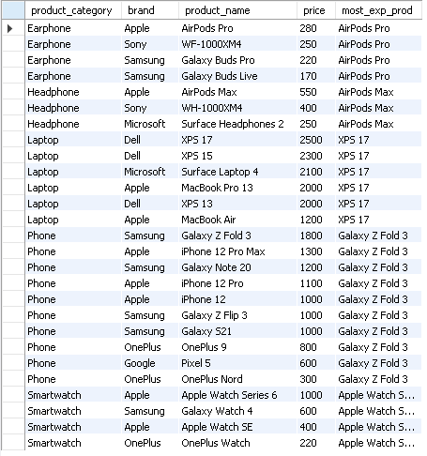
Human resources slide 8
Window Functions
FIRST_VALUE()
The window function "FIRST_VALUE()" is used to extract a value or column value from the first record within a partition.
We pass one argument into FIRST_VALUE() which is what we want to be displayed within the column. This is followed by the mandatory OVER() clause in window functions and in our example, we are separating our products based on the category and then displaying the most expensive product within that category.

Slide 26
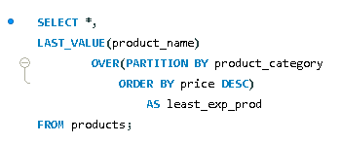
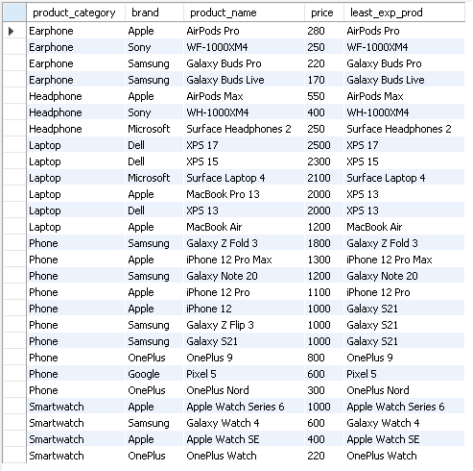
Human resources slide 8
Window Functions
LAST_VALUE()
The window function "LAST_VALUE" will fetch a value or a column from the very last record of a partition.
It's essentially the opposite of the FIRST_VALUE() function we just covered.
However, when using LAST_VALUE we can see in the example to the right that it isn't doing what we want it to, in the last column its just printing out the record names and not the least expensive products.
To fix this we need to look at frame clauses...

Slide 27
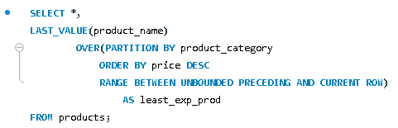
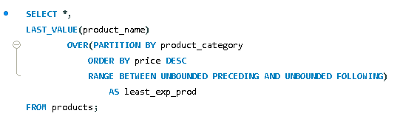
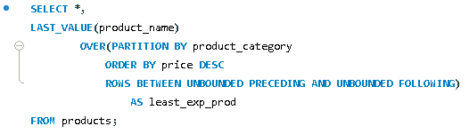
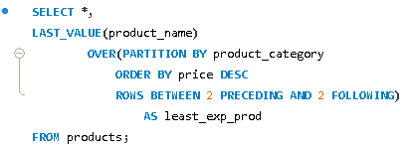
Human resources slide 8
Frame Clause
Default frame clause:
What is a frame and frame clause?
A frame is subset of a partition, and the frame clause specifies how to define the subset.
The frame clause is mentioned inside the OVER() clause after the ORDER BY clause. The default frame clause is "range between unbounded preceding and current row". Even if you don’t type this, an OVER() clause has this by default. (Line 5 on example one)
Some other frame clauses:
"range between unbounded preceding and current row"
The RANGE is defining the range of values that the window function needs to consider
PRECEDING is telling the function to look at the rows preceding the current row
UNBOUNDED is telling the function to start from the very first row of the partition
CURRENT ROW is telling the function to also consider the current row

Slide 28
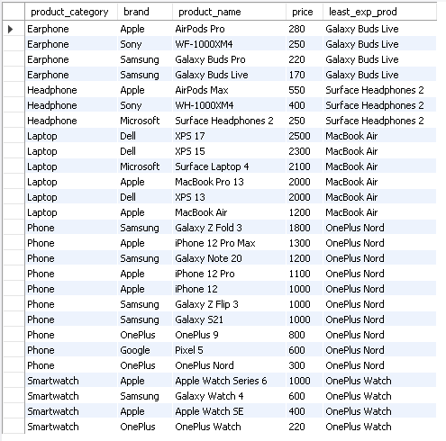
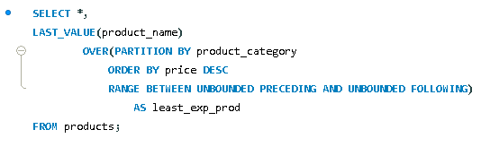
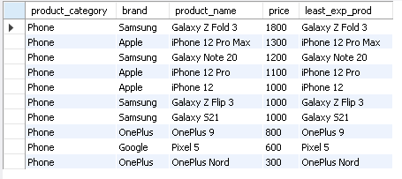
Human resources slide 8
Window Functions
LAST_VALUE() with frame clause
The main issue we had before was that LAST_VALUE() did not have access to all the records of the partition. To fix this we must modify the frame clause so that it does have access from the beginning of the partition to the end of the partition.
To do this we change the "CURRENT ROW" to "UNBOUNDED FOLLOWING" and essentially what it does now is that it will look at all the records after the current row as well as the ones before it.
And as we can see in the example, we now have the lease expensive product for every category showing. We can also use ROWS instead of RANGE but when we have duplicate values (such as products with the same price), RANGE will look at the whole category and use the first product with the same price whilst ROWS will go row by row and print the newest value even if it has the same price. (bottom right example)(used current row)
UNBOUNDED can mean to the end or beginning

Slide 29
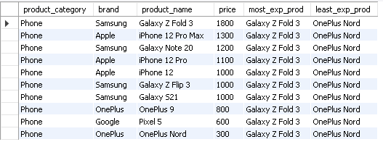
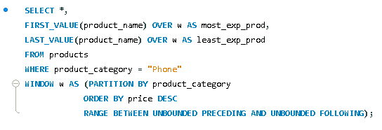
Human resources slide 8
Window Functions
An alternative way of writing window functions
We can use the WINDOW() clause to put all the information we had inside the OVER() clause in one place. This is useful when we are dealing with multiple window functions and don’t want to write out duplicate code.

Slide 30
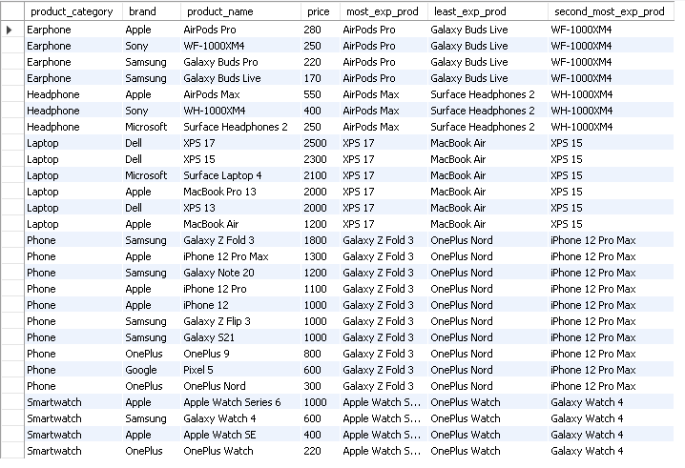
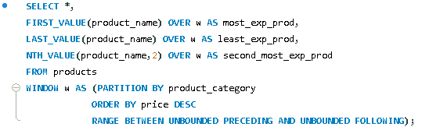
Human resources slide 8
Window Functions
NTH_VALUE()
Similar to FIRST_VALUE() and LAST_VALUE() we use NTH_VALUE() to fetch values but NTH_VALUE() allows us to fetch any value from any position that we specify.
We pass two arguments to NTH_VALUE(), the first being what we want printed in the column and the second being the position we want it to look at. In our example we are getting the second most expensive product, so we input "2".
Also make sure you specify the frame clause or
you will get loads of "null" values.
Here we put what position we want to look at

Slide 31




Human resources slide 8
Window Functions
NTILE()
NTILE() can be used to group together data within your partition and put them into certain buckets. SQL will try to make sure that each bucket has equal number of records.
NTILE() takes one argument and that is how many buckets/ groups we want to create.
We want to name these buckets we have to use a case statement and an alias (such as x). (see example on the right)
As seen in the example to the left we have created 3 buckets but as we have 10 items in total NTILE() automatically gives preference to the first bucket and gives it 4 values.

Slide 32




Human resources slide 8
Window Functions
CUME_DIST()
CUME_DIST() stands for cumulative distribution. We can use it to get a certain percentage of the total data to show, this would be useful in circumstances where the data table has hundreds or thousands of columns and data entries, but you only want to access the top 30%.
We can use subqueries to then filter out the top 30% of our results as seen on the last line below:
Cumulative distribution = current row number (or number of last row with same value) / total number of rows

Slide 33


Human resources slide 8
Window Functions
PERCENT_RANK()
PERCENT_RANK() is used to compare data and order it in comparison to other values. For example, if we want to find out how much more expensive a certain phone is compared to others, PERCENT_RANK() would be used.
PERCENT_RANK() usually has values from 0-1 and its formula is a little different to cumulative distribution
PERCENT_RANK = current row number - 1 / total number of rows - 1

Slide 34


Human resources slide 8
Window Functions
ROW_NUMBER()
ROW_NUMBER() can be used to give a unique number to each row depending on its position. This can be useful in situations where you want to find out who joined the company first.
Like the other window functions, we can also pass PARTITION BY() inside the OVER() clause if we wanted.

Slide 35




Human resources slide 8
Window Functions
LAG()
LAG() can be used to check if a specific value of a user higher or lower compared to the previous user.
We can pass LAG() three arguments, the first being the value we want to compare each user by, the second being the position if the user we want to compare the user to in relation to their current position (so 1 will be the user before, 2 will be 2 users before etc.) and the third is the initial value as the first user will have a value of "null" otherwise.

Slide 36


Human resources slide 8
Window Functions
LEAD()
LEAD() is the same as LAG() but instead of comparing the value to the previous user we compare the value to the user after the current.

Slide 37




Human resources slide 8
CTE's
CTE stands for Common Table Expression and is a temporary result set which is used to manipulate the complex subqueries data. They can be referenced within a SELECT, INSERT, UPDATE or DELETE statement. They are used to simplify complex queries making them more readable and maintainable. Sometimes you may see CTE's be called WITH queries.
The basic structure for a CTE starts of using a WITH query followed by the name of the CTE and then the CTE query definitions within brackets. An example has been created below.
Above we are creating a temporary result table called "CTE_employee" where I will store all the employees who were hired before 2023. This can be useful as you can then call on this table later as shown on the right, rather than having to type out all the aggregate functions all over again. However as it is temporary you must call it within the same block of code

Slide 38
Human resources slide 4
MySQL Query Quiz
SUBQUERIES
JOINS
&
UNIONS
STORED
PROCEDURES
SELECT
QUERIES
WINDOW
FUNCTIONS
QUIZ TIME

Slide 39
Human resources slide 10
Thank You
Muhammed, Ruby and Mikaeel

