Slide 1

node.JS Part II
Ranken Technical College

Slide 2
Objectives
What is npm?
How to use npm
Some common npm commands
Some common npm packages
Source
https://www.npmjs.com/

Slide 3
What is NPM?
Your new best friend.

Slide 4
Node Package Manager (NPM)
npm is the most widely used package manager for Node.js applications.
npm allows us to quickly download, install, and update our project's dependencies.

Slide 5
NPM Ecosystem
The npm ecosystem is made up of three distinct parts:
The Website, the place where users can browse packages and read their documentation
The Registry, the database that stores information and code for all packages
The NPM Client, the command-line tool installed on a developer's machine which allows them to download, install, update, and even publish packages.

Slide 6
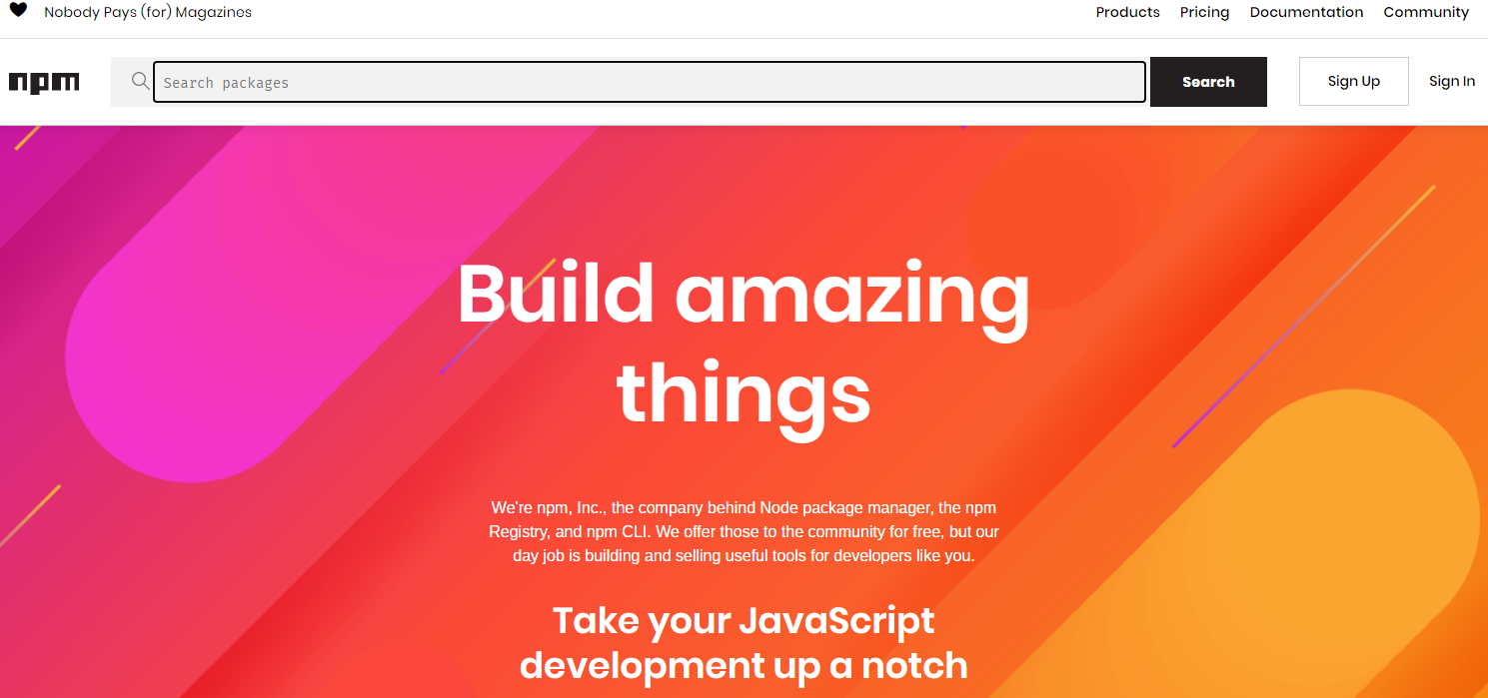
https://www.npmjs.com/

Slide 7
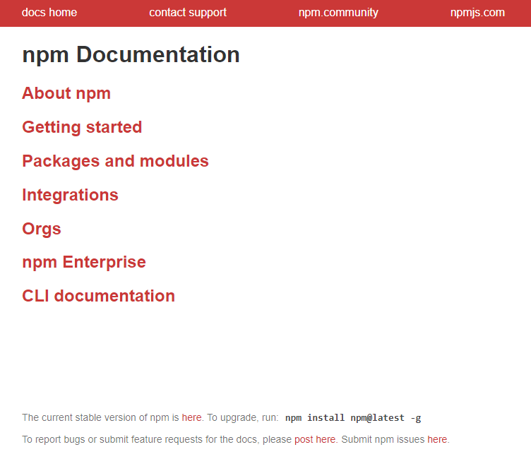
https://docs.npmjs.com/

Slide 8
NPM Commands
Getting to know the npm command line interface (CLI)

Slide 9
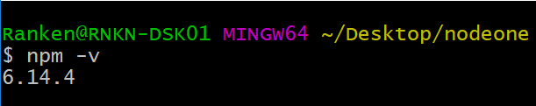
npm -v
Run the command npm –v to find out what version of NPM you have installed

Slide 10
npm init
Run the command npm init to create a package.json file for your project.

Slide 11
package.json
The package.json file is manifest for your project.
It can do a lot of things, which may seem completely unrelated.
It is a central repository of configuration for tools.
It is also where npm stores the names and versions for your project's installed packages.

Slide 12
package.json example
{
"name": "nodeone",
"version": "1.0.0",
"description": "This project creates a simple node.js web server",
"main": "server.js",
"scripts": {
"start": "node server.js",
"nodemon": "nodemon server.js"
},
"author": "Ranken",
"license": "ISC"
}

Slide 13
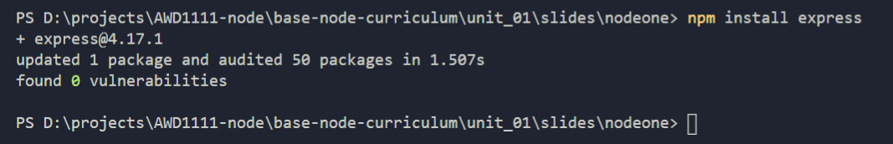
npm install
Run the command npm install <package-name>
to install an npm package and declare it as a dependency in the package.json file
You can also enter this command as npm i <package-name> for brevity

Slide 14
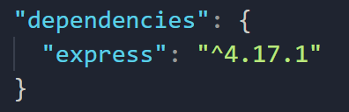
dependencies
After running the npm install command, the following dependency was added to the package.json file

Slide 15
npm install -g
-g is the global install flag, which makes the package available to all projects without having to do individual installs.
Some rules of thumb:
Install globally if the package provides command-line tools
Install locally if the package is part of your application

Slide 16
npm install -D
-D is the development install flag, which means the package will be loaded as a development dependency, and will not be included when the project goes live on a real server

Slide 17
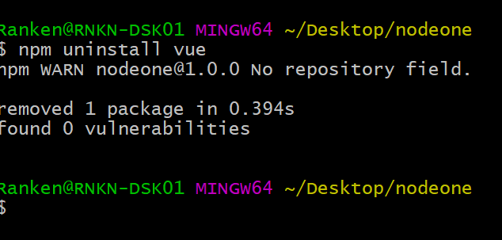
npm uninstall
The command npm uninstall <package-name>
removes a package from your project

Slide 18
npm run
The command npm run <script>
executes a script defined in your package.json file

Slide 19
NPM Packages
Some npm packages you'll get to know and love.

Slide 20
nodemon
nodemon is a command-line tool that helps develop node.js based applications by automatically restarting the node application when you edit a file
nodemon is a replacement wrapper for node. It does not require any additional changes to your code or method of development.
Install
npm install -g nodemon
Usage
nodemon server.js
Source
https://www.npmjs.com/package/nodemon

Slide 21
dotenv
dotenv loads environment variables from a .env file into process.env
it provides convenient mechanism to set environment variables in your dev environment
npm install dotenv
Source
https://www.npmjs.com/package/dotenv

Slide 22
debug
debug provides improved logging functionality over console.log
It creates channels that you can filter the logs by.
It also makes it easy to disable logging in production (for better performance.)
npm install debug
Source
https://www.npmjs.com/package/debug

Slide 23
express
express is a fast and minimalist web framework for node.
(You'll learn much more about express in the next lectures.)
Example
const express = require('express');
const app = express();
app.get('/', (req, res) => res.send('Hello World!'));
app.listen(3000, () => console.log('Server Started.'))
Source
https://www.npmjs.com/package/express

Slide 24
Conclusion
What did we learn today?

Slide 25
What We've Covered
What npm is and how to run it
Major npm commands including:
npm -v
npm init
npm install
npm install -g
npm install -D
npm uninstall
npm run
A few npm packages including: nodemon, debug, dotenv, express

