Slide 1

node.js Part I
Ranken Technical College

Slide 2
Objectives
Install node.js
Build and run a simple node.js application
Build and run a simple node.js web server
Discuss basics of asynchronous methods in JavaScript

Slide 3
Installation
How to install node.js and npm

Slide 4
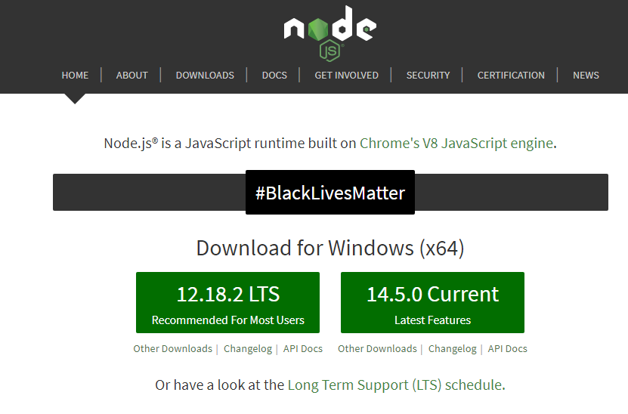
Install Node.js
Download and install the LTS (Long Term Support) version of node.js
from the official Node.js website

Slide 5
Verify your installation
From command line, type in the following command to check node.js install
node -v
From command line, type in the following command to check npm install
npm -v

Slide 6
Command-Line Apps
Let's build a super simple command line application!

Slide 7
Simple Command-Line App
Create a new folder named nodeone
Open this folder in Visual Studio Code
Create a new file named simple.js
Open the simple.js file
Enter the following line of code into the simple.js file:
console.log('My first Node.js Program!');
Save the file

Slide 8
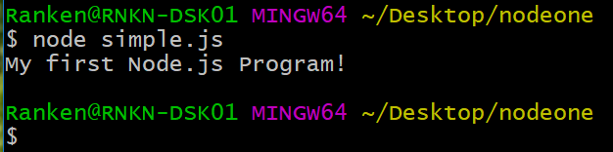
Simple Command-Line App
Open a terminal window inside Visual Studio Code
Type the following command:
node simple.js
The expected results are shown below

Slide 9
Web Servers
Let's build a super simple web server!

Slide 10
Simple Web Server
Close the simple.js file
Create a new file named program2.js
Open this file

Slide 11
Simple Web Server
Enter the code shown below into program2.js and save the file.
const http = require('http');
const PORT = process.env.PORT || 3000;
const server = http.createServer((req, res) => {
res.writeHead(200, { 'Content-Type': 'text/plain' });
res.end('Hello World!');
});
server.listen(PORT, () => {
console.log(`Server is listening on port ${PORT}`);
});

Slide 12
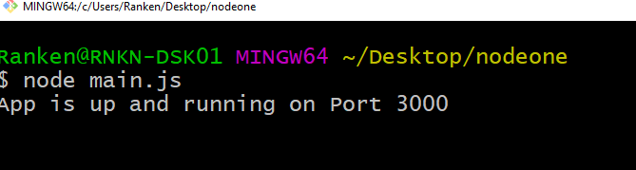
Simple Web Server
Open a terminal window inside Visual Studio Code
Type the following command:
node program1.js
The expected results are shown below

Slide 13
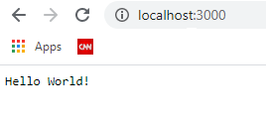
Simple Web Server
Open http://localhost:3000 in your browser

Slide 14
Simple Web Server (each statement explained)
const http = require("http");
Node.js has a built-in module called HTTP, which allows node.js to transfer data over the Hyper Text Transfer Protocol (HTTP).
To include a module (i.e. make it available to the program), use the require() method

Slide 15
Simple Web Server (each statement explained)
const PORT = process.env.PORT || 3000;
You can set the environment variable PORT to tell the web server what port to listen on
process.env.PORT || 3000 means use the environment variable PORT, or use port 3000 if the environment variable has not been set

Slide 16
Simple Web Server (each statement explained)
const server = http.createServer((req, res) => {
res.writeHead(200, { 'Content-Type': 'text/plain' });
res.end('Hello World!');
});
This code actually creates the server.
The server is told to (via the writeHead) return status code 200 (OK), send a plain text response, and write the text Hello World!

Slide 17
Simple Web Server (each statement explained)
server.listen(PORT, () => {
console.log(`Server is listening on port ${PORT}`);
});
This code starts the web server.
When the server starts, it will write the text 'Server is listening on port 3000' (or whichever port was set by the environment variable) to the console
Note the use of `` in this line of code. These represents an ES6 template literal. These literals can contain placeholders, which are indicated by the dollar sign and curly braces ${expression}
When the program runs, this placeholder is replaced with the value of the variable

Slide 18
Asynchronous JavaScript
Writing asynchronous JavaScript using callbacks

Slide 19
Asynchronous JavaScript
Normally, program code runs straight along, with only one thing happening at once. If a function relies on the result of another function, it has to wait for the other function to finish and return, and until that happens, the entire program is essentially stopped from the perspective of the user. This is a.k.a. synchronous programming
Source
https://developer.mozilla.org/en-US/docs/Learn/JavaScript/Asynchronous/Concepts

Slide 20
Asynchronous JavaScript
This is not a good use of computer processing power. There's no sense waiting for something when you could let another task begin and let you know when it's done. This lets you get other work done in the meantime, which is the basis of asynchronous programming
It is up to the programming environment you are using (web browsers, in the case of web development) to provide APIs that allow tasks to run asynchronously
Source
https://developer.mozilla.org/en-US/docs/Learn/JavaScript/Asynchronous/Concepts

Slide 21
Asynchronous JavaScript
JavaScript provides three ways to program asynchronously:
Asynchronous JavaScript programming via the use of callbacks
Asynchronous JavaScript programming via the use of promises
Asynchronous JavaScript programming via the use of async-await

Slide 22
Asynchronous JS Via callbacks
Callbacks are simple functions which are used to notify the calling instance when an asynchronous code block has been executed and the result is available
Shown on the following page is a simple code example that uses a callback
Source
https://codingthesmartway.com/async-programming-with-javascript-callbacks-promises-and-async-await/

Slide 23
Asynchronous JS Via callbacks
const getTodo = (callback) => {
setTimeout(() => {
callback ({ text: 'Complete Code Example' })
}, 2000);
};
getTodo((todo) => {
console.log(todo.text)
});

Slide 24
Asynchronous JS Via callbacks
The getTodo function is defined so that it takes a callback function as a parameter. Inside getTodo the getTimeout function is used to delay the execution of code for 2000 milliseconds (2 seconds). Instead of just returning the object now the callback function is run. As an argument the object which should be returned is passed in

Slide 25
Asynchronous JS Via callbacks
When calling getTodo you must make sure to pass in a callback function as a parameter. In the example this is being done using the fat arrow syntax (=>) to define an anonymous function. Inside that functions the todo.text is output. This function is invoked from inside of getTodo when the 2000 millisecond delay is passed

Slide 26
Asynchronous JS Via promises
Promises include:
Producing code that does something and takes time. For instance, some code that loads data over a network
Consuming code that wants the result of the producing code once it's ready. One or more functions may need this result
A promise is a special JavaScript object that links the producing code and the consuming code together
Source
https://javascript.info/promise-basics

Slide 27
Asynchronous JS Via promises
Promises are a built-in language feature of JavaScript that makes handling asynchronous code easier and more readable
Shown on the following page is the simple code example with the callback replaced by a promise
Source
https://codingthesmartway.com/async-programming-with-javascript-callbacks-promises-and-async-await/

Slide 28
Asynchronous JS Via promises
const getTodo = () => {
return new Promise((resolve, reject) => {
setTimeout(() => {
let error = false;
if(!error)
resolve({ text: 'Complete Code Example' })
else
reject()
}, 2000)
})
}
getTodo().then(todo => {
console.log(todo.text)
})

Slide 29
Asynchronous JS Via promises
This code is basically doing the same as seen before in the callback example but with Promises.
Inside the getTodo function a new Promise is returned. The constructor of the Promise class is expecting to get a function which contains the asynchronous code as a parameter

Slide 30
Asynchronous JS Via promises
The function is also expecting to get two parameters, resolve and reject, which contain the asynchronous code which needs to be executed.
If the asynchronous code executes successfully the resolve function is called
If the asynchronous code does not execute successfully the reject function is called

Slide 31
Asynchronous JS Via async-await
Async functions let the programmer write promise based code as if it were synchronous, but without blocking the execution thread. It operates asynchronously via the event-loop. Async functions will always return a value (promise)
The await operator is used to wait for a Promise. It can be used inside an Async block only. The keyword Await makes JavaScript wait until the promise returns a result
Shown on the following 2 pages is the simple code example with the callback replaced by async-await
Source
https://codingthesmartway.com/async-programming-with-javascript-callbacks-promises-and-async-await/

Slide 32
Asynchronous JS Via async-await
const getTodo = () => {
return new Promise((resolve, reject) => {
setTimeout(() => {
let error = false;
if(!error)
resolve({ text: 'Complete Code Example' })
else
reject()
}, 2000)
})
}

Slide 33
Asynchronous JS Via async-await
async function fetchTodo () {
const todo = await getTodo()
return todo
}
fetchTodo().then(todo => console.log(todo.text))

Slide 34
Asynchronous JS Via async-await
The implementation of the getTodo function has not changed. The Promise is still created and depending on the value of the error variable is resolved or rejected
What has changed is the way the getTodo function is called. A new function fetchTodo is being implemented. The async keyword is used to indicate that this function is executing asynchronous code based on a Promise

Slide 35
Asynchronous JS Via async-await
Inside of fetchTodo getTodo is called using the keyword await. This indicates that getTodo is returning a Promise and we have to wait for the Promise to be resolved (or rejected). The result of what is being returned from the promise is stored in todo
In the next line of code the todo object is being returned. This is possible because by using the keyword await we’re making sure the next line of code is being executed after the Promise (returned from getTodo) has been resolved

Slide 36
Conclusion
What did we learn today?

Slide 37
What We've Covered
The Node.js installation process
How to create and run a simple Node.js application
How to create and run a simple Node.js web server
Asynchronous JavaScript using callbacks
Asynchronous JavaScript using promises
Asynchronous JavaScript using async-await

