Slide 1

node.js Part V
Ranken Technical College

Slide 2
Objectives
Perform client-side form validation using HTML
Perform client-side form validation using JavaScript
Perform client-side form validation using jQuery
Perform client-side form validation using Bootstrap
Perform server-side form validation Using @hap/joi
Deploy a Node.js application using Heroku

Slide 3
Objectives
Perform client-side form validation with JavaScript
Perform server-side form validation with JavaScript
Perform server-side form validation with Joi
Deploy a Node.js application using Heroku

Slide 4
Form Validation
Validation can be defined by many different methods, and deployed in many different ways.
Client side validation is performed by a web browser, before input is sent to a web server
Server side validation is performed by a web server, after input has been sent to the server
Source
https://www.w3schools.com/js/js_validation.asp

Slide 5
HTML Form Validation
HTML5 introduced a new HTML validation concept called constraint validation, is based on:
Constraint validation HTML Input Attributes
Constraint validation CSS Pseudo Selectors
Constraint validation DOM Properties and Methods
Constraint Validation HTML Input Attributes
Source
https://www.w3schools.com/js/js_validation.asp

Slide 6
HTML Form Validation (common attributes)
Attribute Description
disabled Specifies that the input element should be disabled
max Specifies the maximum value of an input element
min Specifies the minimum value of an input element
pattern Specifies the value pattern of an input element
required Specifies that the input field requires an element
type Specifies the type of an input element
Source
https://www.w3schools.com/js/js_validation.asp

Slide 7
HTML Form Validation (common pseudo-selectors)
Selector Description
:disabled Selects input elements with the "disabled" attribute specified
:invalid Selects input elements with invalid values
:optional Selects input elements with no "required" attribute specified
:required Selects input elements with the "required" attribute specified
:valid Selects input elements with valid values
Source
https://www.w3schools.com/js/js_validation.asp

Slide 8
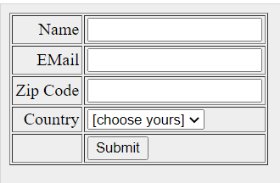
Client-side Validation Using JavaScript
Source
https://www.tutorialspoint.com/javascript/javascript_form_validations.htm

Slide 9
Client-side Validation Using JavaScript
<html>
<head>
<title>Form Validation</title>
<script type = "text/javascript">
<!—// Form validation code will go here. //-->
script>
</head>
<body>
<form action = "/cgi-bin/test.cgi" name = "myForm" onsubmit = "return(validate());">
<table cellspacing = "2" cellpadding = "2" border = "1">
Source
https://www.tutorialspoint.com/javascript/javascript_form_validations.htm

Slide 10
Client-side Validation Using JavaScript
<tr>
<td align = "right">Name</td>
<td><input type = "text" name = "Name" /></td>
</tr
<tr>
<td align = "right">EMail</td>
<td><input type = "text" name = "EMail" /></td>
</tr>
<tr>
<td align = "right">Zip Code</td>
<td><input type = "text" name = "Zip" /></td>
</tr>
Source
https://www.tutorialspoint.com/javascript/javascript_form_validations.htm

Slide 11
Client-side Validation Using JavaScript
<tr>
<td align = "right">Country</td>
<td>
<select name = "Country">
<option value = "-1" selected>[choose yours]</option>
<option value = "1">USA</option>
<option value = "2">UK</option>
<option value = "3">INDIA</option>
</select>
</td>
</tr>
Source
https://www.tutorialspoint.com/javascript/javascript_form_validations.htm

Slide 12
Client-side Validation Using JavaScript
<tr>
<td align = "right"></td>
<td><input type = "submit" value = "Submit" /></td>
</tr>
</table>
</form>
</body>
</html>
Source
https://www.tutorialspoint.com/javascript/javascript_form_validations.htm

Slide 13
Client-side Validation Using JavaScript
<script type = "text/javascript">
<!--// Form validation code will come here.
function validate() {
if( document.myFor m.Name.value == "" ) {
alert( "Please provide your name!" );
document.myForm.Name.focus() ;
return false;
}
if( document.myForm.EMail.value == "" ) {
alert( "Please provide your Email!" );
document.myForm.EMail.focus() ;
return false;
}
Source
https://www.tutorialspoint.com/javascript/javascript_form_validations.htm

Slide 14
Client-side Validation Using JavaScript
if( document.myForm.Zip.value == "" || isNaN( document.myForm.Zip.value ) ||
document.myForm.Zip.value.length != 5 ) {
alert( "Please provide a zip in the format #####." );
document.myForm.Zip.focus() ;
return false;
}
if( document.myForm.Country.value == "-1" ) {
alert( "Please provide your country!" );
return false;
}
return( true );
}
//-->
</script>
Source
https://www.tutorialspoint.com/javascript/javascript_form_validations.htm

Slide 15
Client-side Validation Using jQuery
Form validation in jQuery can be done manually or via a plug-in e.g. validation plug-in
The jQuery validation plugin makes simple client-side form validation easy, while still offering plenty of customization options. The plugin comes bundled with a useful set of validation methods, including URL and email validation, while providing an API to write your own methods
Source
https://jqueryvalidation.org/

Slide 16
Client-side Validation Using jQuery
Step 1: Include jQuery
https://ajax.googleapis.com/ajax/libs/jquery/3.4.1/jquery.min.js
Step 2: Include the jQuery Validation Plugin
https://cdnjs.cloudflare.com/ajax/libs/jquery-validate/1.19.1/jquery.validate.min.js
Step 3: Create the HTML form
See the next page
Source
https://jqueryvalidation.org/

Slide 17
Client-side Validation Using jQuery
<div class="container">
<h2>Registration</h2>
<form action="" name="registration">
<label for="firstname">First Name</label>
<input type="text" name="firstname" id="firstname" placeholder="John"/>
<label for="lastname">Last Name</label>
<input type="text" name="lastname" id="lastname" placeholder="Doe"/>
Source
https://jqueryvalidation.org/

Slide 18
Client-side Validation Using jQuery
label for="email">Email</label>
<input type="email" name="email" id="email" placeholder="john@doe.com"/>
<label for="password">Password</label>
<input type="password" name="password" id="password“>
<button type="submit">Register</button>
</form>
</div>
Source
https://jqueryvalidation.org/

Slide 19
Client-side Validation Using jQuery
Step 4: Create the associated stylesheet
See URL: https://jqueryvalidation.org/
Step 5: Create JavaScript file form-validation.js
See the next page
Source
https://jqueryvalidation.org/

Slide 20
Client-side Validation Using jQuery
// Wait for the DOM to be ready
$(function() {// Initialize form validation on the registration form.
// It has the name attribute "registration“
$("form[name='registration']").validate({
// Specify validation rules
rules: {
// key name on left side is name attribute of an input field. Validation rules defined on right side
firstname: "required",
lastname: "required",
Source
https://jqueryvalidation.org/

Slide 21
Client-side Validation Using jQuery
email: {
required: true,
email: true // email should be validated by the built-in "email" rule
},
password: {
required: true,
minlength: 5
}
},
Source
https://jqueryvalidation.org/

Slide 22
Client-side Validation Using jQuery
// Specify validation error messages
messages: {
firstname: "Please enter your firstname",
lastname: "Please enter your lastname",
password: {
required: "Please provide a password",
minlength: "Your password must be at least 5 characters long"
},
Source
https://jqueryvalidation.org/

Slide 23
Client-side Validation Using jQuery
email: "Please enter a valid email address"
},
// Make sure the form is submitted to the destination defined
// in the "action" attribute of the form when valid
submitHandler: function(form) {
form.submit();
}
});
});
Source
https://jqueryvalidation.org/

Slide 24
Client-side Validation Using Bootstrap 4
Bootstrap includes validation styles for:
danger (ideal for when there's a blocking or required field)
warning (ideal for input values that are in progress, like password strength, or soft validation before a user attempts to submit a form)
success (ideal for ideal for situations when you have per-field validation throughout a form and want to encourage a user through the rest of the fields) states on most form controls
Source
https://v4-alpha.getbootstrap.com/components/forms/#validation

Slide 25
Client-side Validation Using Bootstrap 4
To use, add .has-warning, .has-danger, or .has-success to the parent element. Any .col-form-label, .form-control, or custom form element will receive the validation styles.
Contextual validation text, in addition to your usual form field help text, can be added with the use of .form-control-feedback. This text will adapt to the parent .has-* class. By default it only includes a bit of margin for spacing and a modified color for each state.
Validation icons are URLs configured via Sass variables that are applied to background-image declarations for each state.
Source
https://v4-alpha.getbootstrap.com/components/forms/#validation

Slide 26
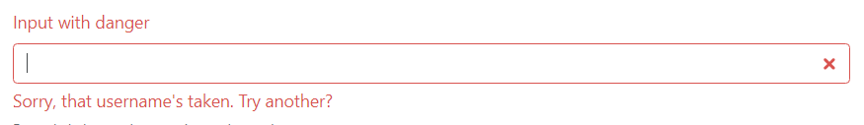
Client-side Validation Using Bootstrap 4
Example:
<div class="form-group has-danger">
<label class="form-control-label" for="inputDanger1">Input with danger</label>
<input type="text" class="form-control form-control-danger" id="inputDanger1">
<div class="form-control-feedback">Sorry, that username's taken. Try another?</div>
<small class="form-text text-muted">Example help text that remains unchanged.</small>
</div>
Source
https://v4-alpha.getbootstrap.com/components/forms/#validation

Slide 27
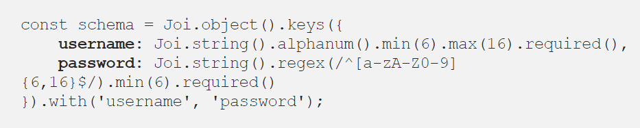
Server-side Validation Using @hap/joi
The idea of Joi is to define the schema of what the object will resemble
For example, suppose we have a login form with username and password fields
Source
https://medium.com/@rossbulat/joi-for-node-exploring-javascript-object-schema-validation-50dd4b8e1b0f

Slide 28
Server-side Validation Using @hap/joi
Joi .object()
We define a Joi.object() to instantiate a Joi schema object to work with. All schemas require Joi.object to process validation and other Joi features
keys()
Within Joi's keys() method, we define the required schema constraints for our login form. Here we define the rules for the username and password values
Source
https://medium.com/@rossbulat/joi-for-node-exploring-javascript-object-schema-validation-50dd4b8e1b0f

Slide 29

Server-side Validation Using @hap/joi
The username must be a string, consist of alpha numeric characters only, and be between 6–16 characters in length. It is also required
The password must be alphanumeric, between 6 and 16 characters, and therefore required.
Source
https://medium.com/@rossbulat/joi-for-node-exploring-javascript-object-schema-validation-50dd4b8e1b0f

Slide 30
Deploying a Node.js app with Heroku
Assumes you have:
Node.js and npm installed
An existing Node.js app
A free Heroku account from: https://signup.heroku.com/dc
The Heroku CLI installed from: https://devcenter.heroku.com/articles/heroku-cli
Source
https://devcenter.heroku.com/articles/deploying-nodejs

Slide 31
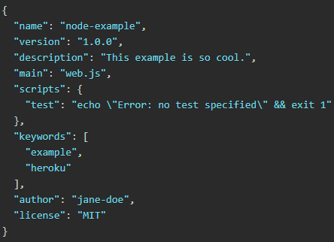
Deploying a Node.js app with Heroku
Declare app dependencies
The package.json file defines the dependencies that should be installed with your application. Here's an example:
Source
https://devcenter.heroku.com/articles/deploying-nodejs

Slide 32

Deploying a Node.js app with Heroku
Specify the version of node
The version of Node.js that will be used to run your application on Heroku, should also be defined in your package.json file. You should always specify a Node.js version that matches the runtime you’re developing and testing with. To find your version type node –version
Source
https://devcenter.heroku.com/articles/deploying-nodejs

Slide 33
Deploying a Node.js app with Heroku
Specifying a start script
To determine how to start your app, Heroku first looks for a Procfile. If no Procfile exists for the Node.js app, Heroku will attempt to start a default web process via the start script in the package.json file
The command in a web process type must bind to the port number specified in the PORT environment variable. If it does not, the dyno will not start.
Source
https://devcenter.heroku.com/articles/deploying-nodejs

Slide 34

Deploying a Node.js app with Heroku
Build and run locally
Run the npm install command in your local app directory to install the dependencies that you declared in your package.json file
Source
https://devcenter.heroku.com/articles/deploying-nodejs

Slide 35

Deploying a Node.js app with Heroku
Build and run locally
Start your app locally using the heroku local command, which is installed as part of the Heroku CLI
Source
https://devcenter.heroku.com/articles/deploying-nodejs

Slide 36

Deploying a Node.js app with Heroku
Keep build artifacts out of git
Source
https://devcenter.heroku.com/articles/deploying-nodejs

Slide 37
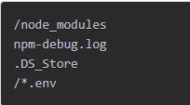
Deploying a Node.js app with Heroku
Keep build artifacts out of git
Prevent build artifacts from going into revision control by creating a .gitignore file that looks something like this:
Source
https://devcenter.heroku.com/articles/deploying-nodejs

Slide 38
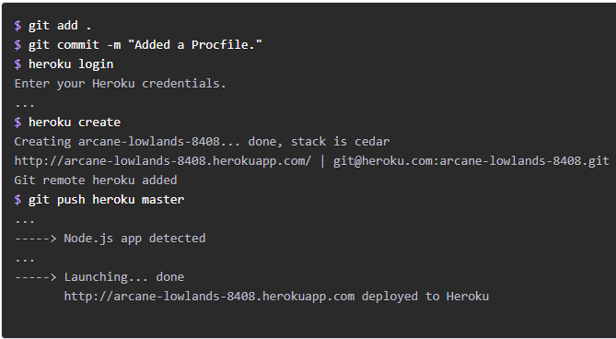
Deploying a Node.js app with Heroku
Deploy your application to Heroku
Source
https://devcenter.heroku.com/articles/deploying-nodejs

Slide 39
What We've Covered
Perform client-side form validation with JavaScript
Perform server-side form validation with JavaScript
Perform server-side form validation with Joi
Deploy a Node.js application using Heroku

