Slide 1

node.js Part I
Ranken Technical College

Slide 2
Objectives
Install node.js
Build and run a simple node.js application
Build and run a simple node.js web server
Discuss basics of asynchronous methods in JavaScript

Slide 3
Installation
How to install node.js and npm

Slide 4
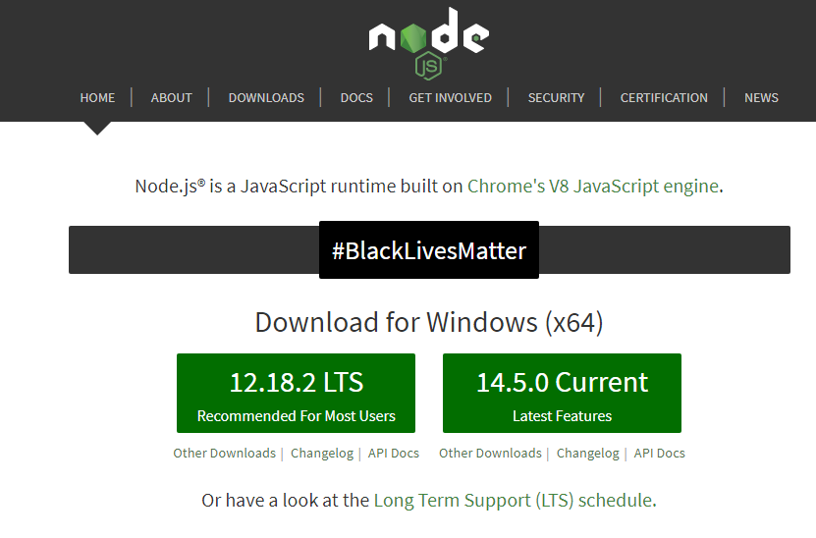
Install Node.js
Download and install the LTS (Long Term Support) version of node.js
from the official Node.js website

Slide 5
Verify your installation
From command line, type in the following command to check node.js install
node -v
From command line, type in the following command to check npm install
npm -v

Slide 6
Command-Line Apps
Let's build a super simple command line application!

Slide 7
Simple Command-Line App
Create a new folder named nodeone
Open this folder in Visual Studio Code
Create a new file named simple.js
Open the simple.js file
Enter the following line of code into the simple.js file:
console.log('My first Node.js Program!');
Save the file

Slide 8
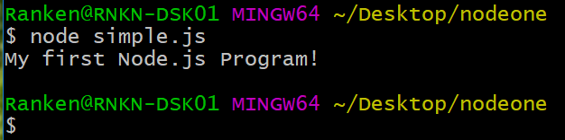
Simple Command-Line App
Open a terminal window inside Visual Studio Code
Type the following command:
node simple.js
The expected results are shown below

Slide 9
Web Servers
Let's build a super simple web server!

Slide 10
Simple Web Server
Close the simple.js file
Create a new file named program2.js
Open this file

Slide 11
Simple Web Server
Enter the code shown below into program2.js and save the file.
const http = require('http');
const PORT = process.env.PORT || 3000;
const server = http.createServer((req, res) => {
res.writeHead(200, { 'Content-Type': 'text/plain' });
res.end('Hello World!');
});
server.listen(PORT, () => {
console.log(`Server is listening on port ${PORT}`);
});

Slide 12
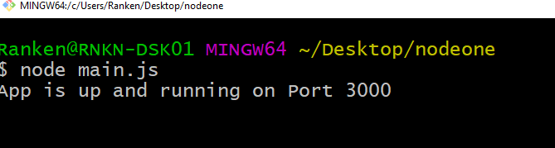
Simple Web Server
Open a terminal window inside Visual Studio Code
Type the following command:
node program1.js
The expected results are shown below

Slide 13
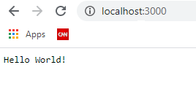
Simple Web Server
Open http://localhost:3000 in your browser

Slide 14
Simple Web Server (each statement explained)
const http = require("http");
Node.js has a built-in module called HTTP, which allows node.js to transfer data over the Hyper Text Transfer Protocol (HTTP).
To include a module (i.e. make it available to the program), use the require() method

Slide 15
Simple Web Server (each statement explained)
const PORT = process.env.PORT || 3000;
You can set the environment variable PORT to tell the web server what port to listen on
process.env.PORT || 3000 means use the environment variable PORT, or use port 3000 if the environment variable has not been set

Slide 16
Simple Web Server (each statement explained)
const server = http.createServer((req, res) => {
res.writeHead(200, { 'Content-Type': 'text/plain' });
res.end('Hello World!');
});
This code actually creates the server.
The server is told to (via the writeHead) return status code 200 (OK), send a plain text response, and write the text Hello World!

Slide 17
Simple Web Server (each statement explained)
server.listen(PORT, () => {
console.log(`Server is listening on port ${PORT}`);
});
This code starts the web server.
When the server starts, it will write the text 'Server is listening on port 3000' (or whichever port was set by the environment variable) to the console
Note the use of `` in this line of code. These represents an ES6 template literal. These literals can contain placeholders, which are indicated by the dollar sign and curly braces ${expression}
When the program runs, this placeholder is replaced with the value of the variable

Slide 18
Asynchronous JavaScript
Writing asynchronous JavaScript using callbacks

Slide 19
Synchronous Programming
Normally, program code runs straight along, with only one thing happening at once.
If a function relies on the result of another function, it has to wait for the other function to finish and return.
Until that happens, the entire program is stopped.
This is known as synchronous programming.
It leads to a very slow user experience and low throughput for our web servers
Source
https://developer.mozilla.org/en-US/docs/Learn/JavaScript/Asynchronous/Concepts

Slide 20
Synchronous Programming
This is not a good use of computer processing power.
There's no sense waiting for something when you could let another task begin, while the first task is waiting.
This allows you to get other work done in the meantime.
This is the basis of asynchronous programming.
It is up to the programming environment you are using to provide APIs that allow tasks to run asynchronously
Source
https://developer.mozilla.org/en-US/docs/Learn/JavaScript/Asynchronous/Concepts

Slide 21
Asynchronous Techniques
JavaScript provides three ways to execute code asynchronously:
Using callbacks
Using promises
Using async-await
Each of these three methods is a simplification of the former.

Slide 22
Callbacks
A callback is function which is called when an asynchronous operation is completed and the result is available

Slide 23
Callback Example
const getTodo = (callback) =>
setTimeout(() => callback('Complete Code Example'), 2000);
getTodo((todo) => console.log(todo.text));
The getTodo function is defined so that it takes a callback function as a parameter.
Inside getTodo the getTimeout function is used to delay the execution of code for 2000 milliseconds (2 seconds).
Instead of returning the object now the callback function must be called.
The result object is passed into the callback function as an argument.

Slide 24
Callback Example
When calling getTodo you must make sure to pass in a callback function as a parameter.
In the example, this is being done using the arrow syntax (=>) to define an anonymous function.
Inside that functions the todo.text is output.
This function is invoked from inside of getTodo when the 2000 millisecond delay is passed
With callbacks you can't rely on a return value from the function, you have to wait for the callback to be execute.

Slide 25
Promises
Promises are a built-in language feature of JavaScript which makes handling asynchronous code easier and more readable
Promises are used to wrap up bits of code that would normally be written as callbacks, in an easier to follow format.
Shown on the following page is the previous code example implemented with promises

Slide 26
Promise Example
const wait = (delay) =>
new Promise((resolve, reject) => setTimeout(() => resolve(), delay));
const getTodo = () =>
wait(2000).then(() => 'Complete Code Example');
getTodo()
.then((todo) => console.log(todo))
.catch((err) => console.error(err));
Same as previous code example, but implemented with promises.
The wait function is constructiing a new Promise object to wrap the timeout logic.
The getTodo function invokes wait, to wait 2 seconds before returning the result.
Finally we invoke the getTodo function and display the output when it completes.

Slide 27
async-await
Async functions let the programmer write promise based code as if it were synchronous, but without blocking the execution thread.
It operates asynchronously using promises.
Async functions will always return a promise.
The await operator is used to wait for a promise. (But can only be used inside and async function.)

Slide 28
async-await example
const wait = (delay) =>
new Promise((resolve, reject) => setTimeout(() => resolve(), delay));
const getTodo = async () => {
await wait(2000);
return 'Complete Code Example';
}
(async () => {
try {
const todo = await getTodo();
console.log(todo);
} catch (err) {
console.error(err)
}
})();
Same as previous code example, but implemented with async-await.
Again, the wait function is constructing a new Promise object to wrap the timeout logic.
An IIFE is required to call getTodo() because top-level await is not yet supported in Node.

Slide 29
Conclusion
What did we learn today?

Slide 30
What We've Covered
How to install node.js
How to create and run a simple node.js application
How to create and run a simple node.js web server
How to write asynchronous code with callbacks, promises, and async-await

