Slide 1
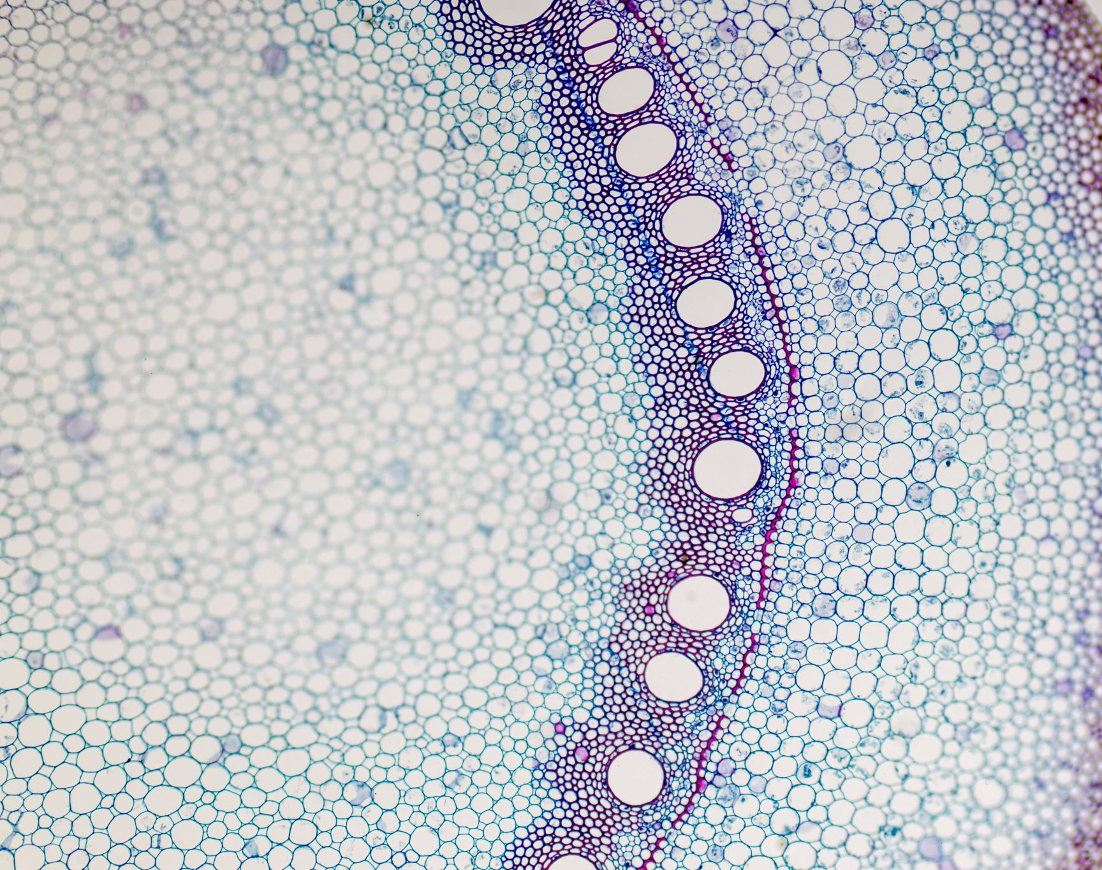
Single Layer Perceptron
Muhammed Rahmetullah Kartal
041701008

Slide 2
Aim
Use one hot encoding in class variables instead of numerating them.
In addition to accuracy metric, use F1 score.
Use another dataset.
Draw the loss-iteration and accuracy-iteration plots.
Use SKLearn Algorithm

Slide 3
Dataset Operations
At first, there were class values in my dataset like ever_married, work_type, residence_type and smoking_status.
After one hot encoding operation input values increased to 21 instead of 10.
All the numeric data normalized with min-max normalization.

Slide 4
Plotting
Plotting the loss-iteration and accuracy-iteration graphs in different learning rates and hidden layer numbers.
These operations are done on validation data.
To plot all graphs epoch number is set to 2000.

Slide 5
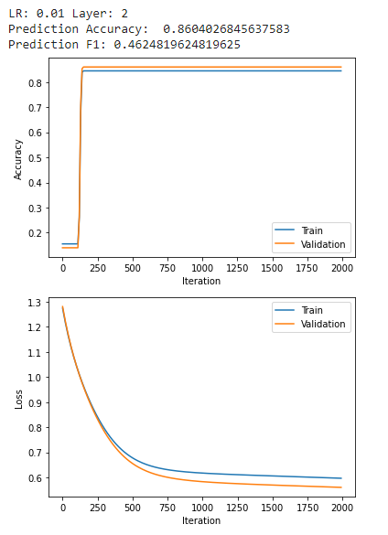
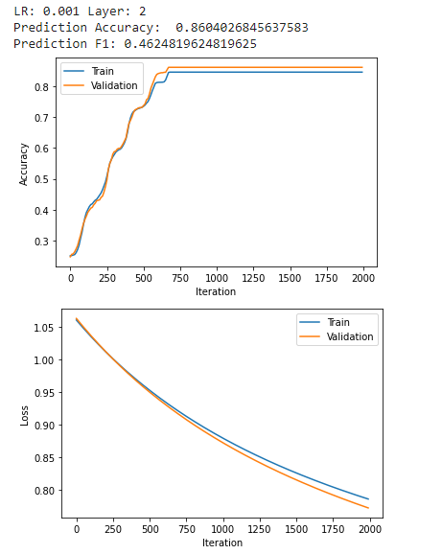
Hidden Layer Nodes: 2
As you can see in the graphs Prediction accuracies are almost same in low learning rates.

Slide 6
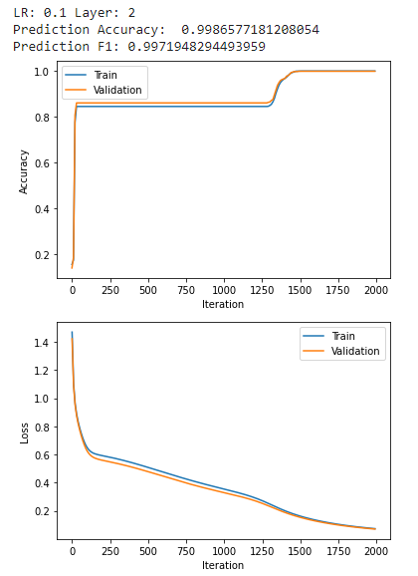
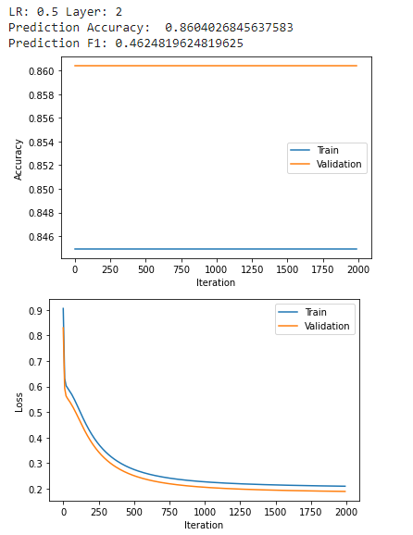
Hidden Layer Nodes : 2
The Accuracy is almost 1 in 0.1 learning rate, so it looks like the best one.

Slide 7
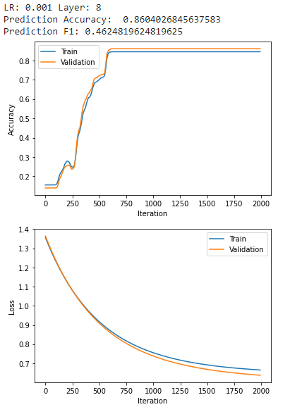
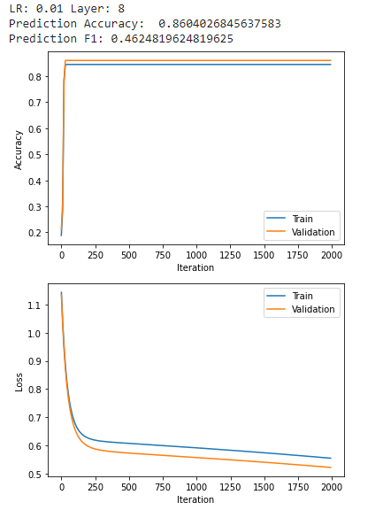
Hidden Layer Nodes : 8
The Accuracies are same with layer number 2, but time is a more than 2.

Slide 8
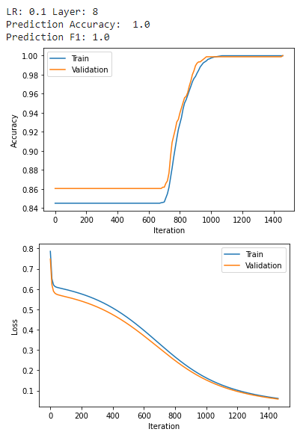
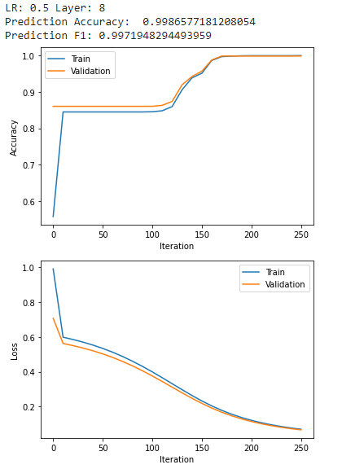
Hidden Layer Nodes : 8
The accuracy is best again in 0.1.

Slide 9
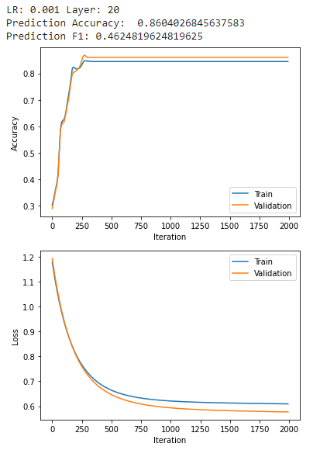
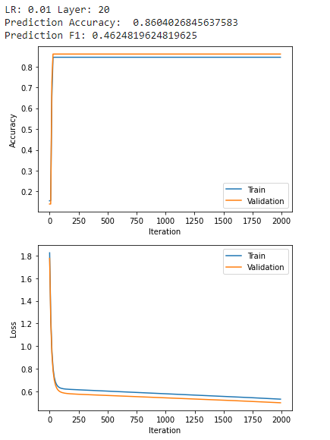
Hidden Layer Nodes : 20
In the low learning rates accuracies aren’t changing.

Slide 10
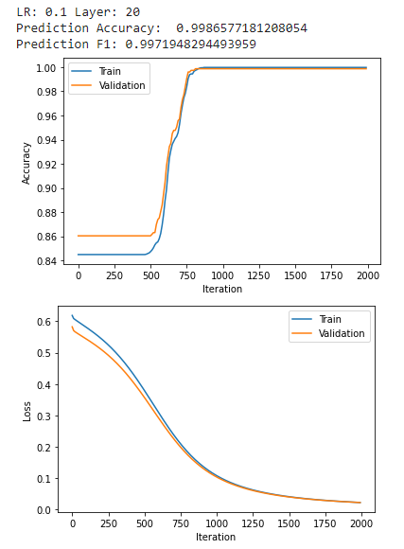
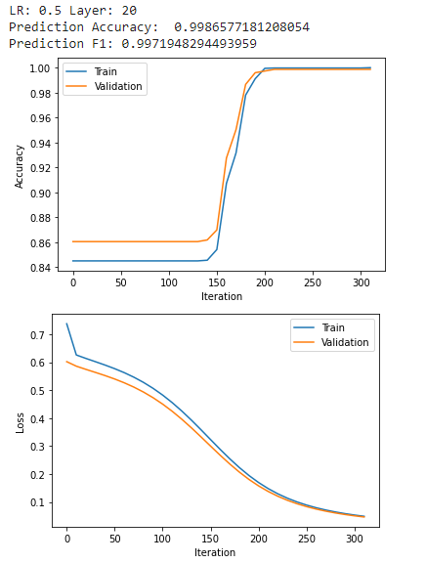
Hidden Layer Nodes : 20
The accuracy is best again in 0.1.

Slide 11
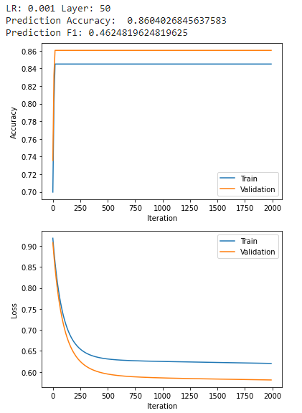
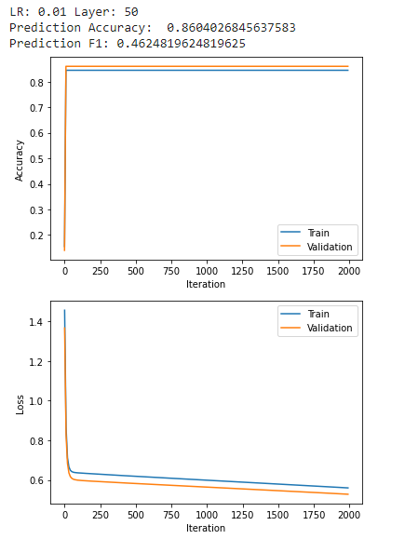
Hidden Layer Nodes : 50
In the low learning rates accuracies aren’t changing.

Slide 12
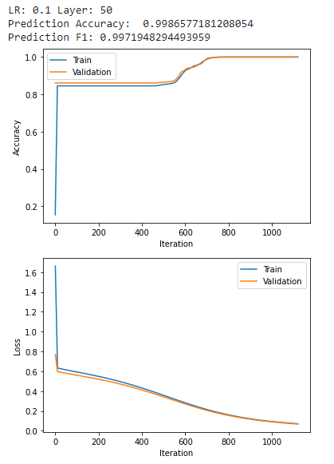
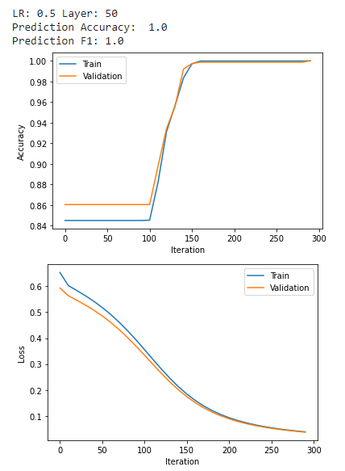
Hidden Layer Nodes : 50
In the low learning rates accuracies aren’t changing.

Slide 13
Parameters
As a resulT, we can say that best accuracy values happened in learning rate = 0.1.
SInce tIme ıs IncreasIng wIth the number of hIdden layer nodes, best value for node numbers IS 20.

Slide 14
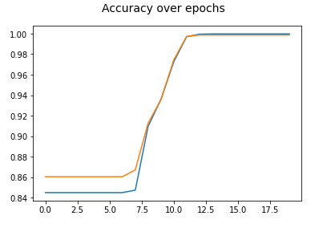
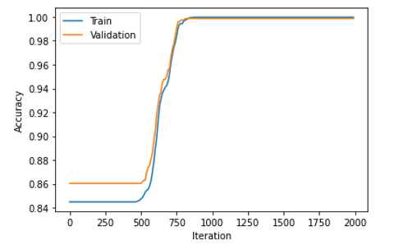
SKLearn vs My Algorithm

Slide 15
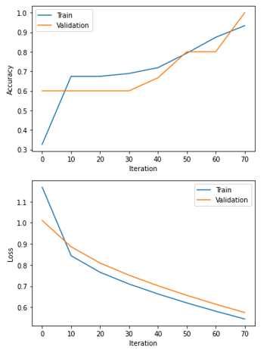
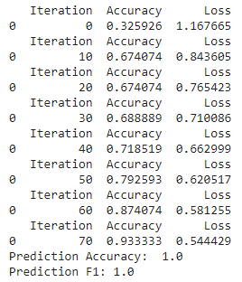
Accuracy in IRIS Dataset

Slide 16

Thank you for listening, do you have any questions?

