Slide 1





END-TO-END DATA ANALYTICS CASE STUDY
Unlocking Growth at Olist
Is the growth sustainable? A diagnostic of revenue quality, category risk, delivery experience, state opportunity and customer retention.
R$14.4M
96,478
25×
94%
REVENUE ANALYSED
DELIVERED ORDERS
REVENUE GROWTH / 13 MO
ONE-TIME BUYERS
Analyst: Muhammed Raazi V · June 2026 9 CSV files · Sept 2016 – Aug 2018 · All figures in BRL
Notes:
Open with the headline: revenue grew 25x to R$14.4M across 96,478 orders. But 94% are one-time buyers — that tension is the whole story of this briefing.

Slide 2




EXECUTIVE SUMMARY — KEY SIGNALS
Explosive growth on the surface — fragility underneath
GROWTH
MARGIN
EXPERIENCE
Rapid revenue growth
AOV compression
Customer experience risk
Revenue grew 25× in 13 months to R$14.4M analysed. On the surface, a dramatic scale-up story.
Average order value slipped from R$175 to R$160. Growth is volume-driven, not margin-led.
A 47% satisfaction drop follows a late delivery, and 94% of customers buy only once.
The bottom line: the growth is real but fragile. The job is to convert one-time volume into retained, higher-value customers by fixing delivery and category quality.
Unlocking Growth at Olist · Executive Briefing
02
Notes:
Three signals: growth (green), margin compression (amber), experience risk (red). The bottom-line banner frames the whole deck — fragile growth, fixable.

Slide 3
SCOPE
Five business questions we set out to answer
01
02
03
Is growth sustainable?
Which categories hide risk?
Does delivery drive satisfaction?
Separate organic demand from promotional spikes such as Black Friday.
Find high-revenue categories with low satisfaction — the “ticking bombs.”
Quantify the rating impact of on-time versus late delivery.
04
05
Where to invest by state?
Who are our customers?
Map revenue, satisfaction and opportunity at the state level.
RFM + KMeans segmentation to target retention and reactivation.
Unlocking Growth at Olist · Executive Briefing
03

Slide 4

DATA & METHOD
Reproducible analysis across nine source files
96,478
9
Workflow
Delivered orders
CSV source files
1
2
3
4
5
Define
Analyse
Visualise
Interpret
Recommend
R$14.4M
24 mo
Revenue analysed
Sept 2016 – Aug 2018
Emphasis on reproducible scripts and validation checks at every stage.
Method note: all figures in Brazilian Real (BRL). Visuals use aggregated monthly and categorical views; customer segmentation via RFM and KMeans (K = 4).
Unlocking Growth at Olist · Executive Briefing
04

Slide 5
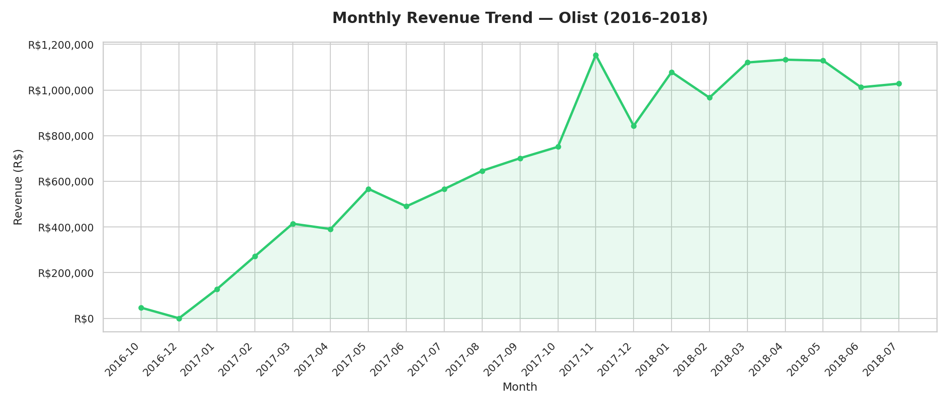
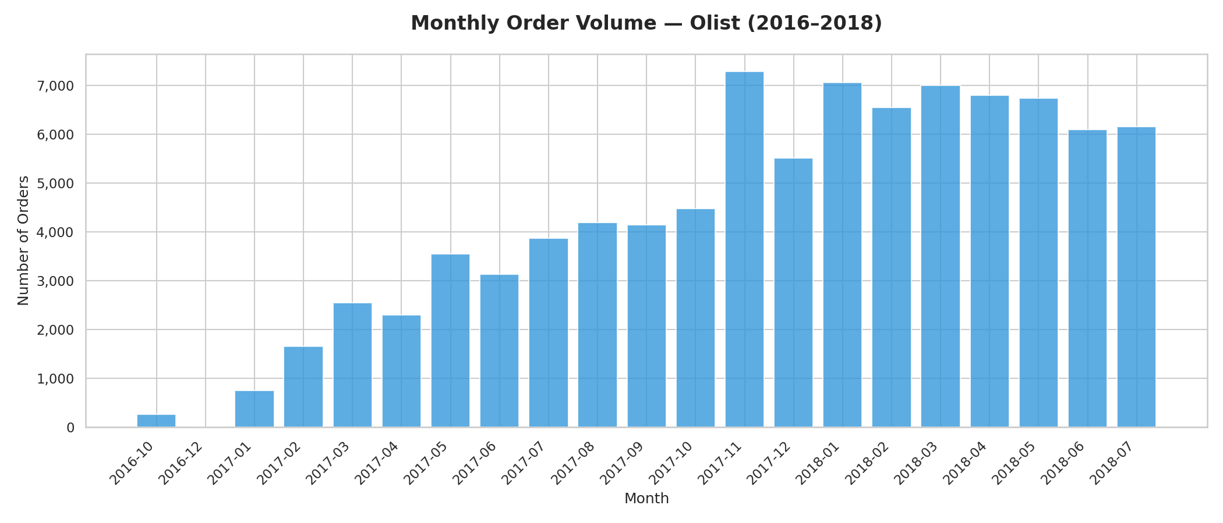
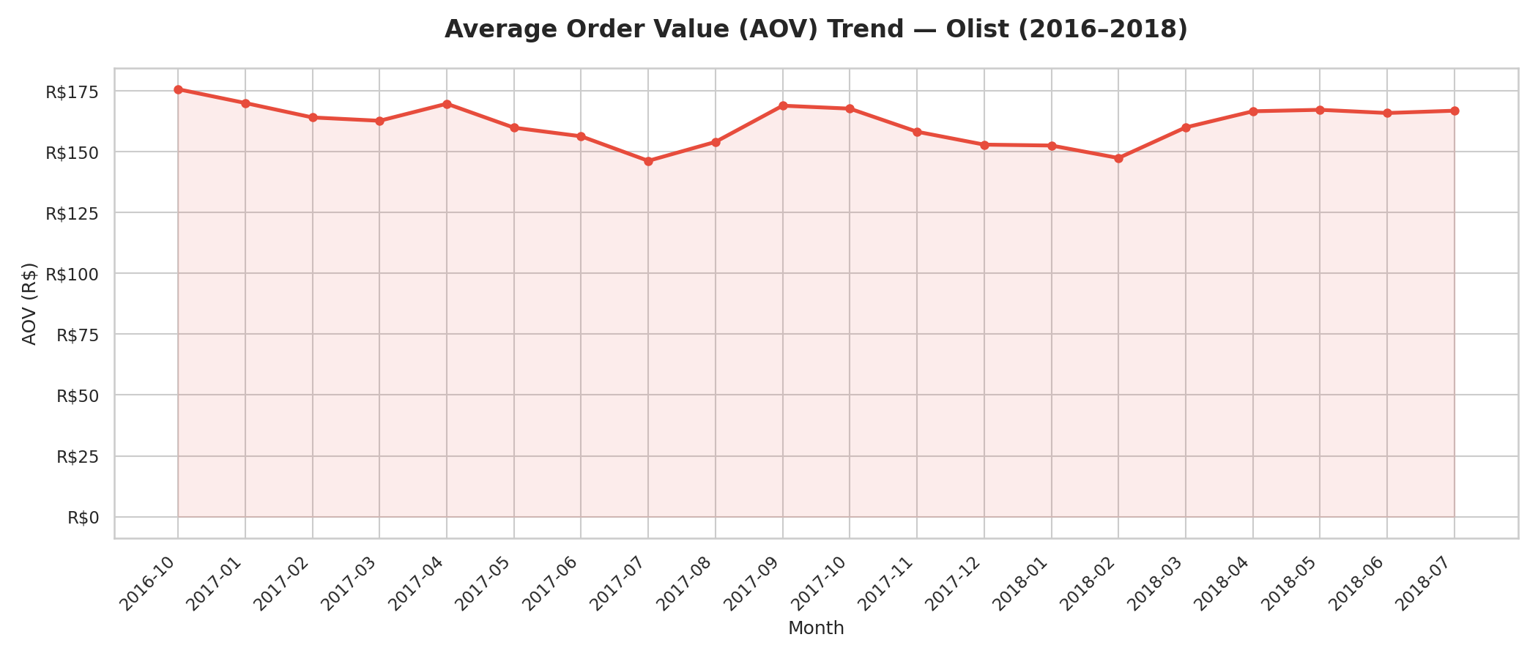
FINDING 1 · REVENUE GROWTH QUALITY
Growth is real — but driven by volume, not basket value
Monthly revenue
Order volume
Average order value
25×
R$175 → R$160
Nov 2017
revenue growth in 13 months
AOV declined as volume surged
sharp spike aligned to Black Friday
What it means High dependence on promotional events creates revenue volatility and margin pressure.
Priority action Shift to AOV levers — bundling, cross-sell, free-ship thresholds, targeted high-margin promos.
Unlocking Growth at Olist · Executive Briefing
05
Notes:
Revenue 25x but AOV fell R$175 to R$160 — growth is transaction-led. The Nov 2017 Black Friday spike shows promo dependence. Action: AOV levers.

Slide 6
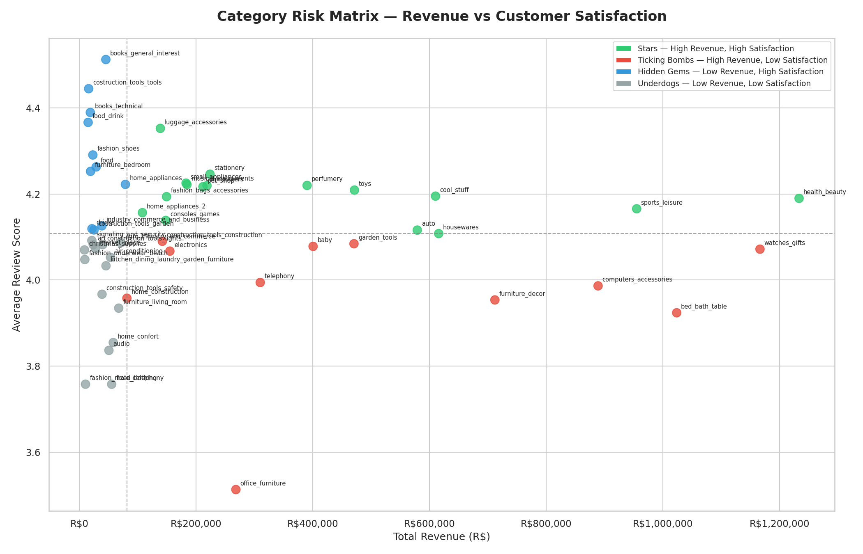
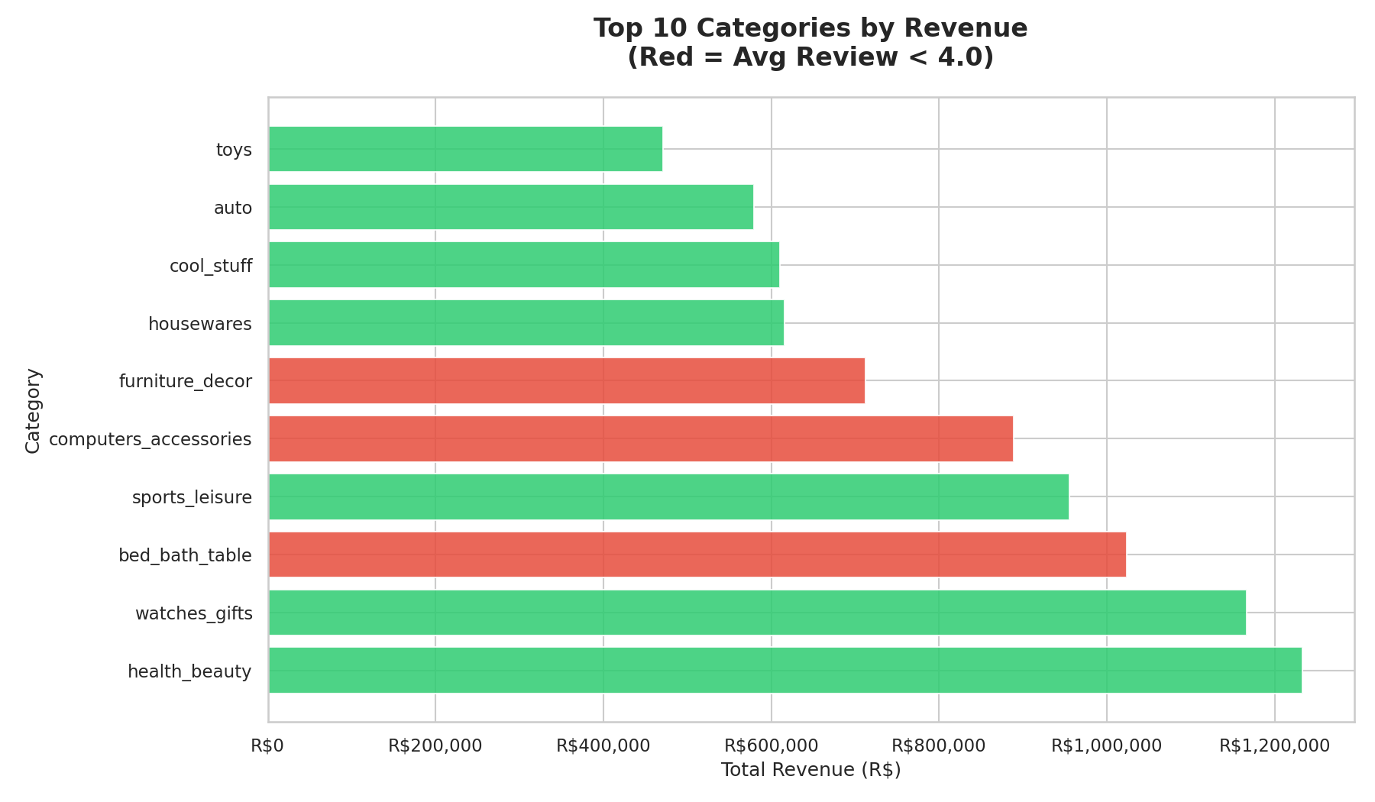
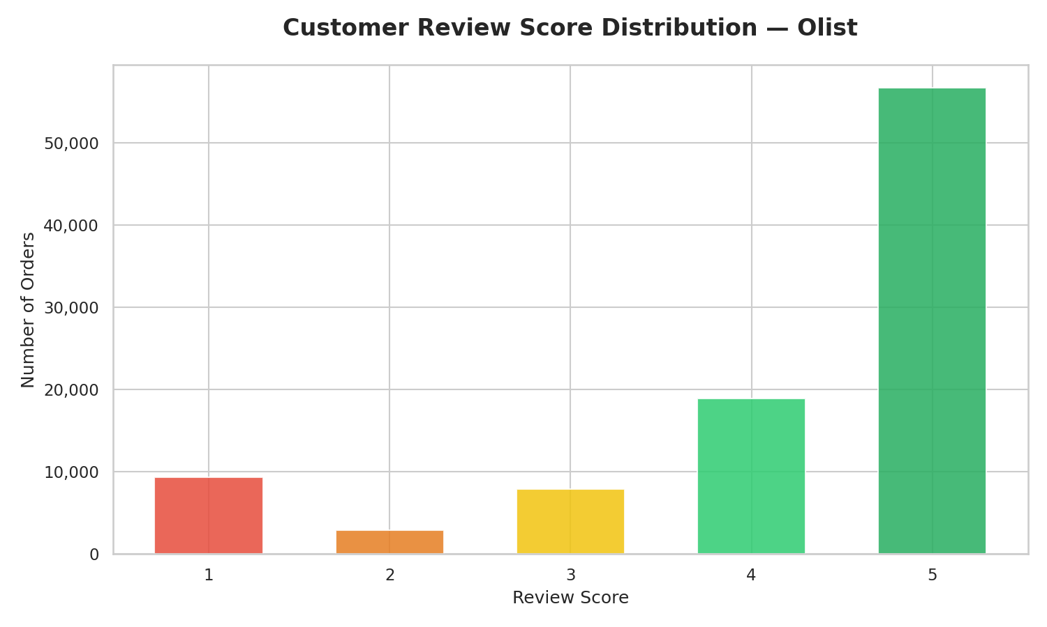

FINDING 2 · CATEGORY RISK MATRIX
High-revenue “ticking bombs” are dragging satisfaction
bed_bath_table
computers
watches_gifts
Action: urgent quality review — product, logistics & returns root-cause.
R$1M+ · rating 3.92
R$888K · rating 3.99
R$1.1M · rating 4.07
Unlocking Growth at Olist · Executive Briefing
06
Notes:
Ticking bombs = high revenue, sub-4 rating: bed_bath_table, computers, watches_gifts. Most reviews are 5-star, so these laggards stand out. Root-cause them.

Slide 7
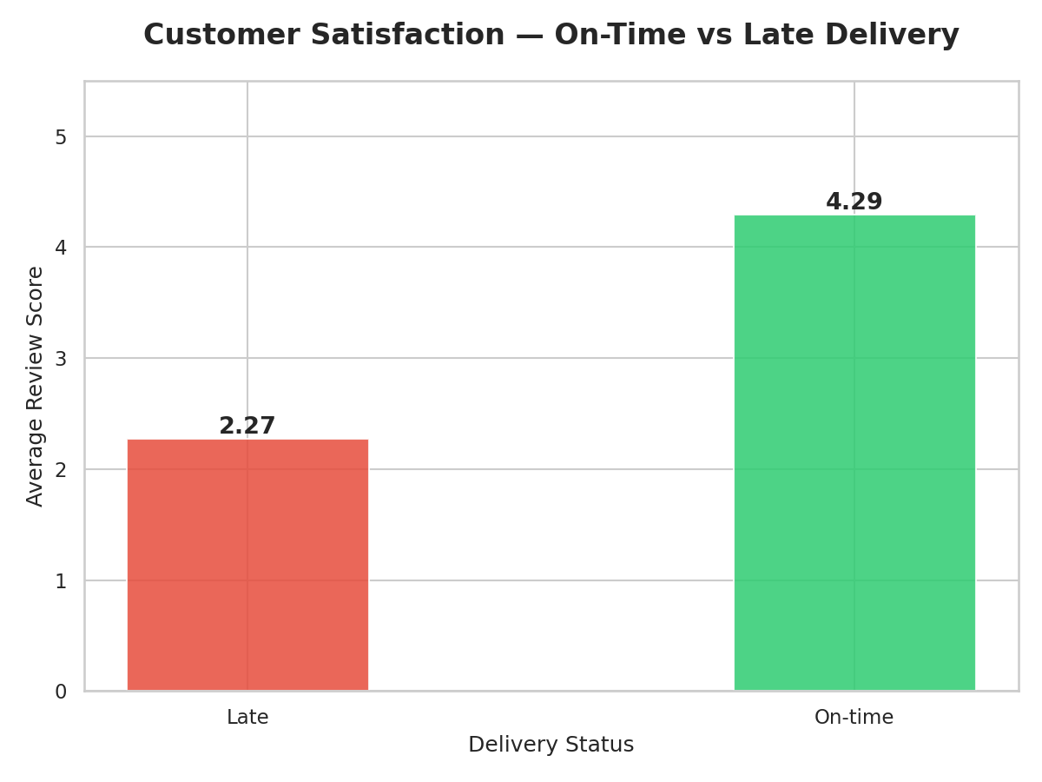
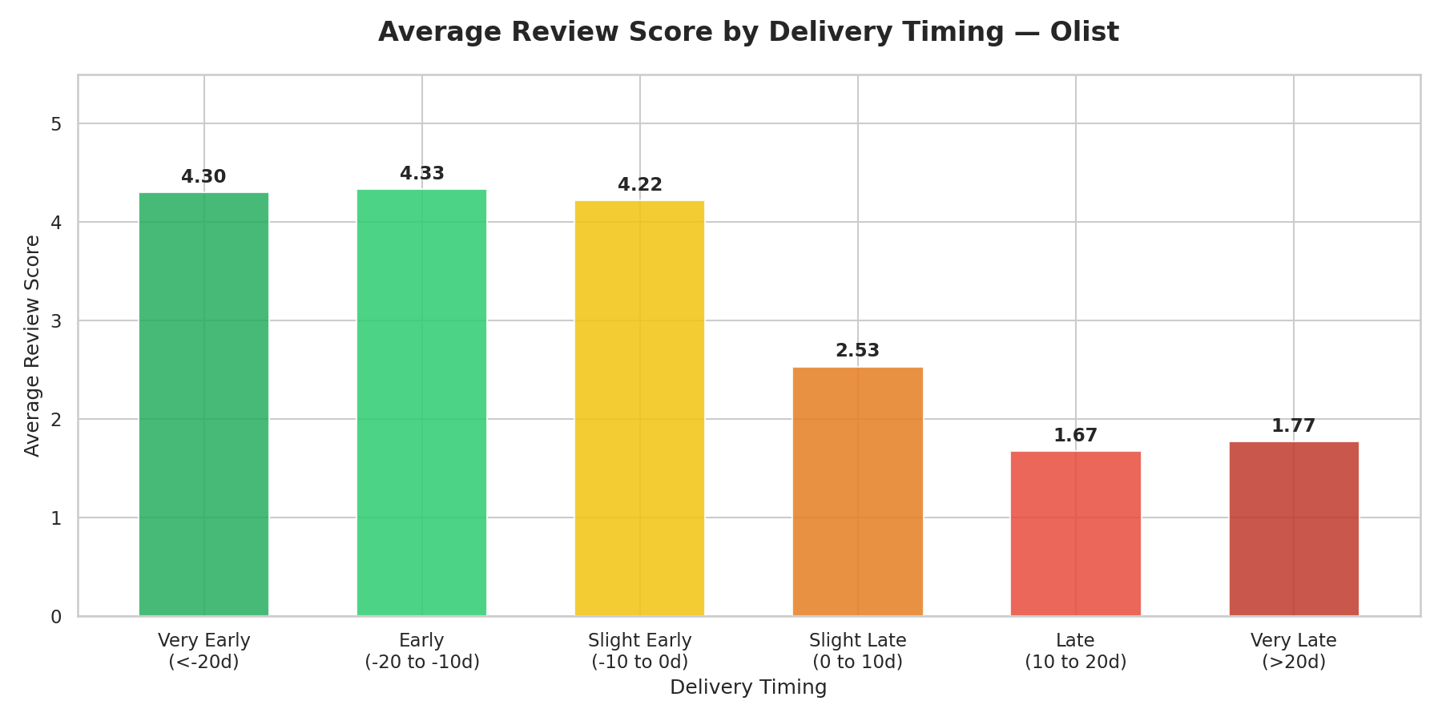

FINDING 3 · DELIVERY IMPACT
Late delivery is the single biggest satisfaction killer
4.29★
average rating, on-time orders
2.27★
average rating, late orders
−47%
satisfaction drop after a late order
0.36%
catastrophic delays — outsized harm
Priority action: real-time SLA monitoring, exception alerts and prioritised recovery flows for delayed orders — the highest-ROI satisfaction lever.
Unlocking Growth at Olist · Executive Briefing
07
Notes:
On-time 4.29 vs late 2.27 stars. Delays are rare (0.36%) but disproportionately damaging, driving the 47% drop. Fix with SLA monitoring + recovery flows.

Slide 8
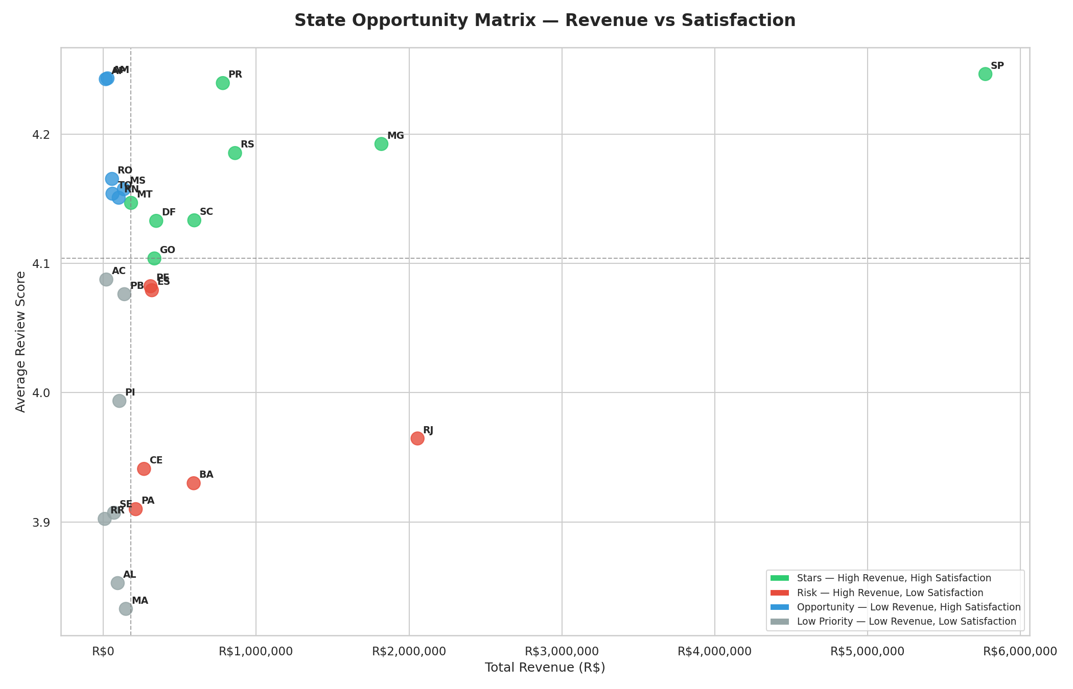
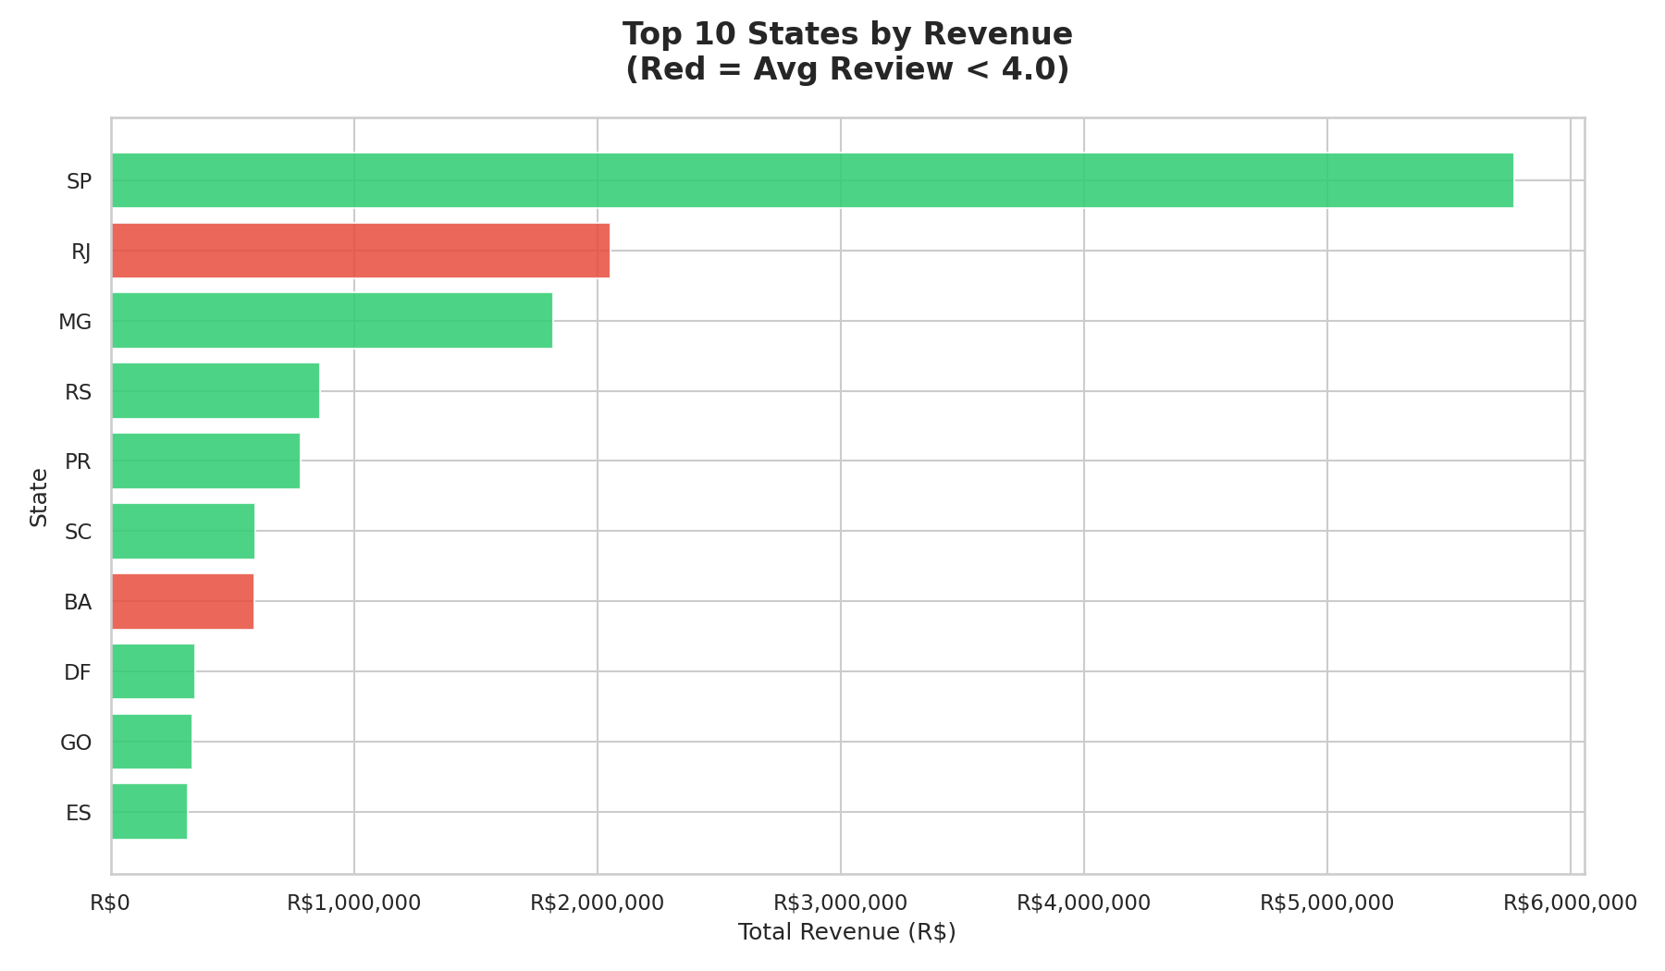
FINDING 4 · STATE OPPORTUNITY & RISK
Concentrated in São Paulo; risk and upside elsewhere
SP — R$5.77M
RJ — R$2.05M
BA — R$591K
MS & MT
rating 4.25 · leader, invest to scale
rating 3.96 · risk, urgent fix
rating 3.93 · risk
low revenue, high satisfaction · growth pilot
Unlocking Growth at Olist · Executive Briefing
08
Notes:
SP dominates revenue with healthy ratings. RJ and BA are high-revenue but low-satisfaction risks needing last-mile fixes. MS/MT are happy but small — acquisition pilots.

Slide 9
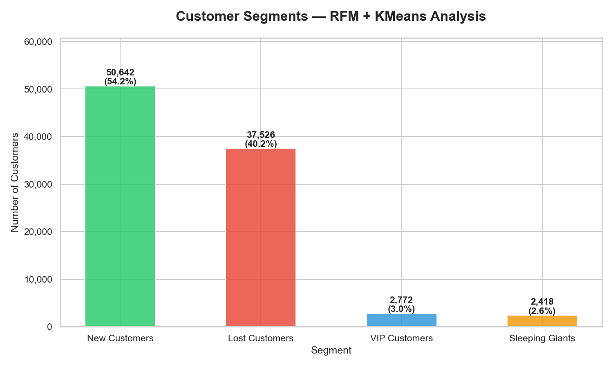
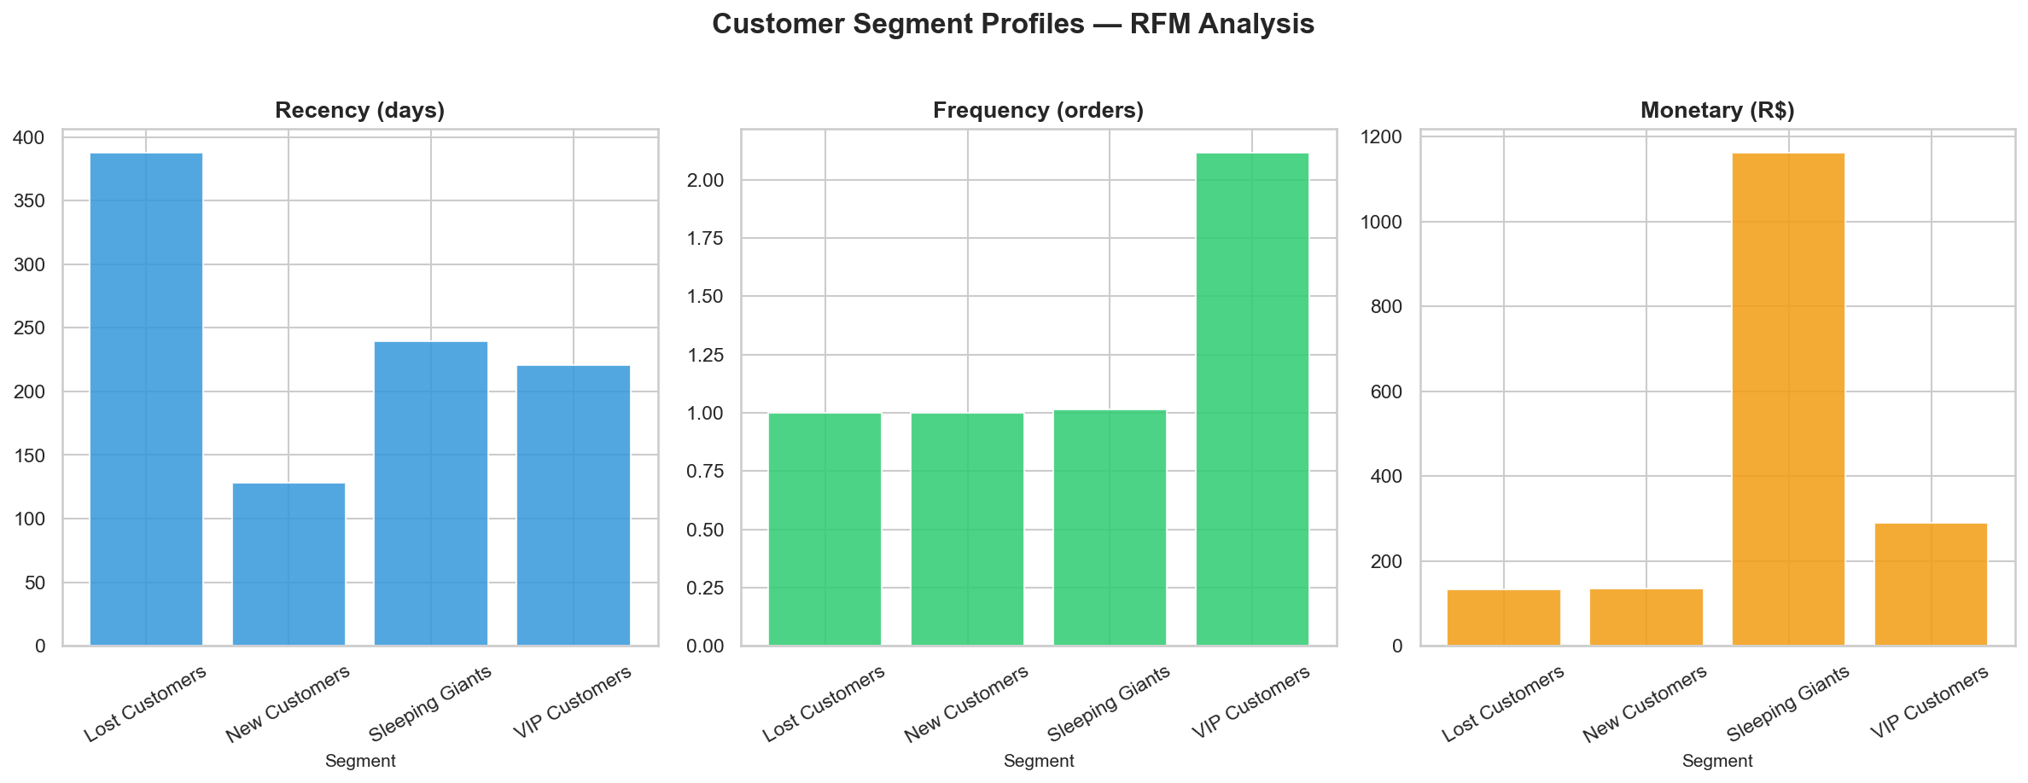
FINDING 5 · CUSTOMER SEGMENTATION (RFM + KMEANS, K=4)
94% buy once — the retention opportunity is enormous
New Customers
Lost Customers
VIP Customers
Sleeping Giants
50,642 (54%)
37,526 (40%)
2,772 (3%)
2,418 (3%)
recency ~128d · high volume, low loyalty
recency ~387d · win-back priority
recency ~220d · small but valuable
avg spend R$1,160 · top reactivation ROI
Unlocking Growth at Olist · Executive Briefing
09
Notes:
Four segments. New + Lost are 94% of customers — proof of the one-time-buyer problem. Sleeping Giants are tiny but spend R$1,160 each — the highest-ROI reactivation target.

Slide 10




RECOMMENDATIONS & NEXT STEPS
Five moves to convert fragile growth into durable revenue
1.
Fix delivery SLA
2.
Quality review: ticking bombs
3.
Win-back campaign
Real-time SLA monitoring, delay escalation and automated compensation — highest satisfaction ROI.
Root-cause across product, returns and seller SLAs for bed_bath_table, computers, watches_gifts.
Target the 37,526 lost customers with personalised offers and delivery guarantees.
4.
Reactivate Sleeping Giants
5.
Grow AOV
High-touch outreach + curated bundles for 2,418 customers (avg R$1,160) — top recovery prize.
Bundles, minimum free-ship thresholds and targeted upsell flows to recover margin.
Unlocking Growth at Olist · Executive Briefing
10
Notes:
Sequence by ROI: delivery SLA first (biggest satisfaction lever), then category quality, then retention plays (win-back + Sleeping Giants), then AOV growth.

Slide 11

CONCLUSION
Growth at Olist is real —
but fragile.
Stabilise the experience
Pursue data-driven retention
Defend margin as you scale
Late delivery and weak categories cost satisfaction — fix them first.
94% buy once; reactivating Sleeping Giants is the highest-ROI move.
Lift AOV so growth stops depending on discounts and promo spikes.
Stabilise customer experience and convert one-time volume into loyal, higher-value customers — that is how Olist turns scale into sustainable revenue.
Muhammed Raazi V · June 2026 · Olist End-to-End Data Analytics Case Study
Notes:
Close on the through-line: real but fragile growth. Three pillars — stabilise experience, retain customers, defend margin. Reactivating Sleeping Giants is the single highest-ROI action.

