Slide 1

ANALYSIS OF WHOLE BODY VIBRATION OF VEHICLE PASSING THROUGH BUMP AT DIFFERENT VELOCITIES
INDIAN INSTITUTE OF TECHNOLOGY GUWAHATI
MUKESH KUMAR -234103423
VINEET KUMAR GARG-234103443
MUHAMMED RISWAN-234103445
ME531-Mechanical Vibrations
Course Coordinator
Prof- Dr. S.K.Dwivedy

Slide 2
01
INTRODUCTION
TABLE OF CONTENTS
02
EQUATION OF MOTION
MATLAB CODE
03
04
MATLAB PLOTTING
05
RESULT & DISCUSSION

Slide 3
INTRODUCTION
Whole-body vibration from prolonged vehicle sitting contributes to over one million annual global fatalities and 50 million non-fatal injuries. The suspension system's role in transmitting forces between the vehicle and road is pivotal for ride safety and handling.
The study investigated the whole-body vibration (WBV) levels that people riding in the vehicle are exposed to while passing through the bumps on road.
Also,the present work is carried out to investigate performance of vehicles in terms of ride comfort and road holding.
We have used the code that uses a numerical simulation method to analyze the response of a vehicle.
The specific method employed here is a time-domain simulation using the state-space representation.
Within the scope of the study evaluated with the help of frequency weighted root-mean-square acceleration (aw)In many studies, it is seen that the frequency-weighted vibration assessment approach mentioned in the ISO 2631 standard is used in the evaluation of the effects of vibration on the human body.

Slide 4
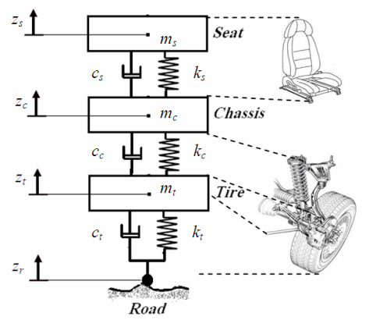
EQUATION OF MOTION
Consider the quarter car model shown in figure – 1.
The equations of motion are given as –
Ms*Zs’’ + Ks*( Zs – Zc ) + Cs*(Zs’ - Zc’) = 0 ………….(1)
Mc*Zc’’ - Ks*( Zs – Zc ) – Ct*(Zs’ – Zc’) + Kc( Zc – Zt) +
Cc(Zc’ – Zt’) = 0 …………..(2)
Mt*Zt’’ – Kc*( Zc – Zt) – Cc*( Zc’ – Zt’) + Kt*( Zt – Zr) = 0 …….(3)
Fig. –1 [Quarter car model]

Slide 5
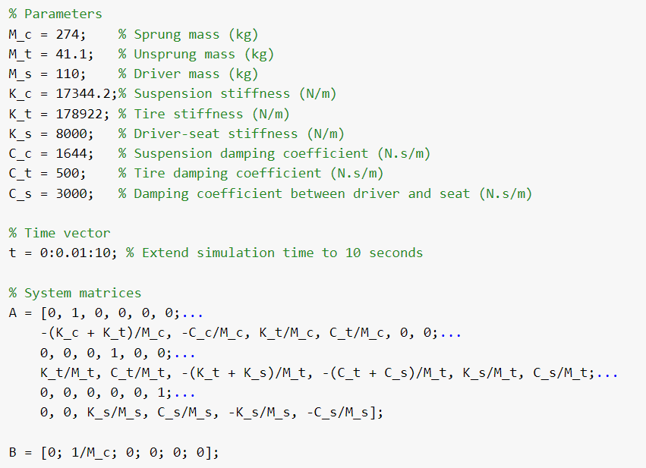
MATLAB CODE

Slide 6
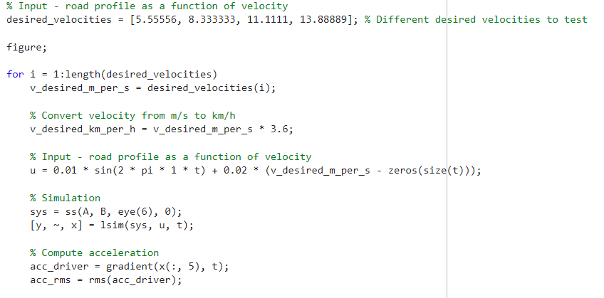
MATLAB CODE

Slide 7
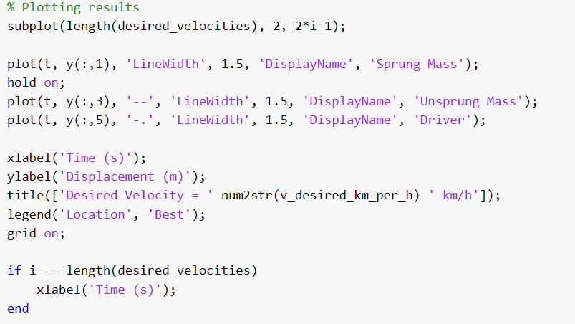
MATLAB CODE

Slide 8
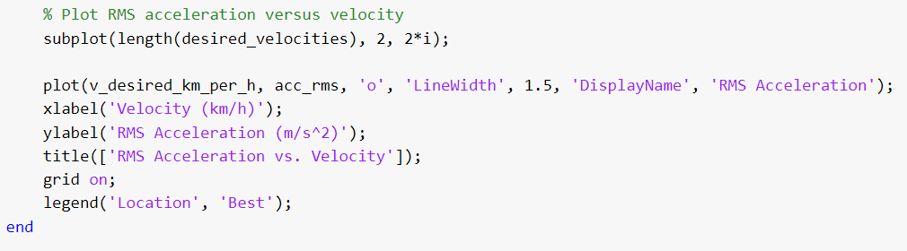
MATLAB CODE

Slide 9
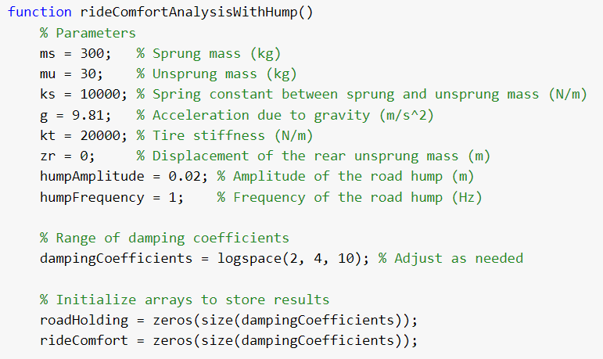
MATLAB CODE

Slide 10
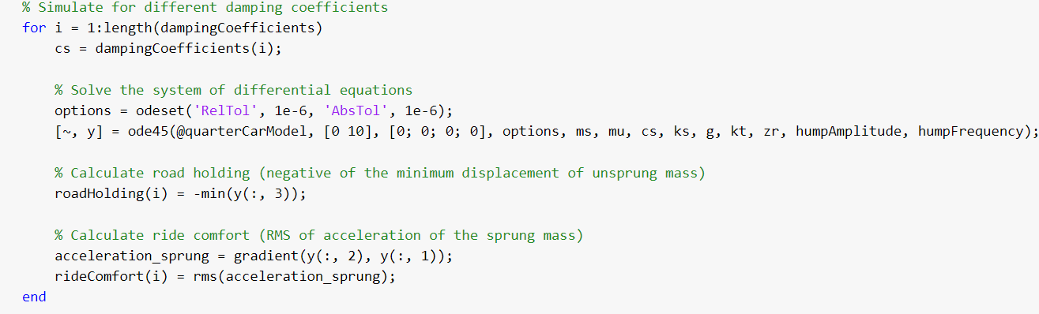
MATLAB CODE

Slide 11
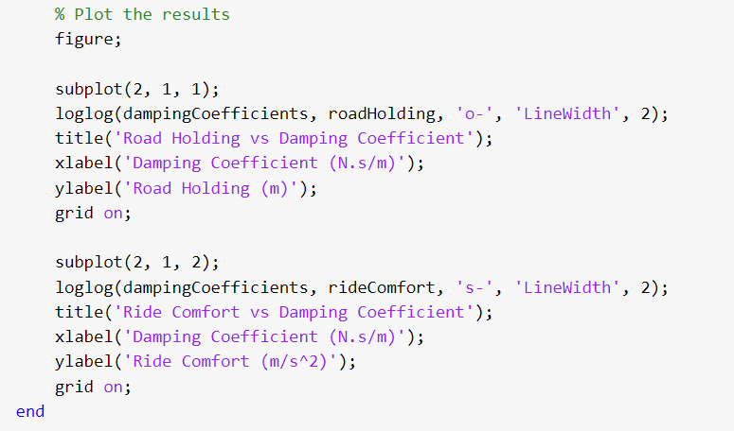
MATLAB CODE

Slide 12
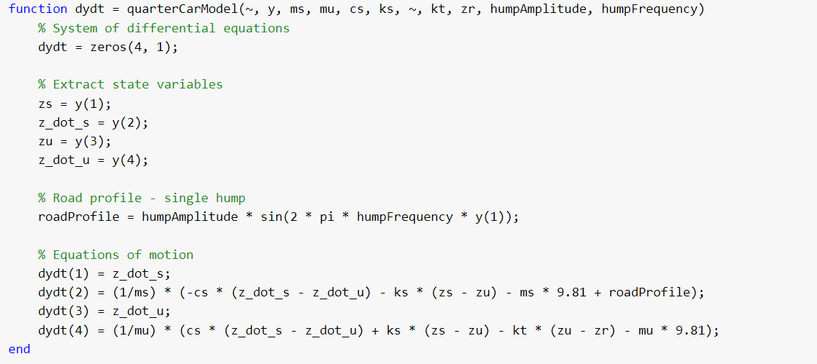
MATLAB CODE

Slide 13
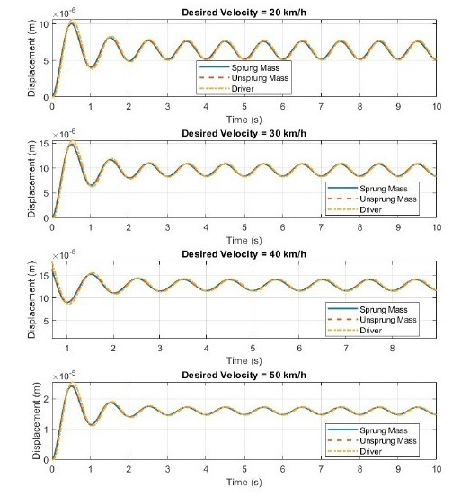
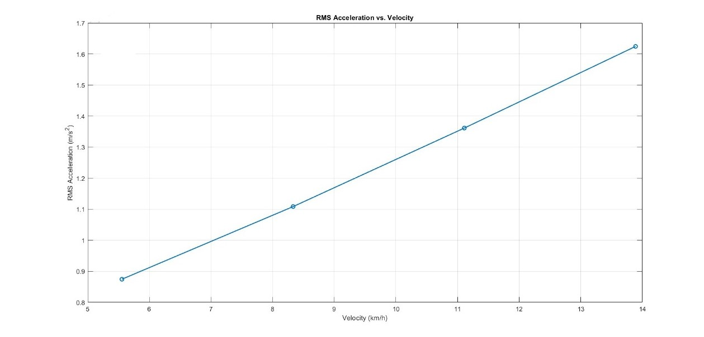
MATLAB PLOTTING
FIGURE 3
FIGURE 2

Slide 14
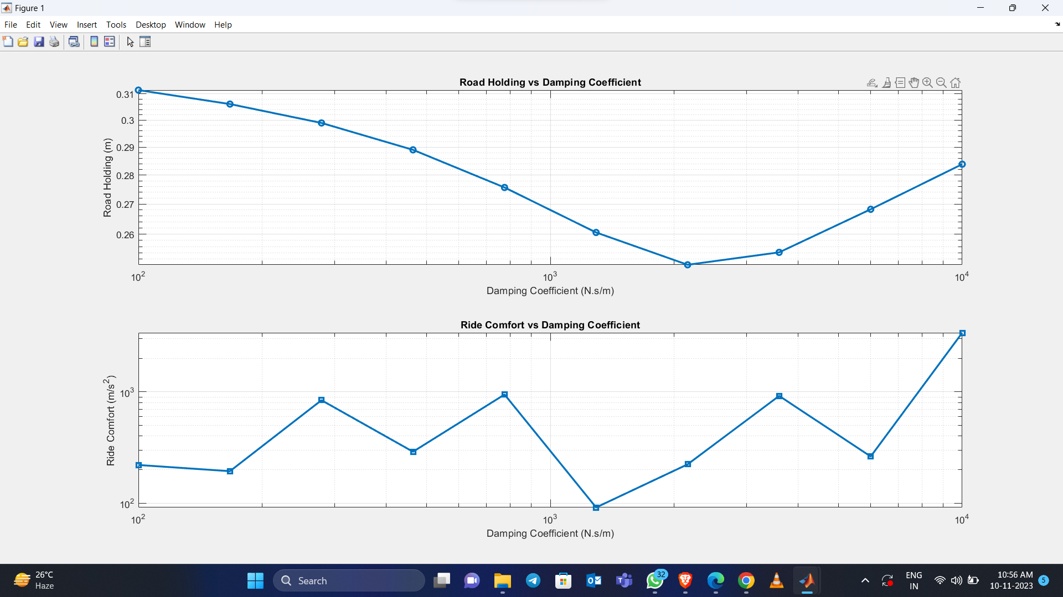
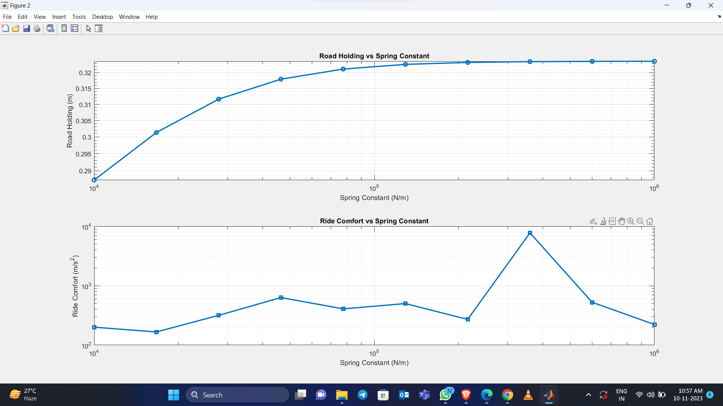
MATLAB PLOTTING
FIGURE 3
FIGURE 4

Slide 15
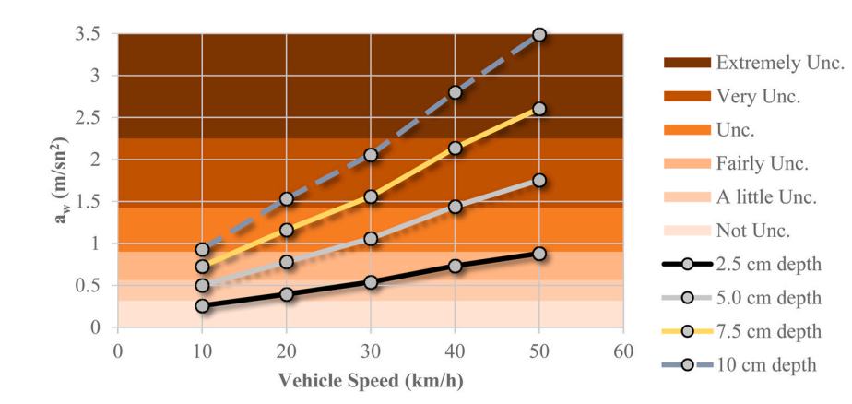
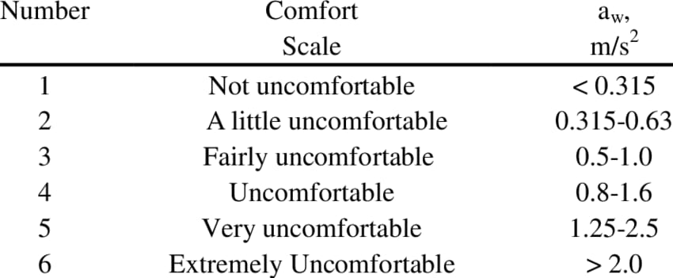
RESULT AND DISCUSION

Slide 16
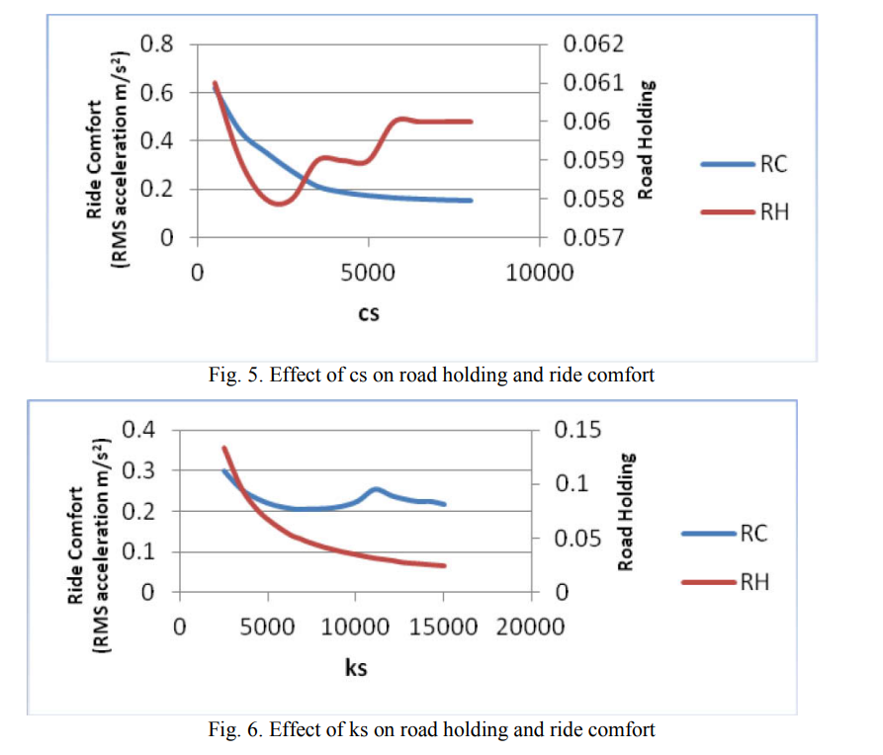
RESULT AND DISCUSION
At low damper coefficient good value ride comfort is obtain. Road holding varies with damping coefficient. For soft stiffness ride comfort good while for hard stiffness ride is bad

Slide 17
RESULT AND DISCUSION
From graphs it is observed that as RMS acceleration value increases it gives decreasing ride comfort. Road holding is the relative displacement between road excitation and tire displacement (zu-zr). When (zu-zr) value is negatives means tire loses contact with road. Ride comfort varies inversely with road holding.

Slide 18
REFERENCE
Quarter Car Model Suspension System and its Validation with the Help of Simulink Model Ms. Varsha Chitale, Prof. R. B. Patil, Prof. Arif Pathan (International Journal of Advanced Research in Science, Communication and Technology (IJARSCT)).
Analysis of Ride comfort and Road holding of Quarter car model bySIMULINK Trupti P. Phalke(Sciencedirect)
Investigation of the effects of whole-body vibration exposure on vehicledrivers when travelling over covered manholes embedded inpublic roadways Ufuk Kırbas(science direct)

Slide 19
THANK YOU

