Slide 1

DETECTION OF ALZHEIMERS’ DISEASE WITH MRI USING MACHINE LEARNING
MTSU Computational and Data Science Department
Sadiat Muhammed

Slide 2
TABLE OF CONTENTS
Problem Definition
Introduction
Synergy between Machine Learning and MRI
Machine Learning Approach
Types of Algorithms and Models
Data Preprocessing and Feature Extraction
Model Development and Evaluation
Results
Conclusion
Acknowledgement
Thank You

Slide 3
PROBLEM DEFINITION
The problem definition is focused on how to effectively and promptly diagnose Alzheimers’ disease using data from Magnetic Resonance Imaging (MRI) and machine learning methods.

Slide 4
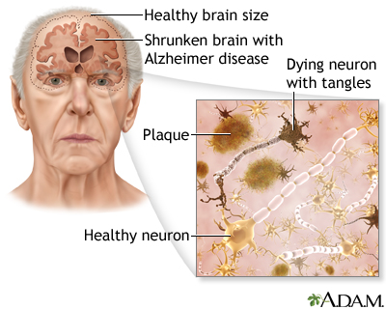
INTRODUCTION
Alzheimer’s disease has no cure with it being the seventh leading cause of death in the world.
MRI scans detect its early signs.
Machine Learning Models effectively classify this images.
Early detection of the disease allows for easy management and treatment of the disease.

Slide 5
SYNERGY BETWEEN MACHINE LEARNING AND MRI
Enhanced Image Analysis
Feature Extractions
Early Detections
Pattern Recognition
Accurate Diagnosis
Predictive Modeling

Slide 6
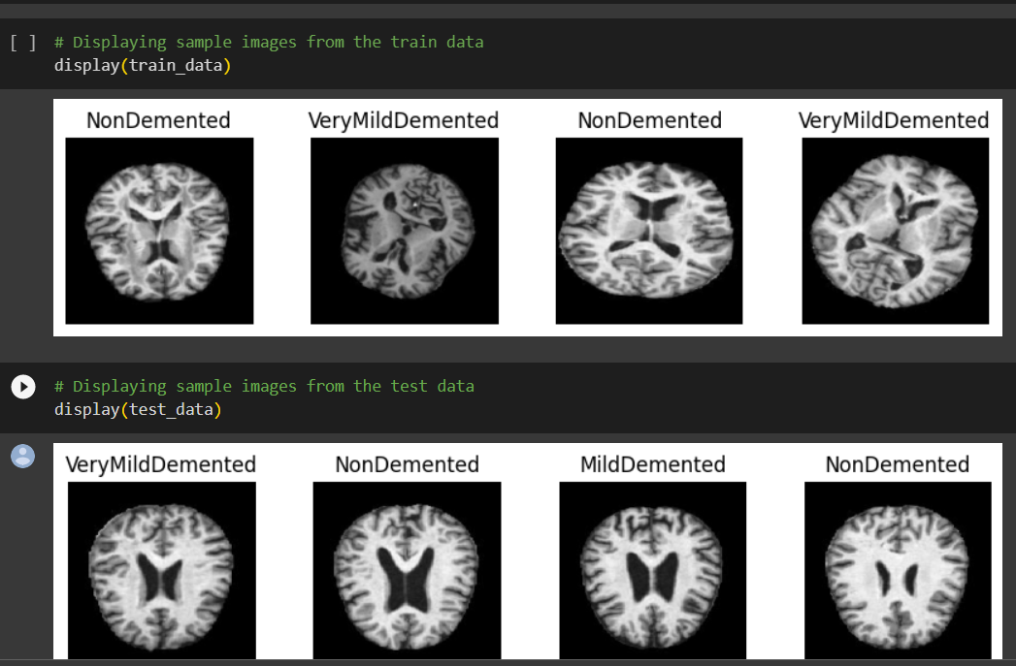
DATASET
Data Collection and Preprocessing:4098 data images was gotten from ADNI website
It is contains 4 classes of images
The data was gotten from Alzheimers’ Disease Neuroimaging Initiative(ADNI)
It can not be cured
Early detection and treatment can make a significant difference in improving the individual quality of life.

Slide 7
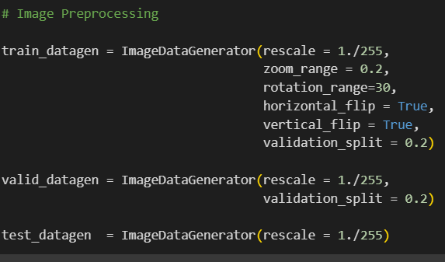
DATA PREPOCESSING
Train data gen was rescaled to 1./255 .the pixel values of the images to the range [0,1]
The code "Validation split = 0.2" divides the training data into two parts: a training set and a validation set. The validation set comprises 20% of the original training data and is used to assess the model's performance during training..
Valid data gen rescaled images to 1/255
Test data gen Rescaled to 1/255

Slide 8
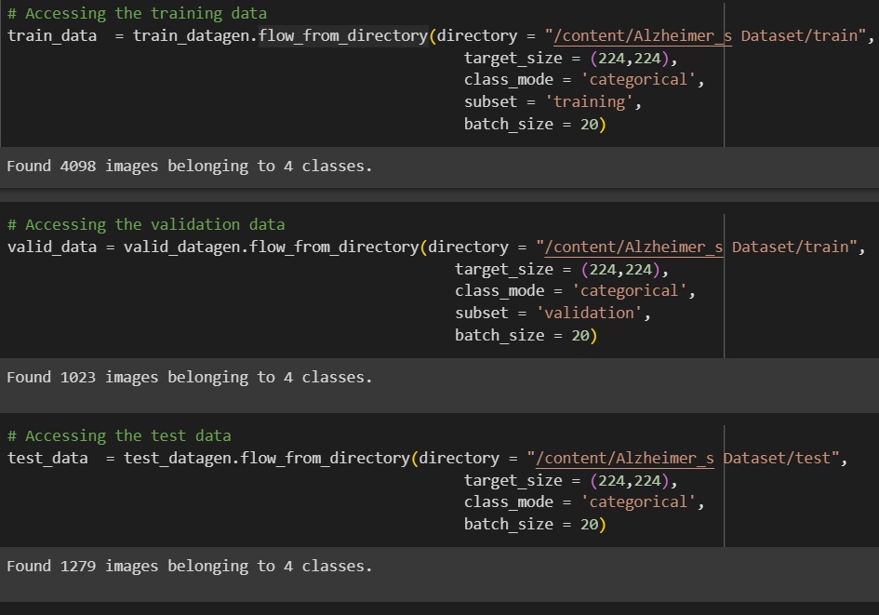
DATA PREPOCESSING
Training data:4098
Images belongs to 4 classes
Validation data:1023 images belongs to 4 classes
Test data:1279 images belongs to 4 classes

Slide 9
DATA PREPOCESSINGAND EXTRACTION
There are 6,400 images in all.
3,200 of which are labeled as Demented
2,240 of which are very mildly demented.
896 of which are mildly demented.
64 of which are moderately demented.
The images were divided into two directories one for training images and the other for testing images.

Slide 10
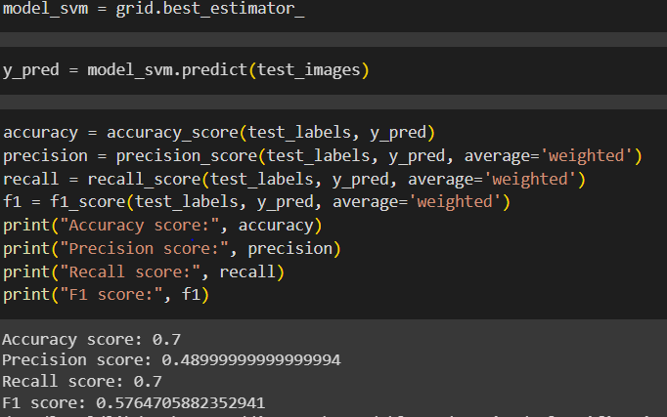
MACHINE LEARNING APPROACH What is Support Vector Machine?
Handles High-dimensional data
Has Ability to capture Complex patterns
Robust against overfitting
Works well with limited training samples

Slide 11
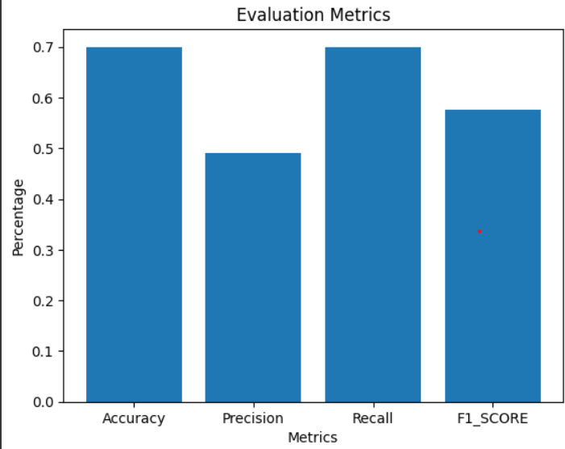
SVM EVALUATION
Accuracy of 70% shows the instances were correctly classified.
Precision of 49% shows true positive predictions.
Recall of 70%
F1_Score of 55%

Slide 12
MACHINE LEARNING APPROACH What is Convolutional Neural Network?
Commonly used for analyzing visual data such as images or videos
It has the ability to automatically learn and extract features from input data.
Scans across images to detect patterns and features at different spatial scales
It is a 9-layer model built with keras Tensorflow.
CNNs have revolutionized the field of computer vision and have achieved remarkable success in various applications.

Slide 13
COMPARISON BETWEEN CNN AND VGG16
CNN utilizes convolutional layers and pooling functions.
VGG-16 uses a uniform structure with small 3 by3 filters and max pooling.
CNN is a deep learning architecture mainly for image analysis and pattern recognition, while VGG-16 focuses on extracting features across various scales and complexities.
VGG-16 has a total of 16 layers
VGG-16 has 13 convolutional layers and 3 fully connected layers

Slide 14
USING TRANSFER LEARNING IN CNN
Takes Layers from a previously trained model
Trainable layers on top of the frozen layers
Freezes them to avoid destroying information they contain during training rounds
Train new layers on a new dataset

Slide 15
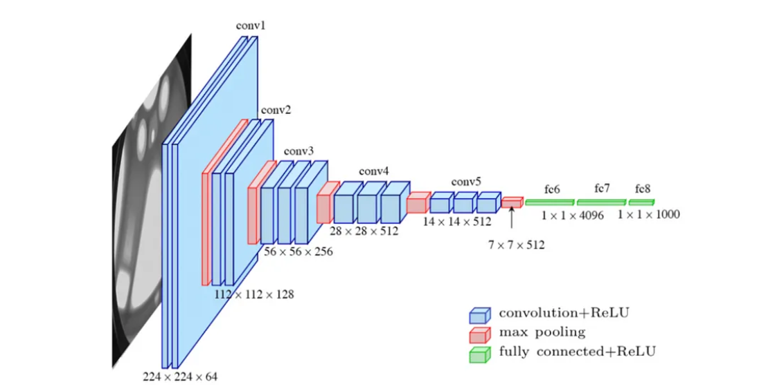
VGG-16 ARCHITECHTURE IN CNN
The model holds a sequential function .
Dropout is a regularization technique that helps to prevent overfitting
A dropout layer of 0.5 rate was added.
Flatten layer flattens the multidimensional output .

Slide 16
DENSE LAYER ARCHITECTURE
A layer in a neural network that represents a fully connected layer
It is placed after the convolutional and pooling layers
Uses four neurons in the neural network model

Slide 17
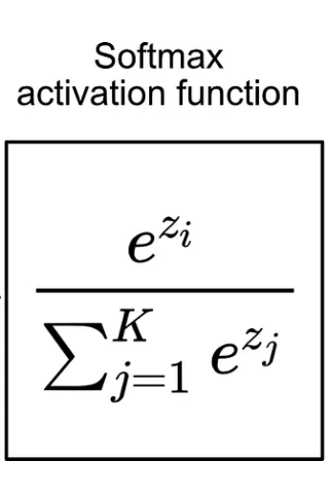
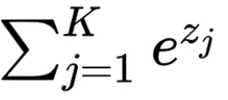
SOFT-MAX ACTIVATION FUNCTION IN NEURAL NETWORK
Soft-max predicts class probabilities in multi-class classification.
e denotes the mathematical constant Euler’s number
Zi represents the input to the SoftMax function for the i-th class
Where the total sum of the exponential values of all the element in the input value is

Slide 18
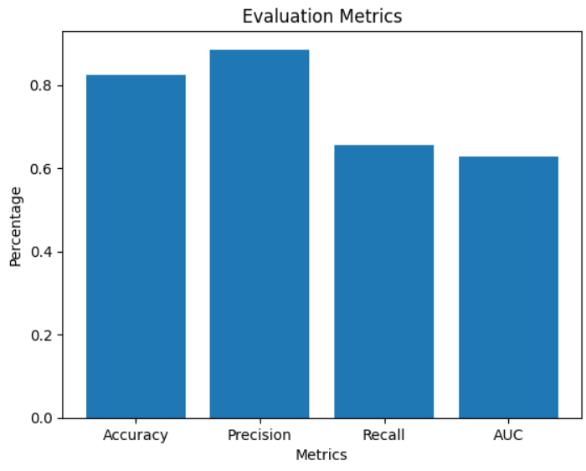
ACCURACY OF THE VGG-16 TRANSFER LEARNING ON A CNN
Accuracy using VGG16 transfer learning on CNN is 80.4% of the datasets
Precision is 84.1%
Recall is 62%
Area under the Curve is 0.56

Slide 19
TENSORFLOW EARLY STOPPING CALLBACK CLASS
It is provided by TensorFlow
It is placed after the convolutional and pooling layers
It is used based on Validation AUC metric
Halts the training process if the validation AUC does not improve for a certain number of epoches

Slide 20
FASTAI
It is known for its simplicity and usability
It works by providing a high-level API built on top of PyTorch
The library is optimized for training on GPUs, making it suitable for training large models and complex architectures.
Uses four neurons in the neural network model

Slide 21
RESULTS AND CONCLUSIONS
. An impressive accuracy rate of 80.4%, with the VGG-16 on CNN outperforming other algorithms in terms of accuracy.
overcame the overfitting problem of machine learning techniques to classify the disease accurately with less computational complexity
Based on this result, it becomes realistic that CNN model detects the disease early.

Slide 22
ACKNOWLEDGEMENT
AiBigData team
I would like to thank Dr Khem Poudel.
I would also like to thank the Computer Science and Computational and Data Science departments.
I would like to also thank the Ai BigData team.
And lastly my fellow computational Data science students that always helps me out when I am stuck.

Slide 23
REFERENCES
M. Chowdhury, C. Li, and K. Poudel, “Combining deep learning with traditional machine learning to improve phonocardiogra- phy classification accuracy,” 2021 IEEE Signal Processing in Medicine and Biology Symposium (SPMB). IEEE, 2021, pp. 1– 5
https://medlineplus.gov/ency/article/000760.html
M. Tanveer, B. Richhariya, R. U. Khan, A. H. Rashid, P. Khanna, M. Prasad, and C. Lin, “Machine learning techniques for the diagnosis of alzheimer’s disease: A review,” ACM Transactions on Multimedia Computing, Communications, and Applications (TOMM), vol. 16, no. 1s, pp. 1–35, 2020

Slide 24
THANK YOU

