Slide 1
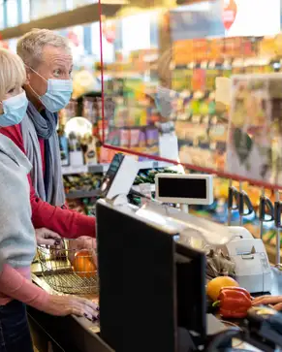
AI BASED DIGITAL WEIGHING SCALE

Slide 2
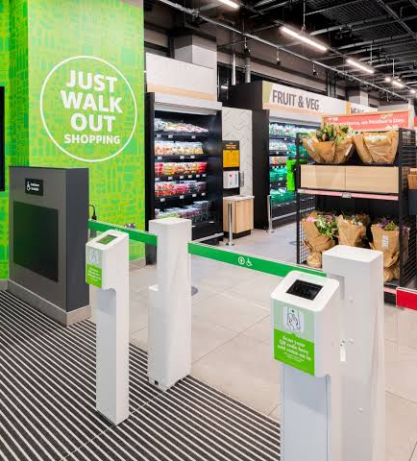
HELLO! We are
PG20CS13
Prof. Seena Thomas (Guide)
Arafat Abdul Jaleel (KSD20CS022) [ T L ]
Muhammed Shaahid Latheef (MEA20CS064)
Fathimath Niyaza Nasreen (KSD20CS047)
Aysha Afa (KSD20CS033)

Slide 3
CONTENTS
Introduction
Motivation
Problem Statement
Objectives
Literature Survey
Project Plan
Design
Reference
Conclusion

Slide 4
INTRODUCTION
The “AI BASED DIGITALWEIGHING SCALE " , the project is like a smart helper for stores. It uses special technology to see and identify items customers want to buy. It can weigh them too and make a bill for the customer. It's a great way to make shopping faster and easier for everyone.
1
4

Slide 5
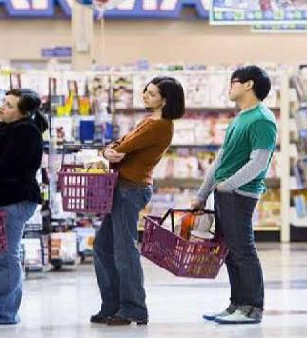
PROBLEM STATEMENT
2
Develop a fully automated weighing machine that detects
objects, measures their weight, and calculates total prices based
on predefined data for efficient and error-free retail transactions.

Slide 6
.
.
.
.
.
I
“
I
I
I
Embrace technology to automate the pricing process, reducing the dependency on staff members.
We aim to enhance the shopping experience, reduce pricing errors and delays in billing area.
MOTIVATION
3
6

Slide 7
OBJECTIVES
4
Automate billing through object detection and weight sensing.
Ensure accurate pricing based on detected items and weights.
Seamlessly integrate with a weighing scale for precision.
Enhance the retail experience with efficiency and accuracy.

Slide 8
DEEP LEARNING
5
Deep learning is a type of machine learning.
It involves building artificial neural networks with multiple layers.
Deep learning is used to analyze and learn from large and complex datasets.
It is applied in various fields such as image and speech recognition, natural language processing, and autonomous vehicles

Slide 9
LITERATURE SURVEY
6
SI.No | Title | Author | Contribution | Year
1 | Automatic Weighing and Packaging Machine | Prajakta Hambir, Nimish Joshi, Pranav Karande, Amol Kolhe ,1,2,3TYBTECH Student, School of Mechanical and Civil Engineering, MIT Academy of Engineering, Alandi (D), Pune, M.S. India. 4Assistant Professor, School of Mechanical and Civil Engineering, MIT Academy Of Engineering, Alandi (D), Pune, M.S. India. | Small and medium-scale food production businesses and grocery stores often struggle with manual weighing, filling, and packaging processes, hindering their growth. Existing automated machines are costly, posing accessibility challenges. This project proposes an affordable solution employing a microcontroller and sensors for automated weighing and packaging. The system enhances efficiency, cuts costs, and minimizes reliance on manual labor. This technology promises accessibility and benefits for small and medium-scale businesses, facilitating growth and modernizing production methods. | 2022

Slide 10
LITERATURE SURVEY
SI.No | Title | Author | Contribution | Year
2 | Computer vision based automated billing system for fruit stores | 1M Sugadev, 2Kudapa Sucharitha, 3 I.Rexline Sheeba, 4Balamurugan Velan 1,3Assistant Professor,4 Associate Professor, 2Under Graduate Student Department of ECE, Sathyabama Institute of Science and Technology, Chennai-119 | This paper describes about the new billing system which is more accurate and time efficient than conventional billing system used in fruit retail shops. The proposed method uses the deep learning neural network approach for classification of fruits and strain gauge type load cell to estimate the weight of the fruit items kept in the basket. The neural network takes input image in the form of clusters and this cluster forms a centroid that is processed to classify fruits like Apple, Banana, Granny Smith, etc. The image processing and weight computation algorithms are implemented in RaspberryPi board with tensor flow and openCV library functions. The proposed system automatically recognize the type of fruits, finds the weight of the fruit in grams, computes the total cost and prints the bill statement. | 2021

Slide 11
LITERATURE SURVEY
SI.No | Title | Author | Contribution | Year
3 | An Intelligent Self-Service Vending System for Smart Retail | Kun Xia, Hongliang Fan * , Jianguang Huang, Hanyu Wang, Junxue Ren, Qin Jian and Dafang Department of Electrical Engineering, University of Shanghai for Science and Technology, Shanghai 200093, China | This paper presents an intelligent self-service vending system for non-barcode items, employing a single camera for real-time product detection and integrating weighing, identification, and online settlement functions. Utilizing deep learning, it enables flexible fruit identification and supports information exchange between devices and platforms. Experimental results demonstrate high accuracy in weight measurement and item prediction, validating its effectiveness in various sales scenarios, as shown in a trial in Yangpu District, Shanghai. | 2021

Slide 12
LITERATURE SURVEY
SI.No | Title | Author | Contribution | Year
4 | Automated shopping trolley for billing system | Bhumika R, Harshitha G.,Chandana K. ,Meghashree R. T.,Dr. Sangappa S. B. Kammavari Sangha Institute of Technology, Bengaluru, Karnataka | The modern technology has increased the standard of living for humans. There has been an emerging demand for quick and easy payment of bills in supermarkets. Every one of us craves for quality in everything we use in our daily lives. This project describes how to build an automated and time-saving system for the world of retail which will make shopping experience impetuous, customer friendly and secure. So, this has resulted in large crowds at shopping malls which have to lead to long lines at the billing counter because the cashier has to scan every product item and then enter it into the billing record. The prevailing billing system is a bit timeconsuming. So, we thought of inventing a remedial electronic product to catch-up with this problem. We call it “Automated shopping trolley for billing system” | 2023

Slide 13
LITERATURE SURVEY
SI.No | Title | Author | Contribution | Year
5 | Smart Shopping System for Billing Automation | Vatsalya Singhi, Kayalvizhi Jayavel, Assistant Professors, Department of Information Technology, Sri Ramaswami Memorial University (SRM), Chennai, India | Creating a smart cart that takes care of instantaneous billing is a leap towards a futuristic and fully automated shopping experience. Buying product in large grocery stores with a vast variety of products is a tedious and time consuming process which can be improved by automating the billing system. The smart shopping cart consists of a portable computational device (like raspberry pi) and an automatic product identification technology (like the radio frequency identification technology). Instant billing without long queues at counters and keeping track of expenditure real time are the two objectives of this intelligent cart. This paper is based on developing a project with the aim to reduce time spent on shopping of everyday items and making the process less tedious. | 2022

Slide 14
LITERATURE SURVEY
SI.No | Title | Author | Contribution | Year
6 | Smart Trolley Application with an Approximate Multiplier Approach Using Embedded Platform | M. Maria Dominic Savio and T. Deepa | The paper introduces a smart trolley designed to alleviate the challenges of shopping in crowded malls. Users log in to access a supermarket map on an LCD screen, view aisle product details, scan barcode for packed goods, and take pictures for unpacked items. Neural networks classify items and calculate prices based on weight. After shopping, users pay online. The prototype includes RFID for location tracking, cameras for barcode scanning and image capture, and a force transducer for weight measurement. Accuracy is validated using the VGG-16 network. | 2022

Slide 15
LITERATURE SURVEY
SI.No | Title | Author | Contribution | Year
7 | IoT-Based Intelligent Shopping Cart to Enhance the Shopping Experience | Sasindu Mihishan M ,J.M.Arsakulasuriya, Hapuarachchi H.Y.R ,Janaka Wijekoon ,Wijemanne D.S, Samantha Rajapaksha Dept.Of Computer Systems and Network Engineering Faculty Of Computing Sri Lanka Institute of Information Technology Malabe,Sri Lanka | The newly introduced automated smart shopping cart is a hybrid of a line-following Raspberry Pibased robotic cart and an Android mobile application built on the Flutter platform and powered by a Firebase cloud database. This novel solution entails making the shopping experience more convenient for customers, particularly those who are accustomed to shopping malls.. | 2021

Slide 16
LITERATURE SURVEY
SI.No | Title | Author | Contribution | Year
8 | Smart Shopping Cart using Machine Vision along with Machine Learning | Rakshit Shetty1, Darshana Pawar2, Rishika Poojari3, Ritvik Patel4, Dr. Jyoti Mali5 1,2,3,4B.E. Student, Dept. of Electronics and Telecommunication, Atharva College of Engineering, Mumbai, India 5Professor, Dept. of Electronics and Telecommunication, Atharva College of Engineering, Mumbai, India | This research work focuses on generating a bill for the shopping cart. The main idea is to save customers time by providing digital billing system and hence maximize shopping experience in supermarkets using machine vision along with object recognition. Fast and reliable communication plays a major role in the success of smart shopping applications. In a “Just Walk Out” shopping scenario, camera is installed on the cart to monitor shopping activities so that items in the cart can be tracked and checked out | 2021

Slide 17
LITERATURE SURVEY
SI.No | Title | Author | Contribution | Year
9 | Autonomous Supermarket Robot Assistance using Machine Learning | S. Nithya Priya, G. Swadesh, K.M Thirivikraman, Mohammed Vazeer Ali, M. Ranjith Kumar Department of Mechatronics Engineering Sri Krishna College o f Engineering and Technology, Coimbatore, TamilNadu, India | In this paper we provide a novel solution for a better and smart shopping experience by designing an Autonomous Supermarket Robot. It can guide the customers through the repository of various products to the desired one and can be switched over to an Autonomous trolley to carry the purchased products. After the purchase, a load cell and a camera are used to predict the purchased product through Deep learning using Convolution neural networks and finally the customers can pay through their bank account. These technologies work on a common framework and provide a promising potential for robot assistance in supermarkets. | 2020

Slide 18
LITERATURE SURVEY
SI.No | Title | Author | Contribution | Year
10 | Smart Market: A Step Towards Digital India Ramneek Kalra HMR Institute of Technology and Management | Shivani Batra Computer Science Department GD Goenka University ms. Kumar, Namrata HMR Institute of Technology and Management | Current research is a step towards moving the scaling trends from manual to digital. As per research survey, Indian Government nowadays is much oriented to UPI Payment, Aadhaar Connect Payment etc. through launched movements like Digital India. So, to keep advancement in digital weighing techniques we introduced with “Smart Market App” which helps to solve whole manual calculation and doing transaction manually to a change to Digital Automation. Plus, with Aadhaar database linked via transaction management services is more secured as compared to manual currency exchange without any authentication. This feature too helps to build an authentication platform/portal where one can, with full support of governmental services can perform transaction securely and quickly. | 2021

Slide 19
LITERATURE SURVEY
SI.No | Title | Author | Contribution | Year
11 | Image recognition based billing system for fruit shop using raspberry PI | A Vennila et al 2021 IOP Conf. Ser.: Mater. Sci. Eng. 1055 012030 | This work describes a system that automatically does the billing of fruits in the retail market. Smart billing system is used for identifying and classifying the fruit types and to calculate the bill amount based on the type and quantity of fruits purchased by the consumer. Fruit identification is done using image processing technique and for weight measurement a load cell is used in the smart system. In this system an SVM classifier is used for fruit recognition. This smart billing system analyzes and classifies fruits successfully and bill calculation is performed accurately | 2021

Slide 20
LITERATURE SURVEY
SI.No | Title | Author | Contribution | Year
12 | ShopSmart – Smart Shopping Application | Battula Bheemeswara Gopi Reddy, Keerthi Vasan S, Sundar S, Sachin Ramsangu S and Anjali | Shopping has been a favorite past-time activity for quite some time. But what makes this activity a cause for regret is the drudgery of long waiting queues in the billing section. We aim to solve the trouble for people by using innovative measures in this regard. We automate the process of shopping by integrating smart systems to make the experience hassle free. RFID is the key technological aspect of our research. We have removed key drawbacks of previously existing solutions and have implemented a foolproof feature to make smart shopping reliable and consistent. Our proposed idea has online payment option, it removes use of paper bill, also totally prevents shoplifting | 2020

Slide 21
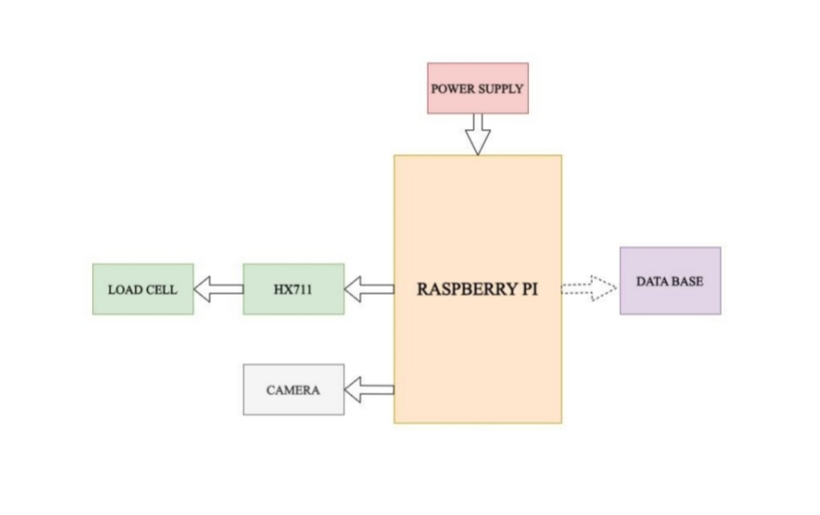
DESIGN
SELECT * FROM table ORDER BY column1 DESC;

Slide 22
Raspberry Pi
Raspberry Pi serves as an embedded system with built-in Wi-Fi capabilities for IoT applications..
Communication with external devices and platforms is facilitated via Wi-Fi connectivity.
The Raspberry Pi contains around 30 GPIO pins for interfacing with sensors and peripherals.
Data exchange and communication are possible wirelessly using Raspberry Pi's integrated Wi-Fi.- It utilizes a B-type data cable for certain connections and data transfer.
Raspberry Pi's compact size and versatility make it suitable for a wide range of IoT projects requiring embedded system functionality and Wi-Fi connectivity.

Slide 23
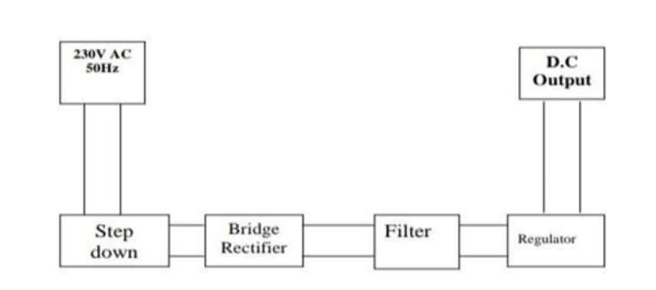
POWER SUPPLY

Slide 24
POWER SUPPLY
Power supply is provided externally as ac current which converts to dc using rectifier.
3.3V is the current used.
It is used to provide current to Raspberry Pi.

Slide 25
LED
It lights when object is placed on weighing scale which indicates object is already present.
It is connected to raspberry pi.

Slide 26
LOAD CELL
It is load cell where objects are placed for weighing.
It is connected to raspberry pi.
It is secured to a base
HX711 is used here which functions as analog to digital converter(adc)
HX711 is pivotal component

Slide 27
SYSTEM
It is used for database and interface.
It takes images from Pi Camera as input .
System is connected to Raspberry Pi through WIFI.
Yolov8 algorithm is used in system for object detection
It provides corresponding output to the buzzer,led and to Raspberry Pi
It also generate digital bill.
Pi Camera is provided.

Slide 28
Pi CAMERA
-PiCamera module is crucial for object detection with YOLOv8 on Raspberry Pi.
Specifically designed for Raspberry Pi, offering adjustable focus and various resolutions.
Captures both still images and video footage seamlessly integrated with Raspberry Pi.
Compact size and efficient design make it ideal for embedded applications.
Ensures reliable and high-quality image capture for accurate object detection in real-time.

Slide 29
IMPLEMENTATION
INTERFACE
DETECT.PY
DATABASE
Raspberry Pi Connection

Slide 30
DETECT.PY
This code appears to be a Python script for detecting specific activities or objects in images using bounding box information obtained from an object detection model.
This script appears to be part of a larger system for detecting and analyzing objects in images/camera, particularly focused on fruits.

Slide 31
Yolo V8
Sure, here's a condensed version:
1.Input Processing: YOLOv8 resizes input images for consistency.
2.Model Architecture: Custom backbone for feature extraction.
3. Feature Extraction: Feature Pyramid Network extracts features at multiple scales.
4. Detection at Multiple Scales: Simultaneous detection for objects of different sizes.
5. Anchor Boxes: Predefined shapes aid accurate object localization.

Slide 32
Yolo V8
6. Class Prediction: Provides class probabilities for detected objects.
7. Non-Maximum Suppression (NMS): Removes redundant bounding boxes post-prediction.
8.Confidence Score: Represents model confidence in object detection.
9. Output: Includes bounding boxes, class probabilities, and confidence scores.
10. Training: Custom loss function guides accurate prediction during training.

Slide 33
Labellmg
For training and object detection is done using labellmg software.
Dataset are uploaded to drive and using google collab we done that.

Slide 34
Raspberry Pi
Os is installed
Connected with database using wifi
Pi cam is connected

Slide 35
HX711
It ia amplifier.
Convert analogue signal to digital signal
By using weight.py python code we measure weight of the object.

Slide 36
Working
Weight is measured using weighing machine
HX711 is used to convert to digital signal.
Pi cam detect object.
It matches with database which has object name and price.
Find full price and Qr code is generated

Slide 37
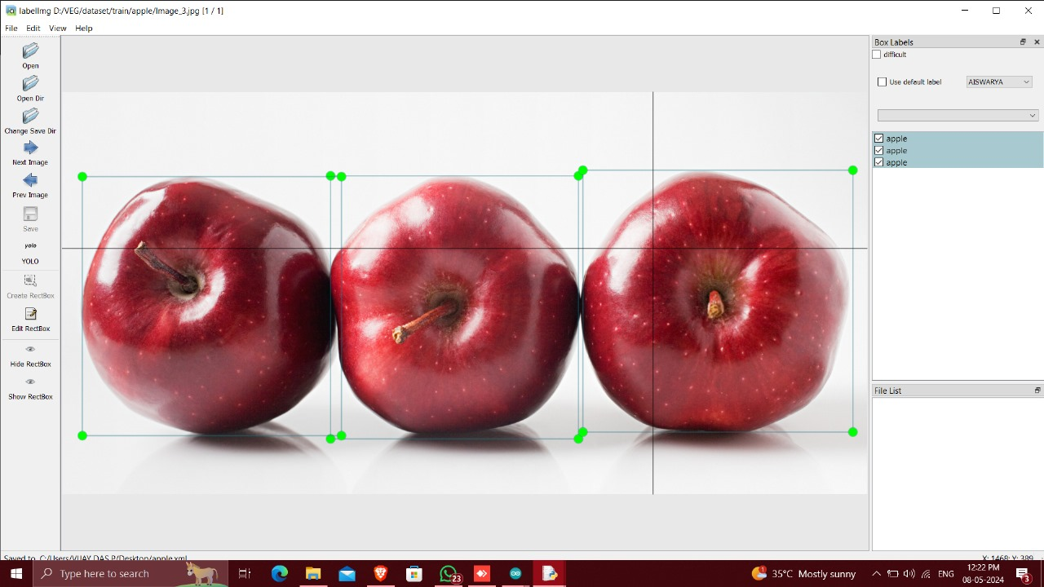

Slide 38
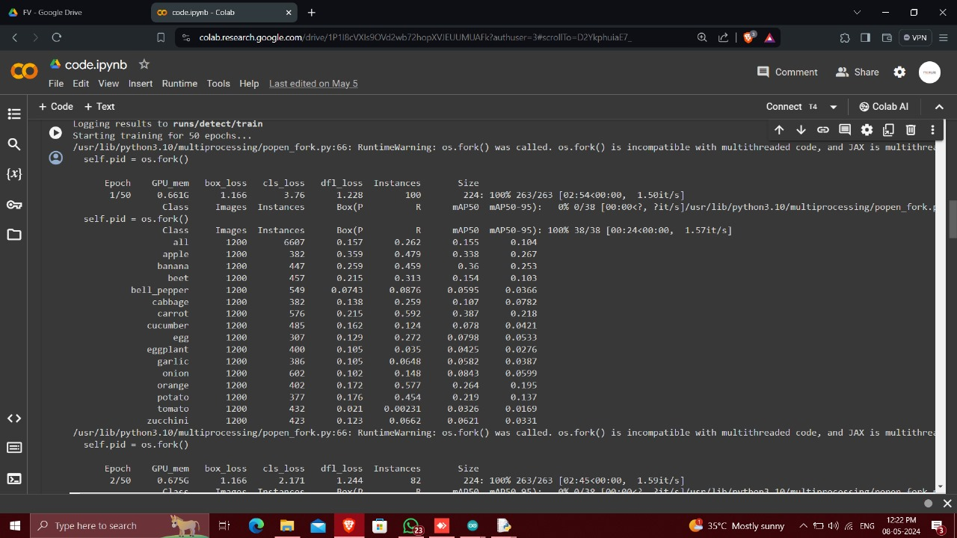

Slide 39
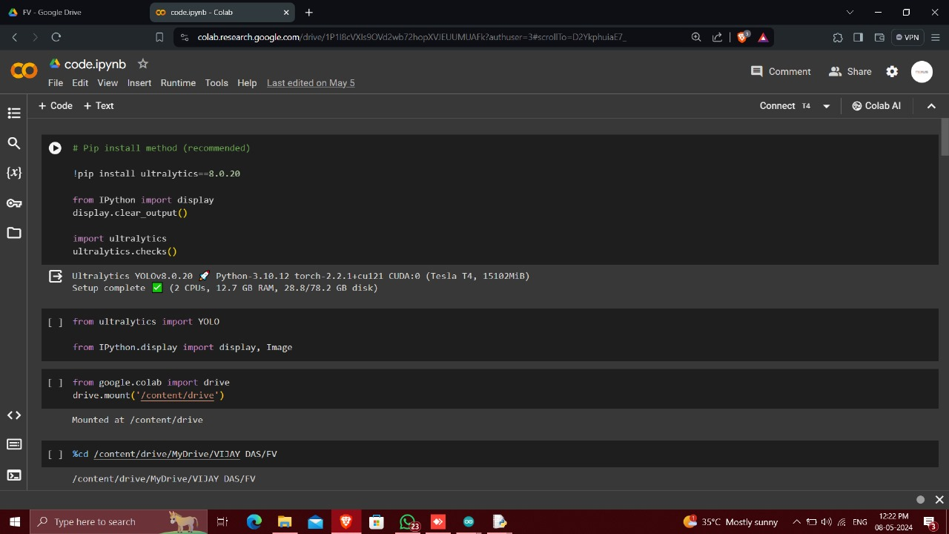

Slide 40
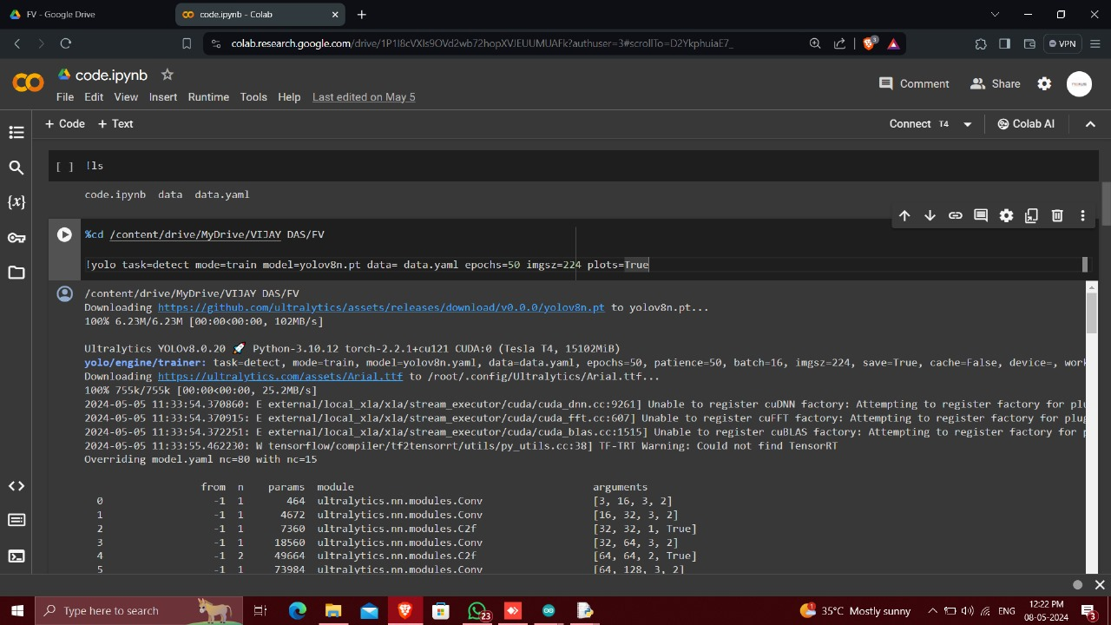

Slide 41
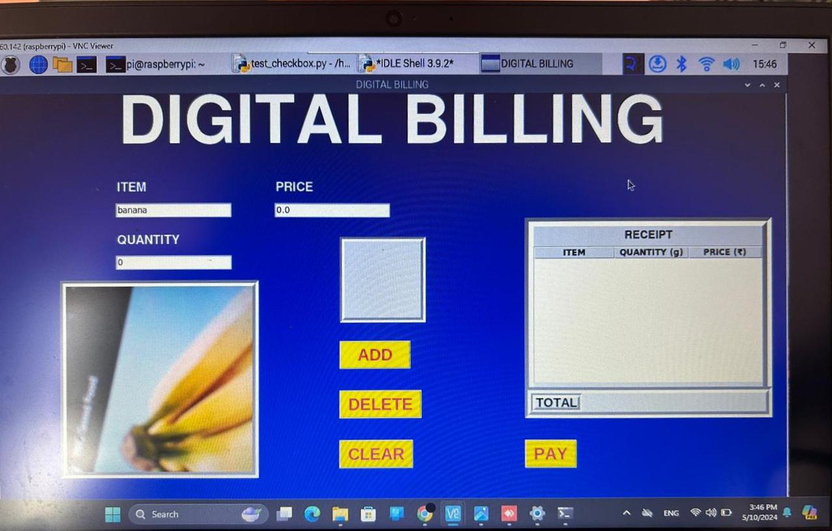
DEMO

Slide 42
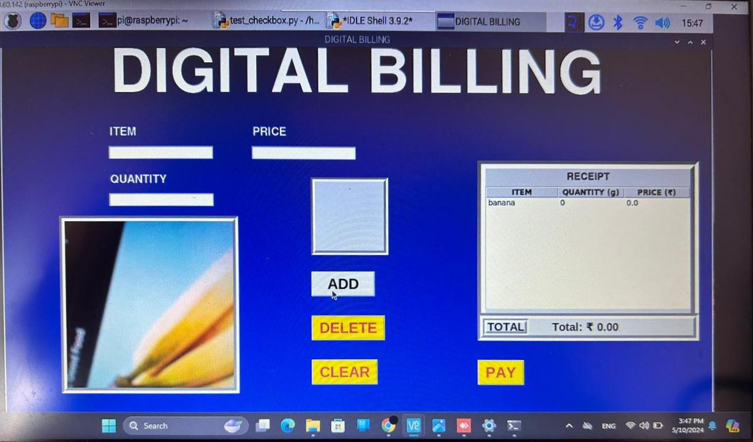

Slide 43
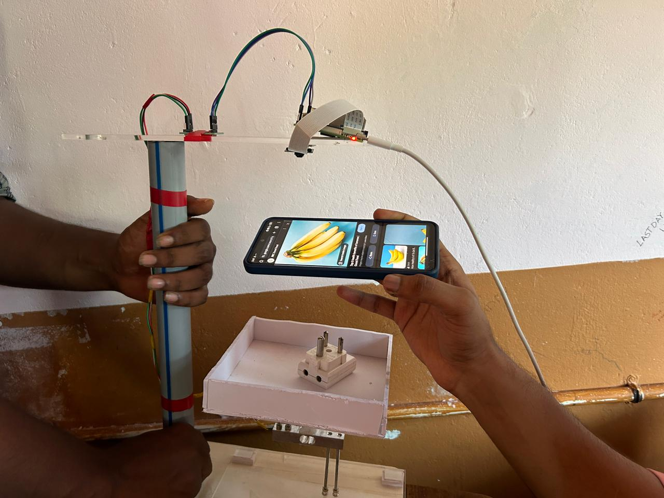
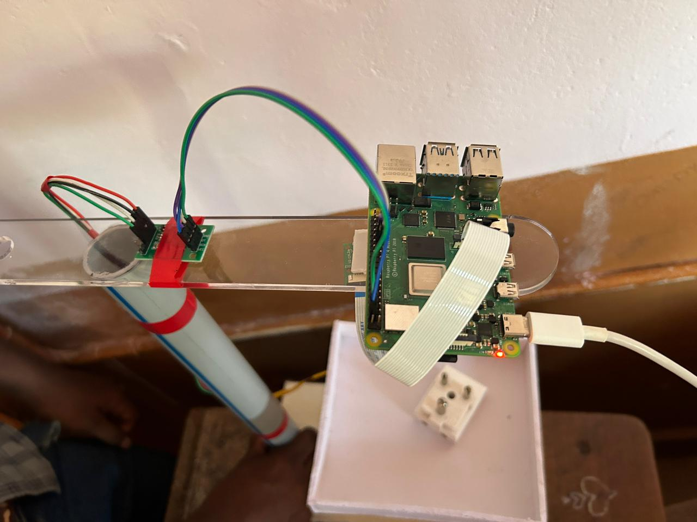

Slide 44
REFERENCE
[1] Arjenaki O.O, Moghaddam P.A and Motlagh M.A ‖Online tomato sorting based on shape, maturity, size, and surface defects using machine vision,‖ .Turkish Journal of Agriculture and Forestry, vol.37, pp. 62- 68,2013.
[2] Shakya, Subarna. "Analysis of Artificial Intelligence based Image Classification Techniques." Journal of Innovative Image Processing (JIIP) 2, no. 01 (2020): 44-54.
[3] IsrarHussain, Qianhua He and Zhuliang 2018 automatic fruit recognition based on DCNN for commercial source trace system International Journal on Computational Science& Applications, 8
[4] Gupta A, Kushwaha M R and Patidar M K , 2019 A Comparative Study of Fruit Recognition System Using Machine Learning Approaches International Journal of Engineering Technology and Applied Science, 5(7).

Slide 45
REFERENCE
[5] R. Want, “An introduction to RFID technology,” IEEE Pervasive Computing, vol. 5, no. 1, pp. 25–33, 2006.
[6] B. Santra and D. P. Mukherjee, “A comprehensive survey on computer vision based approaches for automatic identification of products in retail store,” Image and Vision Computing, vol. 86, pp. 45–63, 2019.
[7] D. Grewal, A. L. Roggeveen, and J. Nordfalt, “*e future of retailing,” Journal of Retailing, vol. 93, no. 1, pp. 1–6, 2017.
[8] Hampshire, “AI spending by retailers to reach abs12 billionby 2023, driven by the promise of improved margins,”April 2019, https://www.juniperresearch.com/press/pressreleases/ai-spending-by-retailers-reach-12-billion-2023

Slide 46
CONCLUSION
The development of a fully automated weighing machine capable of object detection and price calculation addresses critical efficiency and accuracy challenges in the retail sector.
This innovation promises to streamline retail operations, reduce human errors, enhance customer convenience, and optimize overall store management, making it a valuable addition to modern retail environments.

Slide 47
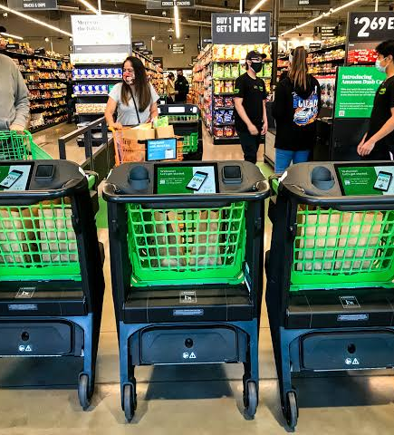
THANKS!

