Slide 1
و
Wakeel وكيل
Agentic platform for UAE Government
MINISTRY OF HUMAN RESOURCES & EMIRATISATION · STORY WALKTHROUGH
The MoHRE Emiratization Compliance Agent —
built and run on Wakeel.
One officer, one description in plain language, and a governed Microsoft 365 agent that
chases business compliance every day — while people keep every decision.
● Microsoft 365 only
● Daily + manual runs
● Governed & auditable
● Arabic / English

Slide 2
THE PROBLEM MOHRE DESCRIBED
Emiratization outreach is real work, done by hand.
Officers track hundreds of businesses in a spreadsheet, email each one for its compliance report, wait for replies, check the answers against policy, chase the late ones, and escalate the hard cases. It is slow, repetitive, and easy to let slip — but every judgement still has to be a person's.
THE REGISTRY
Excel on SharePoint
Business name, contact, sector, compliance status, dates, assigned officer, notes, next action.
THE OUTREACH
Microsoft Outlook
Report requests, reminders, escalations and the daily officer summary.
THE RULEBOOK
SharePoint
SOPs, Emiratization policies, report templates and approved email templates.

Slide 3
THE REQUEST — EXACTLY AS THE OFFICER TYPED IT
No forms. No code. Just describe the job.
wakeel · new agent
Create a Microsoft 365-based G2B Emiratization Compliance Agent for MoHRE.
Use these integrations only:
• Outlook — send outreach, receive responses, send reminders, escalate cases.
• SharePoint — SOPs, Emiratization policies, report templates, approved email templates.
• Excel on SharePoint — maintain the business registry and compliance tracking sheet.
Read the registry to identify businesses requiring outreach, send approved report-request
emails, monitor replies, evaluate responses against SOPs, update Excel status, and send
follow-ups for missing, incomplete, or overdue responses.
Track: Business Name, Contact Email, Sector, Compliance Status, Last Outreach Date, Last
Response Date, Assigned Officer, Notes, Next Action. · Support daily + manual runs.
Statuses: Pending Outreach, Report Requested, Response Received, Incomplete Submission,
Under Review, Follow-up Sent, Escalation Required, Completed.
The agent must not make final legal or enforcement decisions. It reviews, identifies gaps,
recommends next actions, updates records, and escalates to officers. MoHRE-style tone.

Slide 4
PART 1
BUILDING THE AGENT — ABOUT FIVE MINUTES
From a paragraph to a governed, running agent.

Slide 5
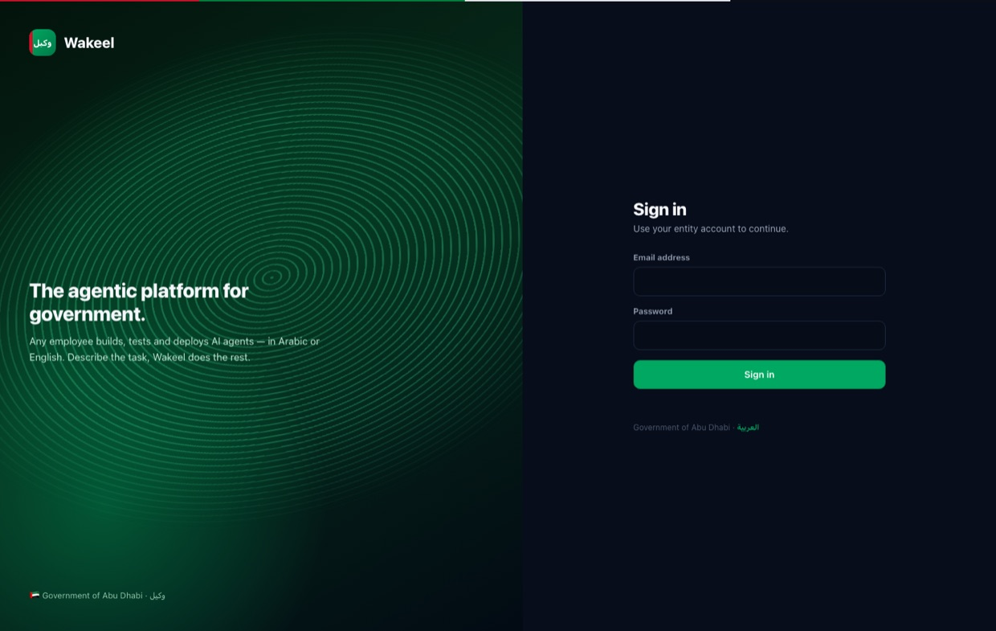
1
The officer signs in
• Any MoHRE employee signs in with their entity account.
• No developer and no setup required.
• Wakeel opens in Arabic or English.

Slide 6
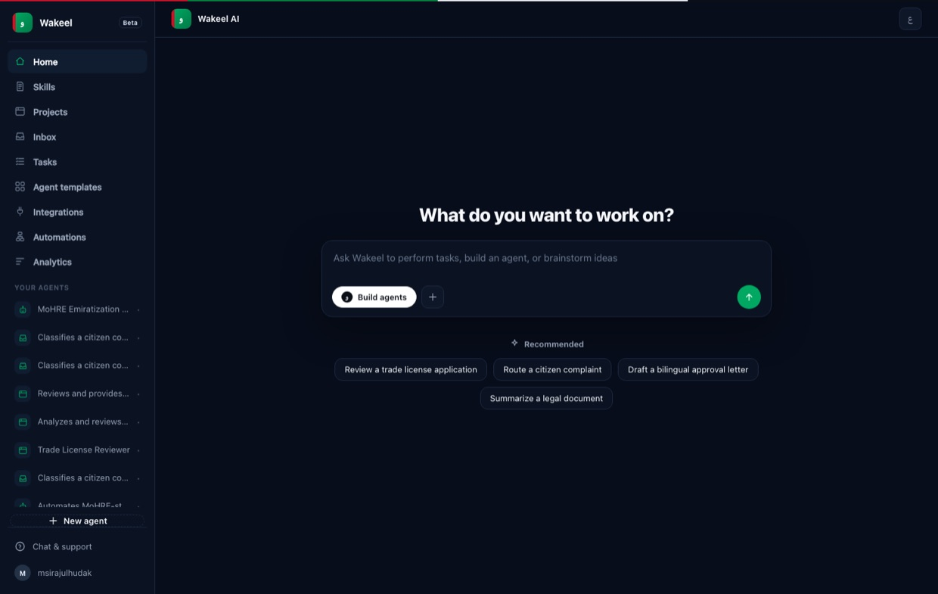
2
They describe it in chat
• Instead of a builder, the officer just writes what they need.
• The MoHRE prompt from the previous slide.
• Wakeel works in the language they use.

Slide 7
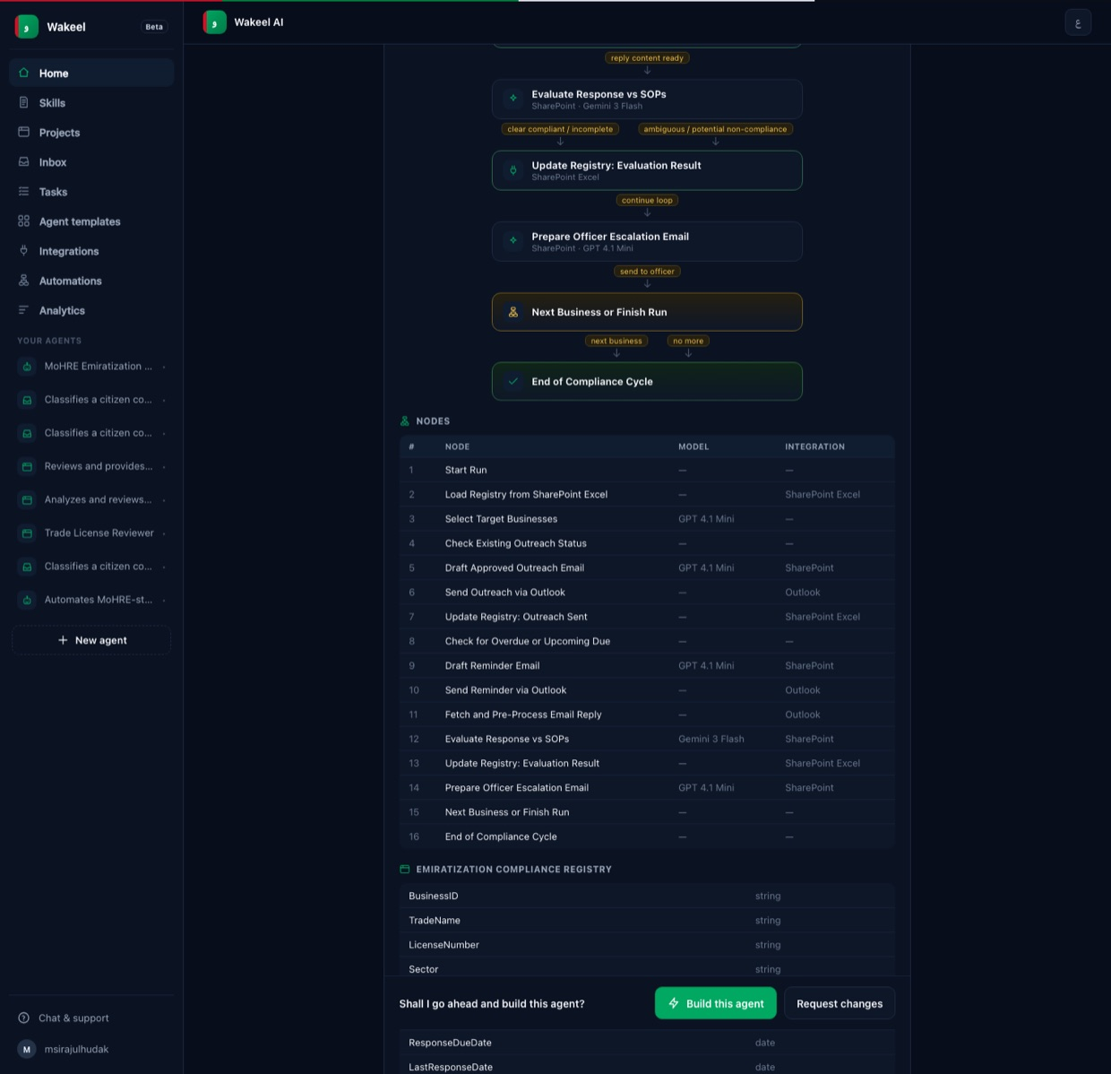
3
Wakeel proposes the architecture — first
• It reasons through triggers, integrations, registry fields, statuses and guardrails.
• Shows the whole design: a per-business loop, a 16-node flow, the Excel schema and allowed statuses.
• Ends with “Shall I build this agent?” — Build or Request changes.
• Nothing is created until the officer approves.
Editable by chatting — e.g. “add an Arabic translation step” or “require sign-off before any rejection”.

Slide 8
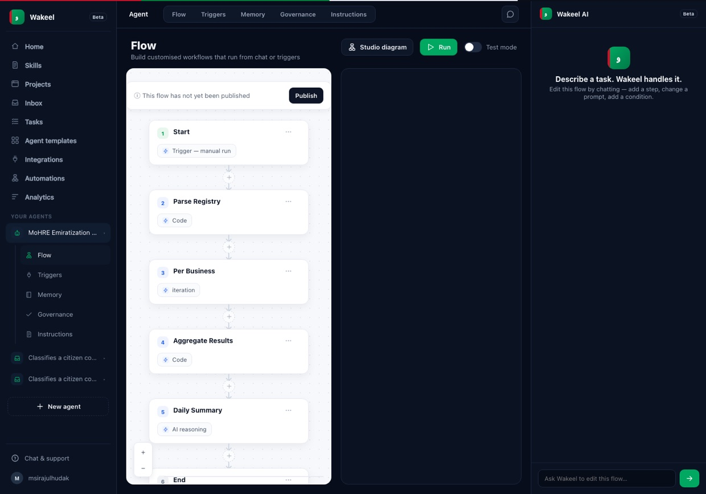
4
The officer reviews the built flow
• On approval Wakeel builds the agent and opens its workspace.
• Every node is visible and runnable — registry read, per-business loop, outreach, review, Excel update, follow-up, escalation and the daily summary.

Slide 9
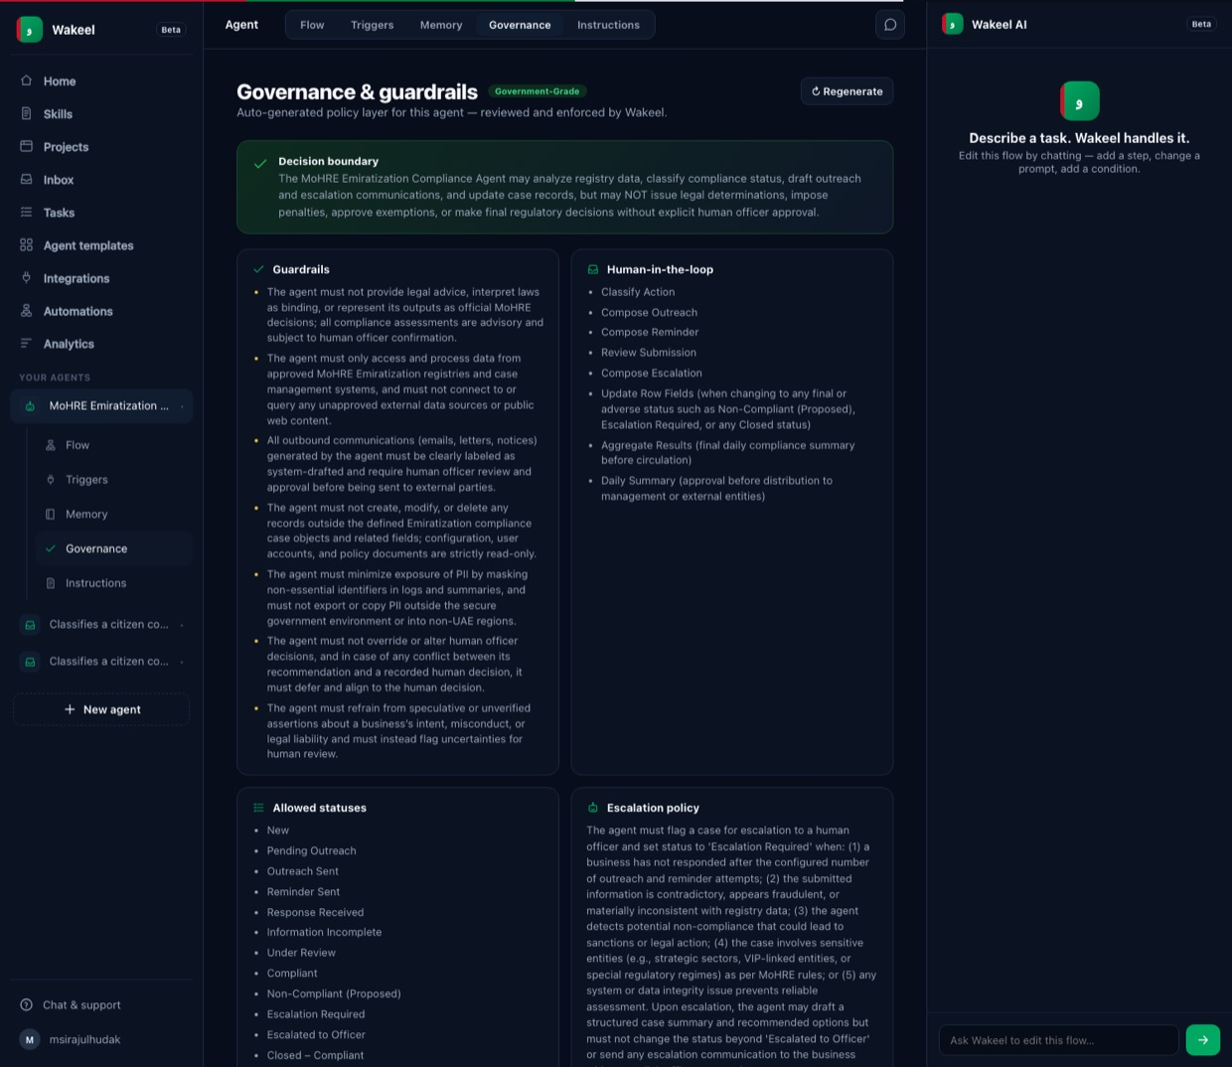
5
Governance & guardrails — auto-generated
• Because it is a government agent, Wakeel writes a policy layer for it.
• Decision boundary, guardrails, human-in-the-loop checkpoints, allowed statuses and escalation policy.
• This is what keeps the agent advisory: it recommends, people decide.

Slide 10
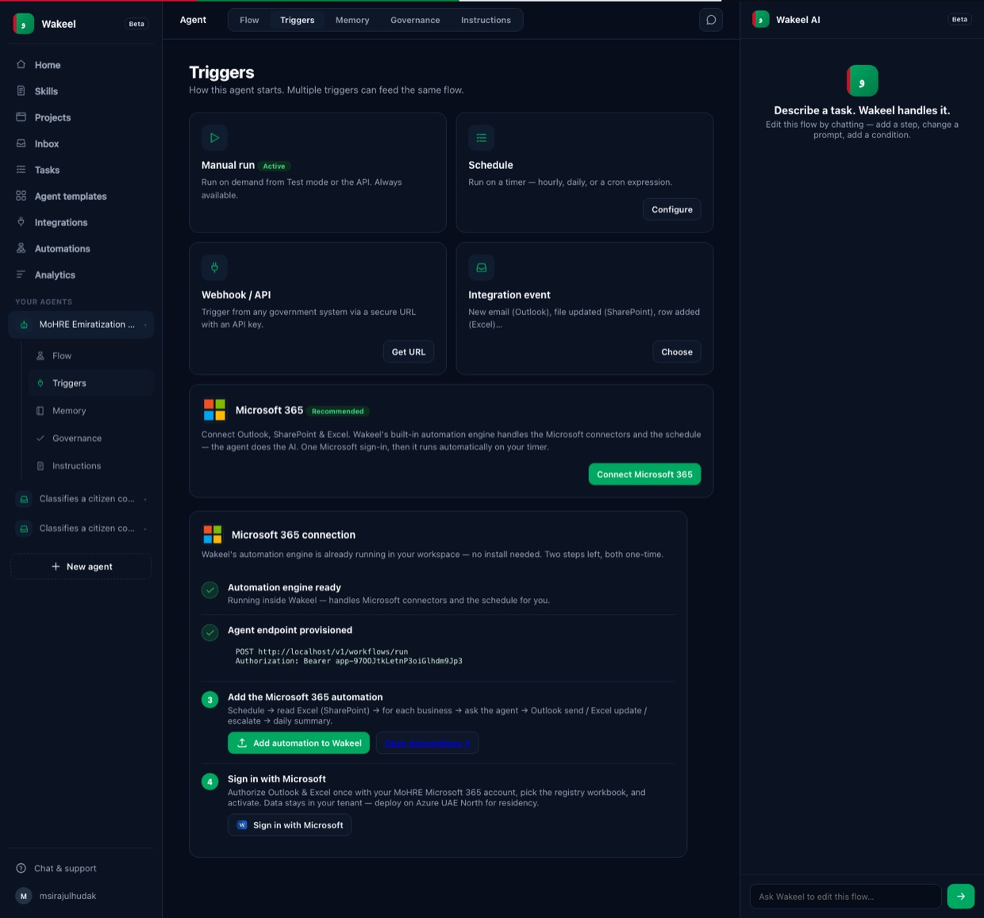
6
Microsoft 365 is connected — as one product
• The officer connects Outlook, SharePoint and Excel.
• Wakeel's built-in engine handles the Microsoft connectors and the schedule; the agent does the thinking.
• One Microsoft sign-in, then it runs on your timer.
• Self-hostable on Azure UAE North for data residency.

Slide 11
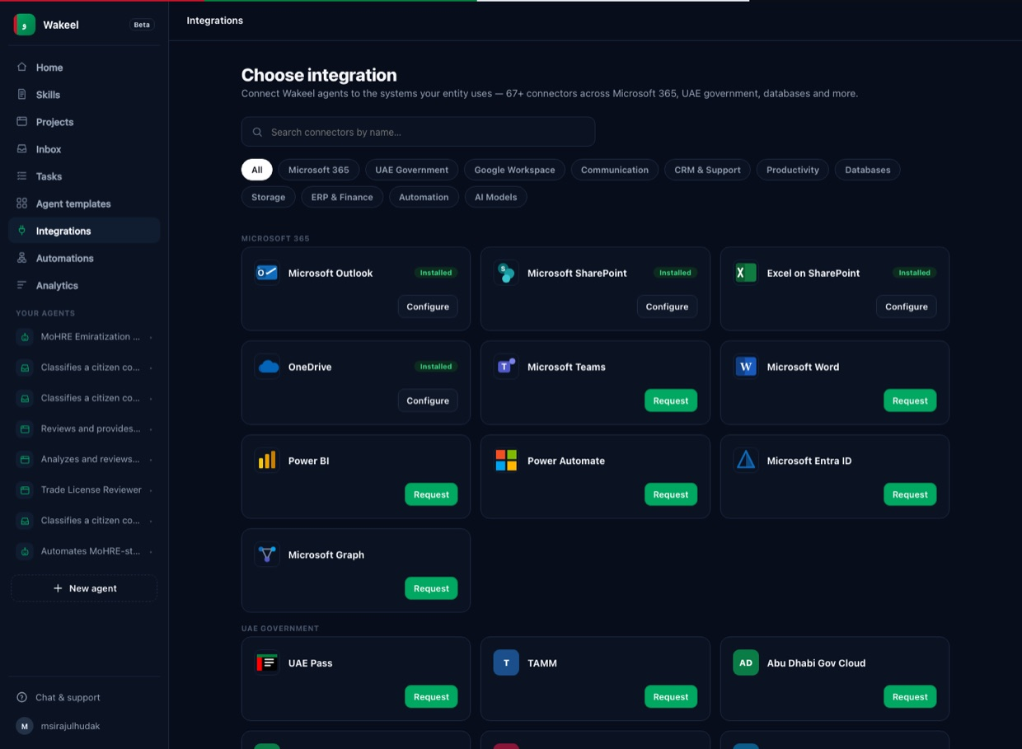
6
The connector catalogue
• Outlook, SharePoint and Excel install natively.
• 400+ connectors across Microsoft 365, UAE government, Google, databases and more.
• Real, recognisable logos — nothing to guess.

Slide 12
7
Test, fine-tune, publish
The officer runs a manual test on a few sample registry rows, adjusts wording, escalation rules or status mapping if needed, and publishes.
The agent is now operational — running daily checks, and available for manual, officer-triggered runs.

Slide 13
PART 2
THE AGENT AT WORK — EVERY DAY
One run of the daily compliance cycle.

Slide 14
SCHEDULED EACH WEEKDAY — OR LAUNCHED ON DEMAND
What the agent does, in order.
STEP 1
Read the registry
Opens the Excel registry on SharePoint and finds businesses needing action.
STEP 2
Send outreach
Emails approved report-requests through Outlook in a professional MoHRE tone.
STEP 3
Monitor replies
Watches Outlook for business responses and marks them received.
STEP 4
Review vs SOPs
Compares each submission to SharePoint policies; flags missing or unclear items.
STEP 5
Update Excel
Writes status, dates, notes, assigned officer and the next action.
STEP 6
Follow up
Sends a polite reminder for missing, incomplete or overdue responses.
STEP 7
Escalate
Marks hard cases “Escalation Required” and notifies the assigned officer.
STEP 8
Daily summary
Emails officers a recap: outreach, replies, incomplete, escalations, completed.

Slide 15
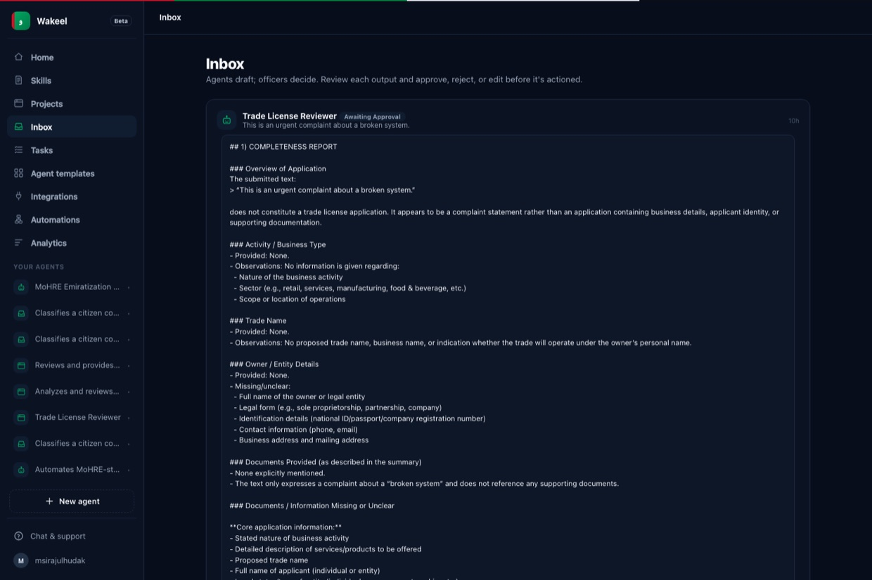
★
The officer decides — always
• The agent drafts; the officer approves, edits or rejects before anything leaves MoHRE.
• Escalations and final outcomes wait in the officer's inbox.
• “Agents draft; officers decide.”

Slide 16
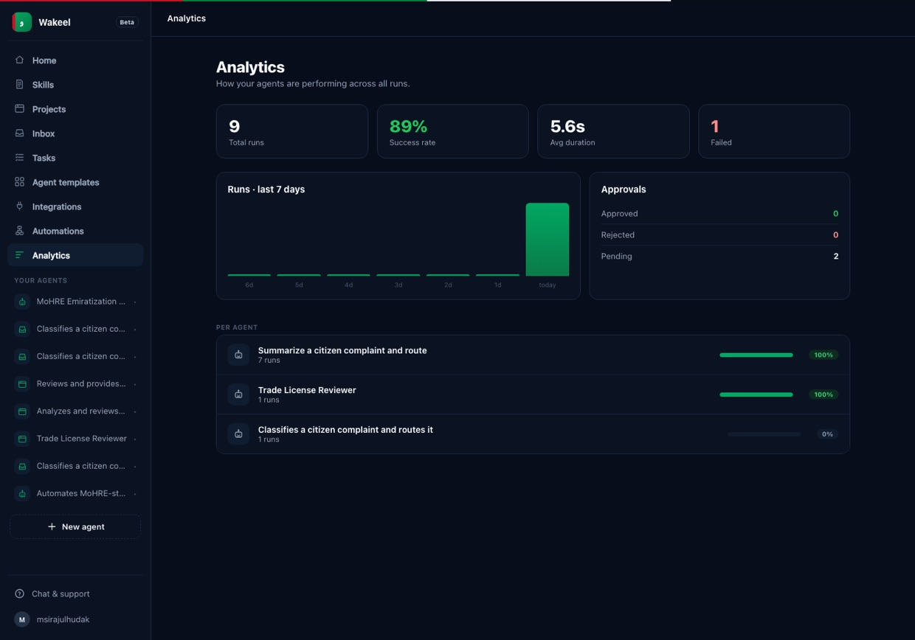
★
Everything is measured
• Runs, success rate, approvals and per-agent performance.
• A live view of how the compliance effort is going across the register.
• When the officer confirms a case is resolved, its status becomes Completed.

Slide 17
THE LINE THAT NEVER MOVES
What the agent does — and what it will never do.
✓
The agent handles the legwork
✕
People keep every judgement
✓ Reads the registry and identifies who needs action
✓ Drafts and sends approved outreach, reminders and escalations
✓ Reviews responses against SOPs and identifies gaps
✓ Keeps the Excel registry accurate and up to date
✓ Recommends the next action and a daily summary
✕ No final legal or enforcement decisions
✕ No penalties, exemptions or regulatory rulings
✕ Nothing marked Completed without officer confirmation
✕ No emails outside the registry without approval
✕ No data leaves the MoHRE Microsoft 365 tenant

Slide 18
IN ONE LINE
A MoHRE officer built a governed Microsoft 365 compliance agent by describing it — and stays in control of every decision it makes.
Wakeel — the experience & governance
Microsoft 365 — the systems
The officer — the decisions
و

