Slide 1





Streamlined NER and Word Analysis using NLP
Team Members: Guide:
1. M Ashfaqulla Sharif
2. B.N.Jaswanth Kumar Md Abdul Aziz
3. S Mahammed Zubair
4. G Praveen Kumar
Disclaimer: The content is curated for educational purposes only.

Slide 2

Named Entity Recognisation using NLP
OUTLINE
Abstract
Problem Statement
Aims, Objective & Proposed System/Solution
System Design/Architecture
System Development Approach (Technology Used)
Algorithm & Deployment
Future Scope
Conclusion
References
Thankyou
Notes:
These are the list of chapters that we are going to cover in these foundation codes. Those are chapter one what are AI and ML? chapter 2 applied Python programming in AI, and chapter 3 is exploratory data analysis for ML.

Slide 3






ABSTRACT
Named Entity Recognisation using NLP
Developed a Named Entity Recognition (NER) and Word Cloud app using Python.
Integrated with spaCy for NLP tasks, Beautifulsoup for scraping and Streamlit for the user interface.
Enables users to analyze text, perform NER, and visualize data through word clouds.

Slide 4

PROBLEM STATEMENT
Named Entity Recognisation using NLP
Analyzing unstructured text data for entity recognition and insights is time consuming.
Lack of user-friendly tools for NLP tasks like Named Entity Recognition and data visualization.
Difficulty in extracting and processing text from web pages efficiently for analysis purposes.

Slide 5

AIM & OBJECTIVE
Named Entity Recognisation using NLP
Aim: To create a user-friendly application for Named Entity Recognition and word cloud generation.
Objectives:
  Enable users to input text for analysis directly or extract text from URLs.
  Implement Named Entity Recognition to identify entities within the text.
  Generate word clouds to visualize the frequency of words in the text.

Slide 6






PROPOSED SOLUTION
Named Entity Recognisation using NLP
Develop a Streamlit-based application integrated with spaCy, beautiful soup and word cloud libraries to achieve NER and data visualization.

Slide 7
System Architecture
Named Entity Recognisation using NLP
Utilizes a client-server architecture with Streamlit as the user interface.
Incorporates spaCy for Named Entity Recognition and word cloud library for data visualization.
Implements functions for text fetching from URLs, NER, and word cloud generation within the Python script.

Slide 8

System Deployment Approach (Technology Used)
Named Entity Recognisation using NLP
Python programming language for application development.
Libraries used include Streamlit for the user interface, spaCy for NLP tasks, and Matplotlib
for plotting word clouds.
Integrates BeautifulSoup for web scraping and requests for fetching HTML content from URLs.

Slide 9

Algorithm & Deployment
Named Entity Recognisation using NLP
Named Entity Recognition algorithm leverages the pre-trained 'en_core_web_sm' model from spaCy.
Word cloud generation algorithm utilizes the WordCloud library to create visual representations of text data.
Deployment involves running the Python script containing the application code on a local machine or a server accessible via a web browser.

Slide 10

Future Scope
Named Entity Recognisation using NLP
Integration of advanced NLP techniques for sentiment analysis and text summarization.
Enhancements in user interface design and functionality for improved user experience.
Deployment of the application as a web service accessible across different platforms.

Slide 11
Conclusion
Named Entity Recognisation using NLP
Developed a versatile application for Named Entity Recognition and word cloud generation.
Enhances text analysis capabilities with user-friendly features and interactive visualizations.
Provides a streamlined solution for NLP tasks, empowering users to gain insights from unstructured text data effectively.

Slide 12
Named Entity Recognisation using NLP
REFERENCE
Streamlit documentation: https://docs.streamlit.io/
spaCy documentation: https://spacy.io/
Matplotlib documentation: https://matplotlib.org/
WordCloud documentation: https://github.com/amueller/word_cloud
Notes:
Reference
These are the references for this session.

Slide 13
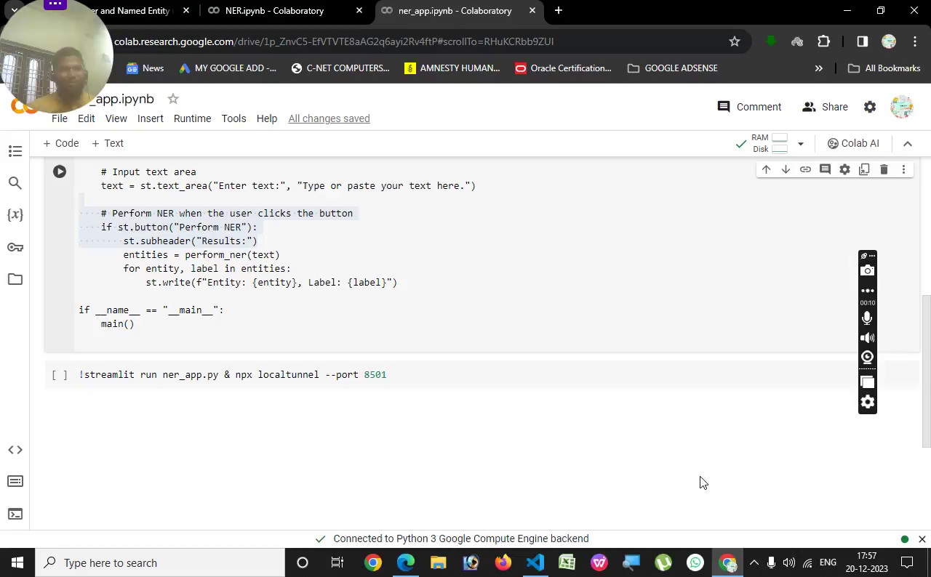
Named Entity Recognisation using NLP

Slide 14
Named Entity Recognisation using NLP
Thank you!
Notes:
thank you very much for joining this PPT, keep learning.

