Slide 1
CSE232 Project 2 Report Muhammed Eyüp 1801042679

Slide 2
Data Path Diagram
go’
go
mult = 0
a = a_in
b = b_in
rst
a == 0
a > 0
Res = mult
mult = mult + b
a = a - 1

Slide 3
FSM Diagram
go’
000
go
La
Lb
001
rst
010
eq
gt
Lres
Sx La Lmult
100
011

Slide 4
Pstates S2 S1 S0 | Inputs gt eq go | Nstates N2 N1 N0
000 | - - 0 | 000
000 | - - 1 | 001
001 | - - - | 010
010 | 1 0 - | 011
011 | - - - | 010
010 | 0 1 - | 100
100 | - - - | 000
N0 = S2’ S1’ S0’ go+ S2’ S1 S0’ gt eq’
N1 = S2’ S1’ S0 + S2’ S1 S0’ gt eq’ + S2’ S1 S0 = S2’ S0 + S2’ S1 S0’ gt eq’
N2 = S2’ S1 S0’ gt’ eq

Slide 5
Pstates S2 S1 S0 | OUTPUTS La Lb Lmult Lres Sa Sr
000 | 0 0 1 1 0 1
001 | 1 1 0 0 0 0
010 | 0 0 0 0 0 0
011 | 1 0 1 0 1 0
100 | 0 0 0 1 0 0
La = S2’S1’S0 + S2’S1S0 = S2’ S0
Lb = S2’S1’S0
Lmult = S2’S1 S0 + S2’ S1’ S0’
Lres = S2 S1’S0’ + S2’ S1’ S0’ = S1’ S0’
Sa = S2’S1 S0
Sr = S2’ S1’ S0’

Slide 6
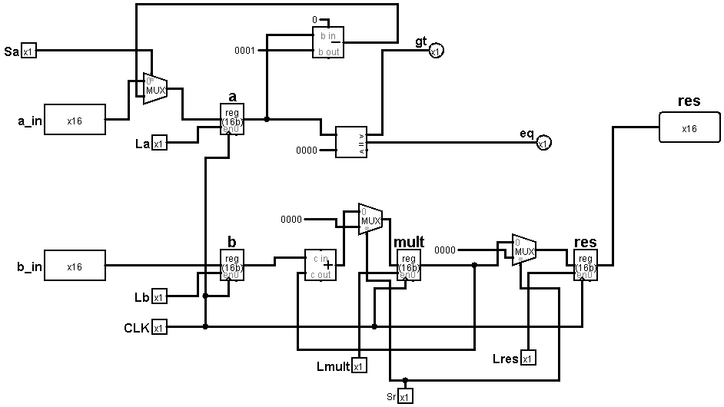
Datapath circuit

Slide 7
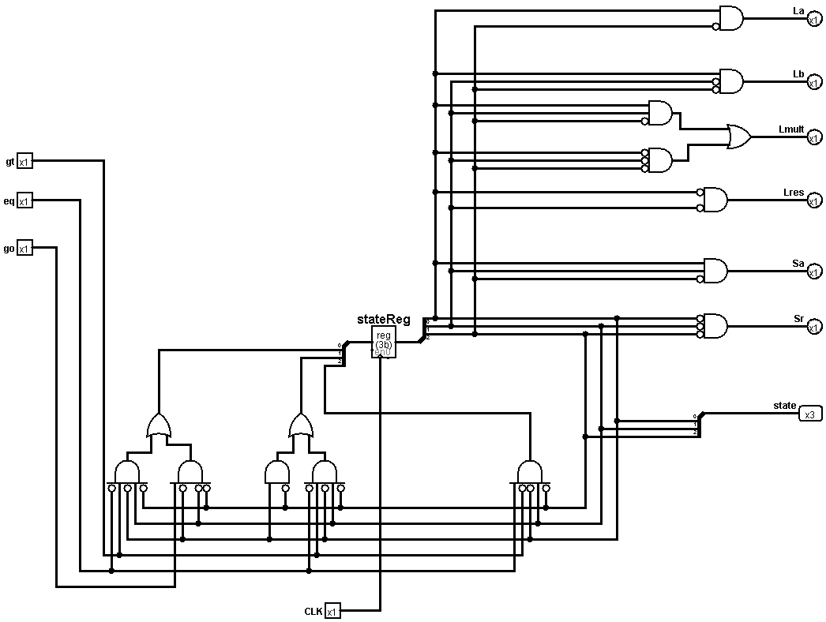
FSM circuit

Slide 8
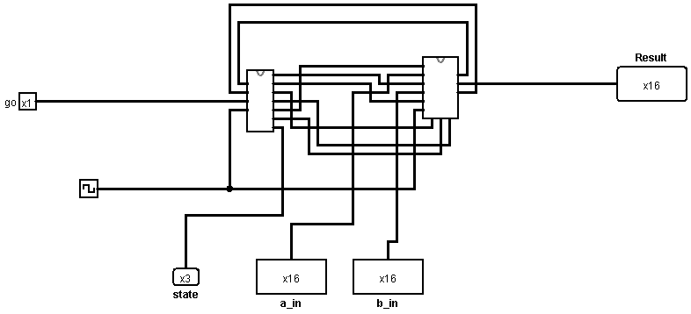
main circuit

Slide 9
Project Report:
The project is a 16bit number multiplier. The circuit can multiply any 16bit positive numbers. The circuit contains a datapath that uses adders an subtractors to calculate the product of two numbers

