Slide 1

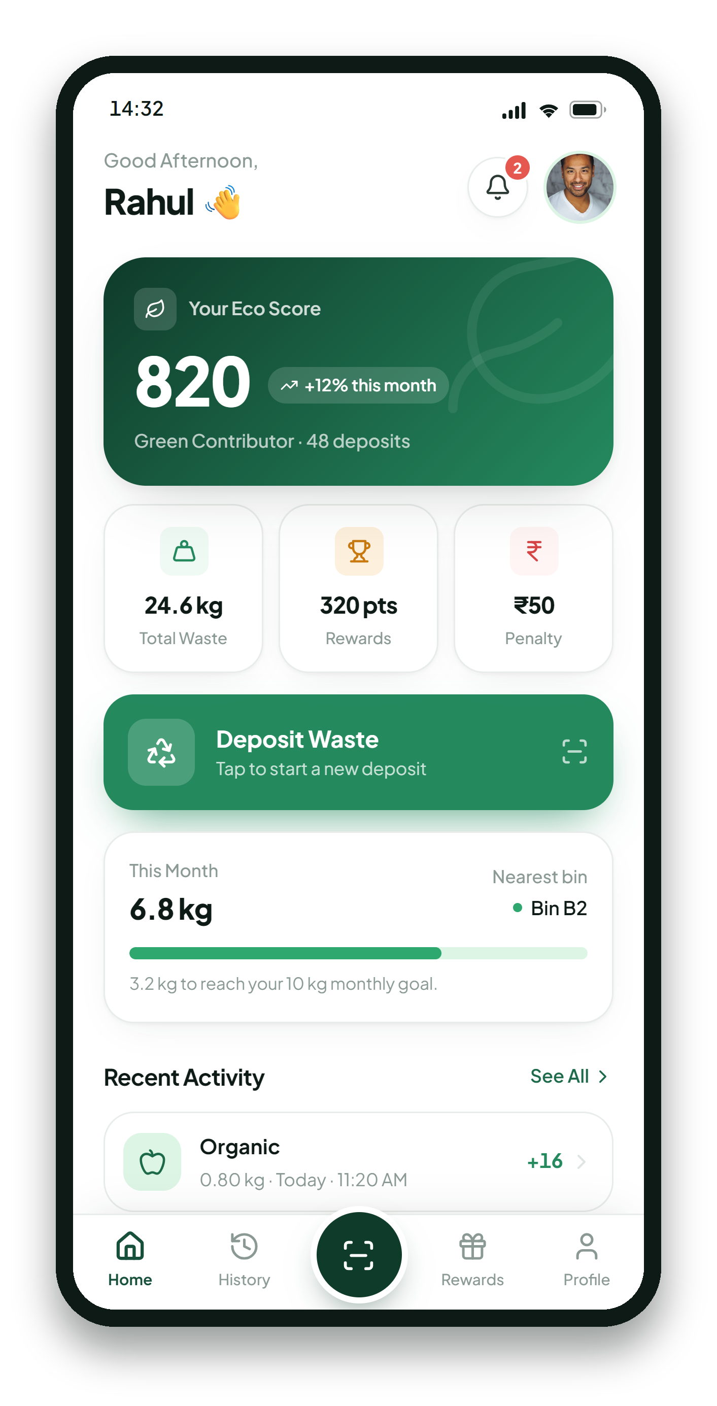

ENGO
SMART WASTE MANAGEMENT SYSTEM
Small Actions.
A Cleaner Tomorrow.
An RFID + AI powered smart bin that turns every waste deposit into a measurable, rewarded action.
Software × AI × IoT × Sustainable Waste Management
WORKING FRONTEND PROTOTYPE
ENGO
01 / 12
Notes:
ENGO is a smart waste management system for our campus. What you are looking at is a working mobile application prototype. It is frontend only today: the data is mock data and the hardware and AI are simulated. The backend, the ESP32 hardware and the production AI are the proposed next phases.

Slide 2





02 THE PROBLEM
Waste management starts with one simple problem.
Campuses collect waste every day. Almost none of them can measure it.
Poor segregation
Recyclables, organics and plastic end up in the same bin.
Limited accountability
No record of who disposed what, or how well they sorted it.
Manual monitoring
Staff check fill levels by hand and log them on paper.
No user engagement
Nothing rewards the people who actually sort correctly.
ENGO
02 / 12
Notes:
Four problems, and they compound. Without segregation at the source, recycling downstream barely works. Without a record of each deposit there is no accountability, and without accountability there is no incentive for anyone to change behaviour.

Slide 3








03 THE IDEA
What if waste disposal became measurable, intelligent and rewarding?
User
RFID
Smart Bin
AI Analysis
Processing
Digital Record
Reward
Arrives at the bin
Card identifies them
Lid opens, waste in
Type and weight read
Routed for treatment
Transaction stored
Points or penalty
Every deposit becomes a verifiable digital transaction — identified, weighed, classified and scored.
ENGO
03 / 12
Notes:
The idea in one line: make the bin know who you are and what you threw away. Once that exists, every other feature — scoring, rewards, penalties, fill-level analytics — follows from the same record.

Slide 4



04 HOW ENGO WORKS
Five steps, start to finish.
The same five steps drive the app, the scoring rules and the future hardware.
01
02
03
04
05
Identify
Deposit
Analyze
Process
Reward
An RFID card links the deposit to a specific student account.
The bin unlocks and the waste is placed inside.
A camera and load cell determine the type and the weight.
Waste is routed into the right processing stream.
Correct disposal earns eco points; mistakes cost them.
All five steps are modelled end to end in the prototype. Steps 1–4 currently run on simulated sensor and AI output.
ENGO
04 / 12
Notes:
Identify, deposit, analyze, process, reward. The prototype walks through all five on screen. Steps one to four are driven by a simulator today rather than by real hardware.

Slide 5
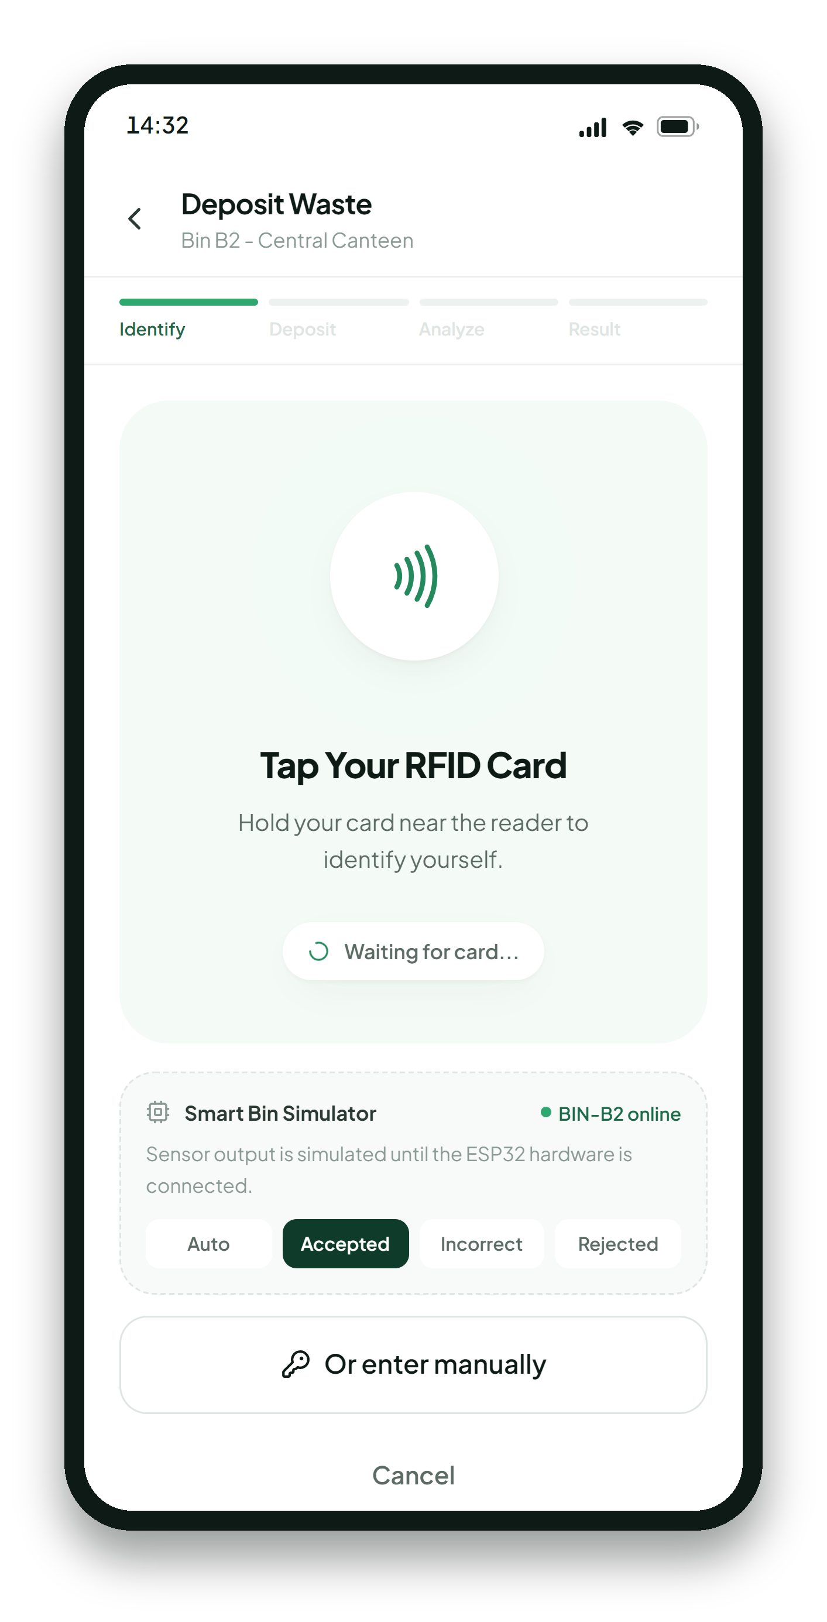
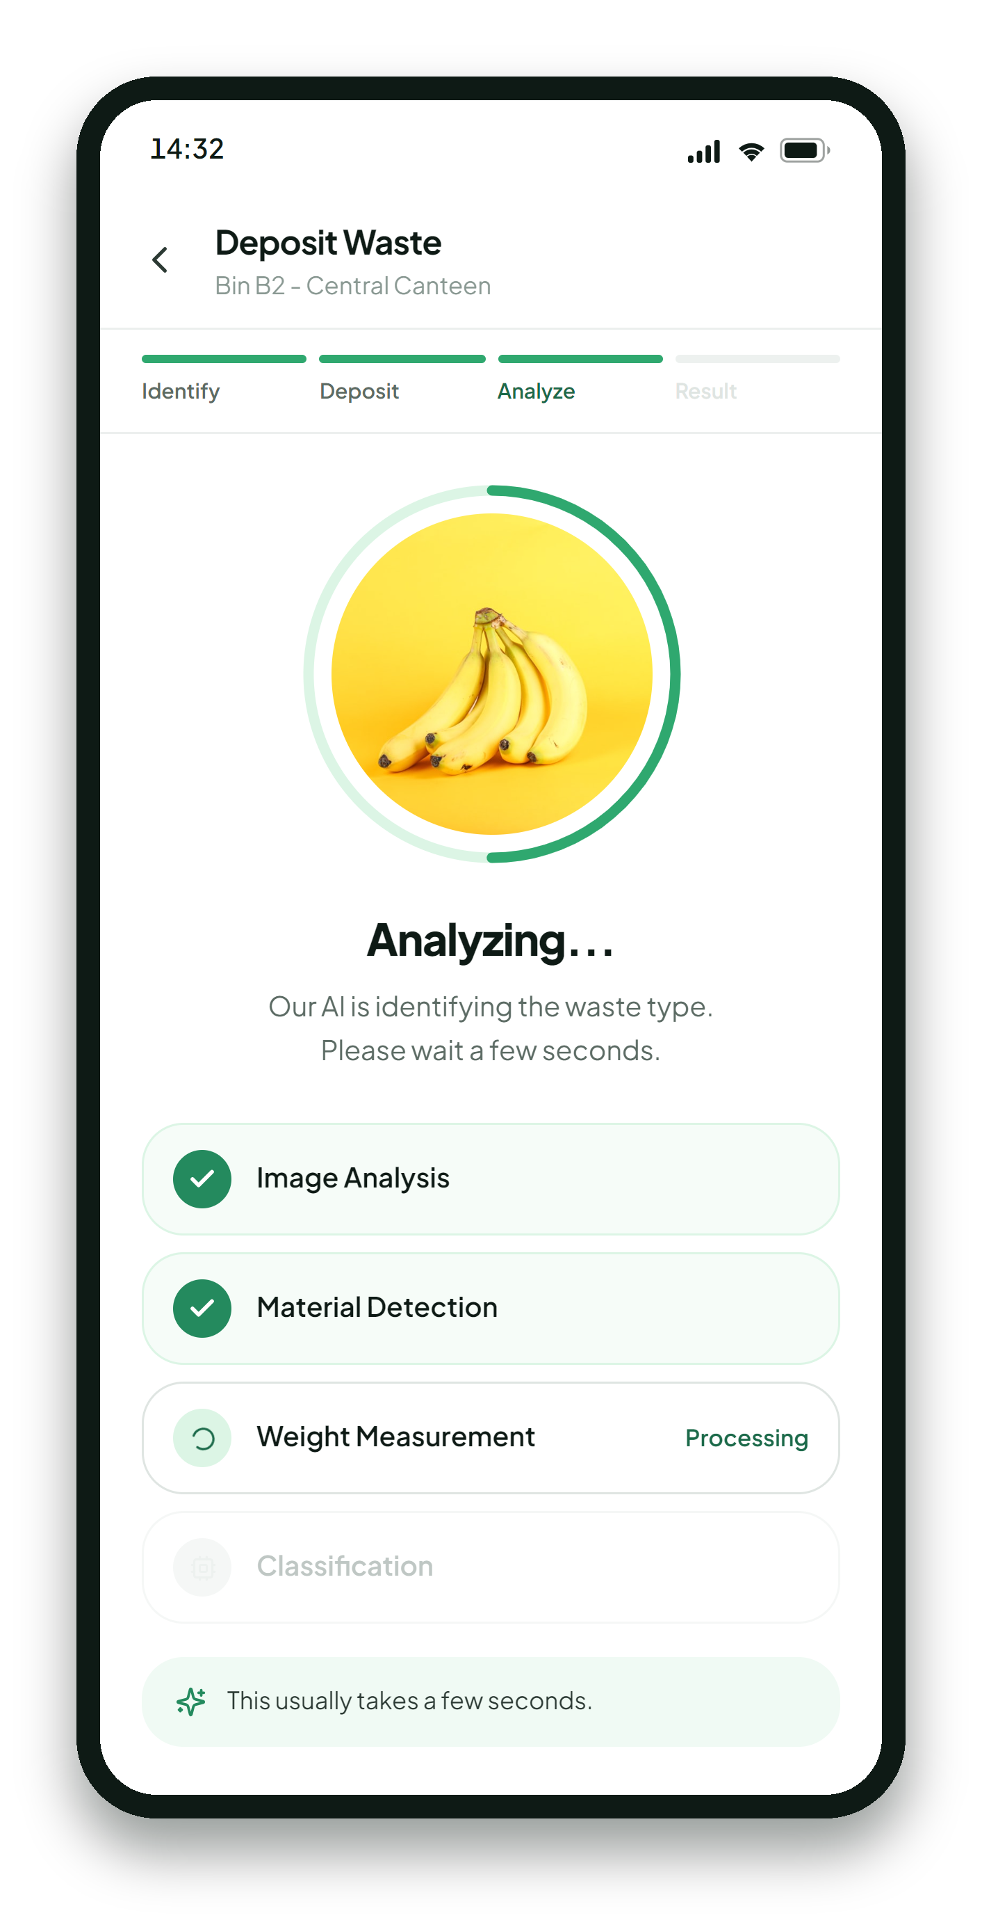
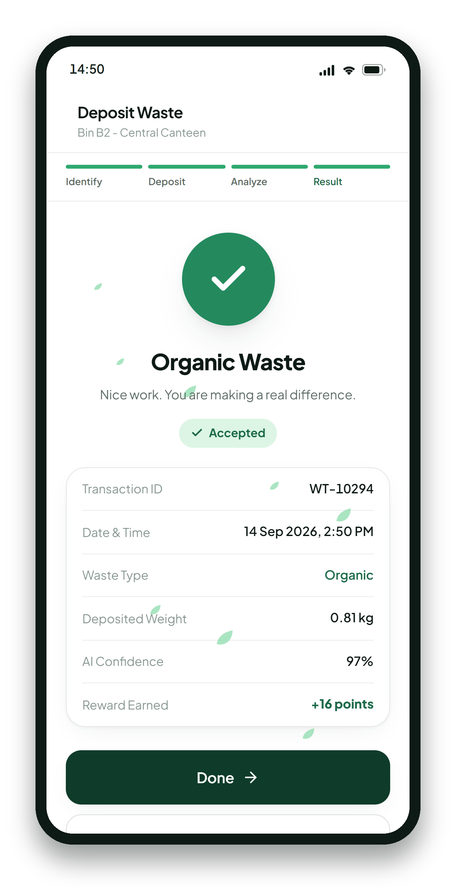
05 THE MOBILE APPLICATION
One app. One complete waste journey.
Thirteen screens, built in React and TypeScript, running on realistic mock data. Every interaction below is live in the prototype.
Home Dashboard
Deposit Waste
AI Detection
Transaction Result
Eco score, totals and recent activity
RFID identification at the bin
Live classification progress
Type, weight, confidence, reward
ENGO
05 / 12
Notes:
These are real screenshots of the running prototype, not mockups. Login, navigation, the deposit flow, history, rewards, penalties and the profile all work.

Slide 6
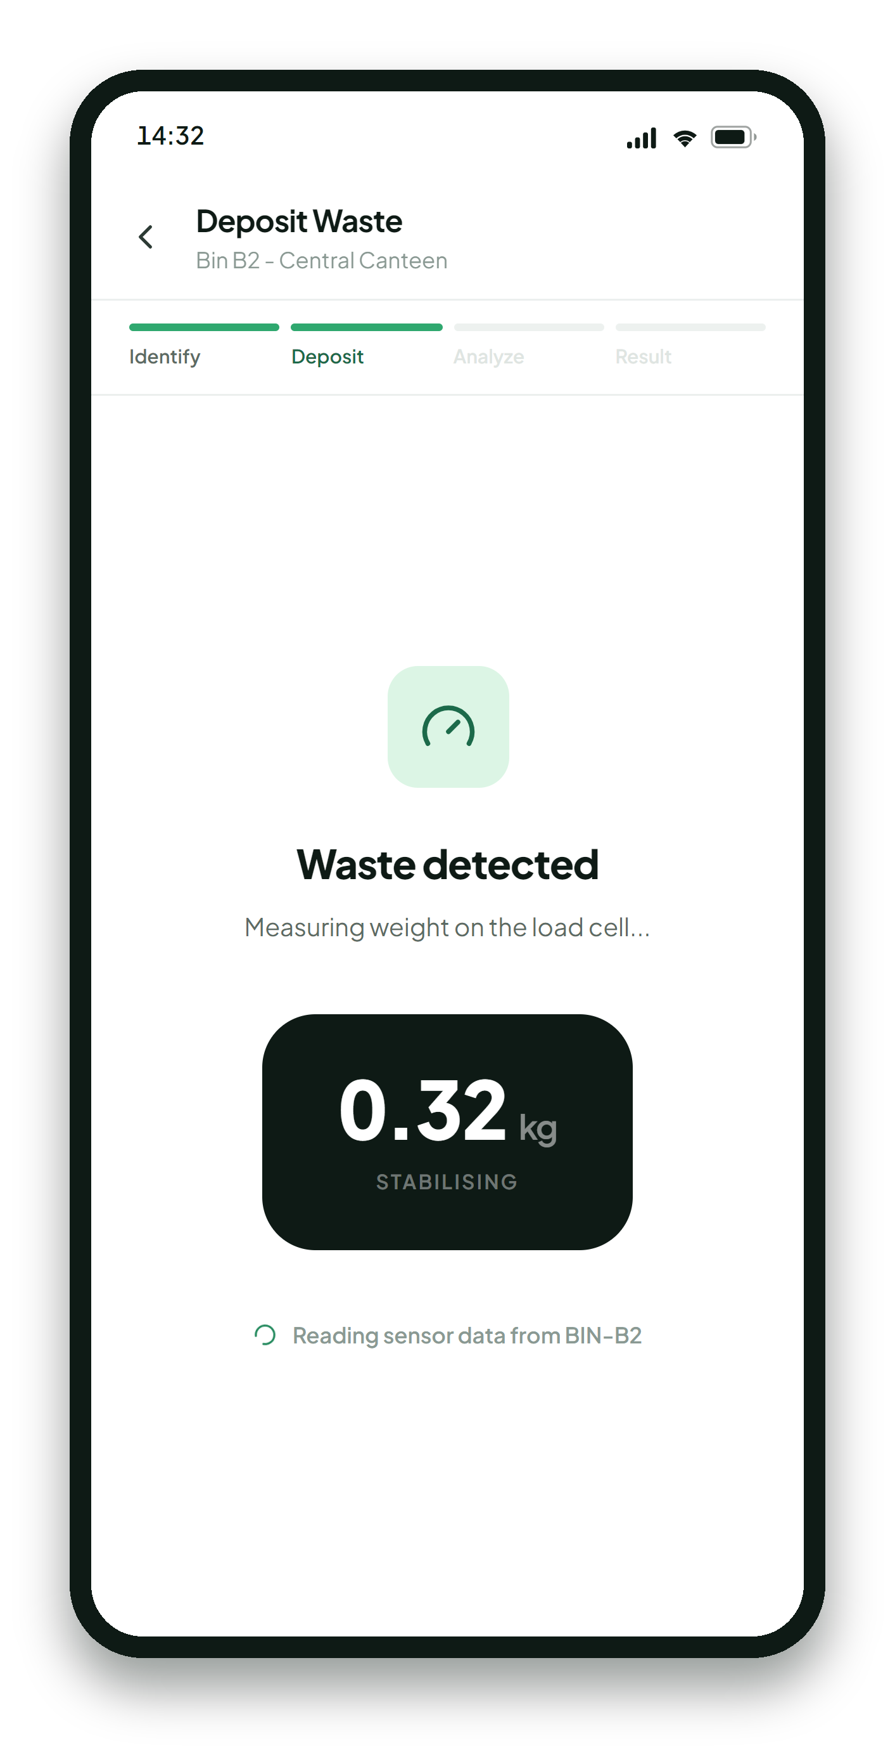

06 USER EXPERIENCE
From RFID tap to verified waste transaction.
Roughly twelve seconds, four screens, zero paperwork.
01 Identify
02 Measure
03 Analyze
04 Record
Card tapped, user recognised
Load cell settles on a weight
Vision model classifies the waste
Transaction written, points applied
ENGO
06 / 12
Notes:
This is the demo we run live. The whole sequence is automatic once you open the deposit screen — it mirrors what the physical bin would emit. A simulator panel lets us force an accepted or a rejected result on demand.

Slide 7



07 AI WASTE DETECTION
PROPOSED INTEGRATION
AI understands what goes into the bin.
Camera captures the waste
A frame is taken the moment the lid closes.
Vision model analyses the image
A hosted model returns a category and a confidence score.
System decides the outcome
Accept, flag as incorrect, or reject — then score it.
Organic
Paper
Plastic
Metal
Other
Today the prototype returns mock classifications from a single aiService module. Swapping it for a hosted vision model — Replicate, for example — needs no change to the interface.
ENGO
07 / 12
Notes:
To be clear: the AI is not live yet. The prototype returns scripted classifications with realistic confidence scores. The architecture is deliberately shaped so a real vision model drops into one file.

Slide 8
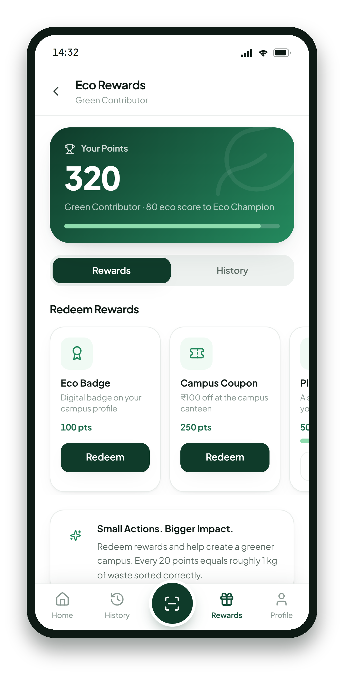
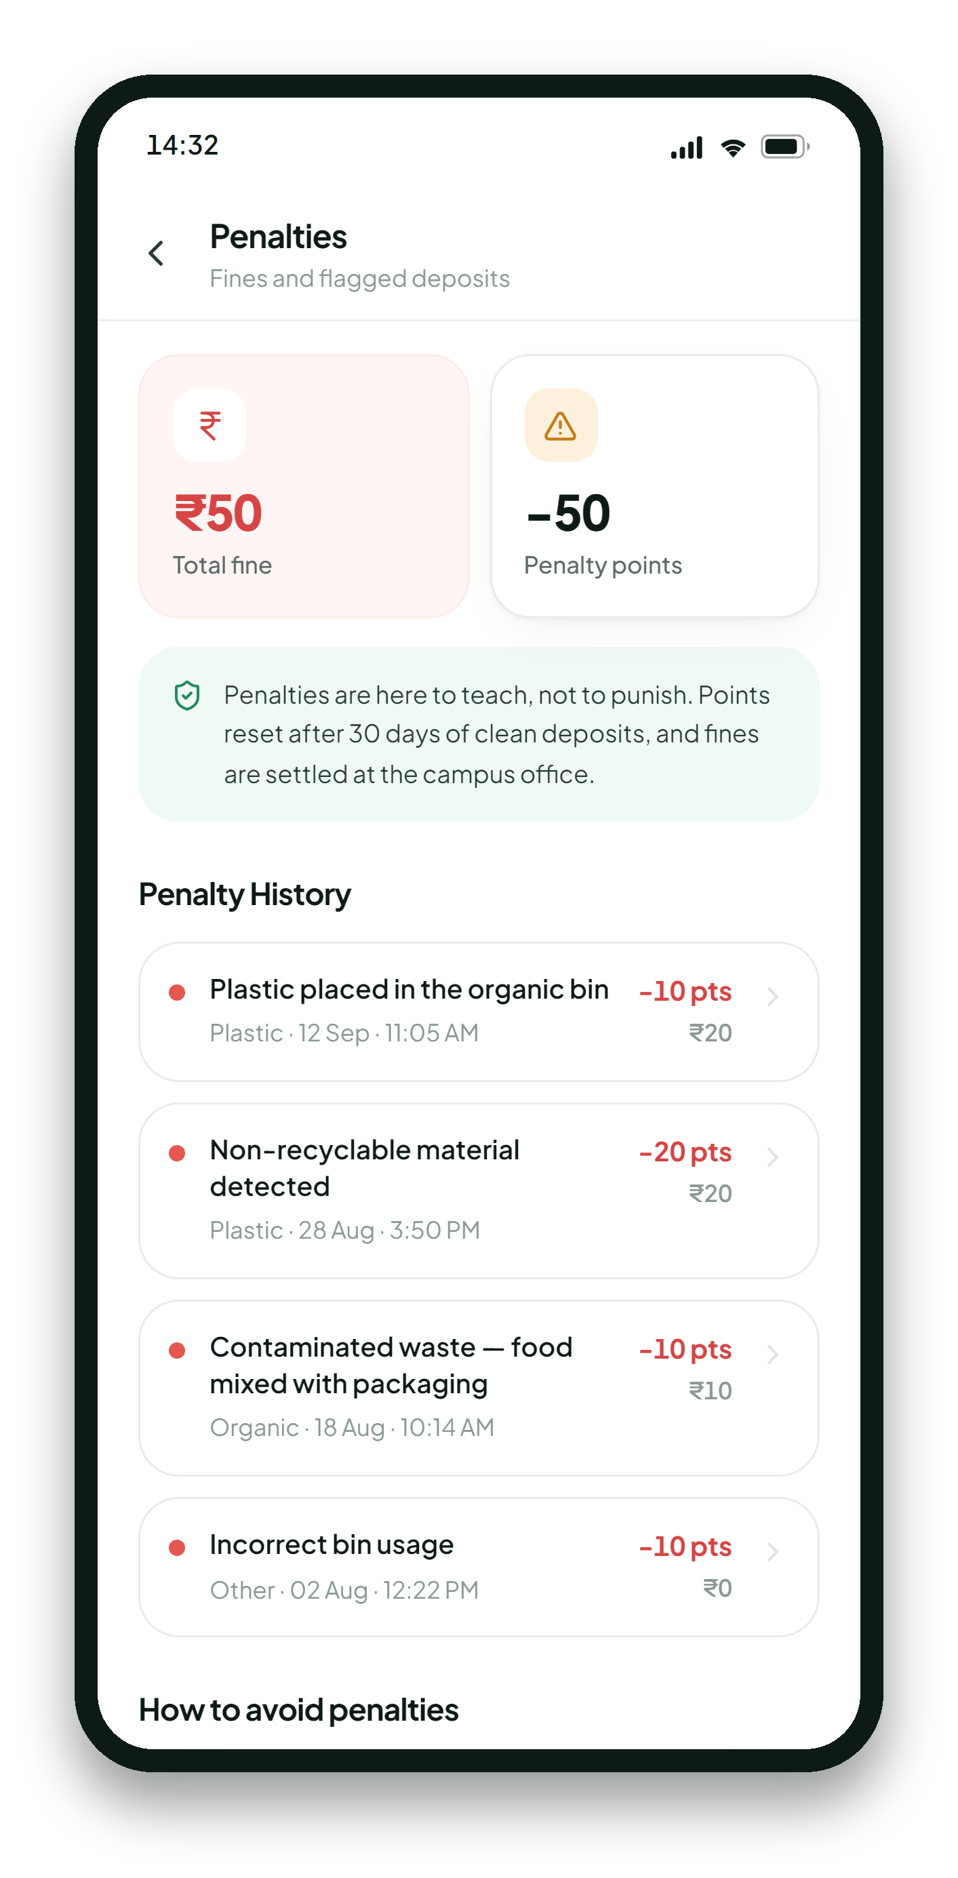





08 REWARDS & ACCOUNTABILITY
Encourage better habits. Build accountability.
REWARD
ACCOUNTABILITY
Correct disposal
Incorrect disposal
Sorted into the right bin
Wrong bin or contaminated waste
Eco points earned
Penalty applied
+20 points per kilogram
Points deducted, small fine logged
Redeem rewards
User awareness
Badges, coupons, a planted tree
The app explains exactly what went wrong
Penalties are framed as guidance, not punishment: every flagged deposit explains the reason, and points reset after 30 clean days.
ENGO
08 / 12
Notes:
The reward side is the carrot; the penalty side is the record. We deliberately kept the penalty screen educational — it tells you what went wrong and how to avoid it, and the points expire.

Slide 9














09 SYSTEM ARCHITECTURE
PROPOSED FINAL ARCHITECTURE
Connecting the physical and digital worlds.
PRESENTATION
User
Mobile Application
SERVICES
Backend / API
Database
AI Vision Service
CONNECTIVITY
IoT Gateway
MQTT / WebSocket
DEVICE
ESP32
RFID Reader
Sensors
Camera
Actuators
Waste Processing
Built — running in the prototype today
Proposed — planned for later phases
ENGO
09 / 12
Notes:
Only the top layer exists today. Everything below the presentation row is proposed. We designed the app against a service layer so those rows can be filled in without redesigning any screen.

Slide 10







10 HARDWARE + SOFTWARE
Every physical action creates a digital event.
PHYSICAL WORLD
DIGITAL WORLD
RFID Reader
User Identification
Weight Sensor
Waste Weight
Fill Sensor
Bin Status
Camera
AI Classification
Servo / Motor
Sorting Command
Processing Unit
Processing Status
In the current prototype these six events are produced by a built-in Smart Bin Simulator, so the app already consumes them in the exact shape the hardware will send.
ENGO
10 / 12
Notes:
This mapping is the contract between the two halves of the project. The app already handles all six event types; the hardware team only has to emit them.

Slide 11

11 DEVELOPMENT ROADMAP
From prototype to working system.
One of six phases complete.
PHASE 01
PHASE 02
PHASE 03
PHASE 04
PHASE 05
PHASE 06
2
3
4
5
6
UI / UX Prototype
AI Integration
Backend + Database
ESP32 + RFID + Sensors
Waste Processing Rig
Complete IoT Integration
Full mobile app on mock data, with the complete deposit journey.
A hosted vision model returns real waste classifications.
Accounts, transactions and rewards persisted server-side.
Real identification, weight and fill-level readings.
A physical prototype that sorts and processes the waste.
Live bin telemetry flowing end to end into the app.
COMPLETE
PLANNED
PLANNED
PLANNED
PLANNED
PLANNED
Phase 01 is finished and demonstrable today. Phases 02 to 06 are scoped but not yet implemented.
ENGO
11 / 12
Notes:
We are honest about where we are. Phase one is done and you can use it right now. The remaining five phases are planned, in this order, because each one unblocks the next.

Slide 12
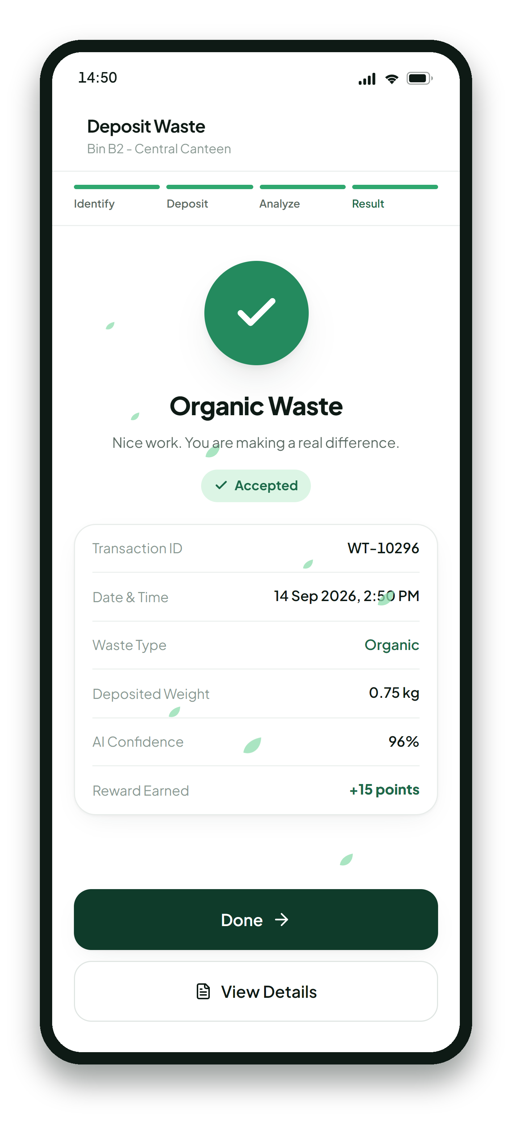
ENGO
A smarter way to manage waste.
IDENTIFY × MEASURE × ANALYZE × REWARD
Small Actions. A Cleaner Tomorrow.
A working frontend prototype today — with a clear, staged path to live AI, a backend and real smart-bin hardware.
ENGO
12 / 12
Notes:
Identify, measure, analyze, reward. That is the whole system in four words. Thank you — happy to run the live demo or take questions.

