Slide 1

Minimum Mass of a D Bar Structure
subject to Yield and Buckling
(As an Example of Verification of Statics Software)
Tensegrity Engineering Analysis Master
Department of Aerospace Engineering, Texas A&M University, TX, USA
TEAM, Feb 4th , 2019

Slide 2






Problem Statement
Given: node locations N, external horizontal force F
Find: Minimum mass m subject to Yield and Buckling, shown in figure below.
Bar
String
n4
$$b_{4}$$
$$b_{3}$$
F
F
$$s_{1}$$
$$s_{2}$$
$$b_{1}$$
$$b_{2}$$

Slide 3

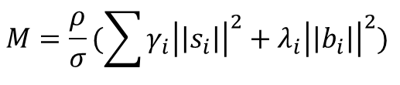





Yield - Solution
$$NK=W$$
and
$$K=C_{s}^{T}\hat{γ}C_{S}−C_{B}^{T}\hat{λ}C_{B}$$
then
$$S\hat{γ}C_{S}−B\hat{λ}C_{B}=W$$
$$S\hat{C_{S_{i}}}γ−B\hat{{C_{B}}_{i}}λ=W_{i}$$
Write into a matrix form in terms of $γ$ and $λ$
$$\begin{matrix}[S\hat{C_{S_{i}}} & −B\hat{{C_{B}}_{i}}\end{matrix}]\left[ \begin{matrix}γ \\ λ\end{matrix}\right]=W_{i}$$
$$\left[\begin{matrix}γ \\ λ\end{matrix}\right]≥0$$
First, let’s consider minimum mass subject to yield condition, and assume same material for bars and strings.
$$M=\frac{ρ}{σ}(\sum{γ_{i}{\left|\left|s_{i}\right|\right|}^{2}+λ_{i}{\left|\left|b_{i}\right|\right|}^{2}) }$$

Slide 4
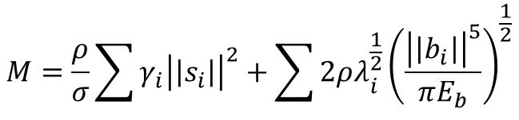

Buckling - Solution
$$NK=W$$
and
$$K=C_{s}^{T}\hat{γ}C_{S}−C_{B}^{T}\hat{λ}C_{B}$$
then
$$S\hat{γ}C_{S}−B\hat{λ}C_{B}=W$$
$$S\hat{C_{S_{i}}}γ−B\hat{{C_{B}}_{i}}λ=W_{i}$$
Write into a matrix form in terms of $γ$ and $λ$
$$\begin{matrix}[S\hat{C_{S_{i}}} & −B\hat{{C_{B}}_{i}}\end{matrix}]\left[ \begin{matrix}γ \\ λ\end{matrix}\right]=W_{i}$$
$$\left[\begin{matrix}γ \\ λ\end{matrix}\right]≥0$$
Second, let’s consider minimum mass subject to buckling condition, and assume same material for bars and strings.
$$M=\frac{ρ}{σ}\sum{γ_{i}{\left|\left|s_{i}\right|\right|}^{2}}+\sum{2ρλ_{i}^{\frac{1}{2}}{\left(\frac{{\left|\left|b_{i}\right|\right|}^{5}}{πE_{b}}\right)}^{\frac{1}{2}}}$$

Slide 5
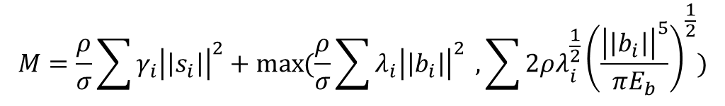
Yield and Buckling - Solution
$$NK=W$$
and
$$K=C_{s}^{T}\hat{γ}C_{S}−C_{B}^{T}\hat{λ}C_{B}$$
then
$$S\hat{γ}C_{S}−B\hat{λ}C_{B}=W$$
$$S\hat{C_{S_{i}}}γ−B\hat{{C_{B}}_{i}}λ=W_{i}$$
Write into a matrix form in terms of $γ$ and $λ$
$$\begin{matrix}[S\hat{C_{S_{i}}} & −B\hat{{C_{B}}_{i}}\end{matrix}]\left[ \begin{matrix}γ \\ λ\end{matrix}\right]=W_{i}$$
$$\left[\begin{matrix}γ \\ λ\end{matrix}\right]≥0$$
Third, let’s consider minimum mass subject to Yield and buckling condition, and assume same material for bars and strings.
$$M=\frac{ρ}{σ}\sum{γ_{i}{\left|\left|s_{i}\right|\right|}^{2}}+\max{(\frac{ρ}{σ}\sum{λ_{i}{\left|\left|b_{i}\right|\right|}^{2} }, \sum{2ρλ_{i}^{\frac{1}{2}}{\left(\frac{{\left|\left|b_{i}\right|\right|}^{5}}{πE_{b}}\right)}^{\frac{1}{2}}})}$$

Slide 6
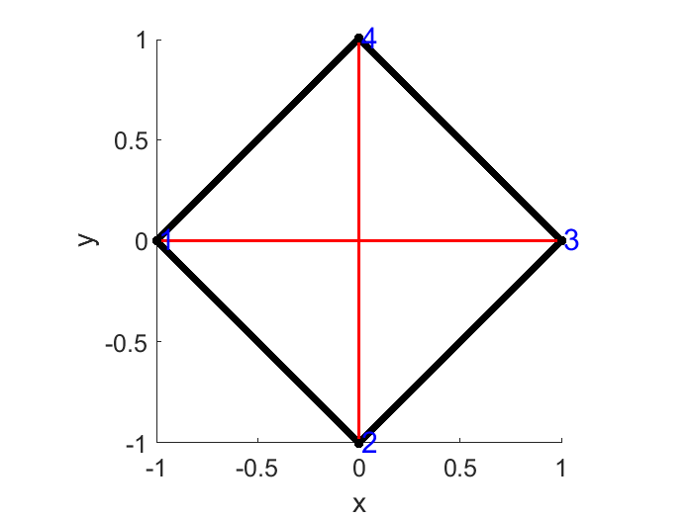
One Example Considering Yield/Buckling
N = -1 0 1 0
0 -1 0 1
0 0 0 0
C_s = -1 0 1 0
0 -1 0 1
Bar
String
b4
b3
n4
F
F
s1
s2
C_b = -1 1 0 0
0 -1 1 0
0 0 -1 1
1 0 0 -1
b1
b2

Slide 7











Analytical Solution
Geometric Analysis
$$\frac{F}{\sqrt{2}}$$
$$\frac{F}{\sqrt{2}}$$
Bar
String
b4
$$F$$
b3
n4
$$\frac{F}{\sqrt{2}}$$
$$\frac{F}{\sqrt{2}}$$
F
$$0$$
F
s1
n3
$$\frac{F}{\sqrt{2}}$$
s2
$$\frac{F}{\sqrt{2}}$$
b1
$$F$$
b2
$$\frac{F}{\sqrt{2}}$$
$$\frac{F}{\sqrt{2}}$$
n2

Slide 8






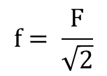
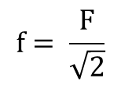



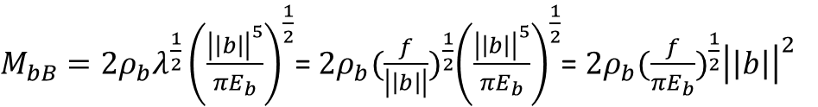

Analytical Solution
Mass of one bar subject to yield
Aluminum Property:
Example:
$$ρ_{b}=2700$$
$$F=10,000 N$$
$M_{bY}=\frac{ρ_{b}}{σ_{b}}λ{\left|\left|b\right|\right|}^{2}$ = $\frac{ρ_{b}}{σ_{b}} \frac{f}{\left|\left|b\right|\right|}{\left|\left|b\right|\right|}^{2}$ = $\frac{ρ_{b}}{σ_{b}} f\left|\left|b\right|\right|$
$$E_{b}=60e09$$
b1=b2=b3=b4=√𝟐
$$f= \frac{F}{\sqrt{2}}$$
$$b=\sqrt{2}$$
$$σ_{b}=110e06$$
s1=s2=2
$M_{bY}=0.2455$ kg
Mass of one bar subject to buckling
$M_{bB}=2ρ_{b}λ^{\frac{1}{2}}{\left(\frac{{\left|\left|b\right|\right|}^{5}}{πE_{b}}\right)}^{\frac{1}{2}}$= $2ρ_{b}{(\frac{f}{\left|\left|b\right|\right|})}^{\frac{1}{2}}{\left(\frac{{\left|\left|b\right|\right|}^{5}}{πE_{b}}\right)}^{\frac{1}{2}}$= $2ρ_{b}{(\frac{f}{πE_{b}})}^{\frac{1}{2}}{\left|\left|b\right|\right|}^{2}$
$$f= \frac{F}{\sqrt{2}}$$
$$b=\sqrt{2}$$
Buckling happens prior of Yield, so mass of one bar subject to Yield and buckling is
$M_{bB}=2.0918$kg
$M_{b}=2.0918$ kg

Slide 9





Analytical Solution
Mass of one string subject to yield
Aluminum Property:
Example:
$$ρ_{b}=2700$$
$$F=10,000 N$$
$M_{sY}=\frac{ρ_{b}}{σ_{b}}γ{\left|\left|s\right|\right|}^{2}$ = $\frac{ρ_{b}}{σ_{b}} \frac{f}{\left|\left|s\right|\right|}{\left|\left|s\right|\right|}^{2}$ = $\frac{ρ_{b}}{σ_{b}} f\left|\left|s\right|\right|$
$$E_{b}=60e09$$
b1=b2=b3=b4=√𝟐
$$f=F$$
$$s=2$$
$$σ_{b}=110e06$$
s1=s2=2
$M_{sY}=0.4909$ kg
Mass of string 1 is 0, mass of string 2
$M_{s}=0.4909$ kg

Slide 10
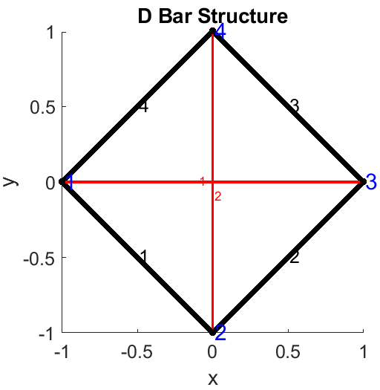
Numerical Solution (By Statics Software)
F
F
Mass of whole structure
$M={4M}_{b}+\left(M_{s}+0\right)=4∗2.0918+0.4909=8.8581$ kg

Slide 11
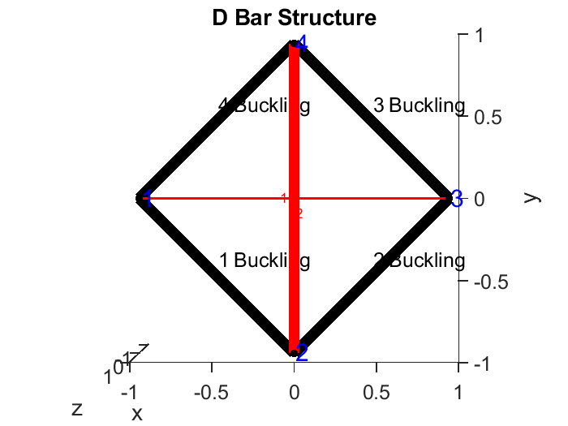
Numerical Solution (By Statics Software)
F
F
Mass_bar = 2.0918 2.0918 2.0918 2.0918 kg
Mass_string = 0.0000 0.4909 kg
MIN_MASS = 8.8580 kg

Slide 12
Thank You!

