Slide 1
DIAGNOSTIC CHAIR (ARM REST)
Presented by
TEAM MISOSA – Waziup bootcamp

Slide 2
PRESENTATION HANDLE
Introduction
Problem Statement
Project Objectives
Methodology
Business Model
Conclusion

Slide 3
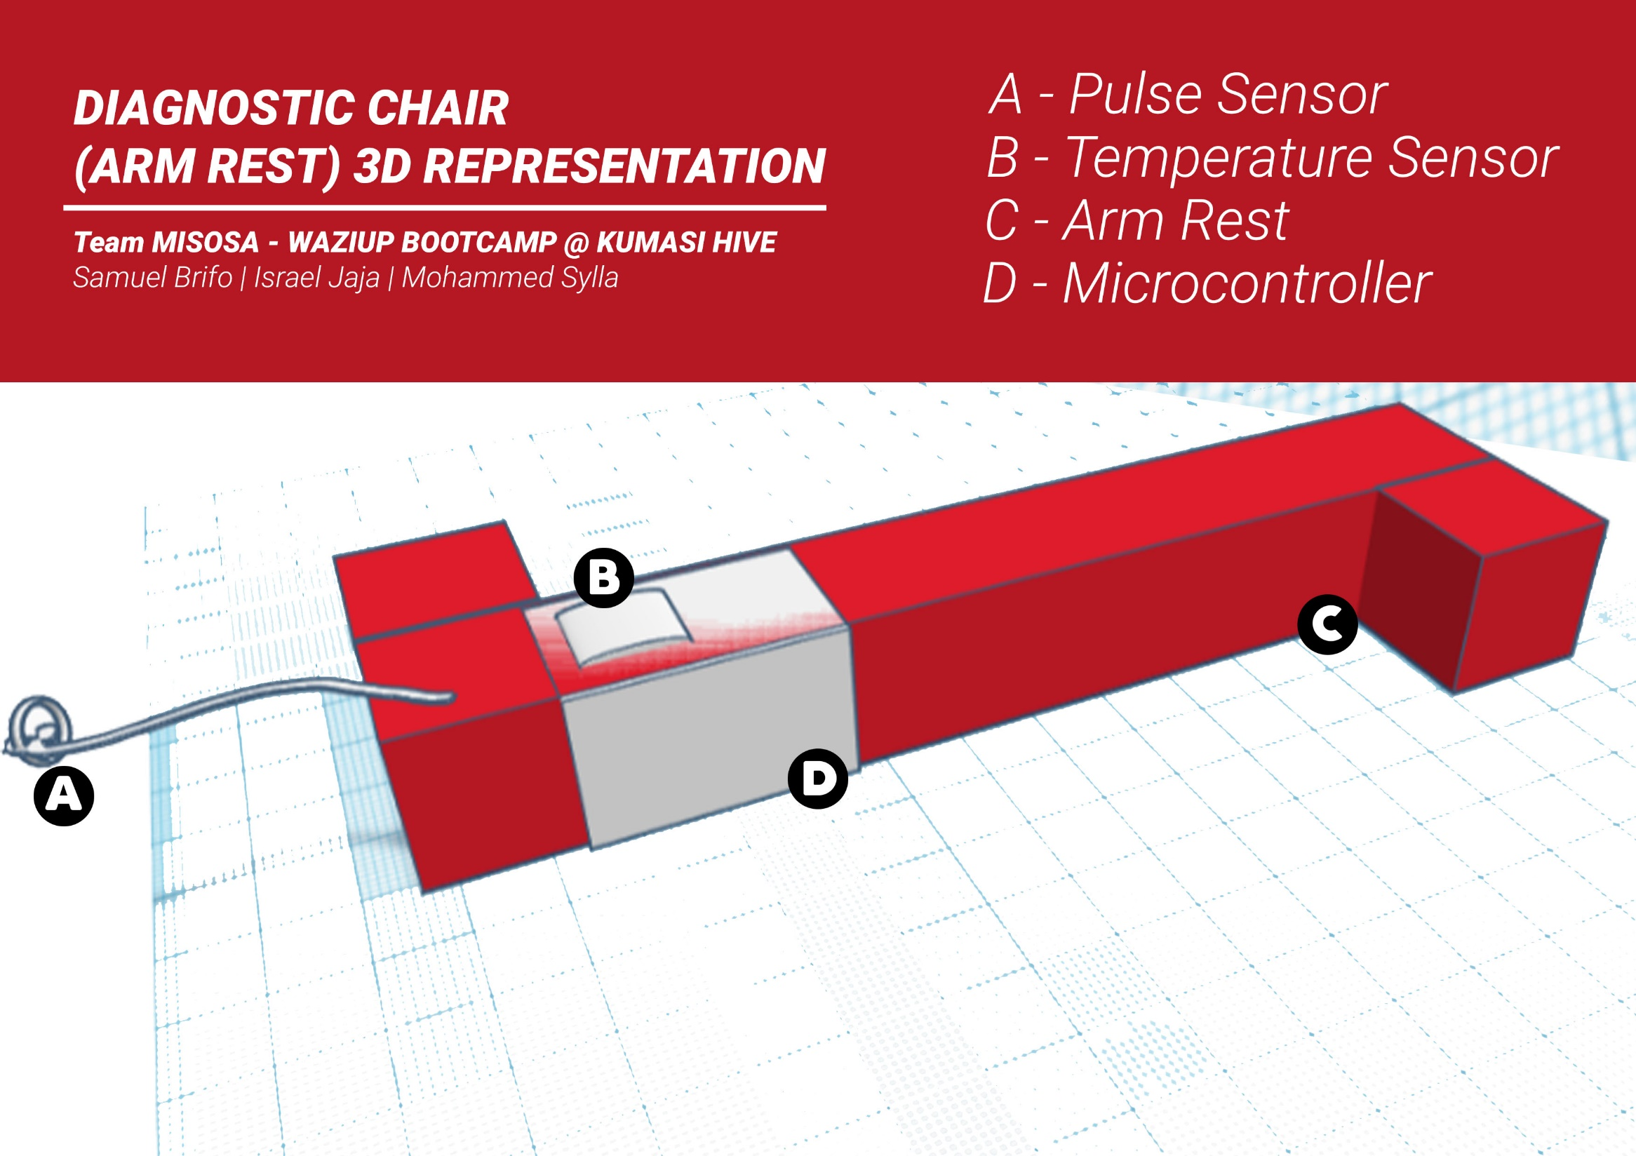

Slide 4
INTRODUCTION
This project is geared towards solving certain challenges associated with health sector in certain areas of the world starting with Ghana
These challenges are usually data related.
They usually cause problems in hospitals, e.g.
Congestions,
Lost hospital cards,
Misfiling of records

Slide 5
PROBLEM STATEMENT
Patient medical records history are not stored electronically.
Patient file not easily and readily accessible by various departments as at when needed.
Undue stress due to the use of the paper card system especially when patient doesn’t remember card details.
Proper medical treatments not administered to patients due to inaccessibility to medical history of patients.

Slide 6
PROJECT OBJECTIVES
To use available technologies (Arduino, Sensors, Waziup platform) to solve existing problem.
To be able to easily pick patients vitals and upload to cloud (Waziup platform).
To create a Browser Application to be able to pick the uploaded data and display to the user(medical personnel).
This vitals will also be made available to the medical personnel upon the next visit of the patient.

Slide 7
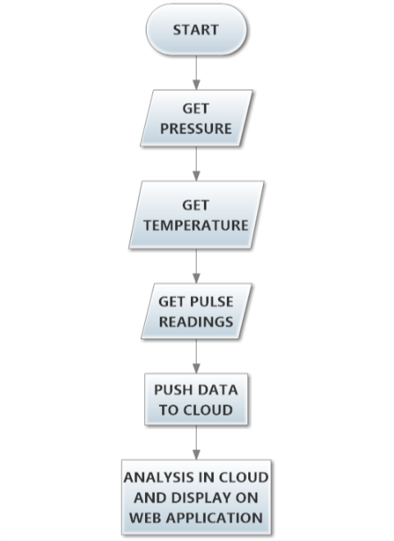
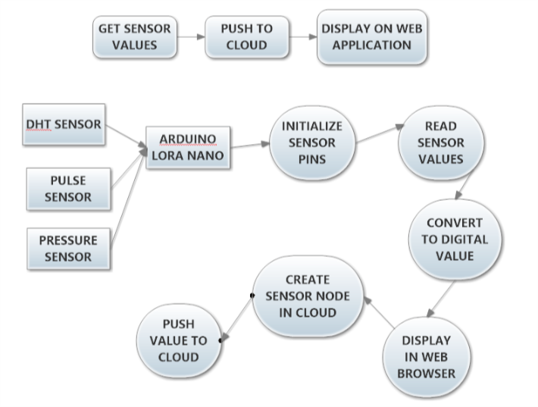
METHODOLOGY (FLOWCHART)

Slide 8
TARGET MARKET AND BUSINESS MODEL
Hospitals
Ministry of Health
World Health Organization
Health NGOs
The device will be sold on contract basis to these organizations and will receive one year free technical services
Will pitch idea to various investment companies/investors

Slide 9
CONCLUSION
Able to connect all necessary sensors and obtain readings
Able to connect to the gateway and push data to cloud ( Waziup Platform
Able to pick the data sent to the cloud and display to the users ( medical personnel)

Slide 11
THANK YOU

