Slide 1
Recommendation engine for raw food supplier
Capstone project for “Applied Data Science Capstone”
Presented by Muheeb Ali

Slide 2
Introduction
Business Understanding:
There is raw food supplier located in Borough “Etobicoke”, Toronto, who supplies local outlets ( cafes, Bakeries, Diners etc…) is about to open a local warehouse in order to present better service for his own suppliers (local farmers for example) and his customers (cafes, Diners etc…) so he wants to pick the optimum location that have close distance to most of the shops in Etobicoke and have proximity to as much shops as possible.

Slide 3
Analytic Approach
The best analytic approach for this use case is Machine Learning, since we want to identify proximities between a desired location (optimum location) and other points of interest in way that the desired location have fair proximity from most of the points of interests, the desired location in this use case is the Warehouse location, and the points of interest are the shops that his warehouse will supply. As well as clustering works best for this use case.

Slide 4
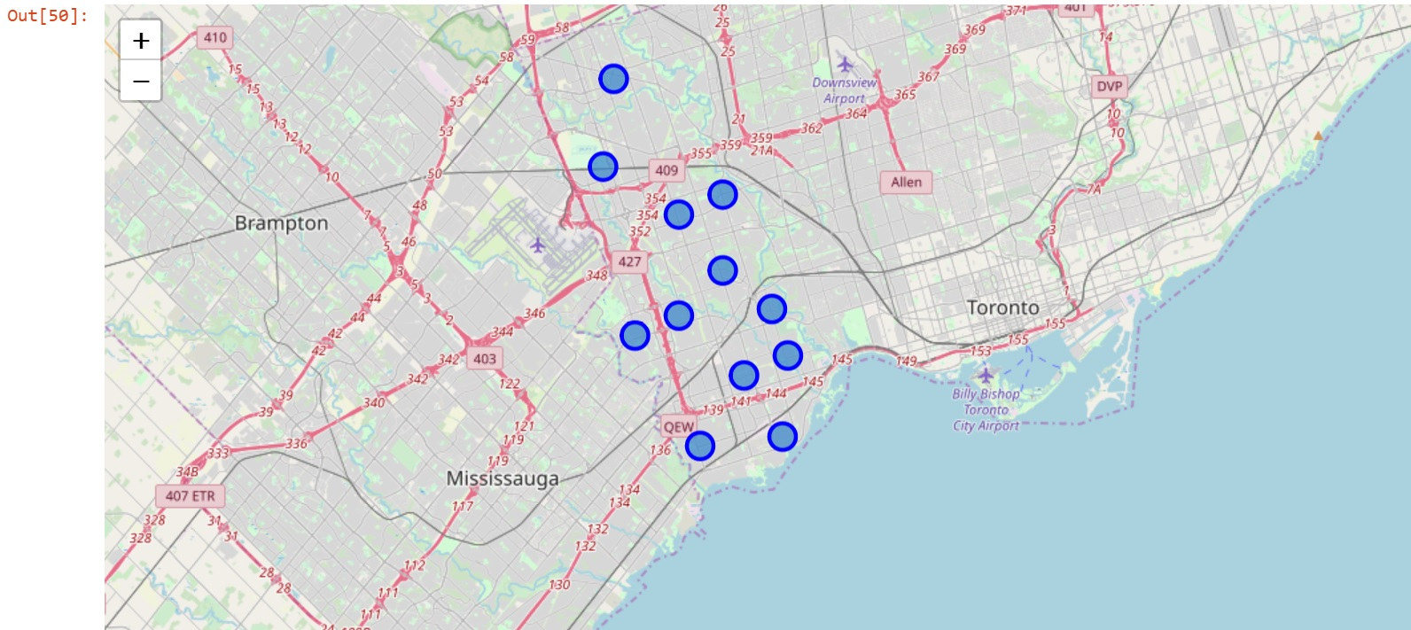
Data Requirement
In the previous mentioned issue, the supplier is located in Etobicoke, so we need to extract its coordinates through google. And use it to pen point it on the map, then enrich it with the local postal codes within its borders, and extract what shops of interest we can find within the borders by using foursquare data to decide the optimum location for the warehouse. The figure below shows the postal codes within Etobicoke.

Slide 5
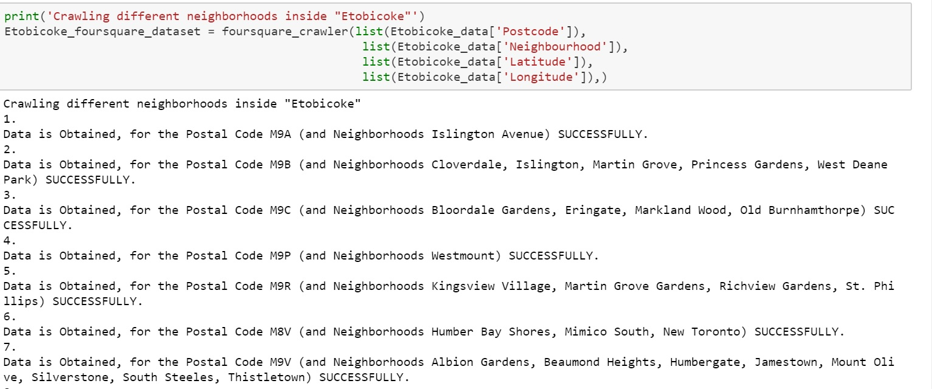
Data Collection
Data was collected from sources:
Wikipedia: https://bit.ly/2DP1Tuk
Geospatial data: http://cocl.us/Geospatial_data
Foursquare data: as in the figure

Slide 6
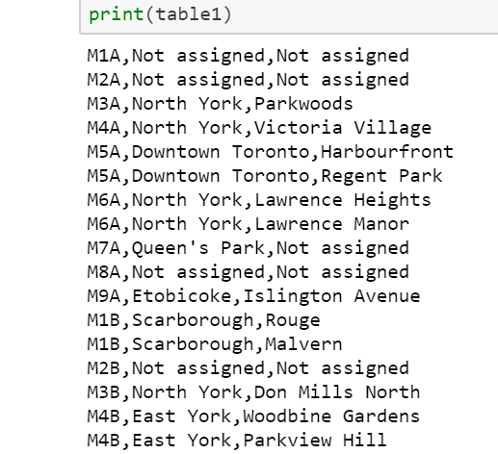
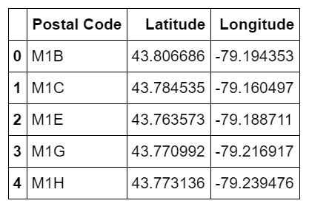
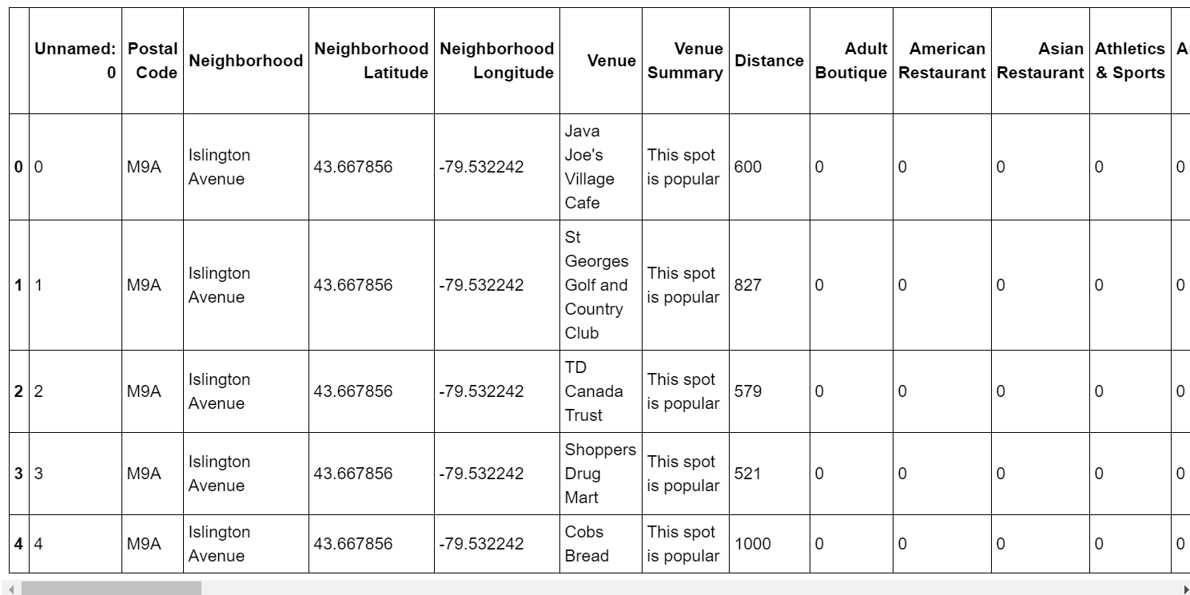
Methodology: Data preparation
1. Getting postalcodes raw data from Wikipedia as in figure, we
get familiar to the data and its fields.
2. We match then with geospatial data and join them on the postal code. And now we have coordinates for each borough.
3. Lastly we crawl foursquare to get venues within the
borough we specified.

Slide 7
Methodology: Data preparation
By connecting to Foursquare API we then can retrieve local data for each Venue in every neighborhood where we were able to mine for data about venues inside each and every neighborhood. For each neighborhood, we have set a radius of 1000m.
After that; by processing the Retrieved Data we can create a Data Frame for All the Venues inside the Etobicoke, when the data is mined, we then perform processing on that raw data to find our desirable features for each venue. The main feature is the category of the venues. After that, the column "Venue's Category" will be One-hot encoded and different venues will have different feature-columns. After One-hot encoding we lastly integrate all restaurants columns to one column "Total Restaurants" and all food joined columns to "Total Joints" column.

Slide 8
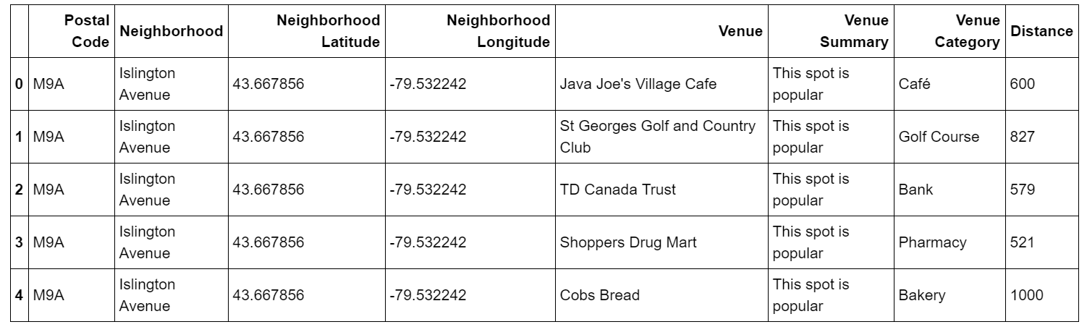
Methodology: Exploratory data
Mine data to create a data frame with all venues in Etobicoke as in the figure.

Slide 9
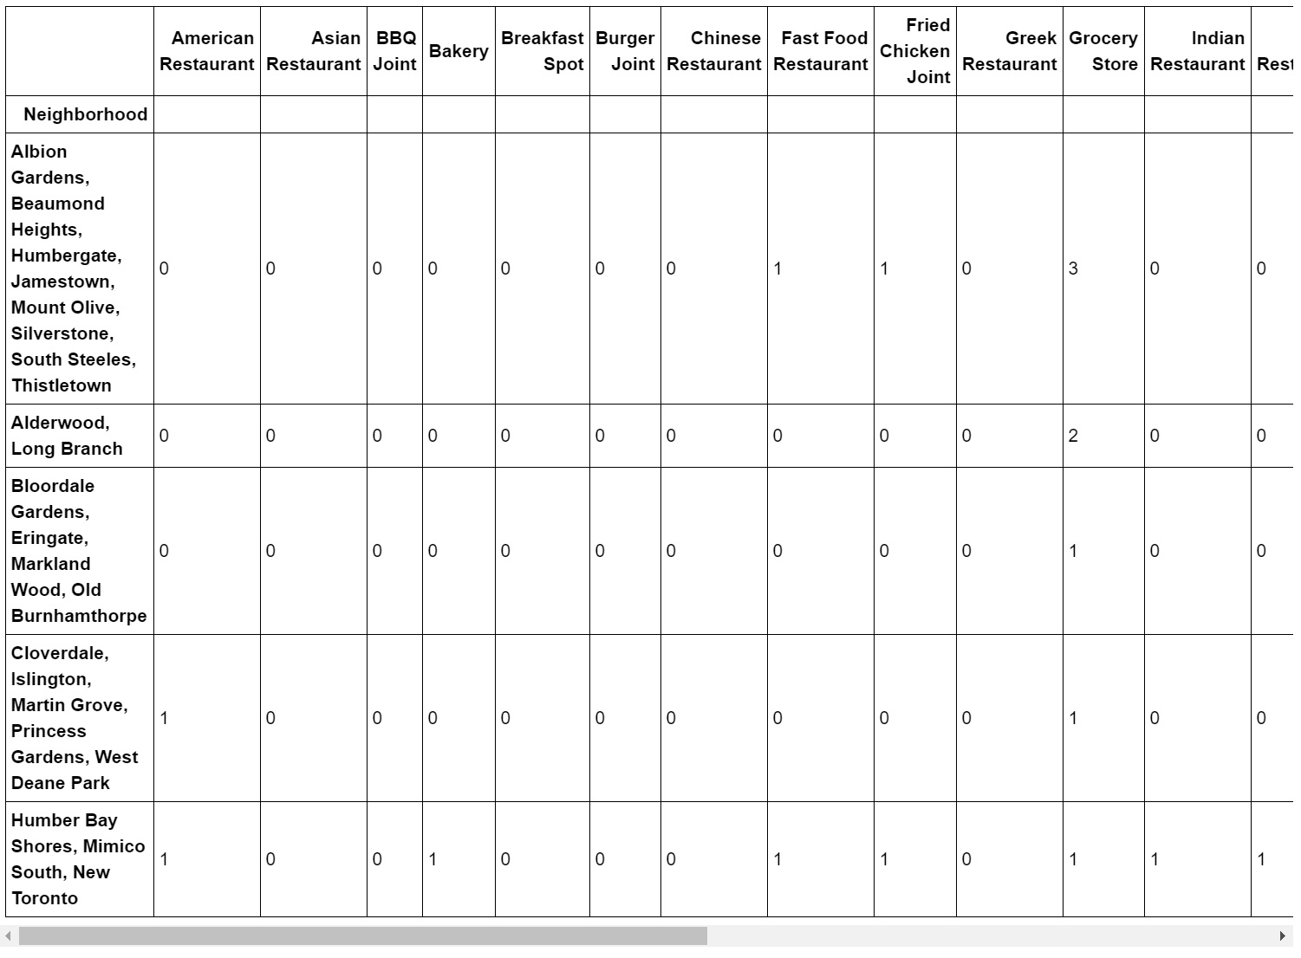
Methodology: Exploratory data
Wrangle the data above and apply one-hot encoding to have it ready for clustering.

Slide 10
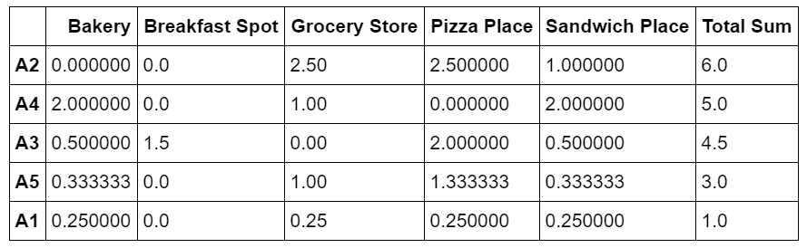
Methodology: ML- Clustering by k-means
Wrangle the data above and apply one-hot encoding to have it ready for clustering.

Slide 11
Methodology: ML- Clustering by k-means
Lastly, we set centers of clusters and compare them for their "Total Restaurants" and their "Total Joints". The group which its center has the highest "Total Sum" will be our best recommendation to the row ingredients supplier.
P.S.: Total Sum = Total Restaurants + Total Joints.
Where the best cluster was coded as A2, then A4 and A3 and so on. This outcome is then given to the supplier in order to start looking for a warehouse in the A2 cluster. And specifically in the below neighborhood:

