Slide 1

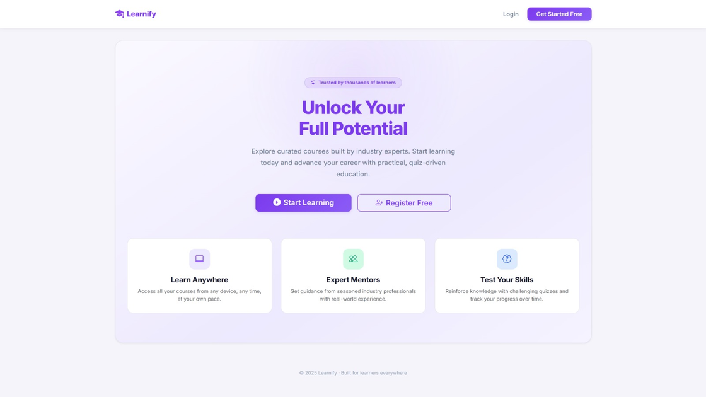
YEAR
PRESENTERS
2026
Mukhammed Teymurlu
Aydin Nagiyev
Toghrul Mammadli
Learnify
Online Course Platform
PROJECT
www.learnify.com

Slide 2
01
02
Account Creation
Teacher Dashboard
Sign up / Log in pages
Creating courses/quizes
Giving feedbacks
WELCOME!
Agenda
03
04
Student dashboard
Data managament
Enrolling courses
Taking quizes
Tracking progress
Relational database structure
Automated scoring logic
Real-time data synchronization
NEXT

Slide 3

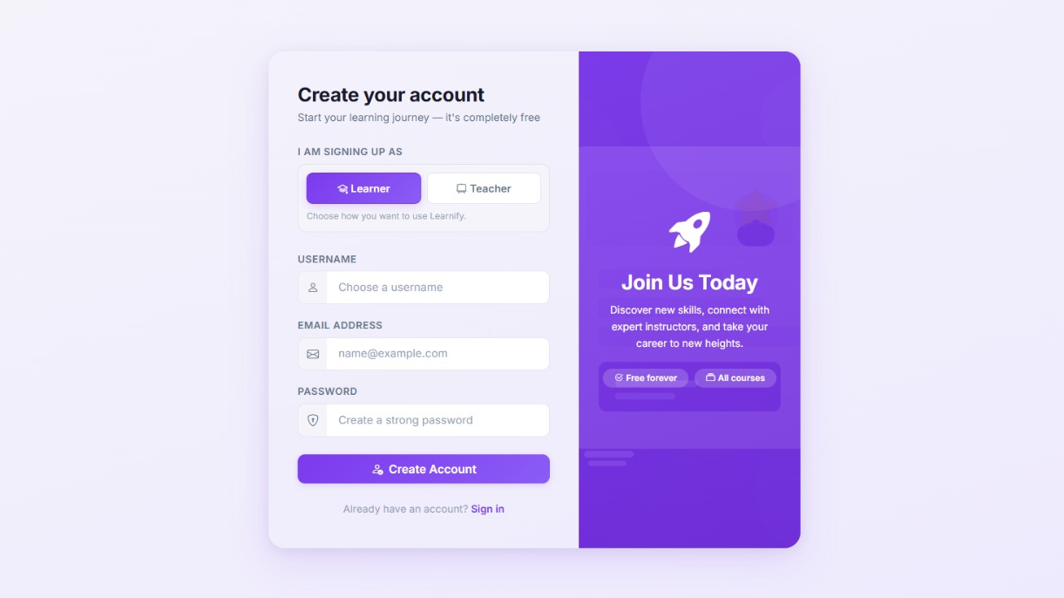
ARE YOU A TEACHER OR A STUDENT?
Creating
Account

Slide 4
Personalized journey
Teacher
Create interactive quizzes, design assessments, and provide detailed performance reviews.
Student
Seamless course enrollment, active lesson participation, and real-time progress tracking.
NEXT

Slide 5
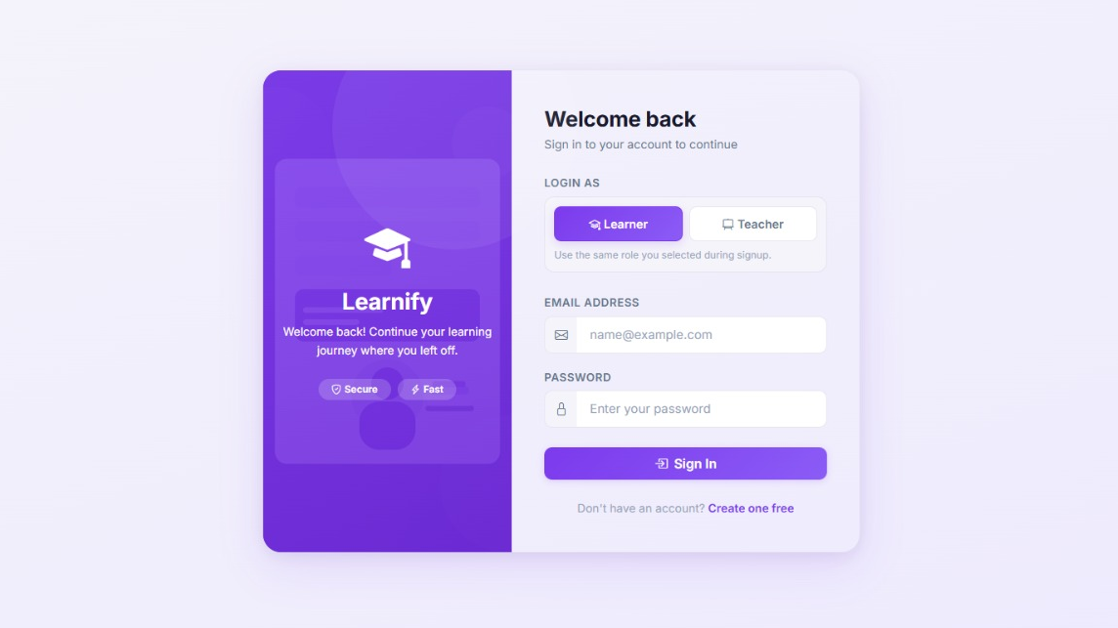
DO YOU ALREADY HAVE AN ACCOUNT?
Sign in
Access your personalized dashboard to continue your learning or teaching journey. A secure and seamless entry to all your courses and tools.
NEXT

Slide 6

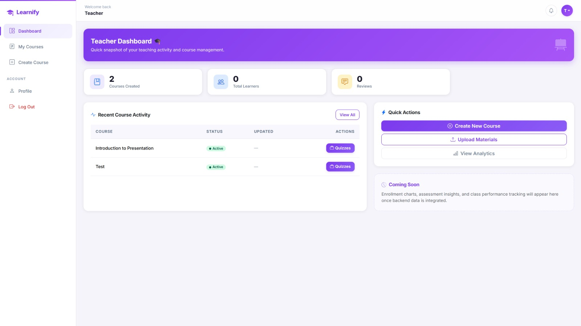
CREATE QUIZES AND GIVE FEEDBACK TO STUDENTS!
Teacher
Dashboard

Slide 7
ACADEMIC MANAGEMENT
Built for efficiency, feedback, and growth
At-a-Glance Analytics
Real-time insights into student engagement and course performance metrics.
Centralized Management
Progress Tracking & Feedback
Quick Action Hub
Streamlined navigation for effortless course creation and content management.
One-click access to essential teaching tools, optimizing daily workflow.
Direct monitoring of student progress with integrated quiz and review systems.

Slide 8
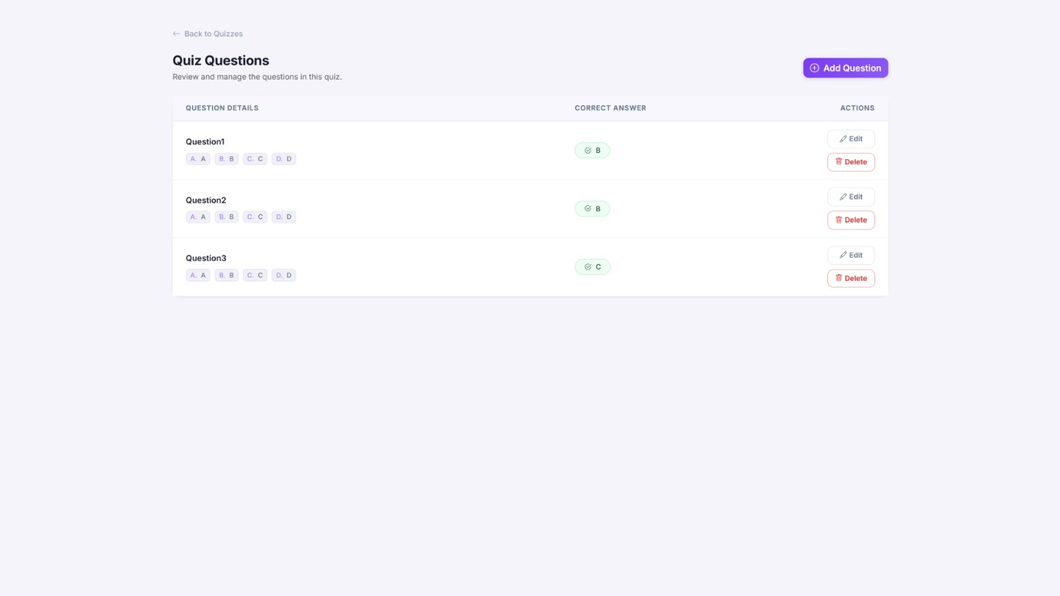
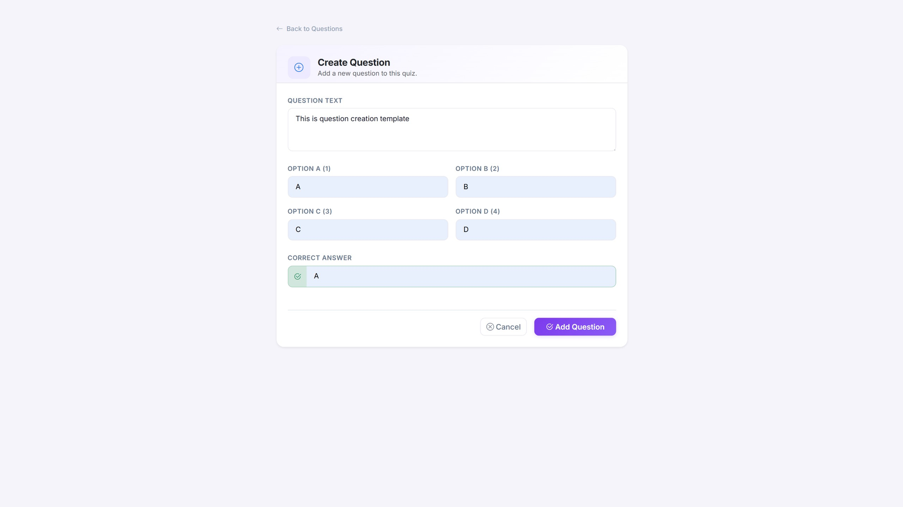
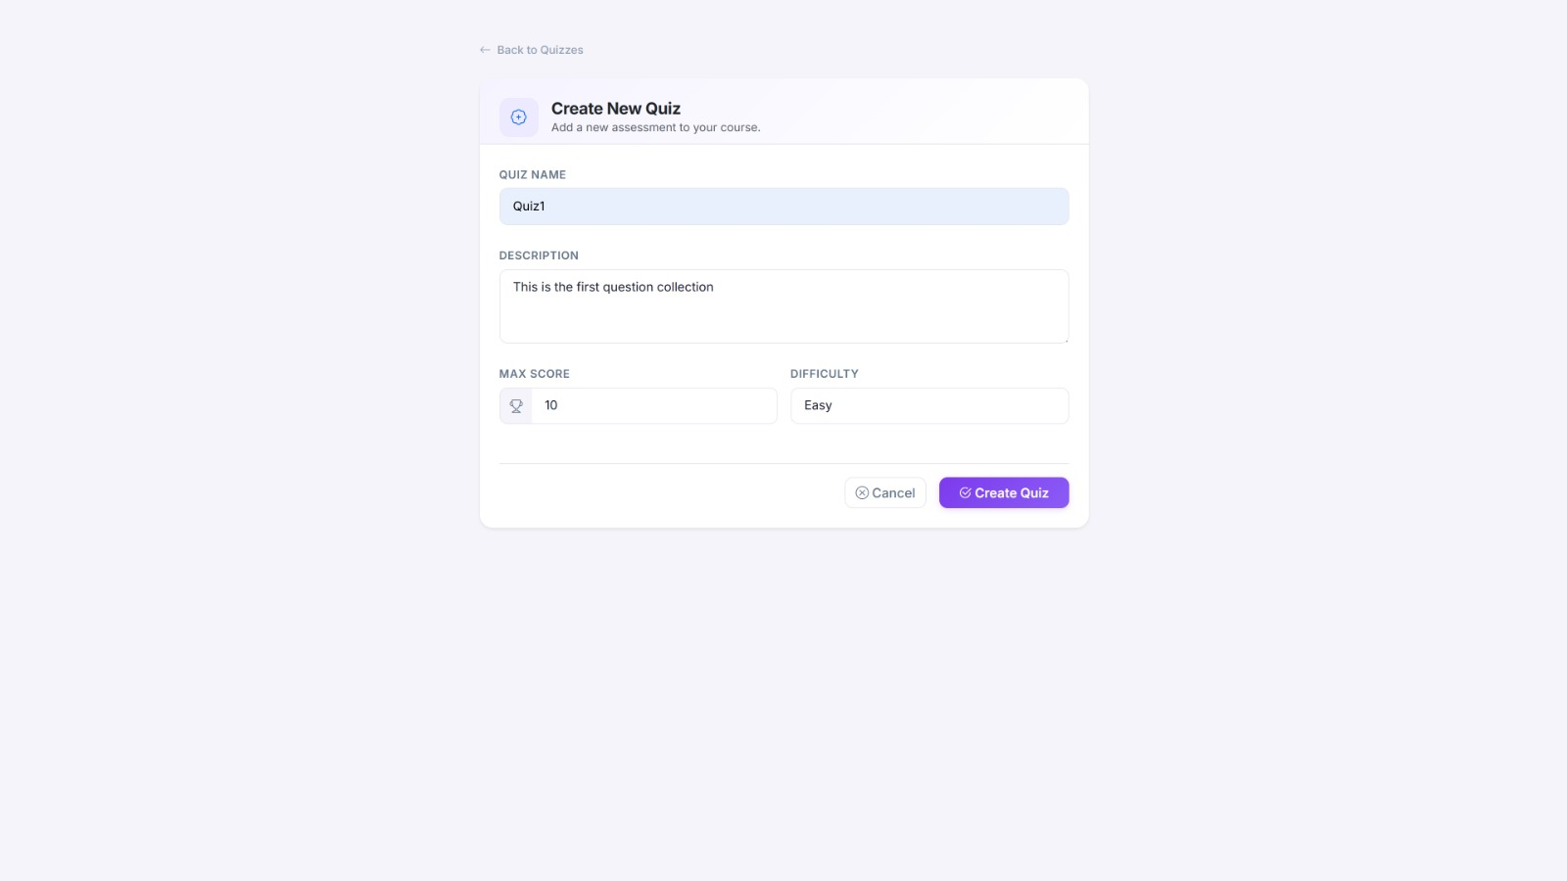
QUIZ CREATION
How to create new quizes and questions

Slide 9
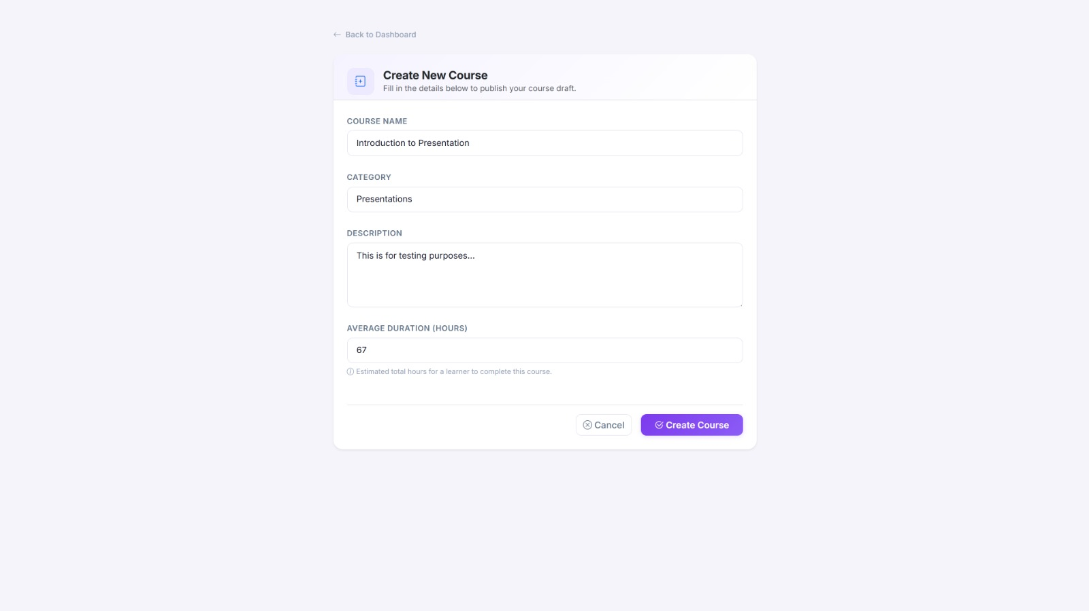
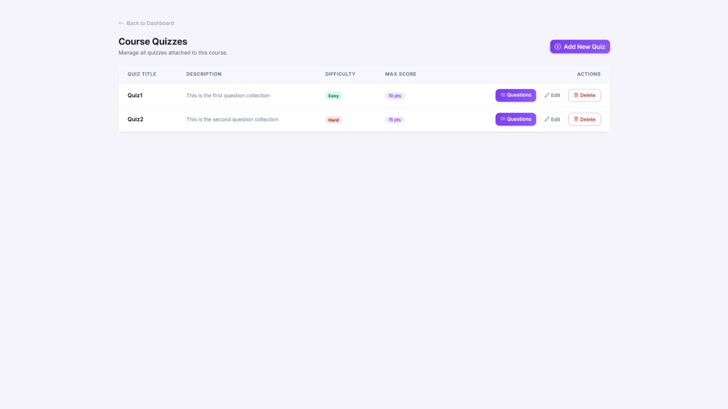
COURSE CREATION
How to create new courses and add quizes

Slide 10

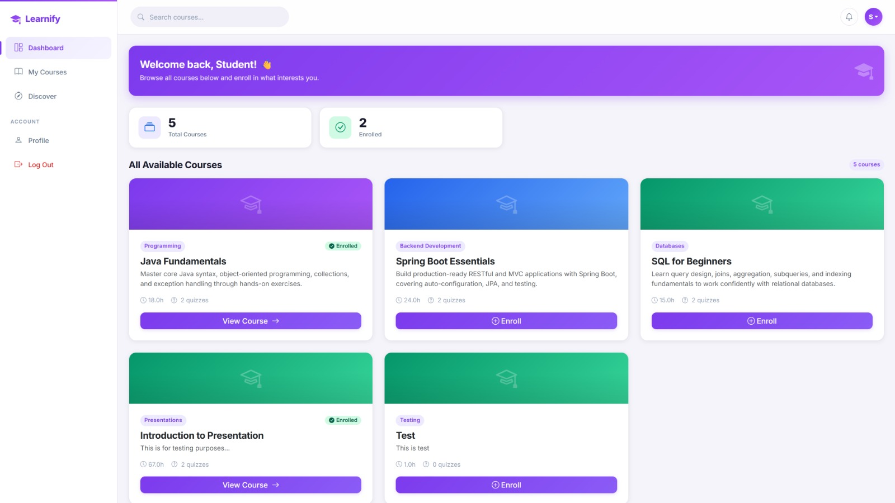
ENROLL A COURSE AND START LEARNING!
Student
Dashboard

Slide 11
STUDENT EXPERIENCE
Designed for clarity, focus, and academic success
PROGRESS OVERVIEW
At-a-glance tracking of enrollment status and overall academic activity.
PERSONALIZED LEARNING PATH
COURSE DISCOVERY & ACCESS
Streamlined navigation for effortless course creation and content management.
Easy access to diverse course materials with clear categories and direct enrollment options.

Slide 12
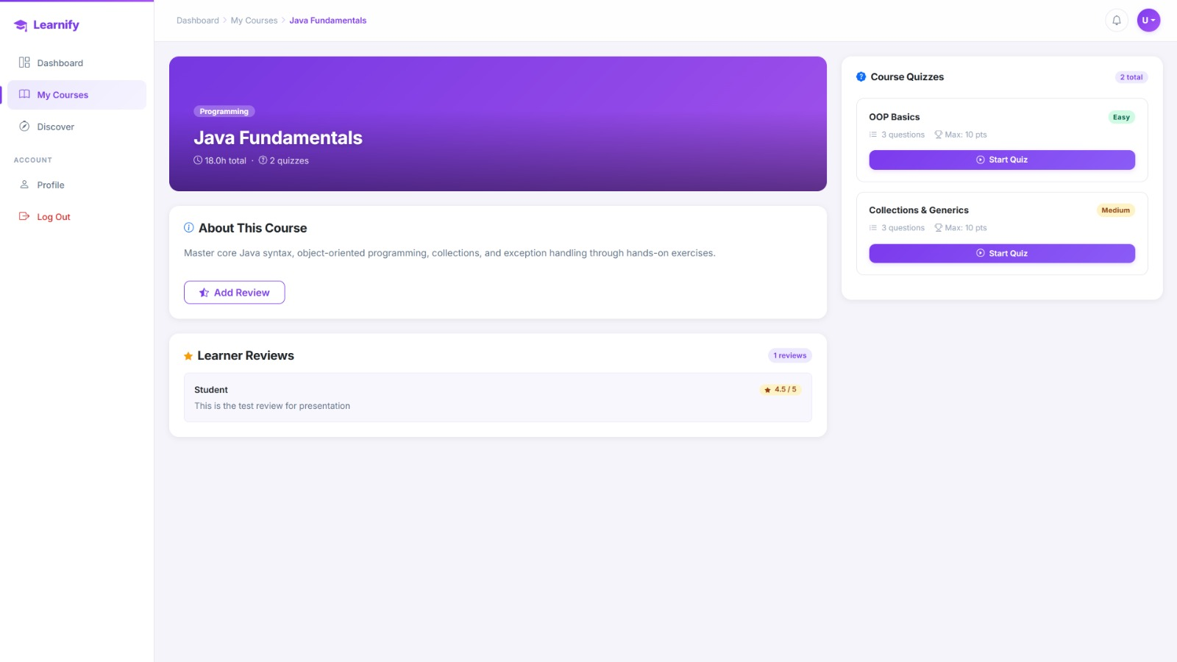
ENROLLING A COURSE
How to take quizes and start learning
FEEDBACK & COMMUNITY
TAKE A QUIZ AND START!
TAKE A QUIZ AND START!
Share your thoughts! You can leave a review and help others discover the best courses on the platform.
Challenge yourself with interactive quizzes to reinforce what you've learned and earn your score!
Challenge yourself with interactive quizzes to reinforce what you've learned and earn your score!

Slide 13
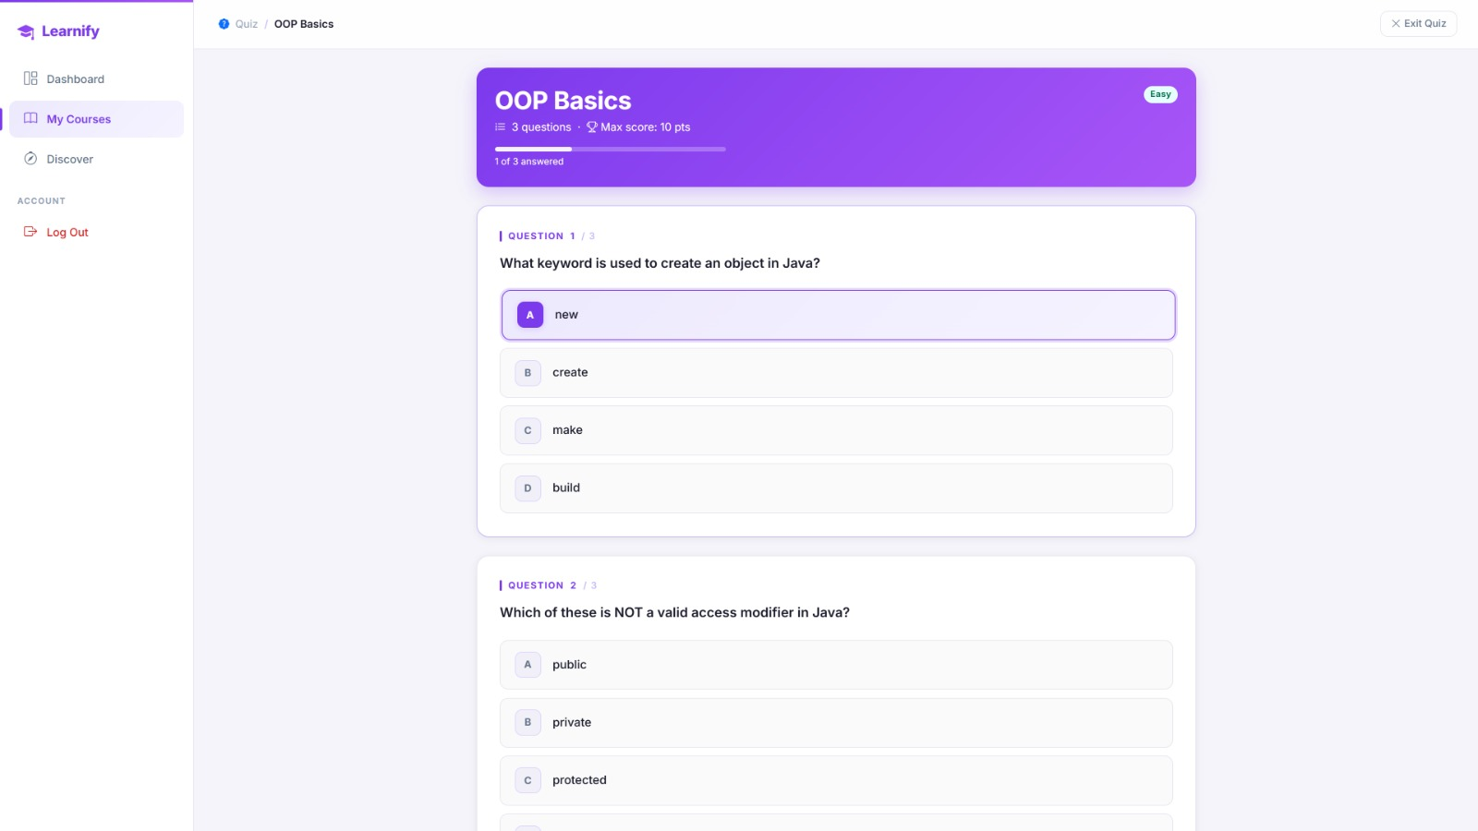
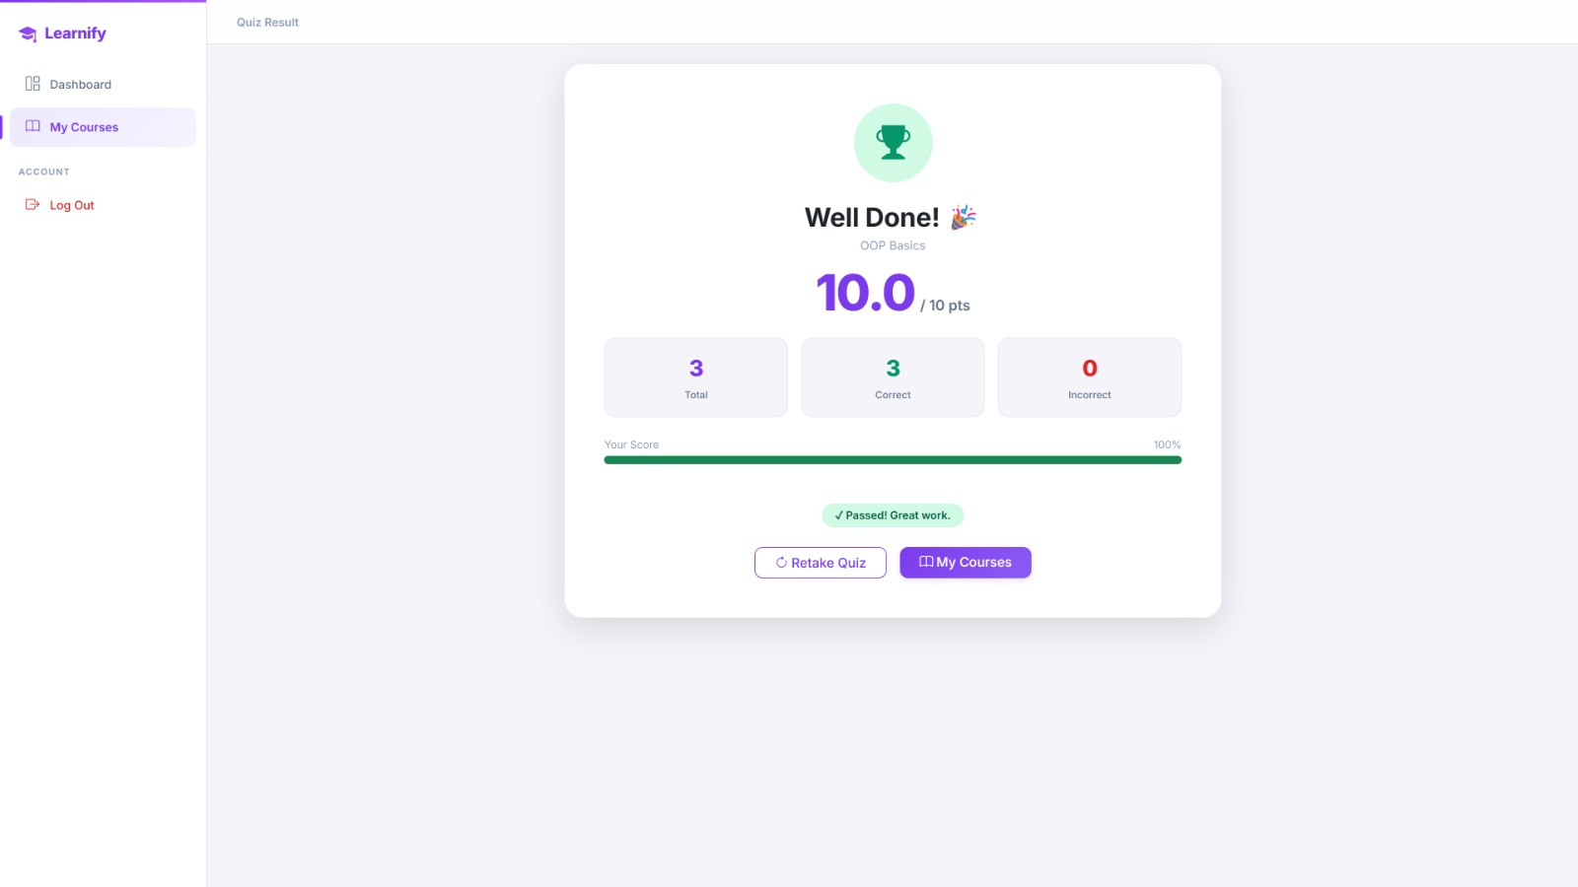
ACADEMIC ACHIEVEMENT
Validate your skills and prepare for core course materials

Slide 14
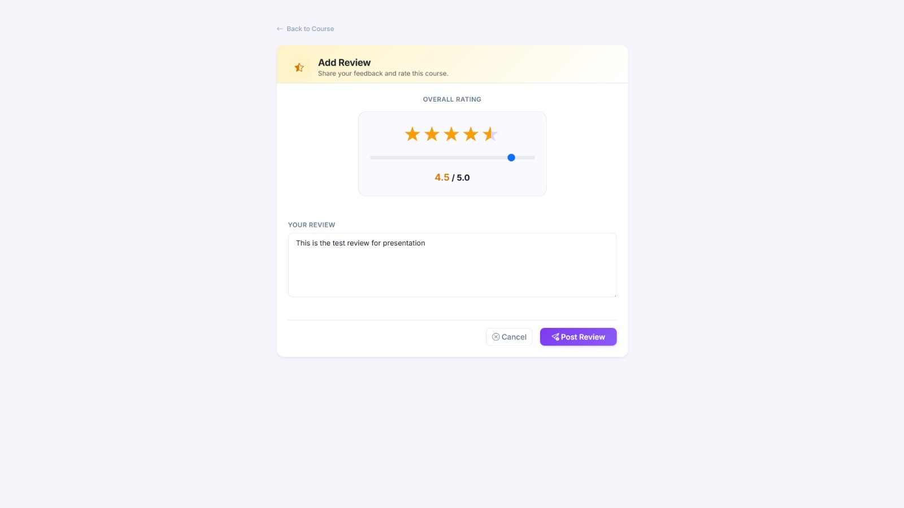
SHARE YOUR FEEDBACK
Voice your opinion and help shape the learning community

Slide 15

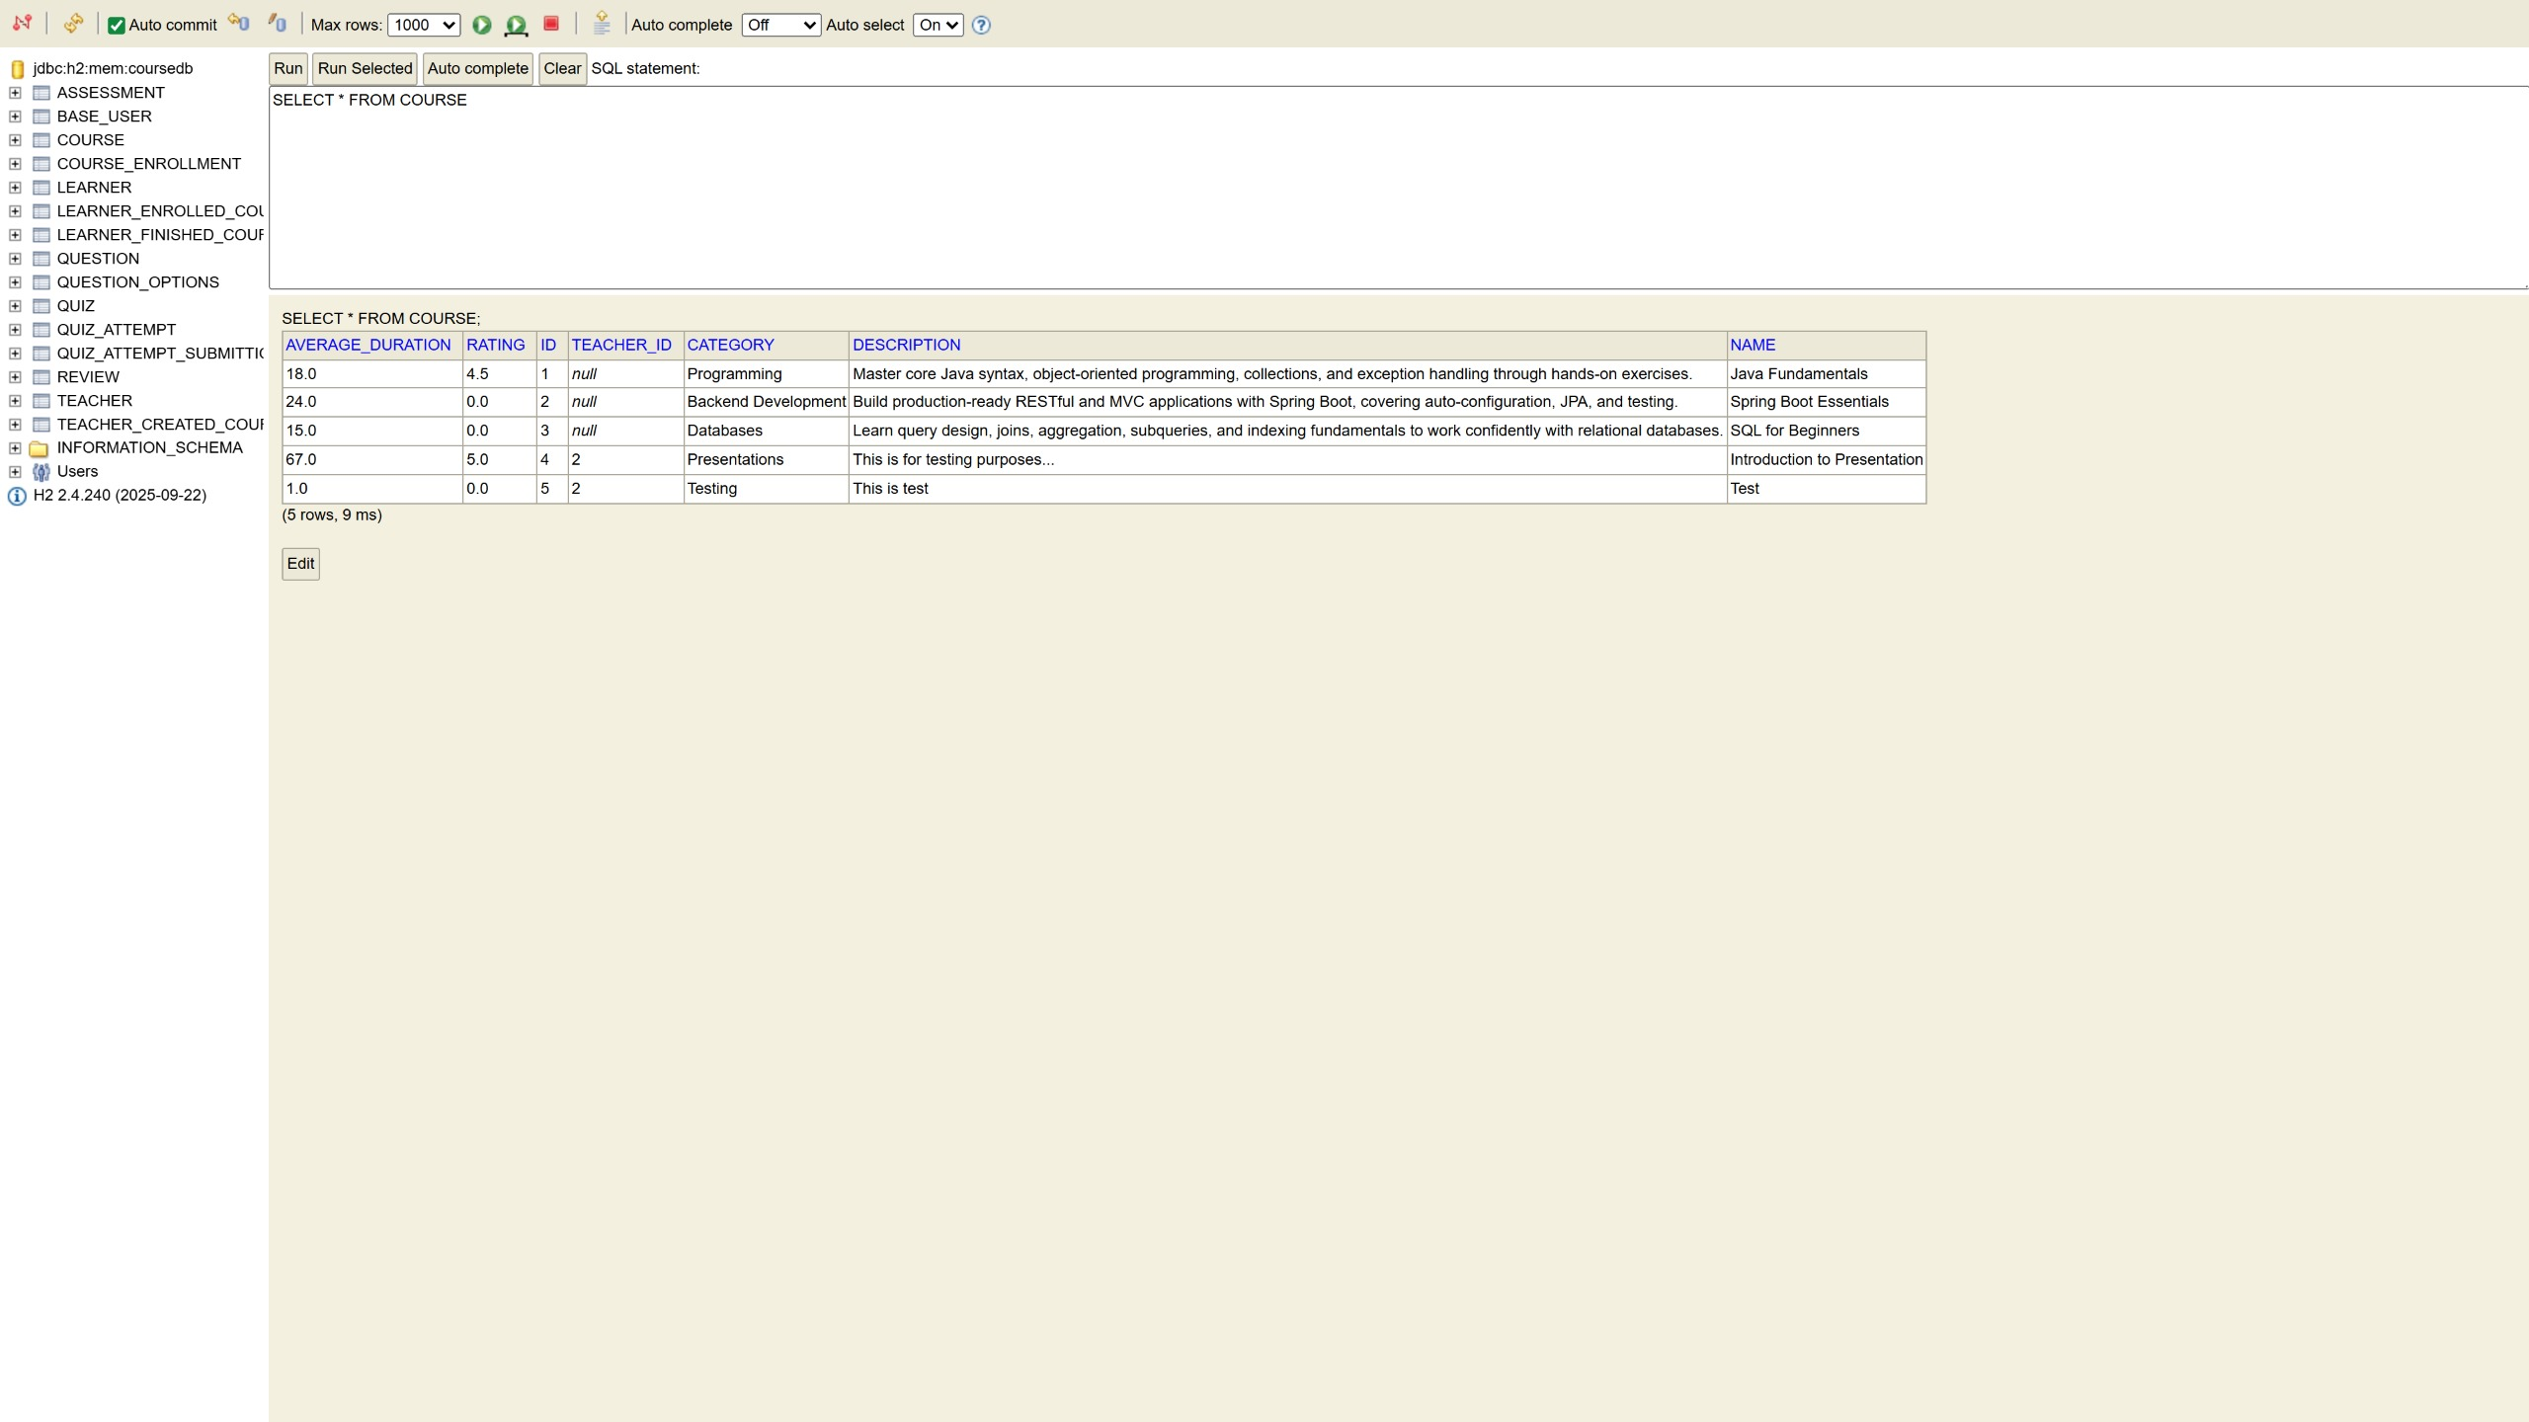
WHERE IS ALL THE DATA STORED?
Data Management

Slide 16
BACKEND MANAGEMENT
A scalable foundation for seamless content delivery
Relational Database Structure
Dynamic Content Management
Well-defined relational tables ensuring data integrity for courses, quizzes, and user profiles.
Flexible data handling that allows for real-time updates to course descriptions, ratings, and categories.

Slide 17
Thank You
Presented
Mukhammad Teymurlu
Aydin Nagiyev
Toghrul Mammadli
www.learnify.com

