Slide 1
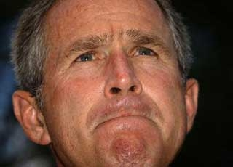
Experimental Design:
OR…. How should I conduct my next experiment?

Slide 2
Experimental Design:
Remember: For comparing groups, we are trying to determine a relationship:
VARIATION BETWEEN GROUPS
VARIATION WITHIN GROUPS

Slide 3
Experimental Design:
How to handle extraneous variables
Reasons for Insignificant or Erroneous Results
- no pattern or effect exists
- small sample size
- poor methodology

Slide 4
Experimental Design:
How to handle extraneous variables
Reasons for Insignificant or Erroneous Results
- no pattern or effect exists
- small sample size
- poor methodology
Poor methodology = how extraneous variables are handled… extraneous variables are those that are NOT independent or dependent variables, BUT CONTRIBUTE TO THE VARIATION BETWEEN OR WITHIN GROUPS.

Slide 5
Experimental Design:
How to handle extraneous variables
Reasons for Insignificant or Erroneous Results
Methodological Choices
- eliminate a variable by controlling it; reduce variation in the variable to ZERO.

Slide 6
Experimental Design:
How to handle extraneous variables
Reasons for Insignificant or Erroneous Results
Methodological Choices
- eliminate a variable by controlling it; reduce variation in the variable to ZERO.
- randomize it: assign subjects to treatments randomly (not haphazardly….), HOPEFULLY EQUALIZING THE AMOUNT OF VARIATION contributed by the variable ACROSS TREATMENTS

Slide 7
Experimental Design:
How to handle extraneous variables
Completely Randomized Design
- Example: Suppose you have four brands of tires (A, B, C, D) and you want to determine if the brands differ in rate of wear.

Slide 8
Experimental Design:
How to handle extraneous variables
Completely Randomized Design
- Example: Suppose you have four brands of tires (A, B, C, D) and you want to determine if the brands differ in rate of wear.
- So, suppose you put A’s on one car (I), B’s on a second car (II),etc…
I II III IV
A B C D
A B C D
A B C D
A B C D

Slide 9
Experimental Design:
How to handle extraneous variables
Completely Randomized Design
- Example: Suppose you have four brands of tires (A, B, C, D) and you want to determine if the brands differ in rate of wear.
- So, suppose you put A’s on one car (I), B’s on a second car (II),etc…
I II III IV
A B C D
A B C D
A B C D
A B C D problem?

Slide 10
Experimental Design:
How to handle extraneous variables
Completely Randomized Design
- So, suppose you put A’s on one car (I), B’s on a second car (II),etc…
I II III IV
A B C D
A B C D
A B C D
A B C D problem?
Tire brand is completely confounded with ‘car’… and where each car goes… maybe car I weighs 1000 lbs more than car II… and tires wear more on that car…

Slide 11
Experimental Design:
How to handle extraneous variables
Completely Randomized Design
- So, you completely randomize… randomly assigning all sampling units to treatments:
I II III IV
C A D A
A A C D
D B B B
D C B C

Slide 12
Experimental Design:
How to handle extraneous variables
Completely Randomized Design
- So, you completely randomize… randomly assigning all sampling units to treatments:
I II III IV
C A D A
A A C D
D B B B
D C B C problem?

Slide 13
Experimental Design:
How to handle extraneous variables
Completely Randomized Design
I II III IV
C A D A
A A C D
D B B B
D C B C problem?
This is “ok”, but there are still biases because there are so few samples per treatment… ‘A’ is not on car III; ‘B’ is not on car I, etc.… so variation due to car could still influence mean performance of tires.

Slide 14
Experimental Design:
How to handle extraneous variables
Completely Randomized Design
I II III IV
C A D A
A A C D
D B B B
D C B C problem?
This is “ok”, but there are still biases because there are so few samples per treatment… ‘A’ is not on car III; ‘B’ is not on car I, etc.… so variation due to car could still influence mean performance of tires.
In a small sample, chance can STILL be the source of a confounding pattern

Slide 15
Experimental Design:
How to handle extraneous variables
Completely Randomized Design
Randomized ‘BLOCK’ Design
- If you think there is an extraneous variable that might influence the experiment, build it into the experiment by ‘blocking’ – subdividing the randomization process into subunits or ‘blocks’.

Slide 16
Experimental Design:
How to handle extraneous variables
Completely Randomized Design
Randomized ‘BLOCK’ Design
- so, you surmise that cars might vary… you aren’t interested in comparing types of car – so car is a random variable, but you believe that differences in these cars might affect tire wear.
I II III IV

Slide 17
Experimental Design:
How to handle extraneous variables
Completely Randomized Design
Randomized ‘BLOCK’ Design
- so, you place a tire from each brand into a ‘block’; randomly assigning ‘blocks’ to cars and wheels:
I II III IV
B D A C
C C B D
A B D B
D A C A

Slide 18
Experimental Design:
How to handle extraneous variables
Completely Randomized Design
Randomized ‘BLOCK’ Design
- now you can ASSESS the effects of TIRE BRAND (which is a ‘fixed effect’ – you want to compare these specific tire brands),
and
The effect of ‘CAR’ (which is a ‘random’ effect, because you are not interested in specific car brands – these are just four different cars, maybe even the same make and model).

Slide 19
Experimental Design:
How to handle extraneous variables
Completely Randomized Design
Randomized ‘BLOCK’ Design
Where else is blocking useful?

Slide 20
Experimental Design:
How to handle extraneous variables
Completely Randomized Design
Randomized ‘BLOCK’ Design
Where else is blocking useful?
- where ever there may be a consistent effect due to another variable:

Slide 21
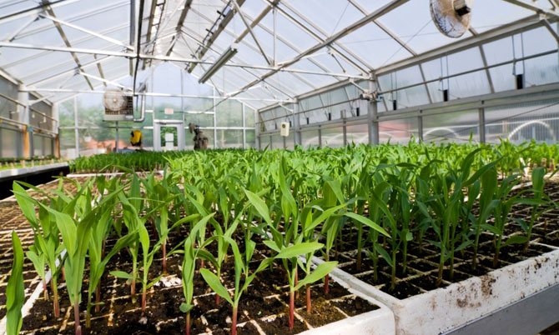
- light on greenhouse benches

Slide 22
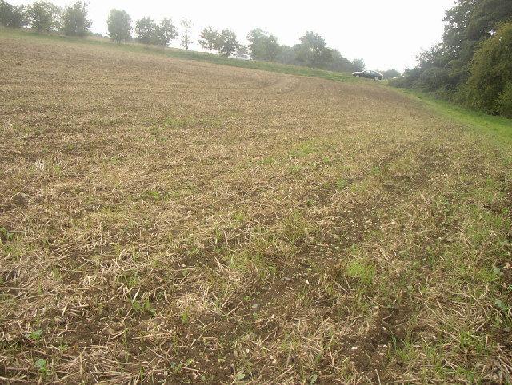
- slope in a field

Slide 23
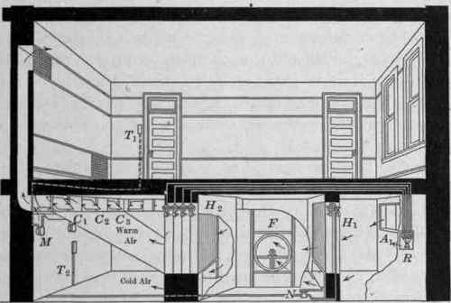
- temperature in a room

Slide 24
Experimental Design:
How to handle extraneous variables
Completely Randomized Design
Randomized ‘BLOCK’ Design
- Now, suppose you have front-wheel drive cars, where the front wheels will wear faster?:
I II III IV
B D A C
C C B D
A B D B
D A C A
3 of the 4 brand ‘C’ tires are on front wheels….

Slide 25
Experimental Design:
How to handle extraneous variables
Completely Randomized Design
Randomized ‘BLOCK’ Design
‘LATIN-SQUARE’ Design
- Across blocks, you assign different brands to different wheels
I II III IV
A B C D
B C D A
C D A B
D A B C

Slide 26
Experimental Design:
How to handle extraneous variables
Completely Randomized Design
Randomized ‘BLOCK’ Design
‘LATIN-SQUARE’ Design
- Across blocks, you assign different brands to different wheels
I II III IV
A B C D
B C D A
C D A B
D A B C
Now you can assess the effects of BRAND, CAR, and WHEEL

Slide 27



Experimental Design:
How to handle extraneous variables
Completely Randomized Design
Randomized ‘BLOCK’ Design
‘LATIN-SQUARE’ Design
‘NESTED’ Design
- Suppose we want to evaluate the quality of hamburgers from McDonalds, Burger King, and Wendy’s.

Slide 28
Experimental Design:
How to handle extraneous variables
Completely Randomized Design
Randomized ‘BLOCK’ Design
‘LATIN-SQUARE’ Design
‘NESTED’ Design
- We can’t “assign” burgers to treatments.. They COME from there… we can randomly select 5 of each…

Slide 29

Experimental Design:
V. ‘NESTED’ Design
- We can’t “assign” burgers to treatments.. They COME from there… we can randomly select 5 of each…
5 replicates
5 replicates
5 replicates
Here, we want to determine whether brands differ relative to VARIATION WITHIN a BRAND, not among all hamburgers. Hamburgers are ‘nested’ within chain, not randomly distributed ACROSS chain.

Slide 30
Experimental Design:
V. ‘NESTED’ Design
‘FACTORIAL’ Design

Slide 31
Experimental Design:
V. ‘NESTED’ Design
‘FACTORIAL’ Design
- ‘FACTORS’ are independent sources of variation – not ‘nested (or dependent) on another variable.

Slide 32
Experimental Design:
V. ‘NESTED’ Design
‘FACTORIAL’ Design
- ‘FACTORS’ are independent sources of variation – not ‘nested (or dependent) on another variable.
- They CAN be ‘blocks’

Slide 33
Experimental Design:
V. ‘NESTED’ Design
‘FACTORIAL’ Design
- ‘FACTORS’ are independent sources of variation – not ‘nested (or dependent) on another variable.
- They CAN be ‘blocks’
- Typically, there are different independent variables that are examined in the same experiment. The ‘beauty’ of a ‘FACTORIAL’ design is that ‘main effects’ and interactive effects of these factors can be determined if there is enough replication.

Slide 34
Experimental Design:
V. ‘NESTED’ Design
‘FACTORIAL’ Design
Tires:
I II III IV
A B C D
A B C D
A B C D
A B C D
Source of Variation df
TOTAL 15
Tire 3
“error” 12

Slide 35
Experimental Design:
V. ‘NESTED’ Design
‘FACTORIAL’ Design
Tires – Randomized Block:
I II III IV
B D A C
C C B D
A B D B
D A C A
Source of Variation df
TOTAL 15
Tire 3
‘BLOCK’ (car) 3
“error” 9

Slide 36
Experimental Design:
V. ‘NESTED’ Design
‘FACTORIAL’ Design
Tires – Latin-Square:
I II III IV
A B C D
B C D A
C D A B
D A B C
Source of Variation df
TOTAL 15
Tire 3
‘BLOCK’ (car) 3
Wheel 3
“error” 6
The variation due to these effects would initially have been part of the ‘experimental error’ variation… inflating that variation to the point where the differences between tire brands can’t be resolved as different.

Slide 37
Experimental Design:
V. ‘NESTED’ Design
‘FACTORIAL’ Design
Tires – Latin-Square:
I II III IV
A B C D
B C D A
C D A B
D A B C
Source of Variation df
TOTAL 15
Tire 3
‘BLOCK’ (car) 3
Wheel 3
“error” 6
The variation due to these effects would initially have been part of the ‘experimental error’ variation… inflating that variation to the point where the differences between tire brands can’t be resolved as different.

Slide 38
Experimental Design:
V. ‘NESTED’ Design
‘FACTORIAL’ Design
Tires – Latin-Square:
I II III IV
A B C D
B C D A
C D A B
D A B C
In this design, there is no replication of treatment combinations – each combination of tire, car, and wheel is represented once.

Slide 39
Experimental Design:
V. ‘NESTED’ Design
‘FACTORIAL’ Design
Tires – Latin-Square:
I II III IV
A B C D
B C D A
C D A B
D A B C
In this design, there is no replication of treatment combinations – each combination of tire, car, and wheel is represented once. So, we cannot describe INTERACTION EFFECTS: where “the effect of one variable depends on the treatment level of another”

Slide 40
Experimental Design:
V. ‘NESTED’ Design
‘FACTORIAL’ Design
So, we cannot describe INTERACTION EFFECTS: where “the effect of one variable depends on the treatment level of another”:
- does brand wear depend on the make of the car?
- does brand wear depend on the wheel the tire is on?
- does the wheel effect depend on the make?
- does the effect of wheel position on brand wear depend on the car make?

Slide 41
Experimental Design:
V. ‘NESTED’ Design
‘FACTORIAL’ Design
New Example:
Response variable – percentage of D. putrida surviving
 | NUMBER of D. tripunctata
NUMBER of D. putrida |  | 10 | 20
 | 10 | 5 replicates | 5 replicates
 | 20 | 5 replicates | 5 replicates
Source of Variation df
TOTAL 19

Slide 42
Experimental Design:
V. ‘NESTED’ Design
‘FACTORIAL’ Design
New Example:
Response variable – percentage of D. putrida surviving
 | NUMBER of D. tripunctata
NUMBER of D. putrida |  | 10 | 20
 | 10 | Mean = 0.9 | Mean = 0.5
 | 20 | Mean = 0.4 | Mean = 0.5
= x1 = 0.7
= x2 = 0.45
Source of Variation df
TOTAL 19
Intraspecific Density 1

Slide 43
Experimental Design:
V. ‘NESTED’ Design
‘FACTORIAL’ Design
New Example:
Response variable – percentage of D. putrida surviving
 | NUMBER of D. tripunctata
NUMBER of D. putrida |  | 10 | 20
 | 10 | Mean = 0.9 | Mean = 0.5
 | 20 | Mean = 0.4 | Mean = 0.5
X1 = 0.65
X2 = 0.5
Source of Variation df
TOTAL 19
Intraspecific Density 1
Interspecific Density 1

Slide 44
Experimental Design:
V. ‘NESTED’ Design
‘FACTORIAL’ Design
New Example:
Response variable – percentage of D. putrida surviving
 | NUMBER of D. tripunctata
NUMBER of D. putrida |  | 10 | 20
 | 10 | Mean = 0.9 | Mean = 0.5
 | 20 | Mean = 0.4 | Mean = 0.5
Source of Variation df
TOTAL 19
Intraspecific Density 1
Interspecific Density 1
Intra x Inter 1
Error 16
Does the effect on intraspecific density depend on the level of interspecific density?

Slide 45
Experimental Design:
V. ‘NESTED’ Design
‘FACTORIAL’ Design
New Example:
Response variable – percentage of D. putrida surviving
 | NUMBER of D. tripunctata
NUMBER of D. putrida |  | 10 | 20
 | 10 | Mean = 0.9 | Mean = 0.5
 | 20 | Mean = 0.4 | Mean = 0.5
Source of Variation df
TOTAL 19
Intraspecific Density 1
Interspecific Density 1
Intra x Inter 1
Error 16
Does the effect on intraspecific density depend on the level of interspecific density?
- at low D. tri density, increasing
D. put density has an effect.
- At high D. tri density, it does not.

